Slide 1

Project Initiation and Appraisal
Vishnuprasad nagadevara

Slide 2
What is a Project?
“a unique interrelated set of tasks with a beginning, an end and a well- defined outcome”

Slide 3
The project life cycle
Identification
Post Project Evaluation
Formulation and Appraisal
Financing decision
Monitoring
Implementation Planning
Follows the life of a project from the initial idea through to its completion
Defines key decisions, information requirements and responsibilities at each phase

Slide 4
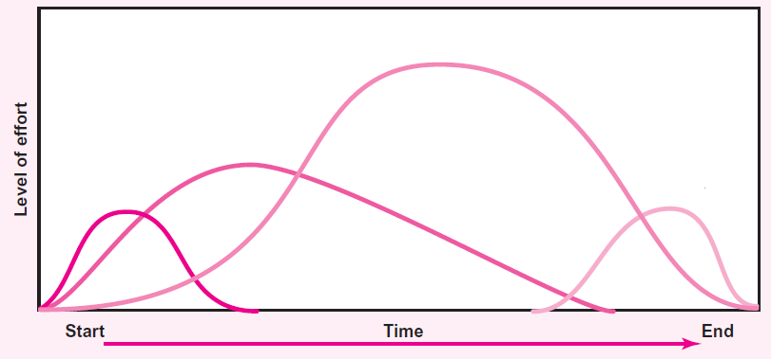
Identification and Appraisal
Executing and Monitoring
Implementation Planning
Post Project Evaluation

Slide 5
Project Appraisal

Slide 6
Project Appraisal
Concept of PIB:
Costs
  Direct Costs: Incurred by the PIB
  Indirect Costs: Incurred by other than PIB
  Intangible Costs: Non-Quantifiable Costs
Benefits
  Direct Benefits: Benefits Accruing to PIB
  Indirect Benefits: Accruing to Other than PIB
  Intangible Benefits: Non-Quantifiable Benefits

Slide 7
Role of PPP
Scenario 1:
  Direct Benefits > Direct Costs
  Private player will be most efficient
Scenario 2:
  Direct Benefits < Direct Costs, BUT
  Direct Benefits + Indirect Benefits > Direct Costs + Indirect Costs
  PPP is most appropriate with VGF and Transfer of Indirect Benefits to Direct Benefits
Scenario 3:
  Direct Benefits + Indirect Benefits < Direct Costs + Indirect Costs BUT
  Intangible Benefits Overweigh everything else
  Most appropriate for Government to Step in completely

Slide 8
Appraisal Criteria
Pay-back Period
Net Present Value
Internal Rate of Return
Benefit-Cost Ratio

Slide 9
Appraisal Examples
Project | Year | Capital Cost | Operational Cost | Value of Output | Net Value
A | 1 | 50000 | 10000 | 30000 | 20000
 | 2 |  | 10000 | 35000 | 25000
 | 3 |  | 10000 | 30000 | 20000
 |  |  |  |  | 65000
Payback period (Years)
2.25
2.25
3.00
B | 1 | 50000 | 10000 | 30000 | 20000
 | 2 |  | 10000 | 35000 | 25000
 | 3 |  | 10000 | 30000 | 20000
 | 4 |  | 10000 | 30000 | 20000
 |  |  |  |  | 85000
C | 1 | 50000 | 10000 | 0 | -10000
 | 2 | 25000 | 10000 | 35000 | 25000
 | 3 |  | 10000 | 40000 | 30000
 | 4 |  | 10000 | 40000 | 30000
 | 5 |  | 10000 | 40000 | 30000
 |  |  |  |  | 105000

Slide 10
Time Value for Money
If you have Rs. 100,000 today and if Bank interest is 10% per annum, what is its value one year from now?
100,000 principal and 10,000 interest = 110,000.
OR Rs. 110,000 one year from now is worth only 100,000 today! (if interest rate is 10%)
What about 2 years?
100,000 will become 110,000 in one year and 110,000 will become 121,000 one year later!
OR 121,000 two years from now is worth only 100,000 today!
We are calculating PRESENT VALUE of Future Income/ Revenue
We multiply with interest rate into the future
We divide by interest rate to get PRESENT VALUE

Slide 11
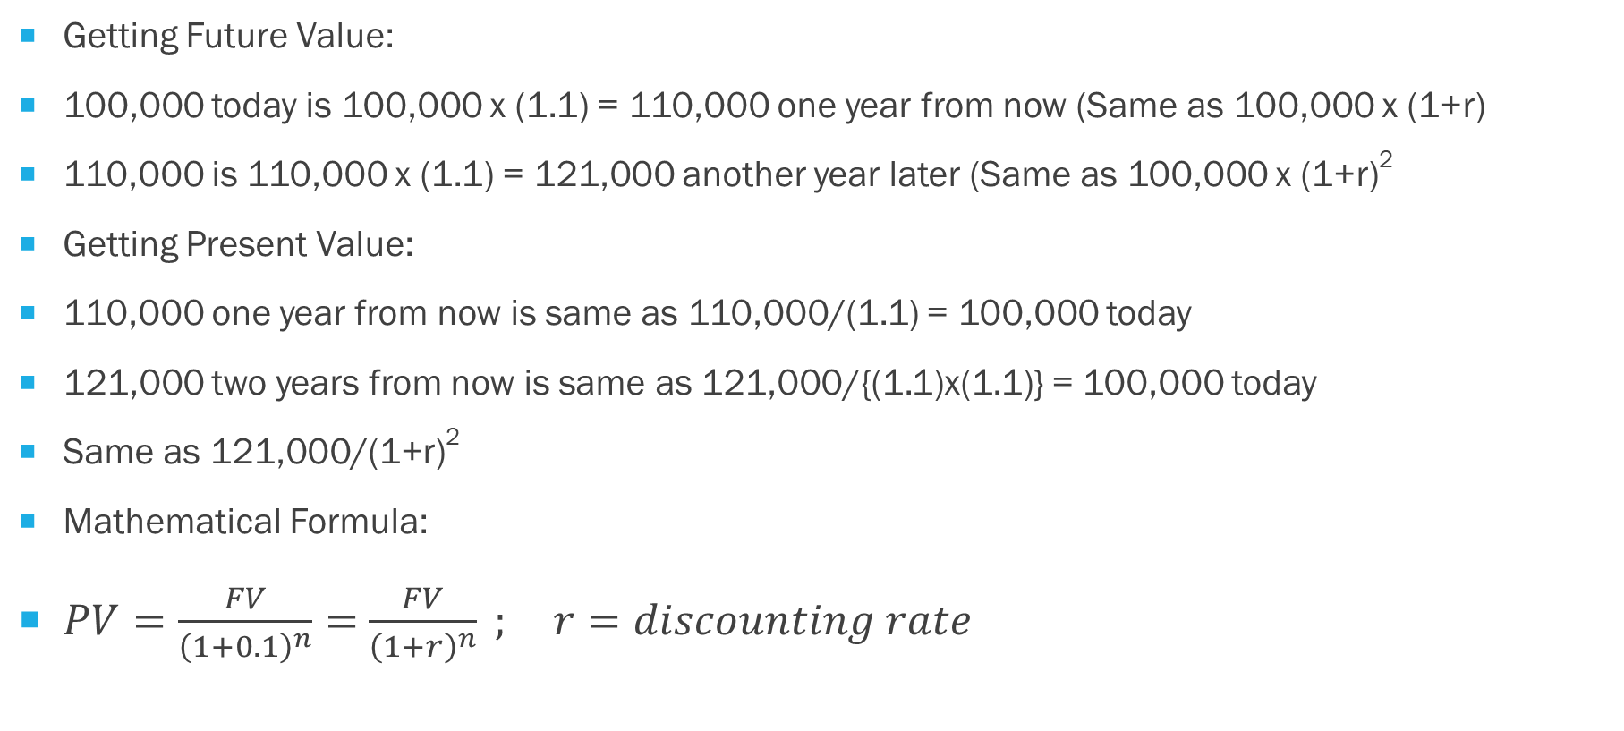
Calculating Future Value and Present Value
Getting Future Value:
100,000 today is 100,000 x (1.1) = 110,000 one year from now (Same as 100,000 x (1+r)
110,000 is 110,000 x (1.1) = 121,000 another year later (Same as 100,000 x (1+r)²
Getting Present Value:
110,000 one year from now is same as 110,000/(1.1) = 100,000 today
121,000 two years from now is same as 121,000/{(1.1)x(1.1)} = 100,000 today
Same as 121,000/(1+r)²
Mathematical Formula:
$PV=\frac{FV}{{\left(1+0.1\right)}^{n}}=$ $\frac{FV}{{\left(1+r\right)}^{n}} ; r=discounting rate$

Slide 12
Appraisal Criteria
Discounting Rate= |  | 10.00% |  |  |  | Present Value
Project | Year | Capital Cost | Operational Cost | Value of Output | Net Value | Benefits | Costs | BCR | NPV | IRR
A | 0 | 50000 | 10000 | 30000 | 20000 | 30000 | 60000 | 1.12 | 9256.20 | -30000
 | 1 |  | 10000 | 35000 | 25000 | 31818 | 9091 |  |  | 25000
 | 2 |  | 10000 | 30000 | 20000 | 24793 | 8264 |  |  | 20000
 |  |  |  |  | 65000 | 86612 | 77355 |  |  | 33.33%
B | 0 | 50000 | 10000 | 30000 | 20000 | 30000 | 60000 | 1.29 | 24282.49 | -30000
 | 1 |  | 10000 | 35000 | 25000 | 31818 | 9091 |  |  | 25000
 | 2 |  | 10000 | 30000 | 20000 | 24793 | 8264 |  |  | 20000
 | 3 |  | 10000 | 30000 | 20000 | 22539 | 7513 |  |  | 20000
 |  |  |  |  | 85000 | 109151 | 84869 |  |  | 54.45%

Slide 13
Appraisal Criteria
Discounting Rate= |  | 10.00% |  |  |  | Present Value
Project | Year | Capital Cost | Operational Cost | Value of Output | Net Value | Benefits | Costs | BCR | NPV | IRR
C | 0 | 50000 | 10000 | 0 | -10000 | 0 | 60000 | 1.07 | 7823.24 | -60000
 | 1 | 25000 | 10000 | 35000 | 25000 | 31818 | 31818 |  |  | 0
 | 2 |  | 10000 | 40000 | 30000 | 33058 | 8264 |  |  | 30000
 | 3 |  | 10000 | 40000 | 30000 | 30053 | 7513 |  |  | 30000
 | 4 |  | 10000 | 40000 | 30000 | 27321 | 6830 |  |  | 30000
 |  |  |  |  | 105000 | 122249 | 114426 |  |  | 14.71%

Slide 14
Introduction
The Anchorage Port
This port was in operation since 1805 and is currently under the administrative control of the Department of Ports of the State Government.
Kalihari Port is not a deep-water port
The port is operating as an anchorage port near Hoop Island.
Hoop Island is 6 km away in the sea from the shoreline and is 21 km long and 2 km wide at its widest point.
Between this narrow island and the Kalihari shoreline, a 100 sq. km stretch of seawater, called the Kalihari Bay, remains calm for most of the year.
This calm area of the bay is used by the ships to load and unload the cargo.

Slide 15
Anchorage Port
The anchorage port handles less than a million tons a year at present.
Only about 6 ships at a time could be handled at the anchorage port at present and the ships have to wait for a long time to load and unload cargo.
This makes the operations very expensive for the ships and the transporters are reluctant to use the port.
The only reason they still use the port is because the LBS Port (about 100 km away) is already clogged and there is no alternative. But, in the process the imports and exports are becoming expensive.

Slide 16
New Port
All cargo are transported between the anchored vessel and the shore by private operators through wooden boats of different sizes.
The cargo is loaded and unloaded at the shore by a group of laborers known as shore labor.
The boats are handled by laborers known as boat labor.
The stevedore labor handles the loading and unloading between the ships and boats.
NEW PORT
The present project visualizes the construction of a deep-water port at the shoreline so that the ships can load and unload the cargo at the wharfs directly
The laborers in the area are afraid that this will completely eliminate the need for boat labor and shore labor creating severe unemployment among these groups.
The new port is designed to handle four times that of anchorage port.

Slide 17
The Issue
Indra Naidu, the member of legislature from Kalihari constituency is worried about the upcoming elections
“People are worried about the loss of their jobs with the modernization of the port”.
“There are thousands of them there and they are worried and the unions are going to make an issue of this. It will be very difficult to explain this to the people, when they lose their only livelihood”.
“This will become a major election issue next year and this was and still is a marginal constituency for our party” – Indra Naidu

Slide 18
The Issue
There are 10,000 labourers (families) employed ➔ effecting 50,000 individual members!
Need to protect their livelihood
Is it a
  Social Welfare Decision?
  Economic Decision?
  Political Decision?

Slide 19
KPIC
The project is to construct a deep-water port at Kalihari.
The Asian Infrastructure Development Bank had already agreed to fund the project
Kalihari Port and Infrastructure Corporation (KPIC) was set up.
It is proposed to channel the funding from The Bank to KPIC and KPIC will in turn take up not only the construction of the project but operate the port for 25 years before handing it back to the state.
While the State government owns 26% of the equity of KPIC, the rest is owned by a major industry group in the state.
A Memorandum of Understanding had already been signed between the State Government, the Bank and KPIC and the state government stood guarantee for the loan and agreed to pay the entire interest on the loan.

Slide 20
Present Scenario
The KPIC has already drawn the first installment.
The orders for some of the equipment have already been placed.
The contracts for civil works have already been awarded and to defer this project at this point will create serious problems for the state government with the Bank.

Slide 21
KFCL
The Kalihari Fertilizer Corporation Ltd. had set up a plant at Kalihari, about 5 years ago
KFCL transports phosphoric acid and liquid ammonia depending on the need at the factory and the storage position at Kalihari.
There is no specific schedule for transport.
They do give an advance notice to the state government regarding the movement of phosphoric acid and liquid ammonia
The rail tankers have to pass through three districts in the state and the district administration has to gear up for any possible emergency.
At the same time, the railways have to keep their traffic clear of the rail tankers, which invariably affects their entire schedule.
Fortunately, there have not been any mishaps till now, but the experts feel that the probability of a major mishap is increasing each day.

Slide 22
Indus Oil Company
KFCL imports the required phosphoric acid and liquid ammonia at the LBS Port, which is about 100 km away from Kalihari.
This is necessitated because of the lack of berthing and handling facilities for handling phosphoric acid and liquid ammonia at Kalihari Port.
As a result, the company has to incur additional expenses for transporting phosphoric acid and liquid ammonia, but also has to maintain duplicate storage facilities at Kalihari as well as at the LBS Port.
They have been complaining that their profitability is being affected by this arrangement.
The new port can handle phosphoric acid and liquid cargo at Kalihari.
The Indus Oil Company (IOC) is ready to invest in Kalihari if only we can ensure handling facilities for the petroleum products.

Slide 23
Plan to protect the livelihood of labourers

Slide 24
Revised Plan
Secretary, Department of Ports submitted a proposal for a new policy for operating the anchorage port and the new port such that there is minimum possible loss of jobs to the laborers.
The total quantity of cargo to be handled at the anchorage port as well as the new port remains the same as in the original proposal, but there is a redistribution of the cargo between the two ports.
It is assumed that the anchorage port can handle a maximum of 1.2 million tons per annum without difficulty and the redistribution is done keeping this in mind.
The anchorage port is given priority on items such as rice bran, fertilizer, and tobacco etc., which are bulky in nature.
Part of the sponge iron is shifted to the anchorage port to make up the total traffic of 1.2 million tons.

Slide 25
Labor Employment and other Costs
On average, 2 shore labourers be employed for every boat labourer employed in the loading and unloading operations.
This ratio is derived based on the “mastar” rolls maintained by the transporters and boat owners.
Similarly, 3 stevedore labourers required for every 2 shore labourers.
It is estimated that each ship day will cost the shipping company Rs. 279,000 (based on the current exchange rate)
Based on the operations of the companies in the reference year, it is calculated that the cost of transporting phosphoric acid and liquid ammonia from LBS Port to Kalihari is Rs. 150 per ton and that of petroleum products is Rs. 21.30 per ton

Slide 26
Benefits
Direct Benefits:
  Handling Charges (including Liquid Cargo)
  Waiver of interest
Indirect Benefits:
  Savings to ships
  Savings to KFCL and IOC
  Increased Taxes
Intangible Benefits:
  Saving of possible damage due to transport of Ammonia and Phosphoric Acid

Slide 27
Costs
Direct Costs:
  Cost of constructing the project
  Taxes paid
Indirect Costs:
  Loss of wages
  Loss of revenue from Boats
  Loss of revenue for Railways
Intangible costs:
  Loss of livelihood for labourers

Slide 28
Investments and other details
Year-wise Investment
It is estimated that the total investment will be Rs. 990 million, of which Rs. 605 million will be incurred during the first year and the remaining in the second year.
The port will be able handle the cargo after the completion of the investment.
It is estimated that the operating cost will be 20 percent of the revenue accrued from cargo handling.
KPIC has decided to use a depreciation rate of 10 percent using written down value method.
It is estimated that the annual maintenance cost will be 10 percent of the capital investment
Based on the current tax structure, the effective rate of tax for KPIC will be 20 percent.

Slide 29
Ship Details
Period (Days) | No. Of Ships | Average Number of Days | Cargo Handled (Tons) | Number of Ships Handled as % of Total
<10 | 51 | 5 | 160,875 | 38.06%
10-19 | 58 | 14 | 585,311 | 43.28%
20-29 | 18 | 23 | 287,683 | 13.43%
30-39 | 5 | 31 | 116,957 | 3.73%
>40 | 2 | 50 | 72,035 | 1.49%
All | 134 |  | 1,222,861 | 100.00%

Slide 30
Details of Boats
Size of the Boat (Tons) | No. Of Boat Laborers Employed | Total Tonnage for the Year | Total Earnings
0-50 | 21 | 4,062 | 134,781
50-100 | 79 | 29,797 | 984,425
100-150 | 181 | 73,605 | 2,491,970
150-200 | 526 | 268,877 | 9,338,909
200-1000 | 238 | 131,627 | 5,026,036
Total | 1,045 | 507,968 | 17,976,121

Slide 31
Efficiency of New Port
 | Tons Handled per Day
Cargo | New Port | Anchorage Port | Ratio
Fertilizer | 2000 | 1000 | 2.00
Iron Pellets | 10000 | 1500 | 6.67
Sponge Iron | 5000 | 1500 | 3.33
Tobacco | 2000 | 1000 | 2.00
Miscellaneous | 2000 | 1000 | 2.00
Item | Year 1 | Year 2 | Year 3 | Year 4 | Year 5 | Year 6 | Year 7 | Year 8 | Year 9
Phosphoric Acid and Liquid Ammonia | 640 | 640 | 640 | 640 | 640 | 640 | 640 | 640 | 640
Petroleum Products | 378 | 378 | 397 | 417 | 438 | 459 | 482 | 507 | 532

Slide 32
Quantities at New Port (Original Plan)
Cargo | Year 1 | Year 2 | Year 3 | Year 4 | Year 5 | Year 6 | Year 7 | Year 8 | Year 9
New Port
Dry Cargo
Dry Fertilizer | 0 | 360 | 380 | 415 | 450 | 485 | 520 | 555 | 590
Iron Pellets | 0 | 770 | 770 | 770 | 770 | 770 | 770 | 770 | 770
Sponge Iron | 0 | 275 | 275 | 275 | 275 | 275 | 275 | 275 | 275
Tobacco | 0 | 50 | 50 | 50 | 50 | 50 | 50 | 50 | 50
Miscellaneous | 0 | 20 | 20 | 20 | 20 | 20 | 20 | 20 | 20
Total | 0 | 1,475 | 1,495 | 1,530 | 1,565 | 1,600 | 1,635 | 1,670 | 1,705
Liquid Cargo
Phosphoric Acid | 0 | 570 | 570 | 570 | 570 | 570 | 570 | 570 | 570
Liquid Ammonia | 0 | 70 | 70 | 70 | 70 | 70 | 70 | 70 | 70
Petroleum Products | 0 | 378 | 397 | 417 | 438 | 459 | 482 | 507 | 532
Total | 0 | 1,018 | 1,037 | 1,057 | 1,078 | 1,099 | 1,122 | 1,147 | 1,172

Slide 33
Quantities at New Port (Revised Plan)
Cargo | Year 1 | Year 2 | Year 3 | Year 4 | Year 5 | Year 6 | Year 7 | Year 8 | Year 9
New Port
Dry Cargo
Dry Fertilizer | 0 | 0 | 0 | 0 | 0 | 18 | 79 | 141 | 205
Iron Pellets | 0 | 770 | 770 | 770 | 770 | 770 | 770 | 770 | 770
Sponge Iron | 0 | 75 | 117 | 174 | 233 | 275 | 275 | 275 | 275
Total | 0 | 845 | 887 | 944 | 1,003 | 1,063 | 1,124 | 1,186 | 1,250
Liquid Cargo
Phosphoric Acid | 0 | 570 | 570 | 570 | 570 | 570 | 570 | 570 | 570
Liquid Ammonia | 0 | 70 | 70 | 70 | 70 | 70 | 70 | 70 | 70
Petroleum Products | 0 | 378 | 397 | 417 | 438 | 459 | 482 | 507 | 532
Total | 0 | 1,018 | 1,037 | 1,057 | 1,078 | 1,099 | 1,122 | 1,147 | 1,172
Total (Original) | 0 | 1,475 | 1,495 | 1,530 | 1,565 | 1,600 | 1,635 | 1,670 | 1,705

Slide 34
Cargo to be handled (Original Plan)
Original Plan as Proposed by KPIC
Cargo | Year 1 | Year 2 | Year 3 | Year 4 | Year 5 | Year 6 | Year 7 | Year 8 | Year 9
Anchorage Port
Dry Fertilizer | 330 | 0 | 0 | 0 | 0 | 0 | 0 | 0 | 0
Rice Bran | 410 | 430 | 452 | 474 | 498 | 523 | 549 | 576 | 605
Tobacco | 20 | 0 | 0 | 0 | 0 | 0 | 0 | 0 | 0
Sal Seed Extract | 50 | 50 | 50 | 50 | 50 | 50 | 50 | 50 | 50
Cotton Seed Extract | 30 | 30 | 30 | 30 | 30 | 30 | 30 | 30 | 30
Groundnut Kernels | 10 | 10 | 10 | 10 | 10 | 10 | 10 | 10 | 10
Imenite Sand | 30 | 30 | 30 | 30 | 30 | 30 | 30 | 30 | 30
Miscellaneous | 40 | 20 | 20 | 20 | 20 | 20 | 20 | 20 | 20
Total | 920 | 570 | 592 | 614 | 638 | 663 | 689 | 716 | 745

Slide 35
Cargo to be handled (Revised Plan)
Revised Plan as Proposed by the Department of Ports
Cargo | Year 1 | Year 2 | Year 3 | Year 4 | Year 5 | Year 6 | Year 7 | Year 8 | Year 9
Anchorage Port
Dry Fertilizer | 330 | 360 | 380 | 415 | 450 | 467 | 441 | 414 | 385
Rice Bran | 410 | 430 | 452 | 474 | 498 | 523 | 549 | 576 | 605
Tobacco | 20 | 50 | 50 | 50 | 50 | 50 | 50 | 50 | 50
Sponge Iron | 0 | 200 | 158 | 101 | 42 | 0 | 0 | 0 | 0
Sal Seed Extract | 50 | 50 | 50 | 50 | 50 | 50 | 50 | 50 | 50
Cotton Seed Extract | 30 | 30 | 30 | 30 | 30 | 30 | 30 | 30 | 30
Groundnut Kernels | 10 | 10 | 10 | 10 | 10 | 10 | 10 | 10 | 10
Imenite Sand | 30 | 30 | 30 | 30 | 30 | 30 | 30 | 30 | 30
Miscellaneous | 40 | 40 | 40 | 40 | 40 | 40 | 40 | 40 | 40
Total | 920 | 1,200 | 1,200 | 1,200 | 1,200 | 1,200 | 1,200 | 1,200 | 1,200
Total (Original) | 920 | 570 | 592 | 614 | 638 | 663 | 689 | 716 | 745

Slide 36
Questions?
Clarifications?
Use Excel

