Slide 1
HR Analytics
Career and Workforce Metrics

Slide 2
Why HR Analytics ?
“In God we Trust, all others plzzzzzz…. Bring data”
(Edward Deming)
“Every organization is unhappy in their own ways”
“Fitz-Enz”
Hence we need
  Data based insights & not “Universal Gyaan”

Slide 3
Why HR Analytics?
“1. What gets Measured,
Gets Managed,
2.What's get managed
Gets Done”
  Peter Drucker

Slide 4
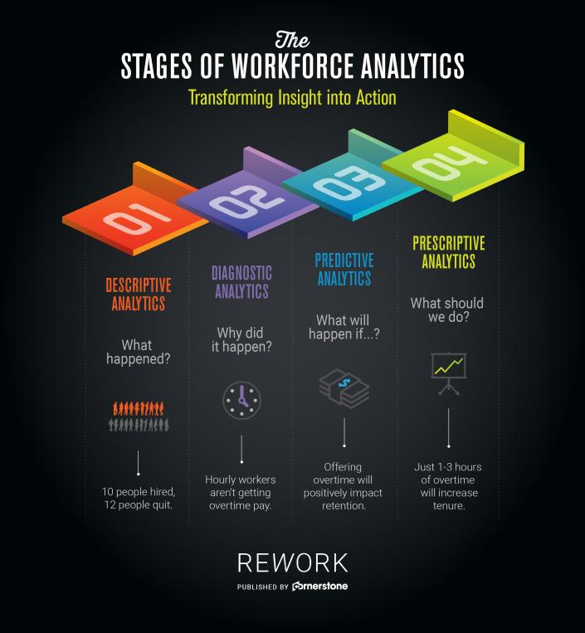

Slide 5
Some Critical Ratio on Span of control
Manager
to
Subordinate ratio
For Head
[Ratio 1:10 to 15]
Ex – Regional VP, HR Head
For Senior Level
[Ratio 1:5 to 7 ]
For Junior Manager Level
[Ratio- 1:4 to 5]
For Mid Level
[Ratio 1:5 to 8 ]

Slide 6
Use: Employee Profiling
Analyze your current Workforce
To identify the skill levels you employ
The kind of interaction/function they perform
Create the template for perfect candidate
For selection or any prediction
Specify the level of commitment etc.
Review the application based on the template
Review according to the template
Technical & Behavioral
Specify the minimum level of qualification
Specify the minimum experience
Helps in identifying the root causes
Helps in shortlisting
Design an open ended questionnaire/MCQ type
Create a Red/Yellow/Green colored tag for the employee
Who is Happy who is UNHAPPY
For Future Pipeline
Take proactive actions
Design data driven policies

Slide 7
Employee Profiling
1. Have a clear understanding about what you want to achieve and why by setting out clear objectives.
2. Conduct an internal stakeholder mapping exercise using a stakeholder models
  Such as the power/ interest matrix
    Identify those employees with influence and interest.
3. Identify all existing data and employee insight that your organization holds.
  For example
    Employee engagement surveys,
    Demographical information,
    Comments on internal social media such as blogs, community pages and online forums.

Slide 8
Employee Profiling
4. Collate all internal feedback including employee complaints, information from pulse groups and face-to-face events and sessions as well as feedback to managers.
5. Speak to your employees and listen to feedback.
  Visit different sites,
  Talk to different employees to
    Find out more about their thoughts and attitudes towards their role, the organization and specific projects.

Slide 9
Employee Profiling
6. From all the information gathered
  Identify common themes
  Trends and attitudes in order to create 5-6 common employee groups
  To broadly describe people who work in your organization.
7. Create a character profile
  For each of the groups to provide a short summary or biography
  It develops typologies the people in this group.
8. Test the employee profiles with senior leadership
  To establish understanding of the profiles and
  How to use them to connect and
  facilitate dialogue with different employees

Slide 10
Employee Profiling
9. Use these profiles
  To develop a targeted and strategic internal communications plan
  To reach employees across your organization.
10. Update these employee profile groups on a regular basis.
  You could review them annually or
  Each time you do your employee engagement survey.

Slide 11
Name – Ajay Kumar
Job Title – HR Analyst
Experience: 5 Years
Expertise: Data Mining and Statistics
Fast track rating: 4.5/5
1 Personal Information
-------------------------------------------------------------------------------------------
2. Job Brief
---------------------------------------------------------------------------------------------
3. Achievements
……………………………………………………………………………………………………………
4. Interests
……………………………………………………………………………………………………………
5. Social Media Presence
…………………………………………………………………………………………………………………

Slide 12
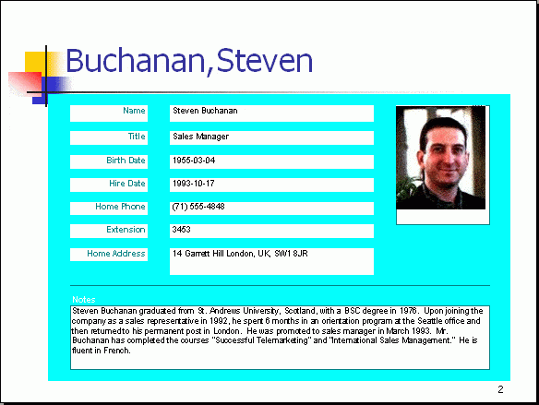
Employee Profile

Slide 13
Churn Rate or Turnover Rate
Employees who have cut ties with your company during a given time period.
Calculation
    Quarterly Churn over rate
      No of employees left in particular quarter/ No of employees that we started in the last quarter
      Or
      Turnover %= (No of employees left in a particular quarter/ Average no of employees)*100
    Ex – A company started with 100 employees in the last quarter and 5 employees left in the last quarter
      Churn over rate = 5%
Churn over can also be calculated in form of
  The value of Recurring Business lost
  The % of Recurring value lost

Slide 14
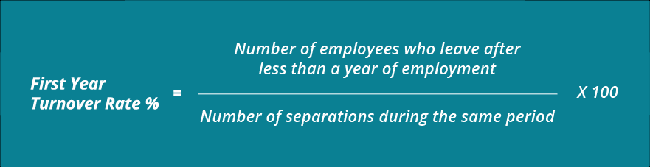
Turnover Rate
Competitive Attrition rate
  % of people churning out voluntarily
Focus on
  New Hire Turnover rate
  It is a healthy sign if New hire are staying log

Slide 15
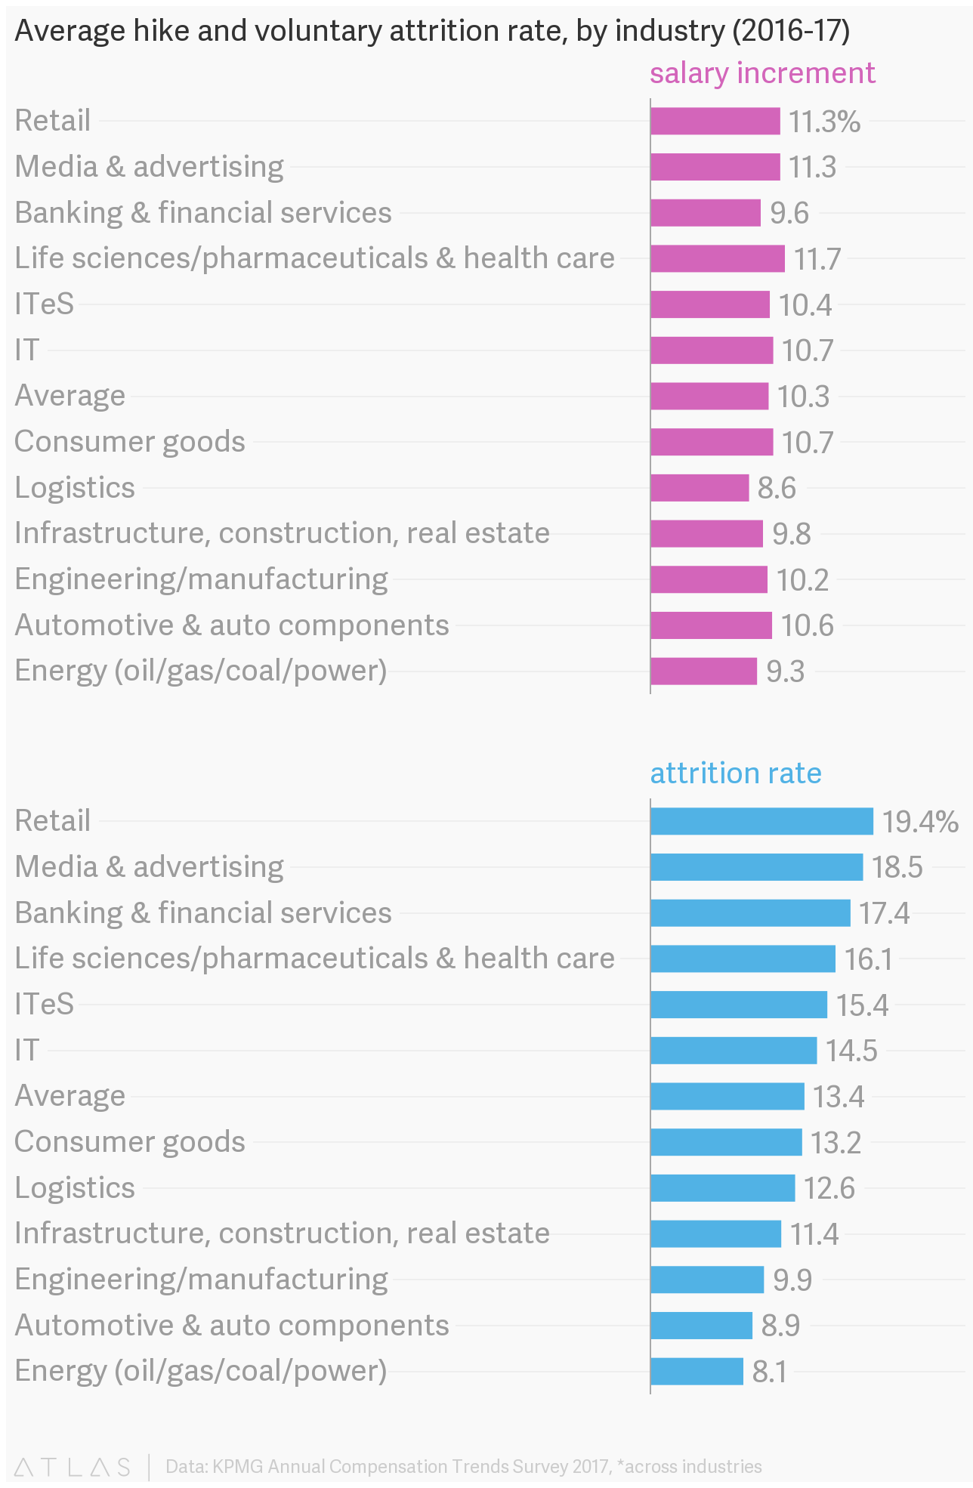
Salary Hike % Attrition Rate

Slide 16
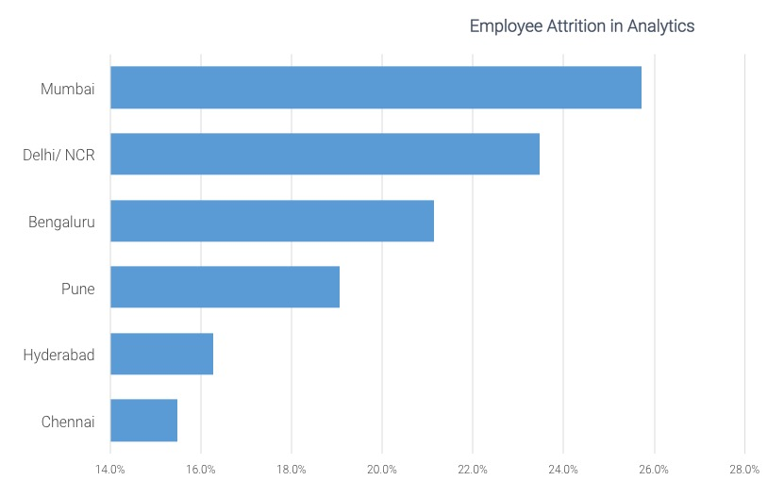
Employee Attrition Rate Across Cities

Slide 17
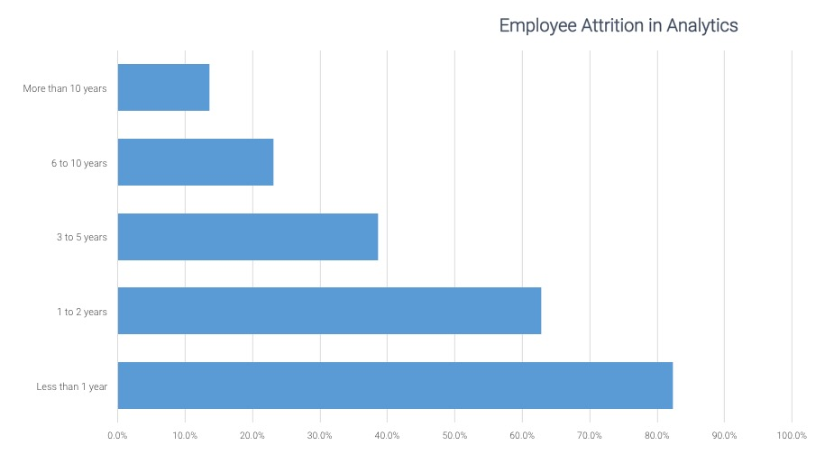
Attrition Across Tenure

Slide 18
A healthy turnover rate
After calculating the turnover rate of your company
  Compare your company’s turnover rate with the average rate within your industry
  If your turnover rate is higher than your industry average, it probably means your management is not as effective as it could be.
Analyze your turnover rate
To better understand your employee turnover, all you have to do is answer three questions:
“Who are the employees who leave?”
“When do they leave?”
“Why they are leaving?”

Slide 19
Who are leaving?
Even if your turnover rate is lower than your industry’s average,
There’s no reason to celebrate unless you can identify who leaves you.
If your top performers are leaving, then you should take immediate action, otherwise your company’s performance will flag.
On the other hand, if your low performers are leaving, celebrate you could stand to gain by enjoying better employee engagement, productivity and profits.

Slide 20
When are people leaving?
Keeping track of when people leave can be very useful.
  For example, your new hire turnover rate can offer a lot of insight.
    First, it can tell you whether your recruitment methods are working??
    If a significant number of your new employees leave because they found their job duties different
    Perhaps you should consider reviewing your job descriptions.
    Investing more time and money developing your orientation process could help too

Slide 21
Why are employees leaving?
When you know why your employees leave, you can change your company’s management style or policies in response.
On-Stay interviews – Help in proactively identifying the root causes
Exit interviews are a useful way to see whether people give similar reasons for leaving, or whether they offer useful suggestions for how you can improve.
For example,
  Employees often say they decided to resign because their input and effort were not appreciated.
  If you hear these kinds of comments in your exit interviews or in performance reviews, HR should work with managers to consider changing PMS

Slide 22
Costs associated with Turnover
Turnover disrupts the flow of a functioning workforce.
When an employee leaves there can be a significant knowledge gap left
More work for the remaining team members.
Recruiting and training a new employee requires staff time and money.
Every time a business replaces a salaried employee, it costs on average 6 to 9 months in salary
For a manager making $40,000 a year, that's $20,000 to $30,000 in recruiting and training expenses, along with other intangibles

Slide 23
Implications for Managers
Differentiate your employees by:
  Job level
  Department
  Location
  Age group
  Gender
  Length of service
Determine where the voluntary turnover rate spikes and if the turnover is acceptable and unacceptable

Slide 24
Separation Clearance Time
Generate a data base for the employees based on their contract type
It helps is tracking the separation to clearance time.
It helps in saving the penalties
It helps in keeping the brand image

Slide 25
Revenue Per Employee
Revenue per employee measures the amount of business generated by 01 employee.
This is a measure of performance of human resources of a company.
It is an indicator of productivity of company’s personnel
But revenue per employee will vary in different industries according to intensity of labor.
  ROE is less in labor-intensive industries.
  On the other hand higher in the high tech
Calculation
  Revenue per Employee = Sales Revenue / Number of Employees

Slide 26
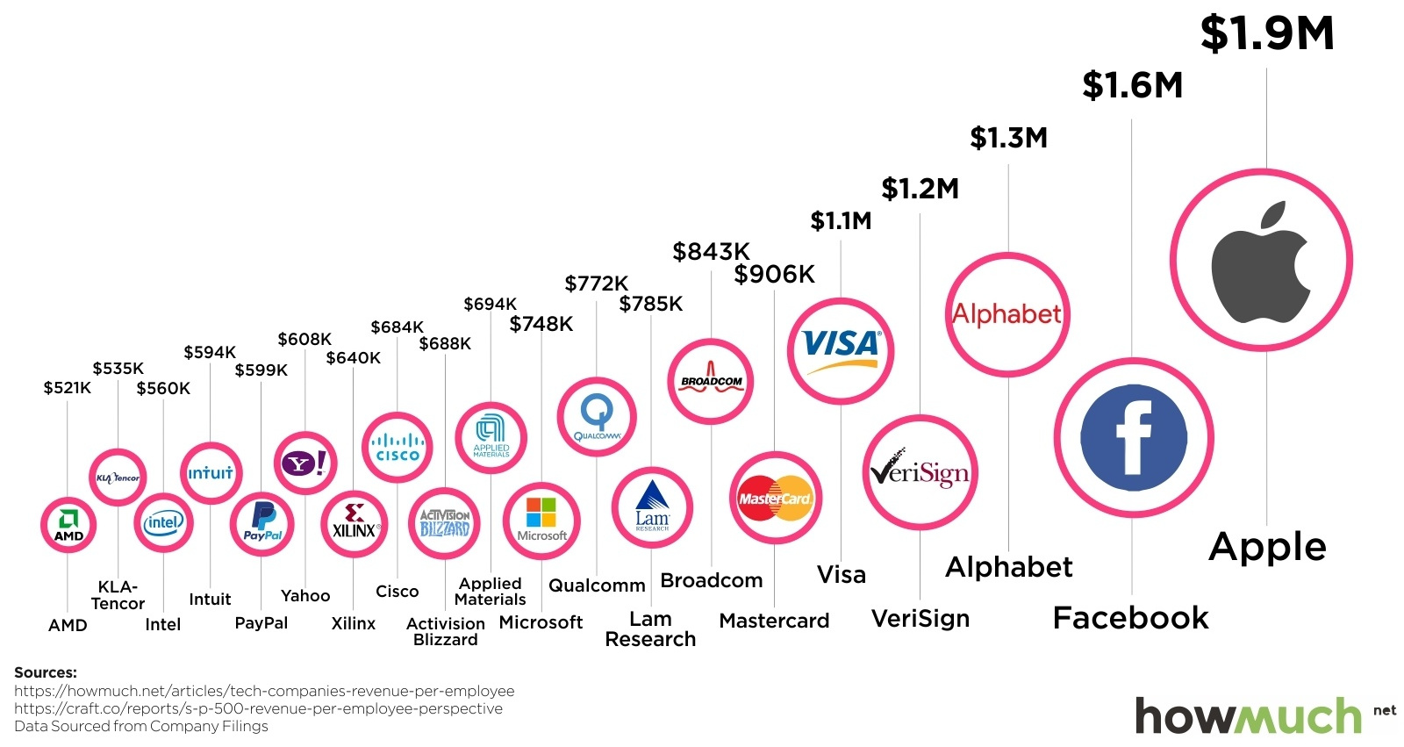
Revenue Per Employee

Slide 27
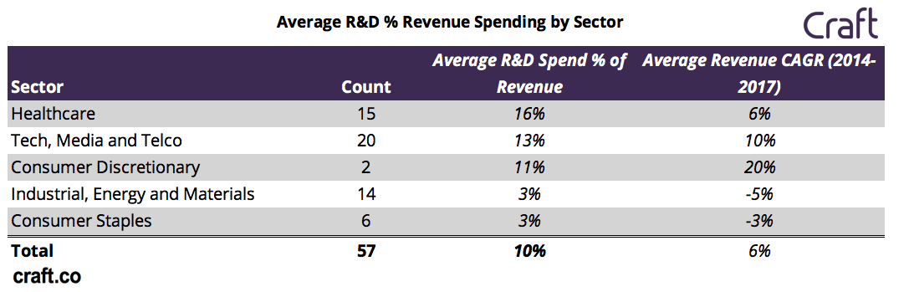
Revenue across Sectors

Slide 28
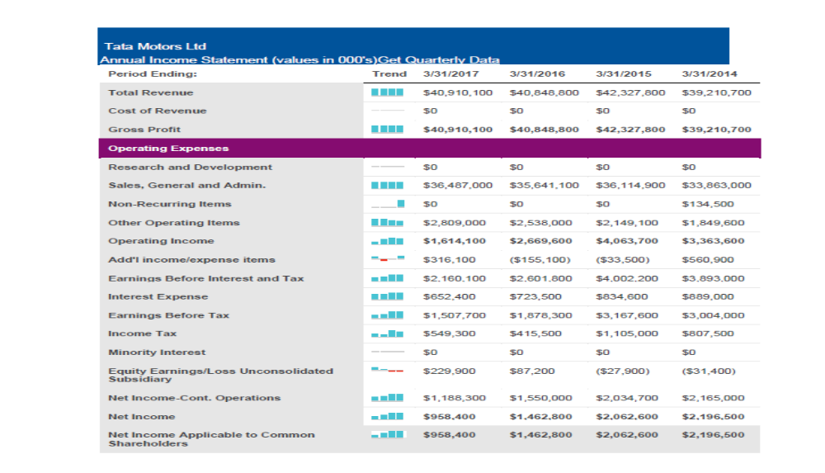

Slide 29
Workforce of Tata Motors (Not realistic)
2017
9000 employees
2016
8000 employees
2015
7500 employees
2014
6000 employees
2013
5500
employees

Slide 30
Calculate the Following Ratios
Revenue per employee
Operating income per employee
EBITA per employee
General Admin cost per employee
Income per employee

Slide 31
What do the ratio tell us?
Revenue per employee isn’t a leading indicator of success, but a lagging one.
It’s also a composite metric that is negatively impacted by significant
  Waves of hiring,
  Sales team ramp time,
  Product and company maturity in a market and many other factors.
All of this means revenue per employee isn’t a metric to optimize for
You need to look for the trend analysis

Slide 32
HR ROI
HR ROI = Organization Net revenue/salaries
Net Revenues = Gross revenue – (Operating expense + salary & benefit)

Slide 33
THANK YOU

