Slide 1
Hedging

Slide 2
Long & Short Hedges
A long futures hedge is appropriate when you know you will purchase an asset in the future and want to lock in the price
A short futures hedge is appropriate when you know you will sell an asset in the future and want to lock in the price

Slide 3
Arguments for and against Hedging
Companies should focus on the main business they are in and take steps to minimize risks arising from interest rates, exchange rates, and other market variables
Shareholders are usually well diversified and can make their own hedging decisions
It may increase risk to hedge when competitors do not
Explaining a situation where there is a loss on the hedge and a gain on the underlying can be difficult

Slide 4
Basis Risk
Basis is usually defined as the spot price minus the futures price
Basis risk arises because of the uncertainty about the basis when the hedge is closed out

Slide 5
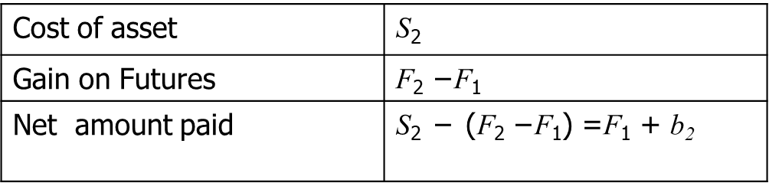
Long Hedge for Purchase of an Asset
Define
    F₁ : Futures price at time hedge is set up
    F₂ : Futures price at time asset is purchased
    S₂ : Asset price at time of purchase
    b₂ : Basis at time of purchase = S₂ ₋ F₂

Slide 6
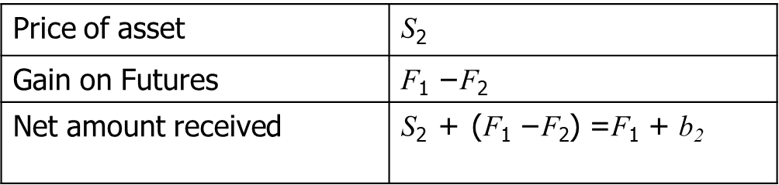
Short Hedge for Sale of an Asset
Define
    F₁ : Futures price at time hedge is set up
    F₂ : Futures price at time asset is sold
    S₂ : Asset price at time of sale
    b₂ : Basis at time of sale

Slide 7
Cross-Hedging
Choose a delivery month that is as close as possible to, but later than, the end of the life of the hedge
When there is no futures contract on the asset being hedged, choose the contract whose futures price is most highly correlated with the asset price. This is known as cross hedging.
The hedge ratio is the ratio of the size of the position taken in futures contracts to the size of the exposure.

Slide 8
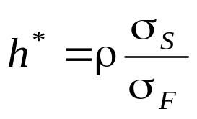
Optimal Hedge Ratio
Proportion of the exposure that should optimally be hedged is
where
σ_{S} is the standard deviation of ΔS, the change in the spot price during the hedging period,
σ_{F} is the standard deviation of ΔF, the change in the futures price during the hedging period
ρ is the coefficient of correlation between ΔS and ΔF.

Slide 9
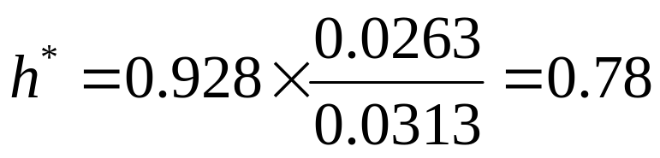

Example
Airline will purchase 2 million gallons of jet fuel in one month and hedges using heating oil futures
From historical data σ_{F} =0.0313, σ_{S} =0.0263, and ρ= 0.928
The size of one heating oil contract is 42,000 gallons
Optimal number of contracts is
which rounds to 37

Slide 10
Stack and Roll
We can roll futures contracts forward to hedge future exposures
Initially we enter into futures contracts to hedge exposures up to a time horizon
Just before maturity we close them out an replace them with new contract reflect the new exposure

Slide 11
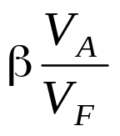
Hedging Using Index Futures
To hedge the risk in a portfolio the number of contracts that should be shorted is
where V_{A} is the value of the portfolio, β is its beta, and V_{F} is the value of one futures contract

Slide 12
Example
S&P 500 futures price is 1,010; one futures contract is for delivery of 250 times the index
Index level = 1,000
Value of Portfolio is $ 5,050,000
Beta of portfolio is 1.5
Risk-free interest rate = 4% per annum
Dividend yield on index = 1% per annum
What position in futures contracts on the S&P 500 is necessary to hedge the portfolio?
1.5 * 5,050, 000 = 30
252,500

Slide 13
Example (Contd…)
Index turns out to be 900 in 3 months and the futures price is 902.
The gain on the short futures = 30 * (1010 – 902) *250 = $810,000
The loss on the index = 10%.
The index pays a dividend of 1% per annum, or 0.25% per 3 months.
An investor in an index earns -9.75% over the 3-month period.
Because the portfolio has a beta of 1.5, the expected return on the portfolio (according to CAPM)
1.0 + [1.5*(-9.75-1.0)] = -15.125
The risk-free rate is approximately 1% per 3 months

Slide 14
Example (Contd…)
The expected value of the portfolio at the end of 3 months
= $ 5,050,000*(1-0.15125) = $ 4,286,187
The expected value of the hedger’s position = $ 4,286,187 + $ 810,000 = $ 5,096,187

