Slide 1
HR Service Delivery IV
SPHRi

Slide 2
Introduction
An organization’s goals are accomplished through people.
The major challenge of any organization is to attract, retain, motivate, and align the types and numbers of people it needs to achieve its goals.
This is accomplished through a value exchange—a situation in which the company and the employee give value to the other in exchange for value received to achieve their respective self-interests.
This notion can be summarized by the phrase, “Value given for value received.”

Slide 3

Value Exchange - Employee

Slide 4

Value Exchange - Employer

Slide 5
Remuneration
Remuneration is used to connote something broad, like a package, essentially implying that it is not only a salary, but many other benefits that are included in this “package.” In general, Remuneration is referred to as the payment made to an employee for his/her services or work. Typically, this is the payment of a salary or wage.

Slide 6
Difference Remuneration vs Compensation
Remuneration is much broader and encompasses not only the periodic payment given to an employee but also other payments and non-monetary benefits. It is the whole package offered to an employee during his/her term of employment with the employer.
Compensation refers to all forms of financial returns and tangible services and benefits employees receive as part of an employment relationship. Also, compensation refers to a form of monetary payment provided to a person who has suffered damage, harm, or injury.

Slide 7

Evolution of Rewards

Slide 8
Total Rewards
Total Reward relates to all aspects of the employment offering, including the remuneration package (base pay, variable pay and benefits) as well as the intangible aspects of the psychological contract such as career development, employment security and working environment.
Total rewards include everything the employee perceives to be of value resulting from the employment relationship ~ WorldatWork

Slide 9

Total Rewards

Slide 10
Steps in the Development of a Total Rewards Strategy
Define your differentiator
Learn what motivates your employees
Develop a total rewards brand
Personalize the experience
Reach people through multiple communication channels
Project cost and risk profile of rewards

Slide 11
Compensation Approaches
Entitlement-oriented approach. Some organizations promote a caring, protective feeling and want employees to feel as if they are a part of the family. These organizations feel that employees are entitled to benefits such as health care, employee assistance or disability insurance as a condition of employment.
Performance-oriented approach. The compensation programs of other organizations are more performance-driven, putting more emphasis on the performance and contributions of individual employees
In general, as benefits increase, there is less emphasis on individual employee contributions and responsibility and more emphasis on the success of the organization as a whole.

Slide 12
Goals of the Total Rewards System
Attracts people who can help the organization meet its mission and vision
Retains valuable employees
Motivates and rewards desired performance
Spends compensation money wisely

Slide 13
Equity
Equity means fair pay treatment for employees. Equity helps to attract, motivate and retain competent employees, making it an important concern
Internal equity refers to the pay relationship among different jobs/skills/competencies within a single organization. To achieve internal consistency, the employee must believe that all jobs are paid what they are worth. For the pay rates to be internally consistent, an organization first must determine the overall importance or worth of each job.
External Equity : A firm achieves external competitiveness when employees perceive that their pay is fair in relation to what their counterparts in other organizations earn. To become externally competitive, organizations must first learn what other employers are paying and then make a decision regarding just how competitive they want to be

Slide 14

Pay Strategies
Organizations will compete for employees with other organizations in the same labor market. Three factors that define labor markets are :

Slide 15

Pay Strategies
Based on what is known about those markets and the competition, organizations usually decide on a pay strategy that matches, leads or lags the competition

Slide 16
Pay Strategies
The correct strategy depends on two things:
How the employees add value to the organization‘s success
The degree to which the organization can afford to pay for a particular strategy
An organization will probably use a combination of these strategies. For example, for critical jobs, the organization may decide to lead the competition; in other areas, it may use a match strategy

Slide 17
Compensation and Benefits Strategy
Business success depends heavily on developing a total rewards strategy that enables the organization to compete cost- effectively for talent.
Elements in a total rewards system that vary from year to year:
Employment costs and conditions
Supply and demand for talent
Laws that affect business and employment
Employees‘ perceived value of rewards

Slide 18
Job Evaluation
Job-Content-Based (Internal) Job Evaluation
In job-content-based job evaluation, the worth and pay opportunities of different jobs are based on an appraisal of their responsibilities and requirements and their relationship to other jobs within the organization.
Market-Based (External) Job Evaluation
Market-based job evaluation is sometimes referred to as market pricing because this method bases the worth and pay opportunities of different jobs on their market value or the going rate in the marketplace.

Slide 19
Salary Surveys
To be competitive and affordable, an organization‘s pay structure must be designed and priced properly. Many organizations use surveys to collect the information that will help them evaluate positions, adjust pay range structures to remain competitive and present salary information to top management. Pay surveys collect information on current market rates and may include the following topics:
Starting wage rates
Base pay
Pay ranges
Incentive plans
Overtime pay
Shift differentials
Vacation and holiday practices

Slide 20
Types of Survey
Internal Surveys :
Organizations that have available resources and expertise may choose to develop their own internal survey to allow for more control over the survey technique and data analysis. The advantage of an internal survey is having the ability to shape the design, administration, data analysis and reporting as needed by the organization.
External Surveys :
Organizations have different options available if they choose an external pay survey. If an organization uses externally published data, it must be sure it knows how the data were generated and when.
Factors may be considered when an organization is deciding between an internal or external pay survey:
Internal time and expertise required
Relevance/match of external surveyed jobs to the organization‘s jobs
How current the external survey data are
Expense associated with the type of survey

Slide 21
Communicating to Employees
The key to a successful total rewards program is employee communication. The more complex the system and the more choices it provides, the greater the need for a communication plan.
Communication is important for three reasons:
Educating employees about the organization‘s total rewards practices
Achieving employees‘ buy-in
Supporting the organization‘s goals for performance management

Slide 22
Direct Communication
Having a written communication plan is the first step toward communicating the compensation plan to employees. However, direct communication is still the preferred method in many instances. Either HR or the employee‘s manager must meet with individual employees in a confidential setting to communicate the following compensation and benefits issues:
Job grade changes
Raises
Individual benefit issues
New policies or procedures that directly affect that employee
Policy infractions (for example, incorrect reporting of overtime)

Slide 23
Effectiveness of the Total Rewards Strategy
The basic objective of the total rewards system is to offer employees a system that encompasses the following:
Compatible with the organization‘s mission and strategy
Matched with the corporate culture
Appropriate for the workforce
Externally and internally equitable
Consistently monitoring the system will pay off in the following ways:
More cost-effective system
More satisfied employees
Fewer legal complications

Slide 24
Poll Question # 1
What are the two main categories of financial rewards?
Compensation and work/life balance
Employee benefits and career development
Direct (monetary) and indirect (benefits)
Training and employee benefits

Slide 25
Answer to Poll Question # 1
Option C - Direct (monetary) and indirect (benefits)

Slide 26
Poll Question # 2
Which compensation approach puts more emphasis on the performance and contributions of individual employees?
Internal equity
External equity
Entitlement-oriented
Performance-oriented

Slide 27
Answer to Poll Question # 2
Option D - Performance-oriented

Slide 28
Poll Question # 3
Which pay strategy offers wage rates and benefits packages similar to that of the competition and is the most common approach?
a. Lag competition
b Match competition
c. Lead competition
d. External equity

Slide 29
Answer to Poll Question # 3
Option B - Match competition

Slide 30
Poll Question # 4
What is the preferred method of communicating the compensation plan to employees?
a. Annual enrollment period meeting
b. Pay surveys
c. Written communication
d. Direct communication

Slide 31
Answer to Poll Question # 4
Option D - Direct communication

Slide 32
Compensation
The Compensation should be Adequate, Equitable, Balanced, Cost effective, Secure, Acceptable to the employer and incentive providing
Compensation is the price of labour hence it has to be in harmony with other price systems in the economy
Differential Piece-work Systems allow you to adjust wage cost per unit in relation to output
The expectancy theory focuses on the link between rewards and behaviors although it emphasizes expected rewards
Compensation systems are designed and managed to achieve cetain objectives
An ideal compensation system will have positive impact on the efficiency and results produced by employees

Slide 33
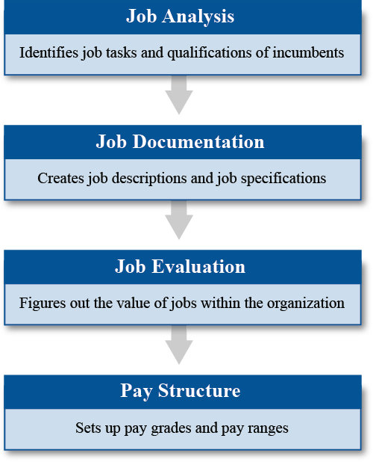
Phases of Compensation System Design Process

Slide 34
Job Analysis
What is the purpose of a job analysis?
To understand the requirements of a job and to develop a pay structure
What is a job analysis?
A systematic method of collecting information about a job and evaluating the job requirements
What are the results of a job analysis?
A written statement of the tasks performed in the job and the basic qualifications:
O Education level
O Experience
O Training
O Knowledge, skills and abilities (KSAs)

Slide 35
Job Description
A job description is a written document describing an employee‘s work activities. (Organizations may use another name for the job description, such as role profile or role description.) The uses of job descriptions as they relate to the design and administration of a compensation system are as follows:
Help to set up evaluation criteria for job performance
Provide data for comparing pay with that of other organizations
Help in assigning objective classifications or job titles to employees
Communicate expectations to both supervisors and employees
Improve an organization‘s ability to defend unwarranted charges of discrimination

Slide 36
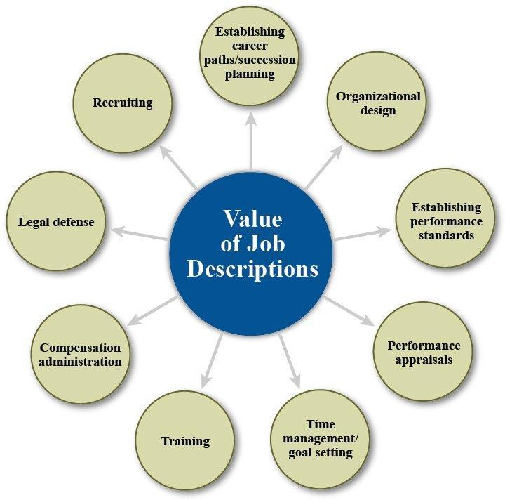
Job Description

Slide 37
Job Specification
The written statement of the minimum qualifications required to perform a specific job is called the job specification. The specification includes both essential and nonessential functions and abilities:
Experience
Education
Training
Licenses and certifications (if required)
Mental abilities and physical skills
Level of organizational responsibility

Slide 38
Job Evaluation
Job evaluation assesses the worth of a position within the organization. This process consists of two main tasks:
Defining the pay rate structure
Setting pay rates equal to rates for similar jobs in other organizations
All methods of job evaluation have the same objective—to develop a system that is measurable and realistic for deciding pay structures. Most evaluation methods can be grouped into one of two categories:
Nonquantitative (whole-job) methods
Quantitative methods

Slide 39
Nonquantitative Evaluation Methods
Nonquantitative methods evaluate the whole job and try to place jobs in order of value to the organization. The sequence will indicate that one job is more important than another job, but it will not tell how much more important.
Examples of two nonquantitative methods include job ranking and job classification.

Slide 40
Job Ranking
The ranking method of job evaluation is the simplest form of job evaluation. Basically, the organization would use a whole job comparison approach and rank order the jobs within the organization from highest to lowest. It is important to note that ranking only gives an organization an indication of how each job fits within the job-worth hierarchy; ranking does not provide any insight as to the relative degree of distance between the various jobs. Ranking jobs within an organization typically follows three steps:
Analyze and document job content.
Identify selected groups of jobs (also known as job sets).
Rank order jobs within the sets

Slide 41
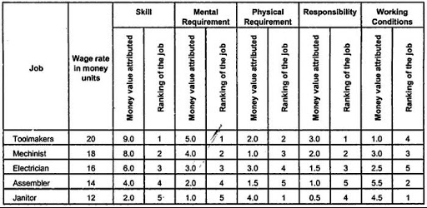
Job Ranking

Slide 42
Job Classification
The job-classification method writes descriptions for each class of jobs. The jobs are then put into the grade that best matches its class description, based on the judgment of the evaluator.
There are a few disadvantages to this method:
Because this process is subjective, with a wide variety of jobs and job descriptions, jobs could easily fall within more than one grade level.
This method relies on job titles and duties and assumes the jobs are similar among organizations. Many organizations are moving to the point-factor method (described below) for these reasons.

Slide 43
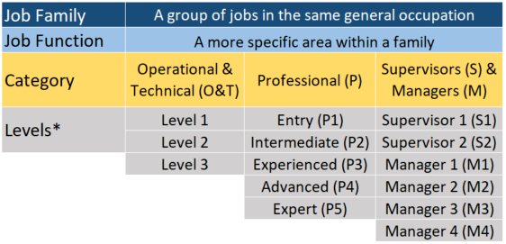
Job Classification

Slide 44
Point-Factor System
The point-factor system is a form of quantitative evaluation. It is the most commonly used method of job evaluation. The compensable factors chosen for the evaluation must reflect the nature of the job being evaluated. For example, hazards and working environment would be pertinent factors in a manufacturing setting but not as relevant in most office jobs. The factors most commonly used in point-factor evaluations include the following:
Skills
Responsibilities
Effort and physical demands
Working conditions
Supervision of others
HR may independently conduct the job evaluation or lead a discussion with an internal or external committee to decide how much each factor (such as skills and working conditions) is present in a specific job. The committee assigns points to each factor and then adds the points to come up with an overall point value for the job. Then they can compare the relative worth of jobs on the basis of their point values.

Slide 45
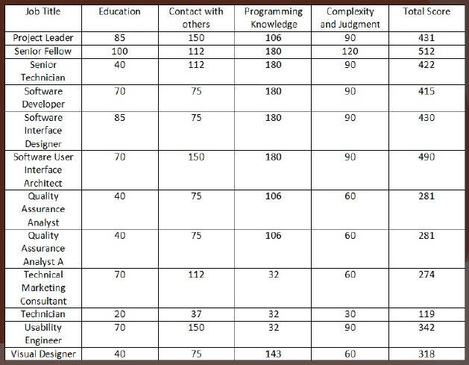
Point Factor System

Slide 46
Market-Based Evaluation
In a market-based evaluation, an organization identifies the labor market in which it wants to compete and uses the current pay rates as the relative worth of corresponding jobs. Although evaluating jobs on the basis of their market value is not a true method of job evaluation, market rates are used as the standard for developing a job-worth hierarchy. Remaining jobs that do not fit the standard are usually put into the hierarchy based on whole-job comparisons (for example, the job-ranking method) with the market-value jobs

Slide 47
Developing a Pay Structure
After the job analysis, job documentation and job evaluation are completed, an organization uses all the data to develop its pay structure. There are two steps to developing a pay structure:
Grouping jobs into pay grades
Setting pay ranges

Slide 48
Compensation Systems
Once the job analysis, job documentation and job evaluation are completed, and the pay structure is developed, the pay system is developed and maintained.
Base-Pay Systems
Most employees receive some type of base pay, in one of these forms:
Hourly wage (for each hour worked)
Salary (the same amount no matter how many hours are worked)
Single- or Flat-Rate System
In single-rate pay or flat-rate pay systems, each employee currently performing the job has the same rate of pay, regardless of performance or seniority. This system is typically used for elected government jobs or union hourly workers

Slide 49
Time-Based Step-Rate System
In a time-based step-rate pay system, the rate is based on how long an employee has been performing the job. Pay increases occur on a set schedule.
In an automatic step-rate pay structure, the pay scale is usually divided into a number of steps that are 3% to 7% apart. At set time periods, each employee with the required seniority receives a one-step increase.
A step-rate system with variability-based performance considerations is similar to the time-based system, except that the size or timing of increases may vary if performance is significantly above or below standard. For example, a very capable employee may skip steps.
In a combination step-rate and performance structure, employees receive increases on a step-rate basis up to the job rate. Above the job rate, increases are granted only for above-standard performance

Slide 50
Performance-Based/Merit Pay System
In a performance-based pay system, the individual employee‘s performance is the basis for the amount and timing of pay increases. Another term for a performance- based pay system is a merit pay system.
In a merit pay system, employees are usually hired at or near the pay range minimum. Pay increases are tied to performance and the degree to which the employee masters the job.

Slide 51
Productivity-Based System
In a productivity-based pay system, pay is decided based on the employee‘s output. The two examples listed here are most frequently used in manufacturing industries:
Straight piece-rate system. The employee receives a base wage rate and is awarded additional compensation for the amount of output produced.
Differential piece-rate systems. The employee receives one piece rate up to the standard and then a higher rate once the standard is exceeded.

Slide 52
Person-Based System
In a knowledge-based system, pay is based on the level of knowledge the employee has in a field. This approach is used mainly for compensating learned professions such as scientists or teachers. Staff professionals may also be paid this way.
Skill-based systems base pay on the number of different skills an employee is qualified to perform. Employees increase their pay by acquiring new skills, even if they do not use the skills on their current assignment. This type of system is most commonly used in a production environment.
Competency-based systems base pay on the level at which an employee can operate in defined competencies, such as training other employees. This type of system is commonly found when rewarding professional groups of employees.

Slide 53
Poll Question # 1
What happens during the job analysis phase of the compensation system design process?
Figure out the value of jobs within the organization.
Create job descriptions and job specifications.
Set up pay grades and pay ranges.
Collect information about a job and evaluate the job requirements.

Slide 54
Answer to Poll Question # 1
Option D - Collect information about a job and evaluate the job requirements.

Slide 55
Poll Question # 2
Which phase of the compensation system design process involves creating job descriptions and job specifications?
Job documentation
Job analysis
Job evaluation
Pay structure

Slide 56
Answer to Poll Question # 2
Option A - Job documentation

Slide 57
Poll Question # 3
What type of methods use a scaling system to show how much more valuable one job is than another?
Job classification
Job ranking
Quantitative evaluation
Nonquantitative evaluation

Slide 58
Answer to Poll Question # 3
Option C - Quantitative evaluation

Slide 59
Questions

