Slide 1
HR Service Delivery - II
SPHRi

Slide 2
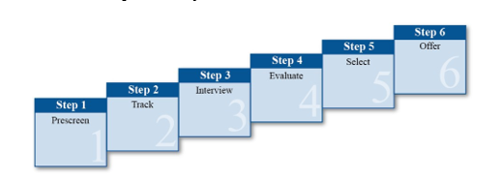
Selection
After HR and line managers have identified and recruited qualified candidates for an open position, they need to gather the information needed to make a selection decision.
Selection is the process of hiring the most suitable candidate for a job.

Slide 3
Step 1: Pre-Screen
The first step of the selection process is to pre-screen the pool of candidates. Pre- screening means examining or interviewing applicants before further selection takes place.
CVs and Application Forms
Pre-screening begins with analyzing the candidate’s curriculum vitae (CV) and/or application form. Efficient pre-screening by HR has the following important uses:
Identifies who fits the minimum selection criteria
Provides a source of questions for the interviewer and for reference checks
Ensures that line management spends time interviewing only qualified candidates

Slide 4
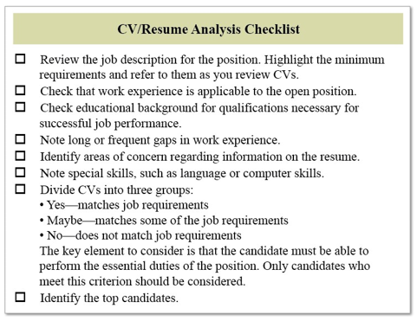
CV/Resume Analysis Checklist

Slide 5
Application Forms
A good application form is one that is complete, easy to read and easy to review
Basic personal data (name, address and phone number)
Education, training and special skills
Work history, with dates of employment
References and authorization to check them
Authorization to verify all information
Statement regarding truthfulness of information
Candidate signature
Many HR professionals believe candidates should submit an application form in addition to a resume, for the following reasons:
The resume provides information the candidate wants you to know; the application provides information you want to know.
The application form may indicate if the candidate has exaggerated accomplishments on the resume.
The candidate’s signature on the application form serves as legal verification that the information is correct and truthful.

Slide 6
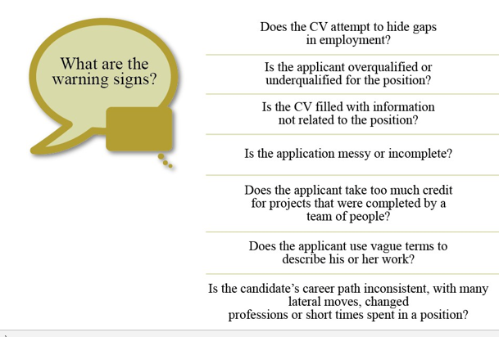
Warning Signs in a CV

Slide 7
Pre-Employment Tests
Pre-employment testing is a useful screening tool for many organizations. An appropriate pre-employment test has the following features:
Is job relevant
Is valid (that is, measures what it claims to measure)
Is reliable (that is, measures consistently)
Helps the organization make more effective employment decisions about candidates
Aptitude Tests :
Aptitude tests assess the candidate’s ability to learn a new skill. For example, a candidate for a factory assembly job may be asked to take a manual skill test.
Cognitive Ability Tests :
Cognitive ability tests assess skills the candidate has already learned. One kind of cognitive ability test is the performance test (also known as the work sample test). There are several kinds of cognitive ability tests. Typing tests are one simple example. Another example is asking an editor to edit a brief section of the organization’s policy manual.

Slide 8
Pre-Employment Tests
Personality Tests
Personality tests assess the candidate’s social interaction skills and patterns of behavior. These tests report what can be described as traits, temperaments or dispositions. Some tests focus on characterizing an individual as being within the normal ranges of adult functioning. Others focus on identification of abnormal behavior.
Psychomotor Tests
Psychomotor tests require a candidate to demonstrate a minimum degree of strength, physical dexterity and coordination in a specialized skill area. This test is appropriate only if the job’s essential functions require such abilities.

Slide 9
Other Pre-Screening Tools
Phone calls and work reference checks are two other tools that HR professionals can use to pre-screen candidates.
Pre-Screening Phone Calls
A phone call with the candidate can be a time-effective form of pre-screening. In a few minutes, interviewers can accomplish the following:
Verify the candidate’s background, experience and availability.
Describe the job in greater detail and answer questions.
If both the interviewer and candidate are still interested, ask the candidate to come to the organization for a pre-screening interview.

Slide 10
Other Pre-Screening Tools
Work Reference Checks
Former employers, clients and colleagues can provide in-depth information about the candidate’s work. The most informative references will be from former or current supervisors, who will know the candidate’s work and will have observed the candidate performing a similar job.
Reference checking has several important purposes:
To achieve better hiring fits
To confirm the honesty and accuracy of the resume
To protect the substantial investment that an organization makes when hiring
Qualifications and Eligibility
Some organizations request verification of the candidate’s academic qualification. For example, candidates may be asked to provide verification that they attended the educational institution listed on the resume or application form.

Slide 11
Step 2: Track
The second step of the selection process is to track the pre-screened applicants.
An applicant tracking system (ATS) is a software system that helps an organization recruit employees. Many applicant tracking systems support the following tasks:
Storing and processing resumes
Making the job requisition process more efficient
Providing reporting metrics that allow organizations to apply their recruiting budget more effectively
Another option for tracking applicants is outsourcing the task to an external agency. In this case, recruiting professionals act as a liaison between external agency recruiters and internal hiring managers or other internal stakeholders involved in the recruiting process. The recruiting professional has the following additional responsibilities:
Serve as a point of contact within the organization to communicate job requirements and recruiting processes to the agency
Ensure that the applications received from the agency are tracked to the organization’s job database and are consistent with the external candidate application process

Slide 12

Step 3: Interview
The third step of the selection process is to interview the qualified candidates.
Types of Interviews
Interviews determine how well the candidate meets the needs of the organization. Organizations tend to use interviews for qualifying candidates more than any other procedure in the selection process.
Interviews can range from short pre-screening interviews (20 minutes or less) to long in-depth interviews (one hour or more).

Slide 13
Behavioral Interview
There are many styles of in-depth interviews. Three are the behavioral interview, the competency-based interview and the structured interview.
Description | Comments
The interviewer focuses on how the applicant previously handled situations (real experiences, not hypothetical ones). The interviewer asks very direct questions to determine if the individual possesses the skills necessary for the job. | Provides insight into how the candidate handled past job- related situations Allows the interviewer to probe more than with traditional interview questions
The premise of the behavioral interview is that past performance is the best predictor of future performance.

Slide 14

Behavioral Interview
An interviewer may ask a candidate for a management position to describe a situation in which the candidate coached a difficult employee. The candidate gives an example that illustrates past performance, while the interviewer looks for the following three key pieces of information:
A description of the situation or task
The action taken
The result or outcome

Slide 15
Competency-Based Interview
Competencies are the skills, behaviors and knowledge that are needed to succeed in a specific job.
Description | Comments
The interviewer asks questions that are based on real situations related to the competencies for the position. The interviewer asks the candidate to provide an example of a time he or she demonstrated the competency. | Provides insight into the candidate’s proficiency in a particular competency Gathers information that is predictive of what the candidate’s behavior and performance is likely to be in the position

Slide 16

Examples of Questions for Competency-Based Interviews

Slide 17
Structured Interview
Description | Comments
The interviewer asks every candidate the same questions. Follow-up questions may be different. The interviewer stays in control of the interview. | Ensures that similar information is gathered from all candidates Gives each candidate the same opportunity to create a good impression Works best when the interviewer wants to ensure that the same questions are asked of all candidates
Different types of questions can be used in the structured interview. The key is that the interviewer asks every candidate the same group of questions.

Slide 18
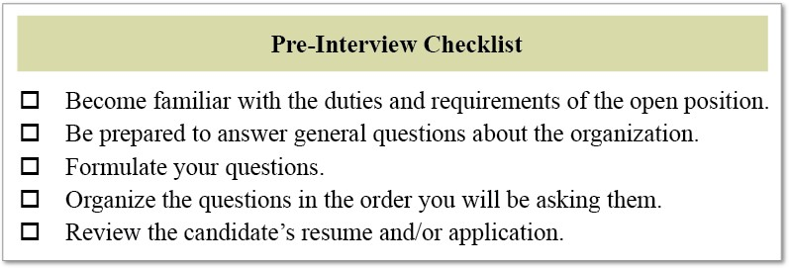
Guidelines for Interviews

Slide 19
Guidelines for an Effective Interview
Action | Description
Establish rapport. | Tell the candidate what to expect during the interview. Establish an environment that encourages the candidate to relax and to provide information.
Listen carefully. | Frequently summarize or paraphrase what you hear to make sure you understand what the candidate is saying. You should observe and listen more than you talk.
Make smooth transitions from one topic to another. | An organized, logical interview works best for both you and the candidate. Cover a topic area thoroughly and then move on to the next area.
Observe nonverbal behavior. | Be aware of facial expressions, gestures and body positions. This applies to both you and the candidate.
Take notes. | Taking notes will help you remember your impressions and significant pieces of information from the interview. However, stay engaged with the candidate, and don’t make notes directly on the application form or resume.
Conclude the interview. | Tell the candidate what the next step in the process will be.

Slide 20
Step 4: Evaluate
The fourth step of the selection process is to evaluate the candidates.
Interview Feedback
Giving feedback to candidates after an interview is an important part of the selection process. Guidelines for providing effective feedback to candidates include the following:
Be honest in your assessment and give the applicant meaningful feedback for future employment.
Provide feedback that is clear and concise allowing the applicant to understand their strengths and weaknesses in comparison to the job requirements.
Give balanced feedback and discuss the person’s strengths first and then weaknesses against the job requirements.
Relate feedback to the job requirements not feelings, impression, or views of the applicant’s personality.
Consider the language used when providing feedback, especially in relation to interview performance.
Give factual examples in support to the feedback being provided.

Slide 21
Background Investigations
Background investigation is the process of authenticating the information supplied to a potential employer by a job applicant in his or her resume, application and interviews. Organizations that conduct thorough background investigations usually make better hiring decisions and may avoid negligent hiring claims. Negligent hiring involves hiring a candidate who the employer knew (or should have known based on a reasonable investigation of the candidate’s background) posed a risk to others in the workplace.
HR professionals often conduct the background investigations. These investigations should be the same for candidates applying for the same job. Make sure a clear connection exists between the background investigations and the requirements of the job.

Slide 22
Common Background Investigations
Internet Search :
An Internet search on the candidate's name, especially using an Internet search engine such as Google.com, helps the organization confirm candidates’ claims about their jobs, performance, awards and other information. Sites such as LinkedIn may also serve to check the candidate’s consistency in claims about job history and achievements
Criminal Background Check
Organizations conduct criminal background checks for the following reasons:
To determine if the candidate has a history of criminal convictions that may disqualify her or him from consideration
To increase the quality of applicant hiring
To reduce the possibility of theft and embezzlement
Credit History Checks
Credit history checks should be conducted only on the following candidates:
Candidates for positions of financial responsibility (such as accounting and finance professionals)
Candidate for positions that involve handling significant amounts of currency or other valuables
If your credit reports are acquired from external vendors, the organization must comply with any applicable credit check laws.

Slide 23
Step 5: Select
The fifth step in the selection process is selecting a candidate to fill the open position.
Selection of the most qualified candidate will be based on the interviews, evaluations, and tests conducted in Steps 3 and 4 of the selection process.
A tie breaker is a method used to select a preferred candidate when two or more candidates are considered equally qualified. The job requirements will help you determine what particular categories are the most important. The winning candidate should be the one who scores higher in the most consequential categories.
In some cases the decision must be based on a personality fit. The wrong fit leads to an unhappy employee, manager and team. The right fit can energize the environment and lead to a happy employee, manager and team. Often the head of the department or the organization must make the final decision about the right fit.

Slide 24
Reliability and Validity of Selection Tools and Methods
Hiring the wrong person for the job is a costly mistake. Selection errors can impact the organization’s human capital management plan, employee morale, management time, training budgets, productivity and profitability. Just as reliability and validity were critical parts of the pre-screening process, you must also establish the reliability and validity of the selection tools and methods.

Slide 25
Reliability and Validity of Selection Tools and Methods
Establishing Reliability
Reliability is the ability of an instrument to measure consistently. For example, if an applicant takes a motor skills test twice, the scores should be similar (allowing for the effect of practice). If the scores differ significantly, the test may not be reliable.
Perfect reliability is difficult to achieve. The following types of errors can lead to inconsistent results:
Failure to measure some aspect of an important attribute
Irrelevant questions in an interview or on a test
Different time limits for candidates in an interview or on a test
Establishing Validity
Validity is the ability of an instrument to measure what it is intended to measure. For example, a typing performance test is probably a valid prerequisite for applicants who will be expected to do typing (such as for a position in an administrative processing center).

Slide 26
Realistic Job Previews
The cost of hiring and training an employee is substantial. Therefore, providing a realistic job preview (RJP) is in the best interest of the candidate and the organization.
A realistic job preview informs candidates about all aspects of the job and the work environment. For some candidates, the RJP can occur earlier in the selection process, during the interview.
The RJP has three purposes:
Gives candidates as much information as possible, so they can make an informed decision about their suitability for the job
Gives organizations an opportunity to portray the job objectively— including both favorable and unfavorable factors
Increases the possibility of a good match between the candidate and the organization

Slide 27
Types of Realistic Job Previews
Organizations can create realistic job previews in a variety of ways, including the following:
Tours of the workplace. A walk-through of the workplace provides a candidate with an accurate impression of the work environment. Candidates can determine their comfort level with the physical format (for example, cubicles or traditional offices, break areas and cafeterias) and with noise levels.
Job simulations. Candidates may experience a simulation of the job in order to determine their suitability. For example, an applicant for a clean- room manufacturing position can wear the clean-room attire that is required several hours a week.
Video presentation. A candidate may view a video presentation before starting to work for an organization. The video can portray the history of the company, the organizational culture, and a discussion of benefits and the path of a typical day.

Slide 28
Step 6: Offer
The last step of the selection process is offering the position to the most qualified candidate.
Contingent Job Offer
Organizations may make a job offer that is contingent on the candidate passing certain tests or meeting certain requirements. This is known as a contingent job offer. The tests or requirements can include the following:
Medical examination
Physical fitness test
Psychological test
Employment Offer
An employment offer should quickly follow the selection of the most qualified candidate. Mishandling this part of the process can result in losing the candidate to another organization or can give the employment relationship a negative start even if the candidate accepts the position.
An employment offer is formally communicated through an offer letter. Employment offers must be worded carefully.

Slide 29
Offer Letter Guidelines
Use a standard letter that has been approved by the legal department.
Clearly state the terms of the offer and any contingencies.
Establish a reasonable acceptance deadline.
Clearly state the acceptance details (for example, requiring a signature returned on a duplicate copy of the offer letter).

Slide 30
Offer Negotiation
In some countries, the offer letter is followed by little or no negotiation. Both the candidate and the organization will have a mutual understanding about what the offer letter will include before the formal offer is made. In other countries, the offer letter may be the starting point of a long negotiation.
After the negotiations are complete, the offer and contract of employment may be finalized.

Slide 31
Employment Contracts
An employment contract is an agreement between the organization and an employee that explains the employment relationship.
A written contract helps clarify employment terms. The specific terms will vary based on the organization, the job and applicable local laws. The following list provides examples of items commonly covered in an employment contract:
Terms and conditions of employment
General duties and job expectations of the employee
Confidentiality and nondisclosure terms
Compensation and benefits
Terms for resignation or termination
Relocation
Severance provisions
Appropriate signatures and date

Slide 32
Difference between an offer and a contract
In general, an offer is not legally binding and can be retracted at any time. A contract confers specific legal obligations on both the organization and the new employee. In some counties, the contract can be very difficult to break without significant costs. Involve legal counsel in developing any offer letter or contract for the organization.

Slide 33
Handling Nonselected Candidates
Candidates who are not selected for the open position should be notified promptly. A personal phone call or letter is the preferred method for such notifications. However, standardized rejection letters may be necessary when there are numerous applicants. If possible, add a paragraph to the letter showing that the organization has given careful thought to the candidate and to the selection. For example, the letter can indicate that the selection was a difficult decision and that the deciding factor was due to the need for a specific skill or competency in the candidate. The candidate is more likely to feel respected and to retain a positive impression of the organization.

Slide 34
Poll Question # 1
Which one of the following statements related to resumes and applications is true?
Resumes highlight the candidate’s strengths.
Many HR professionals believe candidates should submit only a resume and that an application form is not needed.
The application provides information the candidate wants you to know; the resume provides information you want to know.
The presence of any warning signs means that a candidate should immediately be rejected.

Slide 35
Answer to Poll Question # 1
a. Resumes highlight the candidate’s strengths.

Slide 36
Poll Question # 2
Which pre-employment test assesses skills the candidate has already learned?
Aptitude test
Cognitive ability test
Personality test
Psychomotor test

Slide 37
Answer to Poll Question # 2
B. Cognitive ability test

Slide 38
Poll Question # 3
Which of the following is a question used in a behavioral interview?
Describe a time when you used your fact-finding skills to solve a problem.
Do you possess good management skills?
Have you ever dealt with stress in your current position
Describe your current job responsibilities.

Slide 39
Answer to Poll Question # 3
C. Have you ever dealt with stress in your current position?

Slide 40
Poll Question # 4
In which type of interview is each candidate asked the same group of questions?
Behavioral interview
Competency-based interview
Structured interview
Unstructured interview

Slide 41
Answer to Poll Question # 4
C. Structured interview

Slide 42
Poll Question # 5
Which of the following is NOT a feature of an effective RJP (realistic job preview)?
Dispels unrealistic expectations
Accurately represents organizational realities
Helps increase job satisfaction
Increases the likelihood that the candidate will not accept the job offer

Slide 43
Answer to Poll Question # 5
D. Increases the likelihood that the candidate will not accept the job offer

Slide 44
Poll Question # 6
What term is used for an agreement between the organization and an employee that explains the employment relationship?
Contingent job offer
Offer letter
Employment contract
Offer negotiation

Slide 45
Answer to Poll Question # 6
C. Employment contract

Slide 46
New Hire Onboarding
Research on orientation and onboarding shows that a positive start at an organization has the following benefits for employees:
Creates enthusiasm
Reduces anxiety
Encourages social connections

Slide 47
New Employee Orientation
Before the Employee’s Arrival
Employees play a key role in helping an organization meet its goals and objectives. Many organizations begin to inform new employees about their roles before the employees arrive for their first day of work. Offer letters and new hire welcome packages are the most common methods of communicating information to the new employee before the start date.
Typical contents of a new hire welcome package include the following:
Welcome letters (for example, from the organization’s CEO, president and human resources department)
Payroll information
Policies manual
Benefits information
Benefits enrollment forms
In addition to sending the welcome package, the organization should take the following steps to prepare for the employee’s arrival:
Communicate. Contact the employee and provide a personal welcome.
Set up the work area. Verify that the employee’s office space is ready and that the computer, telephone and any other necessary equipment are arranged.
Schedule ahead. Ensure that an orientation program is in place

Slide 48
Orientation/Induction
Orientation, also known as induction, is the first step in the formal process of training employees. Through orientation, employees become familiar with the organization, their department, their coworkers and their job.
Orientation programs usually span one to two days. The orientation provides new employees with three types of information:
Organizational information
Policies, procedures and benefits
Work context (including job procedures)
The purpose of the orientation program is to ease the employee’s transition to a new environment. During the orientation, the employee can establish relationships with coworkers and develop a sense of belonging to the organization. The employee also gains a realistic image of the job. An effective orientation program helps the employee quickly become a productive and contributing member of the organization.
Orientation programs can be divided into a general orientation and a department orientation. HR is usually responsible for the general orientation and can also provide input to the manager on the department orientation. However, the manager is responsible for ensuring that employees understand how they will contribute to their department and how they fit into the organization structure.

Slide 49
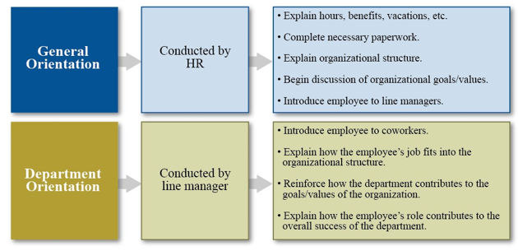
Responsibilities and Activities for General and Department Orientations

Slide 50
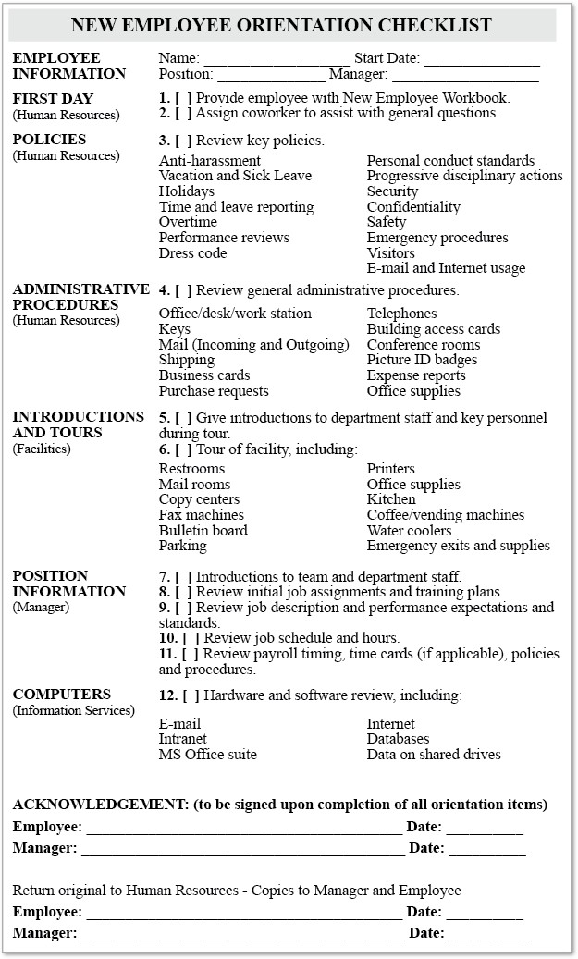
New Employee Orientation Checklist

Slide 51
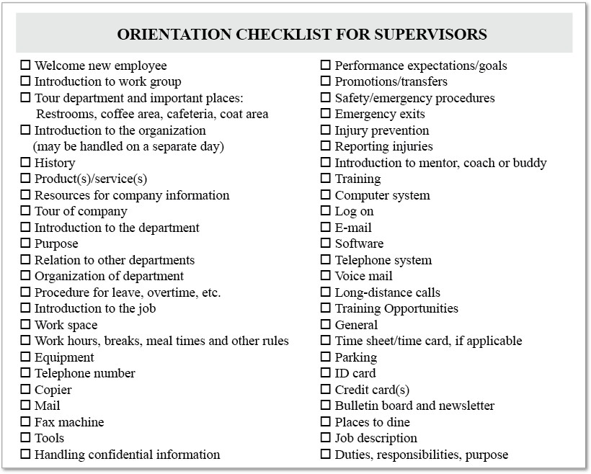
Supervisor Orientation Checklist

Slide 52
New Employee Onboarding
Onboarding is the process of helping new employees learn the organization’s policies, procedures and culture in addition to their job responsibilities.Onboarding includes both the orientation and the first three to twelve months of employment.
The purpose of the onboarding process is to provide the employee with a positive start at the organization. This positive start can have many benefits; including increasing the employee’s enthusiasm, helping reduce anxiety and helping the employee connect with coworkers .
Successful onboarding programs generally include the following factors:
Active rather than passive participation by new employees
Onboarding spread out over a period of time
Use of checklists to ensure that all important material is covered
Avoidance of information overload

Slide 53
Onboarding Roles and Responsibilities
During onboarding, HR professionals, the hiring manager, coworkers and others learn more about the new employees and further integrate them into the organization in the following areas:
Organizational culture and norms
Organizational goals and objectives
Specific functional areas in the organization
Departmental and job expectations
Available work resources and tools
Mentor options
Performance management systems
Work/life balance and support resources

Slide 54
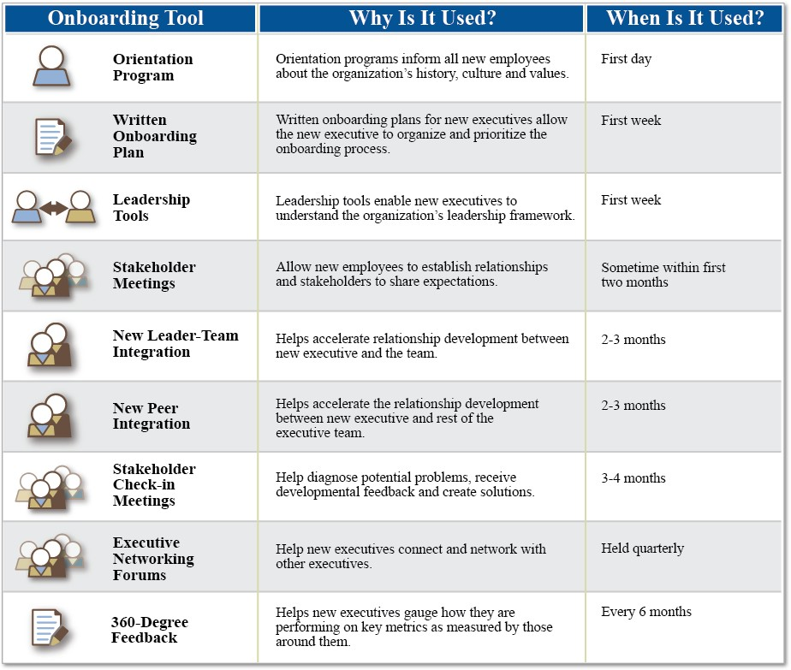
Sample Onboarding Components

Slide 55
Evaluating the Effectiveness of Onboarding
The effectiveness of the onboarding program can be related to the amount of turnover in the first year of employment. Onboarding programs can help employees adjust to the new environment by introducing them to coworkers,lessening feelings of isolation and providing a better understanding of expectations and future opportunities.
HR professionals can evaluate their organization’s onboarding initiatives using metrics that include the following:
Turnover/retention rates. Compare retention rates for various groups. For example, what is the retention rate for employees who began their employment in 2011 compared to employees who began in 2010?
Retention threshold. Track the point at which most new employees tend to exit the organization. For example, if most new employees exit within the first 90 days of employment, the organization can conduct exit interviews to determine the cause of the early exit.
Performance measures. Compare the performance of groups provided with different onboarding experiences. For example, one group is provided with one week of onboarding experiences and a second similar group is provided with a full month.
Formal/informal feedback. Ask new employees open-ended questions to determine their satisfaction with the onboarding process and the organization.
Flexibility. Flexibility and adaptability allow your organization to provide employees with an optimal work environment.

Slide 56
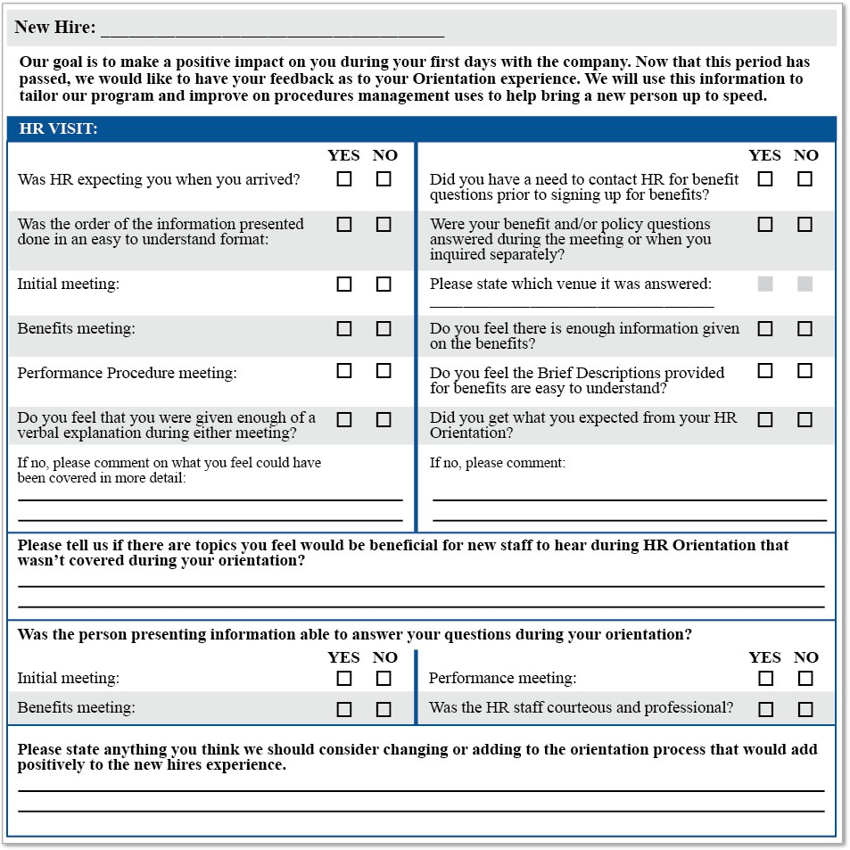
Sample New Hire Survey

Slide 57
Poll Question # 7
Which of the following is NOT usually part of a new employee welcome package that is sent before the employee’s start date?
Welcome letter
Benefits information
Policies manual
ID badge

Slide 58
Answer to Poll Question # 1
D. ID badge

Slide 59
Poll Question # 8
What is the first step in the formal training of new employees?
Orientation
Facility tour
Formal evaluation
Behavioral interview

Slide 60
Answer to Poll Question # 8
A. Orientation

Slide 61
Poll Question # 9
Who is usually responsible for an employee’s general orientation?
Coworkers
HR
Manager
Safe and security

Slide 62
Answer to Poll Question # 9
B. HR

Slide 63
Poll Question # 10
Which of the following is a feature of a successful onboarding program?
Passive rather than active participation by new employees
Onboarding activities completed within a short period of time
The same program fitting the needs of all new employee groups
Avoidance of information overload

Slide 64
Answer to Poll Question # 10
D. Avoidance of information overload

Slide 65
Poll Question # 11
Which of the following helps track the point at which most new employees tend to exit the organization?
Orientation checklist
Open-ended questions
Performance measures
Retention threshold

Slide 66
Answer to Poll Question # 11
D. Retention threshold

Slide 67
Questions

