Slide 1
HR Service Delivery - I
SPHRi

Slide 2
Workforce Planning
Getting the right number of people with the right competencies in the
right jobs at the right time.
A process in which an organisation attempts to estimate the demand for
labour and evaluate the size, nature and sources of supply which will be
required to meet that demand.

Slide 3
Workforce Planning
Workforce planning is the process of identifying and analysing the organization’s need for human capital to allow for the achievement of the organization’s goals. This process includes the following actions:
Forecasting the future composition of the workforce
Identifying any gaps between the current and future staff
Deciding how to close those gaps
Determining how to meet the staffing needs

Slide 4
Benefits of Workforce Planning
Organizations should conduct a regular and detailed workforce planning assessment. The goal is to create the best staffed and trained workforce that can respond to the needs of the organization.
Effective workforce planning offers the following benefits to an organization:
Easily accessing employee data to locate talent anywhere in the organization
Finding the best use for each employee
Recruiting passive job candidates

Slide 5
Organizational Requirements for Staffing
Flexibility is one key to defining staffing needs. The state of the economy can change rapidly and unpredictably. Organizations that respond quickly will have the most success with recruiting and hiring the best talent.
Another key trait is being proactive. Organizations must develop strategic workforce plans that allow them to avoid future surpluses or shortages in the workforce.
Organizations should take the following actions to define their staffing needs over the long term:
Incorporate economic indicators into forecasts of talent supply and demand.
Retain staff with a strong employee value proposition.
Consider hire-back deals, alumni networks and paid sabbaticals to rebuild a workforce

Slide 6
Anticipating Staffing Needs
The HR professional has the responsibility of anticipating the staffing needs of the organization. This responsibility includes managing the communication of staffing issues and changes within the organization. As part of the staffing strategy, HR should consider the following factors:
Estimates of increases or decreases in the organization’s growth, output and revenue
Estimates of corresponding changes in talent needs
Projections of future vacancies
Estimates of the internal and external availability of talent

Slide 7
Issues that impact future staffing
A persistent shortage of people is a shortage that is not linked to a specific event and that spans several years.
A temporary reduction in staff can occur when an organization undergoes restructuring and must decrease the number of staff for a short time.
A temporary reduction can also occur due to a sudden increase in available jobs..
A permanent reduction in staff requires thoughtful communication with all employees in the organization, particularly those involved in the reduction.

Slide 8
Promoting the Organization
An organization’s workforce planning process should include a consideration of how the organization is perceived by potential applicants and why applicants would want to work for the organization. Employment brands and employee value propositions are two effective tools for promoting the organization to applicants.

Slide 9
1. Employment Branding
Employment branding is the process of positioning an organization as a desired employer in the labor market. This process is a key part of an organization’s efforts to attract and retain the best talent. An employment brand creates an image that makes people want to work for and stay working for the organization.
Building an effective employment brand is based on the following four strategies:
Making sure that all key stakeholders work toward the same objective
Involving senior management to show the organization’s commitment to the employment brand
Ensuring that the employment brand reflects the organization’s culture
Selecting appropriate metrics to measure the impact of employment branding

Slide 10
2. Employee Value Proposition
Organizations select the talented people they want to hire. However, talented people also select the organization they want to work for. An organization’s employee value proposition (EVP) answers the question: Why would a talented person want to work for the organization?
The EVP is the foundation of employment branding. An organization’s EVP must accomplish the following:
Align with the organization’s strategic plan, vision, mission and values
Create an image that attracts and retains people
Provide an accurate picture of employment for employees and candidates

Slide 11

The Employment Value Proposition

Slide 12

Benefits of EVP

Slide 13
Diversity and Inclusion Considerations
HR professionals should take the following actions to integrate diversity and inclusion into the organization:
Use social networking to help create a workforce that can navigate different cultures, countries and companies
Connect diversity and inclusion to strategic business outcomes
Encourage diversity practitioners to develop strong business skills and global experience
Help mitigate division between different groups and cultures
Increase the credibility of diversity and inclusion initiatives in the organization by dealing with difficult issues

Slide 14
Legal Considerations in Global Staffing
Many unique employment issues are raised by global and cross-border organizations. The HR professional must take the following actions:
Identify what matters.
Understand the risks and obstacles of noncompliance.
Find solutions for compliance.
The HR professional should seek legal counsel regarding any uncertainties related to the content of any laws, regulations or practices (especially in countries with less developed legal systems).

Slide 15
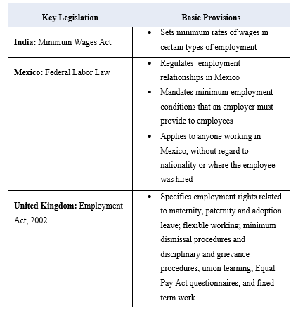
Key Legislation Affecting Global Staffing

Slide 16
The Role of the Staffing Plan
A staffing plan provides an organization with the following benefits:
Provides a strategic basis for making HR decisions
Allows organizations to anticipate change
Provides strategic methods for addressing current and future workforce issues
Can lead to significant cost savings, improved efficiencies and increased productivity
The staffing plan creates a practical link between HR strategic plans and day-to- day staffing activities. The focus of the staffing plan is on short-term implementation.

Slide 17
Staffing Needs Analysis
A staffing needs analysis provides a systematic approach to anticipate the demand for talent and the available supply. The outcome of the analysis is data that HR professionals can use to help ensure the organization is appropriately staffed. The needs analysis usually forecasts needs within a one-year to three-year time frame.
Supply analysis identifies the supply of labor and skills essential to the organization.
Demand analysis forecasts the organization’s future workforce composition.
Gap analysis compares the supply with the demand to identify gaps between the composition of the current workforce and future workforce needs.
Solution analysis is the process of creating strategies to close the gaps identified during the gap analysis.

Slide 18

Staffing Need Analysis

Slide 19
Designing the Staffing Plan
The needs analysis and the tactical objectives are used to design the staffing plan. A staffing plan describes how the tactical objectives will be achieved through the delegation of tasks and the application of resources. The organization’s planning approach should have the following features:
Be consistent with other HR planning initiatives
Be collaborative and easily understood by all participants
Be accepted by those responsible for implementing the plan

Slide 20

Workforce Planning

Slide 21
Poll Question # 1
Which of the following is a key organizational trait needed to define staffing plans?
Being reactive
B. Being unpredictable
C. Being flexible
D. Resisting sudden change

Slide 22
Answer to Poll Question # 1
C Being flexible

Slide 23
Poll Question # 2
What staffing issue typically occurs when an organization undergoes restructuring?
Increase in applicant pool
Persistent shortage of people
Permanent reduction in staff
Temporary reduction in staff

Slide 24
Answer to Poll Question # 2
D. Temporary reduction in staff

Slide 25
Poll Question # 3
What term describes the process of positioning an organization as a desired employer in the labor market?
Employment branding
Employee value proposition
Staffing analysis
Return on investment

Slide 26
Answer to Question # 3
A. Employment branding

Slide 27
Poll Question # 4
When analyzing staffing needs, what step forecasts the organization’s future workforce composition?
Supply analysis
Demand analysis
C. Gap analysis
D. Solution analysis

Slide 28
Answer to Poll # 4
B. Demand analysis

Slide 29
Job Analysis
The success of any organization depends on each employee’s performance on the job. To make the recruitment and selection process effective, both employees and employers must have a clear concept of what a given job is and a clear language to communicate about the job.
A job analysis is a study of the major tasks and responsibilities of jobs in an organization. Job analysis is the foundation of many HR functions and activities. Effective HR practices depend on a thorough understanding of how jobs are performed

Slide 30
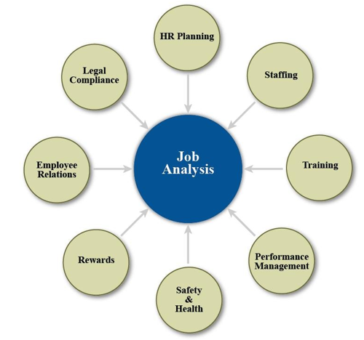
Roles of Job Analysis in HR

Slide 31
Importance of Job Analysis
A job analysis measures the job, not the person doing the job.
A job analysis helps to determine the following information:
The importance of each task and responsibility
How the job relates to other jobs in the organization
The performance qualifications for the job
The conditions under which the work is performed
The general purpose of the job analysis is to understand the requirements of a job and to develop a pay structure. All jobs must be interrelated to accomplish the organization’s vision, mission, goals and objectives. Job analysis is the first step toward that end.

Slide 32
Job Analysis Data
Essential and nonessential tasks, duties and responsibilities
Knowledge, skills, and abilities
Mental and physical attributes required for the job
Level of responsibility in the job (supervision received and given)
Work environment (including equipment used, hazards and general physical conditions that may affect the work)

Slide 33
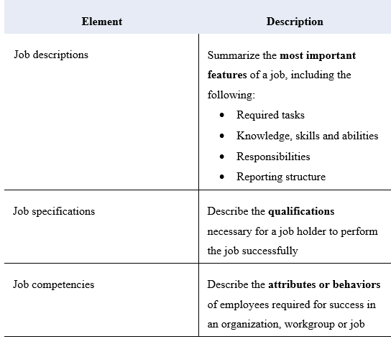
Outcomes of the Job Analysis

Slide 34
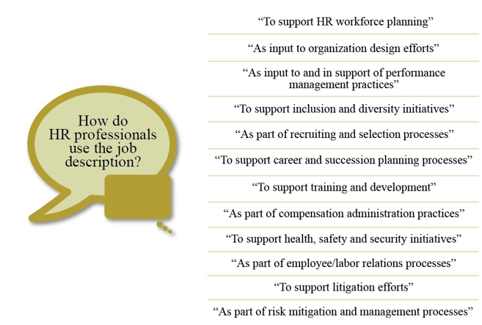
Job Description
A job description is a written document describing an employee’s work activities.

Slide 35
Job Specifications
A job specification is a written description of the minimum qualifications required to perform a specific job. A job specification should reflect what is necessary for satisfactory performance, not what the ideal candidate should have.
Job specifications can be generated during the preparation of the job description. These specifications are often included as part of the job description document.
Examples of job specifications include the following:
Experience
Education
Training
Licenses and certification (if required)
Mental abilities and physical skills
Level of organizational responsibility

Slide 36
Job Competencies
Job competencies are the observable and measurable skills, behaviors and knowledge that are needed to succeed in a specific job. Some organizations use the term ―competencies interchangeably with the knowledge, skills and abilities needed to perform a job successfully. However, competencies are more than basic KSAs. An employee usually develops competency at a job over a period of time. Therefore, job competencies represent the accumulation of multiple abilities and traits and knowledge required for success.
A competency-based job analysis describes a job in terms of competencies instead of job duties. The focus is on what the employee or team must be competent to do in order to perform the job.

Slide 37
Poll Question # 1
What term is used to describe a study of the major tasks and responsibilities of jobs in an organization?
Job analysis
Job description
Job specification
Job competency

Slide 38
Answer to Poll Question # 1
A. Job analysis

Slide 39
Poll Question # 2
Which of the following information is NOT collected during a job analysis?
Job context
Job content
Internal strengths and weaknesses
Performance criteria

Slide 40
Answer to Poll Question # 2
C. Internal strengths and weaknesses

Slide 41
Poll Question # 3
When you collect data for a job analysis, which of the following can be considered a primary source?
Job applicants
Employees who are currently performing the job
Employees throughout the organization
Employees who perform similar jobs at other organizations

Slide 42
Answer to Poll Question # 3
B. Employees who are currently performing the job

Slide 43
Poll Question # 4
Which method of collecting primary source data provides a realistic view of the daily tasks and activities performed in a job?
Interviews
Observation
Questionnaire
Work log

Slide 44
Answer to Question # 4
B. Observation

Slide 45
Recruitment
Recruitment is the process of attracting, screening and hiring qualified people for a job. The goal is to attract a pool of qualified candidates, some of whom will later be given job offers.
Recruitment consists of two crucial factors. One factor is attracting the appropriate quantity of applicants. The other factor is attracting quality applicants.
The starting place for determining who is qualified should be a carefully prepared job analysis, job description and job specification. These three documents are needed to establish selection criteria, evaluate applicants and screen out those who do not meet the minimum qualifications needed for the job.

Slide 46
Recruiting Process
The recruiting process starts with getting approvals for opening a job requisition.
The job requisition is a request to hire a person for an open position. Job requisitions usually include the following information for candidates:
Job description
Job level
Job location
The requisitions also include information required for HR professionals, such as cost estimates and headcount information. Headcount refers to the number of employees an organization has on its payroll.
Requisition forms are required for :
Authorizing the recruitment of full-time, part-time, temporary and contract employees
Authorizing filling a position that has been vacated by the transfer or termination of a current employee
Authorizing creating a new position that is not currently filled by an employee

Slide 47
Recruiting Strategies I
Build a Candidate Pipeline
Building a candidate pipeline means developing a pool of applicants that will be available when a job opening needs to be filled. A candidate pipeline has crucial value to an organization. However, organizations must first know what they are looking for ?
Consider the following strategies for starting and maintaining effective candidate pipelines:
Let potential candidates know that your organization may be interested in hiring them if an appropriate job position becomes available.
Let management know when exceptional talent is available.
Consider creating a new position for a very strong candidate who may not match your organization’s current job openings.
Keep your pipeline to a manageable size

Slide 48
Recruiting Strategies II
Consider Flexible Staffing Options
Also referred to as alternative staffing, flexible staffing uses alternative recruiting sources and workers who are not regular employees.
Flexible staffing can be based on either schedule flexibility or location flexibility. Schedule flexibility includes situations such as compressed workweeks and part- time options. Location flexibility includes working remotely from a location other than the main office or worksite.
Reasons to consider flexible staffing options for your organization include the following situations:
A shortage of available workers for open positions
Seasonal workload demands
Organizational upturns and downturns that make permanent headcounts impractical
Special projects that demand specific skills
Flexible staffing offers organizations the following benefits:
Improved job commitment over a one-year period
Decreased health problems or complications that impact the employee’s work

Slide 49
Recruiting Strategies III
Internal Recruitment Sources :
Organizations can fill open positions through internal promotions and transfers. This internal recruitment allows the organization to capitalize on its investment in recruiting, selecting and developing its current employees.
Effective methods of recruiting internally include the following:
Job postings
Skills assessment tools
Employee databases
Employee referrals

Slide 50

Advantages and Disadvantages of Recruiting Internally

Slide 51
Job Postings
A job posting is an internal system that allows employees to respond to a job opening for a specific position. A posting should provide a brief description of the job, including significant job duties and minimum qualifications, education and experience. Job postings can be communicated through bulletin board notices, newsletters, memos, electronic bulletins or the company Intranet.
In some cases, jobs are not advertised externally until employees have an opportunity to respond to the posting. In other cases, jobs may be simultaneously advertised externally to speed up the hiring process.
Job postings have several advantages:
Allows all qualified employees to compete for positions
Alerts candidates to advancement opportunities in the department or the organization
Allows the organization to reduce the costs of recruiting
Accommodates seniority by establishing qualifications and other position requirements

Slide 52
Skills Assessment Tools
The human resource information system (HRIS) is technology that supports human resources functions. HRIS can be used as a source for internal recruitment.
HRIS skill banks and skill tracking systems can generate computerized employee profiles and skill inventories. These inventories provide a list of candidates who have the needed knowledge, skills and abilities. Having a complete record of each employee’s qualifications provides the following benefits:
Allows organizations to scan records quickly and to locate qualified candidates
Increases the likelihood of a good match between the job and the employee

Slide 53

Employee Referrals
An employee referral program is a recruiting strategy that rewards current employees for referring qualified candidates for open positions

Slide 54
Internal Movement
Internal movement refers to the movement of employees from one job to another within the organization.
We will look in more detail at the following forms of internal movement:
Promotions
Demotions
Relocations
Transfers
International assignments

Slide 55
Promotions
In most organizations, a promotion is an advancement of an employee's rank, usually with greater responsibility and more money. Some reasons for promotion include the following:
Assuming new and different duties of a different position at a higher level
Assuming a position that involves increased responsibilities and the acquisition of additional knowledge, skills or abilities in the same line of work
HR, together with line management, should develop a natural progression of jobs whenever possible. This progression provides employees with a career path for future growth that can also be used as a basis for promotion from within. However, HR management should not create jobs simply to provide a path of upward mobility. Artificial career paths can lead to unrealistic expectations and unnecessary organizational structure and costs.

Slide 56
Demotions
A demotion is moving an employee back or laterally to a position that is better suited to his or her talents. Demotions can occur for several different reasons:
Staff reductions, consolidations or reorganizations
An attempt to move an underqualified employee to a more suitable position
An employee’s request (For example, an employee may not want to continue as a supervisor or may request a part-time schedule.)

Slide 57
Relocations
Relocation means moving an employee to another location for work. This relocation can be within the country or to another country.
The organization should consider several factors related to relocations:
The cost to the organization
The employee’s willingness to accept the relocation
The impact on the employee’s family (including employment opportunities for the spouse)
The need for an orientation program to adjust employees and their families to the new location

Slide 58
Transfers
Often employees transfer to other divisions within an organization. Transfers are usually considered a lateral move with no salary adjustment. Transfers can be initiated by either the employee or management and may involve a move to a different geographic location, function or organizational line.
Reasons for transfers include the following:
The employee desires change but does not want to leave the organization.
The organization finds a better match between the employee’s abilities and the organization’s staffing needs.
The transfer helps the organization balance staffing and reduces the need for terminations.

Slide 59
International Assignments
An international assignee is a person who moves to a new country to work on an international assignment
Reasons for organizations to make an international assignment include the following:
Filling an open position
Transferring technology or knowledge
Developing an employee’s career
Analyzing the market for the organization’s products or services

Slide 60

Recruiting Strategies IV
External Recruitment Sources
During the external recruitment process, HR or the lead recruiter plays the liaison role between the hiring manager and the external recruitment source. As a liaison, the recruiter is the main contact point in the recruitment process and facilitates the communication between the organization and the external recruitment source.

Slide 61

External Recruiting Sources

Slide 62
Poll Question # 1
What form is best used to authorize creating a new position that is not currently filled by an employee?
Requisition form
Requisition Replacement form
Add to Headcount form
Recruitment form

Slide 63
Answer to Poll Question # 1
A. Requisition form

Slide 64
Poll Question # 2
Which of the following statements about effective recruiting is NOT true?
What works for one organization will usually apply to another organization.
Job specifications should reflect the collective input of managers, supervisors, incumbents and others.
Recruiters should show genuine interest in job candidates and treat them like valued prospective employees.
Organizations should recruit continuously rather recruiting only to fill specific existing openings.

Slide 65
Answer to Poll Question # 2
A. What works for one organization will usually apply to another organization.

Slide 66
Poll Question # 3
What is meant by building a candidate pipeline?
Using alternative recruiting sources and workers who are not regular employees
Developing a pool of applicants that will be available when a job opening needs to be filled
Establishing a specific plan of action for meeting your recruitment objectives
Encouraging the best potential candidates to apply

Slide 67
Answer to Poll Question # 3
B. Developing a pool of applicants that will be available when a job opening needs to be filled

Slide 68
Poll Question # 4
Which of the following is an advantage of internal recruiting?
Brings new ideas into the organization
Provides cross-industry insights
May reduce training costs
Can improve employee morale

Slide 69
Answer to Question # 4
D. Can improve employee morale

Slide 70
Questions

