Slide 1
HR R Analytics

Slide 2
Introduction to R

Slide 3
Getting Started With R
R is an interpreted programming language.
It also allows you to carry out modular programming with the help of functions.
It is widely used to analyse statistical information as well as graphical representation.

Slide 4
Run R Programs
You can run R programs in two different ways:
Installing R in your local machine
Using an online environment

Slide 5
Run R Programs
Installing R in your local machine
Visit https://cloud.r-project.org/ and download the right binary for your operating system. If you want to download the latest version of R in Windows, you can visit https://cloud.r-project.org/bin/windows/base/R-4.1.1-win.exe.

Slide 6
Running Your First R Program

Slide 7
Running Your First R Program
message <-"Hello World!“
print(message)

Slide 8
R Comments
Here, # declare variable and # print variable are two comments used in the code.
# declare variable
age = 24
# print variable
print(age)

Slide 9
R Variables and Constants

Slide 10
R Comments
In computer programming, a variable is a named memory location where data is stored. For example,
x = 13.8
Here, x is the variable where the data 13.8 is stored. Now, whenever we use x in our program, we will get 13.8.
x = 13.8
# print variable
print(x)

Slide 11
R Comments
In computer programming, a variable is a named memory location where data is stored. For example,
x = 13.8
Here, x is the variable where the data 13.8 is stored. Now, whenever we use x in our program, we will get 13.8.
x = 13.8
# print variable
print(x)

Slide 12
Rules to Declare R Variables

Slide 13
R Comments
As per our requirements, we can use any name for our variables. However, there are certain rules that need to be followed while creating a variable:
A variable name in R can be created using letters, digits, periods, and underscores.
You can start a variable name with a letter or a period, but not with digits.
If a variable name starts with a dot, you can't follow it with digits.
R is case sensitive. This means that age and Age are treated as different variables.
We have some reserved words that cannot be used as variable names.

Slide 14
Types of R Variables

Slide 15
Types of R Variables
Depending on the type of data that you want to store, variables can be divided into the following types.
Boolean Variables
It stores single bit data which is either TRUE or FALSE. Here, TRUE means yes and FALSE means no. For example,
a = TRUE
print(a)
print(class(a))
Here, we have declared the boolean variable a with the value TRUE. Boolean variables belong to the logical class so class(a) returns "logical".

Slide 16
Types of R Variables
2. Integer Variables
It stores numeric data without any decimal values. For example,
Here, L represents integer value. In R, integer variables belong to the integer class so, class(a) returns "integer".
A = 14L
print(A)
print(class(A))

Slide 17
Types of R Variables
3. Floating Point Variables
It stores numeric data with decimal values. For example,
x = 13.4
print(x)
print(class(x))
Here, we have created a floating point variable named x. You can see that the floating point variable belongs to the numeric class.

Slide 18
Types of R Variables
4. Character Variables
It stores a single character data. For example,
alphabet = "a"
print(alphabet)
print(class(alphabet))
Here, we have created a character variable named alphabet. Since character variables belong to the character class, class(alphabet) returns "character".

Slide 19
Types of R Variables
5. String Variables
It stores data that is composed of more than one character. We use double quotes to represent string data. For example,
message = "Welcome to Programiz!"
print(message)
print(class(message))
Here, we have created a string variable named message. You can see that the string variable also belongs to the character class.

Slide 20
Types of R Variables
Changing Value of Variables
Depending on the conditions or information passed into the program, you can change the value of a variable. For example,
In this program,
"Hello World!" - initial value of message
"Welcome to Programiz!" - changed value of message
You can see that the value of a variable can be changed anytime.
message = "Hello World!"
print(message)
# changing value of a variable
message <- "Welcome to Programiz!"
print(message)

Slide 21
R Constants

Slide 22
R Constants
Constants are those entities whose values aren't meant to be changed anywhere throughout the code. In R, we can declare constants using the <- symbol. For example,
Here, "Welcome to Programiz!" is a string constant.
Note: Constants are also known as scalars.
x <- "Welcome to Programiz!"
print(x)

Slide 23
Types of R Constants
In R, we have the following types of constants.
The five types of R constants -
numeric,
integer,
complex,
logical,
string.
In addition to these, there are 4 specific types of R constants - Null, NA, Inf, NaN.

Slide 24
R Constants
Integer Constants
Integer constants are the integer values we use in our code. These constants end with the letter L. For example,
x <- 15L
print(typeof(x))
print(class(x))
Here, 15L is a constant which has been assigned to x. You can see that the type and class of the constant is integer.

Slide 25
R Constants
Integer Constants
We can use different types of integer constants in our code. For example,
# hexadecimal value
x <- 0x15L
print(x)
# exponential value
x <- 1e5L
print(x)
[1] 21
[1] 100000

Slide 26
R Constants
2. Numeric Constants
In R programming, numeric constants can be integers (4), floating-point numbers (0.55), or exponential numbers (3e-3). For example,
z <- 3e-3
print(z) # 0.003
print(class(z)) # "numeric"
y <- 3.4
print(y) # 3.4
print(class(z)) # "numeric"
[1] 0.003
[1] "numeric"
[1] 3.4
[1] "numeric"

Slide 27
R Constants
Logical Constants
Logical constants in R are either TRUE or FALSE. For example,
x <- TRUE
y <- FALSE
print(x)
print(y)
[1] TRUE
[1] FALSE

Slide 28
R Constants
Logical Constants
Note: We can also use a single character to create logical constants. For example
x <- T
print(x) # TRUE

Slide 29
R Constants
5. Complex Constants
A complex constant is data that contains a real and an imaginary part (denoted by the suffix i). For example,
y <- 3.2e-1i
print(y)
print(typeof(y))
[1] 0+0.32i
[1] "complex"

Slide 30
Special R Constants

Slide 31
R Constants
R programming also provides 4 special types of constants.
NULL - to declare an empty R object. For example,
x <- NULL print(x) # NULL print(typeof(x)) # "NULL"

Slide 32
R Constants
Inf/-Inf - represents positive and negative infinity. For example,
# result is too big so it represents positive infinity
a <- 2^2020
print(a) # Inf # result is too big # represents negative infinity
b <- -2^2020
print(b) # -Inf

Slide 33
R Constants
NaN (Not a Number) - represents undefined numerical value. For example,
print(0/0) # NaN print(Inf/Inf) # NaN

Slide 34
R Constants
NA - represents value which is not available. For example,
print(NA + 20) # NA

Slide 35
Built-In R Constants
R programming provides some predefined constants that can be directly used in our program. For example,
# print list of uppercase letters
print(LETTERS)
# print list of lowercase letters
print(letters)
# print 3 letters abbreviation of English months
print(month.abb)
# print numerical value of constant pi
print(pi)
In the above example, we have used the following built-in constants:
LETTERS - to display a list of all uppercase letters
letters - to display a list of all small letters
month.abb - to print 3 letter abbreviations of all English months
pi - to print the numerical value of the constant pi

Slide 36
Built-In R Constants
R programming provides some predefined constants that can be directly used in our program. For example,
# print list of uppercase letters
print(LETTERS)
# print list of lowercase letters
print(letters)
# print 3 letters abbreviation of English months
print(month.abb)
# print numerical value of constant pi
print(pi)
In the above example, we have used the following built-in constants:
LETTERS - to display a list of all uppercase letters
letters - to display a list of all small letters
month.abb - to print 3 letter abbreviations of all English months
pi - to print the numerical value of the constant pi

Slide 37
R Data Types

Slide 38
R Data Types
Different Types of Data Types
In R, there are 6 basic data types:
logical
numeric
integer
complex
character
raw

Slide 39
R Data Types
1. Logical Data Type
The logical data type in R is also known as boolean data type. It can only have two values: TRUE and FALSE. For example,
bool1 <- TRUE
print(bool1) print(class(bool1))
bool2 <- FALSE
print(bool2) print(class(bool2))
[1] TRUE
[1] "logical"
[1] FALSE
[1] "logical"

Slide 40
R Data Types
1. Logical Data Type
The logical data type in R is also known as boolean data type. It can only have two values: TRUE and FALSE. For example,
bool1 <- TRUE
print(bool1) print(class(bool1))
bool2 <- FALSE
print(bool2) print(class(bool2))
[1] TRUE
[1] "logical"
[1] FALSE
[1] "logical"
In the above example,
bool1 has the value TRUE,
bool2 has the value FALSE.
Here, we get "logical" when we check the type of both variables.

Slide 41
R Data Types
1. Logical Data Type
Note: You can also define logical variables with a single letter - T for TRUE or F for FALSE. For example,
is_weekend <- F
print(class(is_weekend)) # "logical"

Slide 42
R Data Types
2. Numeric Data Type
In R, the numeric data type represents all real numbers with or without decimal values. For example,
[1] 63.5
[1] "numeric"
[1] 182
[1] "numeric“
# floating point values
weight <- 63.5
print(weight)
print(class(weight)) # real numbers
height <- 182
print(height)
print(class(height))

Slide 43
R Data Types
3. Integer Data Type
The integer data type specifies real values without decimal points. We use the suffix L to specify integer data. For example,
integer_variable <- 186L
print(class(integer_variable))
[1] "integer"
Here, 186L is an integer data. So we get "integer" when we print the class of integer_variable.

Slide 44
R Data Types
4. Complex Data Type
The complex data type is used to specify purely imaginary values in R. We use the suffix i to specify the imaginary part. For example,
# 2i represents imaginary part
complex_value <- 3 + 2i
# print class of complex_value
print(class(complex_value))
[1] "complex"

Slide 45
R Data Types
4. Complex Data Type
The complex data type is used to specify purely imaginary values in R. We use the suffix i to specify the imaginary part. For example,
# 2i represents imaginary part
complex_value <- 3 + 2i
# print class of complex_value
print(class(complex_value))
[1] "complex"
Here, 3 + 2i is of complex data type because it has an imaginary part 2i.

Slide 46
R Data Types
5. Character Data Type
The character data type is used to specify character or string values in a variable.
In programming, a string is a set of characters. For example, 'A' is a single character and "Apple" is a string.
You can use single quotes '' or double quotes "" to represent strings. In general, we use:
'' for character variables
"" for string variables
For example,

Slide 47
R Data Types
# create a string variable
fruit <- "Apple“
print(class(fruit)) # create a character variable
my_char <- 'A‘
print(class(my_char))
[1] "character"
[1] "character"
Here, both the variables - fruit and my_char - are of character data type.

Slide 48
R Data Types
6. Raw Data Type
A raw data type specifies values as raw bytes. You can use the following methods to convert character data types to a raw data type and vice-versa:
charToRaw() - converts character data to raw data
rawToChar() - converts raw data to character data
For example

Slide 49
R Data Types
6. Raw Data Type
A raw data type specifies values as raw bytes. You can use the following methods to convert character data types to a raw data type and vice-versa:
charToRaw() - converts character data to raw data
rawToChar() - converts raw data to character data
For example
# convert character to raw
raw_variable <- charToRaw("Welcome to Programiz")
print(raw_variable) print(class(raw_variable)) # convert raw to character
char_variable <- rawToChar(raw_variable)
print(char_variable) print(class(char_variable))

Slide 50
R Data Types
# convert character to raw
raw_variable <- charToRaw("Welcome to IIM Rohtak")
print(raw_variable)
print(class(raw_variable)) # convert raw to character
char_variable <- rawToChar(raw_variable)
print(char_variable)
print(class(char_variable))
[1] 57 65 6c 63 6f 6d 65 20 74 6f 20 50 72 6f 67 72 61 6d 69 7a
[1] "raw"
[1] "Welcome to Programiz"
[1] "character"

Slide 51
R Data Types
6. Raw Data Type
In this program,
We have first used the charToRaw() function to convert the string "Welcome to Programiz" to raw bytes.
This is why we get "raw" as output when we print the class of raw_variable.
Then, we have used the rawToChar() function to convert the data in raw_variable back to character form.
This is why we get "character" as output when we print the class of char_variable.

Slide 52
R Print Output

Slide 53
R Print Output
R print() Function
You can also print a string and variable together using the print() function. For this, you have to use the paste() function inside print(). For example,
# print values
print("R is fun")
# print variables
x <- "Welcome to IIM Rohtak"
print(x)
[1] "R is fun"
[1] "Welcome to IIM Rohtak"

Slide 54
R Print Output
paste() Function
You can also print a string and variable together using the print() function. For this, you have to use the paste() function inside print(). For example,
company <- “IIM Rohtak"
# print string and variable together
print(paste("Welcome to", company))

Slide 55
R Print Output
paste() Function
Notice the use of the paste() function inside print(). The paste() function takes two arguments:
string - "Welcome to"
variable - company
By default, you can see there is a space between string Welcome to and the value Programiz.
If you don't want any default separator between the string and variable, you can use another variant of paste() called paste0(). For example,
company <- “IIM Rohtak"
# using paste0() instead of paste()
print(paste0("Welcome to", company))
Now, you can see there is no space between the string and the variable.

Slide 56
R Print Output
Here,
String: %s - a formatted string
%s - format specifier that represents string values
myString - variable that replaces the format specifier %s
Besides %s, there are many other format specifiers that can be used for different types values.
sprintf() Function
The sprintf() function of C Programming can also be used in R. It is used to print formatted strings. For example,
Specifier | Value Type
%c | Character
%d or %i | Signed Decimal Integer
%e or %E | Scientific notation
%f | Decimal Floating Point
%u | Unsigned Decimal Integer
%p | Pointer address
myString <- "Welcome to IIM Rohtak“ # print formatted string
sprintf("String: %s", myString)

Slide 57
R Print Output
sprintf() Function
The sprintf() function of C Programming can also be used in R. It is used to print formatted strings. For example,
# sprintf() with integer variable
myInteger <- 123
sprintf("Integer Value: %d", myInteger)
# sprintf() with float variable
myFloat <- 12.34
sprintf("Float Value: %f", myFloat)

Slide 58
R Print Output
cat() Function
R programming also provides the cat() function to print variables. However, unlike print(), the cat() function is only used with basic types like logical, integer, character, etc.
# print using Cat
cat("R Tutorials\n")
# print a variable using Cat
message <- "Programiz"
cat("Welcome to ", message)
In the example above, we have used the cat() function to display a string along with a variable. The \n is used as a newline character.
Note: As mentioned earlier, you cannot use cat() with list or any other object.

Slide 59
R Print Output
cat() Function
R programming also provides the cat() function to print variables. However, unlike print(), the cat() function is only used with basic types like logical, integer, character, etc.
# print using Cat
cat("R Tutorials\n")
# print a variable using Cat
message <- "Programiz"
cat("Welcome to ", message)
In the example above, we have used the cat() function to display a string along with a variable. The \n is used as a newline character.
Note: As mentioned earlier, you cannot use cat() with list or any other object.

Slide 60
R Data Structure

Slide 61
R Strings
In this tutorial, you will learn about strings in R with the help of examples.
A string is a sequence of characters. For example, "Programming" is a string that includes characters: P, r, o, g, r, a, m, m, i, n, g.
In R, we represent strings using quotation marks (double quotes, " " or single quotes, ' '). For example,
# string value using single quotes 'Hello'
# string value using double quotes "Hello"
Here, both 'Hello' and "Hello" are strings. We can use either single quotes or double quotes to represent strings in R.
However, we cannot mismatch them. For example, start the string with a single quote and end it with a double quote, 'Hello" and vice versa, "Hello'.

Slide 62
R Strings
Example: Strings in R
message1 <- ‘IIM Rohtak'
print(message1)
message2 <- "Welcome to IIM Rohtak"
print(message2)

Slide 63
R Strings
String Operations in R
R provides us various built-in functions that allow us to perform different operations on strings. Here, we will look at some of the commonly used string functions.
Find the length of a string
Join two strings
Compare two strings
Change the string case

Slide 64
R Strings
1. Find Length of R String
We use the nchar() method to find the length of a string. For example,
message1 <- “IIM Rohtak" # use of nchar() to find length of message1
nchar(message1) # 9

Slide 65
R Strings
2. Join Strings Together
In R, we can use the paste() function to join two or more strings together. For example,
message1 <- “IIM“
message2 <- “Rohtak"
# use paste() to join two strings
paste(message1, message2)

Slide 66
R Strings
3. Compare Two Strings in R Programming
We use the == operator to compare two strings. If two strings are equal, the operator returns TRUE. Otherwise, it returns FALSE. For example,
message1 <- "Hello, World!"
message2 <- "Hola, Mundo!"
message3 <- "Hello, World!"
# compare message1 and message2
print(message1 == message2)
# compare message1 and message3
print(message1 == message3)

Slide 67
R Strings
4. Change Case of R String
In R, we can change the case of a string using
toupper() - convert string to uppercase, tolower() - convert string to lowercase
message <- "R Programming"
# change string to uppercase
message_upper <- toupper(message) cat("Uppercase:", message_upper)
# change string to lowercase
message_lower <- tolower(message) cat("\nLowercase:", message_lower)

Slide 68
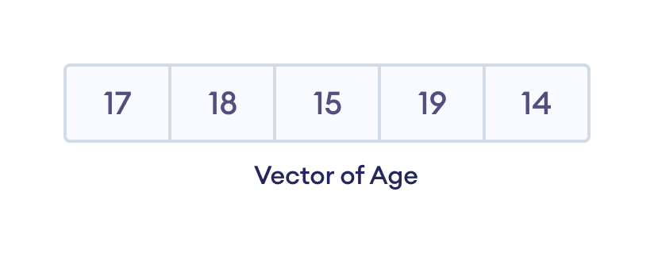
R Vectors
In this tutorial, you will learn about vectors in R with the help of examples.
A vector is the basic data structure in R that stores data of similar types. For example,
Suppose we need to record the age of 5 employees. Instead of creating 5 separate variables, we can simply create a vector.

Slide 69
R Vectors
Create a Vector in R
In R, we use the c() function to create a vector. For example,
# create vector of string types
employees <- c("Sabby", "Cathy", "Lucy")
print(employees)
In the above example, we have created a vector named employees with elements: Sabby, Cathy, and Lucy.
Here, the c() function creates a vector by combining three different elements of employees together.

Slide 70
R Vectors
Access Vector Elements in R
In R, each element in a vector is associated with a number. The number is known as a vector index. We can access elements of a vector using the index number (1, 2, 3 …). For example,
# a vector of string type
languages <- c("Swift", "Java", "R")
# access first element of languages
print(languages[1])
# "Swift" # access third element of languages
print(languages[3]). # "R"
In the above example, we have created a vector named employees with elements: Sabby, Cathy, and Lucy.
Here, the c() function creates a vector by combining three different elements of employees together.

Slide 71

R Vectors
Access Vector Elements in R
In the above example, we have created a vector named languages. Each element of the vector is associated with an integer number.
# a vector of string type
languages <- c("Swift", "Java", "R")
# access first element of languages
print(languages[1])
# "Swift" # access third element of languages
print(languages[3]). # "R"

Slide 72
R Vectors
Access Vector Elements in R
In the above example, we have created a vector named languages. Each element of the vector is associated with an integer number.
Here, we have used the vector index to access the vector elements
languages[1] - access the first element "Swift"
languages[3] - accesses the third element "R“
Note: In R, the vector index always starts with 1. Hence, the first element of a vector is present at index 1, second element at index 2 and so on.

Slide 73
R Vectors
Modify Vector Element
To change a vector element, we can simply reassign a new value to the specific index. For example,
dailyActivities <- c("Eat","Repeat")
cat("Initial Vector:", dailyActivities)
# change element at index 2
dailyActivities[2] <- "Sleep"
cat("\nUpdated Vector:", dailyActivities
Here, we have changed the vector element at index 2 from "Repeat" to "Sleep" by simply assigning a new value.

Slide 74
R Vectors
Numeric Vector in R
Similar to strings, we use the c() function to create a numeric vector. For example,
# a vector with number sequence from 1 to 5
numbers <- c(1, 2, 3, 4, 5)
print(numbers)
# Output: [1] 1 2 3 4 5
Here, we have used the C() function to create a vector of numeric sequence called numbers.
However, there is an efficient way to create a numeric sequence. We can use the : operator instead of C().

Slide 75
R Vectors
Create a Sequence of Number in R
In R, we use the : operator to create a vector with numerical values in sequence. For example,
# a vector with number sequence from 1 to 5
numbers <- c(1, 2, 3, 4, 5)
print(numbers)
# Output: [1] 1 2 3 4 5
Here, we have used the C() function to create a vector of numeric sequence called numbers.
However, there is an efficient way to create a numeric sequence. We can use the : operator instead of C().

Slide 76
R Vectors
Create a Sequence of Number in R
In R, we use the : operator to create a vector with numerical values in sequence. For example,
# a vector with number sequence from 1 to 5
numbers <- 1:5
print(numbers)
Here, we have used the : operator to create the vector named numbers with numerical values in sequence i.e. 1 to 5.

Slide 77
R Vectors
Repeat Vectors in R
In R, we use the rep() function to repeat elements of vectors. For example,
# repeat sequence of vector 2 times
numbers <- rep(c(2,4,6), times = 2)
cat("Using times argument:", numbers)
In the above example, we have created a numeric vector with elements 2, 4, 6. Notice the code,

Slide 78
R Vectors
Repeat Vectors in R
In R, we use the rep() function to repeat elements of vectors. For example,
Here,
numbers - vector whose elements to be repeated
times = 2 - repeat the vector two times
We can see that we have repeated the whole vector two times. However, we can also repeat each element of the vector. For this we use the each parameter.
rep(numbers, times=2)

Slide 79
R Vectors
Let's see an example.
# repeat each element of vector 2 times
numbers <- rep(c(2,4,6), each = 2)
cat("\nUsing each argument:", numbers)
In this example, we have created a numeric vector with elements 2, 4, 6. Notice the code,

Slide 80
R Vectors
Let's see an example.
Here, each = 2 - repeats each element of vector two times
rep(numbers, each = 2)

Slide 81
R Vectors
Length of Vector in R
We can use the length() function to find the number of elements present inside the vector. For example,
languages <- c("R", "Swift", "Python", "Java")
# find total elements in languages using length()
cat("Total Elements:", length(languages))
Here, we have used length() to find the length of the languages vector.

Slide 82
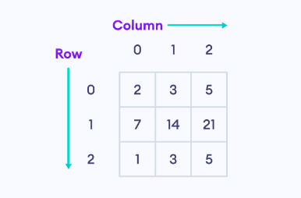
R Matrix
In this tutorial, you will learn about the matrix in R with the help of examples.
A matrix is a two-dimensional data structure where data are arranged into rows and columns. For example,
Here, the above matrix is 3 * 3 (pronounced "three by three") matrix because it has 3 rows and 3 columns.

Slide 83
R Matrix
Create a Matrix in R
In R, we use the matrix() function to create a matrix.
The syntax of the matrix() function is
Here,
vector - the data items of same type
nrow - number of rows
ncol - number of columns
byrow (optional) - if TRUE, the matrix is filled row-wise. By default, the matrix is filled column-wise.
matrix(vector, nrow, ncol)

Slide 84
R Matrix
Let's see an example,
# create a 2 by 3 matrix
matrix1 <- matrix(c(1, 2, 3, 4, 5, 6), nrow = 2, ncol = 3, byrow = TRUE)
print(matrix1)
[,1] [,2] [,3]
[1,] 1 2 3
[2,] 4 5 6

Slide 85
R Matrix
Create a Matrix in R
In the above example, we have used the matrix() function to create a matrix named matrix1.
matrix(c(1, 2, 3, 4, 5, 6), nrow = 2, ncol = 3, byrow = TRUE)
Here, we have passed data items of integer type and used c() to combine data items together. And nrow = 2 and ncol = 3 means the matrix has 2 rows and 3 columns.
Since we have passed byrow = TRUE, the data items in the matrix are filled row-wise. If we didn't pass byrow argument as

Slide 86
R Matrix
Create a Matrix in R
Since we have passed byrow = TRUE, the data items in the matrix are filled row-wise. If we didn't pass byrow argument as
matrix(c(1, 2, 3, 4, 5, 6), nrow = 2, ncol = 3)
[,1] [,2] [,3]
[1,] 1 3 5
[2,] 2 4 6

Slide 87
R Matrix
Access Matrix Elements in R
We use the vector index operator [ ] to access specific elements of a matrix in R.
The syntax to access a matrix element is
matrix[n1, n2]
[,1] [,2] [,3]
[1,] 1 3 5
[2,] 2 4 6

Slide 88
R Matrix
Access Matrix Elements in R
Here,
n1 - specifies the row position
n2 - specifies the column position
Let's see an example,
matrix1 <- matrix(c("Sabby", "Cathy", "Larry", "Harry"), nrow = 2, ncol = 2)
print(matrix1)
# access element at 1st row, 2nd column
cat("\nDesired Element:", matrix1[1, 2])

Slide 89
R Matrix
Access Matrix Elements in R
In the above example, we have created a 2 by 2 matrix named matrix1 with 4 string type datas. Notice the use of index operator [],
matrix1[1, 2]
Here, [1, 2] specifies we are trying to access element present at 1st row, 2nd column i.e. "Larry".

Slide 90
R Matrix
Access Entire Row or Column
In R, we can also access the entire row or column based on the value passed inside [].
[n, ] - returns the entire element of the nth row.
[ ,n] - returns the entire element of the nth column.
For example,
matrix1 <- matrix(c("Sabby", "Cathy", "Larry", "Harry"), nrow = 2, ncol = 2)
print(matrix1)
# access entire element at 1st row
cat("\n1st Row:", matrix1[1, ])
# access entire element at 2nd column
cat("\n2nd Column:", matrix1[, 2])
Here,
matrix1[1, ] - access entire elements at 1st row i.e. Sabby and Larry
matrix1[ ,2] - access entire elements at 2nd column i.e. Larry and Harry

Slide 91
R Matrix
Access More Than One Row or Column
We can access more than one row or column in R using the c() function.
[c(n1,n2), ] - returns the entire element of n1 and n2 row.
[ ,c(n1,n2)] - returns the entire element of n1 and n2 column.
For example,
# create 2 by 3 matrix
matrix1 <- matrix(c(10, 20, 30, 40, 50, 60), nrow = 2, ncol = 3)
print(matrix1)
# access entire element of 1st and 3rd row
cat("\n1st and 2nd Row:", matrix1[c(1,3), ])
# access entire element of 2nd and 3rd column
cat("\n2nd and 3rd Column:", matrix1[ ,c(2,3)])
Here,
[c(1,3), ] - returns the entire element of 1st and 3rd row.
[ ,c(2,3)] - returns the entire element of 2nd and 3rd column.

Slide 92
R Matrix
Modify Matrix Element in R
We use the vector index operator [] to modify the specified element. For example,
Here, the element present at 1st row, 2nd column is changed to 140.
matrix1[1,2] = 140

Slide 93
R Matrix
Modify Matrix Element in R
Let's see an example,
# create 2 by 2 matrix
matrix1 <- matrix(c(1, 2, 3, 4), nrow = 2, ncol = 2)
# print original matrix
print(matrix1)
# change value at 1st row, 2nd column to 5
matrix1[1,2] = 5
# print updated matrix
print(matrix1)

Slide 94
R Matrix
Combine Two Matrices in R
In R, we use the cbind() and the rbind() function to combine two matrices together.
cbind() - combines two matrices by columns
rbind() - combines two matrices by rows
The number of rows and columns of two matrices we want to combine must be equal.
For example,

Slide 95
R Matrix
# create two 2 by 2 matrices
even_numbers <- matrix(c(2, 4, 6, 8), nrow = 2, ncol = 2)
odd_numbers <- matrix(c(1, 3, 5, 7), nrow = 2, ncol = 2)
# combine two matrices by column
total1 <- cbind(even_numbers, odd_numbers) print(total1)
# combine two matrices by row
total2 <- rbind(even_numbers, odd_numbers) print(total2)
Here, first we have used the cbind() function to combine the two matrices: even_numbers and odd_numbers by column. And rbind() to combine two matrices by row.

Slide 96
R Matrix
Check if Element Exists in R Matrix
In R, we use the %in% operator to check if the specified element is present in the matrix or not and returns a boolean value.
TRUE - if specified element is present in the matrix
FALSE - if specified element is not present in the matrix
For example,
matrix1 <- matrix(c("Sabby", "Cathy", "Larry", "Harry"), nrow = 2, ncol = 2)
"Larry" %in% matrix1
# TRUE
"Kinsley" %in% matrix1
# FALSE
Here,
"Larry" is present in matrix1, so the method returns TRUE
"Kinsley" is not present in matrix1, so the method returns FALSE

Slide 97
R Matrix
R List
In this tutorial, we will learn about list in R with the help of examples.
A List is a collection of similar or different types of data.
In R, we use the list() function to create a list. For example,
# list with similar type of data
list1 <- list(24, 29, 32, 34)
# list with different type of data
list2 <- list("Ranjy", 38, TRUE)
Here,
list1 - list of integers
list2 - list containing string, integer, and boolean value

Slide 98
R Matrix
Access List Elements in R
In R, each element in a list is associated with a number. The number is known as a list index.
We can access elements of a list using the index number (1, 2, 3 …). For example,
list1 <- list(24, "Sabby", 5.4, "Nepal")
# access 1st item
print(list1[1])
# 24 # access 4th item
print(list1[4]) # Nepal
In the above example, we have created a list named list1.
Here, we have used the vector index to access the vector elements
list1[1] - access the first element 24
list1[4] - accesses the third element "Nepal“
Note: In R, the list index always starts with 1. Hence, the first element of a list is present at index 1, second element at index 2 and so on.

Slide 99
R Matrix
Modify a List Element in R
To change a list element, we can simply reassign a new value to the specific index. For example,
list1 <- list(24, "Sabby", 5.4, "Nepal")
# change element at index 2
list1[2] <- "Cathy"
# print updated list
print(list1)
Here, we have reassigned a new value to index 2 to change the list element from "Sabby" to "Cathy".

Slide 100
R Matrix
Add Items to R List
We use the append() function to add an item at the end of the list. For example,
list1 <- list(24, "Sabby", 5.4, "Nepal")
# using append() function
append(list1, 3.14)
In the example, we have created a list named list1.
Notice the line, append(list1, 3.14)
Here, append() adds 3.14 at the end of the list.

Slide 101
R Matrix
Remove Items From a List in R
R allows us to remove items for a list. We first access elements using a list index and add negative sign - to indicate we want to delete the item. For example,
[-1] - removes 1st item
[-2] - removes 2nd item and so on.
list1 <- list(24, "Sabby", 5.4, "Nepal")
# remove 4th item
print(list1[-4]) # Nepal
Here, list[-4] removes the 4th item of list1.

Slide 102
R Matrix
Length of R List
In R, we can use the length() function to find the number of elements present inside the list. For example,
list1 <- list(24, "Sabby", 5.4, "Nepal")
# find total elements in list1 using length()
cat("Total Elements:", length(list1))
Here, we have used the length() function to find the length of list1.
Since there are 4 elements in list1 so length() returns 4.

Slide 103
R Matrix
Check if Element Exists in R List
In R, we use the %in% operator to check if the specified element is present in the list or not and returns a boolean value.
TRUE - if specified element is present in the list
FALSE - if specified element is not present in the list
For example,
list1 <- list(24, "Sabby", 5.4, "Nepal") "Sabby" %in% list1
# TRUE
"Kinsley" %in% list1
# FALSE
Here,
"Larry" is present in list1, so the method returns TRUE
"Kinsley" is not present in list1, so the method returns FALSE

Slide 104
R Data Frame
In this tutorial, we will learn about data frames in R with the help of examples.
A data frame is a two-dimensional data structure which can store data in tabular format.
Data frames have rows and columns and each column can be a different vector. And different vectors can be of different data types.
Before we learn about Data Frames, make sure you know about R vector.

Slide 105
R Data Frame
Create a Data Frame in R
In R, we use the data.frame() function to create a Data Frame.
The syntax of the data.frame() function is
Here,
first_col - a vector with values val1, val2, ... of same data type
second_col - another vector with values val1, val2, ... of same data type and so on
dataframe1 <- data.frame(
first_col = c(val1, val2, ...),
second_col = c(val1, val2, ...),
... )

Slide 106
R Data Frame
Create a Data Frame in R
Let's see an example,
data.frame (
Name = c("Juan", "Alcaraz", "Simantha"),
Age = c(22, 15, 19),
Vote = c(TRUE, FALSE, TRUE)
)
Name Age Vote
1 Juan 22 TRUE
2 Alcaraz 15 FALSE
3 Simantha 19 TRUE
Here, Name, Age, and Vote are column names for vectors of String, Numeric, and Boolean type respectively.

Slide 107
R Data Frame
Access Data Frame Columns
There are different ways to extract columns from a data frame. We can use [ ], [[ ]], or $ to access specific column of a data frame in R. For example,
# Create a data frame
dataframe1 <- data.frame (
Name = c("Juan", "Alcaraz", "Simantha"),
Age = c(22, 15, 19),
Vote = c(TRUE, FALSE, TRUE) )
# pass index number inside [ ]
print(dataframe1[1])
# pass column name inside [[ ]]
print(dataframe1[["Name"]])
# use $ operator and column name
print(dataframe1$Name)

Slide 108
R Data Frame
Access Data Frame Columns
In the above example, we have created a data frame named dataframe1 with three columns Name, Age, Vote.
Here, we have used different operators to access Name column of dataframe1.
Accessing with [[ ]] or $ is similar. However, it differs for [ ], [ ] will return us a data frame but the other two will reduce it into a vector and return a vector.

Slide 109
R Data Frame
Combine Data Frames
In R, we use the rbind() and the cbind() function to combine two data frames together.
rbind() - combines two data frames vertically
cbind() - combines two data frames horizontally

Slide 110
R Data Frame
Combine Data Frames
If we want to combine two data frames vertically, the column name of the two data frames must be the same. For example,

Slide 111
R Data Frame
# create a data frame
dataframe1 <- data.frame (
Name = c("Juan", "Alcaraz"),
Age = c(22, 15) )
# create another data frame
dataframe2 <- data.frame (
Name = c("Yiruma", "Bach"),
Age = c(46, 89) )
# combine two data frames vertically
updated <- rbind(dataframe1, dataframe2)
print(updated)

Slide 112
R Data Frame
Here, we have used the rbind() function to combine the two data frames: dataframe1 and dataframe2 vertically.

Slide 113
R Data Frame
Combine Horizontally Using cbind()
The cbind() function combines two or more data frames horizontally. For example,
# create a data frame
dataframe1 <- data.frame ( Name = c("Juan", "Alcaraz"), Age = c(22, 15) )
# create another data frame
dataframe2 <- data.frame ( Hobby = c("Tennis", "Piano") )
# combine two data frames horizontally
updated <- cbind(dataframe1, dataframe2)
print(updated)
Here, we have used cbind() to combine two data frames horizontally.
Note: The number of items on each vector of two or more combining data frames must be equal otherwise we will get an error: arguments imply differing number of rows or columns.

Slide 114
R Data Frame
Length of a Data Frame in R
In R, we use the length() function to find the number of columns in a data frame. For example,
# Create a data frame
dataframe1 <- data.frame (
Name = c("Juan", "Alcaraz", "Simantha"),
Age = c(22, 15, 19),
Vote = c(TRUE, FALSE, TRUE) )
cat("Total Elements:", length(dataframe1))
Here, we have used length() to find the total number of columns in dataframe1. Since there are 3 columns, the length() function returns 3.

Slide 115
R Data Frame
Length of a Data Frame in R
In R, we use the length() function to find the number of columns in a data frame. For example,
# Create a data frame
dataframe1 <- data.frame (
Name = c("Juan", "Alcaraz", "Simantha"),
Age = c(22, 15, 19),
Vote = c(TRUE, FALSE, TRUE) )
cat("Total Elements:", length(dataframe1))
Here, we have used length() to find the total number of columns in dataframe1. Since there are 3 columns, the length() function returns 3.

Slide 116
R Factors
A Factor is a data structure that is used to work with categorizable datas.
Suppose a data field such as marital status may contain only values from single, married, separated, divorced, or widowed.
In such a case, we know the possible values beforehand and these predefined, distinct values are called levels of a factor.

Slide 117
R Data Frame
Create a Factor in R
In R, we use the length() function to find the number of columns in a data frame. For example,
factor(vector)
# create a factor
students_gender <- factor(c("male", "female", "male", "transgender", "female"))
# print the marital_status factor
print(students_gender)
Here, factor() takes a vector as an argument.

Slide 118
R Data Frame
In the above example, we have used the factor() function to create the factor named students_gender.
Notice while printing students_gender, we get two outputs
All the vectors items
predefined possible values we know beforehand i.e. levels of students_gender

Slide 119
R Data Frame
Access Factors Elements
Accessing vector elements is similar to that of vectors. We use the index number. For example,
# create a factor
students_gender <- factor(c("male", "female", "male", "transgender", "female"))
# access 1st element of students_gender
print(students_gender[1])
# access 4th element of students_gender
print(students_gender[4])
In the above example, we have used the index number to access elements of the students_gender
students_gender[1] - returns the 1st element of students_gender i.e "male"
students_gender[4] - returns the 4th element of students_gender i.e. "transgender"
Note that each time we access and print factor elements we get a level of factor too.

Slide 120
R Data Frame
Modify Factor Element
To change a vector element, we can simply reassign a new value to the specific index. For example,
# create a factor
marital_status <- factor(c("married", "single", "single", "divorced", "married"))
# print the marital_status factor
marital_status[1] <- "divorced"
print(marital_status[1])
Here, we have reassigned a new value to index 1 of the marital_status factor to change the element from "married" to "divorced".

Slide 121
R Data Frame
Modify Factor Element
To change a vector element, we can simply reassign a new value to the specific index. For example,
# create a factor
marital_status <- factor(c("married", "single", "single", "divorced", "married"))
# print the marital_status factor
marital_status[1] <- "divorced"
print(marital_status[1])
Here, we have reassigned a new value to index 1 of the marital_status factor to change the element from "married" to "divorced".

Slide 122
R Flow Control

Slide 123
R Booleans (Comparison and Logical Operators)
In R, boolean variables can take only 2 values: TRUE and FALSE. For example,
# declare boolean
x <- TRUE
print(x)
print(class(x))
# declare boolean using single character y <- F
print(y)
print(class(y))
Here, we have declared x and y as boolean variables.
In R, Boolean variables belong to the logical class.
You can also declare boolean variables using a single character - T or F.
Here, T stands for TRUE and F stands for FALSE.

Slide 124
R Boolean With Comparison Operators
Comparison operators are used to compare two values. The output of a comparison is a boolean value. For example, to check if two numbers are equal, you can use the == operator.
Operator | Description | Example
> | Greater than | 5 > 6 returns FALSE
< | Less than | 5 < 6 returns TRUE
== | Equals to | 10 == 10 returns TRUE
!= | Not equal to | 10 != 10 returns FALSE
>= | Greater than or equal to | 5 >= 6 returns FALSE
<= | Less than or equal to | 6 <= 6 returns TRUE

Slide 125
R Boolean With Comparison Operators
Comparison operators are used to compare two values.
x <- 10
y <- 23
# compare x and y
print(x == y) # FALSE
Similarly, to check if x is less than y, you can use the < operator.
x <- 10
y <- 23
# compare x and y
print(x < y) # TRUE
Since, the value stored in x is less than the value stored in y, the comparison x < y results in TRUE.

Slide 126
R Boolean With Comparison Operators
R Boolean With Logical Operators
Logical operators are used to compare the output of two comparisons. There are three types of logical operators in R. They are:
AND operator (&)
OR operator (|)
NOT operator (!)
x <- 10
y <- 23
z <- 12
w <- 54
print(x<y & y>z)
  print(w>x | x>y | z>w)
  x <- 3 + 5i
  # using ! with in-built function
  print(!is.numeric(x))

Slide 127
if...
A decision making program runs one block of code under a condition and another block of code under different conditions. For example,
If age is greater than 18, allow the person to vote.
If age is not greater than 18, don't allow the person to vote.
The syntax of an if statement is:
if (test_expression) {
# body of if
}
Here, the test_expression is a boolean expression. It returns either True or False. If the test_expression is
True - body of the if statement is executed
False - body of the if statement is skipped

Slide 128
if...
Example: R if Statement
x <- 3
# check if x is greater than 0
if (x > 0) {
print("The number is positive")
}
print("Outside if statement")
In the above program, the test condition x > 0 is true. Hence, the code inside parenthesis is executed.

Slide 129
if...else
We can also use an optional else statement with an if statement. The syntax of an if...else statement is:
if (test_expression) {
# body of if statement } else {
# body of else statement
}
The if statement evaluates the test_expression inside the parentheses.
If the test_expression is True,
body of if is executed
body of else is skipped
If the test_expression is False
body of else is executed
body of if is skipped

Slide 130
if...else
Example: R if...else Statement
age <- 15
# check if age is greater than 18
if (age > 18) {
print("You are eligible to vote.")
} else {
print("You cannot vote.")
}

Slide 131
if...else if...else
If you want to test more than one condition, you can use the optional else if statement along with your if...else statements. The syntax is:
if(test_expression1) {
# code block 1 } else if (test_expression2){
# code block 2 } else {
# code block 3 }
Here,
If test_expression1 evaluates to True, the code block 1 is executed.
If test_expression1 evaluates to False, then test_expression2 is evaluated.
If test_expression2 is True, code block 2 is executed.
If test_expression2 is False, code block 3 is executed.

Slide 132
if...else if...else
If you want to test more than one condition, you can use the optional else if statement along with your if...else statements. The syntax is:
x <- 0
# check if x is positive or negative or zero
if (x > 0) {
print("x is a positive number")
} else if (x < 0) {
print("x is a negative number") } else {
print("x is zero")
}

Slide 133
Nested if...else
You can have nested if...else statements inside if...else blocks in R. This is called nested if...else statement.
This allows you to specify conditions inside conditions. For example,

Slide 134
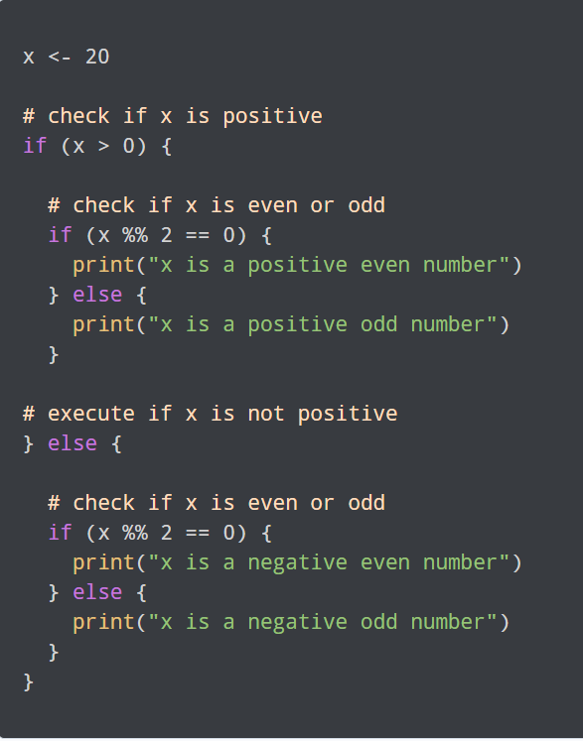
Nested if...else

Slide 135
ifelse() Function
In R, the ifelse() function is a shorthand vectorized alternative to the standard if...else statement.
Most of the functions in R take a vector as input and return a vectorized output. Similarly, the vector equivalent of the traditional if...else block is the ifelse() function.
The syntax of the ifelse() function is:
ifelse(test_expression, x, y)
The output vector has the element x if the output of the test_expression is TRUE. If the output is FALSE, then the element in the output vector will be y.

Slide 136
ifelse() Function
# input vector
x <- c(12, 9, 23, 14, 20, 1, 5)
# ifelse() function to determine odd/even numbers
ifelse(x %% 2 == 0, "EVEN", "ODD")
In this program, we have defined a vector x using the c() function in R. The vector contains a few odd and even numbers.
We then used the ifelse() function which takes the vector x as an input. A logical operation is then performed on x to determine if the elements are odd or even.
For each element in the vector, if the test_expression evaluates to TRUE, then the corresponding output element is "EVEN", else it's "ODD".

Slide 137
R while Loop

Slide 138
While loop
In programming, loops are used to repeat a block of code as long as the specified condition is satisfied. Loops help you to save time, avoid repeatable blocks of code, and write cleaner code.
In R, there are three types of loops:
while loops
for loops
repeat loops

Slide 139
While loop
while loops are used when you don't know the exact number of times a block of code is to be repeated. The basic syntax of while loop in R is:
while (test_expression) {
# block of code
}
Here, the test_expression is first evaluated.
If the result is TRUE, then the block of code inside the while loop gets executed.
Once the execution is completed, the test_expression is evaluated again and the same process is repeated until the test_expression evaluates to FALSE.
The while loop will terminate when the boolean expression returns FALSE.

Slide 140
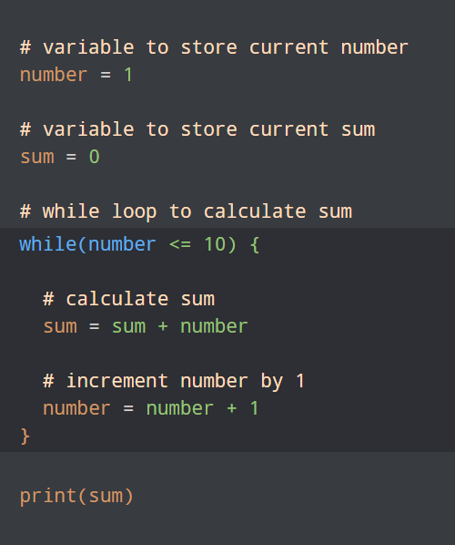
while loop example
Here, we have declared two variables: number and sum. The test_condition inside the while statement is number <= 10.
This means that the while loop will continue to execute and calculate the sum as long as the value of number is less than or equal to 10.

Slide 141
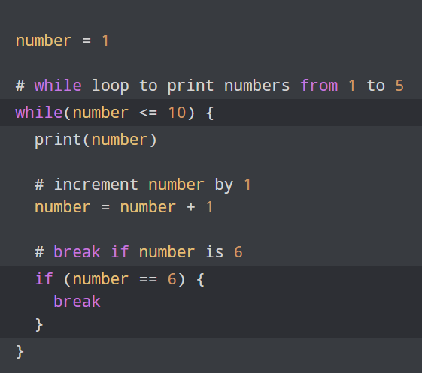
while Loop With break Statement
The break statement in R can be used to stop the execution of a while loop even when the test expression is TRUE. For example,
In this program, we have used a break statement inside the while loop, which breaks the loop as soon as the condition inside the if statement is evaluated to TRUE.

Slide 142
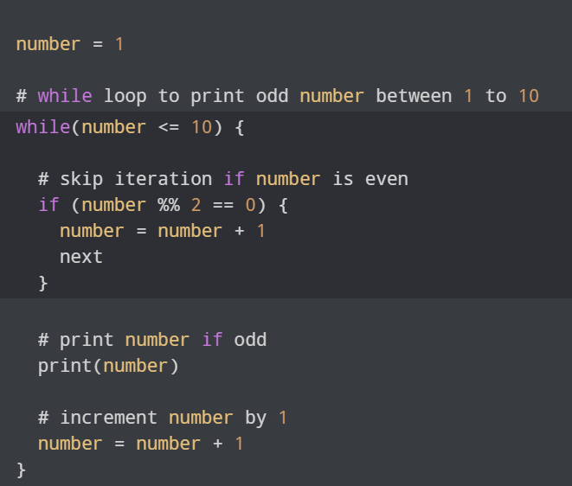
while Loop With next Statement
You can use the next statement in a while loop to skip an iteration even if the test condition is TRUE. For example,
This program only prints the odd numbers in the range of 1 to 10. To do this, we have used an if statement inside the while loop to check if number is divisible by 2.
Here,
if number is divisible by 2, then its value is simply incremented by 1 and the iteration is skipped using the next statement.
if number is not divisible by 2, then the variable is printed and its value is incremented by 1.

Slide 143
for Loop
A for loop is used to iterate over a list, vector or any other object of elements. The syntax of for loop is:
for (value in sequence) {
# block of code
}
Here, sequence is an object of elements and value takes in each of those elements. In each iteration, the block of code is executed. For example,
numbers = c(1, 2, 3, 4, 5)
# for loop to print all elements in numbers
for (x in numbers) { print(x) }

Slide 144
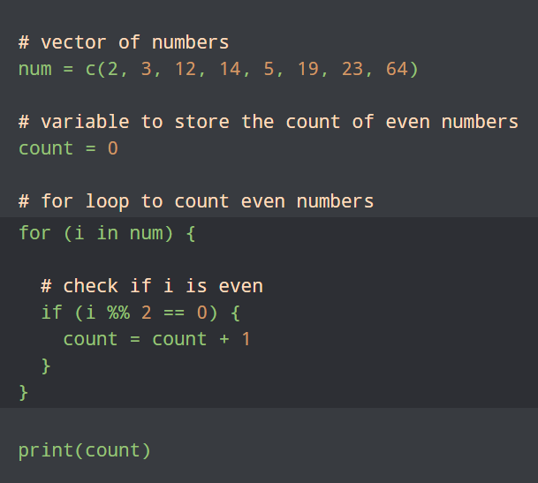
while Loop With next Statement
Example: Count the Number of Even Numbers
In this program, we have used a for loop to count the number of even numbers in the num vector. Here is how this program works:
We first initialized the count variable to 0. We use this variable to store the count of even numbers in the num vector.
We then use a for loop to iterate through the num vector using the variable i.

Slide 145
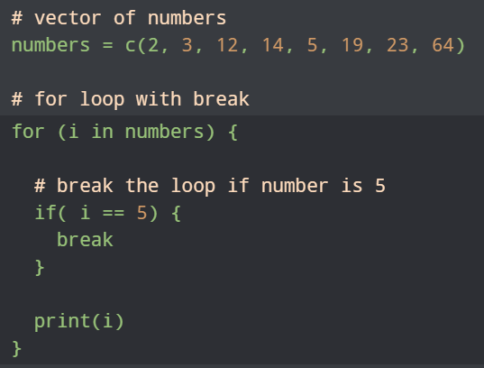
for Loop With break Statement
You can use the break statement to exit from the for loop in any iteration. For example,
Here, we have used an if statement inside the for loop.
If the current element is equal to 5, we break the loop using the break statement.
After this, no iteration will be executed.

Slide 146
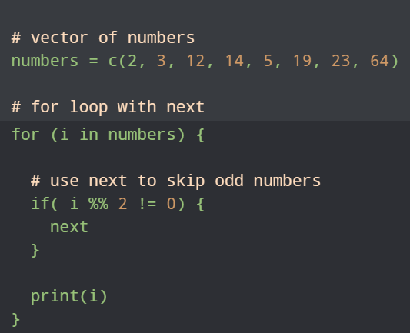
for Loop With next Statement
Instead of terminating the loop, you can skip an iteration using the next statement. For example,
Here, we have used an if statement inside the for loop to check for odd numbers.
If the number is odd, we skip the iteration using the next statement and print only even numbers.

Slide 147
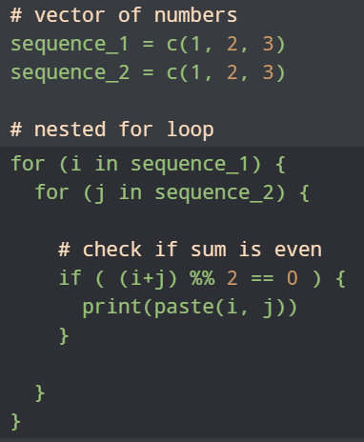
Nested for Loops
You can include a for loop inside another for loop to create a nested loop.
Consider the example below. Suppose we have two sequences of numbers. We want to print all the combinations where the sum of numbers in both the sequences is even.
In the above program, we have created two sequences: sequence_1 and sequence_2, both containing numbers from 1 to 3.

Slide 148
R break and next
We use the R break and next statements to alter the flow of a program. These are also known as jump statements in programming:
break - terminate a looping statement
next - skips an iteration of the loop

Slide 149
R break Statement
You can use a break statement inside a loop (for, while, repeat) to terminate the execution of the loop. This will stop any further iterations.
The syntax of the break statement is:
if (test_expression) {
break }

Slide 150
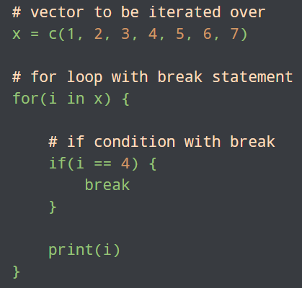
R break Statement
The break statement is often used inside a conditional (if...else) statement in a loop. If the condition inside the test_expression returns True, then the break statement is executed. For example,
Here, we have defined a vector of numbers from 1 to 7. Inside the for loop, we check if the current number is 4 using an if statement.
If yes, then the break statement is executed and no further iterations are carried out. Hence, only numbers from 1 to 3 are printed.

Slide 151
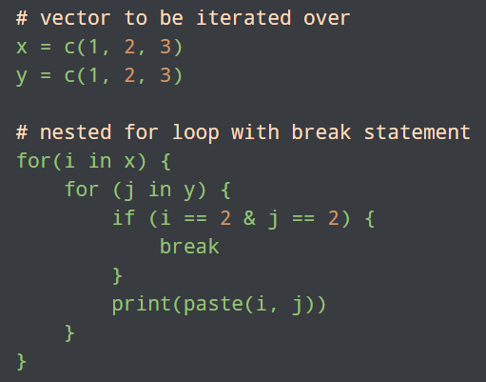
break Statement in Nested Loop
If you have a nested loop and the break statement is inside the inner loop, then the execution of only the inner loop will be terminated. Let's check out a program to use break statements in a nested loop.
Here, we have a break statement inside the inner loop.
We have used it inside a conditional statement such that if both the numbers are equal to 2, the inner loop gets terminated.
The flow then moves to the outer loop. Hence, the combination (2, 2) is never printed.

Slide 152
R next Statement
In R, the next statement skips the current iteration of the loop and starts the loop from the next iteration.
The syntax of the next statement is:
if (test_condition) {
next
}
If the program encounters the next statement, any further execution of code from the current iteration is skipped, and the next iteration begins.

Slide 153
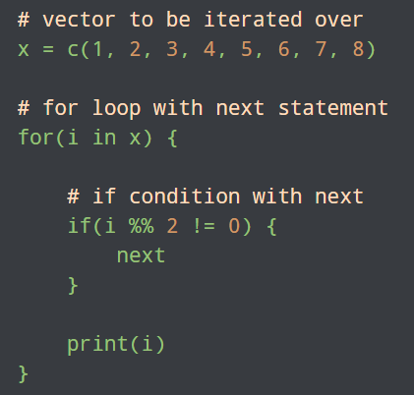
R next Statement
Let's check out a program to print only even numbers from a vector of numbers
Here, we have used an if statement to check whether the current number in the loop is odd or not.
If yes, the next statement inside the if block is executed, and the current iteration is skipped.

Slide 154
R next Statement
Let's check out a program to print only even numbers from a vector of numbers
Here, we have used an if statement to check whether the current number in the loop is odd or not.
If yes, the next statement inside the if block is executed, and the current iteration is skipped.

Slide 155
R Functions

Slide 156
Introduction to R Functions
A function is just a block of code that you can call and run from any part of your program. They are used to break our code in simple parts and avoid repeatable codes.
You can pass data into functions with the help of parameters and return some other data as a result. You can use the function() reserve keyword to create a function in R. The syntax is:
func_name <- function (parameters) {
statement
}

Slide 157
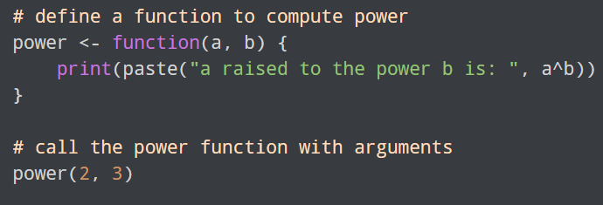
Introduction to R Functions
Call the Function
After you have defined the function, you can call the function using the function name and arguments. For example,
Here, we have called the function with two arguments - 2 and 3. This will print the value of 2 raised to the power 3 which is 8.
The arguments used in the actual function are called formal arguments. They are also called parameters. The values passed to the function while calling the function are called actual arguments.

Slide 158
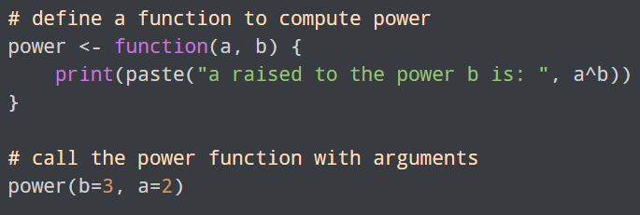
Introduction to R Functions
Named Arguments
In the above function call of the power() function, the arguments passed during the function call must be of the same order as the parameters passed during function declaration.
This means that when we call power(2, 3), the value 2 is assigned to a and 3 is assigned to b. If you want to change the order of arguments to be passed, you can use named arguments. For example,
Here, the result is the same irrespective of the order of arguments that you pass during the function call.

Slide 159
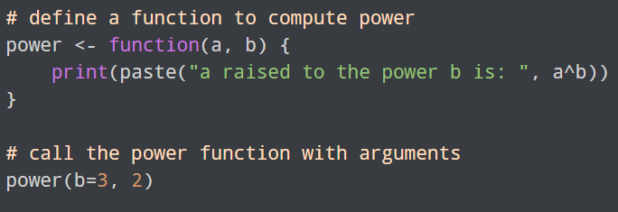
Introduction to R Functions
Named Arguments
You can also use a mix of named and unnamed arguments. For example,

Slide 160
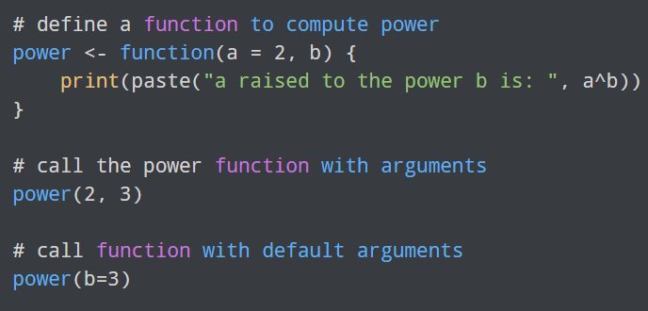
Introduction to R Functions
Default Parameters Values
You can assign default parameter values to functions. To do so, you can specify an appropriate value to the function parameters during function definition.
When you call a function without an argument, the default value is used. For example,
Here, in the second call to power() function, we have only specified the b argument as a named argument. In such a case, it uses the default value for a provided in the function definition.

Slide 161
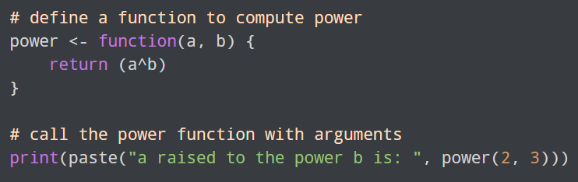
Introduction to R Functions
Return Values
You can use the return() keyword to return values from a function. For example,
Here, instead of printing the result inside the function, we have returned a^b. When we call the power() function with arguments, the result is returned which can be printed during the call.

Slide 162
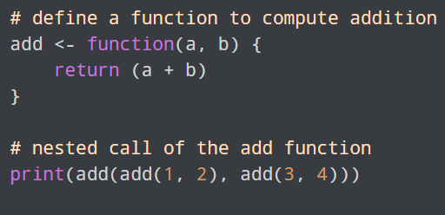
Introduction to R Functions
Nested Function: In R, you can create a nested function in 2 different ways.
By calling a function inside another function call.
By writing a function inside another function.
Call a Function Inside Another Function Call
Here, we have created a function called add() to add two numbers. But during the function call, the arguments are calls to the add() function.
First, add(1, 2) and add(3, 4) are computed and the results are passed as arguments to the outer add() function. Hence, the result is the sum of all four numbers.

Slide 163
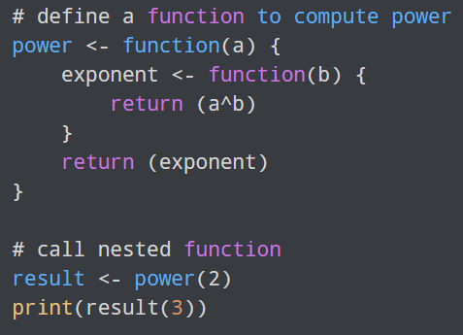
Introduction to R Functions
Nested Function: In R, you can create a nested function in 2 different ways.
Write a Function Inside Another Function
Let's create a nested function by writing a function inside another function.
Here, we cannot directly call the power() function because the exponent() function is defined inside the power() function.
Hence, we need to first call the outer function with the argument a and set it to a variable. This variable now acts as a function to which we pass the next argument b.

Slide 164
R Data Manipulation

Slide 165
R Read and Write CSV Files
In this tutorial, we will learn to Read and Write CSV Files in R with the help of examples.
The CSV (Comma Separated Value) file is a plain text file that uses a comma to separate values.
R has a built-in functionality that makes it easy to read and write a CSV file.

Slide 166
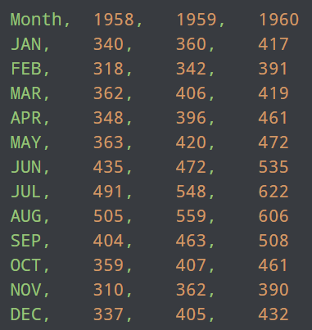
R Read and Write CSV Files
Sample CSV File
To demonstrate how we read CSV files in R, let's suppose we have a CSV file named airtravel.csv with following data:
The CSV file above is a sample data of monthly air travel, in thousands of passengers, for 1958-1960.

Slide 167
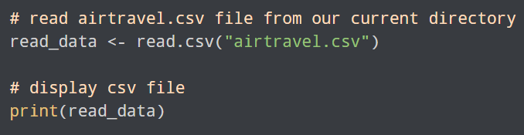
R Read and Write CSV Files
Read a CSV File in R
In R, we use the read.csv() function to read a CSV file available in our current directory. For example,
In the above example, we have read the airtravel.csv file that is available in our current directory. Notice the code,
read_data <- read.csv("airtravel.csv")
Here, read.csv() reads the csv file airtravel.csv and creates a dataframe which is stored in the read_data variable.
Finally, the csv file is displayed using print().
.

Slide 168
R Read and Write CSV Files
Read a CSV File in R
In R, we use the read.csv() function to read a CSV file available in our current directory. For example,
In the above example, we have read the airtravel.csv file that is available in our current directory. Notice the code,
read_data <- read.csv("airtravel.csv")
Here, read.csv() reads the csv file airtravel.csv and creates a dataframe which is stored in the read_data variable.
Finally, the csv file is displayed using print().
.

Slide 169
R Read and Write CSV Files
Read a CSV File in R
In R, we use the read.csv() function to read a CSV file available in our current directory. For example,
Note: If the file is in some other location, we have to specify the path along with the file name as: read.csv("D:/folder1/airtravel.csv").

Slide 170
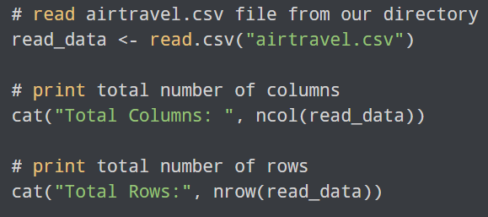
R Read and Write CSV Files
Number of Rows and Columns of CSV File in R
We use the ncol() and nrow() function to get the total number of rows and columns present in the CSV file in R. For example,
In this example, we have used the ncol() and nrow() function to find the total number of columns and rows in the airtravel.csv file.
Here,
ncol(read_data) - returns total number of columns i.e. 4
nrow(read_data) - returns total number of rows i.e. 12

Slide 171
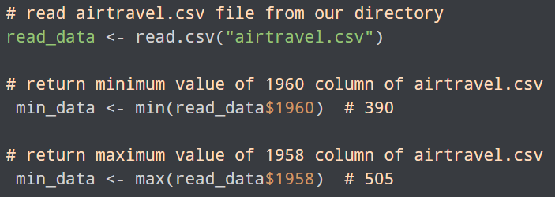
R Read and Write CSV Files
Using min() and max() With CSV Files
In R, we can also find minimum and maximum data in a certain column of a CSV file using the min() and max() function. For example,
Here, we have used the min() and max() function to find the minimum and maximum value of the 1960 and 1958 column of the airtravel.csv file respectively.
min(read_data$1960) - returns the minimum value from the 1960 column i.e. 390
max(read_data$1958) - returns the maximum value from the 1958 column i.e. 505

Slide 172
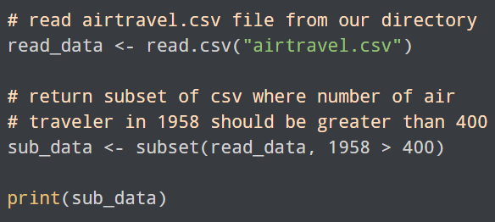
R Read and Write CSV Files
Subset of a CSV File in R
In R, we use the subset() function to return all the datas from a CSV file that satisfies the specified condition. For example,
In the above example, we have specified a certain condition inside the subset() function to extract data from a CSV file.
subset(read_data, 1958 > 400)
Here, subset() creates a subset of airtravel.csv with data column 1958 having data greater than 400 and stored it in the sub_data data frame.
Since column 1958 has data greater than 400 in 6th, 7th, 8th, and 9th row, only these rows are displayed.

Slide 173
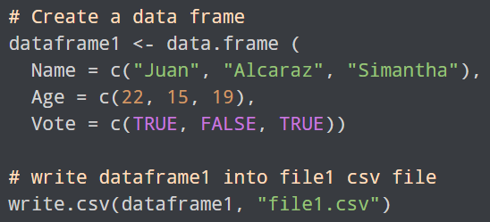
R Read and Write CSV Files
Write Into CSV File in R
In R, we use the write.csv() function to write into a CSV file. We pass the data in the form of dataframe. For example,
In the above example, we have used the write.csv() function to export a data frame named dataframe1 to a CSV file. Notice the arguments passed inside write.csv(),
write.csv(dataframe1, "file1.csv")
Here,
dataframe1 - name of the data frame we want to export
file1.csv - name of the csv file

Slide 174
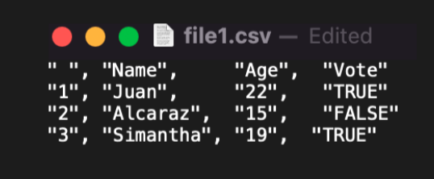
R Read and Write CSV Files
Write Into CSV File in R
Finally, the file1.csv file would look like this in our directory:
In the above example, we have used the write.csv() function to export a data frame named dataframe1 to a CSV file. Notice the arguments passed inside write.csv(),
write.csv(dataframe1, "file1.csv")
Here,
dataframe1 - name of the data frame we want to export
file1.csv - name of the csv file

Slide 175
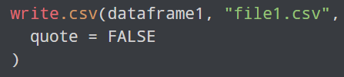
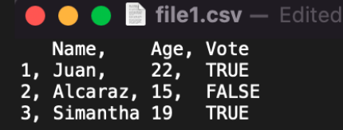
R Read and Write CSV Files
Write Into CSV File in R
If we pass "quote = FALSE" to write.csv() as:
Our file1.csv would look like this:

Slide 176
R Read and Write CSV Files
Write Into CSV File in R
If we pass "quote = FALSE" to write.csv() as:
Our file1.csv would look like this:

Slide 177
R Read and Write xls Files
An xlsx is a file format used for Microsoft Excel spreadsheets. Excel can be used to store tabular data.
R has a built-in functionality that makes it easy to read and write a xlsx file.

Slide 178
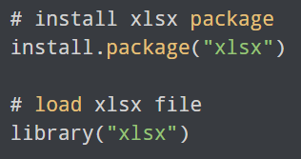
R Read and Write xls Files
Install and Load xlsx Package
In order to read, write, and format Excel files into R, we first need to install and load the xlsx package as:
Here, we have successfully installed and loaded the xlsx package.
Now, we are able to read data from an xlsx file.

Slide 179
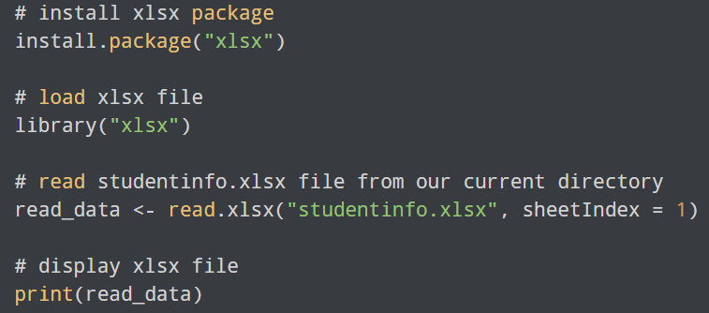
R Read and Write xls Files
Read a xlsx File in R
In R, we use the read.xlsx() function to read a xlsx file available in our current directory. For example,
In the above example, we have read the studentinfo.xlsx file that is available in our current directory. Notice the code,
read_data <- read.xlsx("studentinfo.xlsx", sheetIndex = 1)
Here,
read.xlsx() - reads the xlsx file studentinfo.xlsx and creates a dataframe which is stored in the read_data variable.
sheetIndex = 1 - reads specified worksheet i.e. 1

Slide 180
R Read and Write xls Files
Read a xlsx File in R
In R, we use the read.xlsx() function to read a xlsx file available in our current directory. For example,
Note:
If the file is in some other location, we have to specify the path along with the file name as:
read.xlsx("D:/folder1/studentinfo.xlsx", sheetIndex = 1).
We can also use the read.xlsx2() function if the dataset we are working on is larger.

Slide 181
R Read and Write xls Files
xlsx rowIndex and colIndex Argument in R
In R, we can also read a specific range of data from excel files. We can pass the rowIndex and colIndex argument inside read.xlsx() to read specific range.
rowIndex - reads a specific range of rows
colIndex - read a specific range of columns

Slide 182
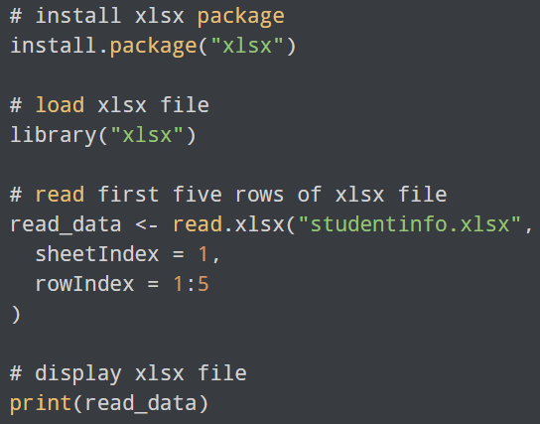
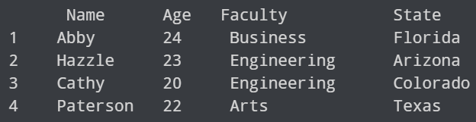
R Read and Write xls Files
Example: Read Range of Rows
In R, we can also read a specific range of data from excel files. We can pass the rowIndex and colIndex argument inside read.xlsx() to read specific range.
rowIndex - reads a specific range of rows
colIndex - read a specific range of columns

Slide 183
R Read and Write xls Files
Example: Read Range of Rows
In R, we can also read a specific range of data from excel files. We can pass the rowIndex and colIndex argument inside read.xlsx() to read specific range.
rowIndex - reads a specific range of rows
colIndex - read a specific range of columns
In the above example, we have passed rowIndex = 1:5 inside read.xlsx() so the function reads only the first five rows from the studentinfo.xlsx file.

Slide 184
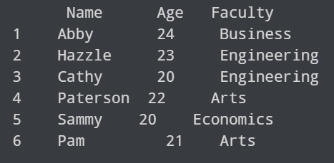
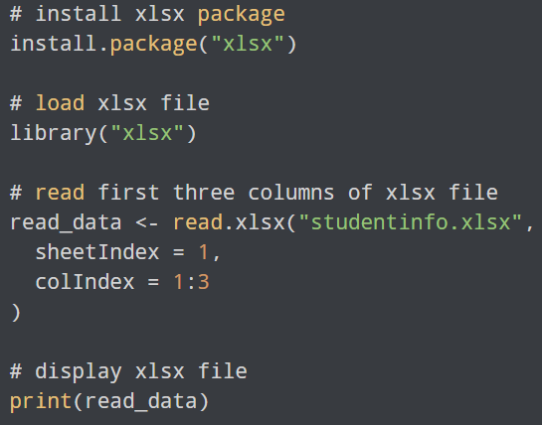
R Read and Write xls Files
Example: Read Range of Columns
Here, colIndex = 1:3 inside read.xlsx() reads only the first three columns from the studentinfo.xlsx file.

Slide 185
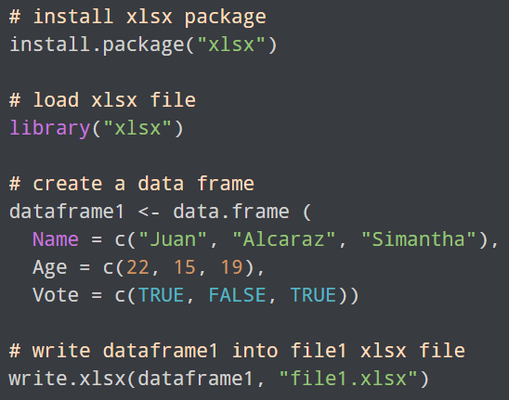
R Read and Write xls Files
Write Into xlsx File in R
In R, we use the write.xlsx() function to write into a xlsx file. We pass the data in the form of dataframe. For example,
In the above example, we have used the write.xlsx() function to export a data frame named dataframe1 to a xlsx file. Notice the arguments passed inside write.xlsx(),
write.xlsx(dataframe1, "file1.xlsx")
Here,
dataframe1 - name of the data frame we want to export
file1.xlsx - name of the xlsx file

Slide 186
R Dataset

Slide 187
R dataset
A dataset is a data collection presented in a table.
The R programming language has tons of built-in datasets that can generally be used as a demo data to illustrate how the R functions work.

Slide 188
R dataset
Most Used built-in Datasets in R
In R, there are tons of datasets we can try but the mostly used built-in datasets are:
airquality - New York Air Quality Measurements
AirPassengers - Monthly Airline Passenger Numbers 1949-1960
mtcars - Motor Trend Car Road Tests
iris - Edgar Anderson's Iris Data
These are few of the most used built-in data sets. If you want to learn about other built-in datasets, please visit The R Datasets Package.
In this tutorial we will be using the airquality dataset to demonstrate the use of datasets in R.
https://stat.ethz.ch/R-manual/R-devel/library/datasets/html/00Index.html

Slide 189
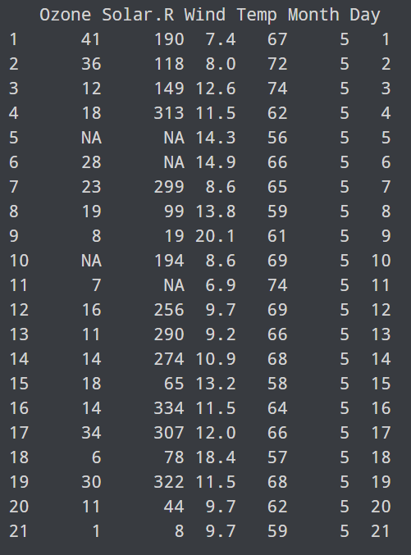

R dataset
Display R datasets: To display the dataset, we simply write the name of the dataset inside the print() function. For example,
https://stat.ethz.ch/R-manual/R-devel/library/datasets/html/00Index.html

Slide 190
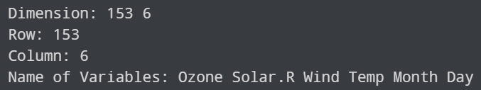
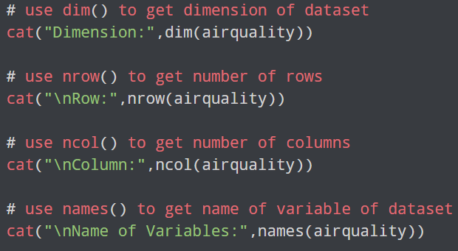
R dataset
Get Informations of Dataset: In R, there are various functions we can use to get information about the dataset like: dimensions of dataset, number of rows and columns, name of variables and so on. For example,
In the above example, we have used various functions to get information about the airquality dataset.
dim() - returns the dimension of the dataset i.e. 153 6
nrow() - returns the number of row (observations) i.e. 153
ncol() - returns the number of column (variables) i.e. 6
names() - returns all the name of variables

Slide 191
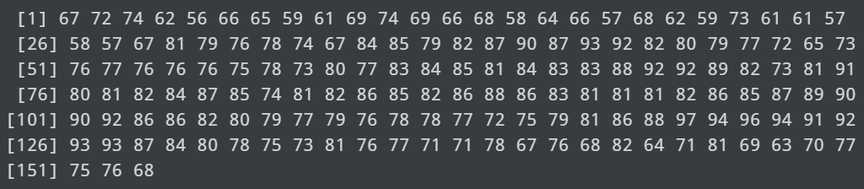

R dataset
Display Variables Value in R: To display all the values of the specified variable in R, we use the $ operator and the name of the variable. For example,
In the above example, we have used the $ operator and the name of the variable to display all values of a variable.
airquality$Temp
Here, we have displayed all values of Temp variable of the airquality dataset.

Slide 192
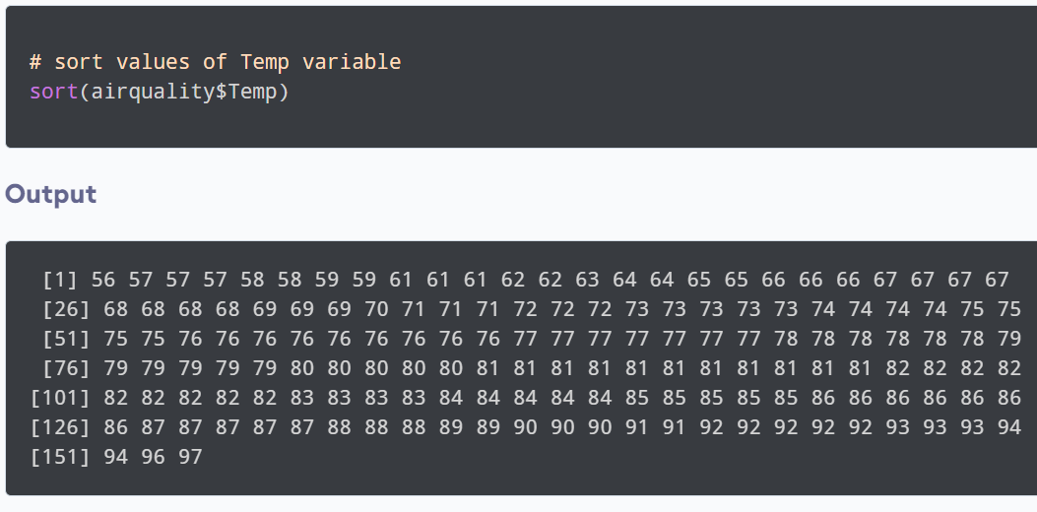
R dataset
Sort Variables Value in R: In R, we use the sort() function to sort values of variables in ascending order. For example,

Slide 193
R dataset
Statistical Summary of Data in R:
We use the summary() function to get statistical information about the dataset.
The summary() function returns six statistical summaries:
min
First Quartile
Median
Mean
Third Quartile
Max

Slide 194
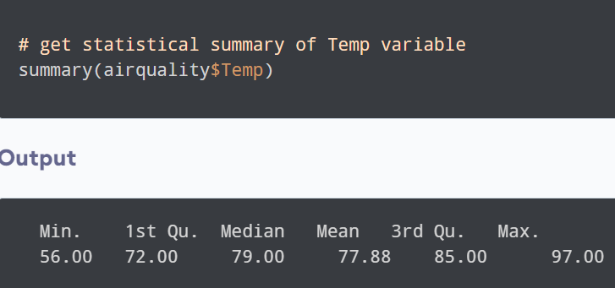
R dataset
Statistical Summary of Data in R:
In the above example, we have used the summary() function to get statistical summary of the Temp variable of airquality dataset.
Here,
Min - is the minimum value i.e. 56.00
1st Qu. - is the first quartile i.e. 72.00
Median - is the median value i.e. 79.00
Mean - is the mean value i.e. 77.88
3rd Qu. - is the third quartile i.e. 85.00
Max - is the maximum value i.e. 97.00

Slide 195
R dataset
R min() and max()
In R, we can find the minimum or maximum value of a vector or data frame.
We use the min() and max() function to find minimum and maximum value respectively.
The min() function returns the minimum value of a vector or data frame.
The max() function returns the maximum value of a vector or data frame.

Slide 196
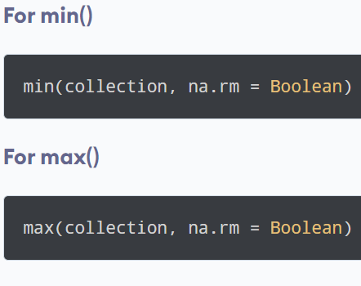
R dataset
Syntax of min() and max() in R
In R, we can find the minimum or maximum value of a vector or data frame.
We use the min() and max() function to find minimum and maximum value respectively.
The min() function returns the minimum value of a vector or data frame.
The max() function returns the maximum value of a vector or data frame.
In both the syntax,
collection - is a vector or data frame
na.rm (optional) - is a boolean value that indicates whether value should be kept or removed,

Slide 197
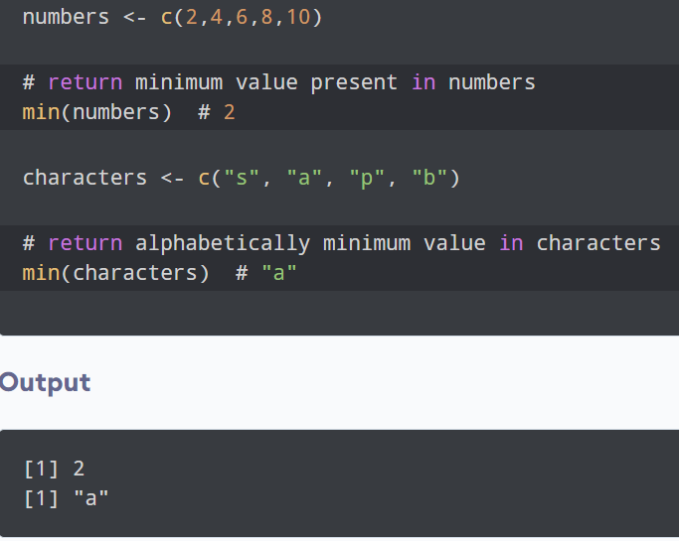
R dataset
Example 1: Use of min() in R
Here,
min(numbers) - returns the smallest number in numbers i.e. 2
min(characters) - returns alphabetically minimum value in characters i.e. "a"

Slide 198
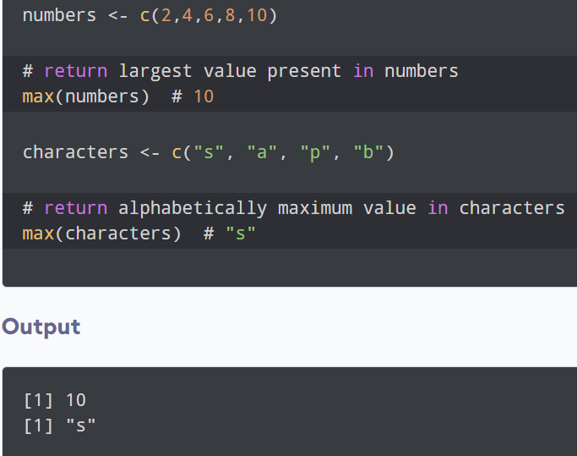
R dataset
Example 2: Use of max() in R
Here,
max(numbers) - returns the largest number in numbers i.e. 10
max(characters) - returns alphabetically maximum value in characters i.e. "s"

Slide 199
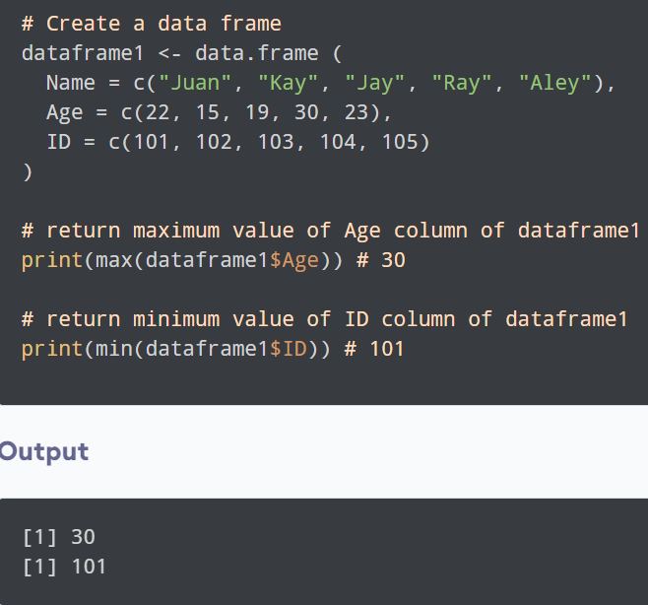
R dataset
min() and max() in a Data Frame: In R, we can use min() and max() to find minimum and maximum value in a certain column of a data frame. For example,
Here,
we have used the max() and min() function to find the maximum and minimum value of the Age and ID column respectively.
max(dataframe1$Age) - returns the maximum value from the Age column of dataframe1 i.e. 30.
min(dataframe1$ID) - returns the minimum value from the ID column of dataframe1 i.e. 101.

Slide 200
R Mean, Median, and Mode

Slide 201
R dataset
Mean, Mode, and Median are measurements of central tendency. In other words, it tells you where the "middle" of a data set is.
Each of these statistics defines the middle differently.
The mean is the average of a data set.
The mode is the most common number in a data set.
The median is the middle of the set of numbers.

Slide 202
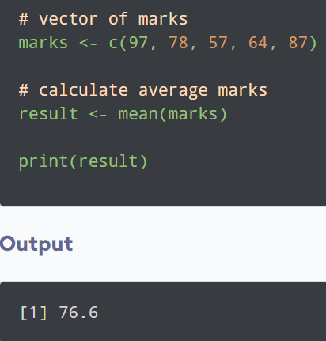
R dataset
Calculate Mean in R
In R, we use the mean() function to calculate the mean. For example,
In the above example, we have used the mean() function to calculate the average result of the marks vector.

Slide 203
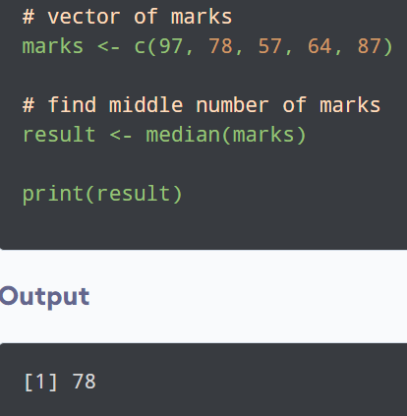
R dataset
Calculate Median in R
We use the median() function to calculate the median in R. For example,,
In this example, we have used the median() function to find the middle value of the marks vector.

Slide 204
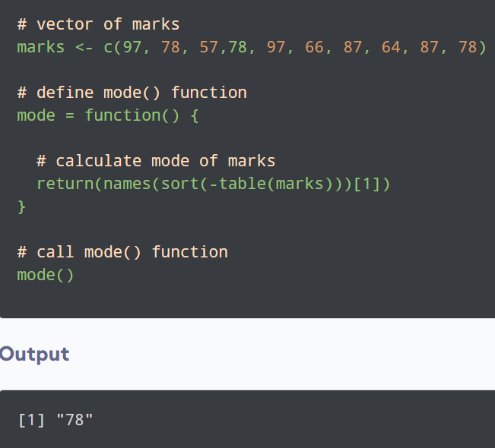
R dataset
Calculate Mode in R: In R, unlike mean and median, there's no built-in function to calculate mode. We need to create a user defined function to calculate mode. For example,
In the above example, we have created a function named mode() to calculate the mode of the marks vector.
Inside the function, we have used the table() function to create a categorical representation of data with the variable names and the frequency in the form of a table.
We will sort marks in descending order and will return the 1st value from the sorted values.
Finally, we have called the mode() function and it returned the most common number in marks i.e. 78

