Slide 1
HR Metrics & Indicators: Developing a Dashboard

Slide 2
Basic Questions
What is a Dashboard?
Why do we use Dashboard?
How do we develop a Dashboard?
What are some design issues in a Dashboard?

Slide 3
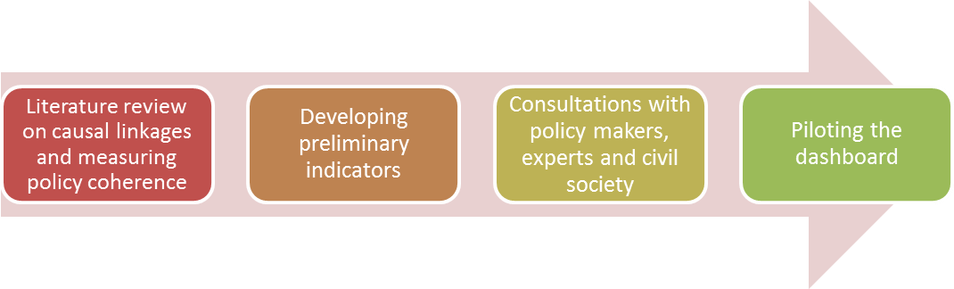
Process of Dashboard Development

Slide 4
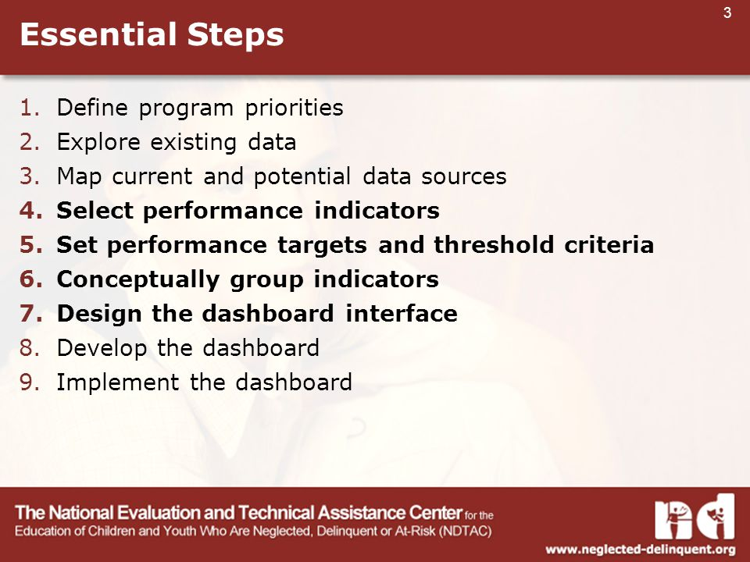
Essential Criteria

Slide 5
Key Performance Indicator (KPI)
  What is a KPI?
    The key to the definition of KPI is the word “key”
    An indicator is a KPI if:
      It is numeric
      It is variable
      It has a strong link with the achievement of business objectives
      Management’s efforts can modify it

Slide 6
Key Performance Indicator (KPI)
KPIs are used to evaluate the performance of
  Individuals
  Business processes
  Organization
KPIs are also known as
  Performance metrics
  Performance ratios
  Business indicators

Slide 7
Types of KPIs
Financial Metrics
  Profit
  Cost
  Actual Revenue/ Target Revenue
  Sales by region
Customer Metrics
  Customer lifetime value
  Customer acquisition cost
    Most important for ecommerce business
  Customer satisfaction & retention
  Number of customers

Slide 8
Types of KPIs
3. Process Metrics
  Customer Support Tickets
    Analysis of the number of new tickets, the number of resolved tickets, and the resolution time will help you create the best customer service department in your industry.
  Percentage Of Product Defects
4. People Metrics
  Employee Turnover Rate (ETR)
  Employee Satisfaction

Slide 9
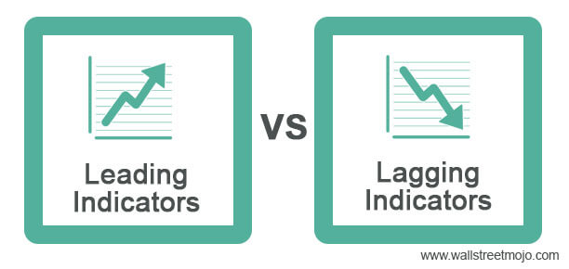
Types of Indicators

Slide 10
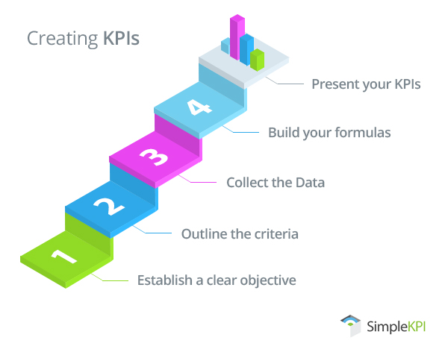

Slide 11
Creating KPIs
Establish a clear objective
  Flows from organizational objectives
  Alignment of KPIs across functions
Outline the criteria for success.
  What will the target be?
    Should be realistic
  When should it be accomplished?
    Time bound
  How will progress be monitored?

Slide 12
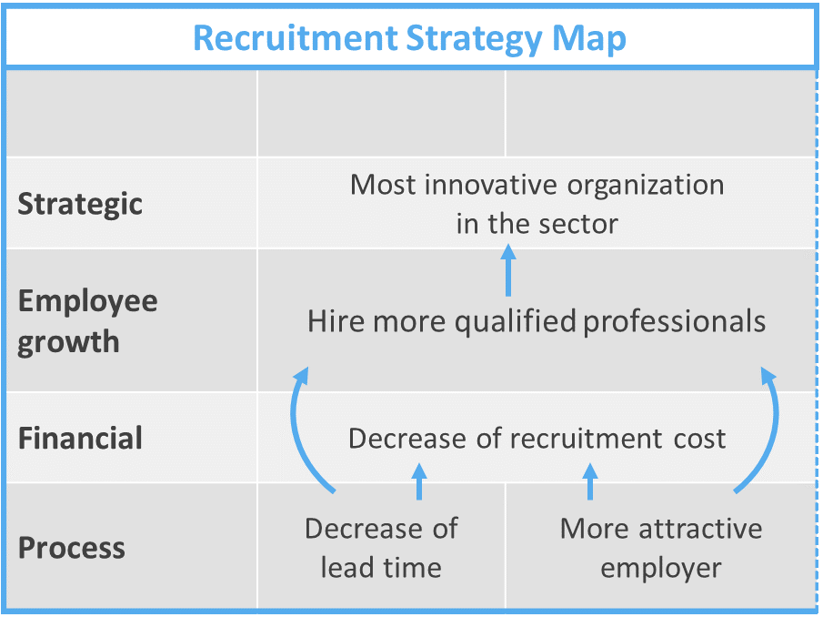

Slide 13
Creating KPIs
Collect the data
  Investigate the availability and accuracy of data
  Use benchmarks and proxies when necessary
Build the KPI formula
  Some KPIs are a combination of various parameters
  Example: productivity per person
Present your KPIs
  Communication must be effective
  Use visuals like graphs, charts, and dashboards
  Group KPIs rationally

Slide 14
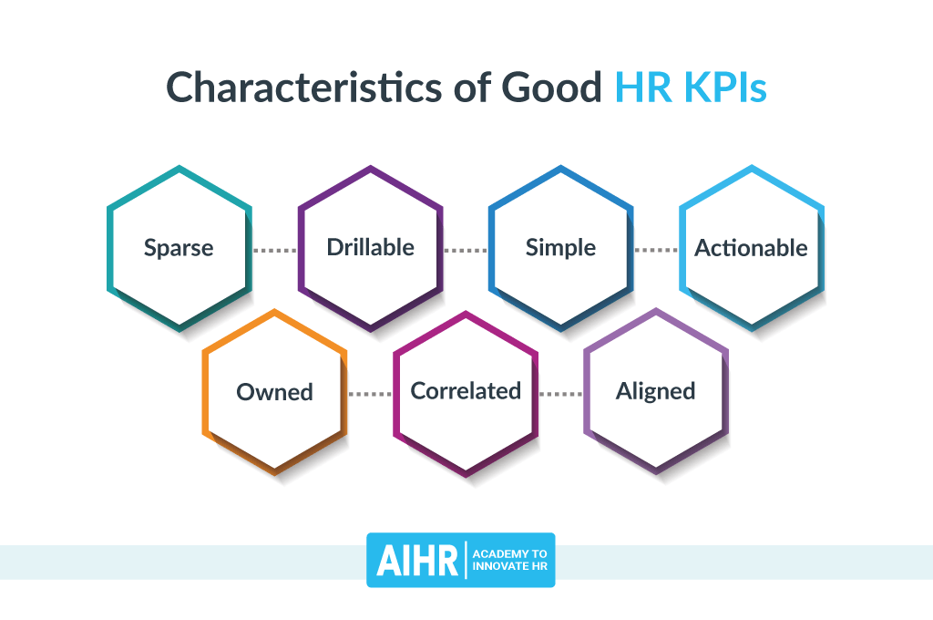

Slide 15
Identify HR KPIs
Average interviewing cost
Absence cost
Average salary
Employee productivity
Average number of unpaid leave per employee
Net Promoter Score

Slide 16
Important HR Metrics

Slide 17
Identifying Important HR Metrics
List of possible HR metrics is pretty exhaustive
Measuring, grouping, and linking all these objectives to other functional objectives is a difficult task
Each organization needs to identify its set of relevant HR KPIs
A smaller set of suggested HR KPIs is presented

Slide 18
Identifying Important HR Metrics
Absenteeism Rate: Evaluate the engagement of your employees
Overtime Hours: Monitor your employees' workload in detail
Training Costs: Analyze the investments in your employees
Employee Productivity: Track the overall effectiveness of your workforce
Talent Satisfaction: Ensure your employees are satisfied in the long run
Cost per Hire: Analyze what it takes to find the perfect fit

Slide 19
Identifying Important HR Metrics
Recruiting Conversion Rate: Find the best recruitment method
Time to Fill: Monitor how long you need to find a new employee
Talent Rating: Assess the quality of your employees
Employee Turnover Rate: See how your retention efforts work
Talent Turnover Rate: Evaluate how many talents you continually change
Turnover Rate By Group: Monitor if your diversity groups are satisfied

Slide 20
Identifying Important HR Metrics
Dismissal Rate: Find out if you’re recruiting the right employees
Female to Male Ratio: Understand the gender diversity in your company
Gender Diversity by Role: Track gender share on managerial positions
Ethnicity Diversity: Discover how diverse your departments are
Recruitment Breakdown By Ethnicity: Ensure a diverse recruitment process
Part-Time Employees: Watch the evolution of part-time workers over time
Average Time Stay: See how long your employees stay in your company

Slide 21
Discussing Important HR Metrics
Are all these KPIs important to your organization?
Which of these KPIs would be important to your organization? Why?
How would you group the KPIs?

Slide 22
Grouping KPIs
Employee Performance
  Absenteeism Rate
  Overtime Hours
  Training Costs
  Employee Productivity

Slide 23
Grouping KPIs
Talent Management
  Talent Satisfaction
  Talent Rating
  Talent Turnover Rate
  Dismissal Rate

Slide 24
Grouping KPIs
Workforce Characteristics
  Turnover Rate
  Female to Male Ratio
  Part-Time Employees
  Average Time Stay

Slide 25
Grouping KPIs
Diversity
  Gender Diversity by Role
  Ethnicity Diversity
  Turnover Rate By Group
  Recruitment Breakdown By Ethnicity

Slide 26
Write KPIs of a Generalist HR Manager ?

Slide 27
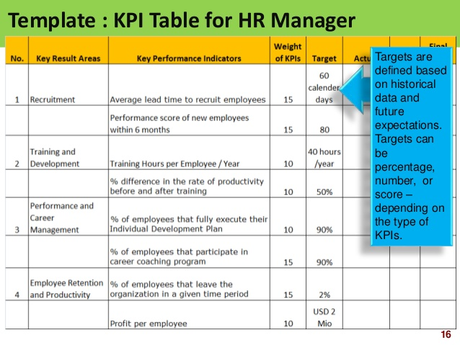

Slide 28
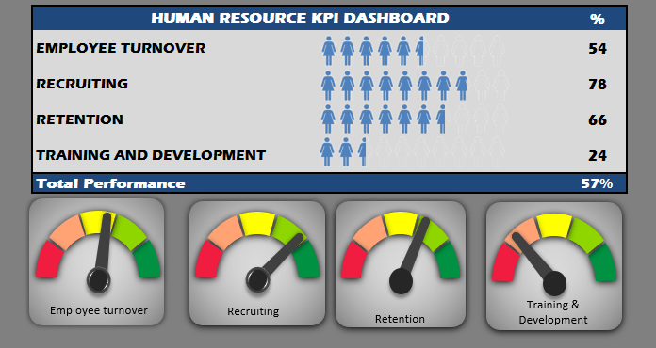

Slide 29
Appendix

Slide 30
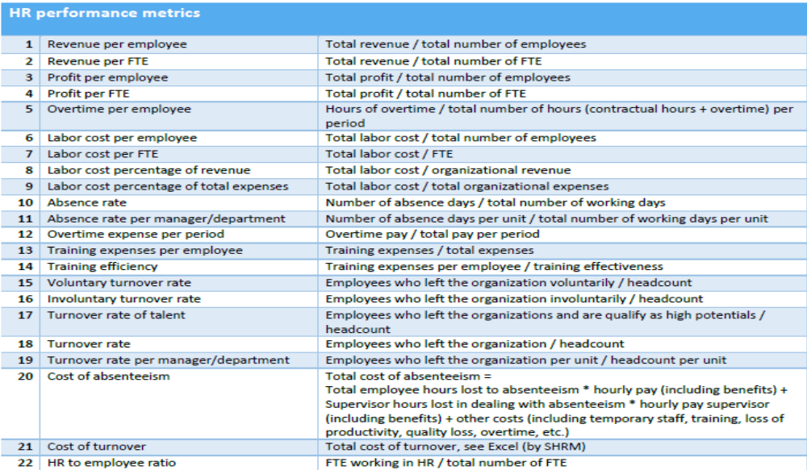

Slide 31


Slide 32


Slide 33
References
Strategy Map: AIHR
Characteristics of KPI: AIHR
List of 19 HR KPIs: Data Pine
Grouping of KPIs: Data Pine
Examples of HR Dashboards:
  Data Pine
  AIHR

