Slide 1
HUMAN RESOURCE INFORMATION MANAGEMENT - I
PHRi

Slide 2
HR Data
Human Resource Information System (HRIS)
Selection of HRIS
Technology and Human Resource Management
Development of HRIS
Change Management

Slide 3
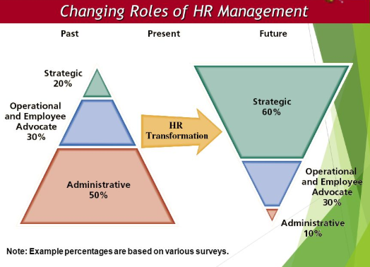
Changing Roles of HRM

Slide 4
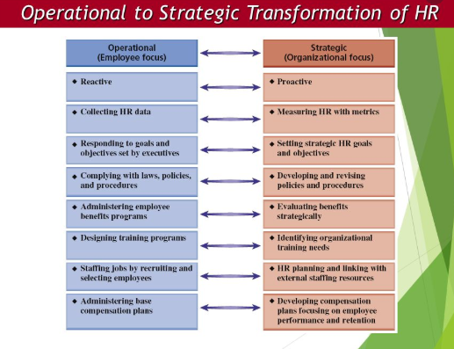
HR Transformation

Slide 5
HRIS
Providing a comprehensive information picture as a single, comprehensive database; this enables organizations to provide structural connectivity across units and activities and increase the speed of information transactions
Collecting appropriate data and converting them to information and knowledge for improved timeliness and quality of decision making

Slide 6
E-HRM vs. HRIS
HRIS are directed towards the HR department itself . Users of these systems are mainly HR staff. These types of systems aims to improve the processes within the HR department itself. While e-HR, the target group is not the HR staff but people outside this department: the employees and management.

Slide 7
Outsourced HR Services
This refers to the delivery of HR through a third-party contractor, most commonly via a service center.
Human Resources Outsourcing (HRO)
Business Process Outsourcing (BPO).

Slide 8
HRO and BPO
HRO is an outsourcer that assumes responsibility for the entire HR function. The vendor will typically take over management of the HR system and all administrative processes in HR.
BPO is an outsourcer that assumes responsibility for a specific process within HR. An example of this would be an outsourcer who assumes responsibility for the management and administration of the benefits programs of a company.

Slide 9
HR Data
Human Resource Information System (HRIS)
Selection of HRIS
Technology and Human Resource Management
Development of HRIS
Change Management

Slide 10
Measurement Methods
Data are individual pieces of factual information recorded and used for the purpose of analysis. It is the raw list of facts that are processed to gain information. The basic concept of data is associated with scientific research collected by different research organisations.
Information is the processed, organized data that is beneficial in providing useful knowledge. For eg., the data compiled in an organized way in a research paper provides information about a particular concept.

Slide 11
Difference Between Data and Information
Data | Information
Data is unorganised raw facts that need processing without which it is seemingly random and useless to humans | Information is a processed, organised data presented in a given context and is useful to humans.
Data is an individual unit that contains raw material which does not carry any specific meaning. | Information is a group of data that collectively carry a logical meaning.
Data doesn’t depend on information. | Information depends on data.
It is measured in bits and bytes. | Information is measured in meaningful units like time, quantity, etc.
Data is never suited to the specific needs of a designer. | Information is specific to the expectations and requirements because all the irrelevant facts and figures are removed, during the transformation process.
An example of data is a student’s test score | The average score of a class is the information derived from the given data.

Slide 12
Types of Data
Primary (data gathered first hand) | Secondary (data gathered by others)
Experiments Pilot projects Surveys/questionnaires Interviews Focus groups Direct observation Testing | Historical data Benchmarking and best-practices reports Purchased data Professional publications Secondhand reports

Slide 13

Types of Measurement

Slide 14
Types of Measurement
Nominal data consist of categories or dimensions and have no numerical meaning by themselves. Examples of nominal data include race, hair colour, and marital status.
Ordinal data are rank orders. Examples of ordinal data include baseball standings (“Who’s in first place?”), seniority lists (“She is third from the top), and budget requests.
Interval data have equal intervals but not necessarily equal ratios. Examples of interval data include performance ratings, the temperature outside, and a score on a personality test.
Ratio data have equal ratios and a true zero point. Examples of ratio data include salary, height, and the number of job applicants.

Slide 15

Mean, Median and Mode

Slide 16
Essentials of Statistics
A measure of central tendency is a single value that attempts to describe a set of data by identifying the central position within that set of data. As such, measures of central tendency are sometimes called measures of central location
Mean : The arithmetic average obtained by adding up all the scores and dividing by the total number of scores.
Median : It is the middle score, or average of middle scores in a distribution
Mode : The category or score with the largest frequency (or percentage) in the distribution.
The mean (average) of a data set is found by adding all numbers in the data set and then dividing by the number of values in the set. The median is the middle value when a data set is ordered from least to greatest. The mode is the number that occurs most often in a data set

Slide 17
Essentials of Statistics
Percentiles : A percentile is a measure at which that percentage of the total values are the same as or below that measure. For example, 90% of the data values lie below the 90th percentile, whereas 10% of the data values lie below the 10th percentile.
Quartiles : Quartiles are values that divide a (part of a) data table into four groups containing an approximately equal number of observations. The total of 100% is split into four equal parts: 25%, 50%, 75% and 100%
Range : The range is a measure of spread: it’s the difference between the highest value and the lowest value in a data set.

Slide 18
Essentials of Statistics
Probability is the measure of the likelihood that an event will occur in a Random Experiment. Probability is quantified as a number between 0 and 1, where, loosely speaking, 0 indicates impossibility and 1 indicates certainty. The higher the probability of an event, the more likely it is that the event will occur.
Standard Deviation (SD) is a measure of variability (it is not a measure of central tendency). Conceptually it is best viewed as the 'average distance that individual data points are from the mean.' Data sets that are highly clustered around the mean have lower standard deviations than data sets that are spread out.
Normal Distribution-also known as a Guasian distribution, the normal distribution follows the shape of a bell curve. That is to say that results cluster around a mean and then fan out into symmetrical tails on either side.

Slide 19

Normal Distribution and Standard Deviation (SD)

Slide 20
Question #
Which of the following measures uses number of incumbents and salary?.
a) Weighted average
b) Unweighted average
c) Median
d) Mode

Slide 21
Answer #
Option A
The weighted average, or weighted mean, gives another picture of the data, with the number of incumbents who receive each salary taken into account

Slide 22
Business intelligence (BI)
BI systems retrieve specified data from multiple databases and store these data in a new database, which becomes that data warehouse. The data in the data warehouse can then be accessed via queries and used to uncover patterns and diagnose problems.
Patterns in large data sets are identified through “data mining”, which involves statistically analyzing large data sets to identify recurring relationships. Data mining is the process of finding anomalies, patterns and correlations within large data sets to predict outcomes.

Slide 23
Analytics
Analytics refers to methods of manipulating and combining metrics in order to gain insights necessary to aid problem solving and decision making. It is the process of looking at that which is measured to understand what it means relative to the data that is being presented.

Slide 24
HR Data
Human Resource Information System (HRIS)
Selection of HRIS
Technology and Human Resource Management
Development of HRIS
Change Management

Slide 25
Human Resource Information System (HRIS)
Human Resource Information System (HRIS) can be briefly defined as integrated systems used to gather, store, and analyze information regarding an organization’s human resources.
HRIS is an information system (IS) used to acquire, store, analyze, retrieve, and distribute information regarding an organization’s human resources. The purpose of the HRIS is to provide service, in the form of accurate and timely information, to the “clients” of the system.

Slide 26

HR Transformation through Information Technology (IT)

Slide 27
Benefits of HRIS
Producing a greater number and variety of accurate and real-time HR-related reports
Streamlining and enhancing the efficiency and effectiveness of HR administrative functions
Shifting the focus of HR from the processing of transactions to strategic HRM
Reengineering HR processes and functions
Improving employee satisfaction by delivering HR services more quickly and accurately to them

Slide 28
Factors affecting HRIS
The size of the organization, with large firms generally reaping greater benefits;
The amount of top management support and commitment;
The availability of resources (time, money, and personnel);
The HR philosophy of the company as well as its vision, organizational culture, structure, and systems; managerial competence in cross-functional decision making, employee involvement, and coaching; and
The ability and motivation of employees in adopting change, such as increased automation across and between functions

Slide 29

HRIS Modules

Slide 30
Types of HRIS
Electronic Data Processing (EDP)
Management Information Systems (MIS)
Decision Support Systems (DSS).

Slide 31
Question #
The HRIS team selects a contractor and must present its decision to the CHRO for budget approval. The CHRO will want to know if the program is cost-effective. The team can BEST make its case by -
Comparing the cost per trainee of this program to that of other programs in the company.
Developing a charge-back plan that shares costs with participating departments.
Showing how the anticipated costs are offset by the expected benefits.
Comparing the contractor's price to the cost of developing the training internally.

Slide 32
Answer #
Option C
The CHRO will be most interested in seeing how the training will benefit the company, either by reducing corporate costs or bringing in additional revenue.

Slide 33
Electronic Data Processing (EDP)
EDP is primarily electronic storage of information and was first applied to automate paperwork. The EDP category of HRIS was the earliest form introduced in the HR field and fits in with the transactional level of HR activities.
The EDP’s basic characteristics include:
A focus on data, storage, processing, and flows at the operational level.
Efficient transaction processing
Scheduled and optimized computer runs
Integrated files for related jobs
Summary reports for management

Slide 34
Management Information Systems (MIS)
The MIS type of HRIS emerged as technology improved over time, and it fits the traditional level of HR activities, such as recruitment, selection, and compensation. The characteristics of MIS include:
An information focus, aimed at middle managers
Structured information flows
Integration of EDP jobs by business function Inquiry and report generation (usually with a database - a collection of information that is organized so that it can easily be accessed, managed, and updated. In one view, databases can be classified according to types of content: bibliographic, full -text, numeric, and images.)

Slide 35
Decision Support Systems (DSS)
HRIS at DSS level began to emerge in the cost-effectiveness era of HRM development, and it fits the transformational level of HR activities—adding value to organizational processes. DSS are focused still higher in the organization, with an emphasis on the following characteristics:
Decision focused, aimed at top managers and executive decision makers
Emphasis on flexibility, adaptability, and quick response
User initiated and controlled
Support for the personal decision-making styles of individual managers

Slide 36
Core HR
There are at least thirteen common human resource information subsystems
Recruitment and Selection
Personnel Administration
Time, Labor, and Knowledge Management
Training and Development
Pension Administration
Compensation and Benefits Administration
Payroll Interface
Performance Evaluation
Outplacement
Labor Relations
Expense and Travel Administration
Organizational Management
Health and Safety

Slide 37
Self-Services
The use of technology to offer services that would be performed by an HR representative. commonly called :
Manager Self-Service (MSS)
Employee Self- Service (ESS)

Slide 38
Informational Self-Service
Informational Self-Service refers to tools that are offered to provide information to employees. These tools are commonly referred to as “Knowledge Management” systems. They contain information about HR policies, processes and can include benefits and compensation information. They are informational in that employees cannot perform a transaction within these systems; they are used for reference purposes only. These can be present in either centralize d or decentralized service delivery models and are almost always found when HR services are outsourced.

Slide 39
Transactional Self Service
These tools are offered for managers and employees to change information captured in HRIS. Employee Self-Service applications include information that the employee changes, which is typically personal in nature. Common changes that occur in an ESS system are employee address, emergency contact, tax withholdings and benefit elections. Manager Self-Service applications include information that a manager changes, which is related to the employees they manage.

Slide 40
HR Portals in Self-Service
A portal is a Web application that resides on the intranet (internally) or Internet (externally) that is designed to aggregate and personalize information for access from a single source. The HR portal in an intranet application is used to perform informational or transactional self-service. Based on an employee’s role in the organization as defined within their security authorizations, the HR portal will present the applications and information the person is allowed to access.
Through the use of single sign on technology, an employee can access an HR application through the portal without having to log into that application, thereby simplifying the process for the employee and eliminating the need for multiple passwords.
The other benefit of an HR Portal is that information can be distributed throughout the organization while being centrally maintained. Policy information and corporate communications can be accessed by all employees regardless of location even though the actual information is stored centrally.

Slide 41
Knowledge Management (KM)
Knowledge Management (KM) is the umbrella term for the management of unstructured information - that is, all kinds of documents. KM can be defined as the process of capturing, distributing and using knowledge effectively. In order to effectively share an organization’s information assets (think: policies, procedures but also expertise and experiences), that knowledge needs to be identified, captured, evaluated and easily retrieved. There are three main approaches to knowledge management:
Technocentric: Focuses on technology, especially software that boosts knowledge sharing and creation.
Organizational: Looks at how to design an organization to best promote knowledge processes.
Ecological: Encourages a knowledge exchange through collaborative networks, rather than through direct management.

Slide 42
SECI Concepts
Socialization is the process where tacit knowledge it transmitted between people..
Externalization process allows tacit knowledge to be morphed into explicit knowledge. Through interaction between an individual and other groups in the organization, the individual’s tacit knowledge is expressed through whatever terms are possible, such as metaphors and stories.
Combination -Knowledge throughout the organization is collected and compiled into a more effective form of explicit knowledge, allowing the more refined forms to be distributed throughout the organization. An example would be a team in a tech firm whose job is to publish reports of successful products made throughout the company.
Internalization is the collective tacit knowledge of the organization is morphed from its explicit knowledge through internalization

Slide 43

SECI Model of Knowledge Management

Slide 44

Knowledge Management Model

Slide 45
Talent Management Systems
The systems that support the processes of onboarding, recruiting, performance management, compensation management, succession planning and learning management are commonly referred to as Talent Management Applications.
ATS
Onboarding
Performance Management
Competency Management
Learning Management
Succession Planning
Compensation Management

Slide 46
Applicant Tracking Systems (ATS)
Recruiting Applications, also known as Applicant Tracking Systems (ATS) or talent acquisition systems, support the process of sourcing and selecting candidates for open jobs. They include the creation of requisitions for the recruitment of a particular job and storing and tracking the résumés of applicants and can include screening of candidates via assessments. Recruiters can use search tools and queries to weed through the mountain of applications for a particular job. Hiring managers are presented candidates for their positions electronically.
Recruiting applications provide benefits on the compliance side as well. Tracking for Affirmative action purposes becomes streamlined. The total cost of sourcing and selecting candidates can be reduced with a recruitment management system. HRIS job and organizational information can be interfaced to the recruitment systems for consistency purposes.

Slide 47
Data Mining and “Big” data
Data mining refers to efforts to identify patterns that exist within data and that may identify unrecognized causal mechanisms that can be used to enhance decision making. To identify these causal mechanisms, data mining uses correlation and multiple regression methods to identify patterns of relationships in extreme ly large datasets.

Slide 48
Predictive Analysis
Predictive analysis involves attempts to develop models of organizational systems that can be used to predict future outcomes and understand the consequences of hypothetical changes in organizations For example, if the organization discovered a correlation between employee job satisfaction and turnover, HR could use this data to suggest modifications to the employees’ work situation or their benefits.

Slide 49
Workforce Modeling
Workforce modeling attempts to understand how an organization’s human capital needs would change as a function of some expected change in the organization ’s environment. This change may be a shift in the demand for the organization’s product, entry into a new market, divestiture of one of the organization’s businesses, or a pending acquisition of or merger with another organization. This process involves establishing a human resource planning program.

Slide 50
HR Data
Human Resource Information System (HRIS)
Selection of HRIS
Technology and Human Resource Management
Development of HRIS
Change Management

Slide 51
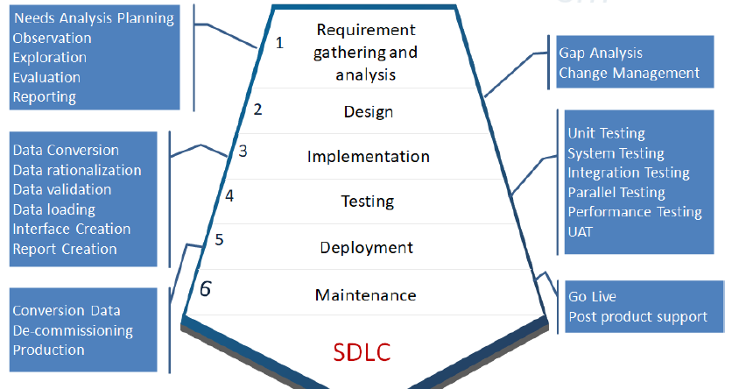
System Development Life Cycle

Slide 52
1. Analysis
Need analysis can be described as the process of gathering, prioritizing and documenting an organization’s HR requirements.
Interviews, focus groups. Surveys and online tools are some methods used in current analysis.
Do a gap analysis

Slide 53
2. Design
The design phase where the business requirements become configuration and system specifications. In this phase the Subject Matter Experts and the Functional Product experts work out how the system will be configured to meet the stated business requirements.
This is also the phase where reporting requirements will be established. When creating the design of the application and new processes that are being introduced, perform an impact assessment

Slide 54
3. Implementation
This is the longest phase of the software development life cycle. This is where the configuration of the application occurs, reports are created, and interfaces and conversion programs are developed. Any application customizations that have been approved to be developed are also in this phase.

Slide 55
4. Testing
During this phase unit testing, integration testing, system testing, acceptance testing are done. Testing includes all of the testing that is required to assure the system is implemented properly. There are functional tests which test that the processes are working as expected from a user perspective, and technical tests which test that the processes are working from an application program perspective

Slide 56
5. Deployment
After successful testing the product is delivered / deployed to the customer for their use, called “Go Live”. This is the phase when everything is ready for the application to be put into production for active use. There are many activities that occur to ready a system and its users for the move into production

Slide 57
6. Maintenance
Once when the customers starts using the developed system then the actual problems comes up and needs to be solved from time to time. This process where the care is taken for the developed product is known as maintenance.

Slide 58
HR Data
Human Resource Information System (HRIS)
Selection of HRIS
Technology and Human Resource Management
Development of HRIS
Change Management

Slide 59
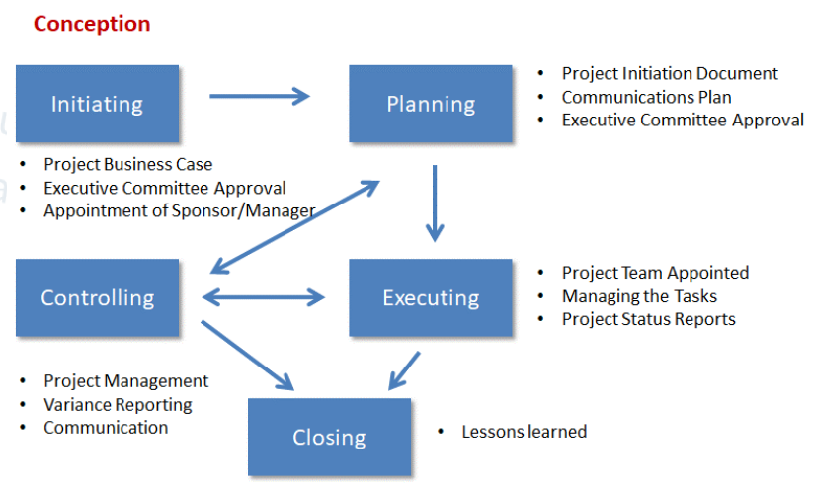
Project Life Cycle

Slide 60
PERT Chart
PERT Chart (Program Evaluation and Review Technique) is a chart that displays the relationships and dependencies between different activities. PERT chart is used to schedule, organize, and coordinate tasks within a project. Using time as the common denominator, PERT analyzes all events that can directly influence the success of a project in terms of time and performance; therefore, it visually outlines the critical path of project tasks.

Slide 61
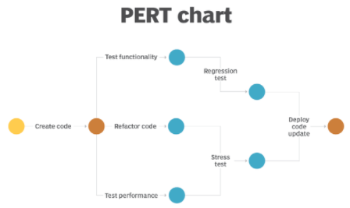
PERT Chart

Slide 62
Gantt chart
Gantt chart is a project planning tool that graphically displays activities of a project in sequential order and plots them against time. Gantt chart is a bar chart that graphically displays a project over an established length of time by resource or task. It is a horizontal bar schedule showing activity start, duration and completion. It shows the connection between events and the calendar and provides a picture of the activity duration.

Slide 63
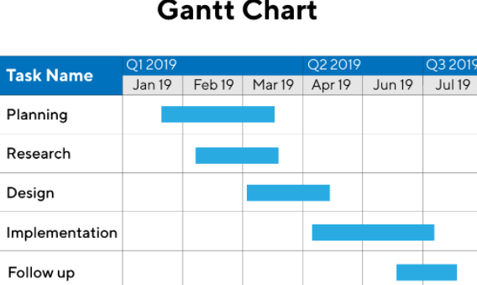
Gantt Chart

Slide 64
Question #
A project manager is assembling the project team. What should HR advise the manager to look for in project team members?.
Commitment to the project's objectives and an understanding of their role.
Knowledge of the project and a willingness to sponsor activities.
Commitment to their regular responsibilities and strong negotiating skills.
Knowledge of leadership and the ability to listen.

Slide 65
Answer
Option A
The project team members must understand the project and be committed to the project's objectives. All team members must understand their roles and obligations as well as rules and processes under which the team will operate

Slide 66
HR Data
Human Resource Information System (HRIS)
Selection of HRIS
Technology and Human Resource Management
Development of HRIS
Change Management

Slide 67
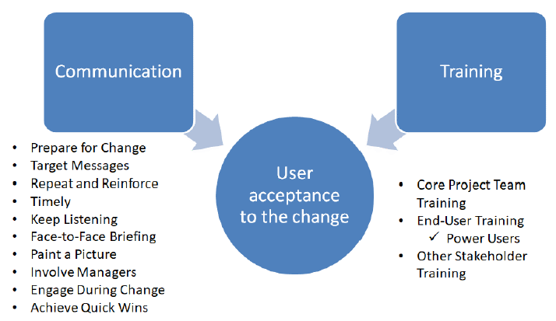
Change Management

Slide 68
Question #
Which of the following is the MOST important role HR can play a major change initiative?.
Assume responsibility for implementing the change.
Communicate regularly with employees.
Question whether the change is needed.
Counsel people who are upset by the change.

Slide 69
Answer #
Option B
Communicate regularly with employees is the most important role for HR in Leading Change

Slide 70
Questions

