Slide 1
Benchmarking
Reference:SHRM

Slide 5
HR Audit
Reference:SHRM

Slide 6
Human resource audits can help
  Identify whether an HR department's specific practice areas or processes are
    Adequate,
    Legal and
    Effective.
  The results obtained from this review can help identify gaps in HR practices, and then
  HR can then prioritize these gaps in an effort to
    Minimize lawsuits or regulatory violations,
    Achieve and maintain world-class competitiveness in key HR practice areas.

Slide 7
Types of Audits
An HR audit can be structured to be either
  Comprehensive or Specifically focused, within the
    Constraints of time, budgets and staff.
Compliance.
  Focuses on how well the organization is complying with current national and local laws and regulations.
Best practices.
  Helps the organization maintain or improve a competitive advantage by comparing its practices with those of companies identified as having exceptional HR practices.
Strategic.
  Focuses on strengths and weaknesses of systems and processes to determine whether they align with the HR department's and the organization's strategic plan.
Function-specific.
  Focuses on a specific area in the HR function (e.g., payroll, performance management, records retention).

Slide 8
The HR Audit Process: A Model
Determine the scope and type of audit.
Develop the audit questionnaire.
Collect the data.
Benchmark the findings.
Provide feedback about the results.
Create action plans.
Foster a climate of continuous improvement.

Slide 9
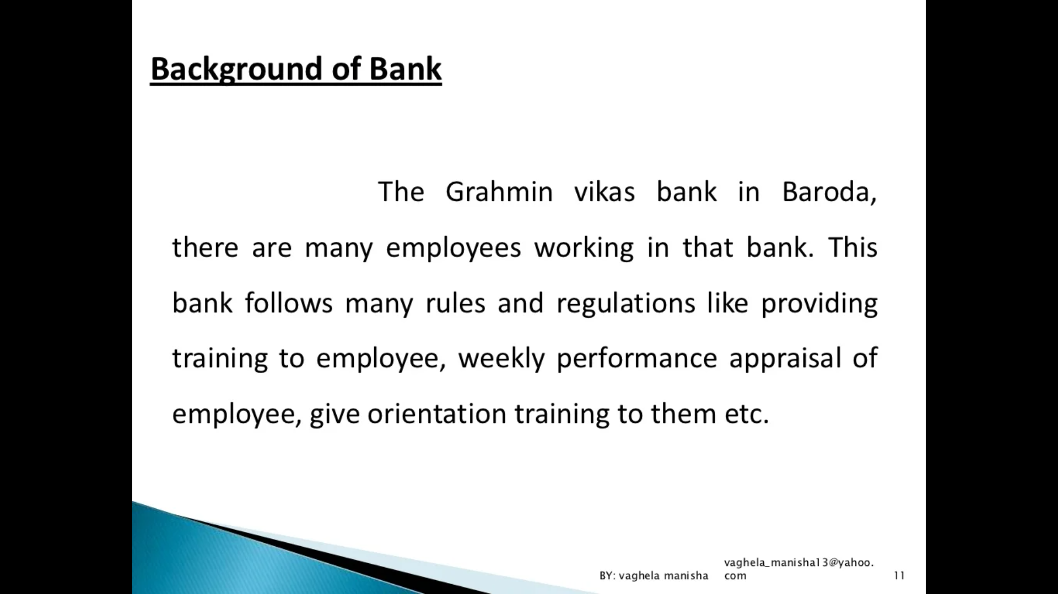

Slide 10
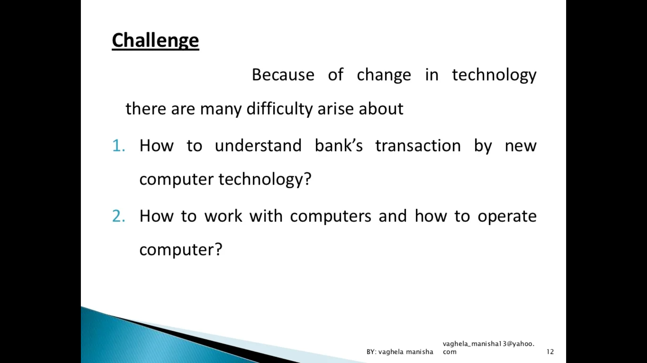

Slide 11
How can HR Audit Help in the present situation??

Slide 12
Reference
https://www.shrm.org/resourcesandtools/tools-and-samples/toolkits/pages/humanresourceaudits.aspx

