Slide 1

HR Analytics
MDP
Prof. Sanket Sunand Dash
Indian Institute of Management Rohtak

Slide 2
Why HR Analytics?
“In God we Trust, all others bring data” (Edward Deming)
“Every organization is unhappy in their own ways”
Hence we need
  Data based insights & not “Universal Gyaan”

Slide 3
Why HR Analytics?
What gets Measured, gets Managed,
What's get managed gets Done “Peter Drucker”

Slide 4
Present scenario of hr analytics
Scarcity of data/Unorganised data
Insight based decisions by HR professionals
Lacks empirical validation
Top management develops low confidence in the HR for analytics
No or less investment in analytics project

Slide 5
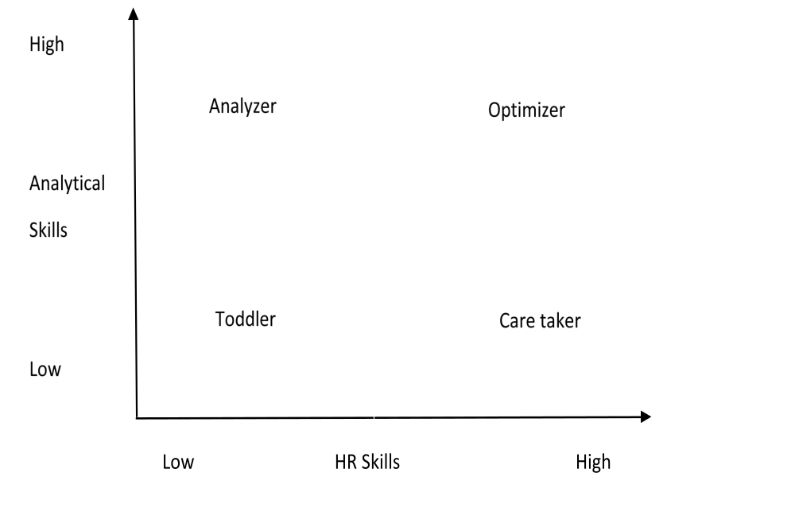
Present scenario of hr analytics
Source: Yadav and Maheswari (2020)

Slide 7
Changing requests from hr manager
Topic | Traditional | Current | Future
Recruitment | I need to recruit Manager? How? | I need a manager. How do I know who will be the best fit? | Can you recommend the best fit people to me in advance so that I have a ready bank of suitable candidates?
L&D | What courses are available for sales men? | I need customer engagement training for my team | Can you notify Ram about his developmental needs? Also recommend developmental action plans of such people
Compensation | Gaby has resigned. See how much we can give hike? | I would like to be notified when people are at risk of leaving | I would like to have benchmark salary information at all level. I would also like recommendations for retaining people
Leadership | What are the succession plans for team A | Who are the best leaders in this company? Who best fits our succession plan? | What competencies best fit the current and future leadership in the company? How do we nurture our current people and manage succession plan?

Slide 9
Stages of analytics
Descriptive
Predictive
Diagnostic
Prescriptive

Slide 10
Why Hr analytics
Measure and Manage
What gets measured, gets managed, what's get managed gets executed “Peter Drucker”
Return on Investment
The business demands on HR are increasingly going to be on analysis just because people are so expensive “David Foster”
Performance Improvement
Organizations following workforce analytics outperform all other organizations by 30% more sales per employee
Linking Business objectives and People Strategies
To clearly demonstrate the interaction of business objectives and workforce strategies to determine a full picture of likely outcomes

Slide 12
Workforce analytics leader
“The analytics leader must frame things in language that business leaders understand” [Mark Berry]
Leader should be able to:
  Understand business, integrate insights, convince others and have credibility
Leader should possess
  Business Acumen
  Consulting Skills
  HR Domain knowledge
  Data science skills
  Communication skills

Slide 13
Essential Skills for success in workforce analytics
Business Acumen
  Financial Literacy
  Political Astuteness
  Internal Awareness
  External Awareness
Consulting
  Problem definition
  Hypothesis building
  Project Management
  Solution Development
  Change Management
  Stakeholder Management

Slide 17
Essential Skills for success in workforce analytics
3. Human Resources and Psychology
  HR Sub functions
  HR interdependencies
  International HR
  Privacy and Ethics
4. Data Sciences
  Quantitative Mathematics & Statistics
  Computer Science: Database and programming
Communications
  Visualization
  Story telling
  Writing
  Presenting
  Marketing

Slide 18
Get or develop a team of desired competencies
Knowledge of Analytics
  Confidence in mathematical and computational skills
Good Field Worker
  Experienced in execution of data collection
Good documenter
  Sound in documentation and report preparation capabilities
Communication through story telling
  Should be able to communicate findings in simple and interesting ways

Slide 19
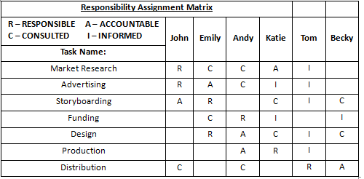

Slide 20
Model of purposeful analytics
Why undertake the project?
Step 1 – Frame business questions
Step 2 – Build Hypotheses
How should the project be carried out?
Step 3 – Gather Data
Step 4 - Conduct Analyses
What will result from the project?
Step 7 – Get your point across
Step 8 – Implement and evaluate
Step 5 – Reveal Insights
Step 6 – Determine Recommendations

Slide 21
Step 1 – Frame business questions
Focus on understanding the business
Use appropriate consulting techniques
  Questioning, listening and paraphrasing skills help in getting the heart of the problem
Summarize the business question back to the project sponsor

Slide 22
Step 2 – Build hypotheses
Write a hypothesis as a statement, not as a question
  If salary will increase attrition will decrease
Use literature to support the hypothesis
  Google scholar can be useful resource
Don’t make hypotheses too ambitious
Discuss the hypothesis with the sponsor
  For clarifying expectations and developing common understanding

Slide 23
Step 3 – how should the project be carried out
Gather data
To test the hypothesis gather existing date or collect new data
But first focus on the existing data
Think carefully before collecting new data so that you avoid collecting repetitive data

Slide 24
Step 4 – conduct analyses
1. Choosing the right method of analysis

Slide 25
Step 5 – Reveal insights
  Clear and in one sentence
  Avoid sharing raw data without interpretation
  Ask yourself what each insight means
    What does it tell me?
    What actions might result from this insight?

Slide 26
Step 6 – determine recommendations
Provide one recommendations to each insights
Group individual recommendations into main themes
Be bold
  Make strong recommendations
Write each recommendation clearly as a statement

Slide 27
Step 7 – get your point across
Translate insights into story
  Ex – From the last 20 years such a such thing is happening…
Carefully consider your visualization
  Don’t just cut paste screen shots of data
  “Show numbers in which people understand”
  Tell story using pictures and not just rows and columns of data

Slide 28
Step 8 – implement and evaluate
Ensure that decisions are made as a result of your project
Formulate actions for implementation based on those decisions
  Engage a change management or implementation expert
Evaluate the ROI for the project
  Evaluate at appropriate time points

Slide 29
Analysis types
Quantitative Analysis
  Exploratory Analysis – Helps in understanding the variables (it’s spread or variance)
    T – Test and ANOVA can be used
  Associate Analysis – Relationship between two variables
    Correlations is used
  Predictive Analysis – Used to make forecasts about the future
  Reduction Analysis – To reduce the information
    Many different variables can be reduced to less variables
      Factor Analysis
  Segment Analysis – Grouping the similar data into groups
    Cluster Analysis – Eg who are the employees in stress prone situation

Slide 30
Analysis types
Qualitative Analysis
  Interviews
  Focussed Group Discussion
  Case study

Slide 31
case: The impact of attrition should we care?
ABCD is a global IT company headquartered in the United Kingdom. It has operations in more than 60 countries, having dense presence in Asian countries (25 countries). The company has approximately 40000 employees out of which 15000 are females. Out of total 40000 employees 18000 employees are working in remote locations in various countries.
Company is financially sound having a revenue of $ 10 billion in 2019-20 and profit of $2 billion
Mr. Piyush Pandey, Global Head of ABC based on some trend analysis figured out that rate of attrition was rising year over year. The company was constantly looking to hire externally while losing valuable employees at various roles.

Slide 32
The impact of attrition should we care?
To tackle this problem he appointed Ms. Maria as the Chief People Analyst. Now assuming yourself as Maria answer the following questions?
  What should be your four prime business questions?
  What should be your hypotheses?
  Which analytical tools will you use?

Slide 33
Solution
The impact of attrition should we care?
Research Question
What factors make employees more likely to leave ABC?
  Are employees leaving for salary?
  Are employees working in remote area more likely to leave?
  Are female employees more likely to leave?
What will be the financial impact of leaving people?
What can we do about it?
What will be the ROI?

Slide 34
Solution
The impact of attrition should we care?
Hypothesis 1: Female employees are more likely to leave ABC compared to male employees
Hypothesis 2 : Employees working in remote areas are more likely to leave ABC compared to employees working in cities

Slide 35
Solution
The impact of attrition should we care?
Which analytical tool will you use?
  Regression Analysis

Slide 36
What could be measured
HR Matrices
Recruitment
Retention
Performance and Career Management
Training
Organization Effectiveness
Compensation
Workforce

Slide 37
Reasons for analytics Resistance
Stakeholder Skepticism | Tips to Address
I don’t need analytics to tell me what to do | Determine the underlying cause of that response: Is it reflecting a perceived threat of being proven wrong? If yes, the best course of action might be a third party partner who can deflect any negative ramifications of a non conforming outcome.
I don’t trust your analysis | Don’t get defensive. Listen for the specific concerns and work to address them
HR does not have that skills | Borrow analytical skills from other functions or hire analytics powerhouses onto your team
HR is not strategic to business | Convey how competitive advantage comes to those who manage the people side analytically

Slide 38
Reasons for analytics Resistance
Financial Frugality | Tips to Address
We can’t afford to do it | Ask questions: Can you afford not to do it especially when finding talent is difficult and expenditures on people is rising
We can’t afford to implement the recommended changes | Plan for potential actions in advance. Choose projects with less costly anticipated actions. Create a business case that contrasts the costs and benefits of action as well as inaction
The budget is ready | Redirect the budget, absorb the work, and overdeliver

Slide 39
Reasons for analytics Resistance
HR Hesitancy | Tips to Address
We don’t know where to start | Hire someone with data analytics skills
We have tried analytics in HR before but it did not work | Share information about the advances in technology and data management The emergence of new data sources Success of analytics in other functions such as marketing and finance
Its too difficult to work with our data | Start with a small, well defined data base
We don’t have the right tools | Start simple. A spreadsheet might provide you the basics you need
We won’t be able to implement actions | Choose a quick Win project Think through possible outcomes and actions before you begin. Discuss in advance with stakeholders to get their buy in

Slide 40
Why analytics project fails
Mistakes while undertaking the project
  No clear purpose of the project
  Lack of proper sponsor
  Poor communication with the sponsor
Mistakes while carrying out the project
  Incomplete, inaccurate data
  Poor choice of statistical tools
  Lack of investment at right time
  Lack of technical competence
  Poor extractions of insights

Slide 41
Agoda: People Analytics and Business Culture
What are some of the key people analytics initiatives in Agoda?
What are the key issues in Agoda?
Who are the key decision-makers?
What is HR Audit?
What is the role of HR Audit in solving Agoda’s problems?

Slide 45
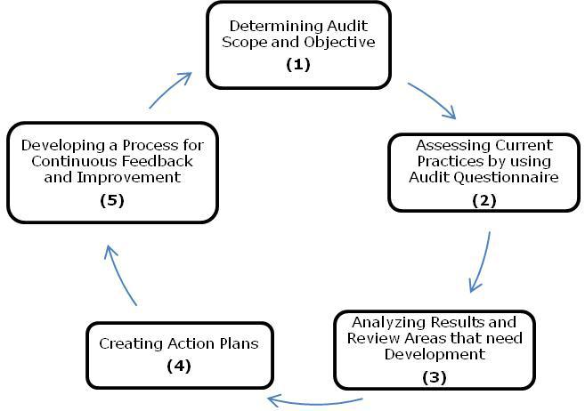
HR audit Process

Slide 46
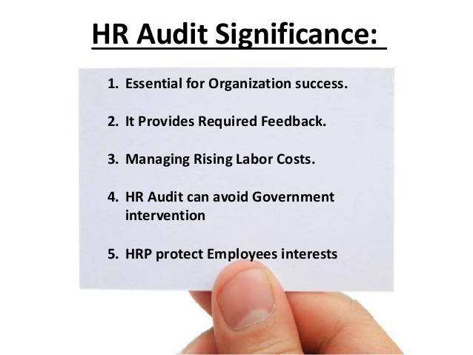
Hr audit significance

Slide 47
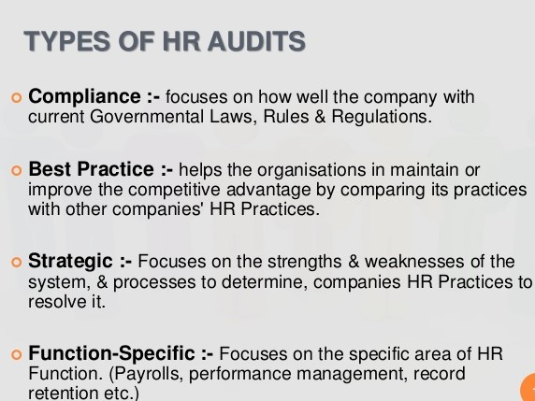

Slide 48
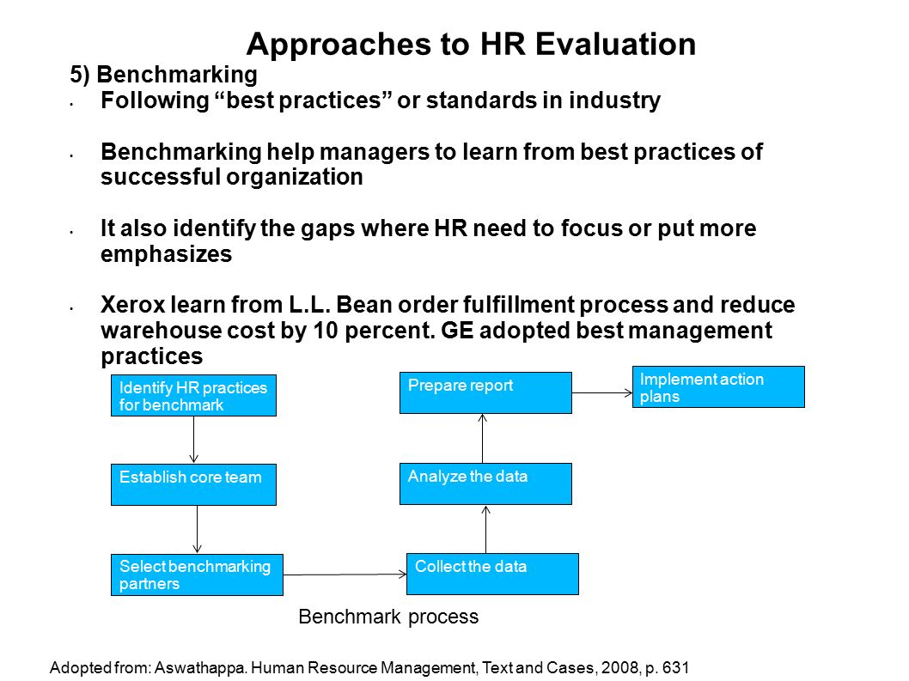

Slide 49
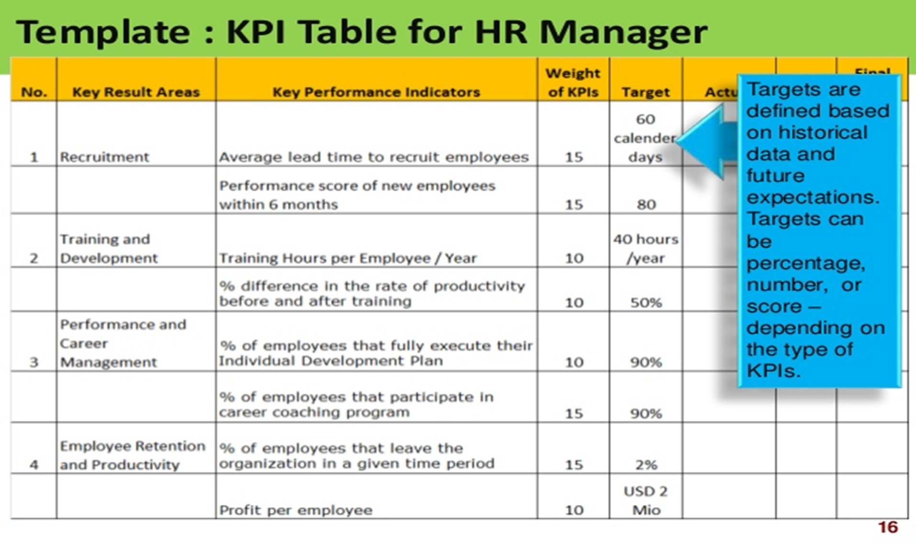
Use of benchmarking

Slide 50

Thank you

