Slide 1
HR Analytics

Slide 2
HR Analytics
“In God we Trust, all others bring data” (Edward Deming)
“Every organization is unhappy in their own ways”
Hence we need
  Data based insights & not “Universal Gyaan”

Slide 3
Why HR Analytics
What gets Measured, gets Managed,
What's get managed gets Done “Peter Drucker”

Slide 4
Changing requests from hr manager
Topic | Traditional | Current | Future
Recruitment | I need to recruit Manager? How? | I need a manager. How do I know who will be the best fit? | Can you recommend the best fit people to me in advance so that I have a ready bank of suitable candidates?
L&D | What courses are available for sales men? | I need customer engagement training for my team | Can you notify Ram about his developmental needs? Also recommend developmental action plans of such people
Compensation | Gaby has resigned. See how much we can give hike? | I would like to be notified when people are at risk of leaving | I would like to have benchmark salary information at all level. I would also like recommendations for retaining people
Leadership | What are the succession plans for team A | Who are the best leaders in this company? Who best fits our succession plan? | What competencies best fit the current and future leadership in the company? How do we nurture our current people and manage succession plan?

Slide 5
Introduction of HR Analytics
Hence, HR Analytics helps in
  Processing these massive HR data,
  Gain insights, and
  Formulate effective HR policies that is best fitted with the business strategy
    Leading to business outcomes
    Mantra “ Focus on outcomes – Income will follow” not the other way

Slide 6
Benefits of HR Analytics
HR analytics is going to play a pivotal role
Add value to the HR discipline with evidence-based human resource management (EBHRM)
Help establish a clear linkage of HR policies and practices with business strategy.
The HR team is now not going to take a back seat but will be proactive in strategy board rooms with their data-driven viewpoints for business strategy and growth.
It is expected that the organizations that will take the lead in developing HR analytical units will reap the benefits and stay ahead of the competition.

Slide 7
Levels of Analytics
Levels of HR Analytics
In general, four-level analytic model (Fitz-enz and John Mattox 2014).
It includes
  Descriptive analytics,
  Diagnostic Analytics
  Predictive Analytics, and
  Prescriptive analytics.

Slide 8
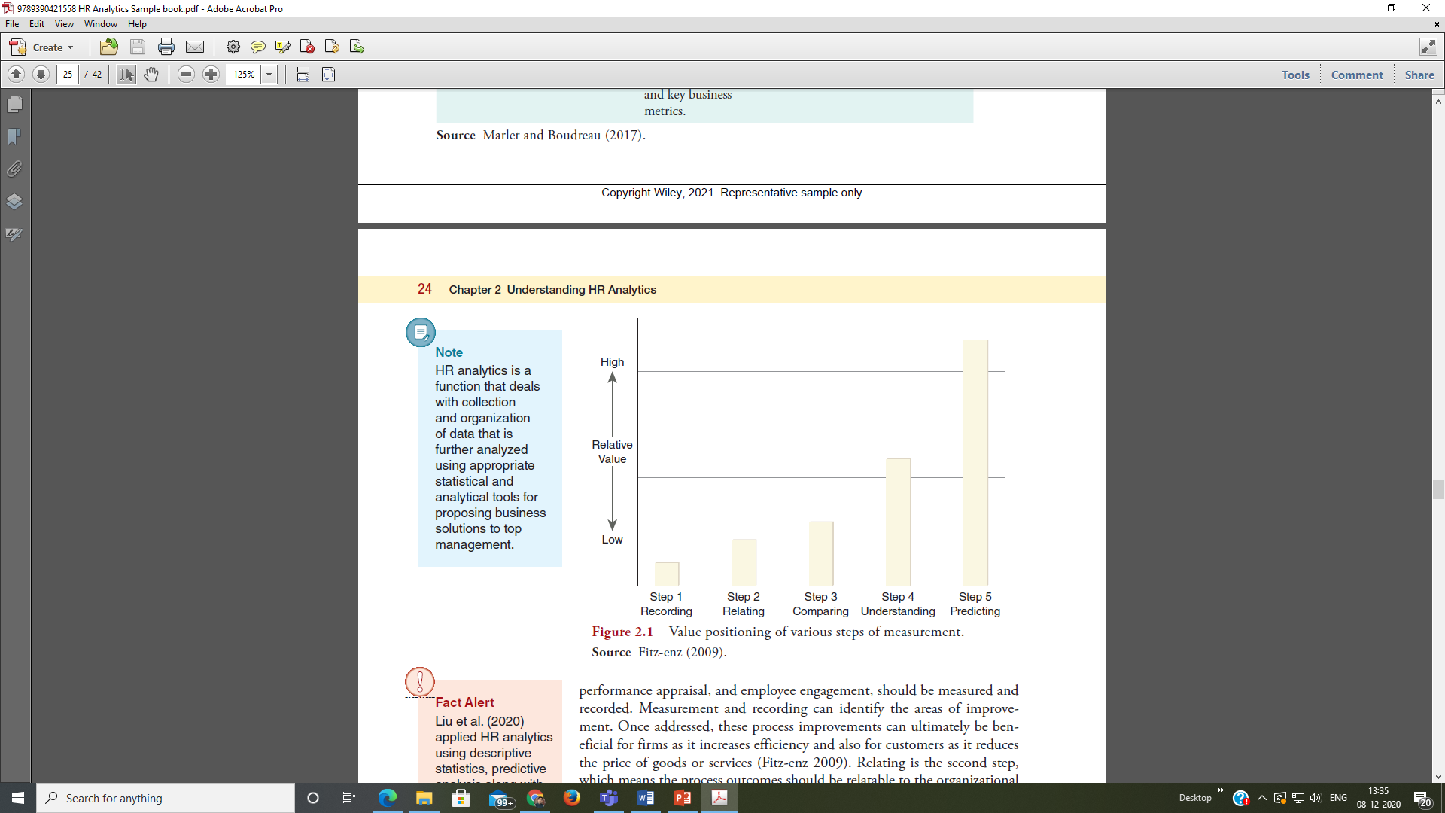
Understanding HR Analytics

Slide 9
Levels of Analytics
Descriptive Analytics:
  Concerned with the description of data and helps in understanding the nature of that data.
Diagnostic Analytics:
  Detects the problem area
Predictive Analytics:
  Develops model between variables indicating problem area using the past data trends.
Prescriptive stage:
  We use statistical analysis to test the model developed in the predictive phase.
It is imperative and critical that the tested model should be a valid and reliable one.

Slide 10
Critical Stakeholders
Establishing an HR analytics unit in organizations is not easy.
It is a tricky change-management process
To successfully adopt a change - Manage the critical stakeholders involved
Important stakeholder of HR analytics will be
  Top management
  HR leadership
  HR Analytics employees
  Other employees (users)
  Partners

Slide 11
Get or develop a team of desired competencies
Knowledge of Analytics
  Confidence in mathematical and computational skills
Managing People with clarity
Good Field Worker
  Experienced in execution of data collection
Good documenter
  Sound in documentation and report preparation capabilities
Communication through story telling
  Should be able to communicate findings in simple and interesting ways

Slide 12
Workforce analytics leader
“The analytics leader must frame things in language that business leaders understand” [Mark Berry]
Leader should possess
  Business Acumen
  Challenge: The data scientists
  Integrate
    Various functions
  Represent
    The position of technical specialists to the stakeholders

Slide 13
Essential steps to be successful in workforce analytics
  Problem definition
  Hypothesis building
  Data Collection
  Solution Development
  Change Management
  Stakeholder Management

Slide 14
Summarize
All HR analytics models
Help us realize our current problem state or developmental areas and
Prescribe a way to reach the desired state.

