Slide 1
HR ADMINISTRATION AND
SHARED SERVICES- III
PHRi

Slide 2
Employee Life Cycle Model
Termination
Offboarding
Transferring
Exit Interview
Resignation
Outplacement

Slide 3
Employee Life Cycle Model
The employee life cycle or ELC is a human resources model that identifies stages in staffing administration and optimize people investment processes.
The 6Bs of talent management is a framework that helps organisations plan through their talent needs for the future. It helps you critically think through what you need to do to ensure you have the right capabilities to deliver on your organisation's strategy.

Slide 4
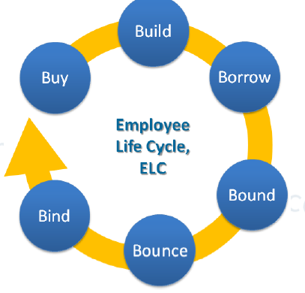
Employee Life Cycle Model

Slide 5
The 6Bs of talent management
Build: Developing internal talent (usually a longer-term plan)
Buy: Acquiring the necessary external talent
Borrow: Contracting, outsourcing or bringing in other units
Bind: Retaining key employees and capabilities
Boost: Accelerating planned promotions
Bounce: Removing employees and using performance management or redundancy

Slide 6
The 6Bs of talent management
Buy : Acquire new talent by recruiting individuals from outside the organization.
Build : Develop talent through training, education, formal job training, job rotation, special assignments, and action learning.
Boost : Move the right people through the organization and into higher positions.

Slide 7
The 6Bs of talent management
Borrow : Partner with consultants, vendors, customers, and suppliers outside the organization in arrangements that transfer skill and knowledge, or recruit individuals from other departments or divisions within the organization.
Bounce : Remove low-performing or under-performing individuals.
Bind : Retain employees with high growth potential and valued talent.

Slide 8
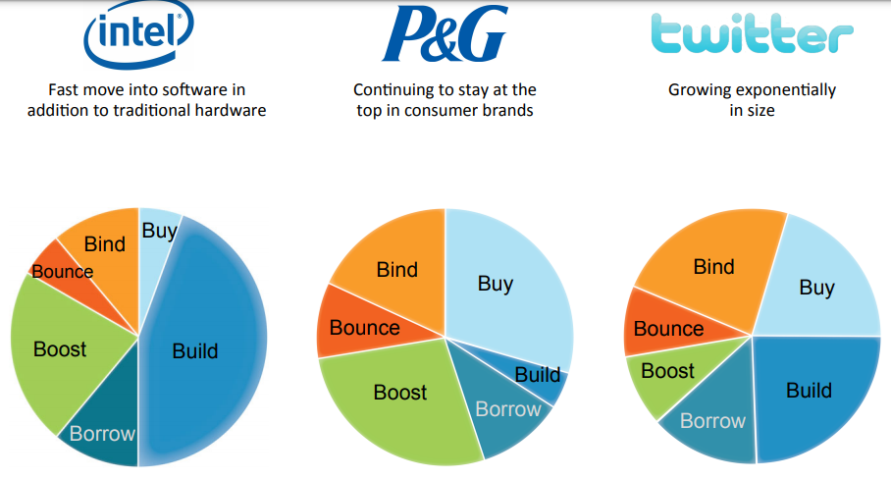
Examples of Talent Strategies

Slide 9
Question # 1
A large Bank needs to layoff 10% of its workforce for reengineering, but does not want to risk discriminating against any employee. In order from most to least weight, which of the following weightings will BEST meet the needs of the Bank?
a) Performance appraisal data, seniority, diversity goals.
b) Seniority, diversity goals, performance appraisal data.
c) Seniority, performance appraisal data, diversity goals.
d) Diversity goals, performance appraisal data, seniority.

Slide 10
Answer # 1
Option A
The bank will be least liable to charges of discrimination if its decisions are based first on performance appraisal data. In this way, all employees have an equal chance of remaining with the company based on their performance. Seniority might be considered next, followed by diversity

Slide 11
Employee Life Cycle Model
Termination
Offboarding
Transferring
Exit Interview
Resignation
Outplacement

Slide 12
Transferring
Transfer is another form of internal mobility of human resources which involves movement of an employee without any change in the employee’s status, responsibilities, and pay. The movement could be -
one section to another section of the same department
one department to another department
one unit to another unit
one place to another place
one function to another function in the form of job rotation

Slide 13
Transfer
A transfer differs from promotion in which the latter involves an upward change in employee’s status, responsibilities, and remuneration while in the case of the former, there is no such change
Transfer may be initiated either by the company or the employee. It also can be temporary or permanent.

Slide 14
Reasons for employee transfers
To increase the effectiveness of the organization.
To increase versatility and competence of key positions.
To deal with fluctuations in work requirements.
To correct incompatibilities in employee relations.
To correct erroneous placement.
To relieve monotony.
To adjust workforce.
To punish employees.

Slide 15
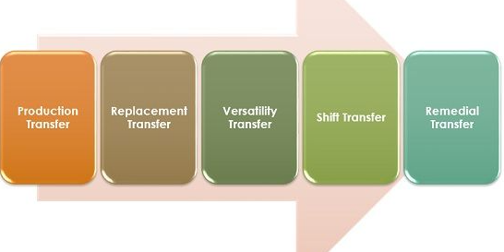
Types of Transfer

Slide 16
Types of Transfer
Production Transfers: The transfers which are done from one department where the labour requirements are increasing. Such transfers are made to meet the company requirements. The surplus employees in one department or section who are efficient might be absorbed in other place where there is a requirement. Such transfers help to stabilize employment

Slide 17
Types of Transfer
Replacement transfers - An employee with a long service may be transferred in some other department to replace a person with a shorter service.
Versatile transfers - It is also known as rotation. It is made to develop all round employees by moving them from one job to another. It also helps to reduce boredom and monotony.

Slide 18
Types of Transfer
Personnel or remedial transfers - Such a transfer is made to rectify mistakes in selection and placement. As a follow up, the wrongly placed employee is transferred to a more suitable job.
Shift transfers - This is pretty common where there is more than one shift and when there is regularized rotation.

Slide 19
Question # 2
Re-assignment of work, related to job in another part of organization, at similar position is called
a) promotions
b) transfers
c) development
d) separation

Slide 20
Answer # 2
Option B
A transfer is a horizontal or lateral movement of an employee from one job, section, department, shift, plant or position to another at the same or another place where his salary, status and responsibility are the same.

Slide 21
Employee Life Cycle Model
Termination
Offboarding
Transferring
Exit Interview
Resignation
Outplacement

Slide 22
Offboarding
Offboarding is the process that leads to the formal separation between an employee and a company through resignation, termination, or retirement. It encompasses all the decisions and processes that take place when an employee leaves.
Turnover Rate:
number of employees leaving X 100
average number of employees

Slide 23
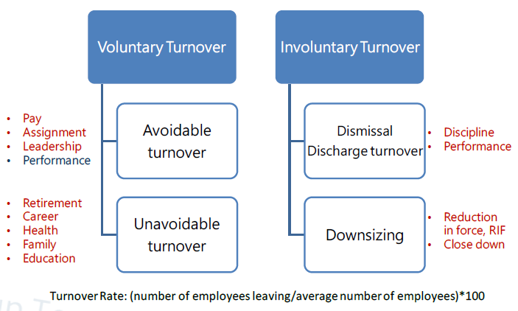
Types of Turnover

Slide 24
Types of Turnover
Functional Turnover: Lower-performing or disruptive employees leave
Dysfunctional Turnover: Key individuals and high performers leave at critical times
Turnover and “Churn” - Hiring new workers while laying off others is called churn.

Slide 25
Question # 3
Your company terminated 705 employees during the quarter. The average headcount is 2,500 for the same time period. What is the separation rate?
a) 0.22.
b) 0.282.
c) 0.3928.
d) 0.718.

Slide 26
Answer # 3
Option B
To calculate employee separation rates, divide the number of employee separations in one period by the average number of headcount during the same period. Therefore, the answer is 705/2500 = 0.282

Slide 27
Employee Life Cycle Model
Termination
Offboarding
Transferring
Exit Interview
Resignation
Outplacement

Slide 28
Termination
Termination of employment refers to the end of an employee’s work with a company. An employee may be terminated from a job of their own free will or following a decision made by the employer.
Dismissal or Discharging an employee can also be referred to as firing an employee.
A layoff is similar to a discharge, except that layoffs are not performed due to the negative behaviour or poor performance of employees
.

Slide 29
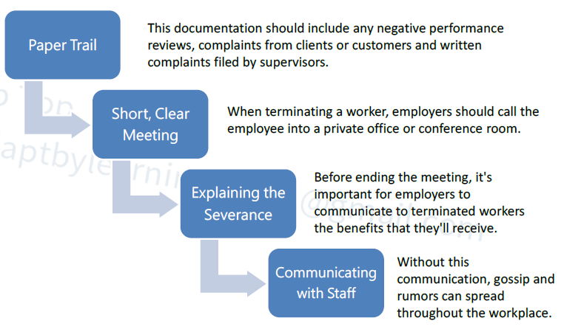
Termination Process

Slide 30
Question # 4
What should an employer do after an employee termination is complete?.
a) Communicate with the rest of their workers about the firing.
b) Build a paper trail detailing the reasons for the dismissal.
c) Tell the terminated employee that he is being terminated.
d) Tell the fired employee how many additional weeks of pay he will receive.

Slide 31
Answer # 4
Option A
After the termination is complete, employers must then communicate with the rest of their workers about the firing. Without this communication, gossip and rumors can spread throughout the workplace. Employers should say that a certain worker was terminated, but shouldn't go into details about the reason for the firing. "Before" employers terminate an employee, they should take the time to build a paper trail detailing the reasons for the dismissal, politely tell the worker that he is being terminated, and explain the severance.

Slide 32
Employee Life Cycle Model
Termination
Offboarding
Transferring
Exit Interview
Resignation
Outplacement

Slide 33
Exit Interview
Exit interviews are structured discussions held with employees before, or shortly after, they leave an organization to gauge their perception of working in the organization.
The real reason businesses conduct exit interviews is to get information about an employee’s work experience with the company.

Slide 34
Employee Life Cycle Model
Termination
Offboarding
Transferring
Exit Interview
Resignation
Outplacement

Slide 35
Resignation
Resignation is the formal act of leaving or quitting one's office or position. A resignation can occur when a person holding a position gained by election or appointment steps down, but leaving a position upon the expiration of a term, or choosing not to seek an additional term, is not considered resignation.

Slide 36
Question # 5
Which of the following is NOT an example of an unavoidable employment separation?
a) Terminations of temporary employment
b) Failure to return after maternity leave
c) Dismissals
d) Retirement

Slide 37
Answer # 5
Option C
All situations except dismissals are examples of unavoidable employment separation.

Slide 38
Employee Life Cycle Model
Termination
Offboarding
Transferring
Exit Interview
Resignation
Outplacement

Slide 39
Outplacement
Outplacement is a systematic process by which a laid-off or terminated employee is counselled in the techniques of career self-appraisal and in securing a new job that is appropriate to his or her talents and needs

Slide 40
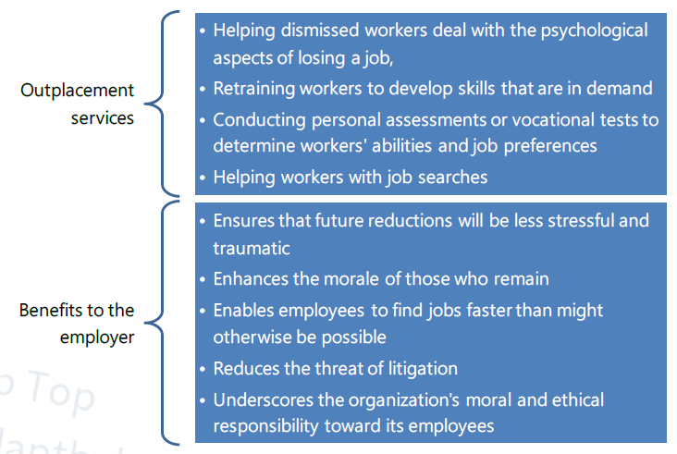
Outplacement

Slide 41
Employee Attendance
Work Time Management
Return to work program
HR Documents and Records
Employee Data Management

Slide 42
Employee Attendance
The organization places great emphasis on the attendance of all employees at work and will monitor each employee’s attendance record.
Attendance is an important aspect of job performance and the organization aims to ensure that lateness and absence are kept to a minimum.

Slide 43
Employee Attendance Policy
Attendance policy is a set of rules related to the attendance of employees. It includes rules related to absenteeism i.e. number of leaves allowed – sick leaves, casual leaves, vacation leaves or other types of leaves authorized by the company.
It also specifies action in case of exceeding the number of leaves, payroll calculation, and action taken for lapses and falsification of attendance record and so on.

Slide 44
Employee Attendance
Work Time Management
Return to work program
HR Documents and Records
Employee Data Management

Slide 45
Return to work (RTW)
RTW is getting employees back to their jobs, taking into account individual circumstances, but establishing streamlined processes to treat employees in a similar manner.
Return to work follows after a leave of absence due to an injury, illness, or chronic disease.
RTW program are included for reduction of lost time, statutory requirements, and protection of the investment in the workforce.

Slide 46
Types of RTW
RTW program can be defined as either a formal or an informal program.
A formal RTW program is one based on specific written and disseminated organizational policies and practices that instruct and direct supervisors and employees in the RTW process following a leave of absence due to an injury, illness, or chronic disease.
An informal RTW program is one where there are few or no written policies or practices to guide the management team or the employees.

Slide 47
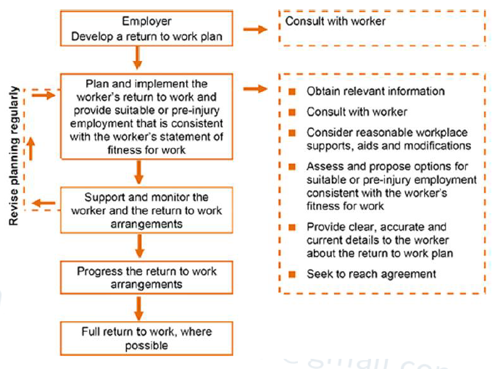
Development of RTW program

Slide 48
Employee Attendance
Work Time Management
Return to work program
HR Documents and Records
Employee Data Management

Slide 49
Overtime for Compressed week
Overtime for a compressed work schedule is defined as any hours in excess of those specified hours which constitute the compressed schedule, which is ordered or approved by management.
For example, employees on a 4/10, overtime is work in excess of 10 hours in a day or 40 hours in a week that is ordered or approved by management. For employees on a 5-4/9, overtime is work in more than 9 hours a day, or 8 hours on the 8 hour day, or 89 hours in a pay period, which is ordered or approved by management

Slide 50
Variable Week and Maxiflex
For variable week and maxiflex work schedules, overtime is defined as work officially ordered or approved by management, which is in excess of 80 hours in a pay period, not including credit hours. Employees are not entitled to overtime if they voluntarily elect to work more than 8 hours a day or 40 hours a week as allowed under these flexible work schedules.

Slide 51
Employee Attendance
Work Time Management
Return to work program
HR Documents and Records
Employee Data Management

Slide 52
Employee Policy
Policies are developed for the many, not the few – when you bring a policy into force you are establishing a standard that will apply broadly across the organization - not just to a few individuals who may be causing problems
A policy creates a rule or standard to be followed consistently and reduces management’s flexibility to treat each situation as unique.

Slide 53
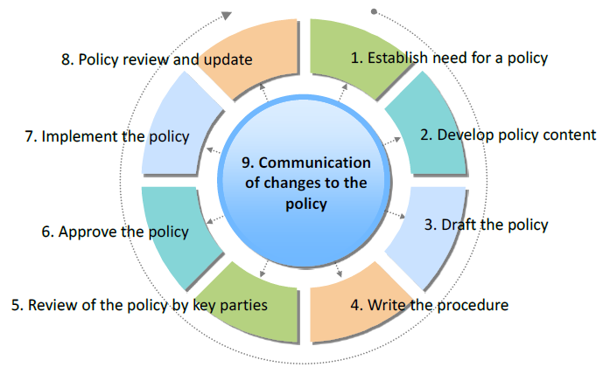
Policy Development Process

Slide 54
Types of Policy
Code of Conduct
Confidentiality Agreements
Conflict of Interest Policy
Attendance Policy
Recruitment Policy
Compensation Policy
Performance Management Policy
Overtime Policy
Vacation and Holiday
Disciplinary Procedure

Slide 55
Employee handbook
An employee handbook describes the organization's policies and procedures. The handbook may also contain general information about the organization such as its priorities, the organization chart, the job classifications, whether positions are covered by a collective agreement and bargaining status for all groups of employees.

Slide 56
Employee Attendance
Work Time Management
Return to work program
HR Documents and Records
Employee Data Management

Slide 57
Employee Data Management
Employers records (often called personnel files) in a personnel file can provide important supportive data for example, to show an employee’s discipline history in support of a termination in subsequent litigation.
The personnel file can also track performance goals, leaves of absence, and any employment-related agreements.
Employers keep certain types of employee records in order to comply with specific provisions under labor laws in different countries.

Slide 58
Type of Employee Data
Basic Information
Hiring Documents
Job Performance and Development
Employment-Related Agreements
Compensation
Confidential Files
Medical records
Termination

Slide 59
Questions

