Slide 1
HR ADMINISTRATION AND
SHARED SERVICES- II
PHRi

Slide 2
SWOT Analysis
Porter’s Generic Strategy
Strategy Choices
PEST Analysis
HR Roles
HR Organisation
HR Outsourcing
Outsourcing Process

Slide 3
SWOT
The primary aim of strategic planning is to bring an organization into balance with the external environment and to maintain that balance over time. Organizations accomplish this balance by evaluating new programs and services with the intent of maximizing organizational performance. SWOT analysis is a preliminary decision-making tool that sets the stage for this work.
SWOT analysis was invented in the 1960s by a management consultant named Albert Humphrey at the Stanford Research Institute.

Slide 4

SWOT Analysis

Slide 5
Strengths
They are characteristics of the business or team that give it an advantage over others in the industry. Strengths must focus upon what the firm can do with its internal resources.
Any asset that the firm owns could certainly be classified as strength,
State-of-the-art production line machinery
A strong brand-name presence
Recognized customer service excellence,
Exclusive access to a strong supply chain network

Slide 6
Weaknesses
Characteristics that place the firm at a disadvantage relative to others.
Poor product positioning
Deteriorating physical assets
Out-of-date production equipment
Poor customer service
High employee turnover that causes the firm to lose talented people can be a major weakness of the firm

Slide 7
Opportunities
In general, any changes in the external environment can be an opportunity to the firm
Changes in tax structure
Improvements in economic trends
The passage of favourable laws
Market positioning
New technologies
International trade agreements

Slide 8
Threats
They are external elements in the environment that could cause trouble for the business.
Changes in consumer preferences
New competitor innovations
Restrictive regulations
Unfavourable trade barriers
Loss of favorable distribution networks
Restrictions on the firm’s cash flows
Anything that can threaten the firm’s market position

Slide 9
Question # 1
Which part of a SWOT analysis reflects the external environment?
Strengths and weaknesses
Opportunities and threats
Weaknesses and opportunities
Strengths and threats

Slide 10
Answer # 1
Option B

Slide 11
SWOT Analysis
Porter’s Generic Strategy
Strategy Choices
PEST Analysis
HR Roles
HR Organisation
HR Outsourcing
Outsourcing Process

Slide 12
PEST Analysis
PEST analysis (political, economic, social and technological) describes a framework of macro-environmental factors used in the environmental scanning component of strategic management. It is part of an external analysis when conducting a strategic analysis or doing market research, and gives an overview of the different macro-environmental factors to be taken into consideration.

Slide 13

PEST Analysis

Slide 14
Question # 2
Which part of the SWOT analysis identifies the core competencies of a global enterprise?
Opportunities and threats
Weaknesses and opportunities
Strengths and threats
Strengths and weaknesses

Slide 15
Answer # 2
Option D

Slide 16
Question # 3
What is the optimal order for the following key elements of strategic planning?
1. Strategy formulation.
2. Evaluation and control.
3. Environmental scanning.
4. Strategy implementation.
a) 2,3,1,4
b) 1,4.2,3
c) 1,4,3,2
d) 3,1,4,2

Slide 17
Answer # 3
Option D

Slide 18
Question # 4
Which of following are the most specific and measurable of the strategic statements?
a) Value statement
b) Mission statement
c) Short-term objectives
d) Strategic goals

Slide 19
Answer # 4
Option C

Slide 20
SWOT Analysis
Porter’s Generic Strategy
Strategy Choices
PEST Analysis
HR Roles
HR Organisation
HR Outsourcing
Outsourcing Process

Slide 21

Strategy Choices

Slide 22
Corporate Strategy
Vertical integration – company grows by gaining control of inputs or outputs or both when a company acquires its input supplier it is called backward integration. When it acquires companies in its distribution chain it is called forward integration. For example, a vertically integrated oil company may end up owning oilfields, refineries, tankers, trucks, and gas (petrol) filling stations. Also called vertical merger. See also horizontal integration.

Slide 23
Corporate Strategy
Horizontal integration – grow by combining with competitors. The merger of companies at the same stage of production in the same or different industries. When the products of both companies are similar, it is a merger of competitors. When all producers of a good or service in a market merge, it is the creation of a monopoly. If only a few competitors remain, it is termed an oligopoly.

Slide 24
SWOT Analysis
Porter’s Generic Strategy
Strategy Choices
PEST Analysis
HR Roles
HR Organisation
HR Outsourcing
Outsourcing Process

Slide 25

Michael Porter
Degree in aerospace and mechanical engineering from Princeton University in 1969
MBA in 1971 from Harvard Business School
PhD in business economics from Harvard University in 1973
Five forces framework was first published in Harvard Business Review in 1979

Slide 26
Strategy Formulation
As the Company’s vision, mission, core value statements, and SWOTs are defined. Businesses can secure a sustainable competitive advantage by adopting one of three generic strategies as follows:
Cost leadership Strategy
Differentiation Strategy
Focus (Niche) Strategy
"Middle of the road" strategy

Slide 27
Cost Leadership Strategy
Cost leadership is to drive cost down through all the elements of the production of the product from sourcing, to labor costs.
This strategy involves the organization aiming to be the lowest cost producer and/or distributor within their industry.
To achieve cost leadership a business will usually need large scale production so that they can benefit from "economies of scale".
Large scale production means that the business will need to appeal to a broad part of the market

Slide 28
Cost Leadership Strategy
A cost leadership business can create a competitive advantage:
by reducing production costs and therefore increasing the amount of profit made on each sale as the business believes that its brand can command a premium price or
by reducing production costs and passing on the cost saving to customers in the hope that it will increase sales and market share

Slide 29
Differentiation Strategy
Differentiation is to focus its effort on particular segments and charge for the added differentiated value.
To be different, is what organization striving for; companies and product ranges that appeal to customers and "stand out from the crowd" have a competitive advantage.
Porter asserts that businesses can stand out from their competitors by developing a differentiation strategy.

Slide 30
Differentiation Strategy
With a differentiation strategy the business develops product or service features which are different from competitors and appeal to customers including functionality, customer support and product quality.
New concepts which allow for differentiation can be protected through patents and other intellectual property rights.

Slide 31
Focus (Niche) Strategy
Focus or Niche is to form a competitive advantage for this niche market and either succeeds by being a low cost producer or differentiator within that particular segment.
Under a focus strategy a business focuses its effort on one particular segment of the market and aims to become well known for providing products/services for that segment.
They form a competitive advantage by catering for the specific needs and wants of their niche market.
A focus strategy is known as a narrow scope strategy because the business is focusing on a narrow (specific) segment of the market

Slide 32
"Middle of the road" strategy
Some businesses will attempt to adopt all three strategies; cost leadership, differentiation and niche (focus).
A business adopting all three strategies is known as "stuck in the middle".
They have no clear business strategy and are attempting to be everything to everyone.
This is likely to increase running costs and cause confusion, as it is difficult to please all sectors of the market.
Middle of the road businesses usually do the worst in their industry because they are not concentrating on one business strength.
In other word, try to do all three would become stuck in the middle and danger.

Slide 33

Competitive Advantage

Slide 34

Porters Generic Strategies

Slide 35

Examples of Business Level Strategy

Slide 36
Question # 5
Which of the following describes the competitive strategies of an organization committed to differentiation?
a) Controlling costs.
b) Exploiting economies of scale.
c) Positioning unique product characteristics.
d) Formalizing policies and procedures.

Slide 37
Answer # 5
Option C
A differentiation strategy calls for the development of a product or service that offers unique attributes that are valued by customers and that customers perceive to be better than or different from the products of the competition.

Slide 38
SWOT Analysis
Porter’s Generic Strategy
Strategy Choices
PEST Analysis
HR Roles
HR Organisation
HR Outsourcing
Outsourcing Process

Slide 39
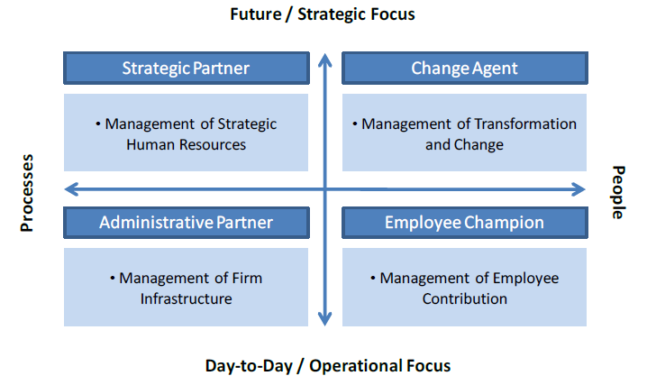
HR Roles Model

Slide 40
HR Roles
HR can help deliver organizational excellence in the following four ways:
HR should become a partner with senior and line managers in strategy execution, helping to move planning from the conference room to the marketplace.
It should become an expert in the way work is organized and executed, delivering administrative efficiency to ensure that costs are reduced while quality is maintained.

Slide 41
HR Roles
It should become a champion for employees, vigorously representing their concerns to senior management and at the same time working to increase employee contribution; that is, employees’ commitment to the organization and their ability to deliver results.
HR should become an agent of continuous transformation, shaping processes and a culture that together improve an organization’s capacity for change.

Slide 42
Administrative Expert
HR executives can also prove their value as administrative experts by rethinking how work is done throughout the organization.
For example, they can design and implement a system that allows departments to share administrative services.
HR can act as internal consultants, not only saving the company money but also improving its competitive situation.

Slide 43
Employee Champion
HR must take responsibility for orienting and training line management about the importance of high employee morale and how to achieve it.
HR should be the employees’ voice in management discussions; offer employees opportunities for personal and professional growth; and provide resources that help employees meet the demands put on them.

Slide 44
SWOT Analysis
Porter’s Generic Strategy
Strategy Choices
PEST Analysis
HR Roles
HR Organisation
HR Outsourcing
Outsourcing Process

Slide 45
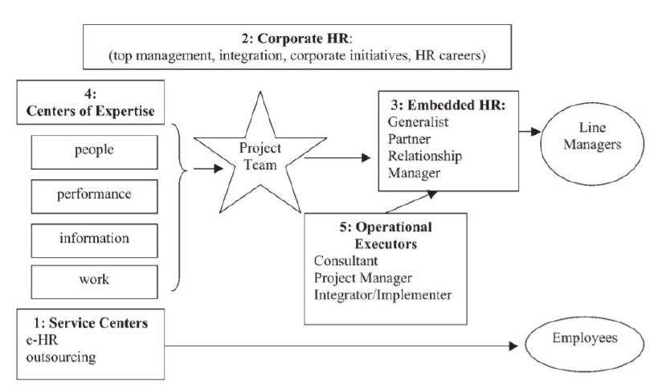
HR Organisation

Slide 46
Global HR Organisation
As a business within a business, the HR organization should be structured to reflect the structure of the larger business. Business organizations align with the strategies of the business they support, and HR should follow suit.
Companies typically organize along a grid of centralization - decentralization, which leads to three basic ways in which a company operates holding company, allied/diversified organization, or single/functional business.

Slide 47
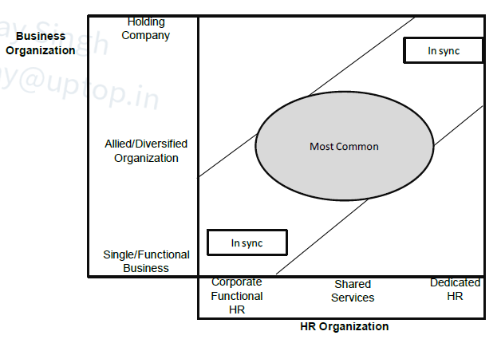
Alignment of Business Organization and HR Organization

Slide 48
1.1 Single/Functional business
In a single/functional business organization, a strong HR functional organization usually makes the most sense. This means identifying staff specialists who can design HR practices that match the needs of the business and deliver them to all corners of the company. Employees who move from site to site want to find familiar terms and work conditions.
Managers want to know what is expected of them regardless of where they work. HR professionals in local plants or operations need a solid line to their HR hierarchy while supporting the business leaders in these local plants or operation

Slide 49
1.2 Corporate HR
They create a consistent firm wide culture face and identity.
They shape the programs that implement the CEO‘s agenda.
They ensure that all HR work done within the corporation is aligned to business goals.
They arbitrate disputes between centers of expertise and embedded HR.
They take primary responsibility for nurturing corporate level employees.
They ensure HR professional development.

Slide 50
2.1 Allied/Diversified Businesses
In a world where corporate growth and industry consolidation lead to the increased presence of diversified/allied organization structures, shared services has become a useful means by which organizations balance the efficiencies of centralization with the flexibility required for competing in different markets and/or geographies.

Slide 51
2.2 Shared Services
Economies of scale
Meeting employee needs and resolving concerns by fewer dedicated HR resources.
Standardization of HR processes, thus reducing redundancy and duplication
Offer new ways to do traditional HR work such as employee assistance programs, relocation administration, benefits claims processing, pensi on plan enrollment and administration, applicant tracking, payroll, and learning administration.

Slide 52
3.1 Holding Company
A company composed of multiple, unrelated, independently managed businesses is best described as a holding company. In a holding company, there is often little or no HR at a corporate level and little impetus to implement HR.
Each business is expected to create and manage its own autonomous HR practices based on the specific needs of the business. Therefore, HR is embedded within the businesses.

Slide 53
3.2 Embedded HR
They engage in and support business strategy discussion.
They represent employee interests and implications of change.
They define requirements to reach business goals and identify where problems may exist.
They select and implement the HR practices that are most appropriate to the delivery of the business strategy.
They measure and track performance to see whether the HR investments made by the business deliver the intended value.

Slide 54
Centers of Expertise (CoE)
Centers of expertise, also called “Centers of excellent”, operate as specialized consulting firms inside the organization. Depending on the size of the enterprise, they may be corporate wide or regional (e.g., Europe) or country-based (e.g., Germany).
They often act like businesses that have multiple clients (business units) using their services.

Slide 55
HR Delivery in Global Organization
The decision to develop regional versus country-specific shared services is based on the size and locations of the employee base, as well as cost.
In countries with large numbers of employees, companies may choose to set up country -specific service centers
Those operating in smaller countries may opt to coordinate through one regional location.

Slide 56
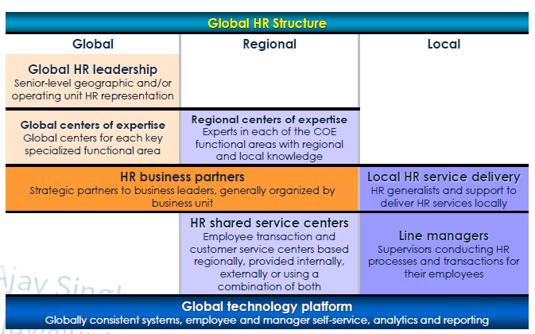
Global HR Structure

Slide 57
HR Shared Service
The true business case for Shared Services involves providing employees and customers with the services they need at the lowest possible cost.
Shared Services have proven to reduce costs and improve processing efficiencies by up to 40%.

Slide 58
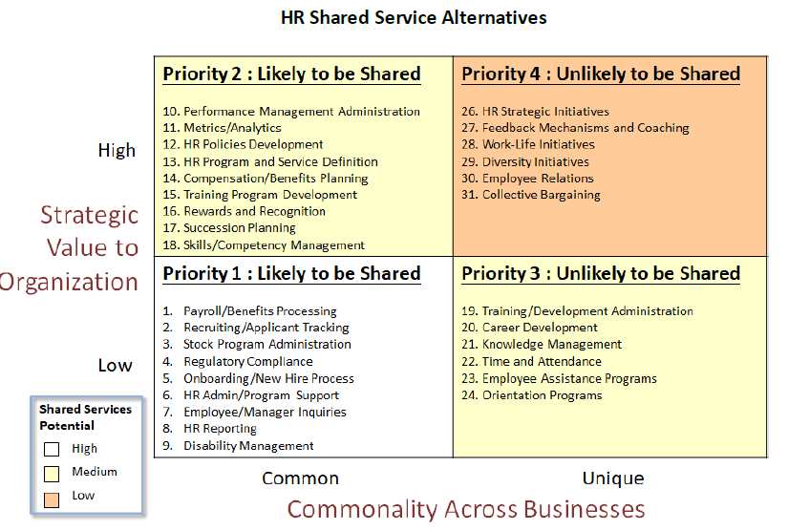
HR Shared Service Alternatives

Slide 59
SWOT Analysis
Porter’s Generic Strategy
Strategy Choices
PEST Analysis
HR Roles
HR Organisation
HR Outsourcing
Outsourcing Process

Slide 60
HR Outsourcing
Contracting with a specialist provider
Streamlined processes to cut down costs
Costs savings for business for having fewer staff members and fewer benefits to pay out
Subcontracting some HR functions offers flexibility

Slide 61
Question # 6
What is the GREATEST advantage of using outsourced vendors?
They can accelerate process improvements within the company
They take relatively little time to manage and integrate with headquarters
They can perform poorly with a minimal impact on the company
They are not a source of liability if they violate the law

Slide 62
Answer # 6
Option A

Slide 63
What to outsource?
Many companies look to outsource non-core functions such as payroll, benefits administration, and even tax filings.
Outsourcing it allows to focus on the organization’s core competencies.

Slide 64
HR Outsourcing
HR outsourcing (also known as HRO) is the process of sub-contracting human resources functions to an external supplier.
Business process HR outsourcing (also known as BPO), where an external supplier manages discrete HR activities, such as payroll administration or recruitment, or perhaps the whole human resources function.
Shared service HR outsourcing, where only the transaction or administrative elements of HR’s activities are subcontracted to an external supplier. This may include the personal interface with employees.
Application (and facilities) service HR outsourcing, where external providers look after the technological (and physical) infrastructure to support human resources activities

Slide 65
Offshoring
Offshoring is the process of relocating a business or business process to another country in order to benefit from reduced labour costs or a more beneficial regulatory environment. A range of processes are commonly offshored, including manufacturing, IT, customer service and research & development

Slide 66
Cosourcing
Cosourcing arrangement refers to an enterprise outsources only one part of a function. Co-sourcing is a way of attacking the problem by providing a service without having to be fully outsourced RPO.

Slide 67
Insourcing
Insourcing refers to contracting a function out to another entity that manages and performs the function on-site, transferring a previously outsourced function back in-house, or the hiring of local workers by foreign companies operating subsidiaries locally. Open sourcing is a way of eliciting innovative ideas from nonemployees or contractors.

Slide 68
Professional Employment Organization (PEOs)
A Professional Employement Organization (PEO) assumes full responsibility of your company's human resources administration.
It becomes a co-employer of your company's workers by taking full legal responsibility of your employees, including having the final say in hiring, firing, and the amount of money employees make.
The PEO and business owner become partners, essentially, with the PEO handling all the HR aspects and the business handling all other aspects of the company.

Slide 69
Question # 7
Which of the following is NOT a reason to outsource?
The ability to share financial risk with a vendor
The ability to gain access to talent and resources
The ability to acquire value without a long-term investment in assets
The ability to transfer both core and non-core competencies

Slide 70
Answer # 7
Option D

Slide 71
SWOT Analysis
Porter’s Generic Strategy
Strategy Choices
PEST Analysis
HR Roles
HR Organisation
HR Outsourcing
Outsourcing Process

Slide 72

Outsourcing Process

Slide 73
Outsourcing Process
Analyze needs and objectives : A thoughtful needs analysis is the most critical stage in which project goals and expectations of the potential third-party contractor are defined.
Plan the budget : Know what can be spent for the outsourced service and what it costs to provide that service ill-house. This information provides a look at the expected financial return on investment.

Slide 74
Outsourcing Process
Develop request for proposal (RFP) : An RFP is a written request asking contractors to propose solutions and prices that fit the customer's requirements. The purpose of all RFP is not only to ensure that responses actually meet HR's needs but also to ensure some consistency among responses so that the responses may be more easily compared.
Forward RFPs to potential vendors : Instructions on the manner and date for submission should be included in this request.

Slide 75
Outsourcing Process
Evaluate vendors : These variables differ based on the organization's size, priorities, and industry. For procuring HRIS, their ability to meet specifications, customization options, and price should be considered.
Choose vendor : Get the names of possible contractors, state contractor licensing, ask to see their certificates for insurance, and assess their business longevity.

Slide 76
Outsourcing Process
Set up contract : This written contract will describe not only the key deliverables of the project but will include additional information such as implementation time frames, payment terms, performance standards, training expectations, and upgrade costs and responsibilities.
Develop and execute project plan : Conduct an initial project planning meeting to review and refine implementation targets in the project schedule. Outsourcing may curtail loss of morale, and therefore it is important to have an employee briefing when an outsourcing partner is announced. This enables employee questions to be answered, and it provides the business rationale for the outsourcing decision in a consistent manner for all employees.

Slide 77
Outsourcing Process
Measure project performance : All payment terms are -usually settled and the contractor could ask for an evaluation of its services.
Restructure Outsourced Organization (if applicable) : It challenges management to build a more flexible organization structured around core competencies and long-term relationships.

Slide 78
Question # 8
Which of the following is NOT a valid criterion for evaluating outsourcing proposals and helping to select the most qualified partner?
Price
Family affiliations
Proven record of performance
Response times and performance clauses

Slide 79
Answer # 8
Option B

Slide 80
New Hire Onboarding
Research on orientation and onboarding shows that a positive start at an organization has the following benefits for employees:
Creates enthusiasm
Reduces anxiety
Encourages social connections

Slide 81
New Employee Orientation
Before the Employee’s Arrival
Employees play a key role in helping an organization meet its goals and objectives. Many organizations begin to inform new employees about their roles before the employees arrive for their first day of work. Offer letters and new hire welcome packages are the most common methods of communicating information to the new employee before the start date.
Typical contents of a new hire welcome package include the following:
Welcome letters (for example, from the organization’s CEO, president and human resources department)
Payroll information
Policies manual
Benefits information
Benefits enrollment forms
In addition to sending the welcome package, the organization should take the following steps to prepare for the employee’s arrival:
Communicate. Contact the employee and provide a personal welcome.
Set up the work area. Verify that the employee’s office space is ready and that the computer, telephone and any other necessary equipment are arranged.
Schedule ahead. Ensure that an orientation program is in place

Slide 82
Orientation/Induction
Orientation, also known as induction, is the first step in the formal process of training employees. Through orientation, employees become familiar with the organization, their department, their coworkers and their job.
Orientation programs usually span one to two days. The orientation provides new employees with three types of information:
Organizational information
Policies, procedures and benefits
Work context (including job procedures)
The purpose of the orientation program is to ease the employee’s transition to a new environment. During the orientation, the employee can establish relationships with coworkers and develop a sense of belonging to the organization. The employee also gains a realistic image of the job. An effective orientation program helps the employee quickly become a productive and contributing member of the organization.
Orientation programs can be divided into a general orientation and a department orientation. HR is usually responsible for the general orientation and can also provide input to the manager on the department orientation. However, the manager is responsible for ensuring that employees understand how they will contribute to their department and how they fit into the organization structure.

Slide 83

Model of Onboarding

Slide 84
New Employee Onboarding
Onboarding is the process of helping new employees learn the organization’s policies, procedures and culture in addition to their job responsibilities.Onboarding includes both the orientation and the first three to twelve months of employment.
The purpose of the onboarding process is to provide the employee with a positive start at the organization. This positive start can have many benefits; including increasing the employee’s enthusiasm, helping reduce anxiety and helping the employee connect with coworkers .
Successful onboarding programs generally include the following factors:
Active rather than passive participation by new employees
Onboarding spread out over a period of time
Use of checklists to ensure that all important material is covered
Avoidance of information overload

Slide 85
Onboarding Roles and Responsibilities
During onboarding, HR professionals, the hiring manager, coworkers and others learn more about the new employees and further integrate them into the organization in the following areas:
Organizational culture and norms
Organizational goals and objectives
Specific functional areas in the organization
Departmental and job expectations
Available work resources and tools
Mentor options
Performance management systems
Work/life balance and support resources

Slide 86
Evaluating the Effectiveness of Onboarding
The effectiveness of the onboarding program can be related to the amount of turnover in the first year of employment. Onboarding programs can help employees adjust to the new environment by introducing them to coworkers,lessening feelings of isolation and providing a better understanding of expectations and future opportunities.
HR professionals can evaluate their organization’s onboarding initiatives using metrics that include the following:
Turnover/retention rates. Compare retention rates for various groups. For example, what is the retention rate for employees who began their employment in 2011 compared to employees who began in 2010?
Retention threshold. Track the point at which most new employees tend to exit the organization. For example, if most new employees exit within the first 90 days of employment, the organization can conduct exit interviews to determine the cause of the early exit.
Performance measures. Compare the performance of groups provided with different onboarding experiences. For example, one group is provided with one week of onboarding experiences and a second similar group is provided with a full month.
Formal/informal feedback. Ask new employees open-ended questions to determine their satisfaction with the onboarding process and the organization.
Flexibility. Flexibility and adaptability allow your organization to provide employees with an optimal work environment.

Slide 87
Poll Question # 5
Which of the following is a feature of a successful onboarding program?
Passive rather than active participation by new employees
Onboarding activities completed within a short period of time
The same program fitting the needs of all new employee groups
Avoidance of information overload

Slide 88
Answer to Poll Question # 5
D. Avoidance of information overload

Slide 89
Poll Question # 6
Which of the following helps track the point at which most new employees tend to exit the organization?
Orientation checklist
Open-ended questions
Performance measures
Retention threshold

Slide 90
Answer to Poll Question # 6
D. Retention threshold

Slide 91
Questions

