Slide 1
HRCI ONLINE EXAM
PHRi, SPHRi, GPHR

Slide 2
Before you take exam
Testing Area Setup
Tips by Pearson site
Exam Tutorial
Check-In Process

Slide 3
Before you take exam
Your computer must have a webcam, microphone, and internet speed that satisfy system requirements and should be turned on/up for your exam
These exams are taken seriously, so please prepare your room as if it was a live test center.

Slide 4
Before you take exam
The exam must be taken in a walled room, with a closed door and without distractions. This also means that if there are others in your home/office, they must not be visually or audibly detected during your exam
Do not leave sight of your webcam during your exam; your exam will be terminated and your exam fees forfeited
To secure the integrity of these exams, no breaks will be allowed during the entirety of your exam

Slide 5
Before you take exam
Testing Area Setup
Tips by Pearson site
Exam Tutorial
Check-In Process

Slide 6
Testing Area Setup
Remove all books, writing utensils (e.g. pen, pencil, marker, etc..), papers, handheld calculators and other electronics besides your phone and computer from the test area.
Turn off and remove all electronics in the area except for your phone and computer.
Set your phone on vibrate - Do not turn off your phone as you will need it to check-in and the proctor may call if they are unable to reach you via chat during your exam

Slide 7
Testing Area Setup
Remove all third parties from the testing area, including pets. If there is noise (e.g. persistent barking, chirping, etc..) during the testing process, the proctor may terminate your exam. Children and infants are also not allowed in the testing area.
Remove all notes, memos, or other written material from the testing area (e.g. adhesive sticky notes, notes on dry-erase boards, etc..).

Slide 8
Testing Area Setup
Remove any wristwatches, jewellery, hats, headwear (including headsets) or other accessories from your person and place outside the testing area.
Disconnect or turn-off any secondary monitors or screens connected to your computer. Secondary screens are prohibited.
Remove food, drinks (except water in clear glass), and any smoking accessories from the testing area. Make sure that your desktop is clean and clear of debris.

Slide 9
Testing Area Setup
Remove/open and accessories that interfere with your computer’s webcam. We recommend lightly cleaning your webcam as needed.
Make sure that your computer’s power adapter is plugged in. Do not take an exam while your computer is running on battery power.
Have your government-issued ID ready. We recommend lightly cleaning your ID if needed

Slide 10
Testing Area Setup
Close out of all unnecessary applications and other browser windows. The test should be the only browser window and the only tab open.
Disable any other firewalls that may be installed on your computer

Slide 11
Testing Area Setup
Work & Company Computers
Personal computers are strongly recommended. However, below are some additional configuration recommendations to reduce the risk of technical issues if you must use a work computer to take an online exam. You may also need to contact your organization’s IT support representative in advance of your appointment to make some of these changes

Slide 12
Work & Company Computers
Disable any applicable browser or internet firewall settings.
Make sure that you are not connected to a Virtual Private Network (VPN).
Ensure that you are not using a web browser with proprietary security settings established by your company.
Disable notifications (emails, meeting requests, etc..) on your email account before initiating the check-in process.

Slide 13
Work & Company Computers
Disable any applicable software designed to record or monitor your screen before initiating the check-in process.
Disable any content filters that may interfere with the launch of the exam.
Ensure that you have the appropriate user rights on your computer that are needed to download and install applications

Slide 14
Warning !
You must always remain in view of your webcam during the entire testing process. This restriction begins at the onset of the check-in process. Failure to be within view of the proctor via your webcam may result in the termination of your exam. Since no breaks are allowed during online exams, we recommend that you take any necessary breaks or relief prior to check-in.

Slide 15
Before you take exam
Testing Area Setup
Tips by Pearson site
Exam Tutorial
Check-In Process

Slide 16
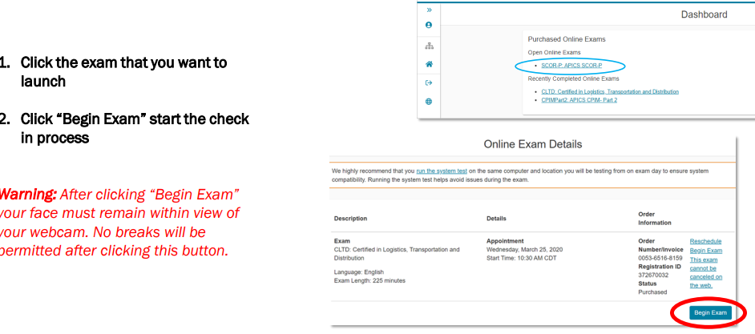
Check-In Process

Slide 17
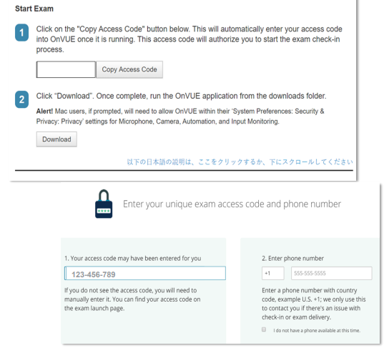
Check-In Process

Slide 18
Check-In Process
1. Follow the instructions provided on the following screens to use your unique exam access code and download the OnVUE application Note: the access code provided will be different for every test-taker and will not match the example shown on this slide. Please enter the access code provided to you at the time you take your exam.

Slide 19
Check-In Process
2. Enter the phone number of the phone that you will be using to complete the check-in process. Note: It is recommended to provide the mobile number of a phone that has picture capabilities as this would best assist with check-in for your exam

Slide 20
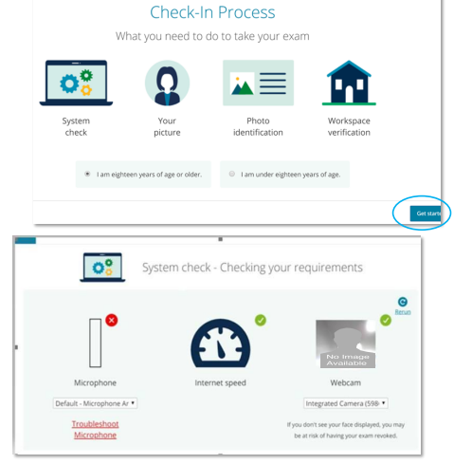
Check-In Process

Slide 21
Check-In Process
3. Begin the Check-In Process by identifying your age group and clicking “Get Started”
4. The system check will check that requirements are met for your computer’s microphone, your internet speed, and your webcam
Note: If any parts of your system do not meet the requirements to host OnVUE, a link will appear below the component that does not meet requirements to assist with troubleshooting

Slide 22
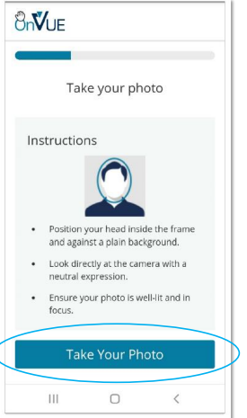
Check-In Process
5. Take a headshot of your face
6. Click “continue”

Slide 23
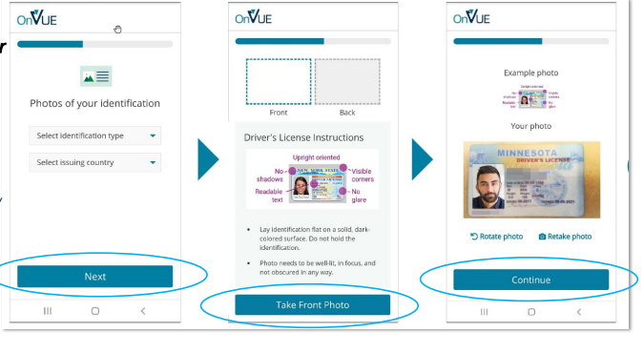
Check-In Process

Slide 24
Check-In Process
You will now need to take a Picture of your government-issued identification
7. Click “Next”
8. Click “take Front Photo”
9. Click “continue”
If clear image of identification does not appear, lightly clean the document and take another picture.

Slide 25
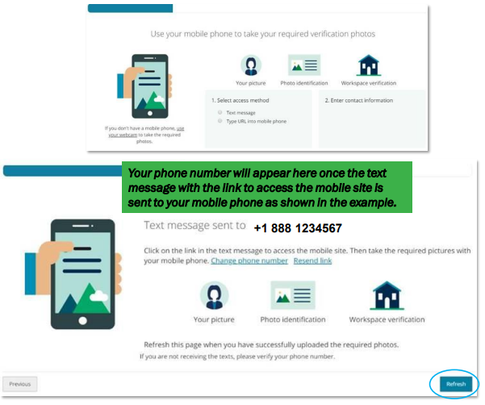
Check-In Process

Slide 26
Check-In Process
9. Once your system has met all requirements, use your mobile phone to take your required verification photos by following the instructions on the next page
Note: You must remove any papers, pens, books, or other prohibited materials from the testing area before taking the photos. Additionally, if you do not have a mobile phone, you can use your webcam to provide all required photos by clicking on the corresponding link.
10.Once you have uploaded the required photos, click “Refresh” at the bottom right of the page

Slide 27
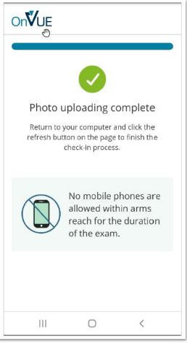
Check-In Process
9. Disable all notifications (sound and vibrate) on your phone and keep it out of arm’s reach

Slide 28
Warning!
Interacting with your phone without being instructed to do so by the proctor - no matter how briefly - after receiving this prompt (image to right), will result in the revocation of your testing session. This applies to cell phones, smartphones and analog home phones alike.

Slide 29
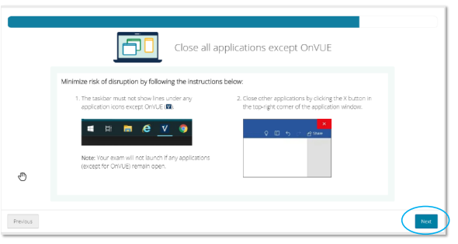
Check-In Process
Close out of all applications except OnVUE

Slide 30
Check-In Process
10.Terminate all applications on your computer except for OnVUE This includes all firewall, security and anti-virus applications.
11.Make sure that your computer is plugged in to a walled power source. DO NOT rely on battery power.
12.Click “Next”

Slide 31
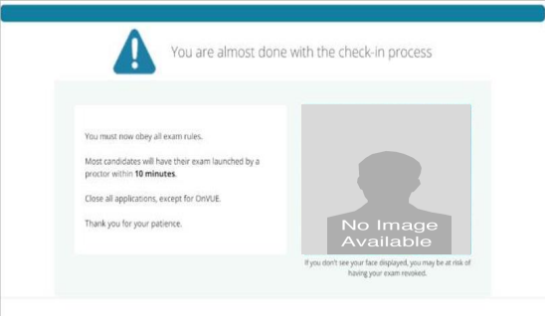
Check-In Process

Slide 32
Check-In Process
13.If you have successfully checked in and provided all necessary verification photos, the screen to the right will appear.
Your proctor should arrive in approximately 10-15 minutes to launch your exam.
Warning: Your face must be within view of your webcam. Leaving the testing area at this point will result in an early termination of your testing session.

Slide 33
Check-In Process
At this point, absolutely do NOT:
Leave the testing area
Access a phone (unless instructed to do so)
Get out of your set for any reason
Talk to anyone but the proctor
Attempt to touch or interact with anything not in view of the webcam or that is a prohibited item
Speak aloud (even mumbling)

Slide 34
Before you take exam
Testing Area Setup
Tips by Pearson site
Exam Tutorial
Check-In Process

Slide 35
What you need to do in advance
Make sure you have a functioning home computer with a webcam and strong internet connection
Run a system check to test the compatibility of the OnVUE application
Have your government-issued ID ready to present during the check-in process (restricted IDs such as U.S. military IDs are not accepted)
Roommates or pets? Make sure your space is free from noise or distractions
Clear the room of any preparation materials or unauthorized items to avoid exam violations

Slide 36
During your online proctored exam
You’ll take photos of your government-issued ID and your testing environment, as well as a headshot
Your photos will be reviewed and your exam will be queued up. Most candidates will start their exam within 15 minutes of their appointment time.
If your pictures don’t pass review, you’ll be joined by a greeter as soon as possible to help you troubleshoot.
You’ll be monitored by a VUE-certified proctor via webcam and microphone throughout your test to ensure the integrity and security of your exam experience.

Slide 37
Final Word
As you go through the check-in process, remember that the proctors aren’t trying to make things difficult. They’re just trying to uphold the integrity of the exam, which should be important to you, too, since you’ve worked so hard to earn the certification

Slide 38
Before you take exam
Testing Area Setup
Tips by Pearson site
Exam Tutorial
Check-In Process

Slide 39
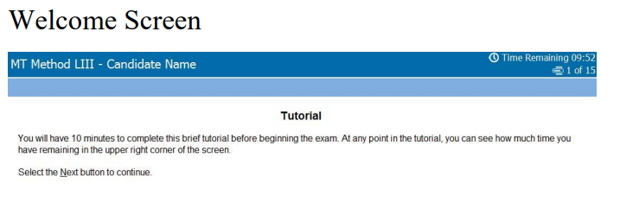
Welcome Screen

Slide 40
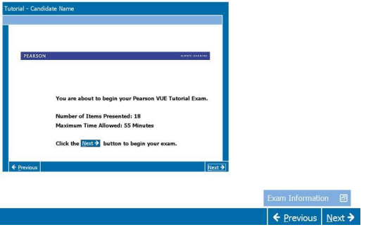
Exam Tutorial

Slide 41

Time Remaining

Slide 42

Flag for Review

Slide 43

Review Screen

Slide 44

End Review

Slide 45

Calculator

Slide 46

Comments

Slide 47

Progress Indicator

Slide 48

Scrollbar

Slide 49
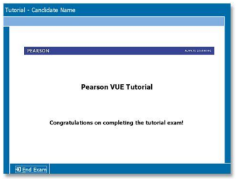
Ending the Exam

Slide 50
All the Best !

