Slide 1
HR Analytics
Sessions 17
Sanket Sunand Dash

Slide 2
Learning Objective
Appreciate the importance of data visualization
Understand the use of Tableau in data visualization
Identify the most common types of data analysis and visualization in Tableau
Perform the data analysis and visualization in Tableau

Slide 3
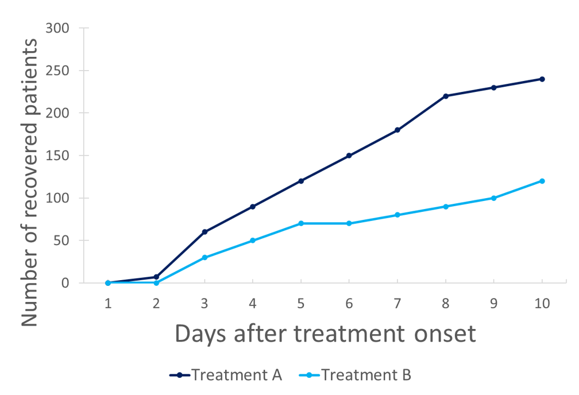
If a picture is worth a thousand words, a graph is worth a thousand pictures
- Anonymous

Slide 4
Tableau vs Excel
Both Tableau and Excel are tools for data analysis and visualization
Parameters
  Data analysis: Excel scores
  Cost: Excel scores
  Data visualization: Tableau scores
  Ease of use: Tableau scores
Tableau automatically slots variables into dimensions and measures

Slide 5
Managerial Pre-requisites
Identify which questions you need to ask
Identify the number of variables
  Are these variables present in the data?
  If yes, what is the nature of variables – categorical or continuous?
Based on the question, choose your analysis

Slide 6
Analysis
Percentage of a dimension
Association between two categorical variables
Mean of a continuous variable
Compare means of two continuous variables
Compare means of 1 continuous variable across categories
Perform regression with 1 independent and 1 dependent variable
Optional: Create bubble charts

Slide 7
Basic Concepts
Tableau divides variables into two types: Dimensions and Measures
Dimensions are discrete and measures can be continuous
All calculation is performed on measures
Calculation includes sum, average and mean

Slide 8
Basic Concepts
Variables can be classified as NOIR: Nominal, Ordinal, Interval and Ratio
Nominal: There is implicit ordering of variables e.g. gender
Ordinal: There is an implicit ordering but equal gaps do not indicate equal differences e.g. job levels
Interval and Ratio: Implicit ordering with equal gaps indicating equal differences e.g. temperature, salary etc.
Nominal and ordinal variables are dimensions while interval and ratio variables are continuous

Slide 9
Trend Lines Model
A linear trend model is computed for average of Monthly Income given Total Working Years. The model may be significant at p <= 0.05.
Model formula: ( Total Working Years + intercept )
Number of modeled observations: 39
Number of filtered observations: 0
Model degrees of freedom: 2
Residual degrees of freedom (DF): 37
SSE (sum squared error): 2.59959e+08
MSE (mean squared error): 7.02592e+06
R-Squared: 0.793708
Standard error: 2650.65
p-value (significance): < 0.0001
Individual trend lines:
Panes Line Coefficients
Row Column p-value DF Term Value StdErr t-value p-value
Monthly Income Total Working Years < 0.0001 37 Total Working Years 441.796 37.0281 11.9314 < 0.0001
intercept 1541.74 825.721 1.86715 0.0698194

Slide 10
Discussion on Case
What is the issue in the case?
What can be the questions that arise from the case?
How can the questions be categorized in terms of the 5 types of analysis

Slide 11
Five types of analysis
Percentage of a dimension
  What is the percentage of attrition?
Association between two categorical variables
  Is attrition more for males than females?
Mean of a continuous variable
  What is the average/median salary in the organization?
Compare means of two continuous variables
  What is the average score of job performance and job satisfaction?
Compare means of 1 continuous variable across categories
  What is the level-wise distribution of salaries?

Slide 12
Regression
Tableau enables users to perform regression if:
  Model is simple regression
    Number of independent variable: 1
    Number of dependent variable: 1
    Both variables are continuous
    Besides linear, other options are available

Slide 13
Steps for Regression
Convert the independent variable to dimensions and drag it to the columns tab
Drag the dependent variable over the ‘Abc’ squares in Measures area until the ‘Show Me’ sign appears. The dependent variable has to be continuous.
Convert independent variable to continuous from discrete
Select ‘line chart’ from the list of recommended charts
Go to Analysis → Trend Line → Show Trend Lines

Slide 14
Bubble Chart
Chart that simultaneously displays three or more variables
In Tableau, two variables have to be continuous (measures) and one or more have to be categorical (dimensions)
The different bubbles can be given different colors, sizes, shapes and labels for distinguishing

Slide 15
Steps for Bubble Chart
Choose three variables including two continuous variables (measures) and a categorical variable (dimension). The dimension is the grouping variable.
The two continuous variables will be populated on x-axis and y-axis. Choose x-axis and y-axis parameters
In Tableau, drag x-axis parameter to the columns section
In Tableau, drag y-axis parameter to the rows section
Drag the grouping variable to the Marks section
Use the various options in Marks section to distinguish between the two diagrams

Slide 16
Points to Remember
Regression is based on correlation
  Causation model has to be grounded in theory
  Real nature of relationship between variables may need additional understanding and research
Use the different options judiciously to differentiate clusters
Have a story in mind while creating charts

Slide 17
Drawbacks of Tableau
Storing data is not so easy
It cannot handle missing data
It might categorize dimensions and measures wrongly

Slide 18
Thank You

