Slide 1
HR Analytics Unit

Slide 2
Learning Objective
Use the transaction costs framework to determine need for a HR Analytics Unit
Evaluate the utility of a dedicated HR analytics unit for Starbucks
Identify the steps in setting up a dedicated HR Analytics unit

Slide 3
Make-or-Buy
Hiring consultants or performing analytics in-house is a make vs buy decision
Primarily three factors affect the make vs buy decision:
  Asset specificity: To what extent do we need to customize the asset to meet our needs?
  Frequency: What is the frequency of usage of the asset?
  Uncertainty: To what extent are we uncertain of the process and its outcome?

Slide 4
Make-or-Buy
We go for a make decision if:
  Asset specificity is high
  Frequency is high
  Uncertainty is low or we believe we are better equipped to deal with it than a third-party provider
Benefits of in-house analytics center
  Data security
  Knowledge enrichment
  Scope for synergies
  Alignment of objectives

Slide 5
Case Study
What are the problems that Starbucks is currently facing?
  Over-investment
  Possible reduction in growth of customers
Can HR Analytics solve these problems?
  HR Planning can help rationalize the number of employees
  HR Analytics can help measure efficiency of training and employee engagement initiatives
  Integrated analytical approach is required as the interlinkages between process are strong:
    More trained and engaged employees → Better quality and speed of processes with less waste → More satisfied and growing customer base → More revenue and less cost

Slide 6
Case Study
Should Starbucks go for a HR Analytics CoE?
  Yes because:
    Analytics requirements are structural part of their operations
    They have a culture of developing proprietary tools
    They have the revenue to fund a dedicated HR Analytics unit
    Business processes are interlinked and their strategy is unique
    They understand their business better than others and speed of resolution is important
    They need to ensure franchise store employees are comparable to company-owned store employees
If yes, what steps should it take?

Slide 7
Value Chain and Current Use of Analytics
Procurement of Coffee
Roasting of Coffee
Supply of Coffee to Stores
Consumption of Coffee and Associated Items
Proprietary blend of systems was used to manage supply chain
Data on roasting curves was input into proprietary computer software
Had an excellent forecasting system

Slide 8
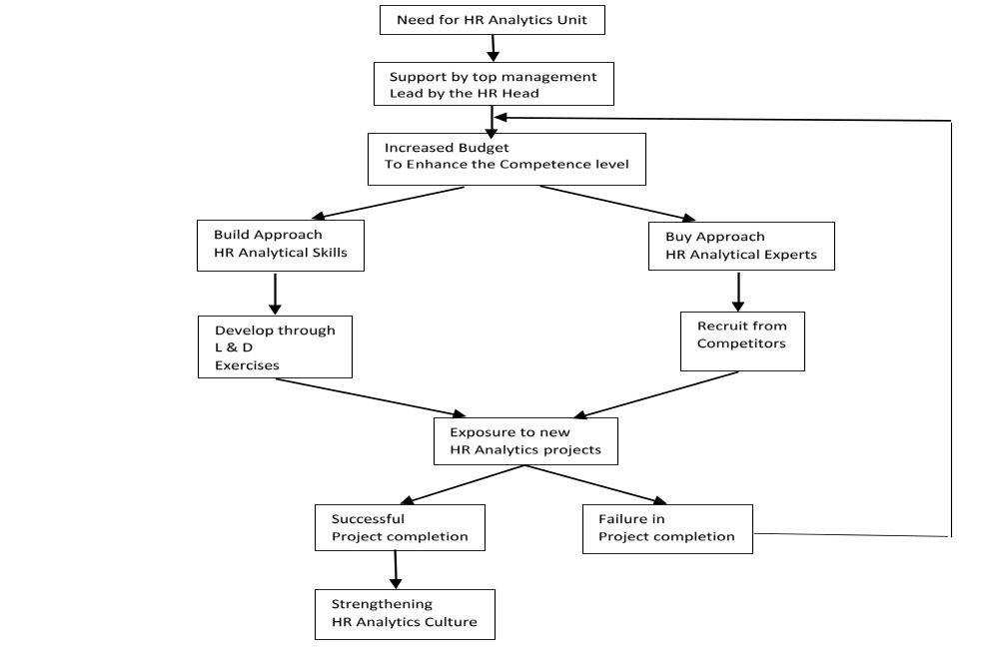
Developing HR Analytics Unit
HR Analytics unit requires people with both analytical and consultative, including communication, skills

Slide 9
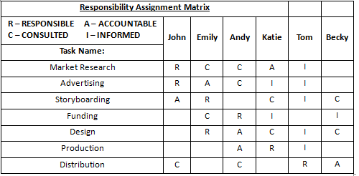
Responsibility Assignment Matrix

Slide 10
Key Points to Remember
Appoint an Analytics CoE to build support
Review Existing Processes in New Light
Find the Right Talent to Build HR Analytics CoE
Choose the Right Structure
Have a Clear Vision and Communicate it Properly
Choose Quick Wins

Slide 11
Key Points to Remember
Collect Trustworthy and Usable Data
  Identify and focus on critical data
  Influence data collection processes
  Measure and monitor
Use Right Tools
Develop Processes and Brand

Slide 12
Thank You

