Slide 1


Global Supply Chain Strategy- Drivers and Performance Metrics
Sachin KAMBLE

Slide 2
Financial Performance Measures
Increasing the surplus allows for a growth of supply chain profitability, which facilitates an improvement in the financial performance of each member of the supply chain.
Now, we define important financial measures that are reported by a firm and affected by supply chain performance.

Slide 3
Financial Performance Measures
  Return on Assets (ROA) = Net Income/ Total Assets
  Return on Equity (ROE) = Net Income/ Stockholder Equity
  ROFL = ROE - ROA
  Net Profit Margin = Net income/Net operating revenues
  Asset Turnover = Net operating revenues/ Total Assets
  Accounts Payable Turnover (APT) = Cost of goods sold/ Accounts payable
  Accounts Receivable Turnover (ART) = Net operating revenues/ Net receivables
  Inventory turnover (INVT)= Cost of goods sold/ Inventories
  Plant Property and Equipment Turnover (PPET)= Net operating revenues/ PPE
  Cycle to Cycle (C2C) = -52/APT+(52/ART)+52/INVT

Slide 4
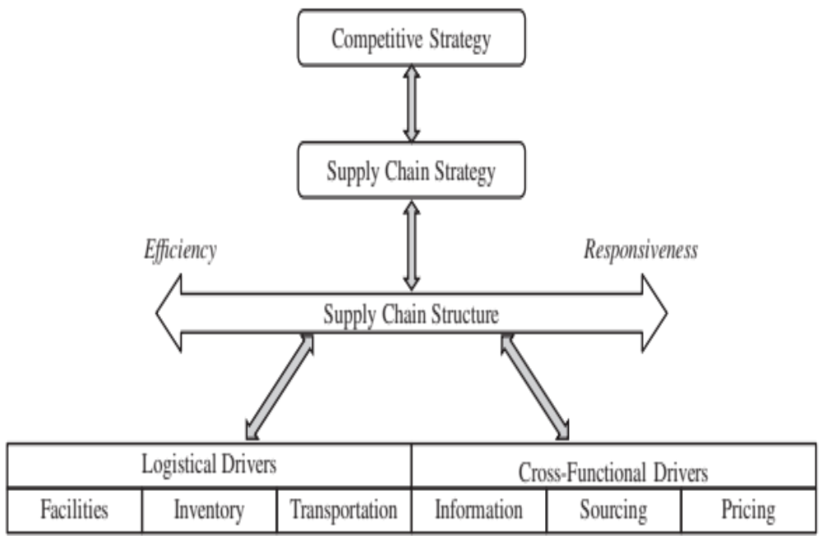
Framework for Supply Chain Decisions
Figure 1 Supply Chain Decision-Making Framework

Slide 5
Drivers of Supply Chain Performance
1. Facilities
    The physical locations in the supply chain network where product is stored, assembled, or fabricated
2. Inventory
    All raw materials, work in process, and finished goods within a supply chain
3. Transportation
    Moving inventory from point to point in the supply chain

Slide 6
Drivers of Supply Chain Performance
4. Information
  Data and analysis concerning facilities, inventory, transportation, costs, prices, and customers throughout the supply chain
5. Sourcing
  Who will perform a particular supply chain activity
6. Pricing
  How much a firm will charge for the goods and services that it makes available in the supply chain

Slide 7
Facilities
Major facility related decisions
  identifying the number of facilities, (Toyota and Honda)
  the extent of flexibility (production systems/ cross-docking)
  the level of capacity
  location
  the markets served by each facility
Tradeoffs
  Increasing the number of facilities, their flexibility, or their excess capacity increases responsiveness but hurts efficiency.

Slide 8
Facilities
Key facility-related metrics
  capacity,
  utilization,
  processing/setup/down/idle time,
  quality, theoretical flow/cycle time of production,
  actual flow/cycle time,
  product variety,
  volume contribution of top 20 percent SKUs/customers,
  average production batch size, and
  service level.

Slide 9
Inventory
The major inventory related decisions include;
identifying the batch size,
the safety inventory,
the seasonal inventory, and
the level of product availability
Tradeoffs
Increasing the safety inventory and level of product availability increases responsiveness but hurts efficiency
Increasing the batch size and seasonal inventory increases holding costs but may decrease production, transportation, and purchasing costs.
Balancing is very important (Amazon.com- books)

Slide 10
Inventory
Key inventory-related metrics are
  average inventory,
  turns,
  products with more than a specified number of days of inventory,
  average replenishment batch size,
  average safety inventory,
  seasonal inventory,
  fill rate, and
  fraction of time out of stock.

Slide 11
Transportation
The major transportation related decisions include;
Designing the transportation network
Selecting the transportation mode
  Pipeline
  Sea
  Road
  Air
Tradeoffs
Faster modes of transport are more expensive but can improve responsiveness while helping decrease inventory and facility costs. (Blue Nile + Fedex)

Slide 12
Transportation
Key transportation-related metrics are;
average inbound transportation cost,
average incoming shipment size,
average inbound transportation cost per shipment,
average outbound transportation cost,
average outbound shipment size,
average outbound transportation cost per shipment, and
fraction transported by mode.

Slide 13
Information
The major information related decisions include
Developing a demand plan as well as a sales & operations plan that optimally matches supply and demand.
It is important that information is shared across the supply chain to ensure that plans at different stages are coordinated. (APPLE Iphone)
Key information-related metrics are
forecast horizon,
forecast error,
variance from plan, and
ratio of demand variability to order variability

Slide 14
Sourcing
The major sourcing related decisions include
deciding whether an activity will be insourced or outsourced,
identifying key factors in supplier selection and selecting the supplier portfolio (ZARA, McDonalds).
Key sourcing-related metrics are
days payable outstanding,
average purchase price,
range of purchase price,
average purchase quantity,
percentage on-time deliveries,
supply quality, and
supply lead time.

Slide 15
Pricing
The major pricing related decisions include
deciding whether the firm will offer quantity discounts,
whether it will offer everyday low pricing or prices that vary over time, and (Walmart/Carrefour)
whether it will offer a fixed price or a menu of prices that vary along some dimension such as response time. (Fedex/UPS/Amazon).
Pricing-related metrics are
profit margin,
days sales outstanding,
incremental fixed cost per order,
incremental variable cost per unit,
average sale price,
average order size,
range of sale price, and
range of periodic sales.

