Slide 1
Globalisation
SPHRi – 8 Aug 2020

Slide 2
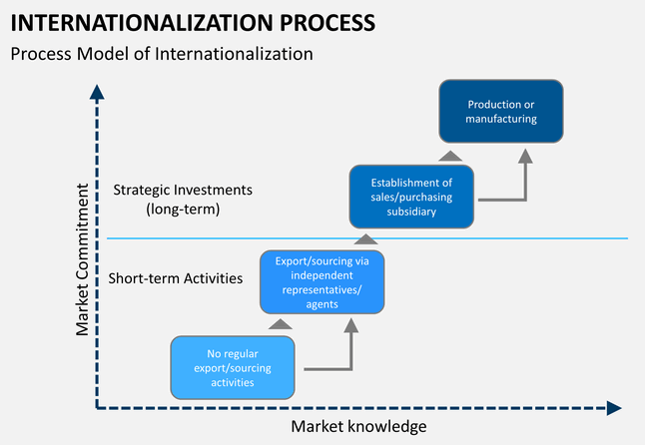
Internationalisation Process

Slide 3

Stages of Globalisation

Slide 4
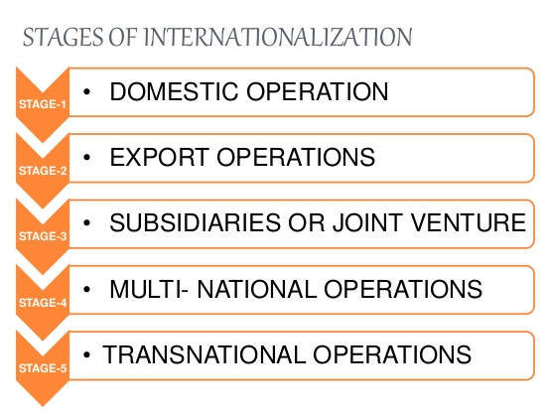
Stages of Internationalisation

Slide 5

The Bartlett Ghoshal matrix
Notes:
Bartlett & Ghoshal

Slide 6
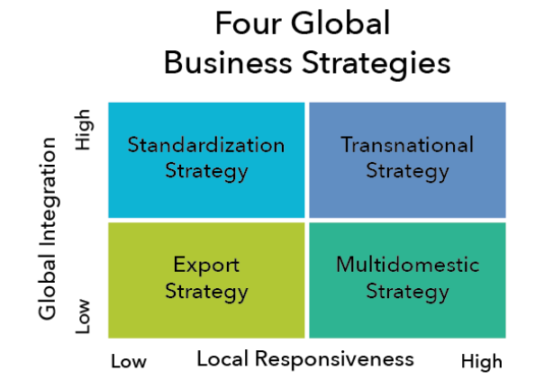
Global Business Strategy

Slide 7
Global Integration & Local Responsiveness
Global integration is the degree to which the company is able to use the same products and methods in other countries. Local responsiveness is the degree to which the company must customize their products and methods to meet conditions in other countries
Local responsiveness is the degree to which the company must customize their products and methods to meet conditions in other countries. The two dimensions result in four basic global business strategies: export, standardization, multidomestic, and transnational

Slide 8
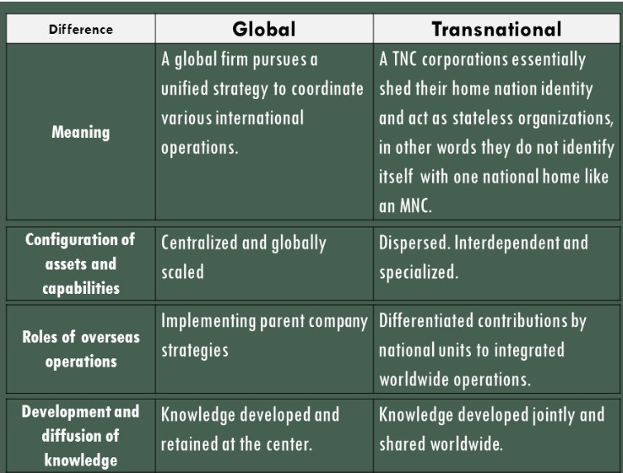
Global vs Transnational

Slide 9
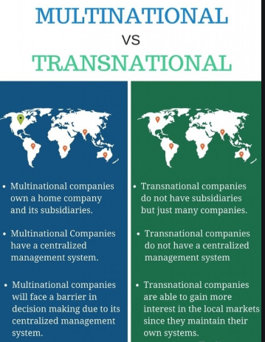
Multinational vs Transnational

Slide 10
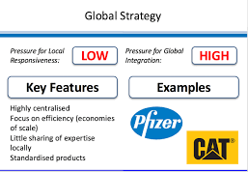
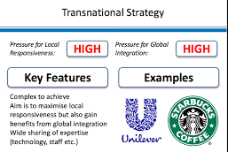
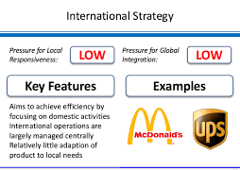
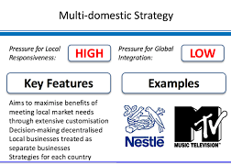
International Growth Matrix example

Slide 11
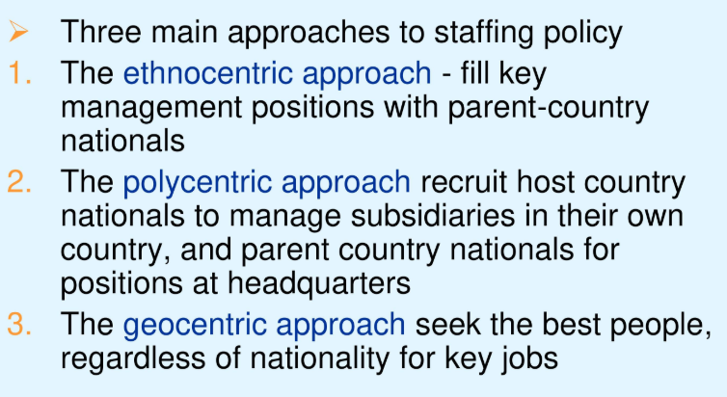
Staffing Approach

Slide 12
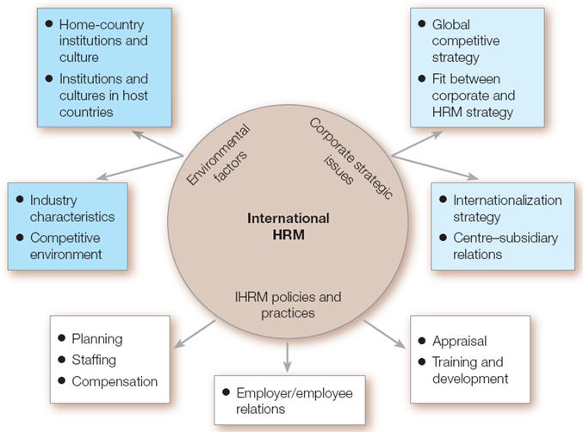
International HRM

Slide 13

P Morgan Model of IHRM
P Morgan Model of IHRM
Notes:
P V Morgan model of IHRM

Slide 14
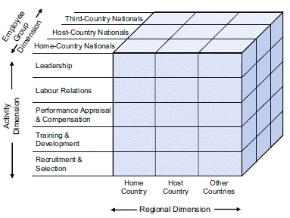
IHRM model

Slide 15
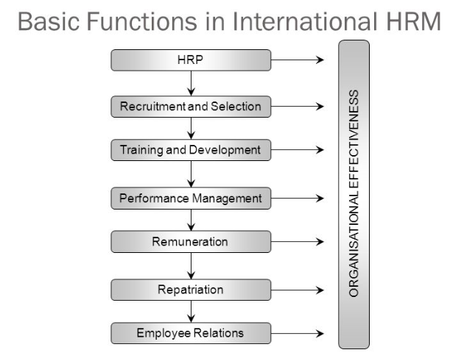
Functions in International HRM

Slide 16
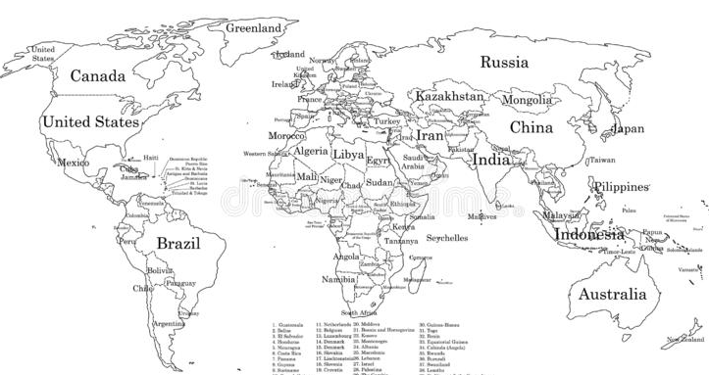
World Map

Slide 17
Global Workforce
Home Country National : Citizens of the organization's headquarters country who reside and work abroad with the intent of returning to the home country
Host Country National : Employees working in their own country
Third Country National : Employees who are citizens of countries other than where they work or where the organization’s headquarters resides

Slide 18

Short Term
homE – E for expatriate or ex patriate
hosT – T for there
All Home Country national are expatriates but all expatriates are not Home Country nationals

Slide 19
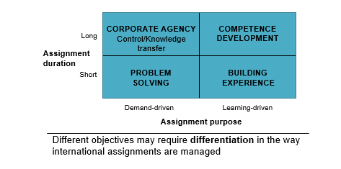
Purpose of Expatriation

Slide 20
Questions

