Slide 1
Employee Gamification

Slide 2
Learning Objective
What is gamification?
Why companies use gamification?
How can gamification help in recruitment and selection?
What is employee engagement?
Employee engagement survey.
Use of gamification in employee engagement.
Notes:
Case: Beeblock

Slide 3
ICT interventions for work engagement
ICT-driven work engagement interventions – classified on three levels of effect:
  Hedonic: ICT-driven WEI used to induce positive and pleasant experiences;
    Gamification
  Eudaimonic: ICT-driven WEI used to support individuals in reaching engaging and self-actualizing experiences;
    focus on the well-being and mental wellness of employees.
  Social/Interpersonal: ICT-driven WEI used to support and improve the connectedness between individuals, groups, and organizations.
    focus on facilitate connectedness between employees on individual, team, as well as organizational level.

Slide 4
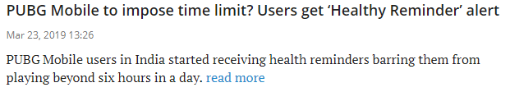
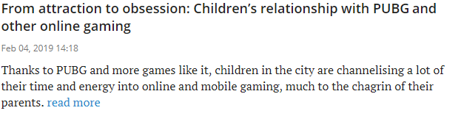
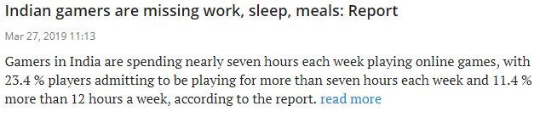
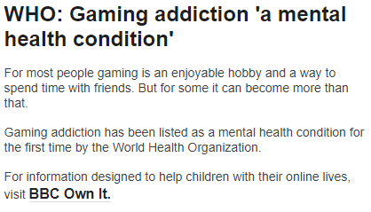
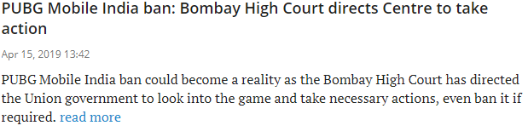
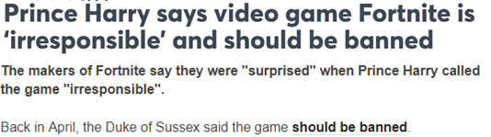
News Bites

Slide 5
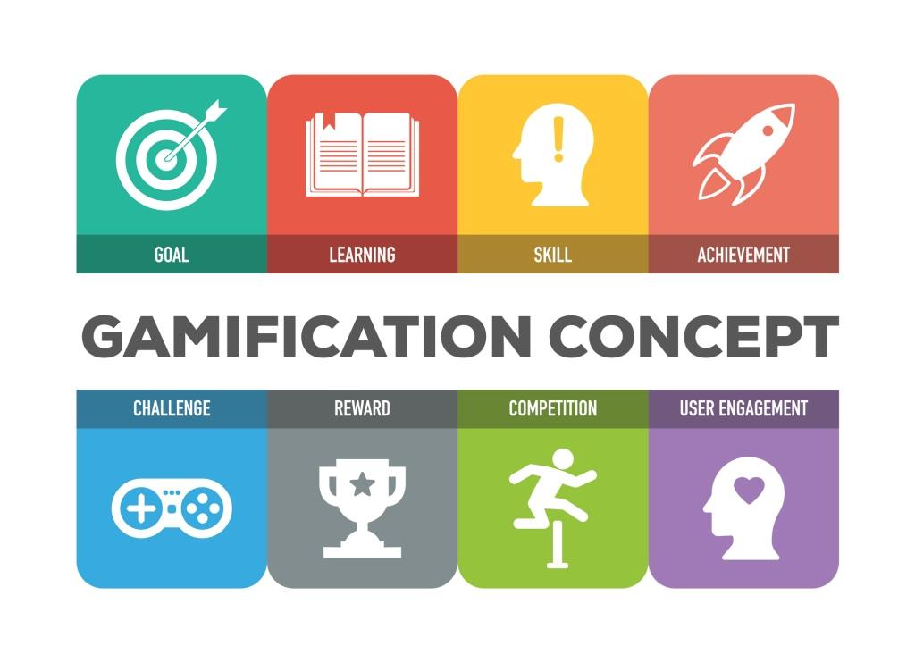
Gamification
Identify
Conceptualise
Integrate
Non-game Environment

Slide 6

Gamification
Use of game design elements in non-game contexts
Creating more game-like experiences in non game contexts
Reverse-engineering what makes games successful and grab it into business environment
The use of game mechanics and experience design to digitally engage and motivate people to achieve their goals
Gamification is using game-based mechanics, aesthetics and game thinking to engage people, motivate action, promote learning, and solve problems

Slide 7
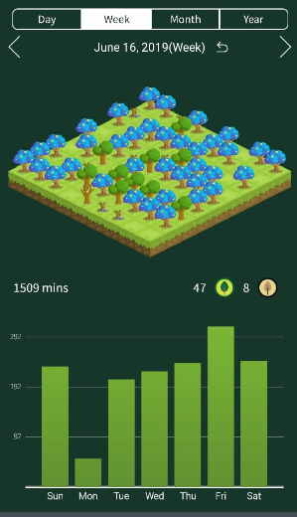
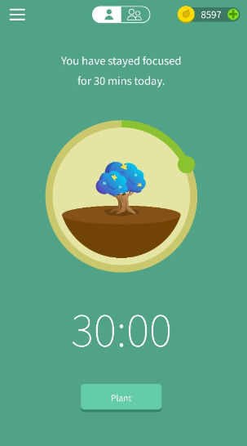
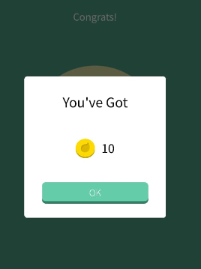
Example: Forest App

Slide 8
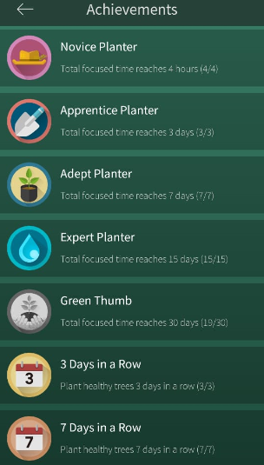
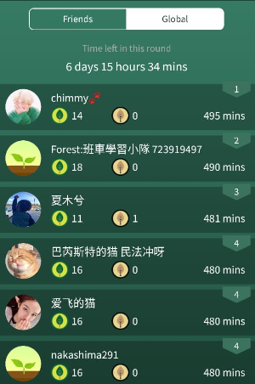
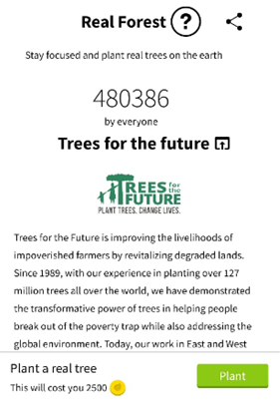
Example: Forest App

Slide 9
Gamified Systems
Traditional IS:
  Utilitarian
  Hedonic
Gamification – combination of both
  Productivity through fun

Slide 10
GAMIFICATION GOALS
Increase engagement
Increase awareness
Boost adoption practices
Develop creativity
Ease the fixing process
Encourage testing habits
Improve skills
Increase persuasion
Promote collaboration
Improve training

Slide 11
Examples
CodeBrag, collabreview, GitPoints - Software Engineering
DevHub - Project Completion
Mint.com - Fostering Financial Independence and Goal Tracking
Recyclebank, Engine Yard - Customer Engagement
Step2 - Customer Loyalty
Bluewolf - Employee Engagement and Motivation
Keas - Employee Wellness, Cost Reduction
Beat the GMAT - User Engagement, Goal Tracking
SCVNGR, The Email Game - Team Building
4food - Social Loyalty, Brand Awareness, Social Missions

Slide 12
Employee Engagement
An engaged employee as one who is satisfied, committed, involved, and enjoys a feeling of empowerment at workplace.
Health Surveys at Workplace
  71% of the working population is actively thinking about changing jobs
    Mental Health America and The Faas Foundation (2017)
  India is leading the list of most stressed population in the world with workplace stress as one of the primary cited reasons
    Cigna 360° Well-Being Survey (2018)

Slide 13
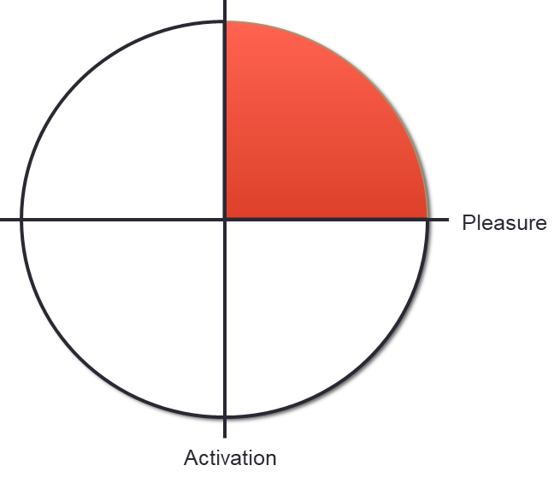
Using Enjoyment to address Engagement
The engaged block is where the activation and pleasure elements are maximized to provide an excited and happy employee.
Enjoyment forms an important part in successfully engaging an employee.
Gamification can induce the element of enjoyment necessary by means of the game mechanics and dynamics it employs.

Slide 14
Other Employee Engagement strategies
Direct benefits such as high salary, periodical bonuses, holiday gifts, earned vacations, and health insurances
Team building activities
Social engagement
Corporate social responsibility (CSR)
Corporate wellness programs, skill training, feedback sessions, work from home initiatives

Slide 15
Components of Gamification
Werbach and Hunter (2012) classified gamification components
  Elements - the “specific forms that mechanics or dynamics can take”
  Mechanics - “the basic processes that drive the action forward and generate player engagement”
  Dynamics - “the big picture aspects of the gamified system”

Slide 16
Elements
To gamify an environment, components are used which have been derived from gamed or relate concepts and called game elements.
The game elements form the basic form the gamification concepts take and are used as the means of gamifying an environment

Slide 17
Elements
Achievements | Countdowns | Levels | Rankings
Activity Feeds | Dashboard | Likes | Ratings
Awards | Duels | Medals | Reviews
Badges | Easter Eggs | Milestones | Rewards
Betting | Feedback | Missions | Stages
Challenges | Forums | Notification | Storyline
Chat | Gifting | Paths | Teams
Checkpoints | Groups | Progress Bar | Titles
Collectibles | Goals | Points | Trophies
Locked Content | Leaderboards | Quests | Virtual Goods

Slide 18
Game Mechanics
Game mechanics is defined as the mechanisms that emerge out of using game elements.
These include rules, regulations, and game features that are present in the gamified environment.
The mechanics overall drives the gamification process and engages the user through game elements.
Examples - point systems, ranking systems, punishments, social interactions, profiles, themes, narratives etc.

Slide 19
Game Dynamics
Game dynamics are the reactions that emerge as a response of the implemented game mechanics.
They are desires and the source of motivations that lead to the response emotion.
Examples of dynamics – reward, status, achievement, self-expression, competition, collaboration, altruism

Slide 20
Pitfalls
It has been estimated that more than 80% of all implementation fail due to poor design of gamified environments.
Participants
Context
Goal

Slide 21
Beeblock: Applebee’s use of Gamification to engage employees
RMH Franchise Corp. was founded in 2012 with a business plan to acquire and operate Applebee’s Neighborhood Grill & Bar restaurants.
RMH faced high employee turnover. Attrition costs are high in the restaurant industry, as team members that work well together and employees that are trained according to franchise and corporate standards cannot be replaced quickly and cheaply.
Retaining staff and preventing constant turnover are two of the most significant challenges in the restaurant business.
The franchisee experienced 120 percent annual turnover, and it cost $400 to $10,000 to replace individual employees, depending on seniority.
The average turnover for hourly-employed restaurant workers was 120%!

Slide 22
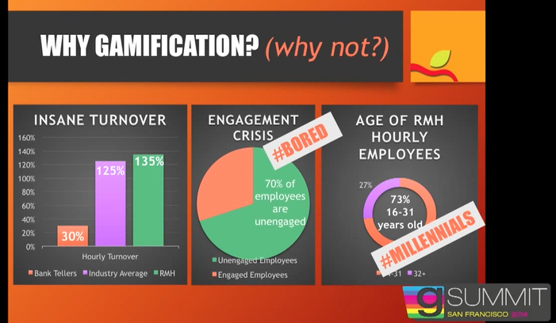
Beeblock: Applebee’s use of Gamification to engage employees
Notes:
https://www.youtube.com/watch?v=wwl4LoXJgvc&t=235s

Slide 23
Beeblock: Applebee’s use of Gamification to engage employees
Prior Absence of any sort of modern rewards and recognition program to motivate its largely millennial employee base.
To reduce turnover, RMH Franchise Corporation, which operates more than 130 Applebee’s restaurants, implemented “Bee Block,” a gamified website for Applebee’s hourly employees.

Slide 24
Motivation
“We needed a program that allowed us to do that,” says Robin Jenkins, communications and employee engagement manager at RMH Franchise, owner of 173 of Applebee’s roughly 2,000 U.S locations.
Starting in 2013, Applebee’s implemented a gamification system. The company’s Nitro product aims to help servers and staff sell new and supplemental menu items, as well as learn about workplace rules and safety, and then earn points and win prizes for making progress.
“It’s not just about money but an opportunity for employees to earn status, more power and motivate them to have short term goals.”

Slide 25
What is BEEBLOCK?
Beeblock website
Beeblock TV
The program motivates its staff through a system of competition and rewards.
Employee would log into the system using a smart phone or a tablet.
The objectives involves fulfilling certain tasks in exchange for points and badges.
Employees who rack up enough points can win prizes, ranging from Applebee gear to products such as Xboxes and iPads.
Voluntary

Slide 26
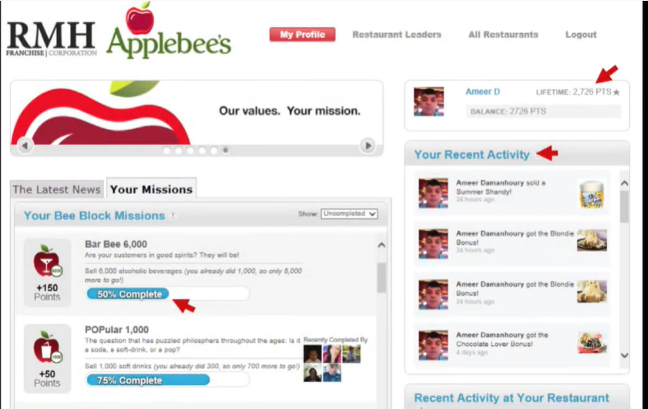
Dashboard

Slide 27
What is BEEBLOCK?
When logged in, employees can
  manage their profiles
  Storyline/Timeline - review their own data
  Newsfeed – Activity of other emplyees
  participate in challenges/missions – which are automated and broadcast in real-time via “Bee TVs” placed strategically throughout restaurant workstations.
    Tasks might include selling certain special menu items that Applebees introduces from time to time.
  Employees can also earn points by successfully completing quizzes on company rules and best practices.
    For example, kitchen staff might be asked to determine when is an appropriate time to wash hands during a shift.

Slide 28
What is BEEBLOCK?
  Online/offline Access
  See Leaderboards – updated every 5 minutes
  Collaboration and Competition
  Information Dissemination
  Real-time Dashboards – BeeTV
  Make a wish – challenges around charity
  By tapping into the motivations of its hourly workforce, Applebee’s improved employee engagement, and showed a significant reduction in turnover.

Slide 29
Going Beyond Engagement
Increase check average
Future Potential
  The system could be used to identify potential managers and to encourage servers to improve their customer service ratings.
  Evaluation and Feedback
  Levels connected to employees
  Guest Surveys
  Social Media elements – User Interactions
    Like, comment, challenge, collaborate
    Connect to facebook, twitter

Slide 30
Points for discussion
Beeblock uses gamification to engage hourly employees. How will the system be different if we want to engage knowledge workers?
Goals - short-term/long-term
Investment Justification
Data sources
Culture
Dashboards

Slide 31
HR gamification
Employee engagement
Team building
Rewarding staff
Promoting wellbeing
Charity events
Recruitment
Onboarding and training

Slide 32
Gamification in Recruitment and Related Areas
Selection and Application Process
  Assessment
    https://www.benchmark.games
Onboarding
Training

Slide 33

Gamification in Recruitment and Related Areas
Domino’s:
Pizza Hero

Slide 34

Gamification in Recruitment and Related Areas
Domino’s: Pizza Hero
Siemens Plantsville
My Marriott Hotel
Cryptic puzzles by Whirlpool

Slide 35
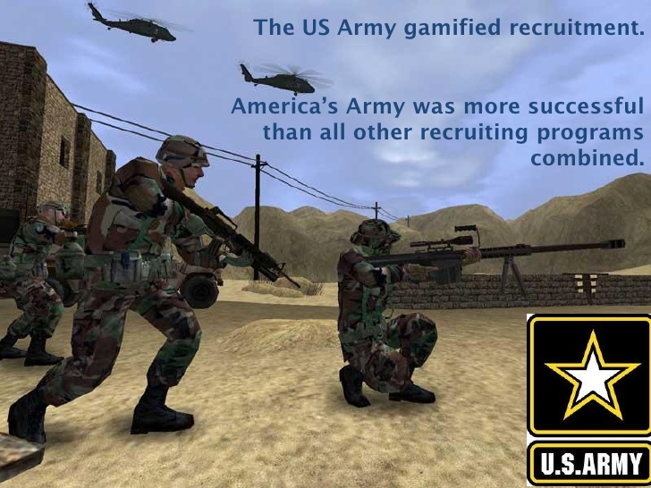
Gamification in Recruitment and Related Areas

Slide 36
Gamification in Recruitment and Related Areas
Employee referrals:
  Gamification can be used to boost the sharing of vacant positions among current employees across social media.
  This would work just like an in-house referral program, except that it now has a much wider audience.
  Many Online platforms already includes this feature.

Slide 37
Gamification in Recruitment and Related Areas
Jeu Facteur Academy by Formapost
  Formapost is a French postal service company, which had to struggle a lot with retaining its employees.
  They launched the game, Jeu Facteur Academy. This game allowed players, who are mostly potential candidates, to “live” 1 week as a newly hired postal carrier.
  This game included situations such as getting up early, learning postal work and even learning about ethics while on the job.

Slide 38
Online Platforms supporting Gamification in Recruitment
System | Customers | Features
Badgeville | Wells Fargo, Wal-Mart, Medtronic | Points, badges and leaderboards Tracks social systems and provides real-time feedback Includes analytics to enable customers to track and characterize users
Bunchball | SAP, Sun Life Financial, T-Mobile | Scalable cloud platform Used to motivate employees, test candidate skills and engage customers
Captain Up | Dell, Hewlett-Packard, McAfee | Social and gaming tools with badges, levels, activity feeds, leaderboards and other rewards Customers can add interactive leaderboards to any website or app Application programming interface adds social layers and competitive elements
Games for Business | PwC, HBO Europe, Huawei | Online simulation models the structure and procedures specified by the customer in a 3-D environment Users follow a work routine: going to meetings, accomplishing tasks, and facing unexpected situations and ethical decisions Measures players based on preset variables
HackerRank | Booking.com, Sabre, VMware | Ranks programmers based on coding skills Programmers compete in challenges and code sprints Recruiters move winners through the selection process
mLevel | US Foods, D4, International Hotels Group | Interactive learning missions accessible via mobile app or Web Individual and team competitions Scenarios uncover what users know about critical topics and require that they react in real time to responses
Pymetrics | Anheuser-Busch | Search platform uses “big data” and machine learning Recommends career paths to job seekers Assesses more than 50 cognitive and personality traits using neuroscience games

Slide 39
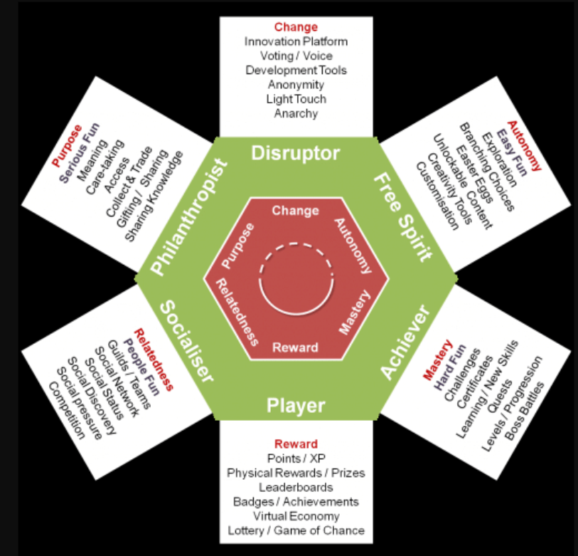
Player Types

Slide 40
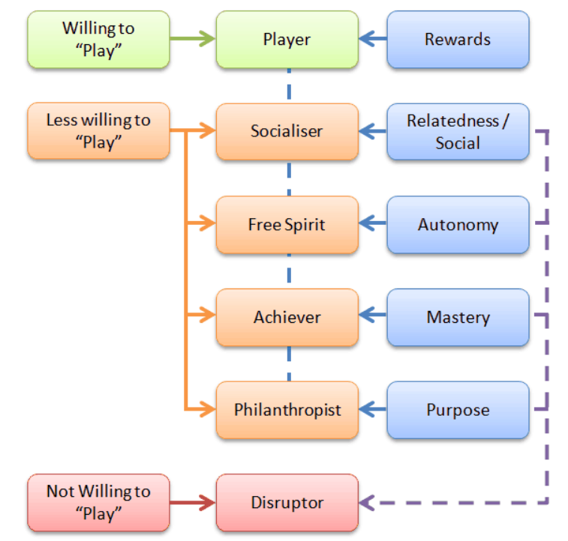
Player Types

Slide 41
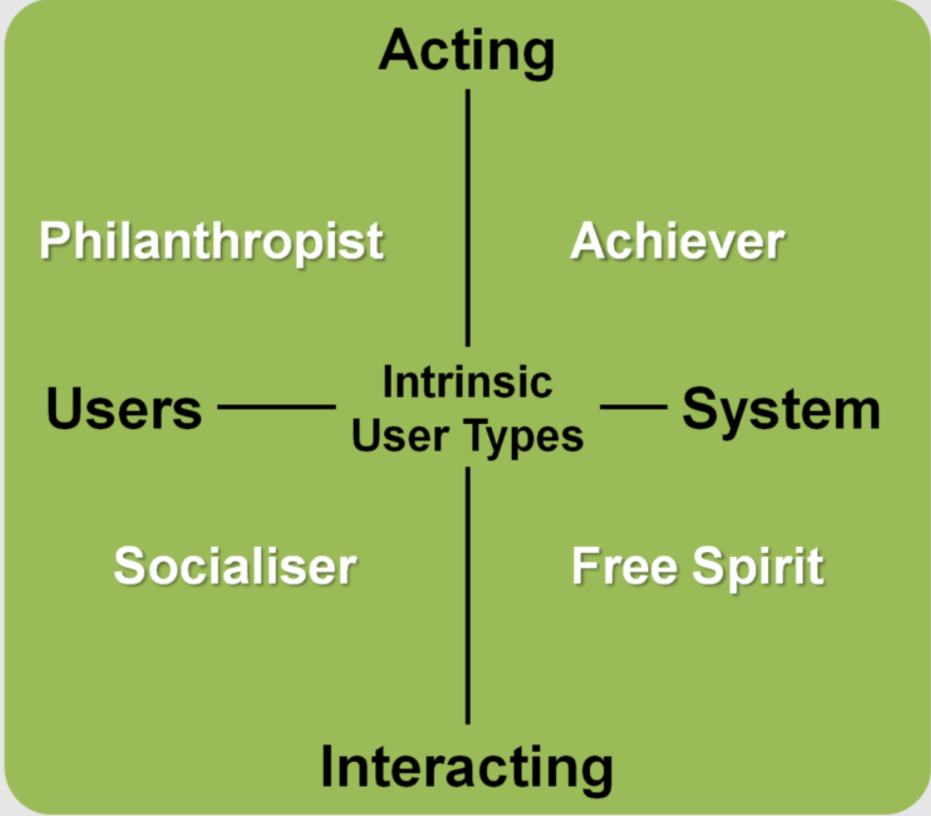
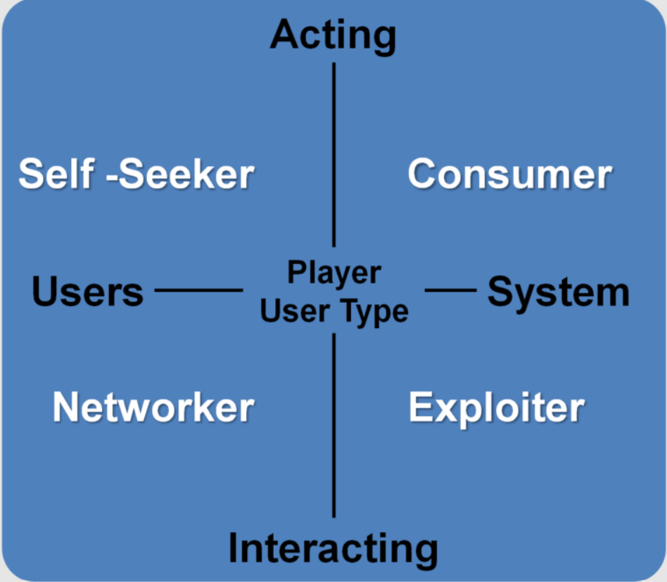
Player Types

Slide 42
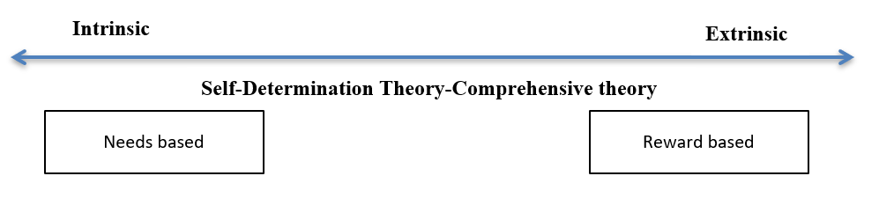
Player Types

Slide 43
Game Components
Rewards:
  Intrinsic vs Extrinsic Rewards
A lunch with their CEO
A month’s primo-parking / coffee making exclusion rights.
Recognition in their organizational newsletter / intranet / social media.
‘Expert’ status on the LMS / a special Badge.
Small giveaway like a t-shirt / trophy / mug / certificate.
A ‘day off’ pass

Slide 44
Game Components
POINTS:
  Motivate Progression
  Encourage Interaction in Your Environment
  Incentivize Social Activity
  Weight Points Appropriately
  Identify Engagement Patterns
  Establish Internal Expertise
  Provide Real World Rewards
  Link XP to Your Other Game Mechanics

Slide 45
Game Components
Levels:
  Customised Paths
  Required and Optional Content
  Experience Points
  Progress Bar
  Fully Customisable and Personalized

Slide 46
Game Components
Leaderboards:
  Rank by Rewards
  Create Metrics Aligned with the Outcomes you Value
  Integrate your Leaderboard with your Other Business Systems
  Make your Rewards Really Rewarding
  Beware of the ‘N-effect’
  Consider Using Team Leaderboards
  Make your Leaderboard Visible at all Times
  Encourage Everyone — Don’t Just Highlight the Top Performers
  Consider Using ‘Seasons’

Slide 47
Game Components
Badges:
  A trigger: the user action that ‘unlocks’ the badge.
  An image: a visual representation of the badge.
  And a description: that explains how the user earned the badge.

Slide 48
Gamification in training
Boost Learner Engagement
Empower Learners to Control Their Learning Outcomes
Promotes a Knowledge Sharing Environment
Enable Shorter Feedback Cycles
Drive Behavioural Change

Slide 49
Gamification in training
Do’s
  Align with Business & Learning Objectives
  Epic Meaning: What’s In It For Me?
  Personalization
  Microlearning
  Encourage Social Learning
Don’ts
  Misaligned Objectives
  Neglecting Your Learner’s Journey
  Complicated Mechanics or Challenges
  Using Gamification To Fix Bad Products or Services
  Implement the Wrong Tools

Slide 50
Important Points to remember
The Rise of Streaks
Value of Scorecards
Learning Pathway
Notes:
Logging in

