Slide 1
INTRODUCTORY SESSION
GPHR

Slide 2
Introduction
Welcome to the batch of GPHR
Brief Introduction about yourself
- Industry
- Location
- If taken any HRCI exams before

Slide 3


House Rules
When in doubt raise the hand option
Unmute microphone while speaking and mute when not needed

Slide 4
HRCI Certification
GPHR Exam
Structure of GPHR Exam
Uptop Student Portal
Class Guidelines

Slide 5

HRCI Certification

Slide 6
HRCI Certification
GPHR Exam
Structure of GPHR Exam
Uptop Student Portal
Class Guidelines

Slide 7
GPHR Exam
Exam time: 3 hours
Exam length: 140 scored questions (mostly multiple-choice) + 25 pretest questions
Pass score is 500 of 700
Computer-based exam at a Pearson VUE testing center or at your home or office using OnVUE

Slide 8
Exam Pass Rates
aPHR 86%
PHR 71%
SPHR 60%
GPHR 77%
PHRca 74%
aPHRi 83%
PHRi 76%
SPHRi 81%
HRCI Exam Pass Rates as of December 31, 2020

Slide 9

Pearson VUE

Slide 10
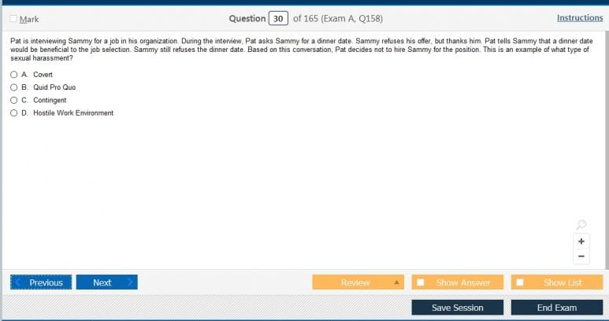
HRCI Exam screen

Slide 11
HRCI Certification
GPHR Exam
Structure of GPHR Exam
Uptop Student Portal
Class Guidelines

Slide 12
Structure of Exam
Traditional multiple choice
Multiple choice, multiple response
Fill in the blank
Drag and drop
Scenarios

Slide 13

Multiple Choice Question

Slide 14

Multiple Choice Multiple Response

Slide 15
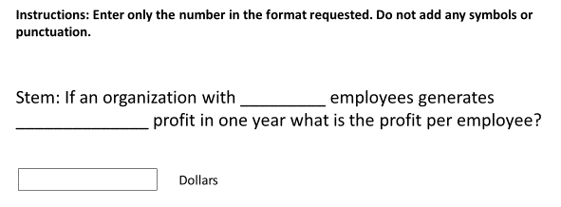
Fill in the blanks

Slide 16

Drag and Drop

Slide 17
Scenario based questions
You have been recently hired as the HR manager within a unit of your organisation that hasn't met its production goals. Your director has made a decision "No training programs will be conducted until the numbers improve". How would you respond:
Training is an important way for employee to position themselves for promotional opportunities, and the employees in this unit may need a ticket out of this underperforming unit
You would like to have the opportunity to determine where the gap is between the actual and desired performance, to see whether training might be an effective way of addressing the bottom-line performance issues.
You believe strongly that you should at least be given the opportunity to engage in training initiatives unless those efforts prove to be ineffective
Removing training opportunities could damage employee morale even more.

Slide 18
HRCI Certification
GPHR Exam
Structure of GPHR Exam
Uptop Student Portal
Class Guidelines

Slide 19
Class Offering
Weekly classes
Quiz
Study materials

Slide 20

Student Portal
Study materials and class presentations
Recordings
Forum for doubt clarification
Weekly Quiz

Slide 21
HRCI Certification
GPHR Exam
Structure of GPHR Exam
Uptop Student Portal
Class Guidelines

Slide 22
Class Timings
6 to 8:45 PM
Divided into two halves
1st half from 6 to 7:15 PM
15 mins break - 7:15 to 7:30 PM
2nd half from 7:30 to 8:45 PM
Alternate Saturdays and ALL Sundays

Slide 23
Questions

