Slide 1
Forecasting

Slide 2
Important Questions
What is the purpose of the forecast?
Which systems will use the forecast?
How important is the past in estimating the future?
Answers will help determine time horizons, techniques, and level of detail for the forecast.

Slide 3
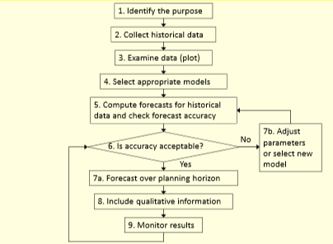
Steps to use a forecasting method

Slide 4
Types of forecasting methods
Qualitative methods
Quantitative methods
Rely on subjective opinions from one or more experts.
Rely on data and analytical techniques.

Slide 5
Qualitative forecasting methods
Grass Roots: deriving future demand by asking the person closest to the customer.
Market Research: trying to identify customer habits; new product ideas.
Panel Consensus: deriving future estimations from the synergy of a panel of experts in the area.
Historical Analogy: identifying another similar market.
Delphi Method: similar to the panel consensus but with concealed identities.

Slide 6
Quantitative forecasting methods
Time Series: models that predict future demand based on past history trends
Causal Relationship: models that use statistical techniques to establish relationships between various items and demand
Simulation: models that can incorporate some randomness and non-linear effects

Slide 7
How should we pick our forecasting model?
Data availability
Time horizon for the forecast
Required accuracy
Required Resources

Slide 8
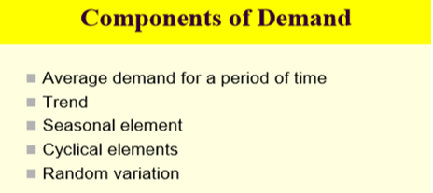
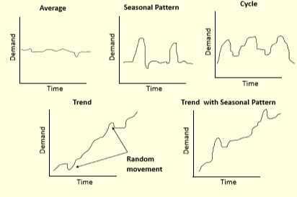
What should we consider when looking at past demand data?

Slide 9
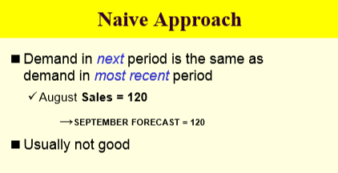
Time Series: Moving average
The moving average model uses the last t periods in order to predict demand in period t+1.
There can be two types of moving average models: simple moving average and weighted moving average
The moving average model assumption is that the most accurate prediction of future demand is a simple (linear) combination of past demand.

Slide 10
Time series: simple moving average
In the simple moving average models the forecast value is
A_{t} + A_{t-1} + … + A_{t-n}
F_{t+1} =
n
t is the current period.
F_{t+1} is the forecast for next period
n is the forecasting horizon (how far back we look),
A is the actual sales figure from each period.

Slide 11
Example: forecasting sales at Kroger
Kroger sells (among other stuff) bottled spring water
What will the sales be for July?
Month | Bottles
Jan | 1,325
Feb | 1,353
Mar | 1,305
Apr | 1,275
May | 1,210
Jun | 1,195
Jul | ?

Slide 12
What if we use a 3-month simple moving average?
A_{Jun} + A_{May} + A_{Apr}
F_{Jul} =
= 1,227
3
What if we use a 5-month simple moving average?
A_{Jun} + A_{May} + A_{Apr} + A_{Mar} + A_{Feb}
F_{Jul} =
= 1,268
5

Slide 13
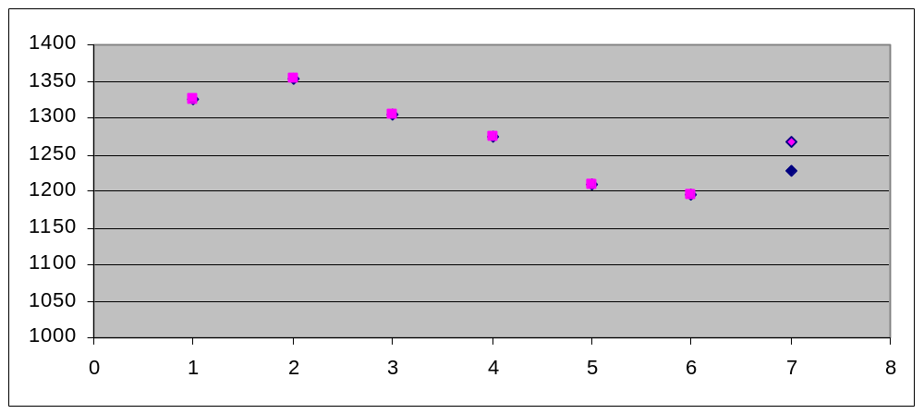
5-month
MA forecast
3-month
MA forecast
What do we observe?
5-month average smoothes data more;
3-month average more responsive

Slide 14
Time series: weighted moving average
We may want to give more importance to some of the data…
F_{t+1} =
w_{t} A_{t} + w_{t-1} A_{t-1} + … + w_{t-n} A_{t-n}
w_{t} + w_{t-1} + … + w_{t-n} = 1
t is the current period.
F_{t+1} is the forecast for next period
n is the forecasting horizon (how far back we look),
A is the actual sales figure from each period.
w is the importance (weight) we give to each period

Slide 15
Why do we need the WMA models?
Because of the ability to give more importance to what happened recently, without losing the impact of the past.
Demand for Mercedes E-class
Actual demand (past sales)
Prediction when using 6-month SMA
Prediction when using 6-months WMA
For a 6-month SMA, attributing equal weights to all past data we miss the downward trend
Time
Jan
Feb
Mar
Apr
May
Jun
Jul
Aug

Slide 16
How do we choose weights?
Depending on the importance that we feel past data has importance
Depending on known seasonality (weights of past data can also be zero).
WMA is better than SMA because of the ability to
vary the weights!

Slide 17
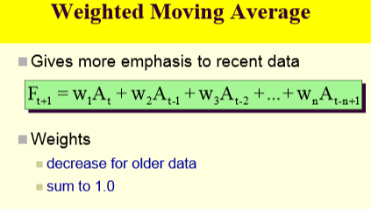
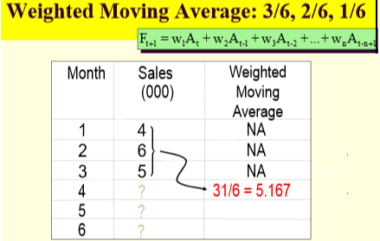
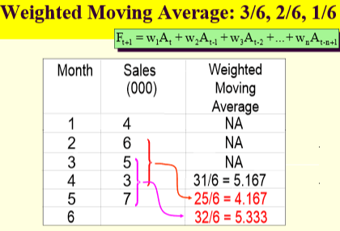

Slide 18
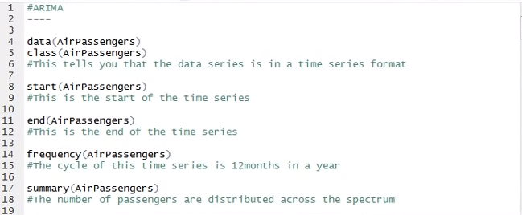

Slide 19
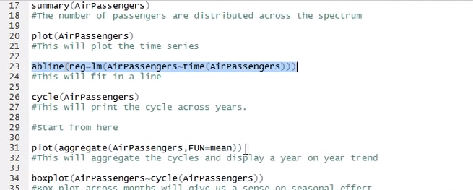

Slide 20
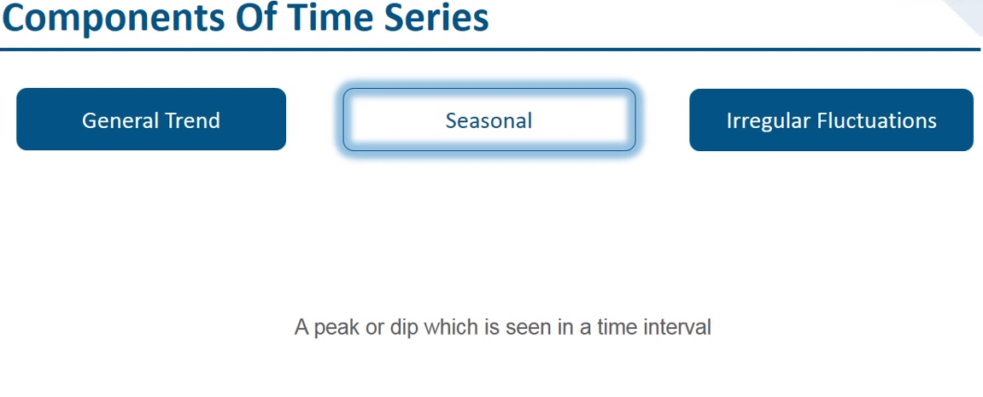

Slide 21
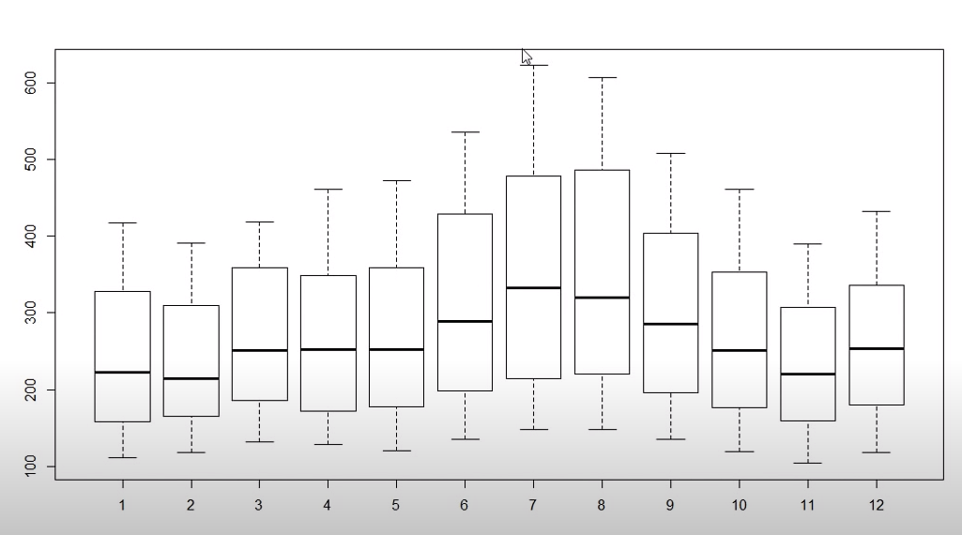

Slide 22
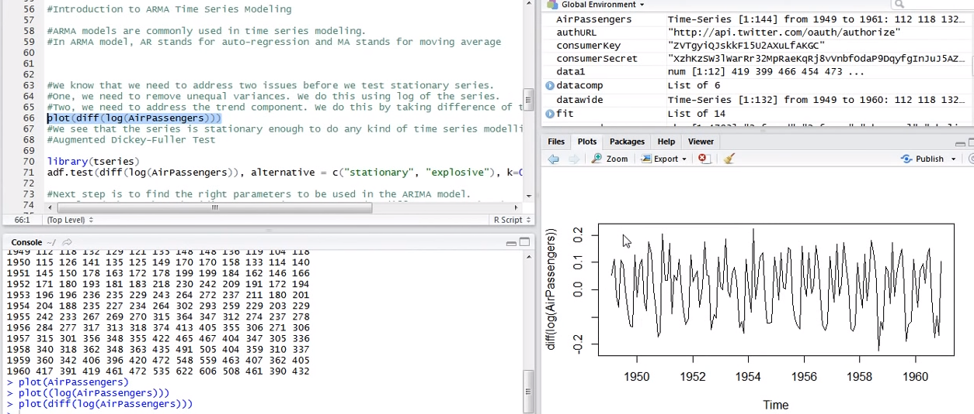

Slide 23
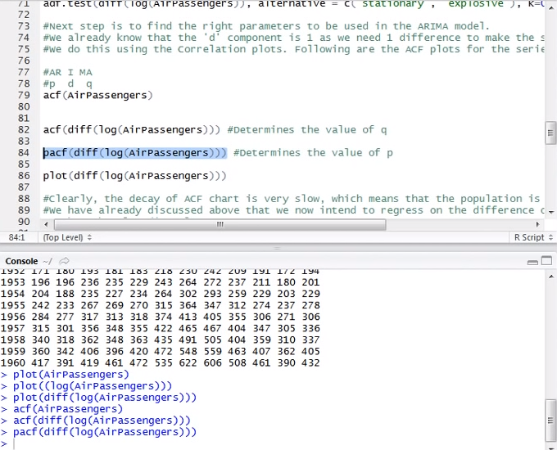

Slide 24
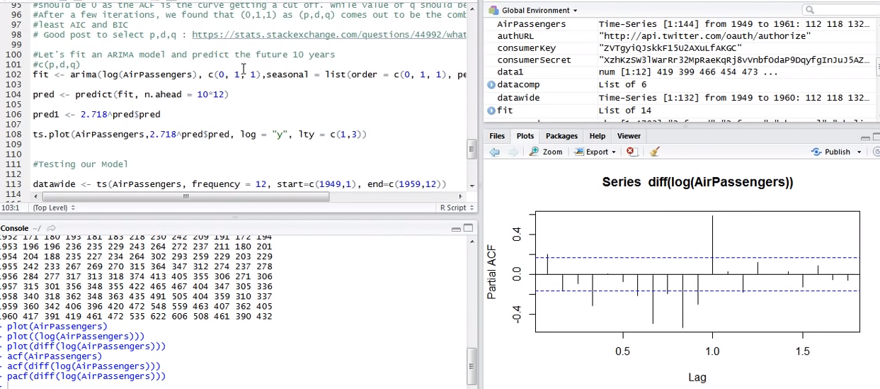

Slide 25
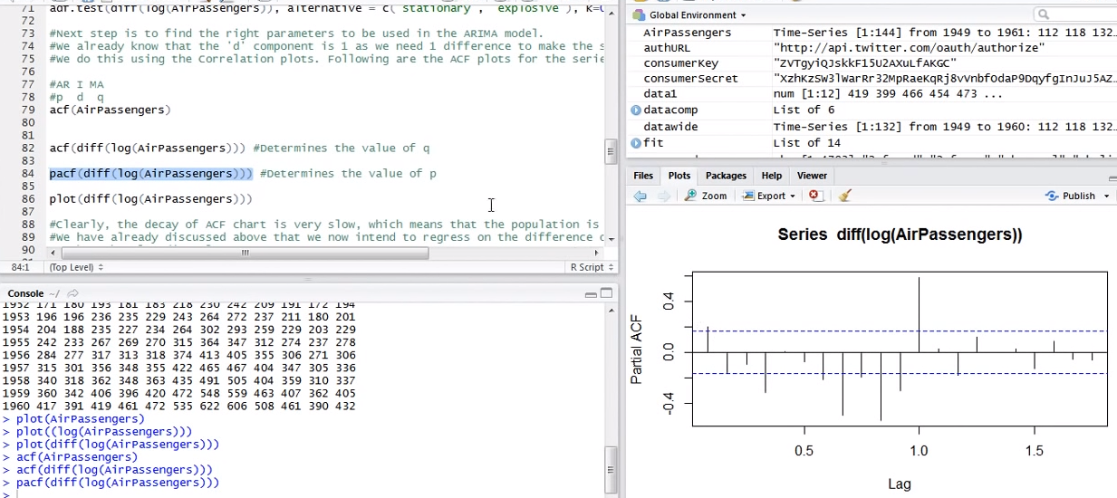

Slide 26
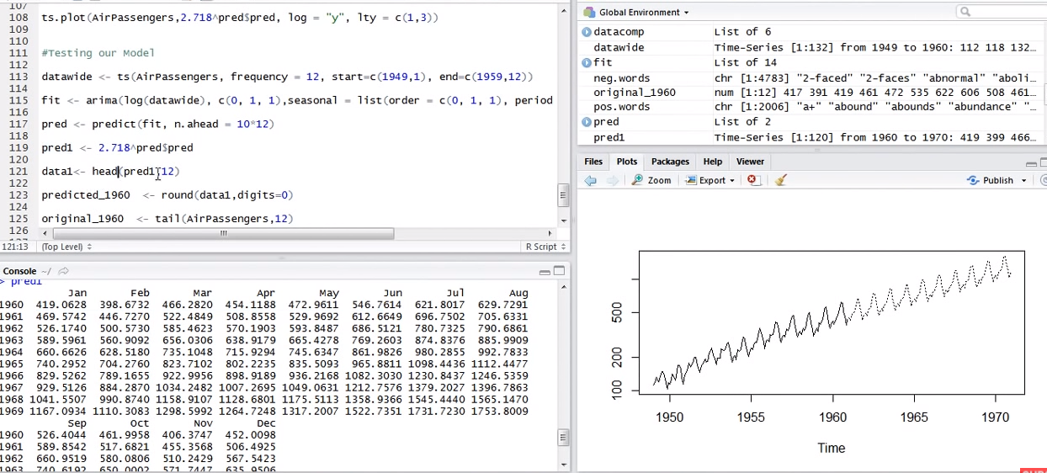

Slide 27
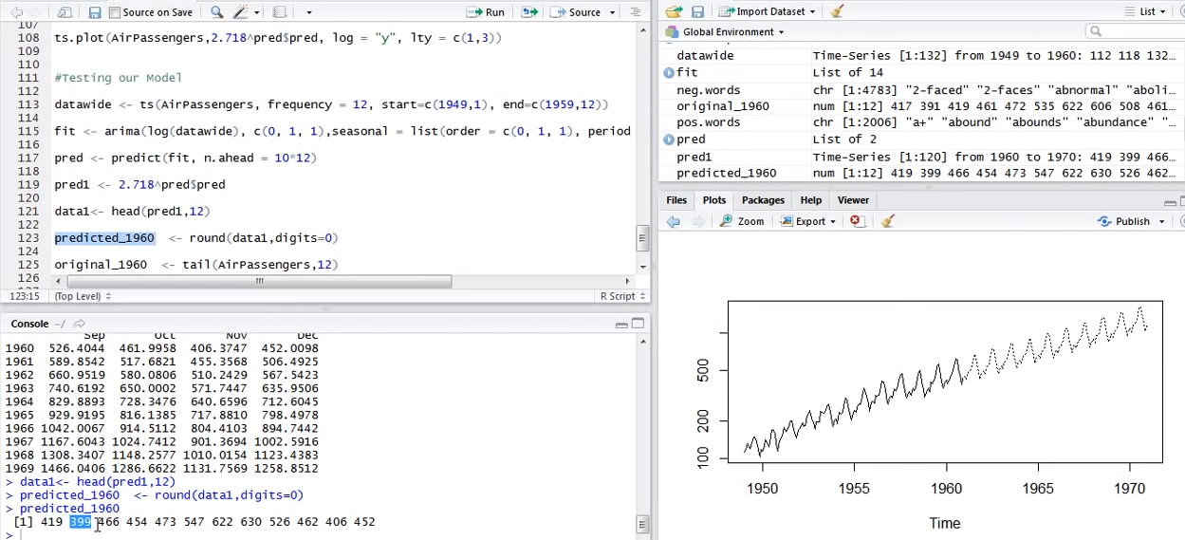

Slide 28
