Slide 1
Financing
Yogesh Chauhan

Slide 2
Corporate Finance: The Big Picture
Maximize the value of the business (firm)
The Investment Decision Invest in assets that earn a return greater than the minimum acceptable hurdle rate
The Financing Decision
Find the right mix of debt and equity to fund your operations
The Dividend Decision
If you cannot find investments that make your minimum acceptable rate, return the cash to owners of your business
The hurdle rate should reflect the riskiness of the investment and the mix of debt and equity used to fund it.
The return should reflect the magnitude and the timing of the cashflows as well as all side effects
The optimal mix of debt and equity maximizes firm value
How you choose to return cash to the owners will depend on whether they prefer dividends or buybacks

Slide 3
Raising capital
There are only two ways in which a business can raise capital.
  The first is debt: The essence of debt is that a debt claim entitles the holder of the claim to a contracted set of cashflows (interest payments and repaying principle). If you fail to make those payments, you lose control of your business.
  The second is equity: With equity, you do get whatever cashflows are left over after you made debt and tax (government) payments.

Slide 4
Debt versus Equity
Fixed claim
Tax Deductible
High priority in financial trouble
Fixed maturity
No management control (why?)
Residual claim
Not Tax Deductible
Low priority in financial trouble
Infinite
Management control (why?)
Debt
Bank debt
Commercial paper
Corporate Bonds
Equity
Owner’s equity
Venture capital
Common stock
Warrants
Hybrid securities
Convertible Debt
Preferred stock
Option-linked bonds

Slide 5
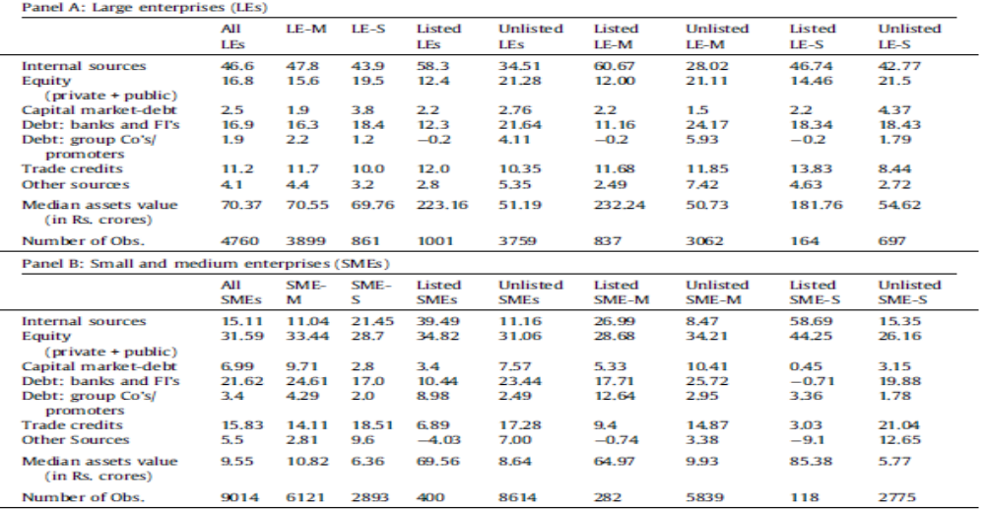
Financing pattern of Indian firms

Slide 6
Financing an idea
An entrepreneur (or manager) has access to a profitable investment project but lacks financing while an investor has funds but no access to such a project.
How can information enhance the contractual relationship between these two parties and how does the use of information affect the choice and design of financial claims?

Slide 7
The role of information
There are two types of second-hand cars; the good, functioning cars (peaches) and the bad, defect-ridden cars (lemons). However, the market for peaches and lemons are not separate. Consumers cannot distinguish between the two for many reasons - they cannot access all the hidden mechanical parts; they are not car experts, or they do not know the history of the vehicle. Thus, they will only find out whether it is a peach or lemon after the purchase - which of course, is too late.
The buyer’s best guess is the average quality. The owner is only willing to pay what the average known quality of the car is. This leads to a market failure - an information asymmetry has led to adverse selection. The peaches, as a reaction to the lower price, will be unwilling or forced to leave the market. Once the peaches start to withdraw, the proportion of lemons increases. Thus, the likelihood of a consumer buying a lemon increases - yes, adverse selection in all its glory.

Slide 8
The role of information
To overcome this problem, the information gap needs to be reduced. To compensate for the lack of expertise, on the consumer’s behalf, an independent third party can be introduced to reveal the quality of the car. Peaches can be given rubberstamp to indicate that they have been inspected and are road-worthy.

Slide 9
Problems with a new venture
Almost, all assets of a new venture are growth assets (promises or stories), therefore, investors cannot differentiate between good firms and bad firms.
Given this fact, investors require information to take better decisions. However, most of times, investors do not have capacity to understand the information or firms are unable to disclose valuable information, because these are business-sensitive information. In either cases, Investors fail to take efficient decisions, leading to mispricing of securities. In order worlds, investors demand higher expected returns.
In such a case, firms have incentive to reduce information asymmetry so that they can receive better price for their securities.

Slide 10
Equity financing for a new venture
Owner’s equity (bootstrapping).
Angel investors
Venture Capital (Private equity) refers to a pool of equity capital which is professionally managed. Wealthy investors may invest in these funds as limited partners. The general partner manages the pool in exchange for a fee and a percentage of the gains on investments and limited partners provide capital.

Slide 11
Characteristics of VCs
Long time horizon
Lack of liquidity, because they, generally, invest in private firms.
High risk, since they invest in unproven business model
Equity participation
Participation in management

Slide 12
Equity choices for publicly traded firms
Initial public offering (IPO) or stock market launch is a type of public offering in which shares of a company are sold to institutional investors and usually also retail (individual) investors.
An IPO is underwritten by one or more investment banks, who also arrange for the shares to be listed on one or more stock exchanges.
For each stock, each investor holds two rights: Cash flow right and Voting right.
  Typically, each stock has one voting right and one cashflow right. However, the firm can issue differential voting right (DVR) stocks.
  Typically, Tata motor’s each stock has one voting right and one voting right
  However, Tata motor’s DVR has 0.10 voting right and 1.05 cashflow right.

Slide 13
Tata Motor and Tata Motor (DVR) (stock prices)

Slide 14
Initial public offering …
Advantages
  Enlarging and diversifying equity base, and therefore, enabling cheaper access to capital.
  Increasing exposure, prestige, and public image and thus, attracting and retaining better management and employees through liquid equity participation (ESOP).
  Facilitating acquisitions (potentially in return for shares of stock)
  Creating multiple financing opportunities: equity, convertible debt, cheaper bank loans, etc.
Disadvantages
  Significant legal, accounting and marketing costs, many of which are ongoing
  Loss of control and stronger agency problems due to new shareholders

Slide 15
The process of IPO
Stage 1: Road show is conducted by investment bankers (also called book running lead managers). At this stage, a price band is not disclosed. The bookrunner carries out the preliminary pricing of the firm and circulates it in the form of a report among its favored institutional clients.
Stage 2: At the end of the road show, the bookrunner uses the recently collected information to arrive at a price band and files a red herring prospectus with the regulator. The red herring prospectus contains the price band on which the book is built. On average, the book building process usually lasts for a period of 5 days (a minimum of 3 days and a maximum of 10 days are prescribed by regulation).
Stage 3: After the book has been built, the issuing firm, in consultation with the bookrunner, decides an offer price for the IPO shares. If the issue has been oversubscribed by investors in any category, allocation is made among the investors in that specific class by prorate basis.
Stage 4: The listing of the IPO is the fourth and final stage of the process. The IPO is listed 21 days after the determination of the offer price.

Slide 16
Recent IPOs
Name of the issue | Issue Price | Start Date | End Date | Price Range | Date of
Prince Pipes and Fittings Limited | 178 | 12/18/2019 | 12/20/2019 | Rs.177 to Rs.178 | 12/30/2019
Ujjivan Small Finance Bank Limited | 37 | 12/2/2019 | 12/4/2019 | Rs.36 to Rs.37 | 12/12/2019
CSB Bank Limited | 195 | 11/22/2019 | 11/26/2019 | Rs.193 to Rs.195 | 12/4/2019
Indian Railway Catering and Tourism Corporation Limited | 320 | 9/30/2019 | 10/3/2019 | Rs.315 to Rs.320 | 10/14/2019
Vishwaraj Sugar Industries Limited | 60 | 9/30/2019 | 10/4/2019 | Rs.55 to Rs.60 | 10/15/2019

Slide 17
Prince Pipes and Fittings Limited
Symbol | PRINCEPIPE
Issue Period | 18-Dec-2019 to 20-Dec-2019
Post issue Modification Period | 23-Dec-2019 (10.00 A.M. to 11.00 A.M.)
Cut-off time for UPI Mandate Confirmation | 23-Dec-2019 (upto 12:00 PM)
Issue Size | Initial Public offer of [.] Equity Shares aggregating upto Rs 5,000 Million (including anchor portion of 56,49,718 Equity Shares)
Issue Type | 100% Book Building
Price Range | Rs. 177 to Rs.178
Face Value | Rs 10
Tick Size | Re 1
Bid Lot | 84 Equity Shares and in multiples thereof
Minimum Order Quantity | 84 Equity Shares
Maximum Subscription Amount for Retail Investor | Rs. 2,00,000
Maximum Bid Quantity for QIB Investors | 1,97,73,936 Equity Shares in multiple of 84 Equity Shares
Maximum Bid Quantity for NIB Investors | 1,41,24,264 Equity Shares in multiple of 84 Equity Shares
IPO Market Timings | 10.00 a.m. to 5.00 p.m.
Book Running Lead Managers | JM Financial Limited and Edelweiss Financial Services Limited
Sponsor Bank | HDFC Bank Limited

Slide 18
Prince Pipes and Fittings Limited: Cumulative Demand Details
Category | No.of shares offered/reserved | % | No. of shares bid for | Times
Qualified Institutional Buyers (QIBs) | 5649718 | 28.57% | 19972680 | 3.54
Foreign Institutional Investors(FIIs) |  |  | 2632392
Domestic Financial Institutions(Banks/ Financial Institutions(FIs)/ Insurance Companies) |  |  | 8494248
Mutual funds |  |  | 6668088
Others |  |  | 2177952
Non-Institutional Investors | 4237288 | 21.43% | 5107956 | 1.21
Corporates |  |  | 119280
Individuals(Other than RIIs) |  |  | 4980276
Others |  |  | 8400
Retail Individual Investors(RIIs) | 9887006 | 50.00% | 18638760 | 1.89
Cut Off |  |  | 14870604
Price bids |  |  | 3768156
Total | 19774012 |  | 43719396 | 2.21

Slide 19
The role of investment bankers
A reputational intermediary firm whose business is to rent its own reputation to client firms to resolve information asymmetry between managers and investors.
Investment bankers’ commitment.
  Firm commitment: Investment bankers buy the securities for less than the offering price and accept risk of not being able to sell. The difference between the investment bank’s buying price and offering price is called gross spread.
  Best offers: Investment bankers don’t give commitment to sell the securities.

Slide 20
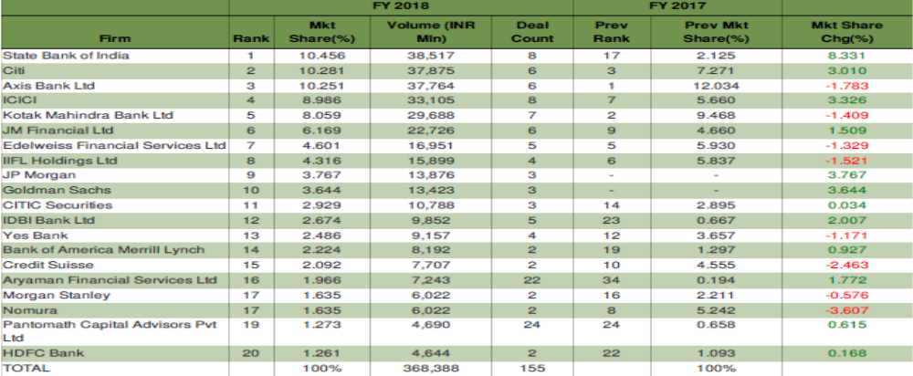
League Tables: Indian IPOs

Slide 21
Green-shoe option
Under Green-shoe option, Investment bankers have right to buy 15% additional share from the firm. Most of times, it is used to stabilize the market price.
Let assume that IPO

Slide 22
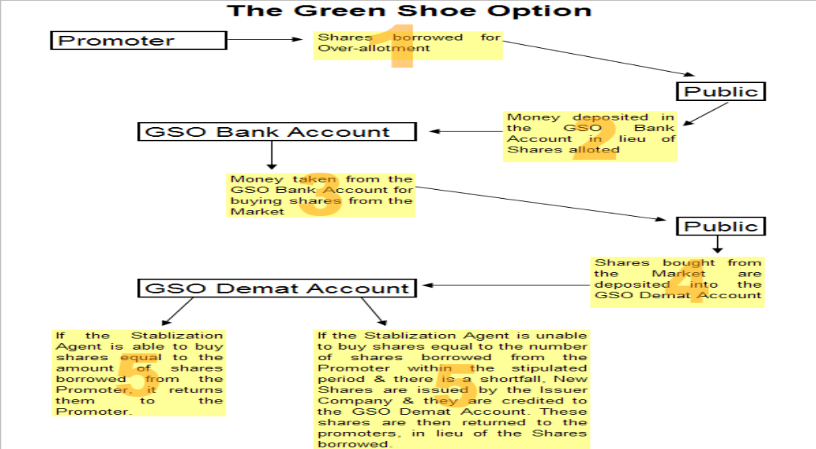

Slide 23
SEBI Guidelines
A pre-issue contract is required to be entered into for this purpose with an existing shareholders.
Underwriter can issue 15% additional shares of the original offer price.
Underwriter can exercise that option within 30 days from the date of allotment of shares.

Slide 24
Underpricing of IPO around the world
Notes:
https://site.warrington.ufl.edu/ritter/files/2019/03/IPO-Underpricing-Around-the-World.pptx

Slide 25
Right issue..
A rights issue or rights offer is a dividend of subscription rights to buy additional securities in a company made to the company's existing security holders.
A right offering allows existing stockholders to keep control of the firm, if they so desire, by giving them the right to buy additional stock in the firm at the price below the market price.

Slide 26
Right issue..
Alok Industries Ltd (Announcement Date) | Right Ratio | Face Value | Premium(Rs) |  | Record Date | Ex-Right Date
4/9/1996 | 2:1 | 0 | 10 |  | 3/1/1997 | 9/12/1996
Equity Shares of Rs. 10/- each for cash at a premium of Rs. 10/- per share aggregating Rs.14,98,03,840/- on rights basis to the equity shareholders in the ratio of two equity shares for every equity share held as on 3rd January 1997, the Record Date.
3/1/2009 | 83:40 | 0 | 1 | 25/03/2009 | 25/03/2009 | 18/03/2009
Note: Rights issue in the ratio of the eighty-three equity shares for every forty equity shares held by the shareholders at Rs 10/- each at a premium of Re 1/- per equity share.
25/09/2012 | 2:3 | 0 | 0 |  | 19/02/2013 | 15/02/2013 | 15/02/2013
Rights issue of equity shares in the ratio of 2:3 of Rs. 10/- each at par.

Slide 27
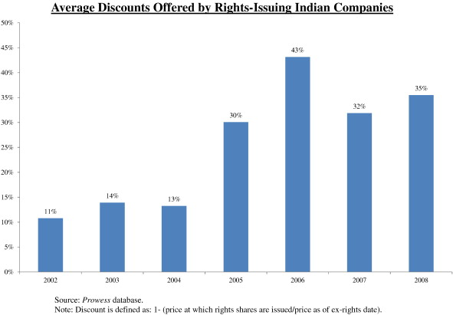

Slide 28
Value of right..
Rights can generally be freely bought and sold by investors in the stock. In general, the value of a right should be equal to the difference between the stock price with the rights attached, right-on-price, and the stock without the rights attached, the ex-rights price.
Market price before the announcement of right issue=Rs. 11.64
The price of right issue=Rs 10
Expected market price after ex-right date=(3*11.64+2*10)/5=Rs. 10.98
Value of right=11.64-10.988=0.652

Slide 29
Follow public offer and offer for sale…
FPO:-A public firm issues fresh shares to the pubic
Offer for sale:- When the promoter sales his/her holding to the public.
  Promoters of Avenue Supermarts, owner of retail chain DMart, will sell 2.28 per cent stake (1.48 crore shares) through the offer for sale (OFS) route

Slide 30
Borrowing (Debt)
Banks (private debt) specialize and spend resources to acquire information and monitor borrowers, which typically results in a higher cost of lending
Bonds (public debt) are commonly referred to as “unmonitored” lending because of the dispersed pool of bond investors who cannot or choose not to “monitor,” or influence, the business activities of the bond issuers.
How should I choose between Bank and bond market to raise funds?
Which borrowing would be less costly to the firm?

Slide 31
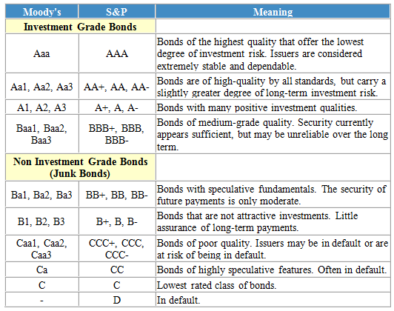
Bond ratings

Slide 32
Why bond rating matters? CRISIL default (%)
Rating category | Default rate
AAA | 0.00%
AA | 0.20%
A | 1.90%
BBB | 3.89%
BB | 11.17%
B | 20.99%
C | 39.01%

Slide 33
Why bond rating matters?
Rating-wise spreads over 10 years benchmark G-sec as on March end
 | AAA | AA | AA | AA-
F06 | 0.96% | 1.21% | 1.63% | 2.17%
F07 | 1.68% | 1.98% | 2.35% | 2.89%
F08 | 1.40% | 1.80% | 2.17% | 2.66%
F09 | 2.02% | 2.69% | 3.06% | 3.55%
F10 | 0.86% | 1.06% | 1.44% | 1.84%
F11 | 0.94% | 1.09% | 1.50% | 1.90%
F12 | 0.69% | 0.84% | 1.36% | 1.76%
F13 | 0.61% | 0.94% | 1.42% | 1.82%
F14 | 0.30% | 0.63% | 1.11% | 1.51%
F15 | 0.27% | 0.61% | 1.09% | 1.49%

Slide 34
Public vs. Private debt
While issuing public debt, the firm must disclose enormous information to the market and stock exchange. It is costly, for instance, the firm has an information that cannot be leaked to the competitors. In such a case, banks’ loans would be preferred because they have ability to produce more information and keep sensitive information confidential. As a result, bank can better price the firm’s claims (can provide loans at lower rate).
Firms need to be monitor for the use of capital. Banks have capacity and incentives, because of loan size, to monitor borrowing firms.
Therefore, small, growth, intangible, and undervalued firm should use private debt.
Can a firm be financed entirely with debt? Why or why not?

Slide 35
Two problems with growth, and riskier firms
One the one hand, growth and riskier firms may reluctant to issue straight debt for raising capital, because they face higher cost of borrowing and thereby, face high financial distress cost.
On the other hand, management of firms in the growth stage may not feel that the current stock price fairly reflects the firm’s growth assets, and so the issuance of equity would be expected to cause excessive dilution of existing stockholders’ claims.

Slide 36
Convertible bond
A convertible bond is a type of debt security that can be converted into a predetermined amount of the underlying company's equity at certain times during the bond's life, usually at the discretion of the bondholder.
A company issues a $1,000 face value convertible bond paying 4% interest with a convertible ratio of 100 shares of the company for every convertible bond and a maturity of 10 years for $1,000. At the end of year nine, a year before maturity, the investor is entitled to $1,000 in principal plus $40 in interest payments, a total of $1,040 if the investor does not convert the bond into equity. However, the company's shares are now trading at $11 after a successful quarter; thus, 100 shares of the company are now worth $1,100 (100 share x $11 share price), surpassing the value of the bond. The investor is likely to convert the bond into equity, receiving 100 shares in the process, and he could sell them in the market for $1,100 in total.

Slide 37
Convertible bond: some terminologies
Conversion ratio= 100 equity stock for each bond (the number of stock for which bond may be exchanged).
Conversion price=Par value/conversion ratio. Conversion price is always more the market price of stock at the time of issuing convertible bonds
Market conversion value is the current value of stocks for which bond may be exchanged ($100*11=$1100).
Conversion premium is excess of bond value over its conversion value ($1100-$1040=$60)

Slide 38
Value of convertible bond
Jan 15, 2020 AirTel issued the FCCBs offer a coupon rate of 1.5% per annum. The bonds can be converted into equity at Rs 534 a share in 2025.

Slide 39
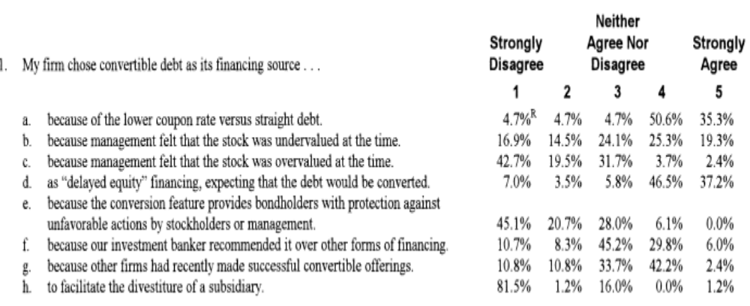
CFOs’ view on convertible bond
Notes:
Billingsley, R. S., & Smith, D. M. (1996). Why do firms issue convertible debt?. Financial Management, 93-99.

Slide 40
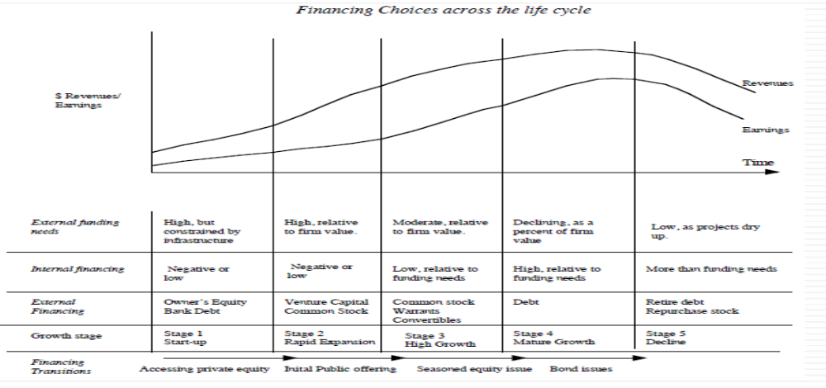
Financing over corporate life cycle

Slide 41
How much should a firm borrow?

Slide 42
Measuring a firm’s financing mix
My firm is having Rs 10 million debt. Is it high or low
The simplest measure of how much debt and equity a firm is using currently is to look at proportion of debt in the total financing: This ratio is called the debt to capital ratio:
  Debt to Capital ratio=Debt/(debt+capital)
Debt includes all interest-bearing liabilities, short-term as well long term. It should also include other commitments that meet the criteria for debt: contractually pre-set payments that must be made, no matter what the firm’s financial standing.
Equity can be defined either accounting terms (book value of equity) or in market value terms (based on the current price). The resulting debt ratios can be very different.

Slide 43
The financing mix question
In deciding to raise financing for a business, Is there an optimal mix of debt and equity?
  If yes, what is the trade off that lets us determine this optimal mix?
  What are the costs of using debt instead of equity?

Slide 44
The illusory benefits of debt
At first sight, the benefit of debt seems obvious. The cost of debt is lower than the cost of equity.
The benefit is an illusion , though, because debt is cheaper than equity for a simple reason. The lender gets both first claim on cashflows and a contractually pre-set cashflows. The equity investor is last in line and must demand a higher rate of return than the lender does.
By borrowing money at a lower rate, you are not making a business more valuable, but moving the risk around.
Total risk of equity holders=business risk + financial risk
Levered beta and unlevered beta

Slide 45
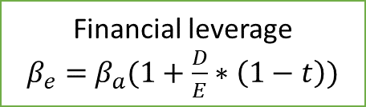
Determinates of beta (equity risk)
Assuming that total risk is born by only equity holders
Beta of equity (Levered Beta)
Beta of Business (Unlevered Beta)
Financial leverage
$β_{e}=$ $β_{a}(1+\frac{D}{E}∗\left(1−t\right))$
Nature of product or service offered by firm:
High elasticity (discretionary) of demand of your product would have higher beta
Operating leverage (Fixed Costs as % of total costs)
Firms with high infrastructure needs and rigid costs structures should have higher betas than firms flexible cost structures
Smaller firms should have higher betas than larger firms.
Young firms should have higher betas than more mature firms
Cyclical firms should have higher beta than non-Cyclical firms .
Luxury Goods firms should have higher beta than basic goods
High priced goods/service firms should have higher betas than low prices goods/service.
Growth firms should have higher beta

Slide 46
Costs and benefits of debt
Advantages of Borrowing | Disadvantages of Borrowing
Tax Benefit: Higher tax rates --> Higher tax benefit | Bankruptcy Cost: Higher business risk --> Higher Cost
Added Discipline: Greater the separation between managers and stockholders --> Greater the benefit | Agency Cost: Greater the separation between stockholders & lenders --> Higher Cost
 | Loss of Future Financing Flexibility: Greater the uncertainty about future financing needs --> Higher Cost

Slide 47
Costs and benefits of debt
Total investment | 10,000 | 10,000
ROI | 10% | 10%
Debt @8% | 0 | 5000
Equity | 10000 | 5000
EBIT | 1000 | 1000
Less Interest | 0 | 400
EBT | 1000 | 600
Less Tax @30% | 300 | 180
PAT | 700 | 420
Benefits of debt
  Tax benefits: The tax code is tilted in favor of debt, with interest payments being tax deductible in most parts of the world, while cashflows to equity are not

Slide 48
A pizza size cannot be changed, but I can reduce the share of my brother by borrowing

Slide 49
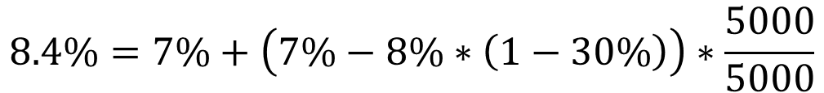
 | Firm A | Firm B | Difference
Return on equity (PAT/equity investments) | 700/10000=7.00% | 420/5000=8.40% | 1.4%
Return on assets (EBIT*(1-t))/Total investments | (1000*(1-.30))/10000=7% | 1000*(1-.30))/10000=7% | 0%
ROE=ROA+(ROA-Interest rate*(1-t))*D/E
$$8.4\%=7\%+\left(7\%−8\%∗\left(1−30\%\right)\right)∗\frac{5000}{5000}$$
Operating decisions
Financing decisions (Financial leverage)

Slide 50
Tax benefits of debt
When you borrow money, you are allowed to deduct interest expenses from your income to arrive at taxable income. This reduces your taxes. When you use equity, you are not allowed to deduct payments to equity (such as dividends) to arrive at taxable income
The dollar tax benefits from the interest payment in any year is a function of your tax rate and the interest payment:
  Tax benefit each year=Tax rate*Interest payments
The caveat is that you need to have the income to cover interest payments to get this tax benefit.
Proposition 1: Other things being equal, the higher the marginal tax rate of a business, the more debt it will have in its capital structure.

Slide 51
Corporate tax rate in India

Slide 52
Tax advantage
You are comparing the debt ratios of real estate corporations, which pay the corporate tax rate, and real estate investment trusts (REIT), which are not taxed, but are required to pay 90% of their earnings as dividends to their stockholders. Which of these two groups would you expect to have the higher debt ratios?

Slide 53
Debt adds discipline to management (Monitoring)
If you are managers of a firm with no debt, and you generate high income and cashflows each year, you tend to become complacent. The complacency can lead to inefficiency and investing in poor projects. There is little or no cost born by the managers.
Forcing such a firm to borrow money can be an antidote to the complacency. The managers now have to ensure that the investments they make will earn at least enough return to cover interest expenses. The cost of not doing so is liquidation and loss of such a job.

Slide 54
Debt and discipline
Assume that you into this argument that debt adds discipline to management. Which of the following types of firms will most benefit from debt adding this discipline?
Conservatively financed (very little debt), privately owned firms.
Conservatively financed, publicly traded firms, with stocks held millions of investors, none of whom hold a large percent of the stock.
Conservatively financed, publicly traded firms, with an activist and primarily institutional holding.

Slide 55
Bankruptcy cost
The expected bankruptcy cost is a function of two variables:
  The probability of bankruptcy, which will depend on how uncertain you are about future cashflows.
    The size of operating cashflows relative to size of cashflows on debt obligations (interest coverage ratio).
    Variance in operating cashflows (business risk; the sensitivity of the demand of the firm’s products with the economic condition)
  The cost of going bankrupt
    Direct costs: the outflows of cash during bankruptcy, such as legal and admin costs, at the time of bankruptcy. The bankruptcy cost of Leman brother $2 billion
    Indirect costs: Costs arising because people perceive you to be in financial trouble.
On Oct 1, 2008, A strong rumor that ICICI Bank has gone bankrupt sent several depositors rushing for ATMs to withdraw money. The ICICI Bank stock is down 37.47% from its recent high of Rs 551.45 on 1 October 2008.

Slide 56
Bankruptcy cost
Firms with following products are likely to have greater bankruptcy (indirect) costs
  Firms that sell durable products with long lives that require replacement parts and service: Tata motor would have greater indirect costs associated with bankruptcy than Avenue supermarts.
  Firms that provide goods or service for which quality is an important attribute that is difficult to determine in advance: Manipal Hospitals would have more indirect costs associated with bankruptcy than Jubilant Foodworks.
  Firms that provide service after sale:

Slide 57
Debt & Bankruptcy cost
Rank the following firms on the magnitude of bankruptcy costs from the most to least, considering both explicit and implicit costs:
A Grocery store
An Airplane Manufacture
High Technology firm

Slide 58
Bankruptcy cost
Proposition 2: firms with more volatile earnings and cashflows should use debt less than otherwise similar firms with stable cashflows.
Proposition 3: Other things being equal, the greater the indirect bankruptcy cost, the less debt the firm can afford to use for any given level of debt.

Slide 59
Agency cost
An agency cost arises whenever you hire someone else to do something for you. It arises because your interests(as the principal) may deviate from those of the person you hired (as the agent).
When you lend money to a business, you are allowing the stockholders to use that money while running that business. Stockholders interests are different from your interests, because
  The lender has fixed claim on the firm’s cashflow.
  Stockholders are residual claim on the firm’s cashflow.
Conflicts of interest between the lender and stockholders
  Stockholders prefer of investing in riskier projects, even if it makes the lender’s claim riskier.
  Stockholders prefer dividends, whereas the lender prefer that the firm should accumulate cash, rather than distributing dividend.

Slide 60
Selfish Investment Strategy 1
The value of outstanding bond=Rs. 100
Option (A)
 | Probability | Value of firm |  | Stock | Bond
Recession | 0.5 | 100 | = | 0 | 100
Boom | 0.5 | 200 | = | 100 | 100
 | Expected firm value=0.5*100+200*.5=150 Expected value of bond=100*0.5+100*0.5=Rs 100 Expected value of stock=0*0.5+100*.5=50
Option (B)
Recession | 0.5 | 50 | = | 0 | 50
Boom | 0.5 | 240 | = | 140 | 100
 | Expected firm =0.5*50+240*.5=145 Expected value of bond=50*0.5+100*0.5=75 Expected value of stock=0*0.5+140*.5=70

Slide 61
Indian Bankruptcy code (NCLT)
The Centre had introduced a new section to the Insolvency and Bankruptcy Code on November 23, 2017 through an ordinance. Section 29-A prescribed that an entity that is connected to the promoters or the management of the company going through insolvency process cannot submit a bid.
434 dividend-paying companies had negative free cash flows last year.

Slide 62
Can debtholders reduce agency problem?
By borrowing money, a firm exposes itself to this conflict and its negative consequence, and it pays the price in terms of both higher interest rates and a loss of freedom in decision making.
In order to protect the interest of borrowers, the monitoring (covenants) is incorporated as part of loan document.
Typically, the monitoring cost of borrowers is higher for firms whose investments cannot be easily observed and monitored. For instance, service firms.
The monitoring cost is also high for firms whose projects are long-term, follow unpredictable paths. For instance, Pharma firms.
Proposition 4: Other things being equal, the greater the agency problems associated with lending to a firm, the less debt the firm can afforded to use.

Slide 63
Debt and Agency Costs
Assume that you are a bank. Which of the following businesses would you perceive the greatest agency costs?
  A Large Technology firm
  A Large Regulated Electric Utility
  A Real Estate corporation
Why?

Slide 64
Loss of future financing flexibility
When a firm borrows up to its capacity, it loses the flexibility of financing future projects with debt.
Thus, if the firm is faced with an unexpected investment opportunity or a business shortfall, it will not be able to draw on debt capacity, if it has already used it up.
Proposition 5: Other things remaining equal, the more uncertain a firm is about its future financing requirements and projects, the less debt the firm will use for financing current projects.

Slide 65
The trade off for Dr. Reddy'S Laboratories Ltd, Bajaj Auto Ltd., and Hindustan Unilever Ltd.
Debt trade-off | Discussion of relative benefits/costs
Tax benefits | Margin tax rate is same for all firms, but there is an offsetting tax benefit for Dr. Reddy , such as Depreciation relative to operating profit.
Added discipline | The benefits would be higher for Dr. Reddy where there is a clear separation of ownership and management (promoter holding =27%).
Expected Bankruptcy costs | Volatility in earnings is higher at Bajaj auto (cyclicality), and Dr Reddy and lower at HUL. Indirect bankruptcy cost likely to be highest at Dr. Reddy, since its products have impact on Human life. Bajaj auto would be at the second place because its products (automobiles) have long lives and require service.
Agency cost | Highest at Dr. Reddy because its assets are intangible and therefore, difficult to monitor. Bajaj Auto is highly visible and easily monitored.
Flexibility needs | Dr. Reddy will value flexibility more than other firms, because Pharma is an unpredictable business, where future investment needs are difficult to forecast. The flexibility needs should be lower at HUL because it is a matured firm and well-established investment needs

Slide 66
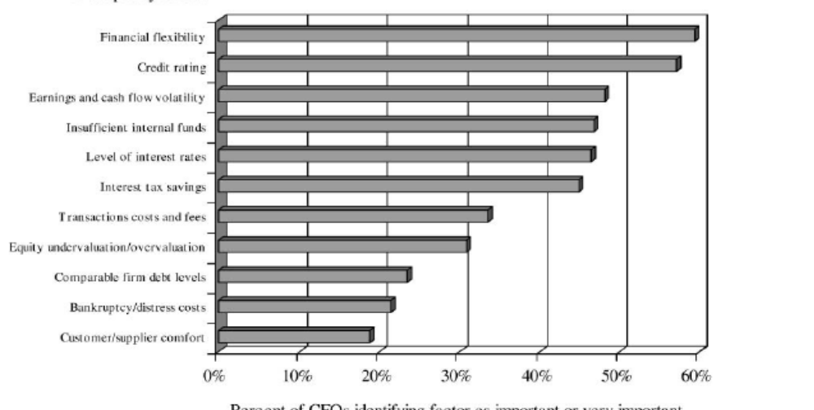
Debt policy factors
Debt policy factors

Slide 67
A firm in a heaven
Assume that you live in a heaven where
There are no taxes
Managers have stockholders' interests at heart and do what’s best for stockholders
No firm ever goes bankrupt
Equity investors are honest with lenders, there is no subterfuge or attempt to find loopholes in loan agreements
Firms know their future financing needs with certainty
How much should you borrow for this firm.

Slide 68
What do firms look at in financing?
There are some who argue that firms follow a financing hierarchy, with retained earnings being the most preferred choice for financing, followed by debt and that new equity is the least preferred choice. In particular
  Managers value flexibility. Managers value being able to use capital (on new investments or assets) without restrictions on that use or having to explain its use to others.
  Managers value control. Managers like being able to maintain control of their businesses.
With flexibility and control being key factors:
  Would you rather use internal financing (retained earnings) or external financing?
  With external financing, would you rather use debt or equity?

Slide 69
Preference rankings long-term finance: Results of a survey
Ranking | Source | Score
1 | Retained Earnings | 5.61
2 | Straight Debt | 4.88
3 | Convertible Debt | 3.02
4 | External Common Equity | 2.42
5 | Straight Preferred Stock | 2.22
6 | Convertible Preferred | 1.72

Slide 70
Analyzing cash return to shareholders

Slide 71
Corporate Finance: The Big Picture
Maximize the value of the business (firm)
The Investment Decision Invest in assets that earn a return greater than the minimum acceptable hurdle rate
The Financing Decision
Find the right kind of debt for your firm and the right mix of debt and equity to fund your operations
The Dividend Decision
If you cannot find investments that make your minimum acceptable rate, return the cash to owners of your business
The hurdle rate should reflect the riskiness of the investment and the mix of debt and equity used to fund it.
The return should reflect the magnitude and the timing of the cashflows as well as all side effects
The optimal mix of debt and equity maximizes firm value
How you choose to return cash to the owners will depend on whether they prefer dividends or buybacks

Slide 72
Cash Dividend
Dividend Process
2-3 weeks 1-4 days 2-3 weeks
Announcement date
Record date
Payment date
Ex-dividend date

Slide 73
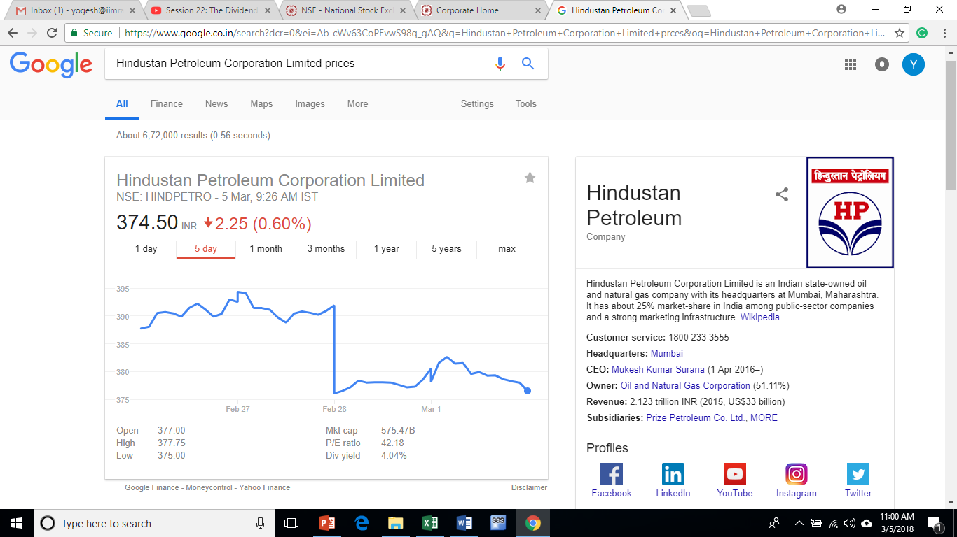
390.90
376.05

Slide 74
Company | Purpose | Ex-Date | Record Date | Difference
Kewal Kiran Clothing Limited | Interim Dividend - Rs 9.50 Per Share | 30-Jan-18 | 31-Jan-18 | 1
Zensar Technologies Limited | Interim Dividend - Rs 5 Per Share | 30-Jan-18 | 31-Jan-18 | 1
Cyient Limited | Interim Dividend - Rs 4 Per Share | 30-Jan-18 | 31-Jan-18 | 1
Sasken Technologies Limited | Interim Dividend - Rs 3 Per Share (Purpose Revised) | 30-Jan-18 | 31-Jan-18 | 1
Bharti Airtel Limited | Interim Dividend - Rs 2.84 Per Share | 30-Jan-18 | 31-Jan-18 | 1
Reliance Nippon Life Asset Management Limited | Interim Dividend - Rs 5 Per Share | 31-Jan-18 | 1-Feb-18 | 1
JM Financial Limited | Interim Dividend - Re 0.70 Per Share | 31-Jan-18 | 1-Feb-18 | 1
Wipro Limited | Interim Dividend - Re 1 Per Share (Purpose Revised) | 31-Jan-18 | 1-Feb-18 | 1

Slide 75
Measures of Dividend policy
Dividend Payout=Dividend/Net Income
  Measures the percentage of earnings that the firm pays in dividends.
  If the net income is negative, the payout ratio cannot be calculated.
Dividend Yield=Dividend per share/Stock price
  Measures the return that an investor can make from dividend alone.
  Expected returns=Capital gain +dividend yield.

Slide 76
Which firms should pay dividends?
Firms that have excess cash, but do not have good project (NPV>0).
Example
Expected EPS=100
Cost of Equity=10%.
Internal growth rate=ROE*(1-dividend payout ratio).
Value of Equity=Expected Dividend/(Cost of equity-Growth)

Slide 77
Case 1: ROE> Cost of equity
Expected EPS | DP | Ke | ROE | Growth | Dividend Amount | Equity Value
100 | 10% | 10% | 11% | 9.90% | 10 | 10990
100 | 20% | 10% | 11% | 8.80% | 20 | 1813
100 | 30% | 10% | 11% | 7.70% | 30 | 1405
100 | 40% | 10% | 11% | 6.60% | 40 | 1254
100 | 50% | 10% | 11% | 5.50% | 50 | 1172
100 | 60% | 10% | 11% | 4.40% | 60 | 1119
100 | 70% | 10% | 11% | 3.30% | 70 | 1079
100 | 80% | 10% | 11% | 2.20% | 80 | 1048
100 | 90% | 10% | 11% | 1.10% | 90 | 1022
100 | 100% | 10% | 11% | 0.00% | 100 | 1000

Slide 78
Case 2: Cost of equity>ROE
Expected EPS | DP | Ke | ROE | Growth | Dividend Amount | Equity Value
100 | 10% | 10% | 9% | 8.10% | 10 | 526
100 | 20% | 10% | 9% | 7.20% | 20 | 714
100 | 30% | 10% | 9% | 6.30% | 30 | 811
100 | 40% | 10% | 9% | 5.40% | 40 | 870
100 | 50% | 10% | 9% | 4.50% | 50 | 909
100 | 60% | 10% | 9% | 3.60% | 60 | 938
100 | 70% | 10% | 9% | 2.70% | 70 | 959
100 | 80% | 10% | 9% | 1.80% | 80 | 976
100 | 90% | 10% | 9% | 0.90% | 90 | 989
100 | 100% | 10% | 9% | 0.00% | 100 | 1000

Slide 79
Case 3: Cost of equity= ROE
Expected EPS | DP | Ke | ROE | Growth | Dividend Amount | Equity Value
100 | 10% | 10% | 10% | 9.00% | 10 | 1000
100 | 20% | 10% | 10% | 8.00% | 20 | 1000
100 | 30% | 10% | 10% | 7.00% | 30 | 1000
100 | 40% | 10% | 10% | 6.00% | 40 | 1000
100 | 50% | 10% | 10% | 5.00% | 50 | 1000
100 | 60% | 10% | 10% | 4.00% | 60 | 1000
100 | 70% | 10% | 10% | 3.00% | 70 | 1000
100 | 80% | 10% | 10% | 2.00% | 80 | 1000
100 | 90% | 10% | 10% | 1.00% | 90 | 1000
100 | 100% | 10% | 10% | 0.00% | 100 | 1000

Slide 80
Share buyback
Unlike dividend that is paid out every year, share buyback is used to one-time returns of cash to investors.
Motivation for share buyback
  Management compensation (ESOP).
  Under valuation or to support their stock prices.
  Tax benefits to investors.
  To increase insider control.
Process of buying back
  Open Market
  Tender offer
    Fixed-price tender
    Dutch auction
      A Dutch auction offer specifies a price range within which the shares will ultimately be purchased

Slide 81
Dutch auction
A firms is wishing to buyback 2 million stock at an offered range of Rs 34 to 42 share. In this case, clearing price is Rs. 40, resulting in an Rs. 80 million outlay
Price | Share Tendered (thousands) | Cumulative share tendered
34 | 200 | 200
35.75 | 250 | 450
37 | 300 | 750
38 | 350 | 1100
39.5 | 400 | 1500
40 | 500 | 2000
40.5 | 650 | 2650
41 | 500 | 3150
42 | 450 | 3600

Slide 82
Repurchase share: SJVN ltd (a Mini Ratna)
On Jan 3, 2018, the board announced to buy around 5% stake by tender offer of Rs. 38.75 per share.
On Jan 4, 2018, stock price increased by nearly 16% (close to offer price), 38.60, whereas BSE Sensex increased by 6.08%.
The firm reported a 16.7 per cent YoY fall in net profit at Rs 434.89 crore for the September quarter. Sales for the quarter declined 14.3 per cent to Rs 727.26 crore during the quarter.

Slide 83
Cash flow position on March 2017
Cash Flow Summary | (in crore)
Cash and Cash Equivalents at Beginning of the year | 1,222.19
Net Cash from Operating Activities+ | 2,376.72
Net Cash Used in Investing Activities+ | -1,199.54
Net Cash Used in Financing Activities+ | -1,621.27
Net Inc/(Dec) in Cash and Cash Equivalent | -444.09
Cash and Cash Equivalents at End of the year | 778.1
Tender offer | 800.00
Debt issued | 21.90

Slide 84
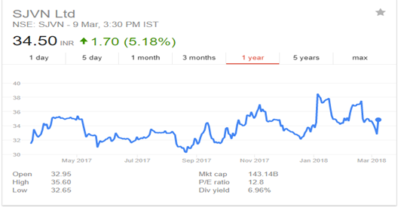
SJVN share prices

Slide 85
Thank for your time

