Slide 1
Financial Statement Analysis
Dr. Praveena Musunuru

Slide 2
Objectives
Financial Statement analysis involves
  the examination of both the relationships among financial statement numbers
  trends in those numbers over time
It is both
  Diagnosis (identifying where a firm has problems)
  Prognosis ( predicting how a firm will do in the future)
Evaluation of the past and prediction of the future

Slide 3
Financial Statements
Listed below are questions posed by various users of a company’s financial statements.
Stockholder: “How did this year’s sales figures compare with last year’s sales figures?”
Banker: “How much in borrowings does the company currently owe?”
Supplier: “How much does the company owe its suppliers in total?”
Stockholder: “Did the company have any dividends in the prior year?”
Advertising Agent: “How much advertising did the company incur in order to generate sales?”
Banker: “What was the company’s total interest cost last year?”

Slide 4
Financial Statements
Profit and Loss Statement/Income Statement
Balance Sheet
Cash Flow Statement

Slide 5
Lehman Brothers
In March 2008, Lehman Brothers announced quarterly profits of US$489 million (Dh1.79 billion). Six months later the Wall Street firm filed for bankruptcy. In spite of four consecutive years of record-breaking profits, the firm ran out of cash. It could no longer do business. The end.
Profits are nice, but cash is what counts.”
Source : The National , Feb 2010

Slide 6
Profit ≠ Cash
Profits are based on accounting rules—timing differences, estimates, and non-cash items. Cash is real. It’s what you use to pay salaries, suppliers, and debt.
The cash flow statement tracks actual cash coming in and going out. It tells you:
Are we truly generating cash from operations?
Are we spending on assets or getting returns?
Are we dependent on loans or able to fund ourselves?

Slide 7
Three heads of Cash Flow
Cash Flow from Operating Activities
Cash Flow from Investing Activities
Cash Flow from Financing Activities
Meaningful grouping assists in understandings trends and comparison

Slide 8
Cash and Cash Equivalents
A statement of cash flows explains the change during the period in cash and cash equivalents.
Cash equivalents consists of short-term highly liquid investments having maturity less than three months, which can be readily converted into cash without decline of its value.

Slide 9
Operating activities
Principal revenue producing activities of the enterprises
  Cash receipts from sale of goods and the rendering of services
  Cash receipts from royalties, fees, commissions and other revenue
  Cash payments to suppliers for goods and service
  Cash payments to and on behalf of employees

Slide 10
Investment activities
Acquisition and disposal of long-term assets and other investments not included in cash equivalents
Cash Payments to acquire fixed assets including intangibles
Cash payments relating to capitalization, R&D costs, self constructed assets
Cash receipts from disposal of fixed assets and investments
Other receipts from investments such as interest and dividend received

Slide 11
Financing activities
Cash flows from those activities which result in change in size and composition of owner’s capital and borrowing
Receipts from issuing shares, debentures , bonds, loans etc
Buy back of shares, Redemption of bonds, preference shares, Payment of loan
Dividend and interest paid

Slide 12
Need for Analysis
  How well the business performed during the period
  Did the earnings grow, decline 0r remain unchanged?
  How was the profit measured?
  How well the firm performed in Comparison to other firms (competitors) in the industry?

Slide 13
Sources of Information
Company Reports
Stock exchanges
Business Periodicals, websites and television
Useful database such as Prowess, Capitaline

Slide 14
Standards of comparison
Past performance
Industry standards
Rule of thumb indicators
Internal standards

Slide 15
Ratio Analysis
1. Assess Financial Health
Understand the company’s profitability, liquidity, and solvency.
Identify strengths and weaknesses in operations.
2. Support Decision-Making
Helps investors decide whether to buy, hold, or sell shares.
Aids managers in strategic planning and budgeting.

Slide 16
Techniques of financial Statement Analysis
Horizontal analysis – Comparison of current year with previous year
Trend analysis – Extension of Horizontal analysis to many years. Choose a base year whose trend number is 100.Following years are expressed as a % of base year value.

Slide 17
Horizontal Analysis?
What is Horizontal Analysis?
  A method of comparing financial statement items across two or more periods to identify trends and growth/decline patterns.
Why Use It?
  Evaluates changes in revenue, expenses, assets, liabilities, etc.
  Helps spot performance trends, highlight potential issues, and guide strategic decisions.

Slide 18
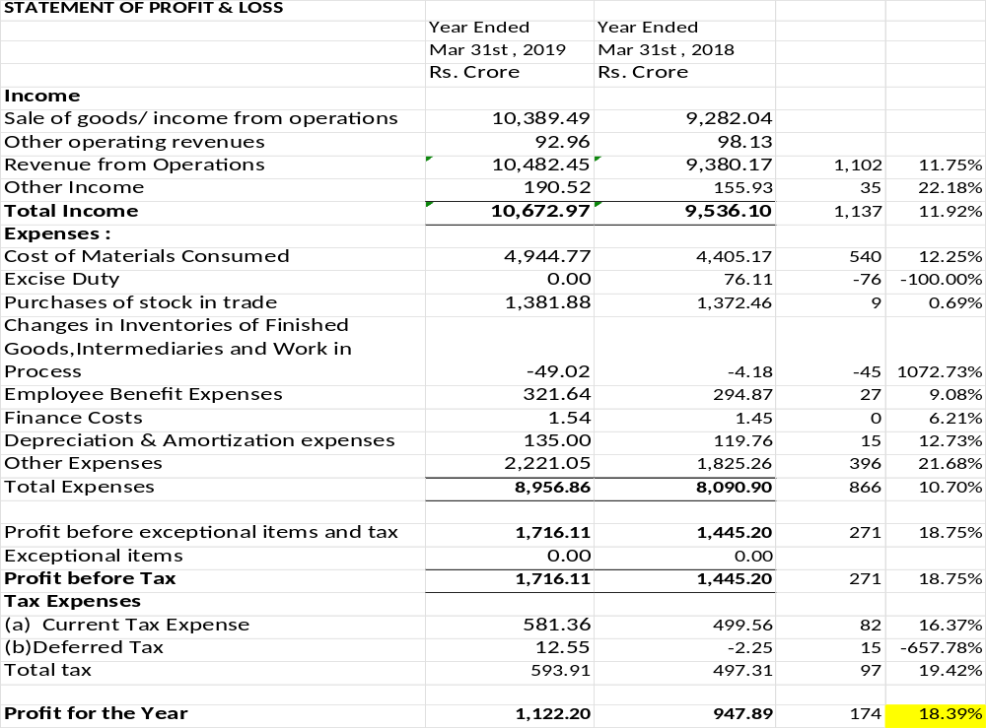

Slide 19
Exceptional Items
  Exceptional items are non-recurring, unusual gains or losses that are not part of a company's regular operations.
  Write-off Provision for bad debts
  Restructuring costs or asset impairments.
  Gains/losses from the sale of a business segment or major asset.
  Unusual legal settlements or write-offs.

Slide 20
Deferred Tax Asset
Deferred Tax Asset (DTA):
Occurs when: The company pays more tax now (in the current period)
but expects to pay less in the future.
Example:
  If a company records a provision for bad debts in financial statements but tax laws allow deduction only when actual write-off happens, a deferred tax asset is created.
  Impact: Reduces tax payable in future periods.

Slide 21
Deferred Tax liability
Occurs when: The company pays less tax now but expects to pay more in the future.
Example:
  If a company uses accelerated depreciation for tax purposes
  (higher depreciation now, lower taxable income), the tax savings today result in a deferred tax liability.
  Impact: Higher tax payable in future periods when depreciation claims decrease.

Slide 22
Deferred Tax
A negative deferred tax in FY18 (-₹2.25 Cr) indicates that the company had a tax benefit in that period.
The shift to ₹12.55 Cr in FY19 suggests that prior deferred tax assets may have been exhausted, or new deferred tax liabilities were recorded.

Slide 24
1. Revenue Growth (+11.92%)
Revenue from operations increased by ₹1,102 Cr (+11.75%).
Other income grew by ₹35 Cr (+22.18%).
2. Cost Management & Efficiency
Cost of Materials Consumed increased by ₹540 Cr (+12.25%), aligned with revenue.
Excise duty elimination (-100%) contributed to profitability.
Employee Expenses (+9.08%), Depreciation (+12.73%) remained manageable.
Inventory management (-₹49 Cr change) improved efficiency.
3. Rising Other Expenses (+21.68%)
Increased spending on marketing, distribution, and operations (₹396 Cr rise)..
4. Tax Management & Net Profit
Total tax expense increased by ₹97 Cr (+19.42%).
Deferred tax impact (-657.78%) suggests tax provisions adjustment.

Slide 25
Summary
Profit increase primarily due to revenue growth, cost control, and excise duty savings.
Other expenses grew, requiring cost efficiency focus.
Overall, strong operational performance supported the 18.39% profit growth.

Slide 26
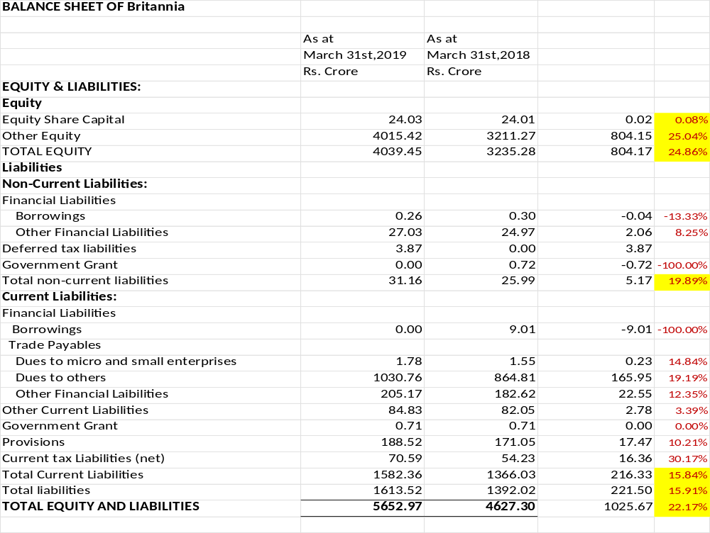

Slide 27
ASSETS
Non-Current Assets :
Property, Plant and Equipment | 1283.85 | 1008.31 | 275.54 | 27.33%
Capital Work-in-Progress | 64.91 | 200.28 | -135.37 | -67.59%
Investment Property | 36.13 | 14.99 | 21.14 | 141.03%
Intangible Assets | 7.62 | 7.97 | -0.35 | -4.39%
Financial Assets
Investments | 1050.97 | 450.65 | 600.32 | 133.21%
Loans | 15.55 | 86.74 | -71.19 | -82.07%
Other financial assets | 1.00 | 0.00 | 1.00
Deferred tax assets (net) | 0.00 | 8.68 | -8.68 | -100.00%
Income tax assets (net) | 29.52 | 14.07 | 15.45 | 109.81%
Other non-current assets | 93.15 | 68.09 | 25.06 | 36.80%
Total | 2582.70 | 1859.78 | 722.92 | 38.87%
Current Assets:
Inventories | 718.89 | 594.58 | 124.31 | 20.91%
Financial Assets
Investments | 594.70 | 735.48 | -140.78 | -19.14%
Trade Receivables | 350.96 | 230.32 | 120.64 | 52.38%
Cash & Cash Equivalents | 24.73 | 88.91 | -64.18 | -72.19%
Bank bal other than C&CE | 15.75 | 8.34 | 7.41 | 88.85%
Loans receivable | 1121.41 | 820.41 | 301.00 | 36.69%
Other financial assets | 119.54 | 98.51 | 21.03 | 21.35%
Other Current Assets | 124.29 | 190.97 | -66.68 | -34.92%
Total current asssets | 3070.27 | 2767.52 | 302.75 | 10.94%
TOTAL ASSETS | 5652.97 | 4627.30 | 1025.67 | 22.17%

Slide 28
Balance Sheet
Positive Indicators:
Strong growth in equity indicates profitability and retained earnings.
Heavy investment in PPE and properties suggests expansion.
Reduced borrowings lower financial risk.
Increase in investments reflects better cash utilization.
⚠ Areas to Monitor:
Rising trade receivables can strain cash flow if not managed properly.
Drop in cash & cash equivalents may indicate aggressive investment or potential liquidity constraints.
Higher trade payables and tax liabilities require close monitoring.

Slide 29
Common Size statements
Vertical analysis
Problem in comparing data of different size, scale etc over periods and between firms
Use of Common denominator- Sales in income statement and total in a balance sheet.
Facilitate structural analysis of the firm

Slide 30
Vertical Analysis – FY 2019 vs FY 2018
As % of Revenue
Total income rose marginally to 101.82% from 101.66%.
Cost of materials consumed remained stable at ~47%.
Other expenses rose to 21.19% from 19.46%.
Total expenses declined to 85.45% from 86.29%.
Net profit margin increased to 10.71% from 10.10%.

Slide 31
Key Takeaways – Vertical Analysis
Equity base strengthened to 71.46% (up from 69.92%)
Total liabilities reduced to 28.54% (from 30.08%)
Non-current assets rose to 45.69% (from 40.19%),
showing a shift toward long-term capital investments.
Non-current investments jumped significantly to 18.59% (from 9.74%),
reflecting a strategic allocation of surplus funds.
Capital work-in-progress dropped sharply to 1.15% (from 4.33%),
suggesting completion of major ongoing projects.
Current assets declined to 54.31% (from 59.81%), mainly due to
reduced cash and short-term investments.
Cash and cash equivalents fell to 0.44% (from 1.92%), indicating lower
liquidity on hand.
Loans receivable increased to 19.84% (from 17.73%),
possibly representing higher inter-company or trade loans.

Slide 32
Overall assessment
Britannia demonstrates excellent financial health with:
Strong capital structure
Low leverage
Healthy long-term investment focus
However, it should:
Monitor liquidity more closely (falling cash)
Evaluate credit exposures (rising loans receivable)
Ensure that investment returns and cash flows are well-aligned with growth plans

Slide 33
Ratio Analysis
Ratio analysis involves the examination of relationships among financial statement items or group of items to assess the financial health of the company
Useful management tool in ascertaining strengths and weakness in the financial status of the company
Helps to evaluate of the past performance as well as current financial health and predict and chart the future growth

Slide 34
A single ratio is not sufficient to adequately judge the financial situation of the company.
Several ratios must be analyzed together and compared with prior-year ratios, or even with other companies in the same industry.
This comparative aspect of ratio analysis is extremely important in financial analysis.
It is important to note that ratios are parameters and not precise or absolute measurements. Thus, ratios must be interpreted cautiously to avoid erroneous conclusions.

Slide 35
Ratio Analysis
Ratios help evaluate various aspects of performance such as
Profitability
Liquidity
Activity / Management efficiency
Solvency
Capital market strength

Slide 36
What do Investors get?
Capital gain
Dividends
Ratios to assess profitability

Slide 37
Profitability
Gross Margin= Gross Profit/Sales
Profit margin or Return on sales = PAT/Sales
Return on assets = PAT/ Average total assets
Assets turnover = Sales/ Average total assets
Earnings per share
Sales is the same as Rev from Operations (Net)

Slide 38
Gross Margin
Gross Margin= Gross Profit / Net Sales
Gross Margin can vary drastically between industries.
For example, digital products sold online will have extremely high Gross Margin as compared to a company that sells Laptop.
Gross margin is extremely useful when we look at the historical trends in the margins.
If the Gross Margins has increased historically, then, it could be either because of price increase or control of direct costs.
However, if the Gross margins show a declining trend, then it may be because of increased competitiveness and therefore resulting in decreased sales price.

Slide 39
Profit margin
Formula: Net Profit ÷ Revenue
Benchmark: Typically 5%–15% for many industries
Interpretation: Indicates what percentage of revenue remains after all expenses. A higher margin reflects efficient cost management and pricing strategies.
Net profit is a “noisy” measure, because of the inclusion of other income and exceptional items
Indication of the cushion available in the event of an unexpected increase in costs or a drop in selling prices.

Slide 40
Return on Assets
ROA=(Net Income/Total Assets)
Higher ROA → Better asset utilization and profitability.
Lower ROA → Inefficiency or capital-intensive operations.
ROA varies by industry; manufacturing firms usually have lower ROA due to asset-heavy businesses.

Slide 41
Asset Turnover Ratio
Asset Turnover Ratio=Net Sales/Average Total Assets
A higher ratio suggests better efficiency in utilizing assets to generate revenue.
A lower ratio may indicate underutilization of assets or high capital intensity.
Industry Variation: Retail and service industries tend to have higher asset turnover, while manufacturing companies typically have lower asset turnover due to heavy investments in fixed assets.

Slide 42
Return on Equity
Net income ÷ Shareholders’ equity
Reflects what company has earned on funds invested by shareholders.
Of interest to current and prospective shareholders.
Important indicator of shareholder value creation.

Slide 43
Return on Operating Assets
Focus on operations
Return on Operating Assets = NOPAT
Average Operating assets
Operating Assets are average assets less investments
NOPAT- Net Operating Profit after Tax

Slide 44
NOPAT
PAT
Adjust : Exceptional items net of tax
Less: Other income net of tax
Add: Finance Cost net of tax
= NOPAT
Tax rate = Maximum marginal rate 34.9% for current year

Slide 45
Profitability
Operating profit margin = NOPAT/ Sales
Operating profit on assets = NOPAT/ Average
Operating
assets
Earnings per share= PAT/ WA equity shares

Slide 46
ROCE(Return on capital employed)
ROCE= Net Operating Income (EBIT) /(Total Assets – Current Liabilities)
ROCE Company’s ability to utilize its capital employed (Debt & Equity) in the business

Slide 47
Let’s Ponder!!
Return on Total Assets of a company is more than 20% for the last 5 years. Do you think it’s a good measure to invest into the company for future benefits?

Slide 48
Why a High ROA is a Positive Sign
Efficient Use of Assets
  ROA > 20% indicates the company generates high profits from its asset base, reflecting operational efficiency.
Sustained Performance
  Consistency over 5 years suggests resilience and good management practices, even across varying economic conditions.
Low Capital Intensity
  Companies with high ROA often operate in low-capex sectors (e.g., tech, FMCG, digital), which is favorable for high returns.

Slide 49
But Not Sufficient Alone
ROA Doesn’t Capture Leverage
May Be Industry-Specific
Other Key Factors Missing
You must also evaluate:
  Revenue growth trends
  Profit margins
  Debt levels
  Valuation metrics (P/E, P/B)
Sustainability of ROA
Is the company doing something exceptional or temporary to keep ROA high
(e.g., asset-light strategy, tax advantages, one-time gains)?

Slide 50
Let’s Ponder!!
Return on Equity of a company A is higher than Company B? Should you invest in Company A?

Slide 51
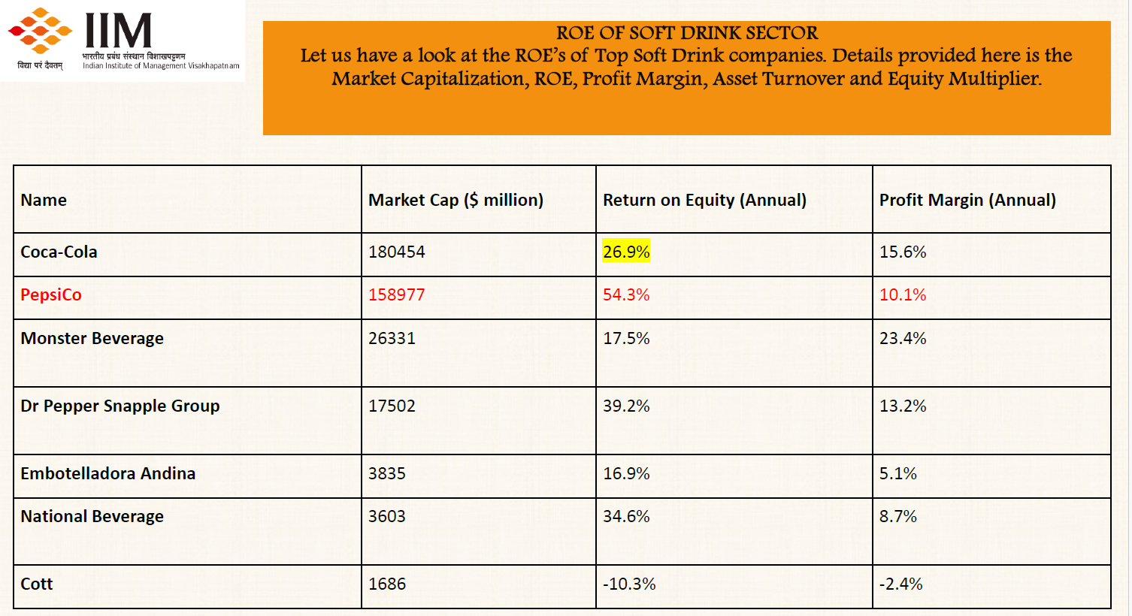

Slide 52
Du Pont Model
ROA= Profit margin X Asset turnover
Leverage = Assets/equity
ROE = Profit margin X Asset turnover X Leverage

Slide 53
Britannia – Profitability Analysis
Return on Equity (ROE)
30.85% (↓ from 32.59%) – still very strong, driven by solid margins.
Profit Margin
Improved to 10.71% from 10.11% – reflects better cost control and pricing power.
Asset Turnover
Declined to 2.04 from 2.25 – indicates slightly lower efficiency in asset usage.

Slide 54
Leverage (Assets/Equity)
Marginally reduced to 1.41 from 1.43 – suggests lower financial risk.
Return on Assets (ROA)
Healthy at 21.83% (vs 22.78%) – consistent operating efficiency.
Britannia continues to deliver high profitability with conservative leverage, making it a financially sound and operationally efficient company.

Slide 55
Liquidity Ratios
Liquidity ratio analysis measure how liquid the company’s assets are (how easily can the assets be converted into cash) as compared to its current liabilities.

Slide 56
Liquidity
Ability to pay debts in the short run
Current Ratio = CA/CL
Quick Ratio = CA minus inventory/CL
Activity Turnover Ratios
Receivable Turnover ratio = Sales/ Average Receivable
Average collection period =Average Receivable/sales*365
Inventory Turnover =COGS/ Average Inventory
Sales can be substituted for COGS in Inventory turnover

Slide 57
Current Ratio
Measures a company's ability to pay off its short-term liabilities with its short-term assets.
Current Ratio = Current Assets / Current Liabilities
A higher ratio indicates more financial flexibility. Typically, a ratio above 1 is considered good, but this can vary by industry.
Thumb Rule-2:1

Slide 58
Quick Ratio or Acid Ratio
Assesses a company's ability to meet short-term obligations with its most liquid assets.
Quick Ratio = (Current Assets – Inventory- Prepaid Expenses) / Current Liabilities
A stricter measure than the current ratio, focusing on more liquid assets. A value of 1 or more is generally seen as satisfactory.
Excluding prepaid expenses, non-trade receivables, and employee loans

Slide 59
Receivable Turnover ratio
Measures the efficacy of a firm’s credit policy and collection mechanism.
It shows the number of times each year the receivables are turned into cash.
Receivable Turnover Ratio = Net Credit Sales / Average Accounts Receivable
Higher values suggest more efficient credit control and collection processes.

Slide 60
Average Collection Period
The average number of days required to collect receivables from customers.
Average Collection Period = (Average Accounts Receivable / Net Credit Sales) * 365
= 365/Receivable Turnover Ratio
Shorter periods are preferred as they indicate quick collection.

Slide 61
Inventory Turnover
Shows how often a company's inventory is sold and replaced over a period.
Inventory Turnover = Cost of Goods Sold / Average Inventory
Higher turnover indicates efficient inventory management; varies significantly across different industries.

Slide 62
Average Holding Period (Days Inventory Outstanding)
Average Holding Period (Days)=365/ Inventory Turnover
If the holding period is increasing year over year, it may suggest that inventory is not being sold as quickly as before, which can tie up capital and increase storage costs.

Slide 63
Liquidity
Average Inventory holding period=
Average Inventory/COGS*365
Operating Cycle = Inventory holding period + debtor(receivable) collection period
Cash Cycle = Inventory holding period + Receivable collection period- Payable payment period
Payable payment period=
Average trade payable/Purchases*365

Slide 64
Operating Cycle
Measures the time it takes for a company to purchase inventory, sell it, and collect the cash from sales.
Operating Cycle = Inventory Holding Period + Receivable Collection Period
A shorter operating cycle is generally preferable as it indicates that the company is quickly turning its inventory into cash.

Slide 65
Payable Payment Period
Reflects the average number of days it takes for a company to pay its suppliers.
Payable Payment Period = (Average Trade Payables / Purchases) * 365
A longer payment period can be beneficial for the company's cash flow, as it indicates that the company retains cash longer.

Slide 66
Cash Cycle
Measures the time it takes for a company to convert its investments in inventory and other resources into cash flows from sales.
Cash Cycle = Inventory Holding Period + Receivable Collection Period - Payable Payment Period
This cycle helps in understanding the company’s efficiency in managing its cash flow.
A shorter cash cycle suggests a more efficient cash management.

Slide 67
Britannia – Liquidity Analysis
Liquidity Ratios
Current Ratio declined slightly: 1.94 vs 2.03 – still healthy, indicating strong short-term solvency.
Quick Ratio dipped to 1.49 (from 1.59) – shows slightly tighter liquidity when excluding inventory.

Slide 68
Inventory Turnover improved to 15.96x (from 15.67x) –better inventory management.
Inventory Holding Period reduced to 22.87 days (from 23.29 days) – quicker stock movement.
Receivables Turnover dropped sharply to 36.07x (from 52.59x) – slower collection efficiency.
Receivables Collection Period increased to 10.12 days (from 6.94 days) – suggests lenient credit or delayed collections.

Slide 69
Solvency
Solvency – Long-term liquidity, Amount of debt financing and risk.
Risk of bankruptcy
Long term investors are interested in safety of their principal amount and interest

Slide 70
Solvency
Debt to equity ratio = Debt/Equity
Debt= Short term & long term borrowings
Interest coverage = EBIT /Interest
Debt Service coverage Ratio = EBITDA/ (Interest + Principal Installment)
Liabilities to Equity Ratio = All Liabilities/ Equity
(useful when short term obligations are rolled over)

Slide 71
Debt to Equity Ratio
Measures a company's financial leverage by comparing its total liabilities to shareholders' equity.
Debt to Equity Ratio = Total Debt / Total Equity
Indicates the proportion of equity and debt used to finance a company's assets.
A higher ratio means more debt, which could be riskier.
What about no debt? Then what?

Slide 72
Interest Coverage Ratio
Assesses how easily a company can pay interest expenses on outstanding debt.
Interest Coverage Ratio = Earnings Before Interest and Taxes (EBIT) / Interest Expense
A higher ratio suggests that the company can easily meet its interest obligations from its earnings.

Slide 73
Debt Service Coverage Ratio (DSCR)
Measures a company's ability to use its operating income to repay all its debt obligations, including repayment of principal and interest.
DSCR = Earnings Before Interest, Taxes, Depreciation, and Amortization (EBITDA) / (Interest Expense + Principal Repayment)
Ratios greater than 1 indicate sufficient earnings to cover debt payments.

Slide 74
Liabilities to Equity Ratio
Measures the relative proportion of entity’s liabilities to shareholders’ equity.
Liabilities to Equity Ratio = Total Liabilities / Total Equity
Provides insight into the company's financing structure.
A high ratio indicates a heavy reliance on debt for funding.

Slide 75
Brittania..
Debt to Equity Ratio
FY 2018–19: 0.00006 (effectively negligible debt) vs.FY 2017–18: 0.0029
indicating extremely low financial risk.
Liabilities to Equity Ratio
0.40:1 in FY 2019 vs 0.43:1 in FY 2018
total liabilities are well covered by equity
Interest Coverage Ratio
1,115x in FY 2019 vs 998x in FY 2018
Extremely high ratio confirms ample ability to meet interest obligations, further supported by low debt levels.

Slide 76
Capital Market Strength
Price Earnings Ratio = Market price/EPS
You can either use closing market price or Average market price (average of high and low price) on 31st March (B/s date)
Market price not controlled by company.
Best measure of how investors judge company’s future performance.
Commonly compared to other companies in same industry.
  Can reflect differing expectations of growth among industries.

Slide 77
Earnings per Share
Basic EPS = (Profit after tax – Preference Dividend)
Weighted number of Equity Shares
If shares are issued or bought back equity shares, then weighted number of shares is based on number of months shares are held.

Slide 78
Basic EPS -example
Infra Limited had 40000 shares on 1st April 2012. On Jan 1st 2013, it issued 10000 equity shares. It had 10% Preference share capital of Rs.80000 throughout the year. The company earned a profit after tax of Rs. 4,33,000 during the year. Compute the Basic EPS.
Weighted average number of shares= 42500
Basic EPS = Rs. 10

Slide 79
Diluted EPS
When there are potentially dilutive equity shares
Presence of convertible preference shares, preference debentures, stock options etc

Slide 80
Diluted EPS
Linux Company had 2,00,000 equity shares and 2000 of 8% convertible debentures of Rs.100 convertible into 10 equity shares each. For the year ended 31st December 2012, the company earned a after tax profit of Rs.8,00,000. Calculate Basic and Diluted EPS if the tax rate is 30%.
Basic EPS = Rs.4
Diluted EPS = Rs.3.69

Slide 81
Dividend Yield
Dividend Yield = Dividend per share/ Average Stock price
Average stock price= Average price at the bg. of the year and end of the year
Total return to shareholder =
(Change in stock price+ Dividend)/ Stock price at bg

Slide 82
Price to book ratio
To compare a company’s market value with its book value.
Price to book ratio = Market price per share/book
value per share
A lower P/B ratio could mean the stock is undervalued

Slide 83
Quality of earnings
Earnings trends continue
Distributable in cash
Conservative practices, choice of accounting policies
Primarily operating income and Not volatile

Slide 84
Importance of Industry Comparisons
Key Point:
  Comparing a company’s performance to industry standards helps overcome the limitations of just looking at its own past trends.
Example:
  If a company’s gross margin is 7% vs. an industry average of 12%, it suggests room for improvement or inefficiencies.

Slide 85
Advantages of Benchmarking
  Identifies relative strengths and weaknesses.
  Provides context for setting performance targets.
  Aids investors in evaluating whether a company outperforms or underperforms peers.

Slide 86
Challenge #1 – Size & Product Mix
  Companies often operate in different segments, making direct comparisons difficult.
  Examples:
  Hindustan Unilever: soaps, detergents, toothpaste, food.
  Procter & Gamble: detergents, plus other products not sold by HUL.
  ITC: food, hotels, tobacco.
  Colgate: toothpaste only.
  Implication:
  Comparing a multi-product firm to a single-product firm may not be meaningful.

Slide 87
Challenge #2 – Accounting Policies
Different companies may follow different accounting methods.
Examples of Variation:
Inventory valuation (FIFO vs. Weighted Average).
Useful life estimates for assets (straight-line vs. accelerated depreciation).
Revenue recognition timing.
Implication:
Ratios and metrics may not be strictly comparable across firms.

Slide 88
Challenge #3 – Fiscal Year Differences
Not all companies have the same year-end date.
Examples:Ambuja Cement follows the calendar year (December 31).India Cements follows March 31.
Companies Act 2013:Generally requires March 31 year-end unless exempt.
Implication:Seasonality and economic conditions can vary, complicating direct comparisons.

