Slide 1
Financial Derivatives

Slide 2
Introduction
Derivative is an instrument whose value depends on the values of other more basic underlying variables
• Each derivative product has an “underlying” associated with it.
• The value of the derivative depends on, among other things, the value of the underlying.
– Physical commodities: Coffee, Crude oil, Wheat etc.
– Financial assets: Currencies, Stocks, Bonds, etc.
– Credit derivatives, Weather derivatives, Derivatives on derivatives

Slide 3
Classes of
derivative
securities
Forward
contracts
Futures
contracts
Options
contracts
Swaps

Slide 4
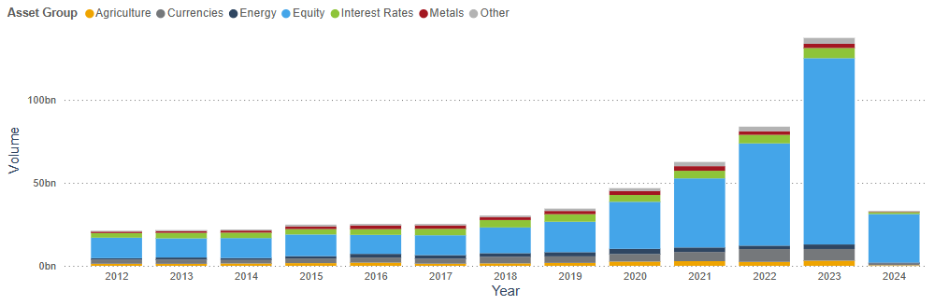
Trading Volume In Global Exchange-Traded Derivatives
Source: FIA

Slide 5
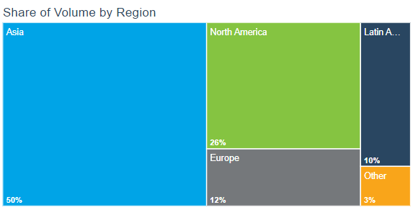
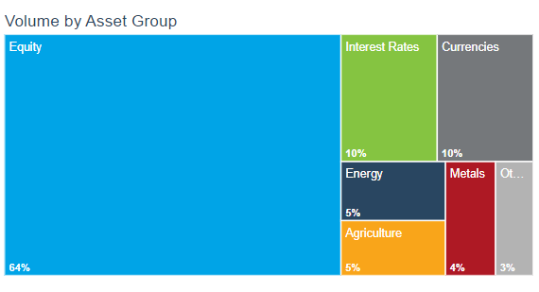
Trading Volume In Global Exchange-Traded Derivatives
Source: FIA

Slide 6

NSE ranked 3rd in the world in the equity segment by the number of trades
The National Stock Exchange (NSE) is world's largest derivatives exchange by the number of contracts traded
Source: Economic Times

Slide 7
Indian Derivatives Markets –
Business Growth In FO Segment (NSE)

Slide 8
Forward Contracts
An agreement to buy or sell an asset at a certain time in the future for a certain price (the delivery or contract price)
An OTC product tailor‐made to the needs of contracting parties
Usually settled by delivery of the underlying but cash settled in some cases
The two parties to the contract bear each other’s credit risk
No money changes hands when contract is first negotiated, and it is settled at maturity

Slide 9
Forward Contracts
price fixed at outset
delivery of asset
pre specified time period
PRESENT
FUTURE
No money changes hands
Goods are delivered and money is paid

Slide 10
Example
price fixed at outset
delivery of asset
pre specified time period
PRESENT
FUTURE
After 90 days
Mitoken agrees to buy 100,000 USD from ICICI Bank 90 days hence at INR 80 per USD. No money/assets change hands

Slide 11
Futures Contracts
A futures contract, like a forward contract is an agreement between two parties to exchange one asset for another, at a specified date in the future.
Terms of the contract fixed upfront.
Futures price – the price for the underlying asset is determined today, but settlement is on a future date.
The futures contract specifies the quantity and quality of the underlying asset and how it will be delivered.

Slide 12
Options
A call option is an option to buy a certain asset by a certain date for a certain price (the strike price)
A put option is an option to sell a certain asset by a certain date for a certain price (the strike price)

Slide 13
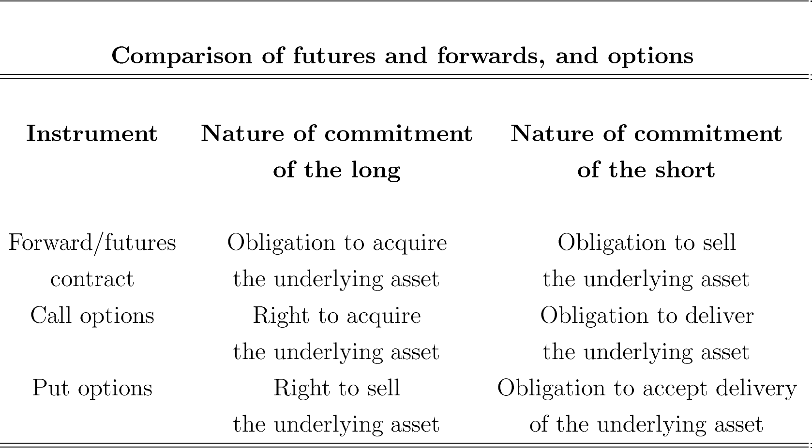

Slide 14
Major Features of Futures Contracts
• Organized Exchanges not OTC markets.
• Standardisation: Amount of asset, expiry dates, deliverable grades etc.
• Clearing House: A party to all contracts. Guarantees performance. Mitigates/Eliminates Credit Risk
• Margins
• Marking to Market : Daily settlement of gains & losses.
• Actual Delivery Is Rare : Futures used mostly for hedging or speculation not for acquiring the underlying asset
https://www.nseindia.com/live_market/dynaContent/live_watch/derivative_stock_watch.htm

Slide 15
Basics of Futures Contracts
Long – a commitment to purchase the commodity on the delivery date.
Short – a commitment to sell the commodity on the delivery date.
Futures are traded on margin.
Profit to long = Spot price at maturity - Original futures price
Profit to short = Original futures price - Spot price at maturity
The futures contract is a zero-sum game, which means gains and losses net out to zero.

Slide 16
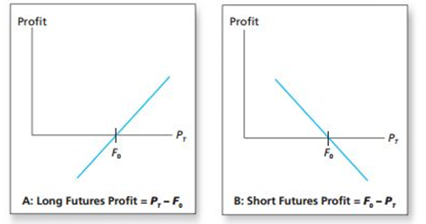
Profits to Buyers and Sellers of Futures
Profit is zero when the ultimate spot price, P_{T} equals the initial futures price, F₀ .

Slide 17
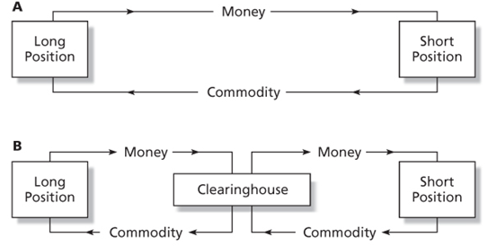

Trading Mechanics
The exchange acts as a clearing house and counterparty to both sides of the trade.
The net position of the clearing house is zero.
Open interest is the number of contracts outstanding.
If you are currently long, you simply instruct your broker to enter the short side of a contract to close out your position.
Most futures contracts are closed out by reversing trades.

Slide 18
Margin and Marking to Market
Marking to Market - each day the profits or losses from the new futures price are paid over or subtracted from the account
Convergence of Price - as maturity approaches the spot and futures price converge
Initial Margin - funds or interest-earning securities deposited to provide capital to absorb losses
Maintenance margin – level at which the account must be replenished, or position reduced
Margin call - when the maintenance margin is reached, broker will ask for additional margin funds

Slide 19
Marking to Market
Observed Futures Price
Time | Contract Price
0 | 4.50
1 | 4.35
2 | 4.15
3 | 4.20
4 | 4.25
Initial Margin - $5,000
Maintenance Margin - $3,750
Two traders entered into the contract at a price of $ 4.50 per bushel of wheat, with each contract representing 5000 bushels

Slide 20
Marking to Market
Margin Account of the Long
Time | Contract Price | Balance | Day's Gain or Loss | Total Gain or Loss | Variation Margin
0 | 4.50 | 5000
1 | 4.35 | 4250 | -750 | -750
2 | 4.15 | 3250 | -1000 | -1750 | 1750
3 | 4.20 | 5250 | 250 | -1500
4 | 4.25 | 5500 | 250 | -1250
Margin Account of the Short
Time | Contract Price | Balance | Day's Gain or Loss | Total Gain or Loss | Variation Margin
0 | 4.50 | 5000
1 | 4.35 | 5750 | 750 | 750
2 | 4.15 | 6750 | 1000 | 1750
3 | 4.20 | 6500 | -250 | 1500
4 | 4.25 | 6250 | -250 | 1250

Slide 21
Trading Strategies
Speculators
seek to profit from price movement
  short - believe price will fall
  long - believe price will rise
Hedgers
seek protection from price movement
  long hedge - protecting against a rise in purchase price
  short hedge - protecting against a fall in selling price

Slide 22
Long & Short Hedges
A long futures hedge is appropriate when you know you will purchase an asset in the future and want to lock in the price
A short futures hedge is appropriate when you know you will sell an asset in the future and want to lock in the price

Slide 23
Using Forward Rates to Reduce Foreign Exchange Risk
Example: A U.S. retailer is going to import electronic games from Japan.
  Purchase price: ¥1 million; current exchange rate is 150 yen per dollar.
Retailer takes long position in a forward contract to buy one million yen at 150 yen per dollar.
This locks in the dollar cost of the purchase.

Slide 24
Using futures markets to reduce input price risk
  The purchase of a commodity futures contract will allow a firm to make a future purchase of the input at today’s price, even if the market price on the item has risen substantially in the interim.
  Eg: Kellogg produces cereal—major component and cost factor is sugar
    Forecasted income and sales volume are set by fixed selling prices
    Cost change impacts forecasts
    To fix sugar costs, Kellogg would like to purchase all sugar today as forecast is based on this price, but cannot
    Kellogg can sign futures contract to purchase sugar in future at price negotiated today

Slide 25
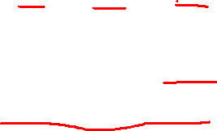
Hedging with Oil Futures
Oil distributor planning to sell 100,000 barrels of oil in April and wishes to hedge against a possible decline in prices. F₀ = $ 75.86. Each contract is for 1,000 barrels.
 | Oil Price
 | $73.86 | $75.86 | $77.86
Revenue from oil sale: 100,000*P_{T} | 7,386,000 | 7,586,000 | 7,786,000
Profit on futures: 100,000*(F₀ - P_{T}) | 200,000 | 0 | -200,000
Total Proceeds | 7,586,000 | 7,586,000 | 7,586,000

Slide 26
Basis and Basis Risk
Basis - the difference between the futures price and the spot price, F_{T} – P_{T}
The convergence property says F_{T} – P_{T}= 0 at maturity
Before maturity, F_{T} may differ substantially from the current spot price
Basis Risk - variability in the basis means that gains and losses on the contract and the asset may not perfectly offset if liquidated before maturity.

Slide 27
Futures Pricing
Spot-futures parity theorem - two ways to acquire an asset for some date in the future:
  Purchase it now and store it
  Take a long position in futures
These two strategies must have the same market determined costs

Slide 28
Spot-Futures Parity Theorem
With a perfect hedge, the futures payoff is certain -- there is no risk.
A perfect hedge should earn the riskless rate of return.
This relationship can be used to develop the futures pricing relationship.

Slide 29
Hedge Example
Investor holds $1000 in a mutual fund indexed to the S&P 500.
The current value of S&P 500 is 1,000.
Assume dividends of $20 will be paid on the index fund at the end of the year.
A futures contract with delivery in one year is available for $1,010.
The investor hedges by selling or shorting one contract.

Slide 30
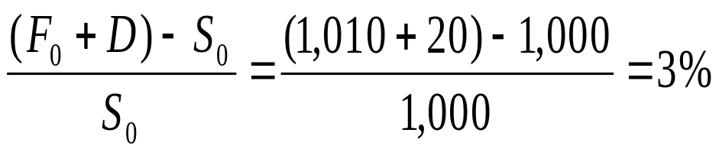
Hedge Example
Value of S_{T} 990 1,010 1,030
Payoff on Short
(1,010 - S_{T}) 20 0 -20
Dividend Income 20 20 20
Total 1,030 1,030 1,030
Rate of return for the hedge

Slide 31
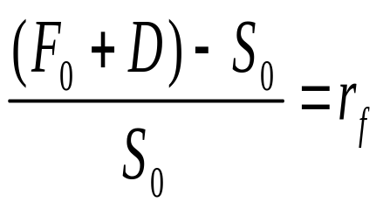
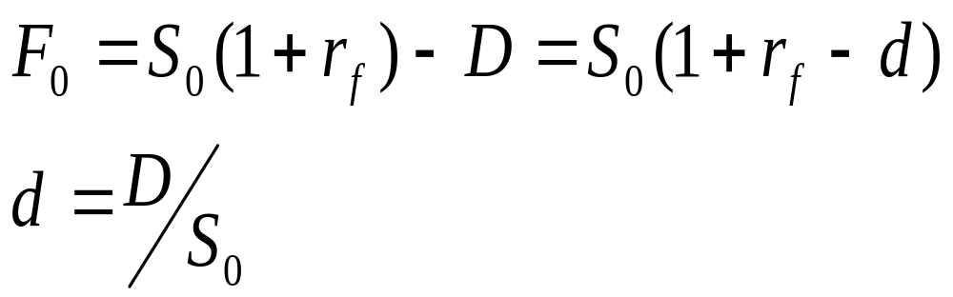
The Spot-Futures Parity Theorem

Slide 32
Arbitrage possibilities
If spot-futures parity is not observed, then arbitrage is possible.
If the futures price is too high, short the futures and acquire the stock by borrowing the money at the risk-free rate.
If the futures price is too low, go long futures, short the stock and invest the proceeds at the risk-free rate.

Slide 33
Futures Market Arbitrage
Suppose the risk-free interest rate is only 1%
The futures price should be $1000(1.01)-20 = $990
The actual futures price, F₀ = $ 1,010
Arbitrage profits
  Shorting the relatively overpriced futures contract
  Buy the relatively under-priced stock portfolio using money borrowed at the 1% market interest rate

Slide 34
Futures Market Arbitrage
Action | Initial Cash flow | Cash flow in 1 year
Borrow $1,000, repay with interest in 1 year | +1,000 | -1,000(1.01)= -$1,010
Buy stock index for $1,000 | -1,000 | S_{T} + $20 dividend
Enter short futures position | 0 | $1,010 - S_{T}
Total | 0 | $20

Slide 35
Futures Market Arbitrage
Action | Initial Cash flow | Cash flow in 1 year
Borrow S₀ dollars | S₀ | -S₀(1+r_{f})
Buy stock for S₀ | -S₀ | S_{T} + D
Enter short futures position | 0 | F₀- S_{T}
Total | 0 | F₀- S₀(1+r_{f}) + D

Slide 36
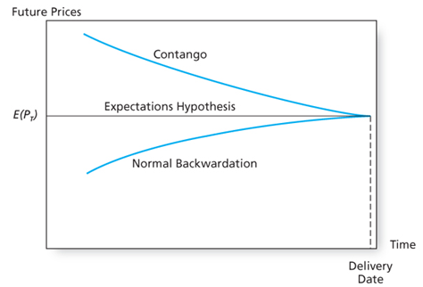
Futures Price Over Time
Expected spot price remains unchanged

Slide 37
The Option Contract
A call option gives its holder the right to buy an asset:
  At the exercise or strike price
  On or before the expiration date
Exercise the option to buy the underlying asset if market value > strike price
A put option gives its holder the right to sell an asset:
  At the exercise or strike price
  On or before the expiration date
Exercise the option to sell the underlying asset if market value < strike price

Slide 38
The Option Contract
The call option buyer has the right to buy the underlying asset but not the obligation
The call option seller (also called the option writer) has the obligation to deliver the asset if the buyer chooses to buy i.e., exercise his option.
The put option buyer has the right to sell the underlying asset but not the obligation
The put option seller writer has the obligation to take delivery of the asset if the buyer chooses to exercise his option.
For this one-sided privilege, the option buyer must pay a premium to the option writer up-front.
The premium is non-refundable whether or not the option buyer exercises the option.

Slide 39
The Option Contract
The purchase price of the option is called the premium.
Sellers (writers) of options receive premium income.
If holder exercises the option, the option writer must make (call) or take (put) delivery of the underlying asset.

Slide 40
Example
Call Options contract on TATAMOTORS with an exercise price of Rs 700 scheduled to expire on Feb 27,2025.
Premium = Rs 5
What happens when the terminal stock price is Rs 710?
What happens when the terminal stock price is Rs 690?

Slide 41
Market and Exercise Price Relationships
In the Money - exercise of the option produces a positive cash flow
Call: exercise price < asset price
Put: exercise price > asset price
Out of the Money - exercise of the option would not be profitable
Call: asset price < exercise price
Put: asset price > exercise price
At the Money - exercise price and asset price are equal

Slide 42
American vs. European Options
American - the option can be exercised at any time before expiration or maturity
European - the option can only be exercised on the expiration or maturity date
https://www.nseindia.com/live_market/dynaContent/live_watch/derivative_stock_watch.htm

Slide 43
Payoffs and Profits at Expiration - Calls
Notation
Stock Price = S_{T} Exercise Price = X
Payoff to Call Holder
(S_{T} - X) if S_{T} >X
0 if S_{T} < X
Profit to Call Holder
Payoff - Premium

Slide 44
Payoffs and Profits at Expiration - Calls
Payoff to Call Writer
- (S_{T} - X) if S_{T} >X
0 if S_{T} < X
Profit to Call Writer
Payoff + Premium

Slide 45
Payoffs and Profits at Expiration - Puts
Payoffs to Put Holder
0 if S_{T} > X
(X - S_{T}) if S_{T} < X
Profit to Put Holder
Payoff - Premium

Slide 46
Payoffs and Profits at Expiration – Puts
Payoffs to Put Writer
0 if S_{T} > X
-(X - S_{T}) if S_{T} < X
Profits to Put Writer
Payoff + Premium

Slide 47
Option versus Stock Investments
Could a call option strategy be preferable to a direct stock purchase?
Suppose you think a stock, currently selling for $100, will appreciate.
A 6-month call with an exercise price of $100 costs $10 (contract size is 100 shares).
You have $10,000 to invest.
Strategy A: Invest entirely in stock. Buy 100 shares, each selling for $100.
Strategy B: Invest entirely in at-the-money call options. Buy 1,000 calls, each selling for $10. (This would require 10 contracts, each for 100 shares.)
Strategy C: Purchase 100 call options for $1,000. Invest your remaining $9,000 in 6-month T-bills, to earn 3% interest. The bills will be worth $9,270 at expiration.

Slide 48
Option versus Stock Investments
Investment Strategy Investment
Equity only Buy stock @ 100 100 shares $10,000
Options only Buy calls @ 10 1000 options $10,000
Leveraged Buy calls @ 10 100 options $1,000
equity Buy T-bills @ 3% $9,000
Yield

Slide 49
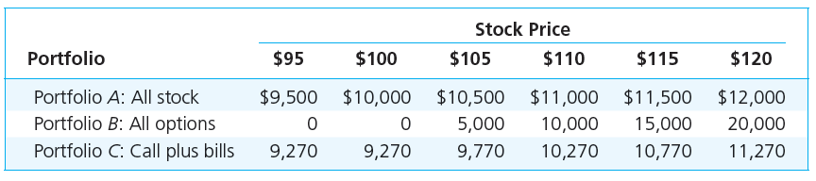
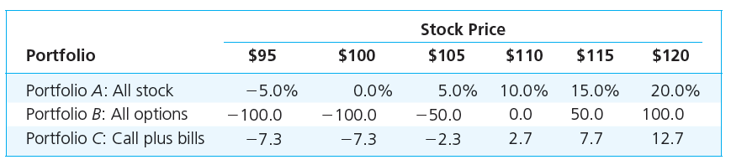
Strategy Payoffs

Slide 50
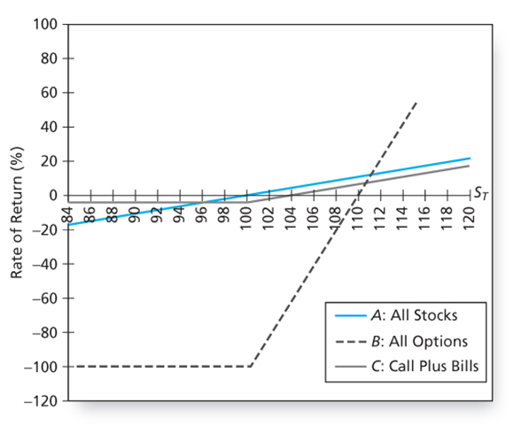
Rate of Return

Slide 51
Strategy Conclusions
The all-option portfolio, B, responds more than proportionately to changes in stock value; it is levered.
Portfolio C, T-bills plus calls, shows the insurance value of options.
  C ‘s T-bill position cannot be worth less than $9270.
  Some return potential is sacrificed to limit downside risk.

Slide 52
Option Strategies
Protective Put
Covered Call
Straddle
Spreads
Collar

Slide 53
Put-Call Parity
Buy a call option
Buy Treasury bills with face value equal to the exercise price of the call option, and with maturity date equal to the expiration date of the option.
For each option that you hold with exercise price X, you would purchase a risk-free zero-coupon bond with face value X.
 | S_{T}<= X | S_{T} >X
Value of call option | 0 | S_{T} - X
Value of zero-coupon bond | X | X
Total | X | S_{T}

Slide 54
Put-Call Parity
Protective Put : Invest in stock and purchase a put option on the stock
 | S_{T}<= X | S_{T} >X
Stock | S_{T} | S_{T}
Put | X - S_{T} | 0
Total | X | S_{T}

Slide 55
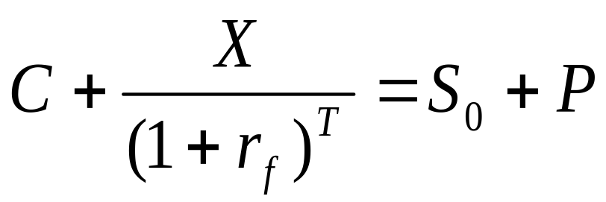
Put-Call Parity
The call-plus-bond portfolio (on left) must cost the same as the stock-plus-put portfolio (on right):

Slide 56

Put Call Parity - Disequilibrium Example
Stock Price = 110 Call Price = 17
Put Price = 5 Risk Free = 5%
Maturity = 1 yr X = 105
117 > 115
acquire the low-cost alternative and sell the high-cost alternative

Slide 57
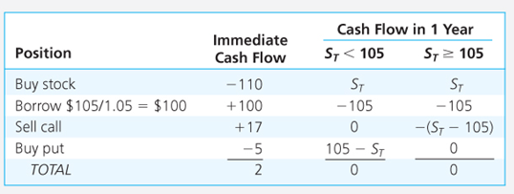
Arbitrage Strategy

Slide 58
Option Values
Intrinsic value - profit that could be made if the option was immediately exercised
  Call: stock price - exercise price
  Put: exercise price - stock price
Time value - the difference between the option price and the intrinsic value, given immediate expiration

Slide 59
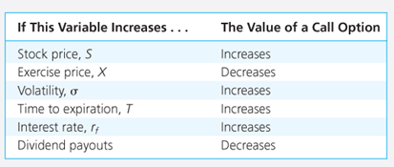
Determinants of Call Option Values

Slide 60
Binomial Option Pricing
Replicating Portfolio
Hedge Ratio

Slide 61
Black-Scholes Option Valuation
C_{o} = S_{o}N(d₁) - Xe^{-rT}N(d₂)
d₁ = [ln(S_{o}/X) + (r + σ²/2)T] / (σ T^{1/2})
d₂ = d₁ - (σ T^{1/2})
C_{o} = Current call option value ; S_{o} = Current stock price
N(d) = probability that a random draw from a normal distribution will be less than d
X = Exercise price; e = 2.71828, the base of the natural log
r = Risk-free interest rate (annualized, continuously compounded with the same maturity as the option)
T = time to maturity of the option in years
ln = Natural log function; σ = Standard deviation of the stock

