Slide 1

Financial Decision Making
Numbers that Support Decision Making in Businesses
Executive Certificate Program in Senior Leadership

Slide 2
Prof. M Shameem Jawed
Associate Professor, IIM Visakhapatnam
Education, Background & Pedagogical Excellence
  Alumnus of IIM Indore with an FPM (Ph.D.) in Finance & Accounting
  Formerly Consultant at SunGard (now FIS) & Assistant Prof. in Finance at MDI.
  Trained twice at Harvard Business School in participant-centered learning and case study methodologies
  1,500+ hours of teaching experience at Post-Graduate, Doctoral, and executive education levels
Teaching & Research Interests
  Corporate Finance | Financial Analytics & Trading Strategies | Cost Management | Corporate Governance | Startup-Finance and Valuation | Behavioural Finance
Academic & Entrepreneurial Leadership
  Chair Positions Held (Past & Present): PGPMCI (DBM/MBA) | MGNF | Entrepreneurship Development
  Founding Director, IIMV FIELD & AIC FIELD
  Established the first incubator at IIMV in 2018, leading it to incubate 180+ startups as of date
  Key sponsors: MSDE, DST, NITI Aayog, MeitY, NSRCEL (IIMB), MTAR, NBCC, S2Tech, among others

Slide 3
Agenda
Today:
Strategic Insights for leaders from Financial Statements
Cost Analysis for Decision Making
Next Module:
Capital Budgeting & project risk analysis

Slide 4
Have we heard of these in our organization?
“What’s the ROI on that software your department wants to buy?”
“The CFO says profits are great but money’s tight— everyone needs to conserve cash.”
“I’ve been studying the figures, and it looks as if your sales reps are sacrificing gross margin for revenue. Have you talked to them about that?”
“Our inventory days are creeping upward. We have to find a way to reverse that trend.”

Slide 5
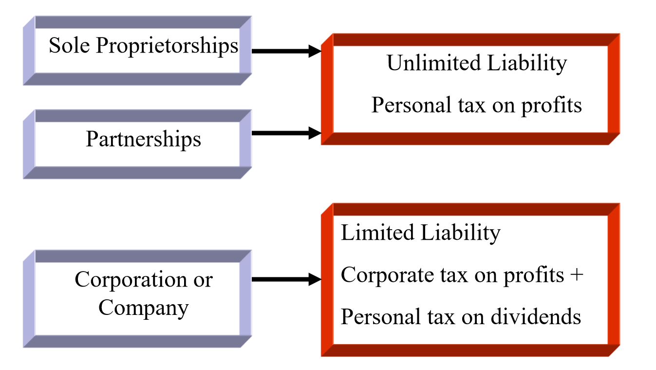
Business Structure

Slide 6
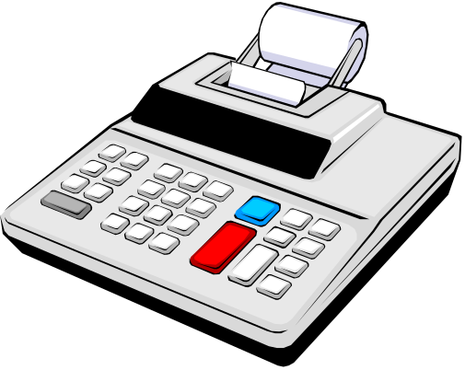
Accounting
The accounting system is a series of steps performed to analyze, record, quantify, accumulate, summarize, classify, report, and interpret economic events and their effects on an organization and to prepare the financial statements.

Slide 7
Accounting as an Aid to Decision Making
Accounting information is useful to anyone who makes decisions that have economic results.
  Managers want to know if a new product will be profitable.
  Owners want to know which divisions are productive.
  Investors want to know if a company is a good investment.
  Creditors want to know if they should extend credit, how much to extend, and for how long.
  Government/regulators want to know if financial statements conform to requirements.

Slide 8
Accounting as an Aid to Decision Making
What is the financial picture of the organization on a given day?
How well did the organization do during a given period?

Slide 9

Financial and Management Accounting
  Financial accounting serves external users.
  Management accounting serves internal users, such as top executives, management, and administrators within organizations.

Slide 10
The Annual Report
Annual report - a document prepared by management and distributed to current and potential investors to inform them about the company’s past performance and future prospects.
  The annual report is one of the most common sources of financial information used by investors and managers.

Slide 11
The Annual Report
Typically, along with the key financial statements, any annual report would have:
  a letter from corporate management
  a discussion and analysis of recent economic events by management
  footnotes that explain many elements of the financial statements in more detail
  the report of the independent auditors
  a statement of management’s responsibility for preparation of the financial statements
  other corporate information

Slide 12
The Key Financial Statements
Balance sheet
Income statement
Cash flow statement
Together these financial statements can help you understand what is going on in your company—or in any other business

Slide 13
Balance sheet
The balance sheet shows a company’s financial position at a specific point in time. It provides a snapshot of its assets, liabilities, and equity on a given day.
Assets = Liabilities + Owners’ Equity

Slide 14
The Balance Sheet
Sections of the balance sheet:
Assets - resources of the firm that are expected to increase or cause future cash flows (everything the firm owns)
Liabilities - obligations of the firm to outsiders or claims against its assets by outsiders (debts of the firm)
Owners’ Equity - the residual interest in, or remaining claims against, the firm’s assets after deducting liabilities (rights of the owners)

Slide 15
Assets
Chapter 1
Probable future economic benefits
  Owned by the organisation
  Has current or future value to the organisation
  Has been acquired at a cost that can be measured.
What a business “owns”!
Examples
  Cash, Investments, Buildings, Plant and machinery, Patents and copyrights
Current vs Non-Current Assets & the,
Concept of Depreciation & Amortization.

Slide 16
Liabilities
Chapter 1
Probable future sacrifices of economic benefits
What a business “owes”
Contractual, statutory, or constructive
Examples
  Loans payable, Warranty obligations, Pensions payable, Income tax payable, Account Payables

Slide 17
Equity
Chapter 1
Residual interest of owners
Examples
  Share capital
  Share premium
  Retained profit = Revenues – Expense - Dividends

Slide 18

Balance Sheet Transactions
The balance sheet is affected by every transaction that an entity encounters.
Each transaction has counterbalancing entries that keep total assets equal to total liabilities and owners’ equity,
- i.e., the balance sheet equation must always be balanced.

Slide 19
Balance Sheet Transactions
Just as the balance sheet equation must always balance, the balance sheet must also always balance.
A balance sheet could be prepared after every transaction, but this practice would be awkward and unnecessary.
  Therefore, balance sheets are usually prepared monthly or on some other periodic schedule.

Slide 20
Income statement
The income statement shows the bottom line. It indicates how much profit or loss was generated over a period of time—usually a month, a quarter, or a Year
Net Income = Revenues – Expenses

Slide 21
Cash flow statement
The cash flow statement tells where the company’s cash came from and where it went.
It shows the relationship between net profit and the change in cash recorded from one balance sheet to the next.
  Operating Activities + Investing Activities + Financing Activities

Slide 22
Cash or Profit, which is more Important?
Let’s understand it with an example.
  For the sake of comparison, we’ll say that it, too, begins the period with $10,000 in the bank.
  Case1: Fertilizers Shop at Gambheeram
    In the first three months the sales are $20,000, $30,000, and $45,000. Cost of goods sold is 60% of sales, and her monthly operating expenses are $10,000. Due to Gov. regulations sells on credit of 75 days the to farmers.
  Case 2: Cigar Shop at RK Beach
    Its sales for the first three months are $50,000, $75,000, and $95,000— Its cost of goods is 60% of sales, and its monthly operating expenses are $30,000 (high rent!).
  Let’s see their profit and cash positions…!

Slide 23
How access the health of a firm using information published in financial statements?
Ratio Analysis

Slide 24
Ratio Analysis: Overview
Ratios facilitate comparison of:
  One company over time
  One company versus other companies
Ratios are used by:
  Lenders to determine creditworthiness
  Stockholders to estimate future cash flows and risk
  Managers to identify areas of weakness and strength

Slide 25
Income Statement
 | 2013 | 2014E
Sales | $5,834,400 | $7,035,600
COGS except depr. | 4,980,000 | 5,800,000
Other expenses | 720,000 | 612,960
Deprec. | 116,960 | 120,000
Tot. op. costs | 5,816,960 | 6,532,960
EBIT | 17,440 | 502,640
Int. expense | 176,000 | 80,000
EBT | (158,560) | 422,640
Taxes (40%) | (63,424) | 169,056
Net income | ($ 95,136) | $ 253,584

Slide 26
Balance Sheets: Assets
 | 2013 | 2014E
Cash | $ 7,282 | $ 14,000
S-T invest. | 20,000 | 71,632
AR | 632,160 | 878,000
Inventories | 1,287,360 | 1,716,480
Total CA | 1,946,802 | 2,680,112
Net FA | 939,790 | 836,840
Total assets | $2,886,592 | $3,516,952

Slide 27
Balance Sheets: Liabilities & Equity
 | 2013 | 2014E
Accts. payable | $ 324,000 | $ 359,800
Notes payable | 720,000 | 300,000
Accruals | 284,960 | 380,000
Total CL | 1,328,960 | 1,039,800
Long-term debt | 1,000,000 | 500,000
Common stock | 460,000 | 1,680,936
Ret. earnings | 97,632 | 296,216
Total equity | 557,632 | 1,977,152
Total L&E | $2,886,592 | $3,516,952

Slide 28
Other Data
 | 2013 | 2014E
Stock price | $6.00 | $12.17
# of shares | 100,000 | 250,000
EPS | -$0.95 | $1.01
DPS | $0.11 | $0.22
Book val. per sh. | $5.58 | $7.91
Lease payments | $40,000 | $40,000
Tax rate | 0.4 | 0.4

Slide 29
Liquidity Ratios
Can the company meet its short-term obligations using the resources it currently has on hand?

Slide 30
Forecasted Current and Quick Ratios for 2014.
CA
CL
$2,680
$1,040
CR₁₄ = = = 2.58.
CA - Inv.
CL
QR₁₄ (Acid Test Ratio)=
$2,680 - $1,716
$1,040
= = 0.93.

Slide 31
Comments on CR and QR
 | 2014E | 2013 | 2012 | Ind.
CR | 2.58 | 1.46 | 2.3 | 2.7
QR | 0.93 | 0.5 | 0.8 | 1.0
Expected to improve but still below the industry average.
Liquidity position is weak.

Slide 32
Asset Management / Efficiency Ratios
How efficiently does the firm use its assets?
How much does the firm have tied up in assets for each dollar of sales?

Slide 33
Inventory Turnover Ratio
COGS
Inventories
Inv. Turnover =
= = 3.45.
$5,800 + $120
$1,716
2014E 2013 2012 Ind.
Inv. T. 3.45 4.0 4.0 6.1

Slide 34
Comments on Inventory Turnover
Inventory turnover is below industry average.
Firm might have old inventory, or its control might be poor.
No improvement is currently forecasted.

Slide 35
Days Sales Outstanding (or)
Receivable Turnover Days
Receivables
Average sales per day
DSO =
= =
= 45.5 days.
Receivables
Sales/365
$878
$7,036/365

Slide 36
Appraisal of DSO
Firm collects too slowly, and situation is getting worse.
Poor credit policy.
Other important one is
  – Days Payable Outstanding (DPO) = Acc. Payable/COGS per day
2014 2013 2012 Ind.
DSO 45.5 39.5 37.4 32.0

Slide 37
Fixed Assets and Total Assets Turnover Ratios
Fixed assets
turnover
Sales
Net fixed assets
=
= = 8.41.
$7,036
$837
Total assets
turnover
Sales
Total assets
=
= = 2.00.
$7,036
$3,517
(More…)

Slide 38
Fixed Assets and Total Assets
Turnover Ratios
FA turnover is expected to exceed industry average. Good.
TA turnover not up to industry average. Caused by excessive current assets (A/R and inventory).
 | 2014E | 2013 | 2012 | Ind.
FA TO | 8.4 | 6.2 | 10.0 | 7.0
TA TO | 2.0 | 2.0 | 2.3 | 2.5

Slide 39
Debt Management Ratios
Does the company have too much debt?
Can the company’s earnings meet its debt servicing requirements?

Slide 40
Leverage Ratios: Debt Ratio
Total debt
Total assets
Debt ratio =
= = 22.7%.
$300 + $500
$3,517
(More…)

Slide 41
Leverage Ratios: Liabilities-to-Assets Ratio
Total liabilities
Total assets
Liabilities/TA ratio =
=
=43.8%.
$1,039.8 + $500
$3,517
(More…)

Slide 42
Times Interest Earned Ratio
EBIT
Int. expense
TIE =
= = 6.3.
$502.6
$80
(More…)

Slide 43
Debt Management Ratios vs. Industry Averages
2014E 2013 2012 Ind.
D/TA 22.7% 59.6% 35.6% 32.0%
TL/TA 43.8% 80.7% 54.8% 50.0%
TIE 6.3 0.1 3.3 6.2
Recapitalization improved situation.

Slide 44
Profitability Ratios
What is the company’s rate of return on:
  Sales?
  Assets?

Slide 45
Profit Margins
Net profit margin (PM):
NI
Sales
$253.6
$7,036
PM = = = 3.6%.
Operating profit margin (OM):
EBIT
Sales
$503
$7,036
OM = = = 7.1%.
(More…)

Slide 46
Profit Margins (Continued)
Gross profit margin (GPM):
Sales − COGS
Sales
$7,036 − $5,800
$7,036
GPM = =
$1,236
$7,036
GPM = = 17.6%.

Slide 47
Profit Margins vs. Industry Averages
2014E 2013 2012 Ind.
PM 3.6% -1.6% 2.6% 3.6%
OPM 7.1 0.3 6.1 7.1
GPM 17.6 14.6 16.6 15.5
Very bad in 2013, but projected to
meet or exceed industry average in 2014.

Slide 48
Basic Earning Power (BEP)
EBIT
Total assets
BEP =
= = 14.3%.
$502.6
$3,517
(More…)

Slide 49
Basic Earning Power vs. Industry Average
-BEP removes effect of taxes and financial leverage. Useful for comparison.
-Projected to be below average.
-Room for improvement.
2014E 2013 2012 Ind.
BEP 14.3% 0.6% 14.2% 17.8%

Slide 50
Return on Assets (ROA) and Return on Equity (ROE)
NI
Total assets
ROA =
= = 7.2%.
$253.6
$3,517
(More…)

Slide 51
Return on Assets (ROA) and Return on Equity (ROE)
NI
Common Equity
ROE =
= = 12.8%.
$253.6
$1,977
(More…)

Slide 52
ROA and ROE vs. Industry Averages
2014E 2013 2012 Ind.
ROA 7.2% -3.3% 6.0% 9.0%
ROE 12.8% -17.1% 13.3% 18.0%
Both are below average but improving.

Slide 53
Effects of Debt on ROA and ROE
ROA is lowered by debt-
-interest expense lowers net income, which also lowers ROA.
However, the use of debt lowers equity, and if equity is lowered more than net income, ROE would increase.

Slide 54
Market Value Ratios
Market value ratios incorporate the:
  High current levels of earnings and cash flow increase market value ratios
  High expected growth in earnings and cash flow increases market value ratios
  High risk of expected growth in earnings and cash flow decreases market value ratios

Slide 55
Interpreting Market Based Ratios
P/E: How much investors will pay for $1 of earnings. Higher is better.
M/B: How much paid for $1 of book value. Higher is better.
P/E and M/B are high if ROE is high, risk is low.

Slide 56
Calculate and appraise the
P/E, P/CF, and M/B ratios.
Price = $12.17.
EPS = = = $1.01.
P/E = = = 12.
NI
Shares out.
$253.6
250
Price per share
EPS
$12.17
$1.01

Slide 57
Market Based Ratios (Continued)
Mkt. price per share
Book value per share
M/B =
= = 1.54.
$12.17
$7.91

Slide 58
Comparison with Industry Averages
2014E 2013 2012 Ind.
P/E 12.0 -6.3 9.7 14.2
M/B 1.5 1.1 1.3 2.9

Slide 59
Common Size Balance Sheets:
Divide all items by Total Assets
Assets | 2012 | 2013 | 2014E | Ind.
Cash | 0.6% | 0.3% | 0.4% | 0.3%
ST Inv. | 3.3% | 0.7% | 2.0% | 0.3%
AR | 23.9% | 21.9% | 25.0% | 22.4%
Invent. | 48.7% | 44.6% | 48.8% | 41.2%
Total CA | 76.5% | 67.4% | 76.2% | 64.1%
Net FA | 23.5% | 32.6% | 23.8% | 35.9%
TA | 100.0% | 100.0% | 100.0% | 100.0%

Slide 60
Divide all items by Total Liabilities & Equity
Liab. & Eq. | 2012 | 2013 | 2014E | Ind.
AP | 9.9% | 11.2% | 10.2% | 11.9%
Notes pay. | 13.6% | 24.9% | 8.5% | 2.4%
Accruals | 9.3% | 9.9% | 10.8% | 9.5%
Total CL | 32.8% | 46.0% | 29.6% | 23.7%
LT Debt | 22.0% | 34.6% | 14.2% | 26.3%
Total eq. | 45.2% | 19.3% | 56.2% | 50.0%
Total L&E | 100.0% | 100.0% | 100.0% | 100.0%

Slide 61
Analysis of Common Size Balance Sheets
Computron has higher proportion of inventory and current assets than Industry.
Computron now has more equity (which means LESS debt) than Industry.
Computron has more short-term debt than industry, but less long-term debt than industry.

Slide 62
Common Size Income Statement:
Divide all items by Sales
 | 2012 | 2013 | 2014E | Ind.
Sales | 100.0% | 100.0% | 100.0% | 100.0%
COGS | 83.4% | 85.4% | 82.4% | 84.5%
Depr. | 0.6% | 2.0% | 1.7% | 4.0%
Other exp. | 9.9% | 12.3% | 8.7% | 4.4%
EBIT | 6.1% | 0.3% | 7.1% | 7.1%
Int. Exp. | 1.8% | 3.0% | 1.1% | 1.1%
Pre-tax earn. | 4.3% | -2.7% | 6.0% | 5.9%
Taxes | 1.7% | -1.1% | 2.4% | 2.4%
NI | 2.6% | -1.6% | 3.6% | 3.6%

Slide 63
Analysis of Common Size Income Statements
Computron has lower COGS (86.7) than industry (84.5), but higher other expenses.
Result is that Computron has similar EBIT (7.1) as industry.

Slide 64
Percentage Change Analysis: % Change from First Year (2012)
Income St. | 2012 | 2013 | 2014E
Sales | 0.0% | 70.0% | 105.0%
COGS | 0.0% | 73.9% | 102.5%
Depr. | 0.0% | 518.8% | 534.9%
Other exp. | 0.0% | 111.8% | 80.3%
EBIT | 0.0% | -91.7% | 140.4%
Int. Exp. | 0.0% | 181.6% | 28.0%
EBT | 0.0% | -208.2% | 188.3%
Taxes | 0.0% | -208.2% | 188.3%
NI | 0.0% | -208.2% | 188.3%

Slide 65
Analysis of Percent Change Income Statement
We see that 2014 sales grew 105% from 2012, and that NI grew 188% from 2012.
So Computron has become more profitable.

Slide 66
Percentage Change Balance Sheets: Assets
Assets | 2012 | 2013 | 2014E
Cash | 0.0% | -19.1% | 55.6%
ST Invest. | 0.0% | -58.8% | 47.4%
AR | 0.0% | 80.0% | 150.0%
Invent. | 0.0% | 80.0% | 140.0%
Total CA | 0.0% | 73.2% | 138.4%
Net FA | 0.0% | 172.6% | 142.7%
TA | 0.0% | 96.5% | 139.4%

Slide 67
Percentage Change Balance Sheets: Liabilities & Equity
Liab. & Eq. | 2012 | 2013 | 2014E
AP | 0.0% | 122.5% | 147.1%
Notes pay. | 0.0% | 260.0% | 50.0%
Accruals | 0.0% | 109.5% | 179.4%
Total CL | 0.0% | 175.9% | 115.9%
LT Debt | 0.0% | 209.2% | 54.6%
Total eq. | 0.0% | -16.0% | 197.9%
Total L&E | 0.0% | 96.5% | 139.4%

Slide 68
Analysis of Percent Change Balance Sheets
We see that total assets grew 139%, while sales grew only 105%.
So, asset utilization remains a problem.

Slide 69
Potential Problems and Limitations of Ratio Analysis
Comparison with industry averages is difficult if the firm operates many different divisions.
Seasonal factors can distort ratios.
Window dressing techniques can make statements and ratios look better.
Different accounting and operating practices can distort comparisons.

Slide 70
Qualitative Factors
There is greater risk if:
  revenues tied to a single customer
  revenues tied to a single product
  reliance on a single supplier?
  High percentage of business is generated overseas?
What is the competitive situation?
What products are in the pipeline?
What are the legal and regulatory issues?

Slide 71
Cost Analysis for
Decision Making

Slide 72
What Do We Mean By COST?
Cost
is the measure of
resources given
up to achieve a
particular purpose.
2-72
Notes:
At the most basic level, a cost may be defined as the sacrifice made, usually measured by the resources given up, to achieve a particular purpose.

Slide 73
Product Costs, Period Costs, and Expenses
Product costs are costs associated with goods for sale until the time period during which the products are sold, at which time the costs become expenses.
Period costs are costs that are expensed during the time period in which they are incurred.
Expenses are the consumption of assets for the purpose of generating revenue.
2-73
Notes:
A product cost is a cost assigned to goods that were either purchased or manufactured for resale. Another term for product cost is inventoriable cost, since a product cost is stored as the cost of inventory until the goods are sold. In the period of the sale, the product costs are recognized as an expense called cost of goods sold.
Period costs are all costs that are not product costs. They are expensed in the period they are incurred.
An expense is the cost incurred when an asset is used up or sold for the purpose of generating revenue.

Slide 74
Manufacturing Costs
Direct
Material
Direct
Labor
Manufacturing Overhead
The
Product
2-74
Notes:
Managerial accountants classify costs by the functional area of the organization to which costs relate. Some examples of functional areas are manufacturing, marketing, administration, and research and development. Manufacturing costs are further classified into the following three categories: direct material, direct labor, and manufacturing overhead.

Slide 75

Direct Material
Cost of raw material that is used to
make, and can be conveniently
traced, to the finished product.
Example:
Steel used to
manufacture
the automobile.
2-75
Notes:
Raw material that is consumed in the manufacturing process, is physically incorporated in the finished product, and can be traced to products conveniently is called direct material.

Slide 76

Direct Labor
Cost of salaries, wages, and fringe
benefits for personnel who work
directly on manufactured products.
Example:
Wages paid to an
automobile assembly
worker.
2-76
Notes:
The cost of salaries, wages, and fringe benefits for personnel who work directly on the manufactured products is classified as direct-labor cost.

Slide 77
Manufacturing Overhead
All other manufacturing costs
Indirect
Material
Indirect
Labor
Other
Costs
Materials used to support the production process. Examples: lubricants and cleaning supplies used in an automobile assembly plant.
2-77
Notes:
All other costs of manufacturing are classified as manufacturing overhead, which includes three types of costs: indirect material, indirect labor, and other manufacturing costs. The cost of materials that are required for the production process but do not become an integral part of the finished product are classified as indirect material costs. Materials that do become an integral part of the finished product but are insignificant in cost are also often classified as indirect material.

Slide 78
Manufacturing Overhead
All other manufacturing costs
Indirect
Material
Indirect
Labor
Other
Costs
Cost of personnel who do not work directly on the product. Examples: maintenance workers, janitors, and security guards.
2-78
Notes:
The costs of personnel who do not work directly on the product, but whose services are necessary for the manufacturing process, are classified as indirect labor.

Slide 79
Manufacturing Overhead
All other manufacturing costs
Indirect
Material
Indirect
Labor
Other
Costs
Examples: depreciation on plant and equipment, property taxes, insurance, utilities, overtime premium, and unavoidable idle time.
2-79
Notes:
All other manufacturing costs that are neither material nor labor costs are classified as manufacturing overhead.

Slide 80
Classifications of Costs in Manufacturing Companies
Manufacturing costs are often
combined as follows:
Direct
Material
Direct
Labor
Manufacturing
Overhead
Prime
Cost
Conversion
Cost
2-80
Notes:
Direct material and direct labor are often referred to as prime costs. Direct labor and overhead are often called conversion costs, since they are the costs of “converting” raw material into finished products.

Slide 81
Cost
estimation
Cost
behavior
Cost
prediction
Process of
determining
cost behavior,
often focuses
on historical
data.
Relationship
between
cost and
activity.
Using knowledge
of cost behavior
to forecast
level of cost at
a particular
activity. Focus
is on the future.
6-81
Notes:
How does a managerial accountant determine the cost behavior pattern for a particular cost item?
The determination of cost behavior, which is often called cost estimation, can be accomplished in a number of ways.
One way is to analyze historical data concerning costs and activity levels.
The relationship between cost and activity, called cost behavior, is relevant to the management functions of planning, control, and decision making.
In order to plan operations and prepare a budget, managers need to predict the costs that will be incurred at different levels of activity.
Knowledge of cost behavior will help the manager to make the desired cost prediction.
A cost prediction is a forecast of cost at a particular level of activity.

Slide 82

Total Variable Cost Example
Your total Pay Per View bill is based on how many Pay Per View shows that you watch.
Total Pay Per View Bill
Number of Pay Per View shows watched
6-82
Notes:
A variable cost changes in total in direct proportion to a change in the activity level (or cost driver).
For example, assume that you pay $4.95 for each Pay Per View show that you watch.
The more shows that you watch, the higher your Pay Per View bill will be.
The total cost of the Pay Per View bill increases in direct proportion to the number of shows watched.
Your text book describes the raw materials that goes into making donuts are also variable costs―the more donuts you make the higher the cost of raw materials.

Slide 83
Variable Cost Per Unit Example
The cost per Pay Per View show is constant. For example, $4.95 per show.
Cost per Pay Per View show
Number of Pay Per View shows watched
6-83
Notes:
However, the variable cost per unit is constant as activity changes. In our Pay Per view example, the cost per show remains at $4.95. To summarize, as activity changes, total variable cost increases in direct proportion to the change in activity level, but the variable cost per unit remains constant.

Slide 84

Step-Variable Costs
Total cost remains
constant within a
narrow range of
activity.
Cost
Activity
6-84
Notes:
Some costs are nearly variable, but they increase in small steps instead of continuously.
Such costs, called step-variable costs, usually include inputs that are purchased and used in relatively small increments.
For a narrow range of activity, the total cost remains the same.
For example, the hourly rate for cashiers at a local grocery store is a set amount.
During hours when there are few customers only three cashiers are needed.
Therefore, at these low activity levels, the total cost for cashiers is the same.

Slide 85
Step-Variable Costs
Total cost increases to a
new higher cost for the next higher range of activity.
Cost
Activity
6-85
Notes:
But when the number of customers increases, the number of cashiers required increases.
The hourly rate, or cost per unit, stays the same but the total cost increases at the next higher range of activity.

Slide 86
Total Fixed Cost Example
Your monthly basic cable TV bill probably does not change no matter how many hours you watch.
Monthly Basic Cable Bill
Number of hours watched
6-86
Notes:
A fixed cost remains unchanged in total as the activity level varies.
Examples of fixed costs include facilities costs, which include property taxes, depreciation on buildings and equipment, and the salaries of maintenance personnel.
The total cost of fixed costs remains constant, regardless of the level of activity.

Slide 87
Fixed Cost Per Unit Example
The average cost per hour decreases as more hours are spent watching cable television.
Monthly Basic cable Bill per hour watched
Number of hours watched
6-87
Notes:
However, the fixed cost per unit does change as activity varies. The fixed cost per unit is calculated by dividing the total fixed costs by the number of units. Therefore, as the activity level increases, total fixed costs does not change, but unit fixed cost declines. For this reason, it is preferable in any cost analysis to work with total fixed cost rather than fixed cost per unit.

Slide 88

Step-Fixed Costs
Example: Office space is available at a rental rate of $30,000 per year in increments of 1,000 square feet. As the business grows more space is rented, increasing the total cost.
Continue
6-88
Notes:
Some costs remain fixed over a wide range of activity but jump to a different amount for activity levels outside that range.
Such costs are called step-fixed costs.

Slide 89
Step-Fixed Costs
Total cost doesn’t change for a wide range of activity, and then jumps to a new higher cost for the next higher range of activity.
90
60
Rent Cost in Thousands of Dollars
30
0 1,000 2,000 3,000
Rented Area (Square Feet)
6-89
Notes:
A company may rent office space at the cost of $30,000 per 1,000 square feet.
Extra space is only available in increments of 1,000 square feet.
The rent remains $30,000 regardless of activity.
As business increases, more square footage is needed.
The next 1,000 square feet costs another $30,000.
As the company expands, another 1,000 square feet is needed, costing another $30,000.

Slide 90


Step-Fixed Costs
  Step-variable costs can be adjusted more quickly and . . .
  The width of the activity steps is much wider for the
  step-fixed cost.
How does this type of fixed cost differ from a step-variable cost?
6-90
Notes:
Step-variable costs differ from step-fixed costs in that they can be adjusted more quickly.
Also, the width of the steps is much wider for step-fixed costs.

Slide 91

Semivariable Cost
A semivariable cost is partly fixed and partly variable.
Consider the
following example:.
6-91
Notes:
A semivariable (or mixed) cost has both a fixed and a variable component.
Assume that a construction company leases a bulldozer and incurs a flat fee of $1500 per month, regardless of how many hours the bulldozer is used.
The company also incurs a cost of $35 per hour used.

Slide 92


Semivariable Cost
The slope is
the variable cost per unit
of activity.
Total semivariable cost
Variable Lease Charge Per Hour
Total Lease Cost
Fixed Monthly
Rental Charge
Rental Charge Per Hour
6-92
Notes:
The company’s monthly bill would always be at least $1,500, the fixed portion of the lease.
The total cost would rise from $1,500, depending on how hours were used.
Therefore, the slope of a total cost line is the variable cost per unit of activity.

Slide 93
Curvilinear Cost
Curvilinear
Cost Function
Curvilinear
Cost Function
A straight-line
(constant unit variable cost) closely approximates a curvilinear line within
the relevant range.
Total Cost
Relevant Range
Activity
6-93
Notes:
The graphs of all of the cost behavior patterns examined so far consist of either straight lines or several straight-line sections.
A curvilinear cost behavior pattern has a curved graph.
Assume that a company groups its trash collection, telephone and electricity costs together as utility costs.
The company’s utilities cost may be a curvilinear cost. Recall that a marginal cost is the cost of producing the next unit.
For low levels of activity, the utilities cost would exhibit decreasing marginal costs because only the electricity costs would increase as production increased.
For high levels of activity the graph would exhibit increasing marginal costs.
If the demand for a particular month is at lower levels of activity, the company can use its modern, energy efficient equipment.
But at higher levels of activity, the older equipment must also be used.
This equipment is less energy-efficient.
As a result, the marginal utilities cost rises as monthly activity increases.

Slide 94
Curvilinear Cost
Curvilinear
Cost Function
Curvilinear
Cost Function
A straight-Line
(constant unit variable cost) closely approximates a curvilinear line within
the relevant range.
Total Cost
Relevant Range
Activity
6-94
Notes:
Management need not concern itself with extreme levels of activity if it is unlikely the company will operate at those activity levels.
Management is interested in cost behavior within the company’s relevant range, the range of activity within which management expects the company to operate.

Slide 95
Engineered, Committed, and Discretionary Costs
Committed
Long-term, cannot be reduced in the short term.
Discretionary
May be altered in the short term by current managerial decisions.
Engineered
Physical relationship with activity measure.
Depreciation on Buildings and equipment
Advertising and Research and Development
Direct
Materials
6-95
Notes:
In the process of budgeting costs, it is often useful for management to make a distinction between engineered, committed, and discretionary costs.
An engineered cost bears a definitive physical relationship to the activity measure. Direct-material cost is an engineered cost.
A committed cost results from an organization’s ownership or use of facilities and its basic organization structure. Property taxes, depreciation on buildings and equipment, costs of renting facilities or equipment, and the salaries of management personnel are examples of committed fixed costs.
A discretionary cost arises as a result of a management decision to spend a particular amount of money for some purpose. Examples of discretionary costs include amounts spent on research and development, advertising and promotion, management development programs, and contributions to charitable organizations.

Slide 96
Some common Decision-Making involving cost-behaviors
1. Clarify the Decision Problem
2. Specify the Criterion
3. Identify the Alternatives
Quantitative
Analysis
4. Develop a Decision Model
5. Collect the Data
6. Make a Decision
14-96
Notes:
3
3
Six steps generally characterize a typical decision-making process.
Defining the problem, determining the objectives of the decision, identifying alternative courses of action, determining what information is relevant, collecting information to support the decision, then selecting the appropriate alternative.

Slide 97

Relevant Information
Information is relevant to a decision problem when . . .
  It has a bearing on the future,
  It differs among competing alternatives.
14-97
Notes:
8
Relevance has certain characteristics also.
Relevant information is future oriented.
To demonstrate this characteristic, you cannot make a decision on what to have for breakfast yesterday.
Why?
Because the decision has already been made! You have either already eaten or skipped yesterday’s breakfast.
You can make a decision on what to have for breakfast tomorrow, in the future.
Relevant information differs between the alternatives.
This makes a difference in the decision. If one item costs $100, and the second item costs $100, there is no difference in the cost. In other words, it is not relevant to the decision.
If the second item cost $115, there would be a difference, so it would be relevant to the decision.
Relevant information makes a difference in a decision.

Slide 98

Identifying Relevant Costs and Benefits
Sunk costs
Costs that have already been incurred. They do not affect any future cost and cannot be changed by any current or future action.
Sunk costs are irrelevant to decisions.
14-98
Notes:
9
11
Sunk costs are costs that have been incurred in the past, and are not relevant to the future, and not relevant to a future decision. A decision has already been made, in the past, and that specific decision cannot be changed. A new decision can be made regarding the past decision, but, that is a new decision. Sunk costs cannot be changed.
Sunk costs are never relevant to a future decision.

Slide 99
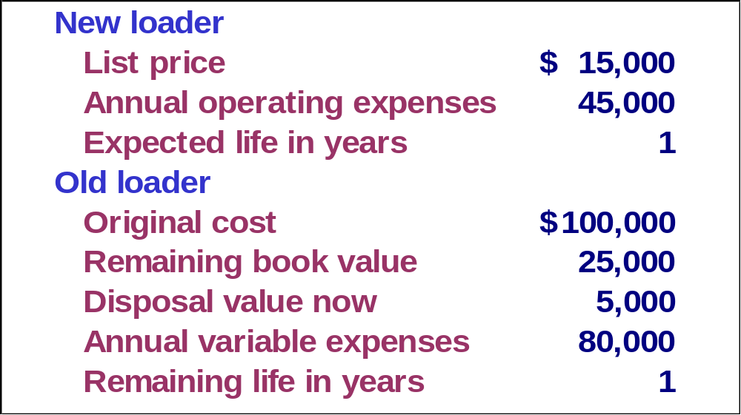
Relevant Costs - Example
Worldwide Airways is thinking about replacing a three-year-old loader with a new, more efficient loader.
14-99
Notes:
11
17
An example might help clarify relevant costs.
In this example, a business is considering the replacement of a loading machine.

Slide 100
Relevant Costs
If we keep the old loader, we will have depreciation
costs of $25,000. If we replace the old loader,
we will write-off the $25,000 when sold. There is
no difference in the cost, so it is not relevant.
We will only have depreciation on the new loader
if we replace the old loader. This cost is relevant.
The $5,000 proceeds will only be realized if we
replace the old loader. This amount is relevant.
The new loader will be depreciated in one year.
14-100
Notes:
12
18
Depreciation of the old loader is not relevant.
The cost of the old loader was incurred in the past, and cannot be changed.
If we decide to replace the old loader, we can sell it for $5,000.
This is relevant to the decision because we will only sell the loader in the future, if the decision to replace the machine is made.
The $5,000 is relevant to the decision to replace the loader.
We will only have depreciation on the new machine if we replace it.
The depreciation cost of the new loader is relevant.

Slide 101
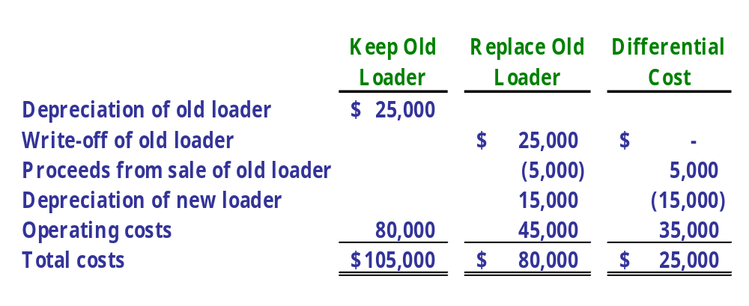
Relevant Costs
The difference in operating costs is relevant
to the immediate decision.
14-101
Notes:
If we buy the new loader, there will be differences between the operating costs of the current loader and the new one.
The differences in operating costs is relevant to the decision to replace the old loader.

Slide 102
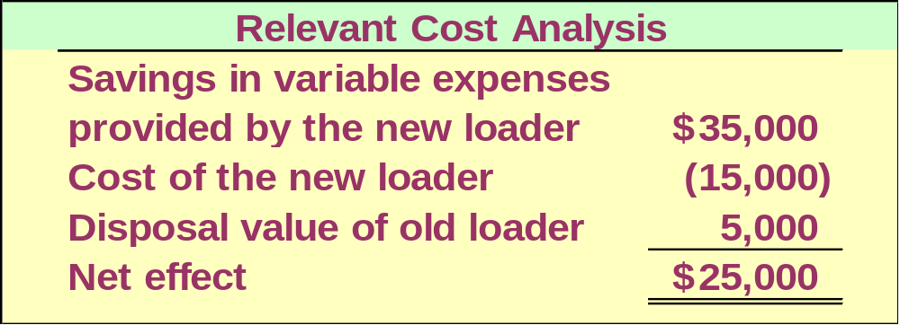
Relevant Costs
Here is an analysis that includes only relevant costs:
14-102
Notes:
30
37
The final analysis of the relevant costs of purchasing the new loader shows that the new loader would have a positive effect of $25,000 to the business.
The decision to purchase a new loader is appropriate.

Slide 103

Analysis of Special Decisions
Let’s take a close look at some special decisions faced by many businesses.
We just received
a special order. Do
you think we should
accept it?
14-103
Notes:
An unexpected order arrived from a potential customer.
We need to decide whether or not to accept this special order.

Slide 104
Accept or Reject a Special Order
A travel agency offers Worldwide Airways $150,000 for a round-trip flight from Hawaii to Japan on a jumbo jet.
Worldwide usually gets $250,000 in revenue from this flight.
The airline is not currently planning to add any new routes and has two planes that are idle and could be used to meet the needs of the agency.
The next screen shows cost data developed by managerial accountants at Worldwide.
14-104
Notes:
59
71
A travel agency e-mails us. They want to charter one of our aircraft for a round trip flight from Japan to Hawaii. We have two airplanes that could potentially be used to fly this trip. The managerial accountant prepared some information to help the team make the decision whether or not to accept this offer.

Slide 105
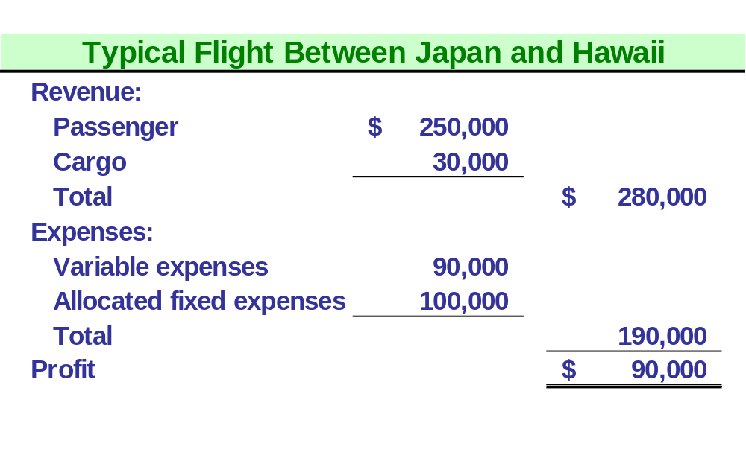
Accept or Reject a Special Order
Worldwide will save $5,000 in reservation
and ticketing costs if the charter is accepted.
14-105
Notes:
Normally, we would earn revenues of $280,000 and incur expenses of $190,000 on a trip such as this.
However, we would not have to provide ticketing and reservation services and would save $5,000 in these costs.

Slide 106
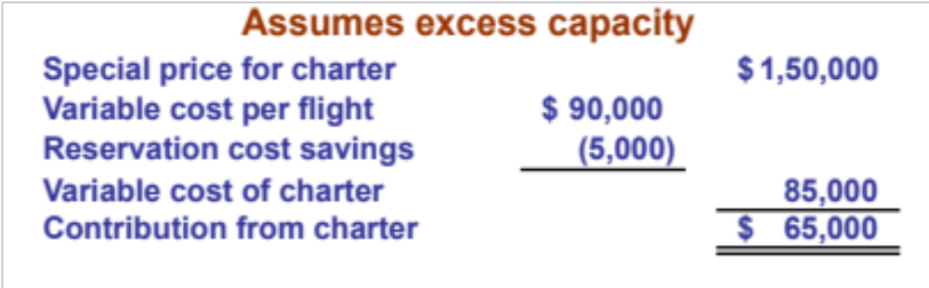
Accept or Reject a Special Order
Since the charter will contribute to fixed costs and
Worldwide has idle capacity, the company should
accept the flight.
14-106
Notes:
Since we have two airplanes that are not being used, we only need to consider our variable costs of making the trip.
We would also save the ticketing costs, reducing our variable costs by $5,000.
Even though we would normally receive $250,000 for a trip such as this, we should accept the offer.
The trip would contribute to paying our fixed costs, or, if our fixed costs are already paid, it would contribute this amount directly to profit.
Worldwide should accept this offer.

Slide 107

Accept or Reject a Special Order
What if Worldwide had no excess capacity?
If Worldwide adds the charter, it will have to cut its least profitable route that currently contributes $80,000 to fixed costs and profits. Should Worldwide still accept the charter?
14-107
Notes:
What should we do if all of our airplanes are busy and we would have to pull our airplane from a regular route?

Slide 108
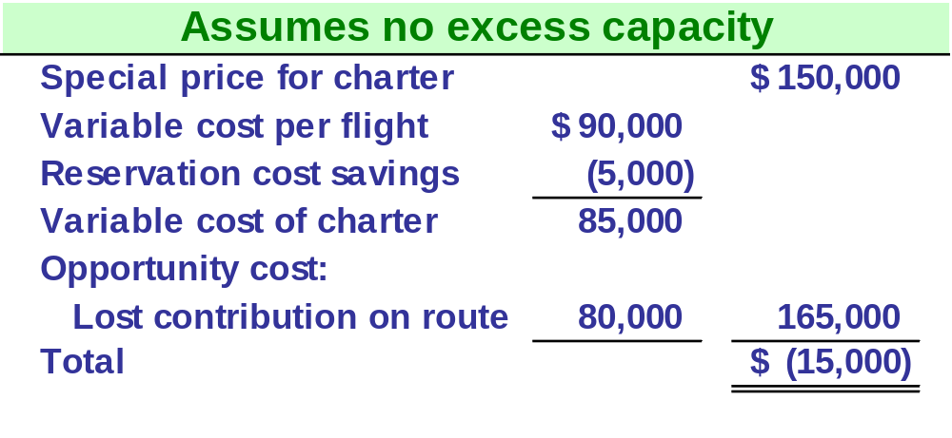
Accept or Reject a Special Order
Worldwide has no excess capacity, so it should reject the special charter.
14-108
Notes:
Since we would not earn the revenues from our regular route, we would have to charge for the lost revenue of the route that was not taken, a lost opportunity.
The total cost to us exceeds the amount of the offer so we should reject the special offer.

Slide 109
Accept or Reject a Special Order
With excess capacity . . .
  Relevant costs will usually be the variable costs associated with the special order.
Without excess capacity . . .
  Same as above but opportunity cost of using the firm’s facilities for the special order are also relevant.
14-109
Notes:
The decision to accept or reject a special offer can be summed up like this.
If we do have excess capacity, the relevant costs will usually be the variable costs.
If we do not have excess capacity, we would have to add the opportunity cost of using our facilities.

Slide 110
Outsource a Product or Service
A decision concerning whether an item should be produced internally or purchased from an outside supplier is often called a “make or buy” decision.
Let’s look at another decision faced by the management of Worldwide Airways.
14-110
Notes:
49
61
Sometimes the decision is whether we should produce a product, or whether we should have someone else produce that product.
This is called a make buy decision.

Slide 111
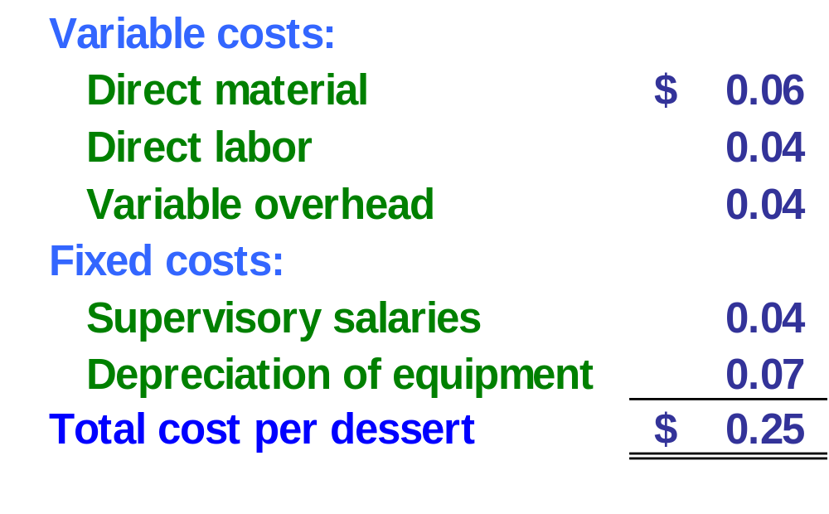
Outsource a Product or Service
An Atlanta bakery has offered to supply the in-flight desserts for 21¢ each.
Here are Worldwide’s current cost for desserts:
14-111
Notes:
50
62
We currently make our own desserts that are served on flights.
Our cost summary is shown here.

Slide 112
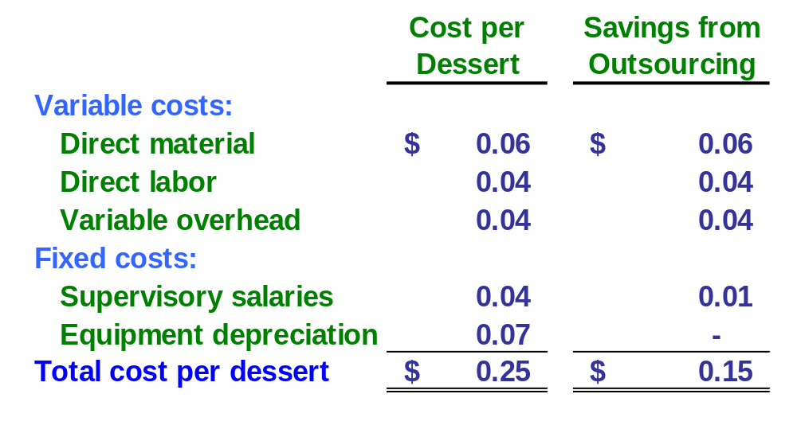
Outsource a Product or Service
Not all of the allocated fixed costs will be saved
if Worldwide purchases from the outside bakery.
14-112
Notes:
Our variable costs will remain in the analysis, but some of our allocated fixed costs will not be relevant to this decision.
We will incur somewhat less in supervisor salaries, but will still have some since someone needs to make sure the desserts are delivered and loaded properly.
Our depreciation will not change under either decision, so that cost is not relevant.
Our relevant costs are 15 cents per dessert.

Slide 113

Outsource a Product or Service
If Worldwide purchases the dessert for 21¢, it will only save 15¢ so Worldwide will have a loss of 6¢ per dessert purchased.
Wow, that’s
no deal!
14-113
Notes:
If we bought from the outside source, our cost would be 21 cents, and our relevant cost for this decision are 15 cents.
We should not accept this special offer, since we would lose 6 cents per dessert served.
Beware of Unit-Cost Data for decision-making purposes, unitized fixed costs can be misleading.
Fixed costs often are allocated to individual units of product or service for product-costing purposes.
For decision-making purposes, however, unitized fixed costs can be misleading.
Remember that fixed costs are fixed in total, not on a per unit basis.
Also, many fixed costs remain, regardless of a decision to outsource or to continue to produce.

Slide 114
Decisions Involving Limited Resources
Firms often face the problem of deciding how limited resources are going to be used.
Usually, fixed costs are not affected by this decision, so management can focus on maximizing total contribution margin.
Let’s look at the Martin, Inc. example.
14-114
Notes:
64
76
Organizations typically have limited resources. Limitations on floor space, machine time, labor hours, or raw materials are common.
Fixed cost often continue regardless of the decision, so maximizing the contribution margin is most often the appropriate decision.

Slide 115
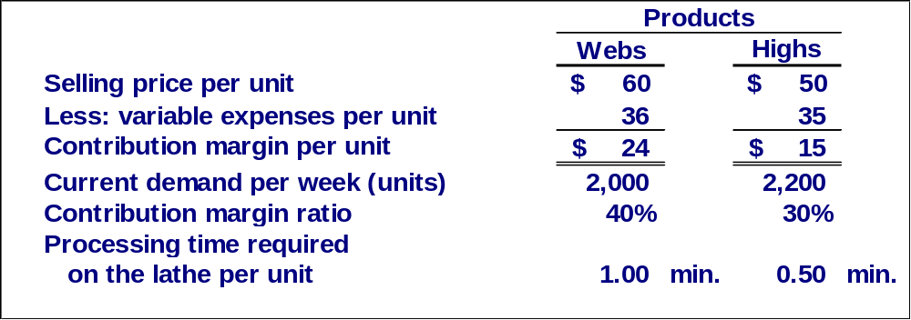
Limited Resources
Martin, Inc. produces two products and selected data are shown below:
14-115
Notes:
65
77
Martin Company produces two products with the costs shown.

Slide 116
Limited Resources
The lathe is the scarce resource because there is excess capacity on other machines. The lathe is being used at 100% of its capacity.
The lathe capacity is 2,400 minutes per week.
Should Martin focus its efforts
on Webs or Highs?
14-116
Notes:
66
78
The lathe is used 100% of the time in production.
It is working at its maximum capacity, and is the scarce, or limited resource.
Sometimes this is known as the bottleneck.

Slide 117
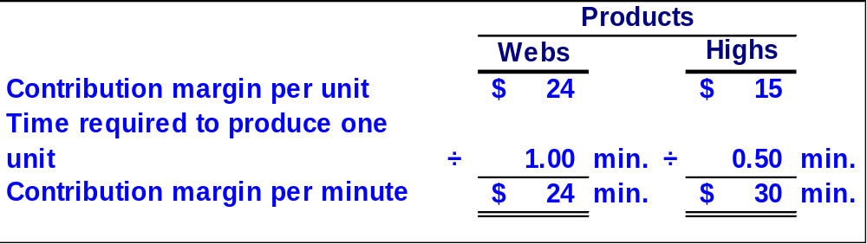
Limited Resources
Let’s calculate the contribution margin per unit of the scarce resource, the lathe.
Highs should be emphasized. It is the more valuable use of the scarce resource, the lathe, yielding a contribution margin of $30 per minute as opposed to $24 per minute for the Webs.
If there are no other considerations, the best plan would be to produce to meet current demand for Highs and then use remaining capacity to make Webs.
14-117
Notes:
71
83
Webs have a contribution margin of $24 per minute.
Highs have a contribution margin of $30 per minute.
All other things being equal, and if the company can sell all the highs it can produce, the company should produce and sell all the highs it can.
Webs should only be produced when more highs cannot be sold, and they have excess capacity to produce webs.

Slide 118
Limited Resources
Let’s see how this plan would work.
Allotting the Scarce Resource – The Lathe
Weekly demand for Highs 2,200 units
Time required per unit x .50 minutes
Time required to make Highs 1,100 minutes
Total lathe time available 2,400 minutes
Time used to produce Highs 1,100 minutes
Time available for Webs 1,300 minutes
Time required per unit x 1.00 minute
Production of Webs 1,300 units
14-118
Notes:
75
87
The weekly demand for highs is 2,200 units and would use 1,100 minutes of lathe time.
This leaves 1,300 minutes worth of lathe time to produce Webs.

Slide 119
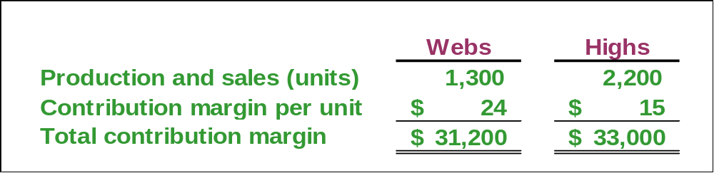
Limited Resources
According to the plan, Martin will produce 2,200 Highs and 1,300 Webs. Martin’s contribution margin looks like this.
The total contribution margin for Martin, Inc. is $64,200.
Any other combination would result in less contribution.
14-119
Notes:
76
88
Martin would have a total contribution margin of $64,000.
If Martin was able to sell more highs, it would increase production of highs to the maximum capacity of the lathe.

Slide 120

Wish you BEST for all your future endeavors!!!
I hope you had a Good Learning Experience…!
It was indeed a pleasure learning along with you all…

Slide 121
Thank you…

