Slide 1
Talent Retention Metrics and Talent Analytics Maturity Model
Facilitator: Dr. Pooja Patnaik

Slide 2
How much important are your employees for you? …and Why?

Slide 3
What do you do to keep them with you?

Slide 4
Do you really want all your employees to be with you?

Slide 5
Flowchart
Retention Index
Voluntary and Involuntary turnover
Turnover by department, grades, performance, and service tenure
Internal hired index
Talent Analytics Maturity Model

Slide 6
HR Metrics!

Slide 7
HR Metrics
Metrics are measurable factors that can be used to demonstrate the contributions of HR strategies to an organization
Human Resource (HR) metrics refer to data points that measure the cost and effectiveness of the HR process and specific HR initiatives
Peter Drucker’s words, “What gets measured gets improved.”

Slide 8
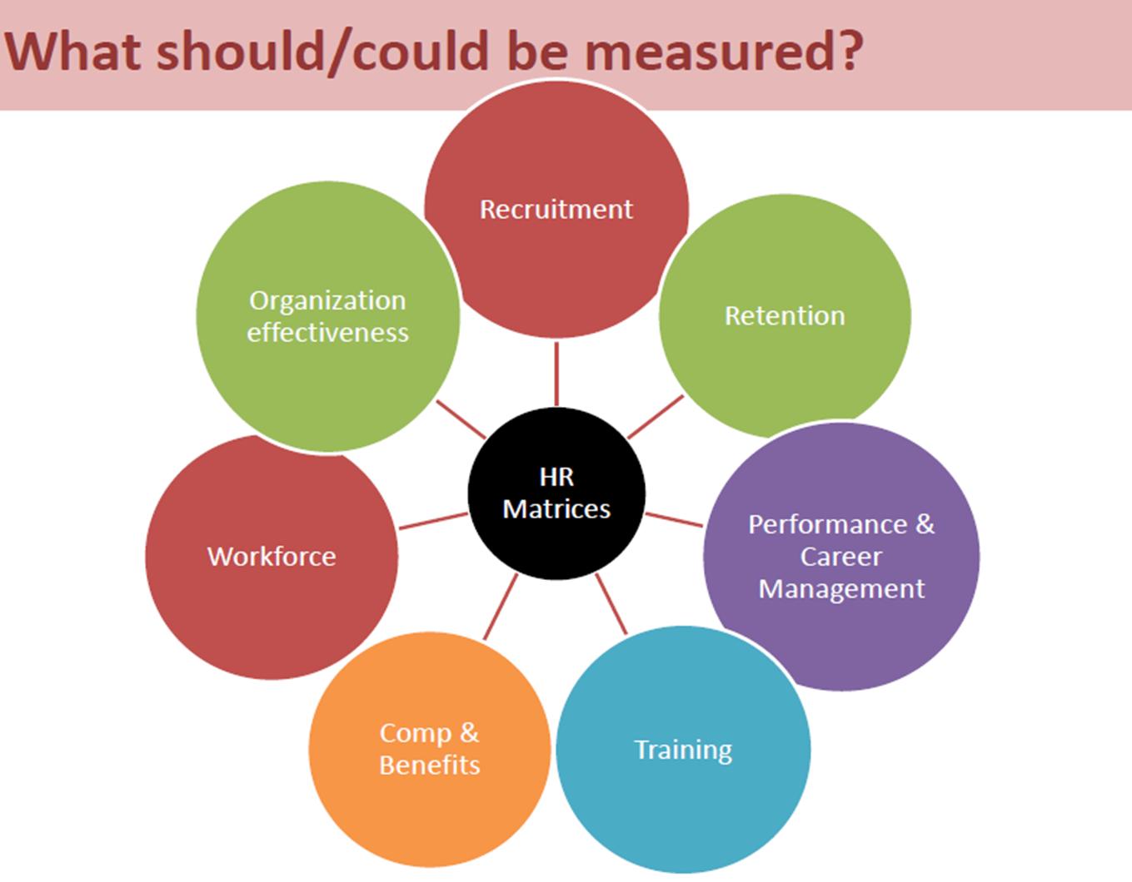
Example
Headcount
Time to fill
Cost per hire
Turnover rate
Absence rate
Health cost per employee
Revenue per FTE

Slide 9
HR Metrics- Measuring Change
HR Metrics (measurement) can help —
  by counting (we had three new hires this month),
  by qualitative assessment (on a scale of 1 to 10, that class was an 8),
  by time (it took two months applied to the HR profession,
  by a combination of the three.

Slide 10
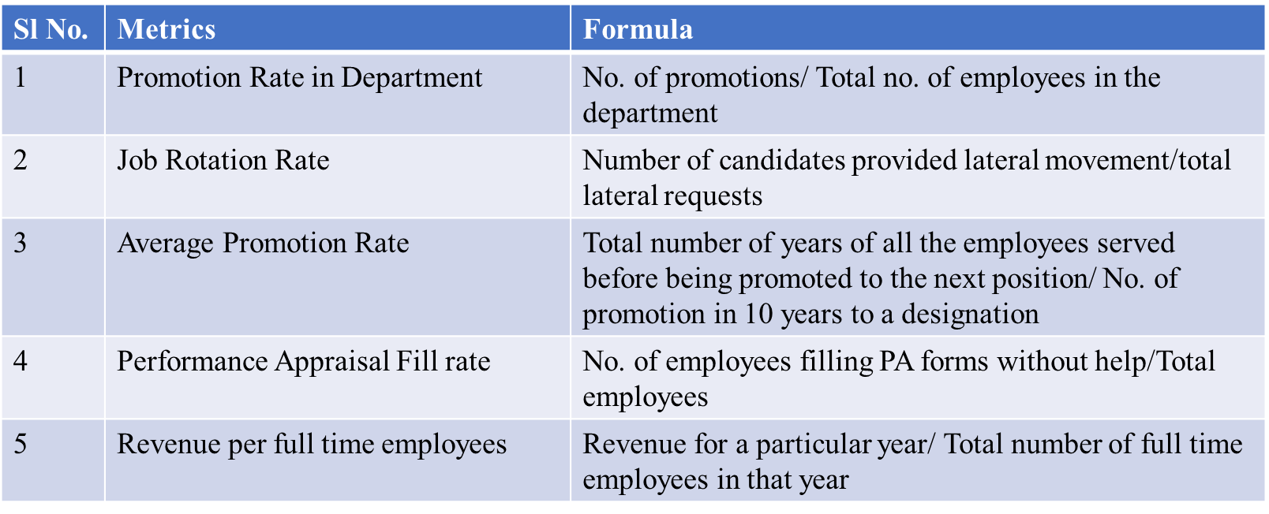
HR Metrics

Slide 11
Absence rate = workdays missed / total workdays scheduled x 100
Acceptance rate = (acceptances / offers) x 100
Average performance rating = (sum of all performance ratings / number of employees) x 100
Cost of HR per employee = total HR compensation / number of employees
Cost per hire = total cost of recruiting and HR staffing / number of new hires
Diversity rate = (total number of employees / number of employees from a diverse background) x 100
Employee referral program success = number of referrals hired / number of open jobs resulting in referrals
Health care costs per employee = total health care costs / number of employees enrolled in health care
Percentage of vacation days used = (number of vacation days used / number of vacation days offered) x 100
Retention rate = number employees staying across time period / number of employees at start of time period x 100
Training completion rate = number of employees who completed training / total number of employees x 100
Training cost per employee = total training costs / number of employees
Training participation rate = (number of participants / number of eligible employees) x 100
Training ROI = (value of increased performance - cost of employee training) / cost of employee training x 100
Turnover rate = number of departures during a specific time period / average number of employees during the same period) x 100

Slide 12
Investing in HR Metrics !
Competitive advantage
Improve
Quantify and demonstrate the value of HR
Maximize return on HR investments
HR contributes to overall business results
Tracking the effectiveness of HR
Human Capital represents 50-60% of all operating costs
Pro-active action can be taken to enhance workforce productivity, capability, satisfaction and engagement, leading to optimum workforce performance

Slide 13
Criteria for selecting Metrics
Companies should ensure the metric fits the corporate culture E.g. If a company's culture emphasizes speed or being the first to market, it would select metrics related to time.
A metric should echo the critical success factors that make a company's product or service successful. E.g. HR might choose to measure the satisfaction of managers and applicants.
Metrics should focus on issues that are likely to be reported to the chief executive officer.
HR should measure the performance of new hires, because that has a direct impact on productivity.

Slide 14
CUP Test
Does it make a contribution to overall organisational business objectives?
Does it provide an insight into whether organisational resources are being utilised at their optimum level?
Does it make any assessment of productivity which could lead to efficiency gains and therefore a better customer experience?

Slide 15
What data are you capturing
  Historical metrics give a good general indication of an organization's health.
  Real-time metrics are the snapshots which can act as warning signs that a process may be about to go horribly wrong
  Forward-looking metrics extend current and historical trends into the future to enable contingency planning.

Slide 16

Be careful
Developing and implementing HR metrics in a vacuum
Developing more metrics than it is feasible to maintain and utilize:
  Collecting data and calculating metrics is time-consuming and expensive, it's important to focus your energies on the ones that really matter.

Slide 17
Talent Management
Antecedents
Organization culture
Leadership
HRM practices- Recruitment, Person-Job Fit
Talent Development Process
Performance appraisals
Incentivizing
Career Planning
Succession Planning
Consequences
E Sat Score
Employee Engagement
Job Crafting
Well-Being
Happiness
Work-Life Balance
Performance, Potential and Productivity
Retention

Slide 18
Old Way | New Reality
People need companies | Companies need people
Machines, Capital, geography are competitive advantage | Talented people are competitive advantage
Better talent makes some difference | Better talent makes huge difference
Jobs are scarce | Talented people are scarce
Employees are loyal and jobs are secure | People are mobile and commitment is short term
People are happy with standard package | People demand much more
Old Way | New Reality
HR is responsible for people management | All managers, CEOs, the TMT are responsible for strengthening the Talent Pool
We provide good pay and benefits | We shape our company, jobs, even strategy to appeal to talented people
Recruiting is like purchasing | Recruiting is like marketing
Development happens through training | Development happens through stretch jobs, mentoring and coaching
We treat all the employees equally as all have the equal capability | We affirm all our employees but invest differently in our A, B and C players
Source: War for Talent by Micheals, Handfield-Jones, Axelrod- HBS

Slide 19
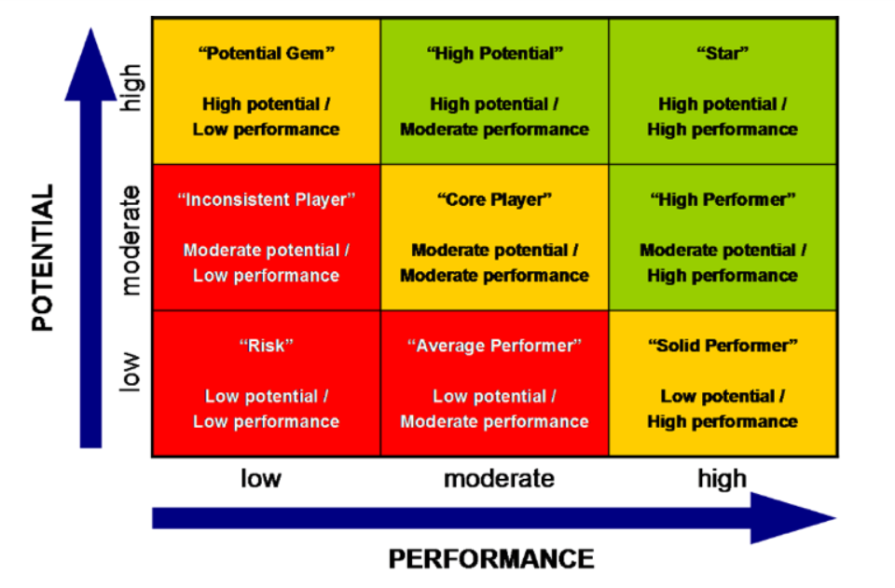
Talent Management 9 Grid Model

Slide 20

is the world’s only data driven TM function
“All people decisions are based on data & analytics”
"We want to bring the same level of rigor to people-decisions that we do to engineering decisions"
“You can measure everything”... “we measure revenue, productivity, engineering” - Eric Schmidt
“The best thing about using data to influence managers… is that it’s hard for them to contest it”

Slide 21
Retention is an important issue among executives
A SHRM/economist survey of global executives showed these top issues over 10 years:
  Retaining and rewarding the best people
  Attracting the best people to the organization

Slide 22
Data really educates managers on retention

Slide 23
Talent Retention- Please Introspect!
What constitutes too little and too much turnover for this organization?
What is the turnover of top talent vs. total turnover?
What is the turnover rate for talent in strategic roles?
What is the turnover rate for talent in hard to fill jobs?
What is the turnover rate within the first two years on the job?
What is the turnover rate for diverse talent?
What is the turnover rate by location, department and manager?
When do people leave in their tenure with the organization?
What is the turnover rate for different workforce generations?
What are the percentages of voluntary and involuntary turnover?
What percentage of involuntary turnover is related to poor performance?
Are managers held accountable for losing valued employees?

Slide 24
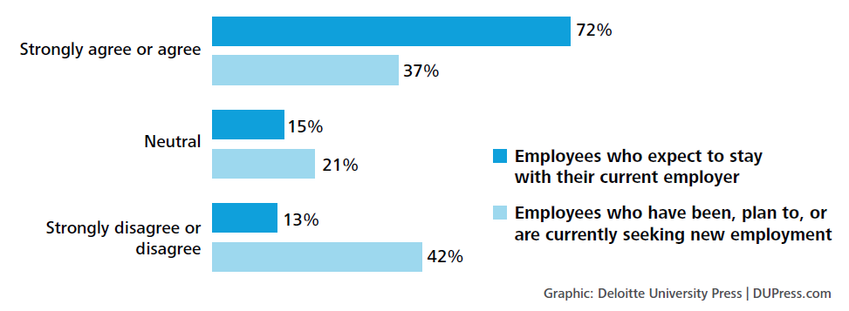
My job makes good use of my talent and abilities

Slide 25
Turnover Metrics
Turnover rate: Divide the number of terminations by the total employee census.
To arrive at a qualitative measure, you must first determine what aspects of turnover are important to your organization.
If your organization has high turnover within the first year, you may want to calculate the turnover rate just for the employees who leave within that time period.
For example, if there are a total of 150 separations through a year, and 32 of those were within one year of employment, your first year turnover rate is 21.33%.
https://www.bamboohr.com/blog/key-hr-metrics

Slide 26
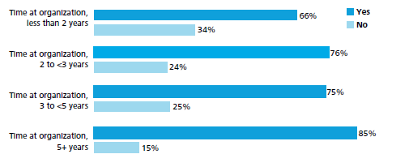

Slide 27
Attrition
Attrition typically reflects total voluntary and involuntary turnover.
Some quality-of-attrition metrics to consider are the following:
Regrettable separation rate – Employees who left the company but who the company had planned to retain.
Non-regrettable separation rate – Employees who left the company whose departure did not hurt the company.
Controllable separation rate – Employees who left for a reason that, if known, the organization might have been able to address.
Uncontrollable separation rate – Employees who left for a reason that, even if known, the organization could not have prevented.
High-performer separation rate – Employees designated as high performers who left the company.

Slide 28

Employee Turnover Rates
Computing Turnover Rates:
Thus, if there were 25 separations during a month and the total number of employees at mid month was 500, the turnover rate would be:
(25/500)*100=5 Percent

Slide 29


Computing Turnover Rates (cont’d):
  Another method of computing the turnover rate is one that reflects only the avoidable separations (S). This rate is computed by subtracting unavoidable separations (US) from all separations. The formula for this method is as follows:
where M represents the total number of employees at mid month. For example, if there were 25 separations during a month, 5 of which were US, and the total number of employees at mid month (M) was 500, the turnover rate would be:

Slide 30
Complementary metrics
Cautionary notes
High turnover rates can cause alarm. Ensure that you benchmark against like organizations, in sector and industry. Assess the state of labour supply and demand in your region. Perform further analysis on the turnover rate to determine the real issues.
This metric is key to understanding all aspects of the talent cycle within your organization. On its own, it may indicate that the retention processes of the business are not working. Review this metric alongside the following to develop a clearer picture of your retention effectiveness:
  Cost of Voluntary Turnover
  Resignation Rate
  Retirement Rate
  Involuntary Turnover Rate
  Voluntary Turnover Rate by Job Level
  Involuntary Turnover Rate by Job Level
  1st year Turnover Rate

Slide 31
Voluntary Turnover Rate
Employees who left the organization voluntarily as a percentage of headcount.
How this metric should be used
Use this metric to determine the volume of employees that are opting to leave the organization.
Complement the Voluntary Turnover Rate with analysis from an employee exit survey.
An increase in voluntary turnover can point to a lack of competitiveness in salary, a drop in leadership credibility, poor retention practices or an improved job market.

Slide 32
Cost of Voluntary Turnover
What this metric means
  The average cost to replace each employee who left your organization voluntarily.
This metric can be used to calculate the impact of turnover on the organization’s overall costs.
How this metric should be used
  Use this metric to describe the impact of turnover to the organization’s productivity, costs and, in turn, profits, either from increased expenditures, decreased revenues, or both.

Slide 33
Costs Associated with the Turnover of One Computer Programmer
Turnover costs = Separation costs + Replacement costs + Training costs)
Separation costs
Exit interview cost for salary and benefits of both interviewer and departing employee during the exit interview = $30+$30 = $60
Administrative and record-keeping action = $30
Total separation costs = $60 + $30 = $90
Replacement costs
Advertising for job opening = $2,500
Preemployment administrative functions and record-keeping action = $100
Selection interview = $250
Employment tests = $40
Meetings to discuss candidates (salary and benefits of managers while participating in meetings)= $250
Total replacement costs = $2,500 + $100 + $250 + $40 + $250 = $3,140
Training costs
Booklets, manuals, and reports = $50
Education = $240/day for new employee’s salary and benefits x 10 days of workshops, seminars, or courses = $2,400
One-to-one coaching = ($240/day/new employee + $240/day/staff coach or job expert) x 20 days of one-to-one coaching = $9,600
Salary and benefits of new employee until he or she gets “up to par” = $240/day for salary and benefits x 20 days = $4,800
Training costs = $50 + $2,400 + $9,600 + $4,800 = $16,850
Total turnover costs= $90 + $3,140 + $16,850 = $20,080

Slide 34
Involuntary Turnover Rate
Employees who left the organization involuntarily as a percentage of headcount.
How this metric should be used
Use this metric to determine the volume of employees that are being asked to leave the organization.
Some level of involuntary turnover is ideal to ensure the performance management process is effective.
An involuntary turnover rate that is trending higher or that is significantly greater than other like organizations could be an indicator of an ineffective recruitment process or a fundamental shift in the organizational structure.
The Involuntary Turnover Rate includes employees who have been dismissed, laid off, have declared Long-term Disability or have passed away.
Unlike other metrics, organizations should not set targets for involuntary turnover rates.

Slide 35
Resignation Rate
Employees who resigned from the organization as a percentage of headcount.
How this metric should be used
Use this metric to determine the rate at which employees are choosing to leave the organization.
Resignations are generally the most preventable of all employee turnover. Perform further analysis by asking the employee why they are leaving with an exit survey.
Complementary metrics
Your overall resignation rate is an important metric for tracking the overall effectiveness of your retention programs and compensation strategy. However, it does not provide sufficient detail to be able to determine where problems may exist and therefore how correct them. The metrics below should be used in conjunction with your overall resignation rate to create a clearer picture:
1st Year Resignation Rate
Resignation Rate by length of service
Resignation Rate by age group

Slide 36
Retirement Rate
Employees who retired as a percentage of headcount.
How this metric should be used
A rising retirement rate in the economic region could indicate a future labour supply issue.
This metric is particularly important for any organization developing a strategic workforce plan.
Complementary metrics
Retirement rate is a key workforce planning metric. It can determine how quickly the talent pipeline will need to be re-supplied and how much development the organization will need to undertake to replace the knowledge and experience that leaves when people retire. Other metrics which can provide the complete picture are:
Average Retirement Age
Average Age
External Time-to-Fill
Succession Planning Rate

Slide 37
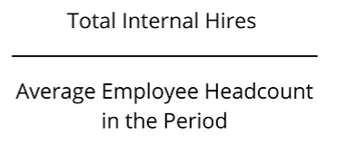
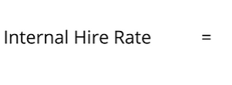
Internal Hire Rate
Internal hires occur when the organization fills open positions with existing employees. It includes both lateral and vertical movements of employees across the organization.
Companies use Internal Hire Rate to capture the total number of positions filled internally via promotion, transfer, or other moves (internal hires may or may not be accompanied by an increase in compensation), expressed as a percentage of total average employee headcount.

Slide 38
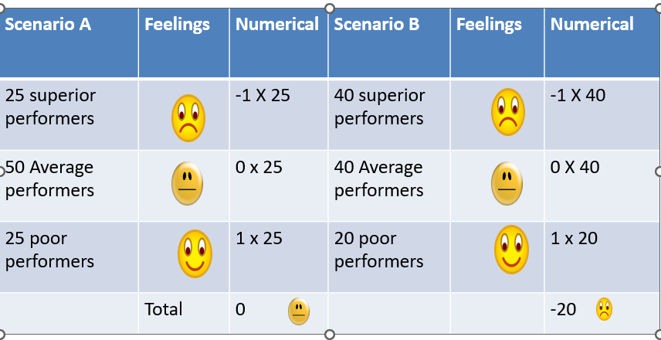
Giving Data Context
Is all turnover bad?

Slide 39
Talent Management Index
New Hire High Performer Rate. It’s calculated by the percentage of new hires, rated by individual organization standards, as high-quality, high potential or high-performing employees.
Percent of High Performers. It measures the percent of the population that is rated as high performing. The best use of this metric, when calculated as part of Talent Management Index, is on an individual manager basis to hold management accountable for nurturing and developing the organization’s most promising talent.
High Performer Turnover Rate. This metric allows organizations to measure management effectiveness in retaining top talent at the organization

Slide 40
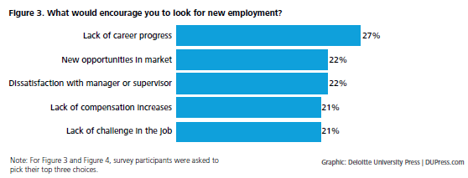

Slide 41
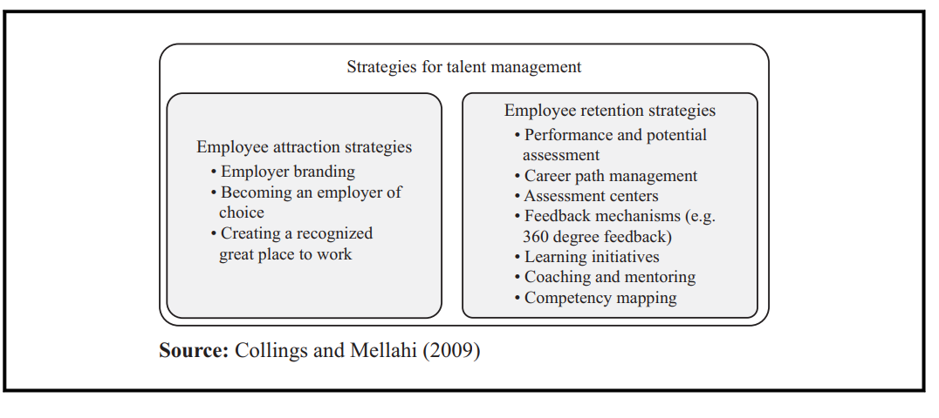
Strategies for Talent Management

Slide 42
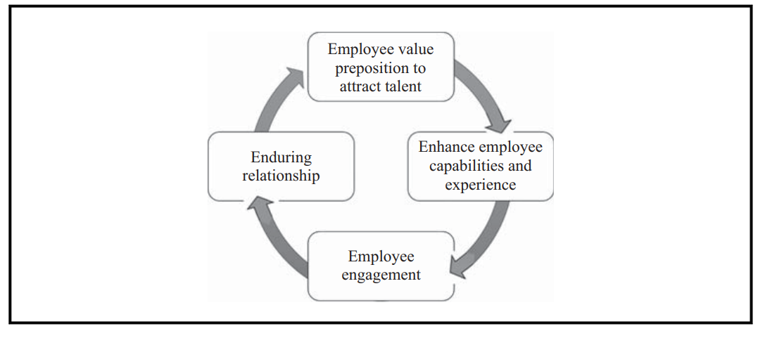
4E Framework to improve Retention

Slide 43
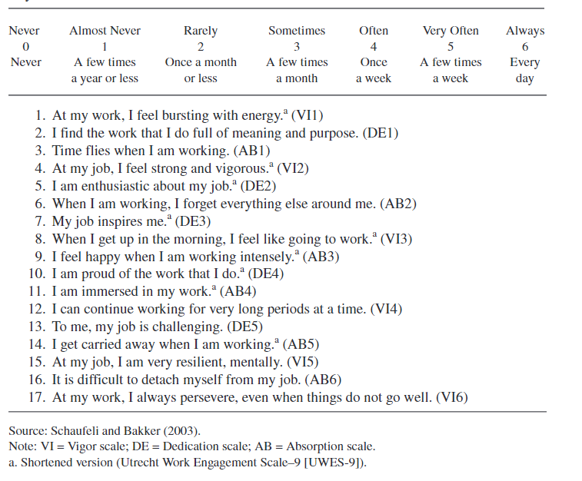
How do we Measure Employee Engagement

Slide 44

Data Points for HR Problems!-General
Absenteeism
Disciplinary procedure
Grievance procedure
Authority and accountability
Functions
Teams
Workplace cultures (OCTAPACE)
Compensation, Incentives
Contracts of employment
Job descriptions
Health and Safety at workplaces
Retention
Recruitment
Turnover

Slide 45
In God we trust. All others bring data.” — Edward Deming

Slide 46
From Metrics to Analytics
What’s driving this shift to analytics?
To get More from Talent!

Slide 47
Moving from Metrics to Analytics
Adopt a strategy aimed at gathering specific data needed to address specific business objectives.
Step One
Step Two
Step Three
Collect the ‘right’ data
Transform data into usable information
Develop action-oriented reports

Slide 48
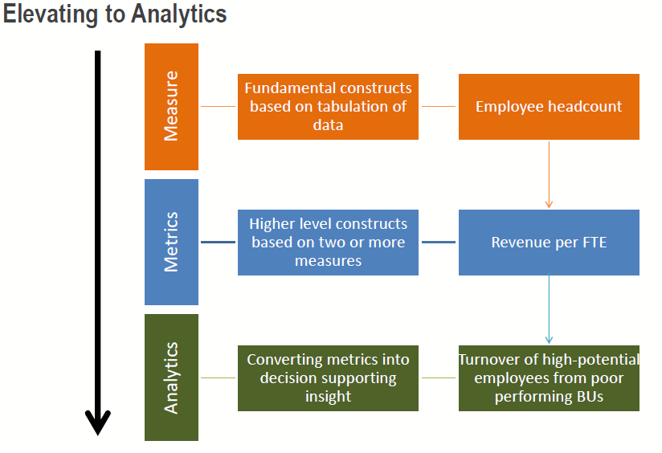

Slide 49
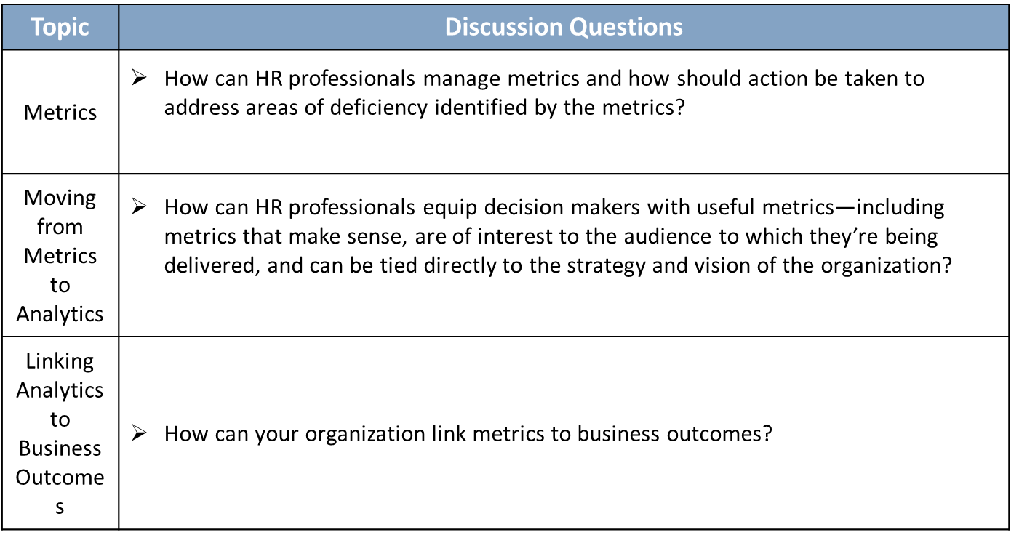
Without analytics, metrics lack a clear objective and/-or a connection to business performance.

Slide 50
Stages of analytics maturity
No analytics refers to companies with no analytical processes whatsoever.
Descriptive analytics lets us know what happened, gathering and visualizing historical data.
Diagnostic analytics identifies patterns and dependencies in available data, explaining why something happened.
Predictive analytics creates probable forecasts of what will happen in the future, using machine learning techniques to operate big data volumes.
Prescriptive analytics provides optimization options, decision support, and insights on how to get the desired result.

Slide 51
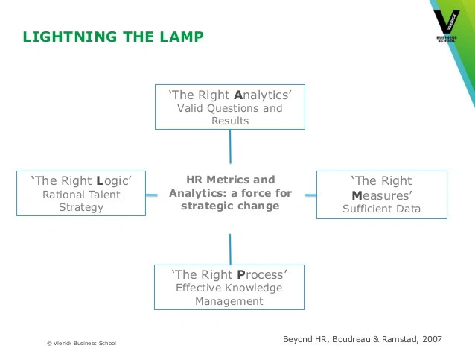

Slide 52
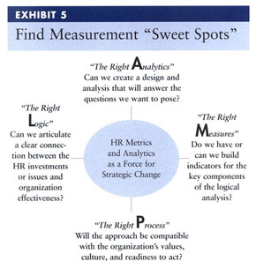
LAMP Model of Talent Analytics

Slide 53
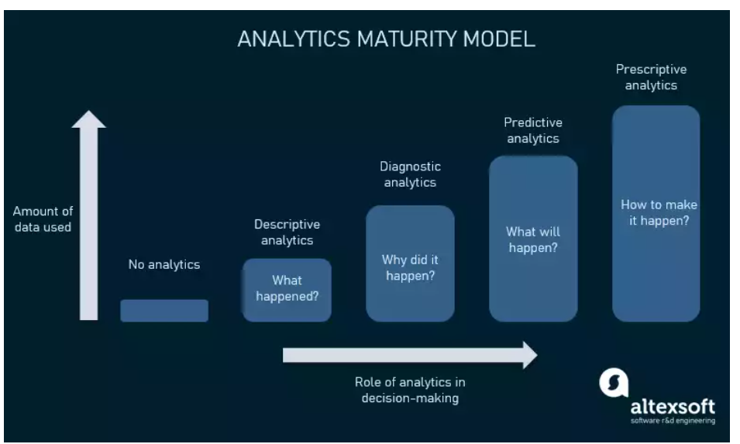
https://www.aihr.com/blog/test-hr-analytics-maturity-level/

Slide 54
Mastering Talent Analytics
DELTA
  access to high-quality data,
  enterprise orientation,
  analytical leadership,
  strategic targets, and
  analysts.

Slide 55
Case-Mr. Mehta’s Dilemma: A Case of Performance Appraisal Politics
Do you agree with Mr. Mehta’s decision allowing Rajesh to go on study leave? What are the factors that Mr. Mehta would have considered before taking the decision?
Did Rajesh Handle the grievance appropriately?
Could the organization have managed the performance appraisal process differently? Why and how?
How should have Mr. Desai managed the performance appraisal process?
Can bringing analytics help in this context? Justify your stance

Slide 56
Thank You

