Slide 1
Futures & Options

Slide 2
What is a Derivative?
A derivative is an instrument whose value depends on, or is derived from, the value of another asset.
Examples: futures, forwards, swaps, options…

Slide 3
Forward contracts
A forward contract is an agreement to buy (if you are long) or sell (if you are short) something in the future, at an agreed upon price (the futures price). A forward contract is traded in the over-the-counter market; usually between two parties.
One of the parties to a forward contract assumes a long position and agrees to buy the underlying assets on a certain specified future date for a certain specified price. The other party assumes a short-position and agrees to sell the asset on the same date for the same price.

Slide 4
Forward contracts: An example
Quote on the exchange rate between Indian Rupee(INR) and US dollar (USD)
 | Bid | Ask
Spot | 75.48 | 75.68
1-month forward | 76.86 | 77.01
2-month forward | 77.52 | 77.75
3-month forward | 78.05 | 78.35
Bid is the price at which bank is willing to Buy
Ask is the price at which the bank is willing to Sell
Bid-ask spread is the profit of the bank.

Slide 5
Forward contracts: An example
Assume that you are expected to receive payment in US dollar 1,00,0000 after 3 months and you are uncertain about exchange rate. After selling (short-position) 3 months forward contract (78.05), you can lock the value of dollar, close to Rs. 78.05, thereby mitigating your exchange rate risk.

Slide 6
Futures contract
Like a forward contract, a futures contract is an agreement between two parties to buy or sell an asset a certain time in future for a certain price. In order to mitigate counterparty risk, a stock exchange is a counterparty in each trade, and therefore it is traded at stock exchange. To make trading possible, the exchange specifies certain standardized features of the contract.

Slide 7
NIFTY futures
INSTRUMENT TYPE | SYMBOL | EXPIRY DATE | LAST PRICE | VOLUME (Contracts) | OPEN INTEREST | Market lot
Index Futures | NIFTY | 25-Jun-20 | 10,028.20 | 169339 | 143760 | 75
Index Futures | NIFTY | 30-Jul-20 | 10,023.95 | 5285 | 11334 | 75
Index Futures | NIFTY | 27-Aug-20 | 10,046.05 | 666 | 5958 | 75
In India, all F&O products have three contract based on expiry; near month,
next month, far month.
Each contract is expired on the last Thursday of the month

Slide 8
Closing out positions
Most of futures contracts do not lead to delivery. Closing out a position means entering into the opposite trade to the original one.
For example, Investors who bought one NIFTY Index futures on March 5, 2020, can close out the position by selling one NIFTY Index futures contract.

Slide 9
Convergence of Futures to Spot
As the delivery for a futures contract is approached , the futures price converges to the spot price
of underlying assets.
Futures
Price
Spot Price
Spot Price
Futures
Price
Time
Time
(a)
(b)

Slide 10
The operation of Margins
A margin is cash or marketable securities deposited by an investor with his or her broker
The balance in the margin account is adjusted to reflect daily settlement
Margins minimize the possibility of a loss through a default on a contract, thereby reducing counterparty risk.
There are two types of margins that are normally measured. At the time of taking position, investors are required to deposit the Initial margin on the position. Initial margin includes Span (Standard Portfolio Analysis of Risk) margin that is based on the 99% value at risk over a one-day horizon, and exposure margin.
Exposure margin
  For Index options and Index futures contract:
  3% of the notional value of a futures contract.
  For option contracts and Futures Contract on individual Securities:
  The higher of 5% or 1.5 standard deviation of the notional value of gross open position in futures on individual securities and gross open positions in options on individual securities in an underlying. The standard deviation of daily logarithmic returns of prices in the underlying stock in the cash market in the last six months is computed on a rolling and monthly basis at the end of each month.

Slide 11

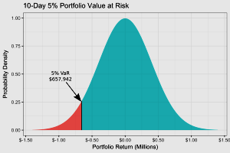
Value at risk
Value at risk is used to measure market risk. It particularly measures probability of loss (X), not more than V amount over N days. Assume that X=95% and N=10 days, it means that we are interested in loss level over 10 days that we are 99% confident will not exceeded.

Slide 12
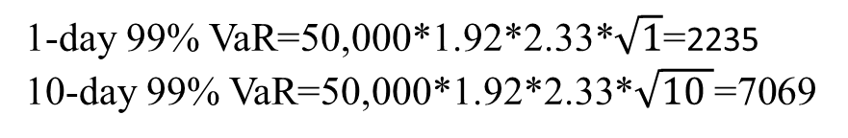
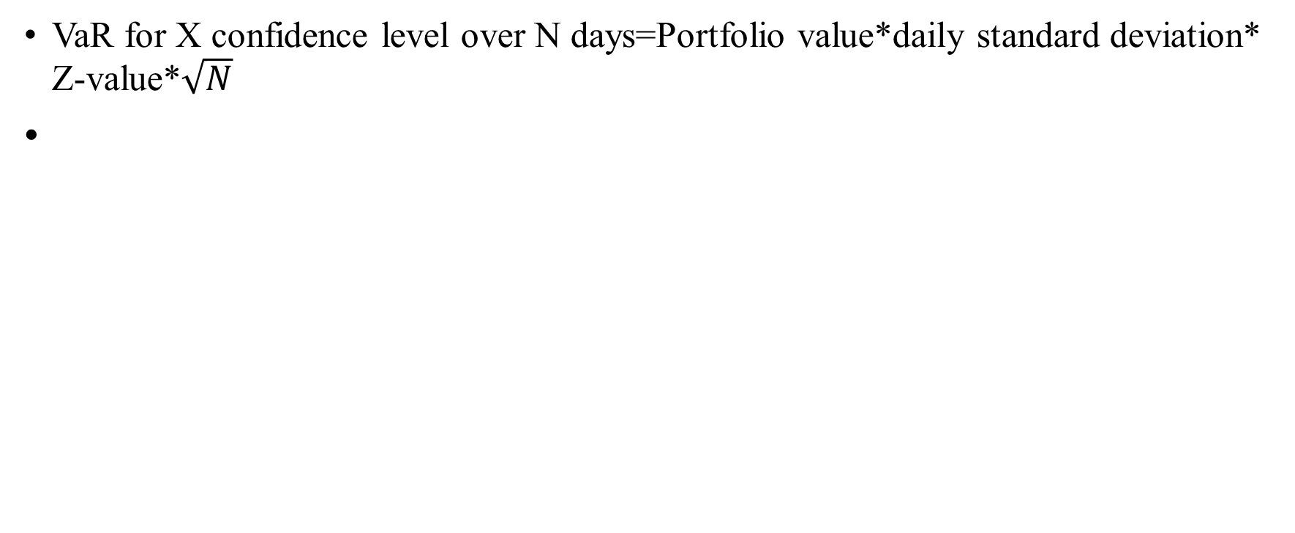
Value at risk(VaR)
VaR for X confidence level over N days=Portfolio value*daily standard deviation* Z-value*$\sqrt{N}$
 | AAPL | GLD
Variance (daily) | 0.0369% | 0.0036%
Std (daily) | 1.92% | 0.60%
Value of investment (in Rs) | 50,000 | 50,000
Z-value at 99% CL | =NORMSINV(.99)=2.33
1-day 99% VaR=50,000*1.92*2.33*$\sqrt{1}$=2235
10-day 99% VaR=50,000*1.92*2.33*$\sqrt{10 }$=7069

Slide 13
Example of a Futures Trade
An investor takes a long position in 2 December gold futures contracts on June 5
  contract size is 100 oz.
  futures price is US$1,250
  initial margin requirement is US$6,000/contract (US$12,000 in total)
  maintenance margin (mark to market) is US$4,500/contract (US$9,000 in total)

Slide 14
A Possible Outcome and mark to market
Day | Trade Price ($) | Settle Price ($) | Daily Gain ($) | Cumulative Gain ($) | Margin Balance ($) | Margin Call ($)
1 | 1,250.00 |  |  |  | 12,000
1 |  | 1,241.00 | −1,800 | − 1,800 | 10,200
2 |  | 1,238.30 | −540 | −2,340 | 9,660
….. |  | ….. | ….. | ….. | ……
6 |  | 1,236.20 | −780 | −2,760 | 9,240
7 |  | 1,229.90 | −1,260 | −4,020 | 7,980 | 4,020
8 |  | 1,230.80 | 180 | −3,840 | 12,180
….. |  | ….. | ….. | ….. | ……
16 | 1,226.90 |  | 780 | −4,620 | 15,180
-2.7*200

Slide 15
Hedging Strategies Using Futures
Hedging is a risk management strategy employed to offset losses in investments by taking an opposite position in a related asset.
A long futures hedge is appropriate when you know you will purchase an asset in the future and want to lock the price. This strategy is appropriate if you want to reduce your exposure for upside prices.
A short futures hedge is appropriate when you know you will sell an asset in the future and want to lock the price. This strategy is appropriate if you want to reduce your exposure for downside prices.

Slide 16
A short futures hedge
Assume that on Jun 5, 2020, you, as an oil producer, has just negotiated a contract to sell 1 million barrels of crude oil. It has been agreed that the price that will apply in the contract is the market price Aug 15, 2020. On Jun 5, 2020, the oil price is $80 per barrel. Now, you are facing oil price risk if oil price goes down..
Future oil contract price that has deliver in August is $ 79 per barrel with the size of 1000 barrel .
Your strategy: Short (Sell) 1000 (1000000/1000) future contract.
Assume that the spot (futures) price of oil is either $75 or $85 barrel on August 15.
Profit (loss) from future contract:
  When Price $75: $79-$75=$4 gain
  When Price $85: $79-$85=-$6 loss
Effective price for you: Spot price at the time of delivery+ Profit(loss) from future market
  When Price $75:$75+$4=$79
  When price $85=$85-6$=$79
By using future contract, we lock our price close to $79

Slide 17
A long future hedge
Assume that on Jun 5, 2020, you, as an oil buyer, has just negotiated a contract to buy 1 million barrels of crude oil. It has been agreed that the price that will apply in the contract is the market price Aug 15, 2020. On Jun 5, 2020, the oil price is $80 per barrel. Now, you are facing oil price risk if oil price goes up
Future oil contract price that has deliver in August is $ 79 per barrel with the size of 1000 barrel .
Your strategy: Buy(buy) 1000 (1000000/1000) future contract.
Assume that the spot (futures) price of oil is either $75 or $85 barrel on August 15.
Profit (loss) from future contract:
  When Price $75: $79-$75=-$4 lose
  When Price $85: $79-$85=$6 profit
Effective price: Spot price at the time of delivery- Profit(loss) from future market
  When Price $75:$75+$4=$79
  When price $85=$85-6$=$79
By using future contract, we lock our price close to $79

Slide 18
Cross-hedging
When, the asset underlying the future contract is not same as the asset whose price is being hedged, we use cross-hedging. For example, an airline that is concerned about the future price of jet fuel. Since jet fuel futures are not actively traded, it might choose to use heating oil futures contracts to hedge its exposure.
Hedge ratio is the ratio of the size of the position taken in futures contracts to the size of the exposure. Therefore, when the asset underlying futures contract is the same as the asset being hedged, the hedge ratio will be equal to 1.

Slide 19
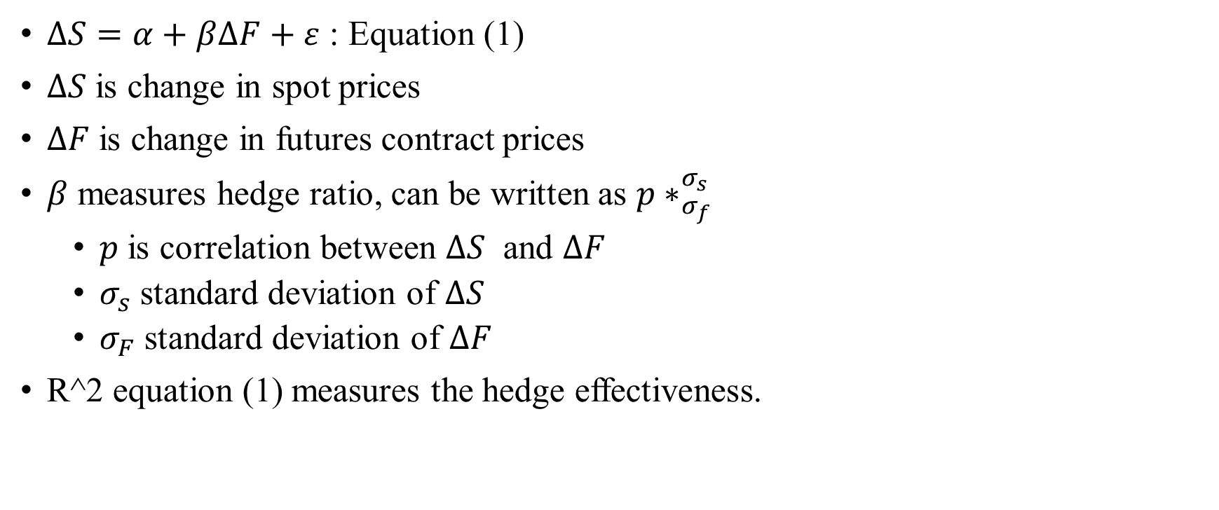
Hedge ratio for cross-hedging
$∆S=α+β∆F+ε$ : Equation (1)
$∆S$ is change in spot prices
$∆F$ is change in futures contract prices
$β$ measures hedge ratio, can be written as ${p∗}_{σ_{f}}^{σ_{s}}$
  $p$ is correlation between $∆S$ and $∆F$
  $σ_{s}$ standard deviation of $∆S$
  $σ_{F}$ standard deviation of $∆F$
R^2 equation (1) measures the hedge effectiveness.

Slide 20
Hedge ratio for cross-hedging
Month | Δ in Future Price (ΔF) | Δ in Spot Jet Fuel Price (ΔS)
1 | 0.021 | 0.029
2 | 0.035 | 0.02
3 | -0.046 | -0.044
4 | 0.001 | 0.008
5 | 0.044 | 0.026
6 | – 0029 | -0.019
7 | -0.026 | -0.01
8 | -0.029 | -0.007
9 | 0.048 | 0.043
10 | -0.006 | 0.011
11 | -0.036 | -0.036
12 | -0.011 | -0.018
13 | 0.019 | 0.009
14 | -0.027 | -0.032
15 | 0.029 | 0.023

Slide 21
Hedge ratio for cross-hedging: Regression results
 | Coefficients | Standard Error | t Stat | P-value | Lower 95% | Upper 95% | Lower 95.0% | Upper 95.0%
Intercept | 0.001 | 0.003 | 0.334 | 0.744 | -0.005 | 0.007 | -0.005 | 0.007
Δ in Future Price (ΔF) | 0.778 | 0.086 | 9.007 | 0.000 | 0.591 | 0.964 | 0.591 | 0.964
R Square 0.862
Hedge ratio=0.778
The hedging effectiveness is 86.2%

Slide 22
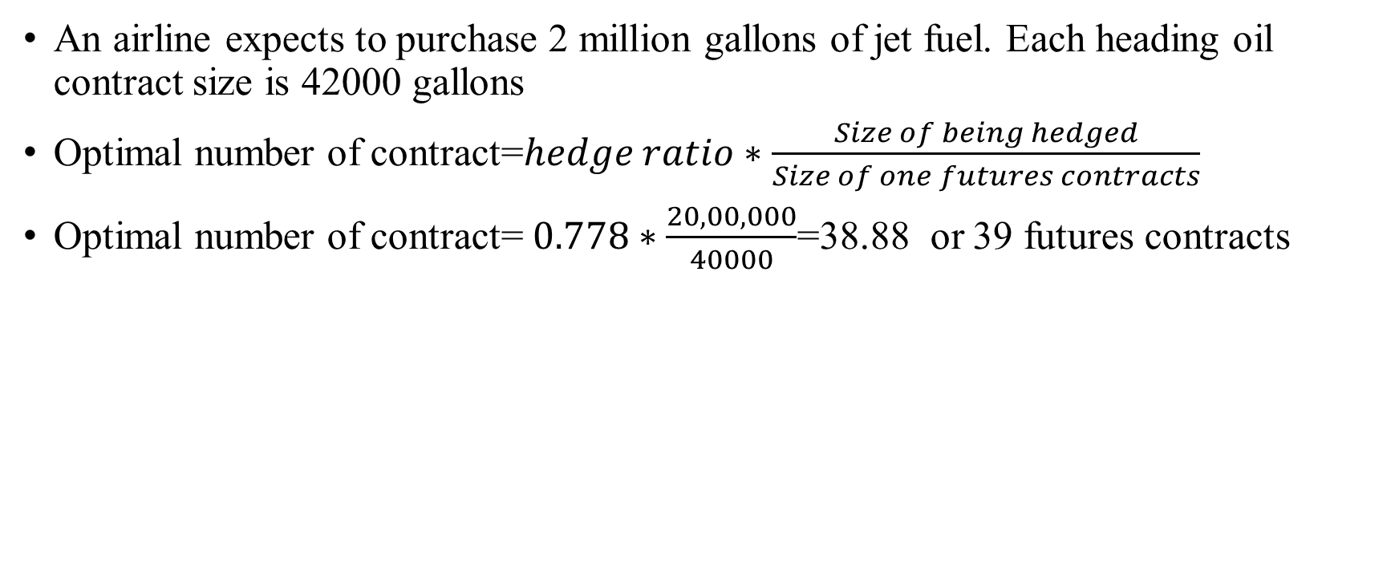
Optimal number of contract
An airline expects to purchase 2 million gallons of jet fuel. Each heading oil contract size is 42000 gallons
Optimal number of contract=$hedge ratio∗\frac{Size of being hedged}{Size of one futures contracts}$
Optimal number of contract= $0.778∗\frac{20,00,000}{40000}$=38.88 or 39 futures contracts

Slide 23
Options

Slide 24
Options
An option is the right to either buy or sell something at a set price, within a set period of time
  Call Options: The buyer of a call option has the right but not the obligation to purchase. But, the seller of a call option has the obligation to sell.
  Put Options.
  The buyer of a put option has the right but not the obligation to sell. But, the seller of a put option has the obligation to purchase

Slide 25
Option Terminology
Exercise (or strike) price (X): The price stated in the option contract at which the security can be bought or sold.
S: spot prices
Option price: The market price of the option contract.
Expiration date: The date the option matures.
Call option payoff: Max(0,S-X)
Put option payoff: Max(0, X-S)

Slide 26
Consider the following data:
Exercise price = $25.
Stock Price(a) | Exercise price (b) | Call Option | Put option
10 | 25 | 0 | 15
15 | 25 | 0 | 10
20 | 25 | 0 | 5
25 | 25 | 0 | 0
30 | 25 | 5 | 0
35 | 25 | 10 | 0
40 | 25 | 15 | 0
45 | 25 | 20 | 0
50 | 25 | 25 | 0
Notes:
8

Slide 28
Put Option Payoff

Slide 29
Terminology
Moneyness :
  At-the-money option
  In-the-money option
  Out-of-the-money option

Slide 30
Stock Option (Jun 5, 2020)
SYMBOL | EXPIRY DATE | OPTION TYPE | STRIKE PRICE | Value of call option | UNDERLYING VALUE | Moneyness
BAJFINANCE | 25-Jun-20 | Call | 2,400.00 | 144 | 2,357.05 | out the money
BHARTIARTL | 25-Jun-20 | Call | 600 | 15 | 574.7 | out the money
BHARTIARTL | 25-Jun-20 | Call | 580 | 21.75 | 574.7 | out the money
BHARTIARTL | 25-Jun-20 | Call | 620 | 10.15 | 574.7 | out the money
BHARTIARTL | 25-Jun-20 | Call | 700 | 2.55 | 574.7 | out the money
RELIANCE | 25-Jun-20 | Call | 1,600.00 | 51.55 | 1,593.10 | out the money
RELIANCE | 25-Jun-20 | Call | 1,700.00 | 18.85 | 1,593.10 | out the money
RELIANCE | 25-Jun-20 | Call | 1,620.00 | 41.9 | 1,593.10 | out the money
RELIANCE | 25-Jun-20 | Call | 1,640.00 | 34.9 | 1,593.10 | out the money
RELIANCE | 25-Jun-20 | Call | 1,660.00 | 28 | 1,593.10 | out the money
SBIN | 25-Jun-20 | Call | 180 | 11.2 | 179.55 | out the money
SBIN | 25-Jun-20 | Call | 200 | 4.45 | 179.55 | out the money
SBIN | 25-Jun-20 | Call | 190 | 7.15 | 179.55 | out the money
SUNPHARMA | 25-Jun-20 | Call | 500 | 25.95 | 504.15 | In the money
SUNPHARMA | 25-Jun-20 | Call | 520 | 17.5 | 504.15 | out the money
SUNPHARMA | 25-Jun-20 | Call | 510 | 21.4 | 504.15 | out the money
TATAMOTORS | 25-Jun-20 | Call | 110 | 7.25 | 107.2 | out the money
TCS | 25-Jun-20 | Call | 2,100.00 | 42 | 2,053.00 | out the money

Slide 31
Effect of Variables on Option Pricing
Variable | Call option | Put option
Spot prices (S) | + | −
Strike price (K) | − | +
Time to maturity (T) | + | +
Volatility of underlying assets (σ | + | +
Risk-free rate (r) | + | −
Dividend (d) | − | +

Slide 32
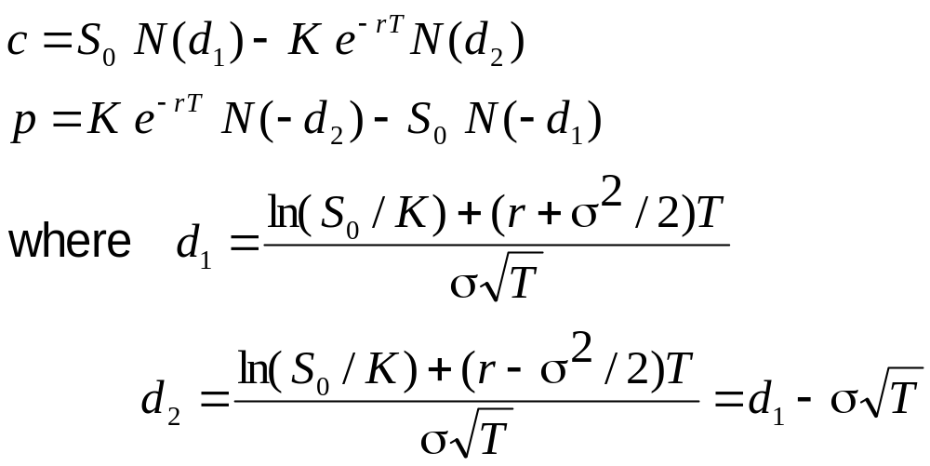
The Black-Scholes-Merton Formulas for Options value

Slide 33
Value of option: BAJFINANCE
Type of Option | Call Option
Stock Price (S₀) | $ 2,357.00
Exercise (Strike) Price (K) | $ 2,400.00
Time to Maturity (in years) (t) (20/256) | 0.08
Annual Risk-Free Rate (r) | 6.00%
Annualized Volatility (σ) | 60.00%
Option Price | $ 143.19

Slide 34
Volatility index (VIX)

