Slide 1
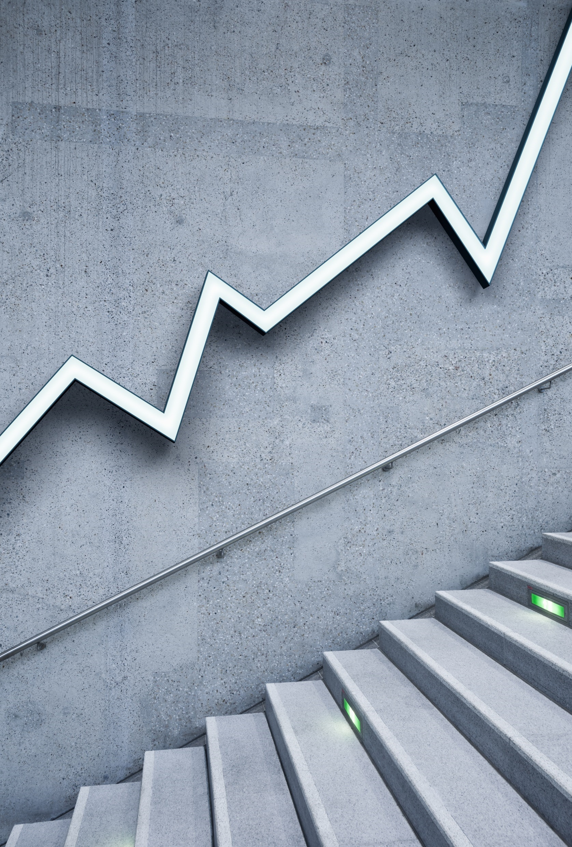
Financial Markets –
An overview

Slide 2
The Financial System
Plays a vital role in the economic growth of a country
Intermediates between the flow of funds belonging to those who save and those who invest in productive assets
Mobilizes and allocates scarce resources of a country
Financial Institutions, markets, instruments

Slide 3
Real Assets vs. Financial Assets
Real Assets
Financial Assets
Have Productive Capacity
Examples: Land, buildings, machines, intellectual property
Claims on real assets
Do not contribute directly to productive capacity
Examples: Stocks, bonds

Slide 4
Real Assets vs. Financial Assets
Real Assets generate net income to the economy
Financial Assets define the allocation of income/wealth among investors
  Consume today or investing for the future.
  If invest, place wealth in financial assets by purchasing securities.
  Firms use the money so raised to pay for real assets.
  Investor’s return on securities come from the income produced by the real assets that were financed by the issuance of those securities.

Slide 5
Categories of Economic Units
Economic Units
transacting in
financial markets
Government Sector
Business Sector
Household Sector

Slide 6
Income and Expenditure
Income = Expenditure
Balanced Budget Units (BBU)
Income > Expenditure
Surplus Budget Units (SBU)
Income < Expenditure
Deficit Budget Units (DBU)

Slide 7
Function of a Financial System
SBU
DBU
funds
claims
e.g.
government
business entities
e.g.
household sector

Slide 8
Financial Claims
SBU
DBU
funds
claims
debt instruments
equity shares

Slide 9
Why do we require financial assets?
Properties of Financial Assets
Serve as a store of value
Promise future returns
They are fungible
Properties of Financial Assets
Serve as a store of value
Promise future returns
They are fungible

Slide 10
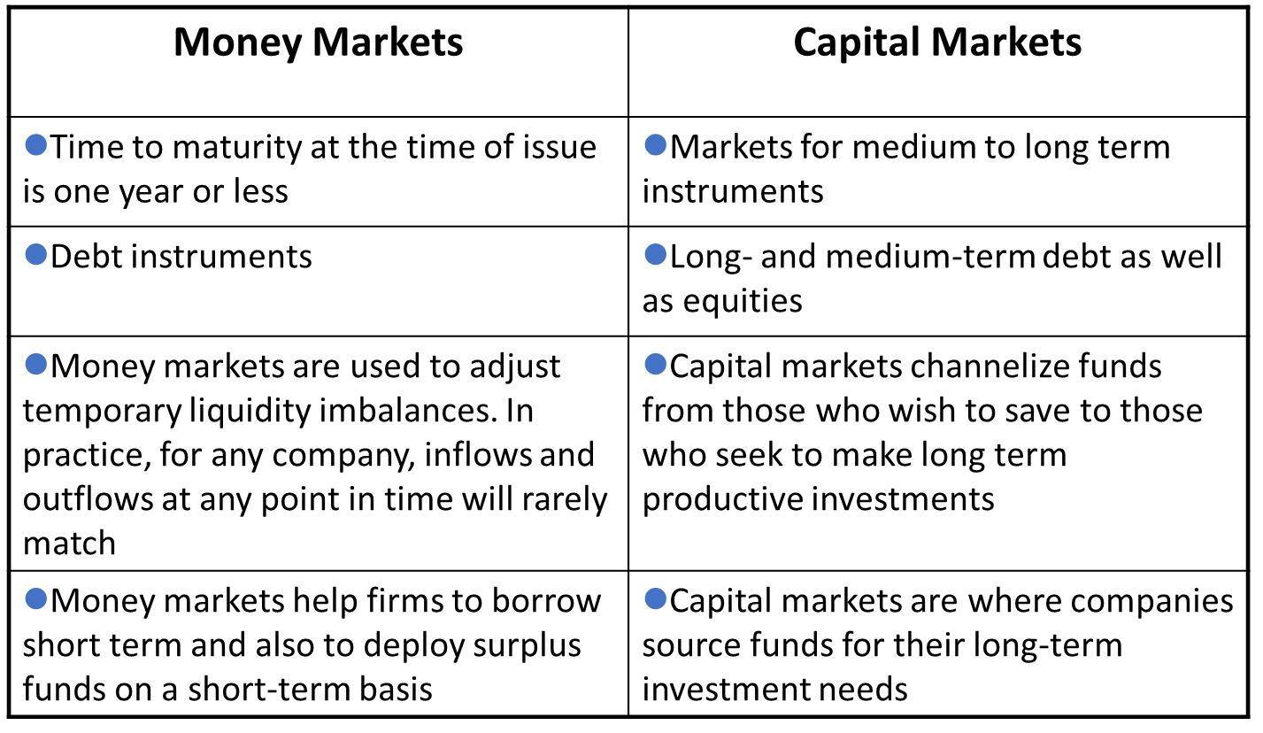
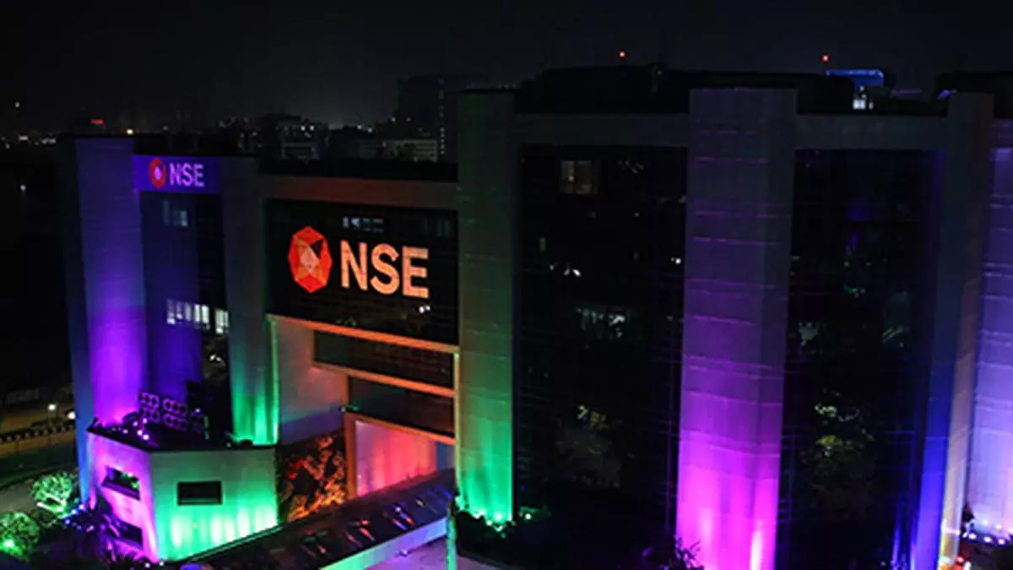
Financial Markets

Slide 11
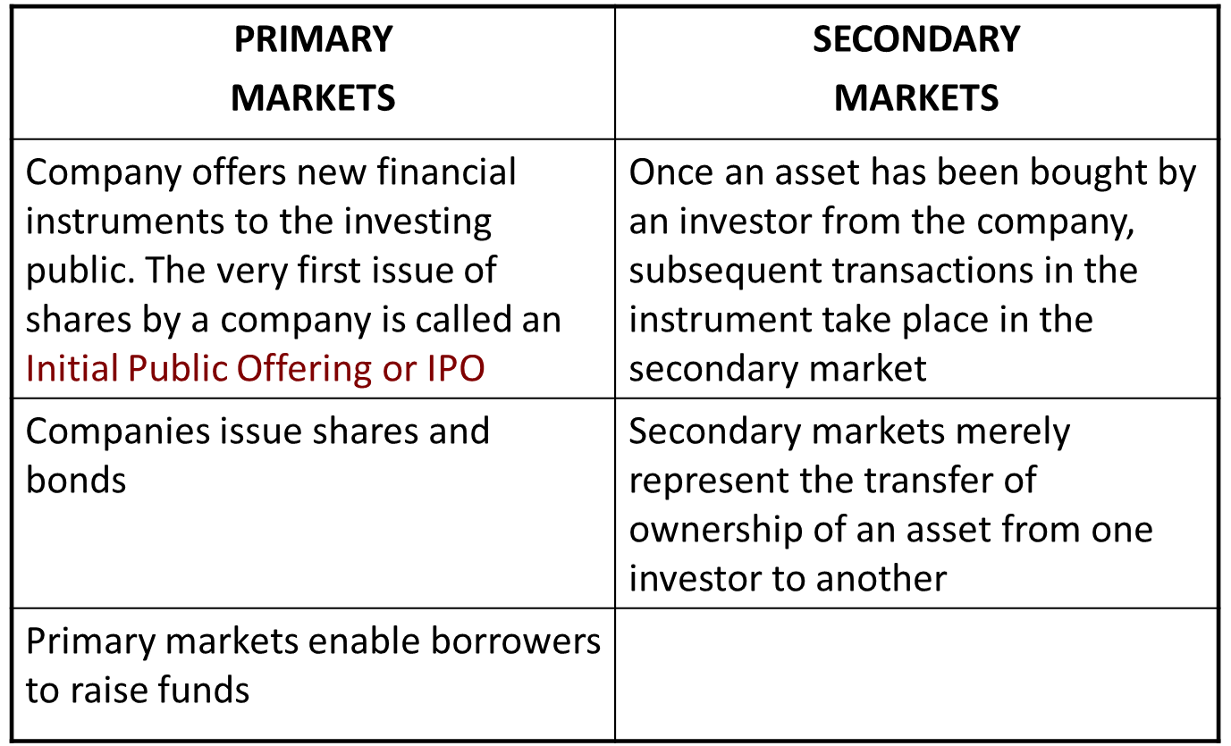
Financial Markets

Slide 12
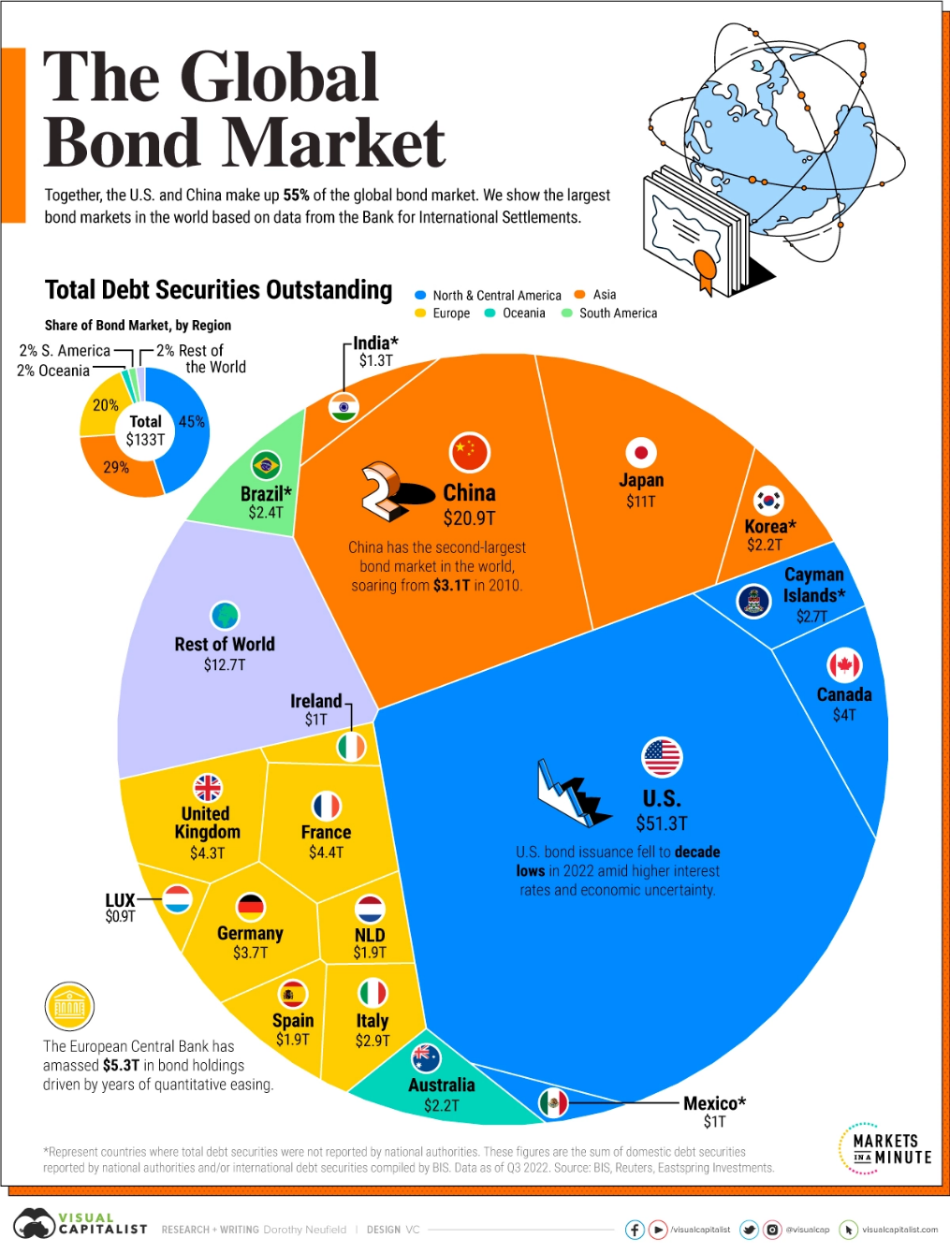

Slide 13
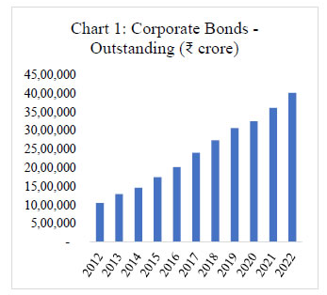
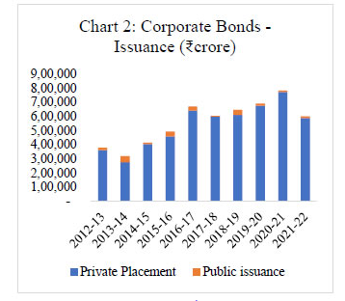
Corporate Bonds - Indiaond market in India
The outstanding stock of corporate bonds has increased four-fold from ₹10.51 lakh crore at the end of FY 2012 to ₹40.20 lakh core at the end of FY 2022 (Chart 1).
Annual issuances during this period have increased from ₹3.80 lakh crore to close to ₹6.0 lakh crore (Chart 2).
Source: https://www.rbi.org.in

Slide 14
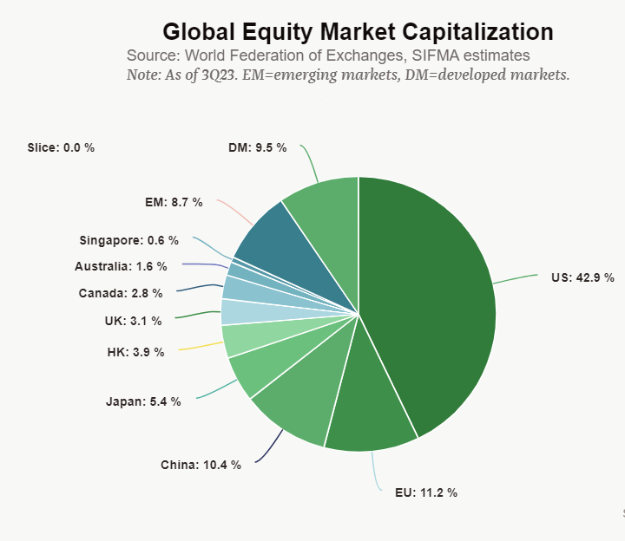
Source: SIFMA

Slide 15
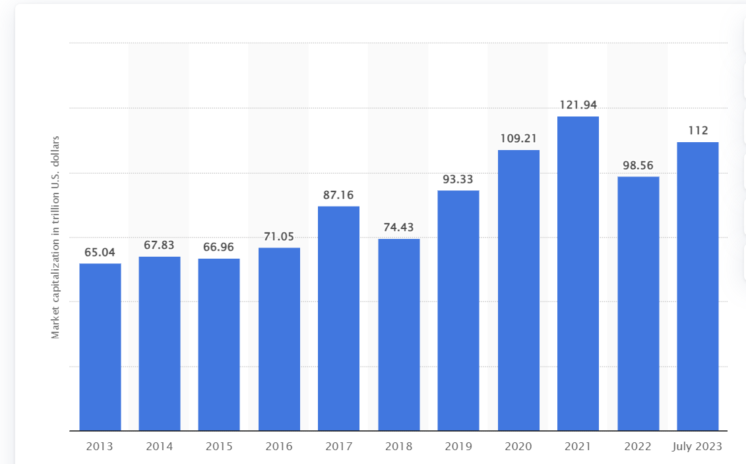
Total market capitalizations of domestic companies listed on stock exchanges worldwide from 2013 to July 2023
https://www.statista.com/statistics/274490/global-value-of-share-holdings-since-2000/

Slide 16
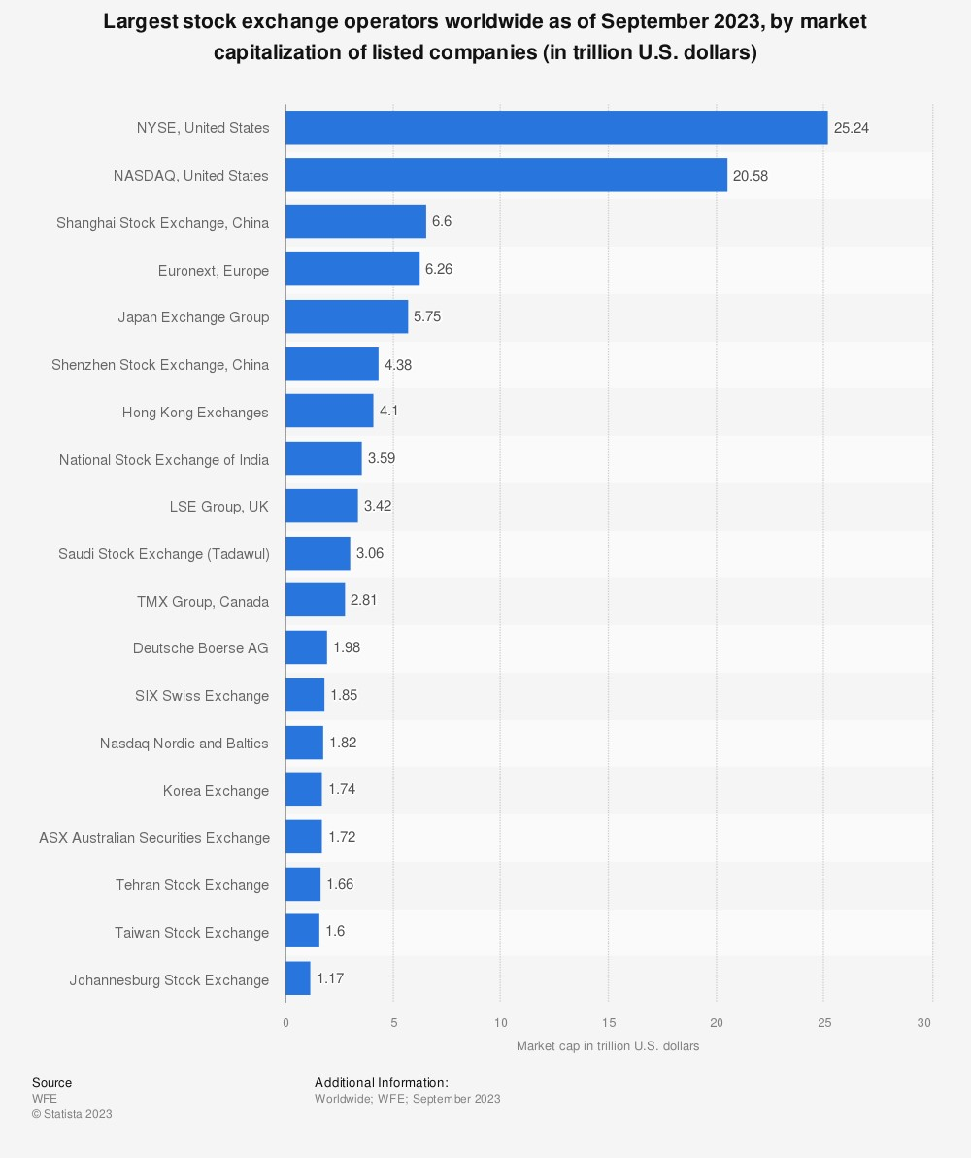

Slide 17
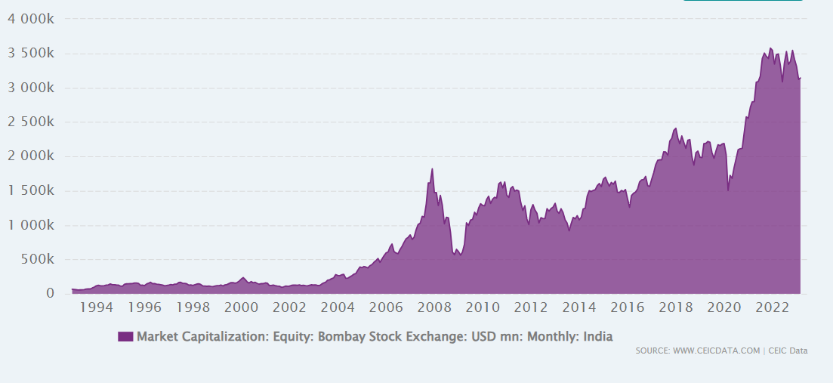
INDIA’S MARKET CAP
(Upto Oct 2023)

Slide 18
Introduction to Derivatives
Derivative is an instrument whose value depends on the values of other more basic underlying variables
• Each derivative product has an “underlying” associated with it.
• The value of the derivative depends on, among other things, the value of the underlying.
– Physical commodities: Coffee, Crude oil, Wheat etc.
– Financial assets: Currencies, Stocks, Bonds, etc.
– Credit derivatives, Weather derivatives, Derivatives on derivatives

Slide 19

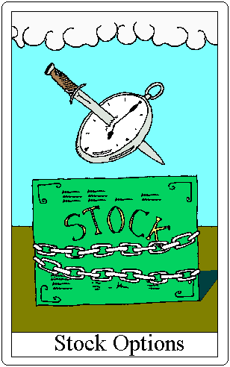
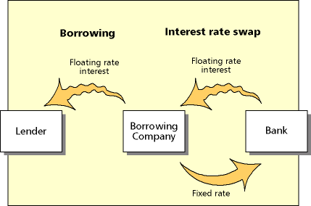
Categories of Derivative Securities
Derivative
Securities
Futures &
Forward contracts
Options
contracts
Swaps

Slide 20
How are Derivatives Traded?
On exchanges such as the Chicago Board Options Exchange, International Securities Exchange
In the over-the-counter (OTC) market where traders working for banks, fund managers, and corporate treasurers contact each other directly

Slide 21
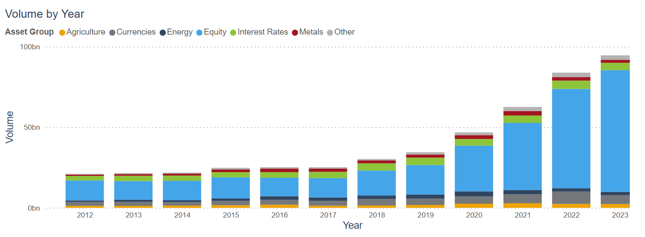
Trading Volume In Global Exchange-Traded Derivatives
Source: FIA

Slide 22
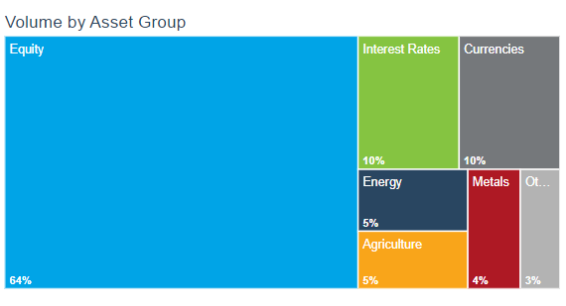
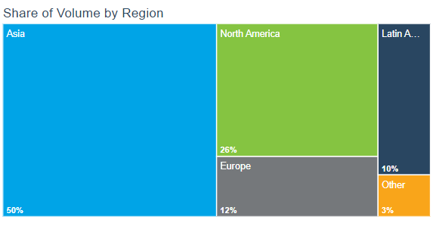
Trading Volume In Global Exchange-Traded Derivatives
Source: FIA

Slide 23

The National Stock Exchange (NSE) is world's largest derivatives exchange in 2022 by the number of contracts traded
NSE ranked 3rd in the world in the equity segment by the number of trades in 2022
Source: Economic Times

Slide 24
Indian Derivatives Markets – Business Growth In FO Segment (NSE)

Slide 25
Forward Contracts
An agreement to buy or sell an asset at a certain time in the future for a certain price (the delivery or contract price)
An OTC product tailor‐made to the needs of contracting parties
Usually settled by delivery of the underlying but cash settled in some cases
The two parties to the contract bear each other’s credit risk
No money changes hands when contract is first negotiated, and it is settled at maturity

Slide 26
Futures Contracts
A futures contract, like a forward contract is an agreement between two parties to exchange one asset for another, at a specified date in the future.
Terms of the contract fixed upfront.
Futures price – the price for the underlying asset is determined today, but settlement is on a future date.
The futures contract specifies the quantity and quality of the underlying asset and how it will be delivered.

Slide 27
Options
A call option is an option to buy a certain asset by a certain date for a certain price (the strike price)
A put option is an option to sell a certain asset by a certain date for a certain price (the strike price)

Slide 28
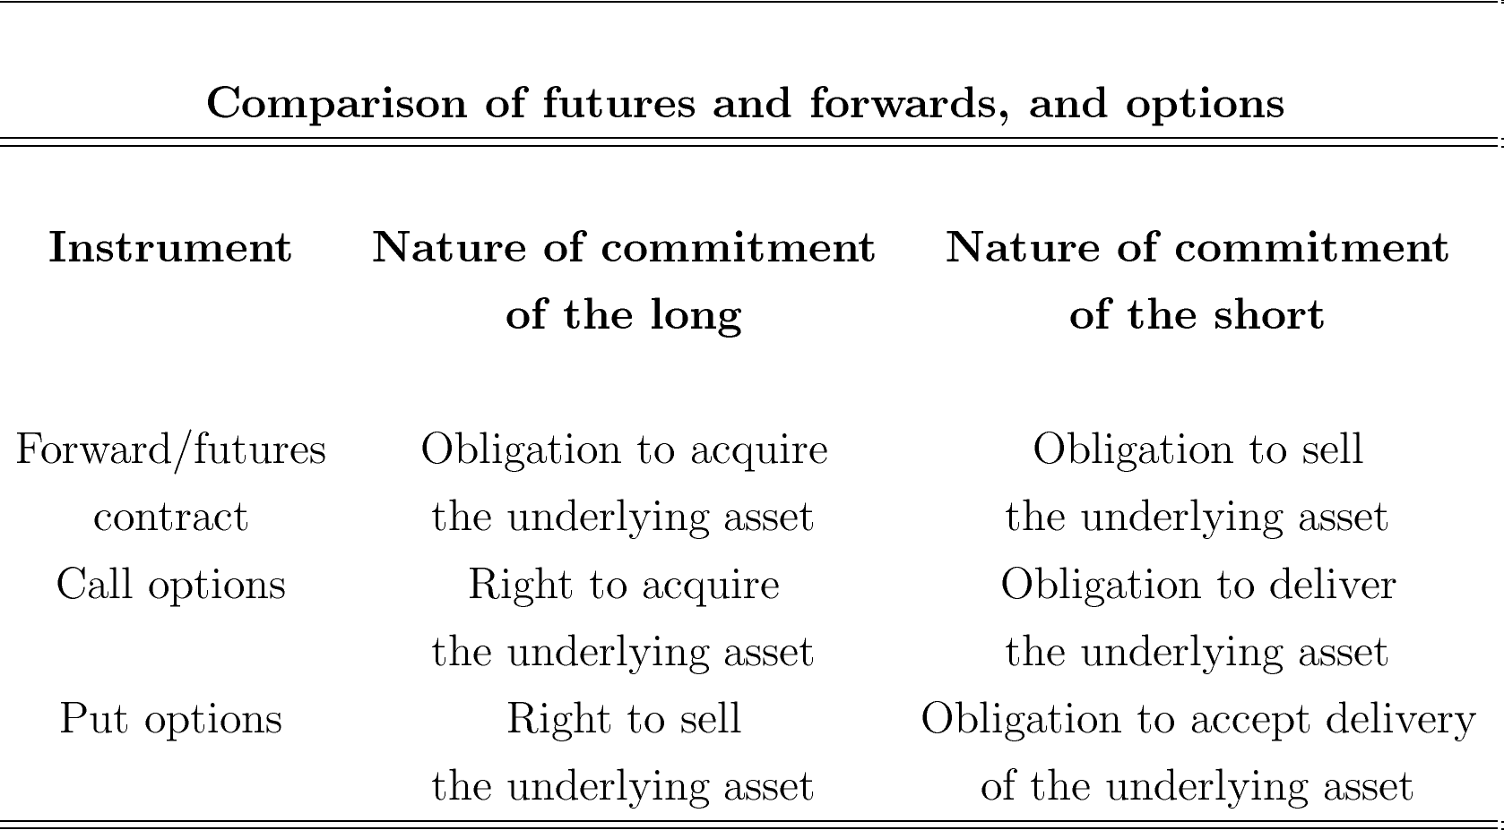

Slide 29
Major Features of Futures Contracts
• Organized Exchanges not OTC markets.
• Standardisation: Amount of asset, expiry dates, deliverable grades etc.
• Clearing House: A party to all contracts. Guarantees performance. Mitigates/Eliminates Credit Risk
• Margins
• Marking to Market : Daily settlement of gains & losses.
• Actual Delivery Is Rare : Futures used mostly for hedging or speculation not for acquiring the underlying asset
https://www.nseindia.com/live_market/dynaContent/live_watch/derivative_stock_watch.htm

Slide 30
Basics of Futures Contracts
Long – a commitment to purchase the commodity on the delivery date.
Short – a commitment to sell the commodity on the delivery date.
Futures are traded on margin.
Profit to long = Spot price at maturity - Original futures price
Profit to short = Original futures price - Spot price at maturity
The futures contract is a zero-sum game, which means gains and losses net out to zero.

Slide 31
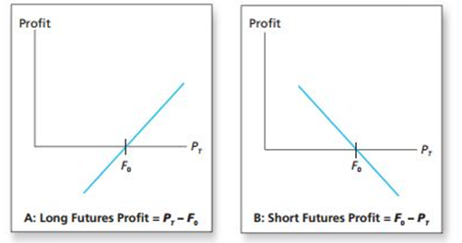
Profits to Buyers and Sellers of Futures
Profit is zero when the ultimate spot price, P_{T} equals the initial futures price, F₀ .

Slide 32
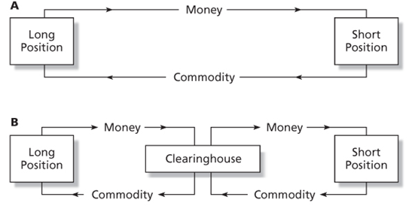
Trading Mechanics
The exchange acts as a clearing house and counterparty to both sides of the trade.
The net position of the clearing house is zero.
Open interest is the number of contracts outstanding.
If you are currently long, you simply instruct your broker to enter the short side of a contract to close out your position.
Most futures contracts are closed out by reversing trades.

Slide 33
Margin and Marking to Market
Marking to Market - each day the profits or losses from the new futures price are paid over or subtracted from the account
Convergence of Price - as maturity approaches the spot and futures price converge
Initial Margin - funds or interest-earning securities deposited to provide capital to absorb losses
Maintenance margin – level at which the account must be replenished, or position reduced
Margin call - when the maintenance margin is reached, broker will ask for additional margin funds

Slide 34
Marking to Market
Observed Futures Price
Time | Contract Price
0 | 4.50
1 | 4.35
2 | 4.15
3 | 4.20
4 | 4.25
Initial Margin - $5,000
Maintenance Margin - $3,750
Two traders entered into the contract at a price of $ 4.50 per bushel of wheat, with each contract representing 5000 bushels

Slide 35
Marking to Market
Margin Account of the Long
Time | Contract Price | Balance | Day's Gain or Loss | Total Gain or Loss | Variation Margin
0 | 4.50 | 5000
1 | 4.35 | 4250 | -750 | -750
2 | 4.15 | 3250 | -1000 | -1750 | 1750
3 | 4.20 | 5250 | 250 | -1500
4 | 4.25 | 5500 | 250 | -1250
Margin Account of the Short
Time | Contract Price | Balance | Day's Gain or Loss | Total Gain or Loss | Variation Margin
0 | 4.50 | 5000
1 | 4.35 | 5750 | 750 | 750
2 | 4.15 | 6750 | 1000 | 1750
3 | 4.20 | 6500 | -250 | 1500
4 | 4.25 | 6250 | -250 | 1250

Slide 36
Trading Strategies
Speculators
seek to profit from price movement
  short - believe price will fall
  long - believe price will rise
Hedgers
seek protection from price movement
  long hedge - protecting against a rise in purchase price
  short hedge - protecting against a fall in selling price

Slide 37
Using Forward Rates to Reduce Foreign Exchange Risk
Example: A U.S. retailer is going to import electronic games from Japan.
  Purchase price: ¥1 million; current exchange rate is 150 yen per dollar.
Retailer takes long position in a forward contract to buy one million yen at 150 yen per dollar.
This locks in the dollar cost of the purchase.

Slide 38
Using futures markets to reduce input price risk
  The purchase of a commodity futures contract will allow a firm to make a future purchase of the input at today’s price, even if the market price on the item has risen substantially in the interim.
  Eg: Kellogg produces cereal—major component and cost factor is sugar
    Forecasted income and sales volume are set by fixed selling prices
    Cost change impacts forecasts
    To fix sugar costs, Kellogg would like to purchase all sugar today as forecast is based on this price, but cannot
    Kellogg can sign futures contract to purchase sugar in future at price negotiated today

Slide 39
Hedging with Oil Futures
Oil distributor planning to sell 100,000 barrels of oil in January and wishes to hedge against a possible decline in prices. F₀ = $ 95.86. Each contract is for 1,000 barrels.
 | Oil Price
 | $93.86 | $95.86 | $97.86
Revenue from oil sale: 100,000*P_{T} | 9,386,000 | 9,586,000 | 9,786,000
Profit on futures: 100,000*(F₀ - P_{T}) | 200,000 | 0 | -200,000
Total Proceeds | 9,586,000 | 9,586,000 | 9,586,000

Slide 40
Basis and Basis Risk
Basis - the difference between the futures price and the spot price, F_{T} – P_{T}
The convergence property says F_{T} – P_{T}= 0 at maturity
Before maturity, F_{T} may differ substantially from the current spot price
Basis Risk - variability in the basis means that gains and losses on the contract and the asset may not perfectly offset if liquidated before maturity.

Slide 41
Futures Pricing
Spot-futures parity theorem - two ways to acquire an asset for some date in the future:
  Purchase it now and store it
  Take a long position in futures
These two strategies must have the same market determined costs

Slide 42
Spot-Futures Parity Theorem
With a perfect hedge, the futures payoff is certain -- there is no risk.
A perfect hedge should earn the riskless rate of return.
This relationship can be used to develop the futures pricing relationship.

Slide 43
Hedge Example
Investor holds $1000 in a mutual fund indexed to the S&P 500.
The current value of S&P 500 is 1,000.
Assume dividends of $20 will be paid on the index fund at the end of the year.
A futures contract with delivery in one year is available for $1,010.
The investor hedges by selling or shorting one contract.

Slide 44
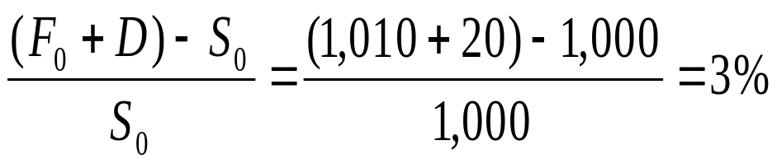
Hedge Example
Value of S_{T} 990 1,010 1,030
Payoff on Short
(1,010 - S_{T}) 20 0 -20
Dividend Income 20 20 20
Total 1,030 1,030 1,030
Rate of return for the hedge

Slide 45
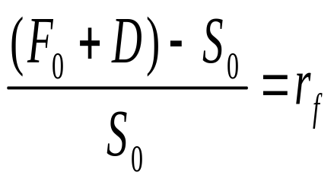
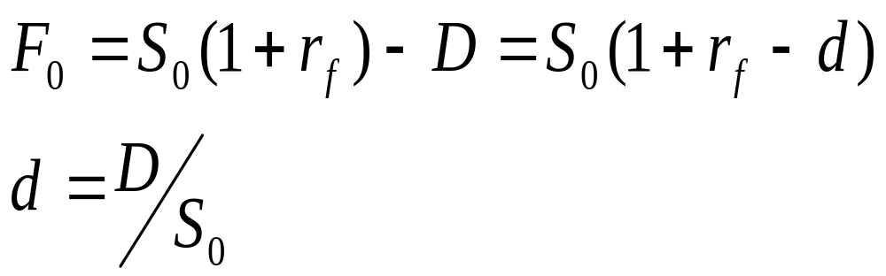
The Spot-Futures Parity Theorem

Slide 46
Arbitrage possibilities
If spot-futures parity is not observed, then arbitrage is possible.
If the futures price is too high, short the futures and acquire the stock by borrowing the money at the risk-free rate.
If the futures price is too low, go long futures, short the stock and invest the proceeds at the risk-free rate.

Slide 47
Futures Market Arbitrage
Suppose the risk-free interest rate is only 1%
The futures price should be $1000(1.01)-20 = $990
The actual futures price, F₀ = $ 1,010
Arbitrage profits
  Shorting the relatively overpriced futures contract
  Buy the relatively under-priced stock portfolio using money borrowed at the 1% market interest rate

Slide 48
Futures Market Arbitrage
Action | Initial Cash flow | Cash flow in 1 year
Borrow $1,000, repay with interest in 1 year | +1,000 | -1,000(1.01)= -$1,010
Buy stock index for $1,000 | -1,000 | S_{T} + $20 dividend
Enter short futures position | 0 | $1,010 - S_{T}
Total | 0 | $20

Slide 49
Futures Market Arbitrage
Action | Initial Cash flow | Cash flow in 1 year
Borrow S₀ dollars | S₀ | -S₀(1+r_{f})
Buy stock for S₀ | -S₀ | S_{T} + D
Enter short futures position | 0 | F₀- S_{T}
Total | 0 | F₀- S₀(1+r_{f}) + D

Slide 50
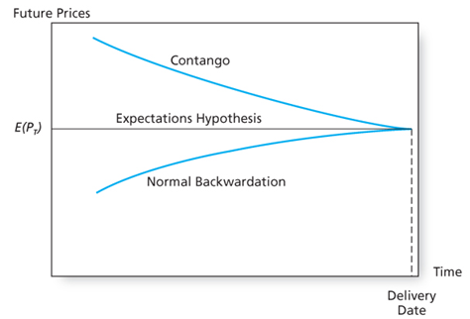
Futures Price Over Time
Expected spot price remains unchanged

