Slide 1
Risk Management and Investment Management

Slide 2
The Investment Decision
Top-down process with 3 steps:
  Capital allocation between the risky portfolio and risk-free asset
  Asset allocation in the risky portfolio across broad asset classes
  Security selection of individual assets within each asset class

Slide 3
Risk vs Return
There is a trade off between risk and expected return
The higher the risk, the higher the expected return

Slide 4
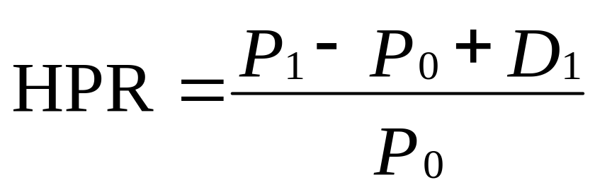
Return
Rates of return: Single period
  HPR = Holding period return
  P₀ = Beginning price
  P₁ = Ending price
  D₁ = Dividend during period one

Slide 5
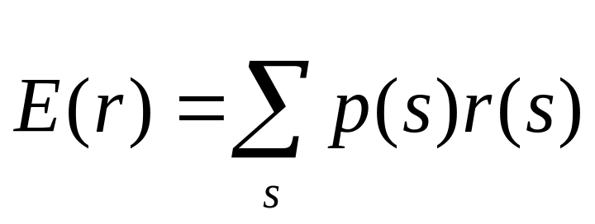
Expected Return and Standard Deviation
Expected returns
  p(s) = Probability of a state
  r(s) = Return if a state occurs
  s = State

Slide 6
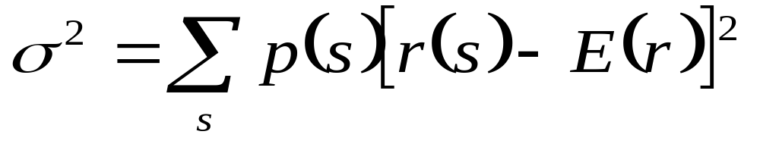
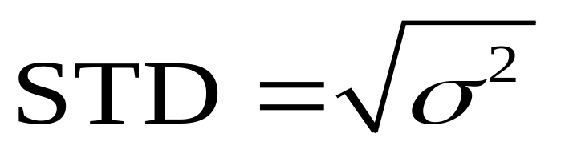
Expected Return and Standard Deviation
Variance (VAR):
Standard Deviation (STD):

Slide 7
Excess Returns and Risk Premium
Excess Return
  The difference in any particular period between the actual rate of return on a risky asset and the actual risk-free rate
Risk Premium
  The difference between the expected HPR on a risky asset and the risk-free rate

Slide 8
Example
Suppose Treasuries yield 5% and the returns for an equity investment are:
Probability | Return
0.05 | +50%
0.25 | +30%
0.40 | +10%
0.25 | –10%
0.05 | –30%
What is the expected return and standard deviation of the equity investment?

Slide 9
Risk and Risk Aversion
Speculation
Gamble
Taking considerable risk for a commensurate gain
  Parties have heterogeneous expectations
Bet on an uncertain outcome for enjoyment
  Parties assign the same probabilities to the possible outcomes

Slide 10
Speculation and Gambling
The central difference between gambling and speculation is the lack of “commensurate gain”
A gamble is the assumption of risk for enjoyment of the risk itself
Speculation is undertaken in spite of the risk involved because one perceives a favourable risk-return trade-off
To turn gamble into speculative venture requires an adequate risk premium to compensate risk-averse investors for the risks they bear
Risk-aversion and speculation are consistent
A risky investment with a risk premium of zero (fair game) amounts to a gamble

Slide 11
Risk Aversion and Utility Values
Utility Values
  Investors are willing to consider:
    Risk-free assets
    Speculative positions with positive risk premiums
  Portfolio attractiveness increases with expected return and decreases with risk
  What happens when return increases with risk?

Slide 12
Example
 |  | Risk free rate | 5%
Available risky portfolios
Portfolio | Risk Premium | Expected Return | Risk (SD)
L (low risk) | 2% | 7% | 5%
M (medium risk) | 4% | 9% | 10%
H (high risk) | 8% | 13% | 20%
Each portfolio receives a utility score to assess the investor’s risk/return trade off

Slide 13
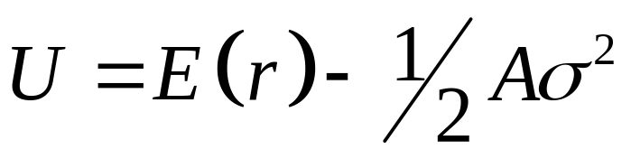
Risk Aversion and Utility Values
Utility Function
  U = Utility
  E(r) = Expected return on the asset or portfolio
  A = Coefficient of risk aversion
  σ² = Variance of returns
  ½ = A scaling factor

Slide 14
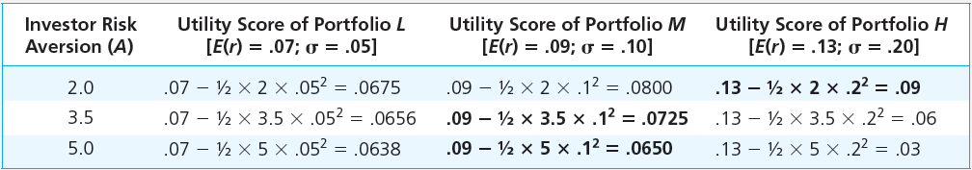
Utility scores of alternative portfolios with varying degrees of risk aversion

Slide 15
Risk Aversion and Utility Values
Utility is enhanced by high expected returns and diminished by high risk.
Risk-free portfolios receive a utility score equal to their rate of return, because they receive no penalty for risk.
The extent to which the variance of risky portfolios lowers utility depends on A.
More risk-averse investors penalize risky investments more severely.
Investors choosing among competing investment portfolios will select the one providing the highest utility level.

Slide 16
Estimating Risk Aversion
Use questionnaires
Observe individuals’ decisions when confronted with risk
Observe how much people are willing to pay to avoid risk

Slide 17
Question
A portfolio has an expected rate of return of 20% and standard deviation of 30%.
T-bills offer a safe return on 7%.
Would an investor with risk-aversion parameter A=4 prefer to invest in T-bills or the risky portfolio?
What if A=2?

Slide 18
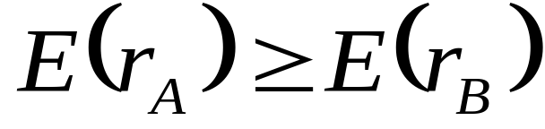
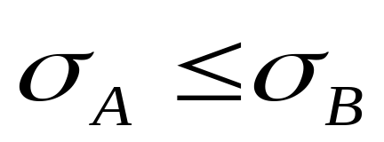
Estimating Risk Aversion
Mean-Variance (M-V) Criterion
  Portfolio A dominates portfolio B if:
  and

Slide 19
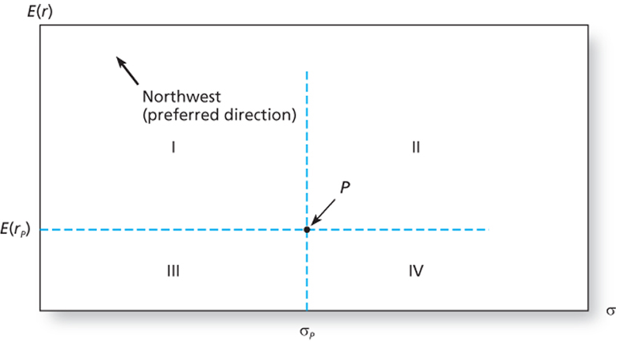
The trade-off between risk and return of a potential investment portfolio, P

Slide 20
The trade-off between risk and return of a potential investment portfolio, P
Portfolio P, with expected return E(r_{P}) and standard deviation σ_{P,} is preferred by risk-averse investors to any portfolio in quadrant IV
Any portfolio in quadrant I dominates portfolio P
In the expected return-standard deviation plane, the preferred direction is northwest
  Simultaneously increase the expected return and decrease the variance of the rate of return
  Any portfolio that lies northwest of P is superior to it
  Portfolios in quadrant II and III
    depends on the nature of investor’s risk aversion

Slide 21
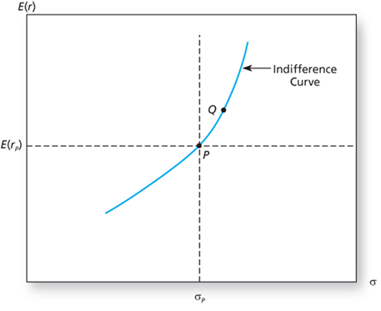
The indifference curve

Slide 22
The indifference curve
Suppose an investor identifies all portfolios that are equally attractive as portfolio P
Starting at P, an increase in standard deviation lowers utility; it must be compensated for by an increase in expected return
Point Q is equally desirable to this investor as P
Investors will be equally attracted to portfolios with high risk and high expected returns compared with other portfolios with lower risk but lower expected returns
These equally preferred portfolios will lie in the mean-standard deviation plane on a curve called the indifference curve.
Connects all portfolio points with the same utility value.

Slide 23
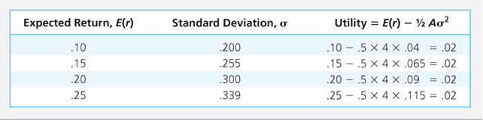
Utility values of possible portfolios for investor with risk aversion, A = 4

Slide 24
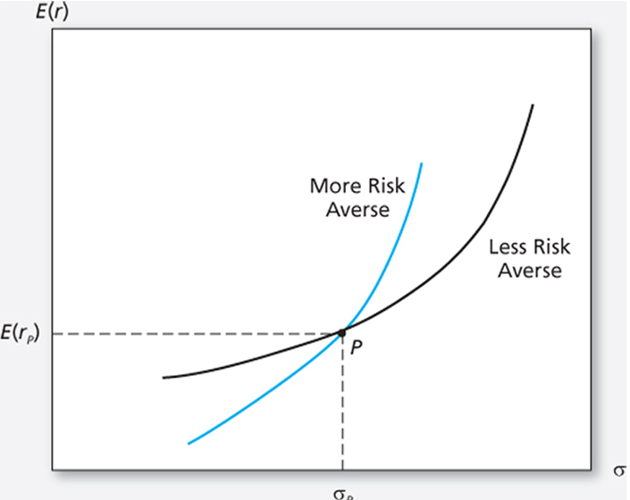
The indifference curve

Slide 25
Capital Allocation Across Risky and Risk-Free Portfolios
The simplest way to control risk is to manipulate the fraction of the portfolio invested in risk-free assets versus the portion invested in the risky assets
How much of the portfolio to be placed in risk-free asset vs risky asset classes?

Slide 26
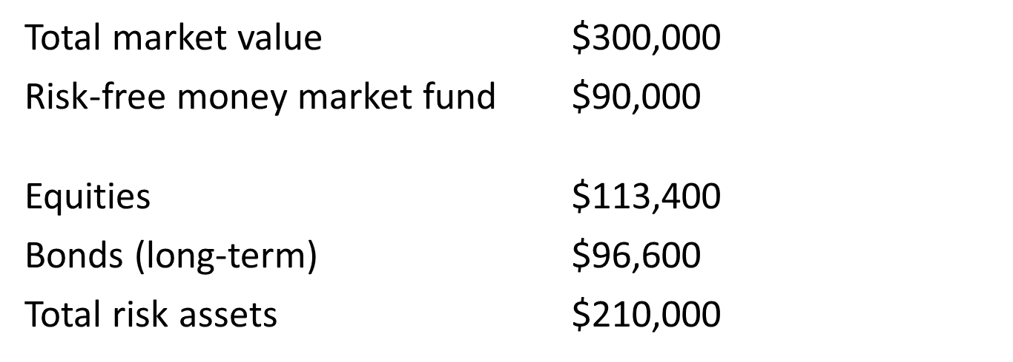
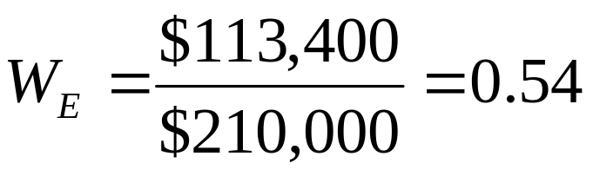
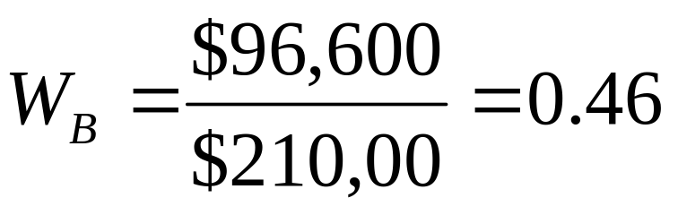
Example

Slide 27
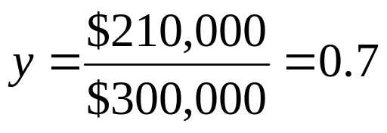
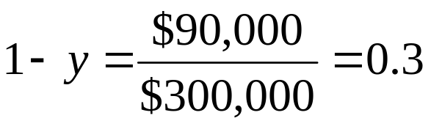
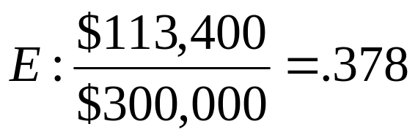
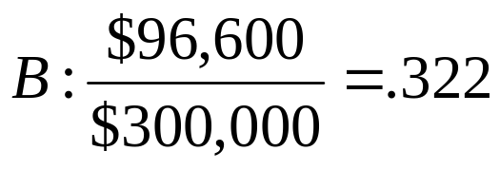
Example
Let
  y = Weight of the risky portfolio, P, in the complete portfolio
  (1-y) = Weight of risk-free assets

Slide 28
Example
Suppose the owner of this portfolio wishes to decrease risk by reducing the allocation to the risky portfolio from y = 0.7 to y = 0.56
The risky portfolio = 0.56* $ 300,000 = $ 168,000
    Sale of $ 42,000 of the original $ 210,000 of risky holdings
    Proceeds used to purchase more of risk-free asset (money-market fund)
  Total holdings in the risk-free asset will increase to $ 300,000 * (1- 0.56) = $ 132,000
    Original holdings + New contribution : $ 90,000 + $ 42, 000 = $ 132,000

Slide 29
Example
The proportions of each asset in the risky portfolio is kept unchanged
The weights of E and B in the risky portfolio are 0.54 and 0.46, respectively
  Sell 0.54 * $ 42,000 = $ 22,680 of E
  Sell 0.46 * $ 42,000 = $ 19,320 of B
  E: W_{E} = 113,400 – 22,680 = 0.54
  210,000 – 42,000
  B: W_{B} = 96,600 – 19,320 = 0.46
  210,000 – 42,000

Slide 30
The Risk-Free Asset
Only the government can issue default-free securities
  A security is risk-free in real terms only if its price is indexed and maturity is equal to investor’s holding period
T-bills viewed as the risk-free asset
Money market funds also considered risk-free in practice

Slide 31
Portfolios of One Risky Asset and a Risk-Free Asset
It’s possible to create a complete portfolio by splitting investment funds between safe and risky assets
Let
  y = Portion allocated to the risky portfolio, P
  (1 - y) = Portion to be invested in risk-free asset, F

Slide 32
One Risky Asset and a Risk-Free Asset: Example
The rate of return on the complete portfolio,
r_{C} = yr_{P} + (1-y)r_{f}
Taking the expectation of this portfolio’s rate of return,
E(r_{C} )= yE(r_{P} )+ (1-y)r_{f}
= r_{f} + y [E(r_{P} ) - r_{f} ]
The base rate of return for any portfolio is the risk-free rate.
The portfolio is expected to earn a proportion, y, of the risk premium of the risky portfolio, E(r_{P} ) - r_{f}
Investors are risk averse and unwilling to take a risky position without a positive risk premium

Slide 33
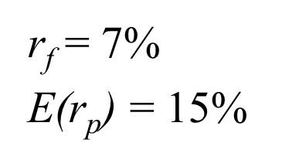
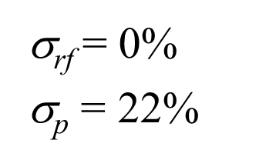
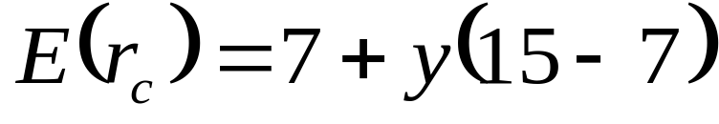
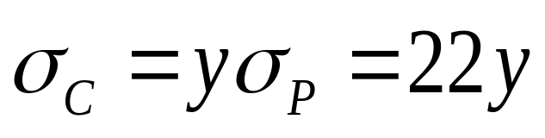
One Risky Asset and a Risk-Free Asset: Example
The expected return on the complete portfolio:
The risk of the complete portfolio:

Slide 34
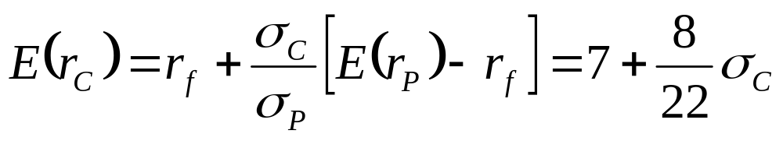
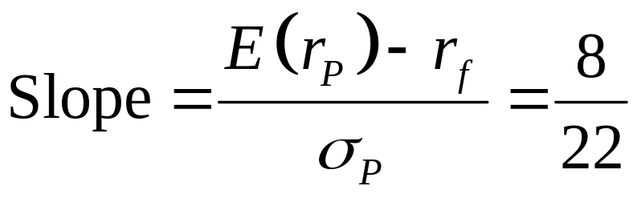
One Risky Asset and a Risk-Free Asset: Example
Rearrange and substitute y = σ_{C}/σ_{P}:

Slide 35
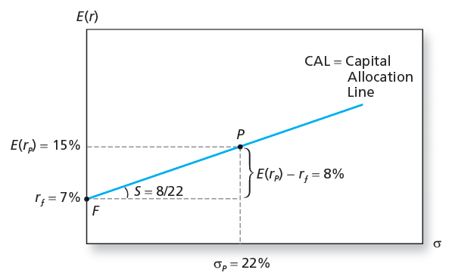
The Investment Opportunity Set

Slide 36
Capital Allocation Line
CAL depicts all the risk-return combinations available to investors
The slope of the CAL, denoted S, equals the increase in the expected return of the complete portfolio per unit of additional standard deviation
  Incremental return per incremental risk
  Reward to Volatility ratio

Slide 37
One Risky Asset and a Risk-Free Asset
A portfolio equally divided between the risky asset and the risk-free asset , y = 0.5
Expected rate of return E(r_{C} )= 7 + 0.5 * 8 = 11%
Risk premium = 4%
Standard deviation of σ_{C} = 0.5 * 22 = 11%
It will plot on the line FP midway between F and P
Reward to Volatility ratio = 4/11 = 0.36

Slide 38
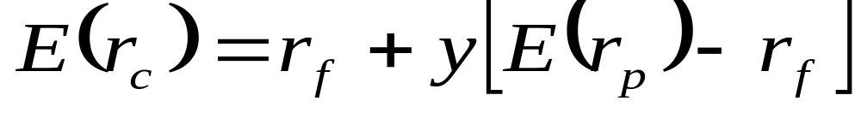
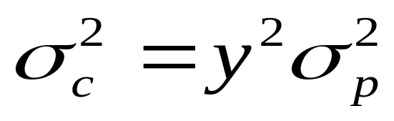
Risk Tolerance and Asset Allocation
The investor must choose one optimal portfolio, C, from the set of feasible choices
  Expected return of the complete portfolio:
  Variance :

Slide 39
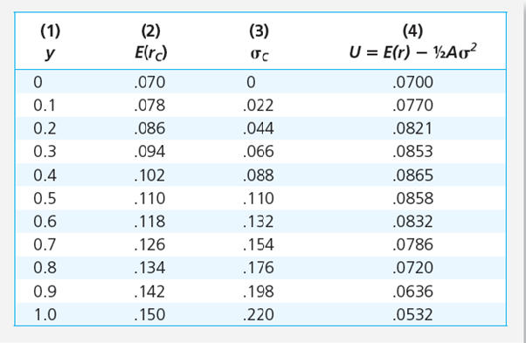
Utility Levels for Various Positions in Risky Assets
Investor’s Risk aversion, A=4

Slide 40
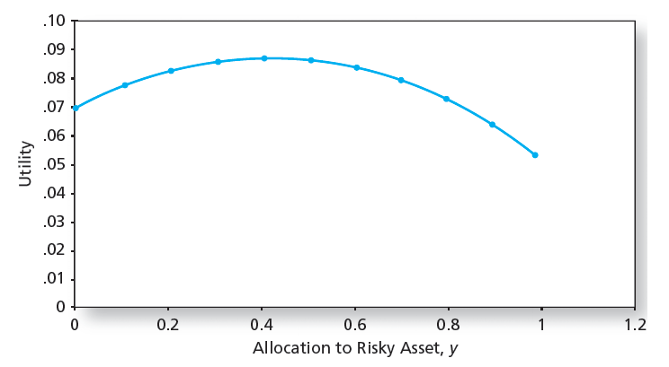
Utility as a Function of Allocation to the Risky Asset, y

Slide 41
Utility as a Function of Allocation to the Risky Asset, y
Utility is highest at y =0.41
When y is less than 0.41, investors are willing to assume more risk to increase expected return
At higher levels of y , risk is higher, and additional allocations to the risky asset are undesirable
Solve the utility maximization problem, and the optimal position for risk-averse investors in the risky asset, y* = E(r_{P} ) - r_{f}
A σ_{P}²

Slide 42
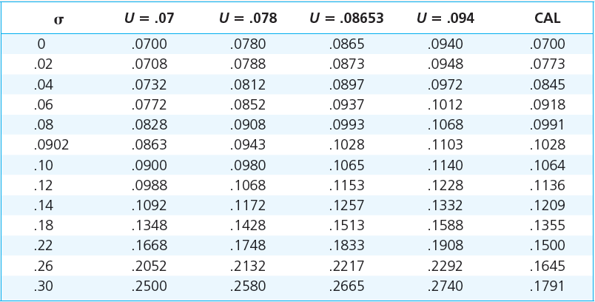
Expected Returns on Four Indifference Curves and the CAL

Slide 43
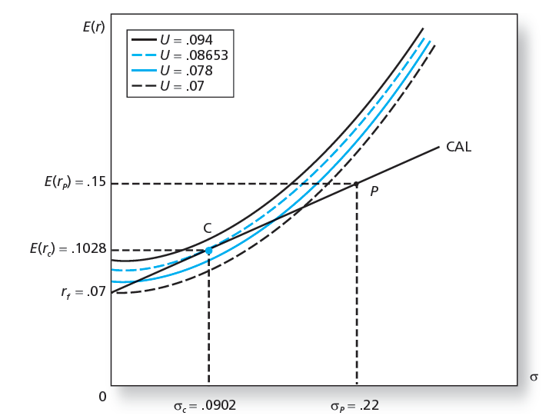
Finding the Optimal Complete Portfolio

Slide 44
Passive Strategies: The Capital Market Line
The passive strategy avoids any direct or indirect security analysis
Supply and demand forces may make such a strategy a reasonable choice for many investors
A natural candidate for a passively held risky asset would be a well-diversified portfolio of common stocks such as the S&P 500

Slide 45
Passive Strategies: The Capital Market Line
The Capital Market Line (CML)
  Is a capital allocation line formed investment in two passive portfolios:
    Virtually risk-free short-term T-bills (or a money market fund)
    Fund of common stocks that mimics a broad market index

Slide 46
Diversification and Portfolio Risk
Market risk
  Risk attributable to market wide risk sources and remains even after extensive diversification
  Also called systematic or non-diversifiable
Firm-specific risk
  Risk that can be eliminated by diversification
  Also called diversifiable or nonsystematic

Slide 47
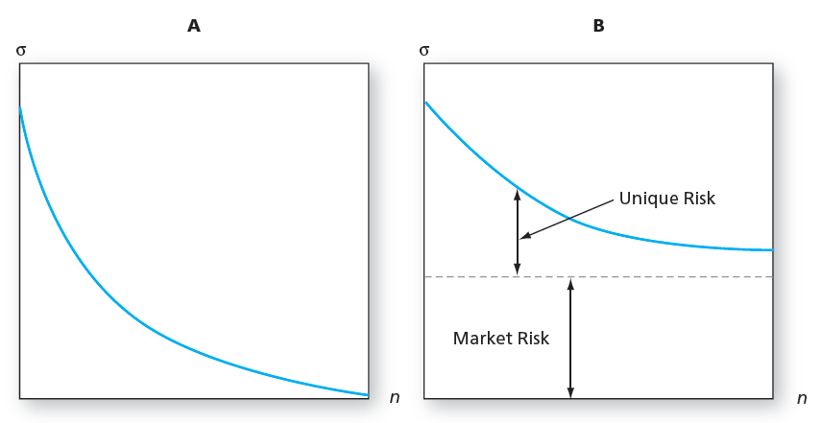
Portfolio Risk and the Number of Stocks in the Portfolio
Panel A: All risk is firm specific. Panel B: Some risk is systematic or market wide.

Slide 48
Portfolios of Two Risky Assets
  Portfolio risk (variance) depends on the correlation between the returns of the assets in the portfolio
  Covariance and the correlation coefficient provide a measure of the way returns of two assets move together (covary)

Slide 49
Portfolios of Two Risky Assets: Return
Portfolio return: r_{p} = w_{D}r_{D} + w_{E}r_{E}
  w_{D} = Bond weight
  r_{D} = Bond return
  w_{E} = Equity weight
  r_{E} = Equity return
  E(r_{p}) = w_{D} E(r_{D}) + w_{E}E(r_{E})

Slide 50
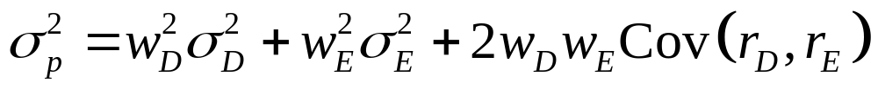
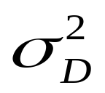
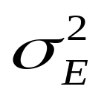
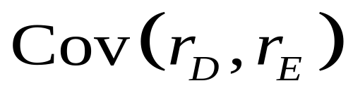
Portfolios of Two Risky Assets: Risk
Portfolio variance:
  = Bond variance
  = Equity variance
  = Covariance of returns for bond and equity

Slide 51
Portfolios of Two Risky Assets: Covariance
Covariance of returns on bond and equity:
Cov(r_{D,}r_{E}) = ρ_{DE} σ_{D} σ_{E}
  ρ_{DE} = Correlation coefficient of returns
  σ_{D} = Standard deviation of bond returns
  σ_{E} = Standard deviation of equity returns

Slide 52
Portfolios of Two Risky Assets: Correlation Coefficients
Range of values for ρ_{1,2}
- 1.0 > ρ > +1.0
  If ρ = 1.0, the securities are perfectly positively correlated (no diversification)
  If ρ = - 1.0, the securities are perfectly negatively correlated (perfect hedge)

Slide 53
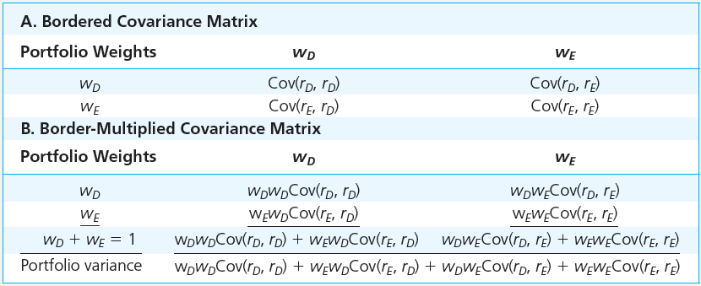
Computation of Portfolio Variance From the Covariance Matrix

Slide 54
Example
Consider a portfolio of three funds, X,Y, Z with weights w_{x}, w_{y}, and w_{z}.
What is the portfolio variance?
W_{x}² σ_{x}² + w_{y}² σ_{y}² + w_{z}² σ_{z}² + 2 w_{x} w_{y} Cov (r_{x}, r_{y} ) + 2 w_{x} w_{z} Cov (r_{x}, r_{z} ) +
2 w_{y} w_{z} Cov (r_{y}, r_{z} )

Slide 55
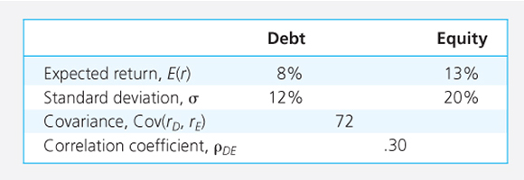
Descriptive Statistics

Slide 56
Portfolio weights
E(r_{P} ) = 8W_{D} + 13W_{E}
σ_{P}² = 12² W_{D}² + 20² W_{E}² + 2* 12* 20 * 0.3 * W_{D} * W_{E}
₌ 144 W_{D}² + 400 W_{E}² + 144 W_{D} W_{E}
What will be the expected return and standard deviation of the portfolio if weights are 0.5 each for debt and equity?
E(r_{P} )= 10.5%; σ_{P} = 13.1%

Slide 57
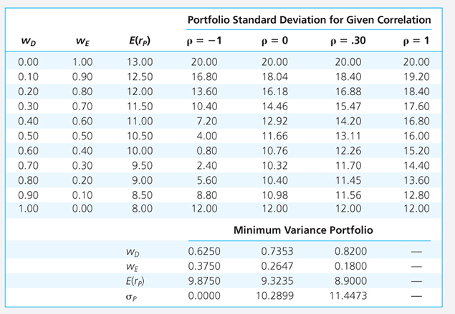
Expected Return and Standard Deviation with various correlation coefficients

Slide 58
Minimum-Variance Portfolio weights
w_{Min} (D) = σ_{E}² – Cov (r_{D}, r_{E})
----------------------------
σ_{D}² + σ_{E}² - 2 Cov (r_{D}, r_{E})
w_{Min} (E) = 1 - w_{Min} (D)

Slide 59
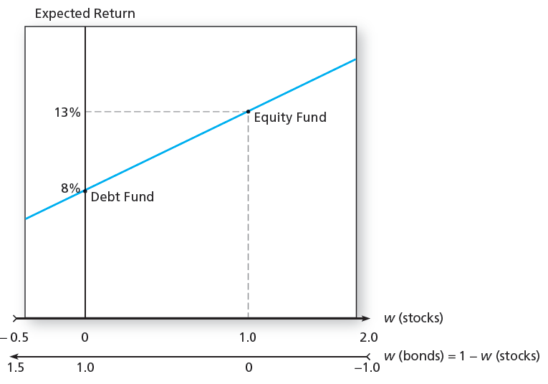
Portfolio Expected Return

Slide 60
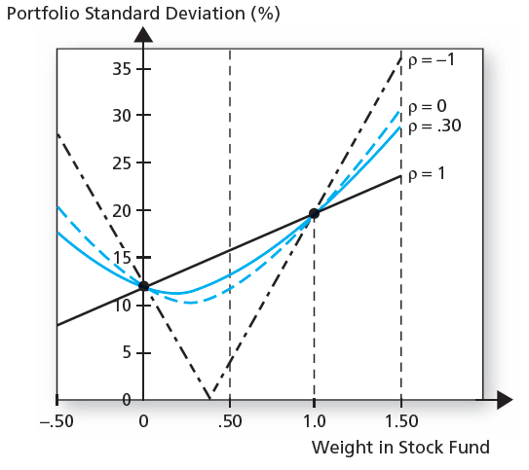
Portfolio Standard Deviation

Slide 61
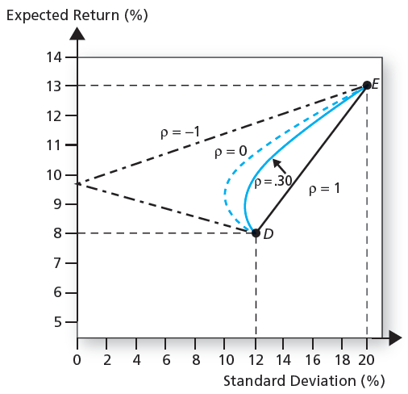
Portfolio Expected Return as a Function of Standard Deviation

Slide 62
The Minimum Variance Portfolio
The minimum variance portfolio is the portfolio composed of the risky assets that has the smallest standard deviation; the portfolio with least risk
The amount of possible risk reduction through diversification depends on the correlation:
  If ρ= +1.0, no risk reduction is possible
  If ρ = 0, σ_{P} may be less than the standard deviation of either component asset
  If ρ= -1.0, a riskless hedge is possible

Slide 63
Asset Allocation with Stocks, Bonds, and Bills
Asset allocation: Constructing the risky portfolio of major asset classes - bonds and stock with the highest possible Sharpe ratio
Sharpe ratio is defined as the risk premium in excess of the risk-free rate, divided by the standard deviation
The portfolio that maximises the Sharpe ratio is the solution to the asset allocation problem

Slide 64
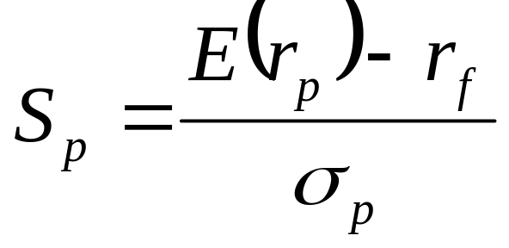
The Sharpe Ratio
Maximize the slope of the CAL for any possible portfolio, P
The objective function is the slope:
The slope is also the Sharpe ratio

Slide 65
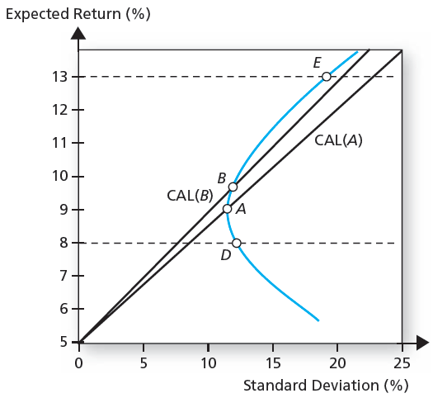
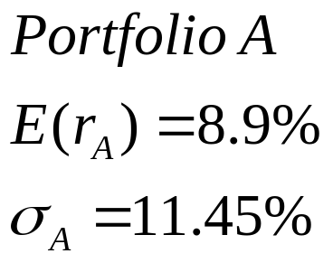
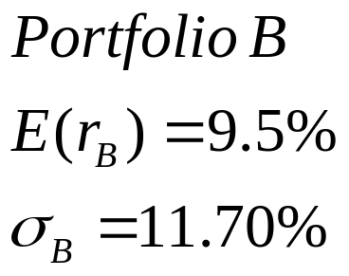
The Opportunity Set of the Debt and Equity Funds and
Two Feasible CALs

Slide 66
Asset Allocation
Two possible CALs are drawn from the risk-free rate (r_{f} = 5% ) to two feasible portfolios.
CAL (A) is drawn through the minimum-variance portfolio A, which is invested 82% in bonds and 18% in stocks
S_{A} = 8.9 – 5 = 0.34
        11.45
        CAL (B) is drawn through portfolio B which is invested 70% in bonds and 30% in stocks
S_{B} = 9.5 – 5 = 0.38
        11.7
        Portfolio B dominates Portfolio A

Slide 67
Optimal Risky Portfolio
w_{D} = E(R_{D}) σ_{E}² - E(R_{E}) Cov (R_{D}, R_{E})
------------------------------------------
E(R_{D}) σ_{E}² + E(R_{E}) σ_{D}² - [E(R_{D}) + E(R_{E})] Cov (R_{D}, R_{E})
w_{E} = 1- w_{D}
(Note - The solution employs excess returns)

Slide 68
Optimal Risky Portfolio
W_{D} = 0.40
W_{E} = 1- 0.40 = 0.60
E(r_{P} ) = 0.4* 8+ 0.6*13 = 11%
σ_{P} =[ (0.4² *144) + (0.6² *400) + (144*0.4*0.6) ]^{1/2} = 14.2%
This asset allocation produces an optimal risky portfolio whose CAL has a slope of
S_{p} = 11 – 5 = 0.42
        14.2

Slide 69
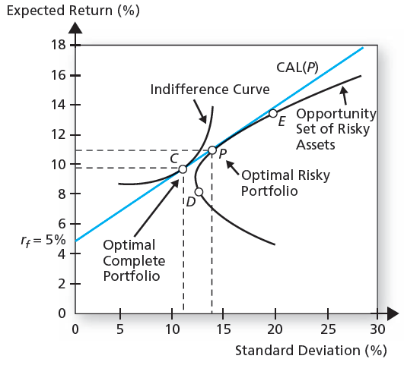
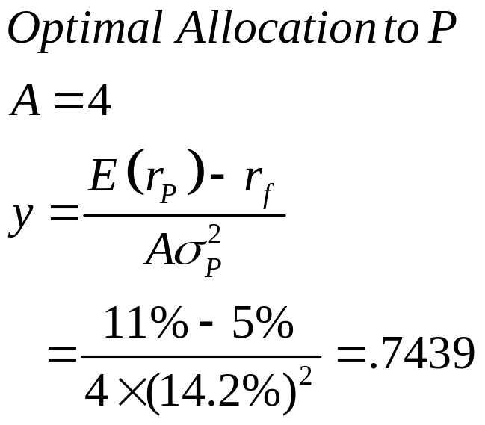
Determination of the Optimal Overall Portfolio

Slide 70
The Optimal Complete Portfolio
An investor with a coefficient of risk aversion A =4 would take a position in portfolio P
y = E(r_{P} ) – r_{f}
A σ_{P}²
= 0.11 – 0.5 = 0.7439
4*.142²
Investor will invest 74.39% of wealth in Portfolio P and 25.61% in T-bills.
Portfolio P consists of 40% in bonds, 60% in stocks
Investment in bonds = yw_{D} = 0.4* 0.7439 = 0.2976
Investment in stocks = yw_{E} = 0.6* 0.7439 = 0.4463

Slide 71
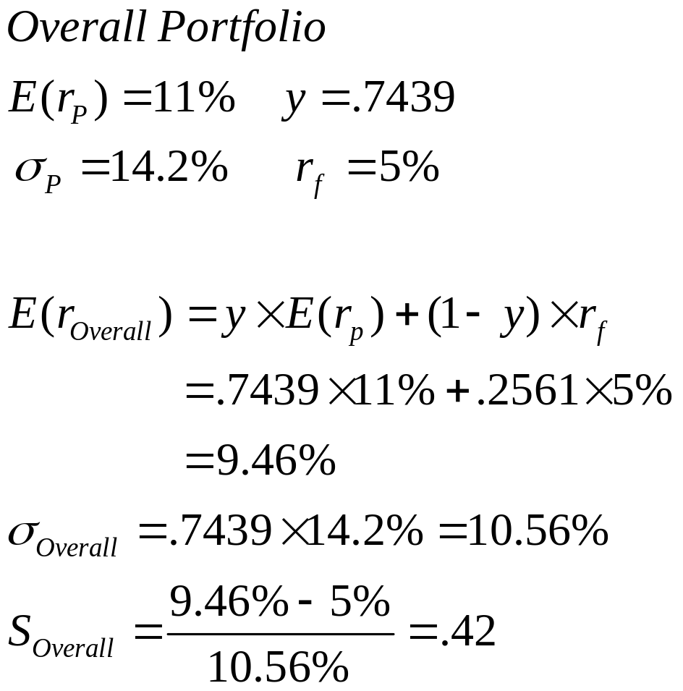

The Proportions of the Optimal Complete Portfolio

Slide 72
Summarize
1. Specify the return characteristics of all securities (expected returns, variances, covariances)
2. Establish the risky portfolio (asset allocation)
3. Allocate funds between risky portfolio and the risk-free asset (capital allocation)

Slide 73
Markowitz Portfolio Optimization Model
Security selection
  The first step is to determine the risk-return opportunities available
    Minimum variance frontier – graph of lowest possible variance that can be attained for a given portfolio return

Slide 74

The Minimum-Variance Frontier of Risky Assets

Slide 75
Efficient Frontier
The part of the frontier that lies above the global minimum-variance portfolio is called the efficient frontier of risky assets
For any portfolio on the lower portion of the minimum-variance frontier, there is a portfolio with the same standard deviation and a greater expected return positioned directly above it.

Slide 76
Markowitz Portfolio Optimization Model
Search for the CAL with the highest reward-to-variability ratio
Everyone invests in P, regardless of their degree of risk aversion
  More risk-averse investors put more in the risk-free asset
  Less risk-averse investors put more in P

Slide 77

The Efficient Frontier of Risky Assets with the Optimal CAL

Slide 78
Efficient Frontier of Risky Assets
For any risk level, we are interested only in that portfolio with the highest expected return
Alternatively, the frontier is the set of portfolios that minimizes the variance for any target expected return

Slide 79
Markowitz Portfolio Optimization Model
Capital Allocation and the Separation Property
  Portfolio choice problem may be separated into two independent tasks
    Determination of the optimal risky portfolio is purely technical
    Allocation of the complete portfolio to risk-free versus the risky portfolio depends on personal preference

Slide 80
A portfolio manager will offer the same risky portfolio, P, to all clients regardless of their degree of risk aversion
The degree of risk aversion of the client comes into play only in capital allocation, the selection of the desired point along CAL
A more risk-averse client will invest more in the risk-free asset and less in the optimal risky portfolio than will a less risk-averse client
Both will use Portfolio P as their optimal risky investment vehicle.

