Slide 1
Risk Management and Investment Management

Slide 2
The Investment Decision
Top-down process with 3 steps:
  Capital allocation between the risky portfolio and risk-free asset
  Asset allocation in the risky portfolio across broad asset classes
  Security selection of individual assets within each asset class

Slide 3
Risk vs Return
There is a trade off between risk and expected return
The higher the risk, the higher the expected return

Slide 4
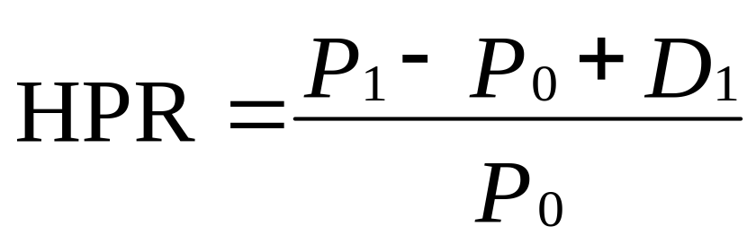
Return
Rates of return: Single period
  HPR = Holding period return
  P₀ = Beginning price
  P₁ = Ending price
  D₁ = Dividend during period one

Slide 5
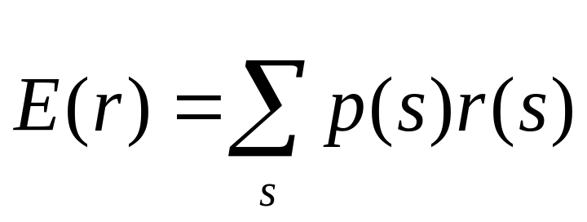
Expected Return and Standard Deviation
Expected returns
  p(s) = Probability of a state
  r(s) = Return if a state occurs
  s = State

Slide 6
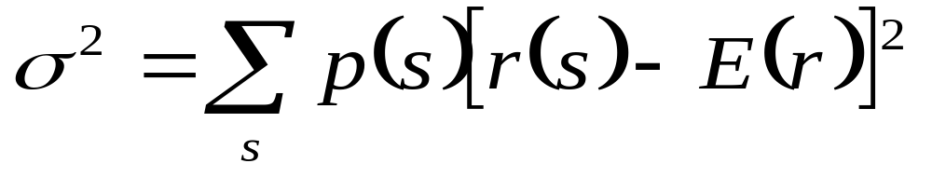
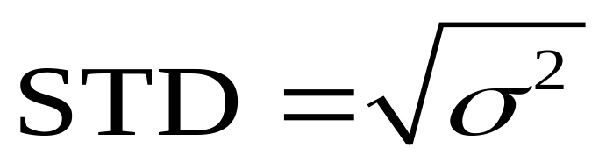
Expected Return and Standard Deviation
Variance (VAR):
Standard Deviation (STD):

Slide 7
Excess Returns and Risk Premium
Excess Return
  The difference in any particular period between the actual rate of return on a risky asset and the actual risk-free rate
Risk Premium
  The difference between the expected HPR on a risky asset and the risk-free rate
  .

Slide 8
Example
Suppose Treasuries yield 5% and the returns for an equity investment are:
Probability | Return
0.05 | +50%
0.25 | +30%
0.40 | +10%
0.25 | –10%
0.05 | –30%
What is the expected return and standard deviation of the equity investment?

Slide 9
Risk and Risk Aversion
Speculation
Gamble
Taking considerable risk for a commensurate gain
  Parties have heterogeneous expectations
Bet on an uncertain outcome for enjoyment
  Parties assign the same probabilities to the possible outcomes

Slide 10
Speculation and Gambling
The central difference between gambling and speculation is the lack of “commensurate gain”
A gamble is the assumption of risk for enjoyment of the risk itself
Speculation is undertaken in spite of the risk involved because one perceives a favourable risk-return trade-off
To turn gamble into speculative venture requires an adequate risk premium to compensate risk-averse investors for the risks they bear
Risk-aversion and speculation are consistent
A risky investment with a risk premium of zero (fair game) amounts to a gamble

Slide 11
Speculation and Gambling
Suppose two investors disagree sharply about future exchange rate of the US dollar against the British pound.
They may choose to bet on the outcome:
  A will pay B $100 if the value of £1 exceeds $1.30 one year from now
  B will pay A if the pound is worth less than $1.30
Only two relevant outcome:
  (i) the pound will exceed $1.30, or
  (ii) it will fall below $1.30

Slide 12
Speculation and Gambling
If A and B agree on the probabilities of the two possible outcomes, and if neither party anticipates a loss, it must be that they assign p = 0.5 to each outcome.
  Expected profit to both is zero and each has entered one side of a gambling prospect
If A and B assign different probabilities to the outcome
  A assigns p<0.5, whereas B’s assessment is p>0.5
  Investors on each side of a financial position see themselves as speculating rather than gambling

Slide 13
Risk Aversion and Utility Values
Utility Values
  Investors are willing to consider:
    Risk-free assets
    Speculative positions with positive risk premiums
  Portfolio attractiveness increases with expected return and decreases with risk
  What happens when return increases with risk?

Slide 14
Example
 |  | Risk free rate | 5%
Available risky portfolios
Portfolio | Risk Premium | Expected Return | Risk (SD)
L (low risk) | 2% | 7% | 5%
M (medium risk) | 4% | 9% | 10%
H (high risk) | 8% | 13% | 20%
Each portfolio receives a utility score to assess the investor’s risk/return trade off

Slide 15
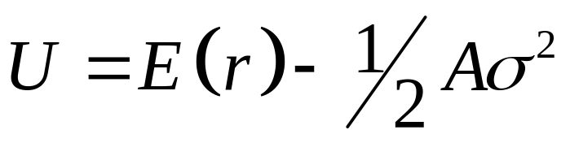
Risk Aversion and Utility Values
Utility Function
  U = Utility
  E(r) = Expected return on the asset or portfolio
  A = Coefficient of risk aversion
  σ² = Variance of returns
  ½ = A scaling factor

Slide 16
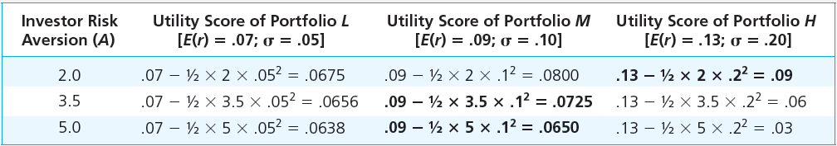
Utility scores of alternative portfolios with varying degrees of risk aversion

Slide 17
Risk Aversion and Utility Values
Utility is enhanced by high expected returns and diminished by high risk.
Risk-free portfolios receive a utility score equal to their rate of return, because they receive no penalty for risk.
The extent to which the variance of risky portfolios lowers utility depends on A.
More risk-averse investors penalize risky investments more severely.
Investors choosing among competing investment portfolios will select the one providing the highest utility level.

Slide 18
Estimating Risk Aversion
Use questionnaires
Observe individuals’ decisions when confronted with risk
Observe how much people are willing to pay to avoid risk

Slide 19
Question
A portfolio has an expected rate of return of 20% and standard deviation of 30%.
T-bills offer a safe return on 7%.
Would an investor with risk-aversion parameter A=4 prefer to invest in T-bills or the risky portfolio?
What if A=2?

Slide 20
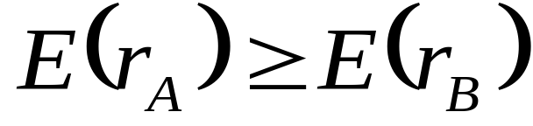
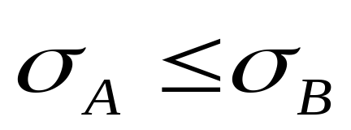
Estimating Risk Aversion
Mean-Variance (M-V) Criterion
  Portfolio A dominates portfolio B if:
  and

Slide 21
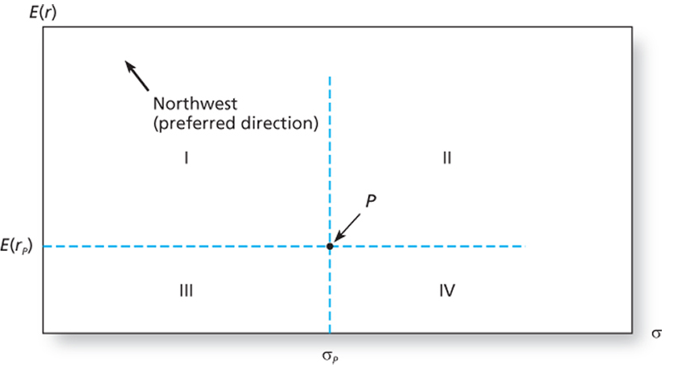
The trade-off between risk and return of a potential investment portfolio, P

Slide 22
The trade-off between risk and return of a potential investment portfolio, P
Portfolio P, with expected return E(r_{P}) and standard deviation σ_{P,} is preferred by risk-averse investors to any portfolio in quadrant IV
Any portfolio in quadrant I dominates portfolio P
In the expected return-standard deviation plane, the preferred direction is northwest
  Simultaneously increase the expected return and decrease the variance of the rate of return
  Any portfolio that lies northwest of P is superior to it
  Portfolios in quadrant II and III
    depends on the nature of investor’s risk aversion

Slide 23
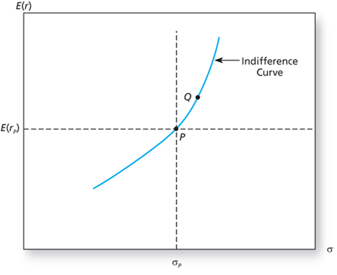
The indifference curve

Slide 24
The indifference curve
Suppose an investor identifies all portfolios that are equally attractive as portfolio P
Starting at P, an increase in standard deviation lowers utility; it must be compensated for by an increase in expected return
Point Q is equally desirable to this investor as P
Investors will be equally attracted to portfolios with high risk and high expected returns compared with other portfolios with lower risk but lower expected returns
These equally preferred portfolios will lie in the mean-standard deviation plane on a curve called the indifference curve.
Connects all portfolio points with the same utility value.

Slide 25
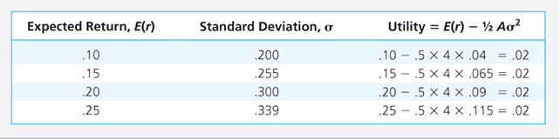
Utility values of possible portfolios for investor with risk aversion, A = 4

Slide 26
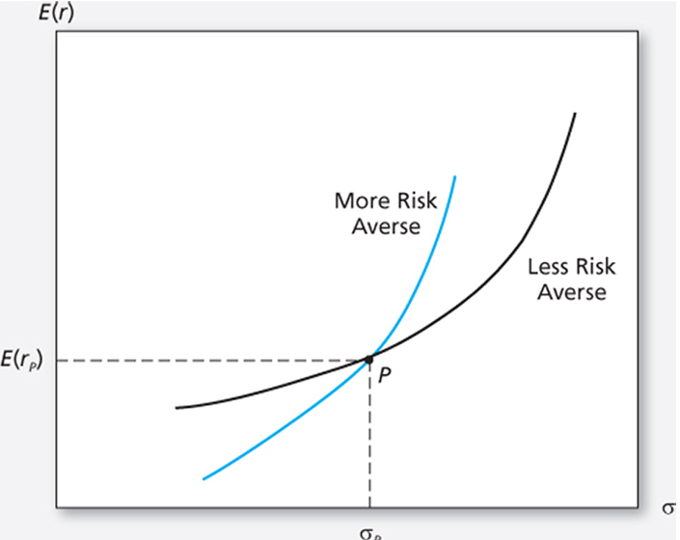
The indifference curve

Slide 27
Capital Allocation Across Risky and Risk-Free Portfolios
The simplest way to control risk is to manipulate the fraction of the portfolio invested in risk-free assets versus the portion invested in the risky assets
How much of the portfolio to be placed in risk-free asset vs risky asset classes?

Slide 28
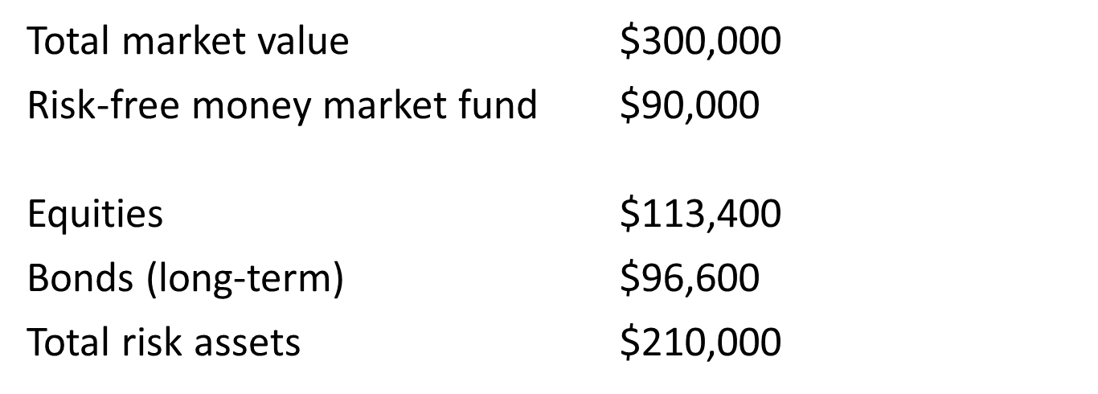
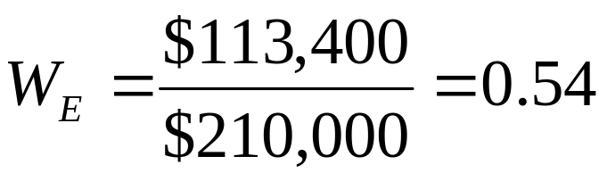
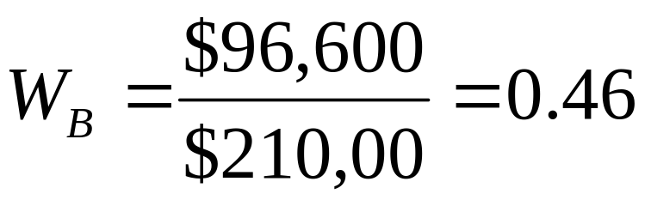
Example

Slide 29
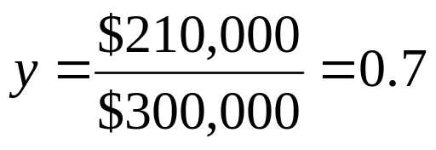
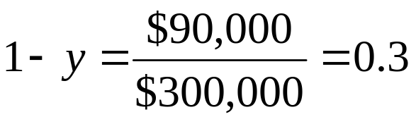
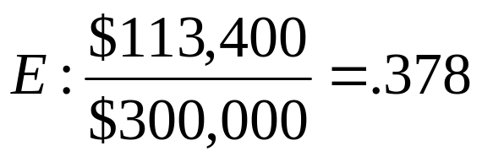
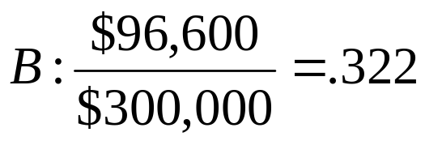
Example
Let
  y = Weight of the risky portfolio, P, in the complete portfolio
  (1-y) = Weight of risk-free assets

Slide 30
Example
Suppose the owner of this portfolio wishes to decrease risk by reducing the allocation to the risky portfolio from y = 0.7 to y = 0.56
The risky portfolio = 0.56* $ 300,000 = $ 168,000
    Sale of $ 42,000 of the original $ 210,000 of risky holdings
    Proceeds used to purchase more of risk-free asset (money-market fund)
  Total holdings in the risk-free asset will increase to $ 300,000 * (1- 0.56) = $ 132,000
    Original holdings + New contribution : $ 90,000 + $ 42, 000 = $ 132,000

Slide 31
Example
The proportions of each asset in the risky portfolio is kept unchanged
The weights of E and B in the risky portfolio are 0.54 and 0.46, respectively
  Sell 0.54 * $ 42,000 = $ 22,680 of E
  Sell 0.46 * $ 42,000 = $ 19,320 of B
  E: W_{E} = 113,400 – 22,680 = 0.54
  210,000 – 42,000
  B: W_{B} = 96,600 – 19,320 = 0.46
  210,000 – 42,000

Slide 32
The Risk-Free Asset
Only the government can issue default-free securities
  A security is risk-free in real terms only if its price is indexed and maturity is equal to investor’s holding period
T-bills viewed as the risk-free asset
Money market funds also considered risk-free in practice

Slide 33
Portfolios of One Risky Asset and a Risk-Free Asset
It’s possible to create a complete portfolio by splitting investment funds between safe and risky assets
Let
  y = Portion allocated to the risky portfolio, P
  (1 - y) = Portion to be invested in risk-free asset, F

Slide 34
One Risky Asset and a Risk-Free Asset: Example
The rate of return on the complete portfolio,
r_{C} = yr_{P} + (1-y)r_{f}
Taking the expectation of this portfolio’s rate of return,
E(r_{C} )= yE(r_{P} )+ (1-y)r_{f}
= r_{f} + y [E(r_{P} ) - r_{f} ]
The base rate of return for any portfolio is the risk-free rate.
The portfolio is expected to earn a proportion, y, of the risk premium of the risky portfolio, E(r_{P} ) - r_{f}
Investors are risk averse and unwilling to take a risky position without a positive risk premium

Slide 35
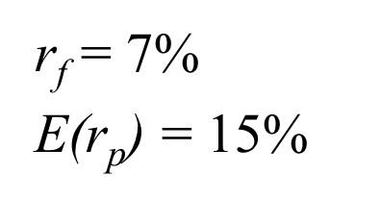
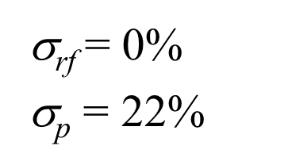
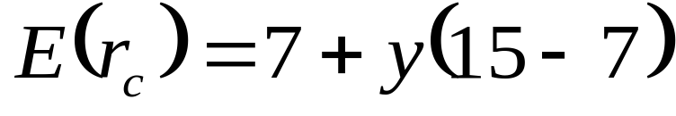
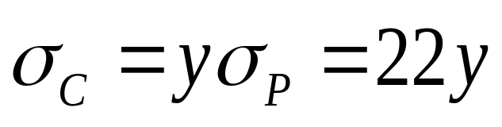
One Risky Asset and a Risk-Free Asset: Example
The expected return on the complete portfolio:
The risk of the complete portfolio:

Slide 36
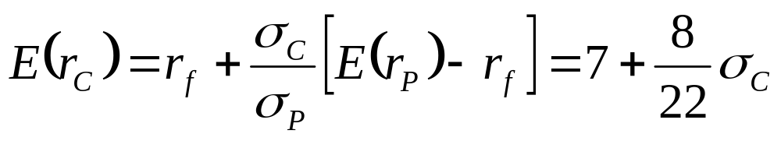
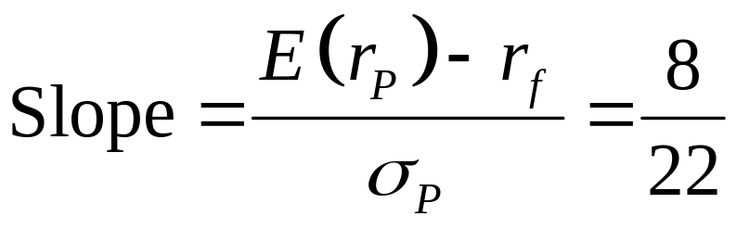
One Risky Asset and a Risk-Free Asset: Example
Rearrange and substitute y = σ_{C}/σ_{P}:

Slide 37
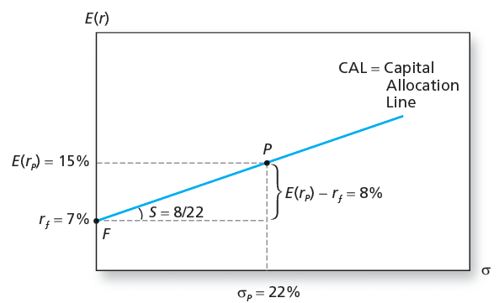
The Investment Opportunity Set

Slide 38
Capital Allocation Line
CAL depicts all the risk-return combinations available to investors
The slope of the CAL, denoted S, equals the increase in the expected return of the complete portfolio per unit of additional standard deviation
  Incremental return per incremental risk
  Reward to Volatility ratio

Slide 39
One Risky Asset and a Risk-Free Asset
A portfolio equally divided between the risky asset and the risk-free asset , y = 0.5
Expected rate of return E(r_{C} )= 7 + 0.5 * 8 = 11%
Risk premium = 4%
Standard deviation of σ_{C} = 0.5 * 22 = 11%
It will plot on the line FP midway between F and P
Reward to Volatility ratio = 4/11 = 0.36

Slide 40
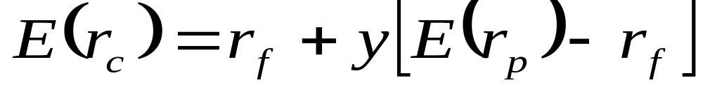
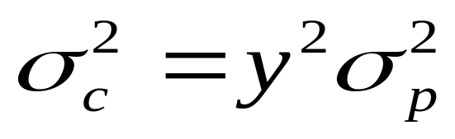
Risk Tolerance and Asset Allocation
The investor must choose one optimal portfolio, C, from the set of feasible choices
  Expected return of the complete portfolio:
  Variance :

Slide 41
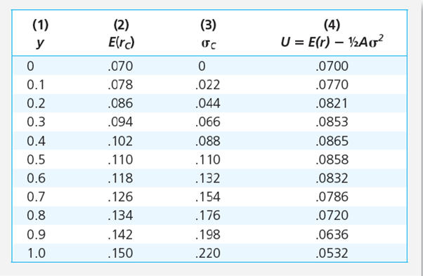
Utility Levels for Various Positions in Risky Assets
Investor’s Risk aversion, A=4

Slide 42
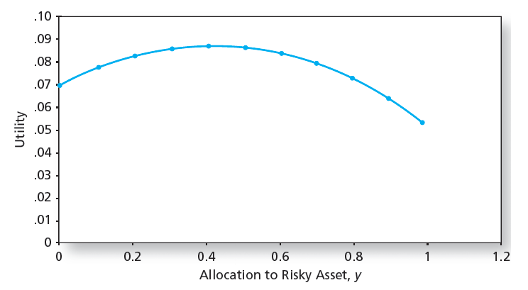
Utility as a Function of Allocation to the Risky Asset, y

Slide 43
Utility as a Function of Allocation to the Risky Asset, y
Utility is highest at y =0.41
When y is less than 0.41, investors are willing to assume more risk to increase expected return
At higher levels of y , risk is higher, and additional allocations to the risky asset are undesirable
Solve the utility maximization problem, and the optimal position for risk-averse investors in the risky asset, y* = E(r_{P} ) - r_{f}
A σ_{P}²

Slide 44
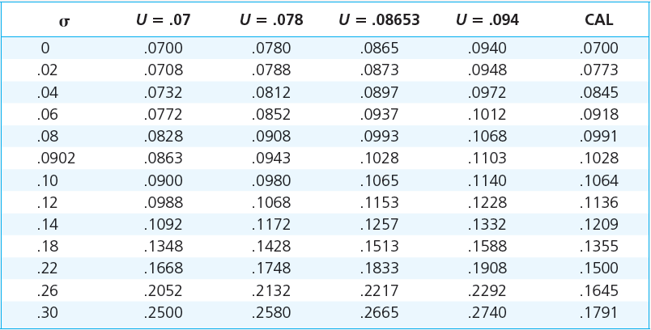
Expected Returns on Four Indifference Curves and the CAL

Slide 45
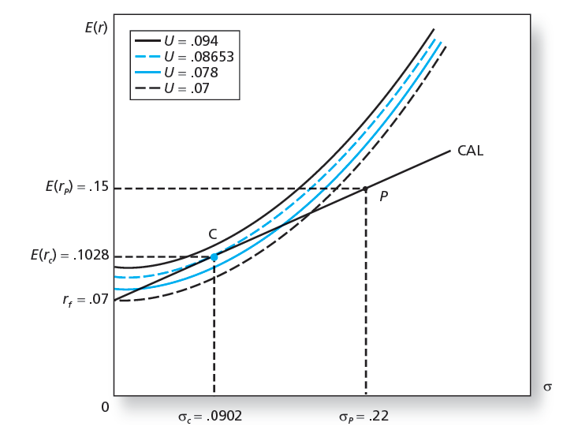
Finding the Optimal Complete Portfolio

Slide 46
Passive Strategies: The Capital Market Line
The passive strategy avoids any direct or indirect security analysis
Supply and demand forces may make such a strategy a reasonable choice for many investors
A natural candidate for a passively held risky asset would be a well-diversified portfolio of common stocks such as the S&P 500

Slide 47
Passive Strategies: The Capital Market Line
The Capital Market Line (CML)
  Is a capital allocation line formed investment in two passive portfolios:
    Virtually risk-free short-term T-bills (or a money market fund)
    Fund of common stocks that mimics a broad market index

Slide 48
Question 1
Consider a portfolio that offers an expected rate of return of 12% and a standard deviation of 18%. T-bills offer a risk-free 7% rate of return. What is the maximum level of risk aversion for which the risky portfolio is still preferred to bills?

Slide 49
Question 2
You manage a risky portfolio with expected rate of return of 18% and standard deviation of 28%. The T-bill rate is 8%.
A) Your client chooses to invest 70% of a portfolio in your fund and 30% in a T-bill money market fund. What is the expected value and standard deviation of the rate of return on his portfolio?

Slide 50
Question 2
B) Suppose that your risky portfolio includes the following investments in the given proportions:
Stock A 25%
  Stock B 32%
  Stock C 43%
  What are the investment proportions of your client’s overall portfolio, including the position in T-bills?

Slide 51
Question 2
C) What is the reward-to-volatility ratio of your risky portfolio? Your client’s?
D) Suppose that your client decides to invest in your portfolio a proportion y of the total investment budget so that the overall portfolio will have an expected rate of return of 16%
  What is the proportion y ?
  What are your client’s investment proportions in your three stocks and the T-bill fund?
  What is the standard deviation of the rate of return on your client’s portfolio?

Slide 52
Question 2
E) Suppose that your client prefers to invest in your fund a proportion y that maximises the expected return on the complete portfolio subject to the constraint that the complete portfolio’s standard deviation will not exceed 18%
  What is the investment proportion, y?
  What is the expected rate of return on the complete portfolio?

Slide 53
Question 2
F) Your client’s degree of risk aversion is A= 3.5
  What proportion, y, of the total investment should be invested in your fund?
  What is the expected value and standard deviation of the rate of return on your client’s optimized portfolio?

Slide 54
Question 3
Investment | Expected return E(r) | Standard deviation σ
1 | 0.12 | 0.30
2 | 0.15 | 0.50
3 | 0.21 | 0.16
4 | 0.24 | 0.21
Which investment would you select if you were risk averse with A =4
Which investment would you select if you were risk neutral?

Slide 55
Diversification and Portfolio Risk
Market risk
  Risk attributable to market wide risk sources and remains even after extensive diversification
  Also called systematic or non-diversifiable
Firm-specific risk
  Risk that can be eliminated by diversification
  Also called diversifiable or nonsystematic

Slide 56
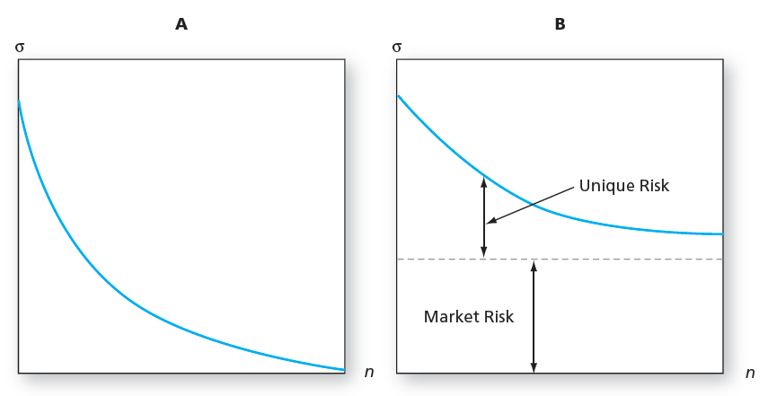
Portfolio Risk and the Number of Stocks in the Portfolio
Panel A: All risk is firm specific. Panel B: Some risk is systematic or market wide.

Slide 57
Portfolios of Two Risky Assets
  Portfolio risk (variance) depends on the correlation between the returns of the assets in the portfolio
  Covariance and the correlation coefficient provide a measure of the way returns of two assets move together (covary)

Slide 58
Portfolios of Two Risky Assets: Return
Portfolio return: r_{p} = w_{D}r_{D} + w_{E}r_{E}
  w_{D} = Bond weight
  r_{D} = Bond return
  w_{E} = Equity weight
  r_{E} = Equity return
  E(r_{p}) = w_{D} E(r_{D}) + w_{E}E(r_{E})

Slide 59
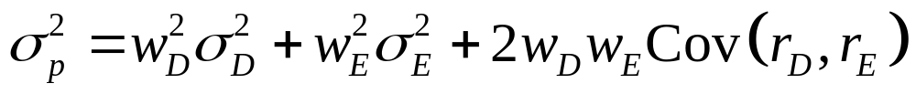
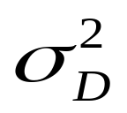
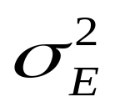
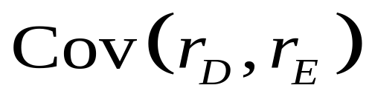
Portfolios of Two Risky Assets: Risk
Portfolio variance:
  = Bond variance
  = Equity variance
  = Covariance of returns for bond and equity

Slide 60
Portfolios of Two Risky Assets: Covariance
Covariance of returns on bond and equity:
Cov(r_{D,}r_{E}) = ρ_{DE} σ_{D} σ_{E}
  ρ_{DE} = Correlation coefficient of returns
  σ_{D} = Standard deviation of bond returns
  σ_{E} = Standard deviation of equity returns

Slide 61
Portfolios of Two Risky Assets: Correlation Coefficients
Range of values for ρ_{1,2}
- 1.0 > ρ > +1.0
  If ρ = 1.0, the securities are perfectly positively correlated (no diversification)
  If ρ = - 1.0, the securities are perfectly negatively correlated (perfect hedge)

Slide 62
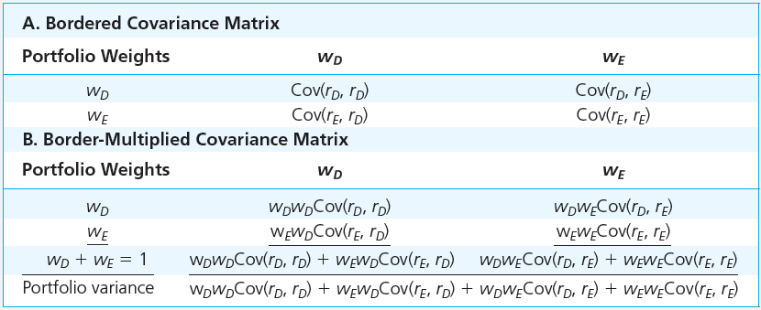
Computation of Portfolio Variance From the Covariance Matrix

Slide 63
Example
Consider a portfolio of three funds, X,Y, Z with weights w_{x}, w_{y}, and w_{z}.
What is the portfolio variance?
W_{x}² σ_{x}² + w_{y}² σ_{y}² + w_{z}² σ_{z}² + 2 w_{x} w_{y} Cov (r_{x}, r_{y} ) + 2 w_{x} w_{z} Cov (r_{x}, r_{z} ) +
2 w_{y} w_{z} Cov (r_{y}, r_{z} )

Slide 64
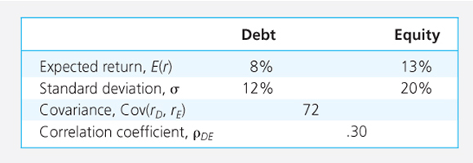
Descriptive Statistics

Slide 65
Portfolio weights
E(r_{P} ) = 8W_{D} + 13W_{E}
σ_{P}² = 12² W_{D}² + 20² W_{E}² + 2* 12* 20 * 0.3 * W_{D} * W_{E}
₌ 144 W_{D}² + 400 W_{E}² + 144 W_{D} W_{E}
What will be the expected return and standard deviation of the portfolio if weights are 0.5 each for debt and equity?
E(r_{P} )= 10.5%; σ_{P} = 13.1%

Slide 66
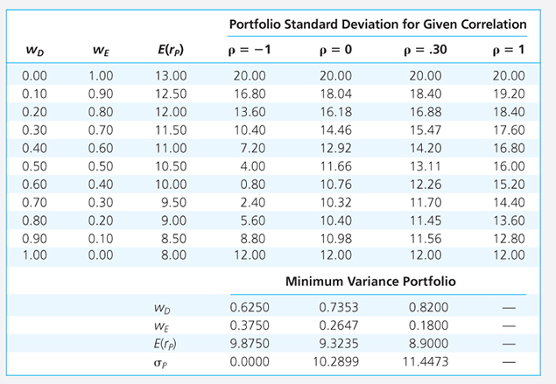
Expected Return and Standard Deviation with various correlation coefficients

Slide 67
Minimum-Variance Portfolio weights
w_{Min} (D) = σ_{E}² – Cov (r_{D}, r_{E})
----------------------------
σ_{D}² + σ_{E}² - 2 Cov (r_{D}, r_{E})
w_{Min} (E) = 1 - w_{Min} (D)

Slide 68
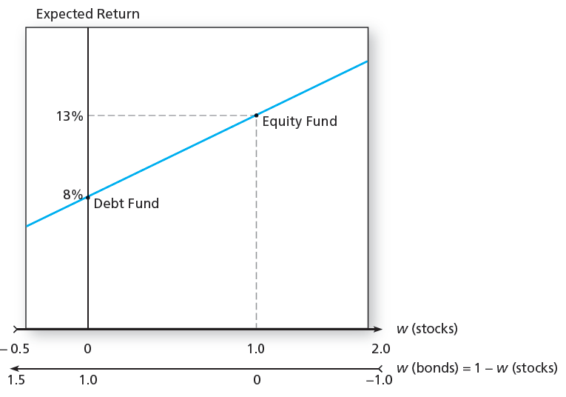
Portfolio Expected Return

Slide 69
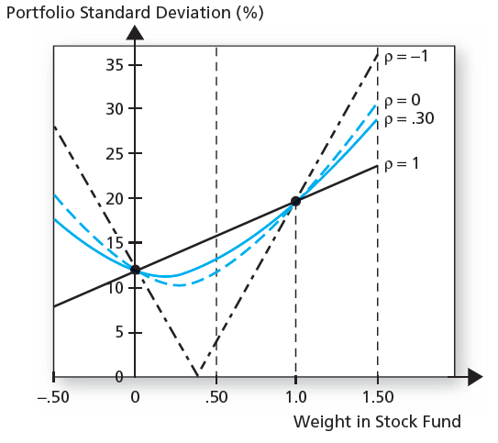
Portfolio Standard Deviation

Slide 70
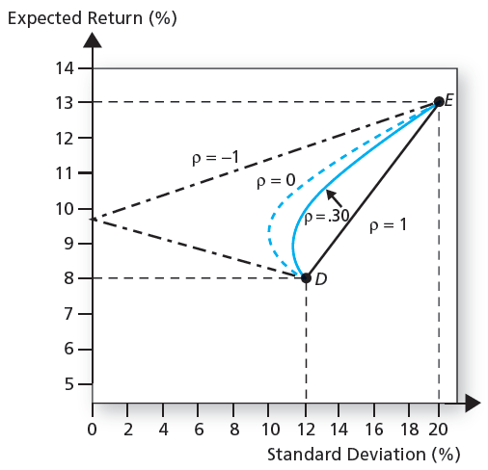
Portfolio Expected Return as a Function of Standard Deviation

Slide 71
The Minimum Variance Portfolio
The minimum variance portfolio is the portfolio composed of the risky assets that has the smallest standard deviation; the portfolio with least risk
The amount of possible risk reduction through diversification depends on the correlation:
  If ρ= +1.0, no risk reduction is possible
  If ρ = 0, σ_{P} may be less than the standard deviation of either component asset
  If ρ= -1.0, a riskless hedge is possible

Slide 72
Asset Allocation with Stocks, Bonds, and Bills
Asset allocation: Constructing the risky portfolio of major asset classes - bonds and stock with the highest possible Sharpe ratio
Sharpe ratio is defined as the risk premium in excess of the risk-free rate, divided by the standard deviation
The portfolio that maximises the Sharpe ratio is the solution to the asset allocation problem

Slide 73
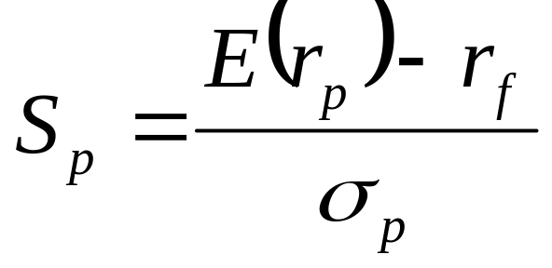
The Sharpe Ratio
Maximize the slope of the CAL for any possible portfolio, P
The objective function is the slope:
The slope is also the Sharpe ratio

Slide 74
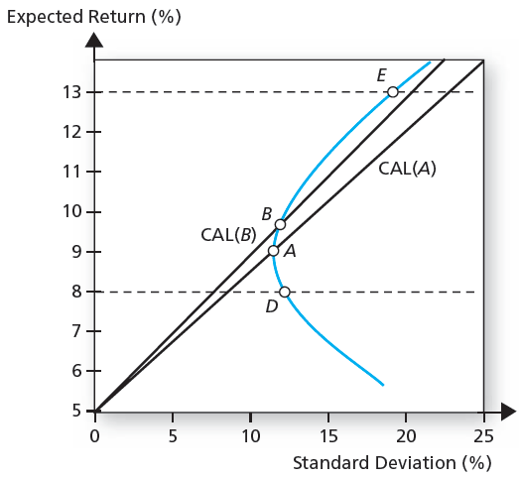
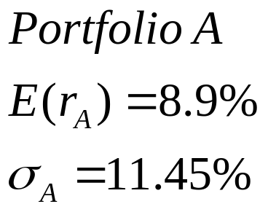
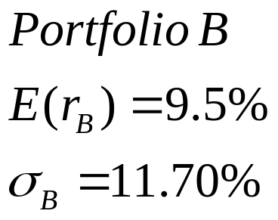
The Opportunity Set of the Debt and Equity Funds and
Two Feasible CALs

Slide 75
Asset Allocation
Two possible CALs are drawn from the risk-free rate (r_{f} = 5% ) to two feasible portfolios.
CAL (A) is drawn through the minimum-variance portfolio A, which is invested 82% in bonds and 18% in stocks
S_{A} = 8.9 – 5 = 0.34
        11.45
        CAL (B) is drawn through portfolio B which is invested 70% in bonds and 30% in stocks
S_{B} = 9.5 – 5 = 0.38
        11.7
        Portfolio B dominates Portfolio A

Slide 76
Optimal Risky Portfolio
w_{D} = E(R_{D}) σ_{E}² - E(R_{E}) Cov (R_{D}, R_{E})
------------------------------------------
E(R_{D}) σ_{E}² + E(R_{E}) σ_{D}² - [E(R_{D}) + E(R_{E})] Cov (R_{D}, R_{E})
w_{E} = 1- w_{D}
(Note - The solution employs excess returns)

Slide 77
Optimal Risky Portfolio
W_{D} = 0.40
W_{E} = 1- 0.40 = 0.60
E(r_{P} ) = 0.4* 8+ 0.6*13 = 11%
σ_{P} =[ (0.4² *144) + (0.6² *400) + (144*0.4*0.6) ]^{1/2} = 14.2%
This asset allocation produces an optimal risky portfolio whose CAL has a slope of
S_{p} = 11 – 5 = 0.42
        14.2

Slide 78
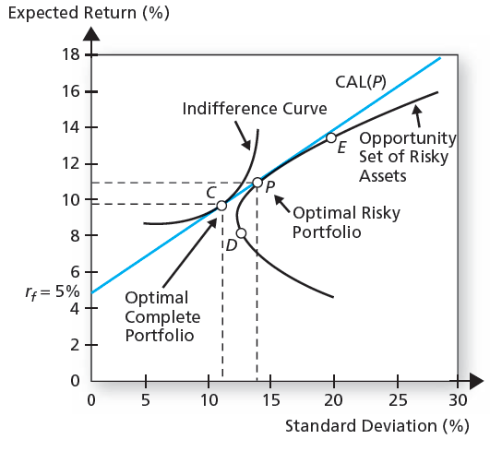
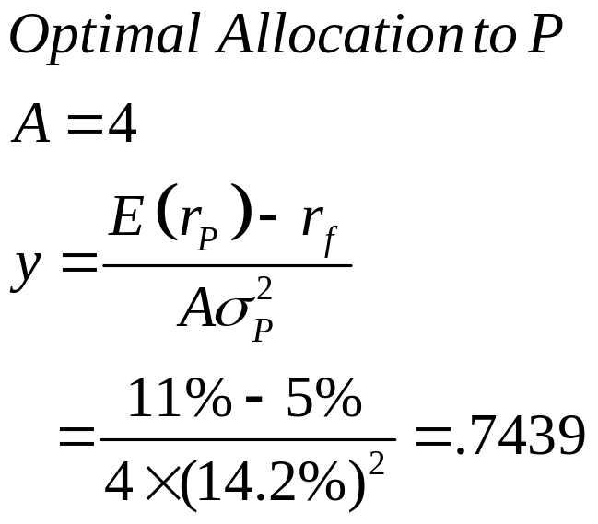
Determination of the Optimal Overall Portfolio

Slide 79
The Optimal Complete Portfolio
An investor with a coefficient of risk aversion A =4 would take a position in portfolio P
y = E(r_{P} ) – r_{f}
A σ_{P}²
= 0.11 – 0.5 = 0.7439
4*.142²
Investor will invest 74.39% of wealth in Portfolio P and 25.61% in T-bills.
Portfolio P consists of 40% in bonds, 60% in stocks
Investment in bonds = yw_{D} = 0.4* 0.7439 = 0.2976
Investment in stocks = yw_{E} = 0.6* 0.7439 = 0.4463

Slide 80
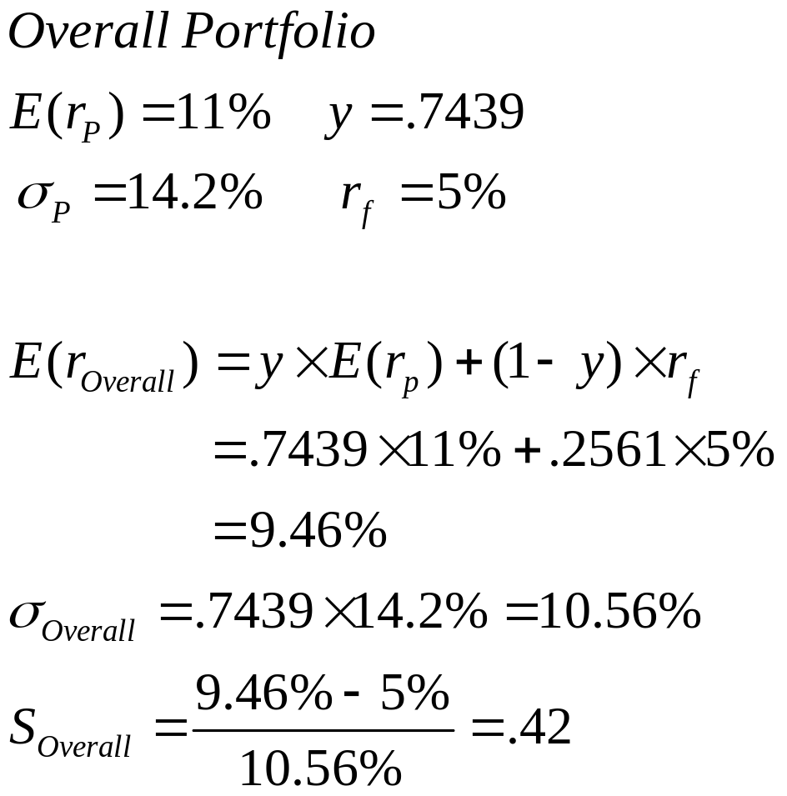

The Proportions of the Optimal Complete Portfolio

Slide 81
Summarize
1. Specify the return characteristics of all securities (expected returns, variances, covariances)
2. Establish the risky portfolio (asset allocation)
3. Allocate funds between risky portfolio and the risk-free asset (capital allocation)

Slide 82
Markowitz Portfolio Optimization Model
Security selection
  The first step is to determine the risk-return opportunities available
    Minimum variance frontier – graph of lowest possible variance that can be attained for a given portfolio return

Slide 83

The Minimum-Variance Frontier of Risky Assets

Slide 84
Efficient Frontier
The part of the frontier that lies above the global minimum-variance portfolio is called the efficient frontier of risky assets
For any portfolio on the lower portion of the minimum-variance frontier, there is a portfolio with the same standard deviation and a greater expected return positioned directly above it.

Slide 85
Markowitz Portfolio Optimization Model
Search for the CAL with the highest reward-to-variability ratio
Everyone invests in P, regardless of their degree of risk aversion
  More risk-averse investors put more in the risk-free asset
  Less risk-averse investors put more in P

Slide 86

The Efficient Frontier of Risky Assets with the Optimal CAL

Slide 87
Efficient Frontier of Risky Assets
For any risk level, we are interested only in that portfolio with the highest expected return
Alternatively, the frontier is the set of portfolios that minimizes the variance for any target expected return

Slide 88
Markowitz Portfolio Optimization Model
Capital Allocation and the Separation Property
  Portfolio choice problem may be separated into two independent tasks
    Determination of the optimal risky portfolio is purely technical
    Allocation of the complete portfolio to risk-free versus the risky portfolio depends on personal preference

Slide 89
A portfolio manager will offer the same risky portfolio, P, to all clients regardless of their degree of risk aversion
The degree of risk aversion of the client comes into play only in capital allocation, the selection of the desired point along CAL
A more risk-averse client will invest more in the risk-free asset and less in the optimal risky portfolio than will a less risk-averse client
Both will use Portfolio P as their optimal risky investment vehicle.

