Slide 1

Executive Certificate Program in
Financial Risk Management
Session on Operational Risk Management
20th Oct 2024 (Sunday) - Time: 09.00 AM – 12.00 Noon
CH S S MALLIKARJUNA RAO
(Former MD & CEO of Punjab National Bank & Allahabad Bank)
Currently serving on the Boards of
Axis Bank Ltd.
IFTAS (Indian Financial Technology & Allied Services – 100% Subsidiary of RBI).
Finance Industry Development Council (FIDC).

Slide 2
FRM – Operational Risk Management
Operational Risk Management
Key Functions in Operational Risk Management:
Risk Profile.
  Risk Indicators.
  Self Assessment.
  Loss Database including Frauds
  Capital Model.
Appropriate Policy measures.
Implementation of Tools and Capital Management.
Consolidation, Reporting and analysis of Data.
Adopting Best Practices.
Risk Mitigation Measures including the Insurance coverage.

Slide 3
FRM – Operational Risk Management
Operational Risk Management – Business Lines
Business Lines:
Investment Banking – Corporate Finance.
Investment Banking – Merchant Banking and Advisory Services.
Investment Banking – Trading and Sales.
Commercial Banking – Corporates
Retail Banking – MSME
Retail Banking – Private Banking viz. Housing / Vehicle / Consumer
Retail Banking – Card Services.
Payments and settlements.
Agency Services – Custody and Corporate Services.
Customer onboarding - Liabilities Management.
Customer Complaints – Turn Around Time (TAT).
Project Implementation.

Slide 4
FRM – Operational Risk Management
Operational Risk Management – Loss Events
Loss Events:
Internal and External Frauds.
Employment practices and workplace safety leading to losses.
Losses arising from negligence in professional obligation with Clients, Products & Practices.
Losses arising from damage to physical assets.
Losses arising from Business disruption and system failures.
Losses from failed transactions processing, execution and delivery and process management.

Slide 5
FRM – Operational Risk Management
Guidance Note on Operational Risk Management & Operational Resilience – RBI Circular dated 30th April 2024.
Purpose:
To Promote and further improve the effectiveness of Operational Risk Management of the Regulated Entities (Res).
To enhance their Operational Resilience given the interconnections and interdependencies, with in the financial system, that result from the complex and dynamic environment in which the REs operate.
This Guidance Note has been prepared based on the BSBS (Basel Committee on Banking Supervision) Principles issued in March 2021 viz. (a) Revisions to the Principles for the Sound Management of Operational Risk and (b) Principles for Operational Resilience as well as some of the International Best Practicies.
This Note has adopted a Principle-based and proportionate approach to ensure smooth implementation across REs of various sizes, nature, complexity, geographic location and risk profile of their businesses. The exact approach could differ from RE to RE.
Guidance Note attempts to improve and further strengthen the Operational Risk Management Framework (ORMF) of the REs.
This Guidance Note applies to all the REs viz. (a) all Banking Companies, corresponding new Banks, Regional Rural Banks, Local Area Banks, Payment Banks, Small Finance Banks (b) All Primary (Urban) Cooperative Banks, State Cooperative Banks and Central Cooperative Banks, (c) All All India Financial Financial Institutions viz. EXIM Bank, NABARD, NHB, SIDBI and NaBFID, and (d) All Non Banking Finance Companies including Housing Finance Companies.

Slide 6
FRM – Operational Risk Management
Guidance Note on Operational Risk Management & Operational Resilience (Contd…)
The Guidance Note on Operational Risk Management & Operational Resilience has been built on three pillars viz.
PILLER 1: Prepare and Protect.
  Governance and Risk Culture.
  Responsibilities of Board of Directors and Senior Management.
  Risk Management Identification and Assessment.
  Change Management.
  Monitoring and Reporting.
  Control and Mitigation.
PILLAR 2: Build Resilience.
  Business Continuity Planning and Testing.
  Mapping Interconnectedness and Interdependencies.
  Third Party Dependency Management.
  Incident Management.
  ICT (Information and Communication Technology) including Cyber Security.
PILLAR 3: Learn and Adapt.
  Disclosure and Reporting.
  Lessons learnt, exercise and adapting.
  Continuous improvement through feedback systems.

Slide 7
FRM – Operational Risk Management
Guidance Note on Operational Risk Management & Operational Resilience (Contd…)
As part of the REs Operational Risk Management Framework (ORMF), the Three Lines of Defence redefined are:
First Line of Defence: Business Unit Management is responsible for identifying and managing the risks inherent in the products, services, activities, processes and systems for which it is accountable. REs should have a policy that defines clear roles and responsibilities of relevant Business Units.
Second Line of Defence: A functionally independent Organisational Operational Risk Management Function (OORMF), responsibilities of which include: (a) Developing an independent view regarding Business Units’ identified Material Operational Risks, Design and effectiveness of Key Controls and Risk Tolerance, (b) Challenging the relevance and consistency of the Business Units’ implementation of ORM Tools, (c) Developing and maintaining Operational Risk Management and Measurements Policies, (d) Reviewing an contributing to the Monitoring and Reporting of the Operational Risk Profile and (e) Designing and providing Operational Risk Training and instilling Risk awareness.
Third Line of Defence: An Audit function that provides an independent assurance to the Board regarding the appropriateness of RE’s ORMF. This function’s staff should not be involved in development, implementation and operation of Operational Risk Management Processes. The functions of Audit include Validation and Verification of Systems and processes used by REs as part of Operational Risk Management.

Slide 8
FRM – Operational Risk Management
Guidance Note on Operational Risk Management & Operational Resilience (Contd…)
Across the three Pillars, the Guidance Note contains 17 Principles detailed as under:
PILLAR 1: Prepare and Protect
Governance and Risk Culture:
Principle 1: The Board of Directors should take the lead in establishing a strong risk management culture, implemented by Senior Management viz. Setting Standards & Incentives for professional & responsible behaviour and ensuring Risk Management and Ethics training for Staff.
Principle 2: REs should develop, implement and maintain an ORMF that is fully integrated into the REs overall risk management processes. The ORMF to include the Nature of Business, Size, Complexity of Business and Risk Profile of the RE concerned.
Responsibilities of Board of Directors and Senior Management:
Principle 3: The Board of Directors should approve and periodically review the ORMF and Operational Resilience approach and ensure that Senior Management implements the policies, processes and systems of the ORMF and Operational Resilience, effectively at all levels.
Principle 4: The Board of Directors should approve and periodically review a Risk Appetite and Tolerance Statement for Operational Risk that articulates the nature, types and levels of the Operational Risk the RE is willing to assume.
Principle 5: Senior Management should develop a clear, effective and robust governance structure with well defined, transparent and consistent lines of responsibility.

Slide 9
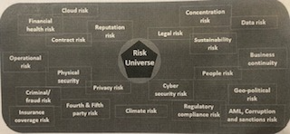
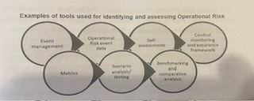
FRM – Operational Risk Management
Guidance Note on Operational Risk Management & Operational Resilience (Contd…)
Across the three Pillars, the Guidance Note contains 17 Principles detailed as under: (Contd…)
Risk Management environment – Identification and Assessment:
Principle 6: Senior Management should ensure the comprehensive identification and assessment of the operational risk inherent in all material products, activities, processes and systems to make sure the inherent risks and incentives are well understood. Both internal and external threats and potential failures in people, processes and systems should be assessed promptly on an ongoing basis including the third party relationships.
Risk Universe (Spectrum of Risks) Tools used in ORM

Slide 10
Financial Risk Management (FRM)
Guidance Note on Operational Risk Management & Operational Resilience (Contd…)
Risk Universe comprising Pillar 2 Risks
Interest Rate Risk in the Banking Book,
Business Model Risk,
Credit Concentration Risk,
Reputational Risk,
Strategic Risk,
Legal Risk,
Liquidity Risk,
Settlement Risk,
Risk of weakness in Credit Risk Mitigants.
Residual Risk of Securitization.
Cyber Security / IT Infrastructure Risk,.
Human Capital Risk,
Group Risk,
Outsourcing / Vendor Management Risk,
Collateral Risk.

Slide 11
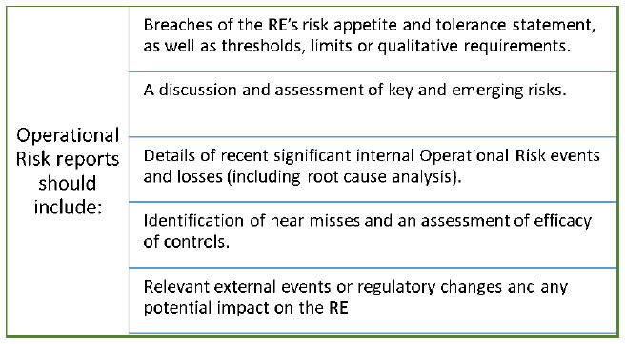
FRM – Operational Risk Management
Guidance Note on Operational Risk Management & Operational Resilience (Contd…)
Across the three Pillars, the Guidance Note contains 17 Principles detailed as under: (Contd…)
Change Management:
Principle 7: Senior Management should ensure that the RE’s Change Management process is comprehensive, appropriately resourced and adequately articulated between the relevant lines of defence.
Monitoring and Reporting:
Principle 8: Senior Management should implement a process to regularly monitor Operational Risk Profiles and material operational exposures. Appropriate reporting mechanisms should be in place at the Board of Directors, Senior Management, and Business Unit levels to support proactive management of Operational Risk.

Slide 12
FRM – Operational Risk Management
Guidance Note on Operational Risk Management & Operational Resilience (Contd…)
Across the three Pillars, the Guidance Note contains 17 Principles detailed as under: (Contd…)
Control and Mitigation:
Principle 9: REs should have a strong control environment that utilises policies, processes and systems; appropriate internal controls; and appropriate risk mitigation and / or transfer strategies.
Examples of principal elements of a policy compliance assessment are:
• Top-level reviews of progress towards stated objectives
• Verification of compliance with management controls
• Review of the treatment and resolution of instances of non-compliance
• Evaluation of the required approvals and authorisations to ensure accountability to an appropriate level of management
• Tracking of reports for approved exceptions to thresholds or limits, management overrides and other deviations from policy, regulations and laws
Examples of these controls are:
• Clearly established authorities and/or processes for approval
• Close monitoring of adherence to assigned risk thresholds or limits
• Safeguards for access to, and use of, RE assets and records
• Appropriateness of staffing level and training to maintain technical expertise
• Ongoing processes to identify business units or products where returns appear to be out of line with reasonable expectations.
• Regular verification and reconciliation of transactions and accounts
• Mandatory leave policy that allows for employees posted in sensitive positions or areas of operations to compulsorily be sent on leave for a stipulated period in a single spell every year, while maintaining an element of surprise for the employee.

Slide 13
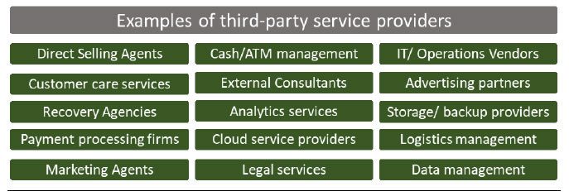
FRM – Operational Risk Management
Few examples of what constitute third-party service providers is shown in figure below (indicative and not an exhaustive list)
Guidance Note on Operational Risk Management & Operational Resilience (Contd…)
Across the three Pillars, the Guidance Note contains 17 Principles detailed as under: (Contd …)
PILLAR 2: Build Resilience
Mapping of Interconnectedness and Interdependencies:
Principle 10: Once an RE has identified its critical operations, it should map the internal external interconnections and interdependencies that are necessary for the delivery of critical operations consistent with its approach to operational resilience.
Third Party dependency management:
Principle 11: REs should manage their dependencies on relationships including those of, but not limited to, third parties (which include intergroup entities), for the delivery of critical operations.

Slide 14
FRM – Operational Risk Management
Few examples of what constitute third-party service providers is shown in figure below (indicative and not an exhaustive list)
Guidance Note on Operational Risk Management & Operational Resilience (Contd…)
Across the three Pillars, the Guidance Note contains 17 Principles detailed as under: (Contd …)
PILLAR 2: Build Resilience
Business Continuity Planning and Testing:
Principle 12: REs should have Business Continuity plans in place to ensure their ability to operate on an ongoing basis and limit losses in the event of a severe business disruption. Business continuity plans should be linked to the RE’s ORMF. REs should conduct Business continuity exercises under a range of severe but plausible scenarios in order to deliver critical operations through disruption.
Incident Management:
Principle 13: REs should develop and implement response and recovery plans to manage incidents that could disrupt the delivery of critical operations in line with the RE’s Risk appetite and tolerance for disruption. REs should continuously improve their incident response and recovery plans by incorporating the lessons learnt from previous incidents.
Information and Communication Technology (ICT) including Cyber Security:
Principle 14: REs should implement a robust ICT risk management programme in alignment with their ORMF and ensure a resilient ICT including Cyber Security that is subject to Protection, Detection, Response and Recovery programmes that regularly tested, incorporate appropriate situational awareness and convey relevant timely information for risk management and decision making processes to fully support and facilitate the delivery of RE’s Critical operations.

Slide 15
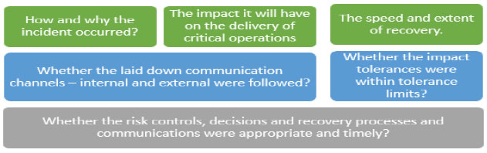
FRM – Operational Risk Management
Few examples of what constitute third-party service providers is shown in figure below (indicative and not an exhaustive list)
Guidance Note on Operational Risk Management & Operational Resilience (Contd…)
Across the three Pillars, the Guidance Note contains 17 Principles detailed as under: (Contd …)
PILLAR 3: Learn and Adapt
Disclosure and Reporting:
Principle 15: An RE’s public disclosures should allow stakeholders to assess its approach to Operational Risk Management and its Operational Risk Exposure.
Lessons learned Exercise and Adapting:
Principle 16: A lessons learned exercise should be conducted after a disruption to a critical or important business service to enhance an RE’s capabilities to adapt and respond to future operational events.

Slide 16
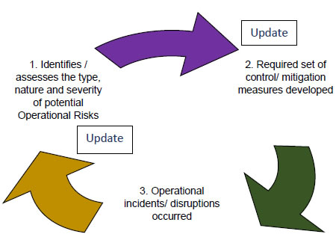
FRM – Operational Risk Management
Few examples of what constitute third-party service providers is shown in figure below (indicative and not an exhaustive list)
Guidance Note on Operational Risk Management & Operational Resilience (Contd…)
Across the three Pillars, the Guidance Note contains 17 Principles detailed as under: (Contd …)
PILLAR 3: Learn and Adapt
Continuous improvement through feedback systems:
Principle 17: An RE should promote an effective culture of learning and continuous improvement as operational resilience evolves through effective feedback systems.

Slide 17
FRM – Operational Risk Management
Liquidity Coverage Ratio (LCR)
LCR – The objective and ingredients:
The LCR refers to the proportion of highly liquid assets held by the Bank to ensure their ongoing ability to meet short term obligations.
The Ratio is a generic stress test that aims to anticipate market – wide shocks and make sure that Banks possess suitable capital preservation, to ride out of any short term liquidity disruptions, that may affect the market.
LCR is a requirement under Basel III whereby Banks are required to hold an amount high quality liquid assets that enough to fund cash outflows for 30 days.
LCR = High Quality Liquid Assets Amount (HQLA) / Total Net Cash flow amount over 30 days.

Slide 18
FRM – Operational Risk Management
Liquidity Coverage Ratio (Contd. . . )
HQLA – Illustrative List:
Cash and Govt Securities.
Marketable securities issued or guaranteed by foreign sovereigns provided they are assigned zero risk, and traded in large, deep and active repo or cash markets.
Corporate Bonds (Not issued by Banks/FIs/ NBFCs) with rating above AA-, assigned with 20% risk weight, to be reckoned at 15% discount – with rating between A and BBB-, assigned with risk weight between 20% to 50%, to be reckoned at 50% discount.
Commercial Papers (not issued by Banks/FIs/NBFCs) with rating above AA-, to be reckoned at 15% discount – with rating between A and BBB-, assigned with risk weight between 20% to 50%, to be reckoned at 50% discount. Etc.,
Items of Cash outflows:
Demand Deposits (volatile portion) and Term Deposits under maturity.
Commitments under Lending.
Definitive payments under Contingent Liabilities.
Net Derivative cash outflows / Liquidity needs.

Slide 19
FRM – Operational Risk Management
Net Stable Funding Ratio (NSFR)
The objective of NSFR is to ensure that Banks maintain a stable funding profile in relation to the composition of their assets and off-balance sheet activities. A suitable funding structure in this respect will reduce the over reliance on short term wholesale funding and encourages better assessment of funding risk across all on and off balance sheet items, and promotes funding stability.
NSFR is defined as the amount of Available Stable Funding (ASF), relative to the amount of Required Stable Funding (RSF). This ratio should be equal to at least 100% on an ongoing basis.
Available Stable Funding is defined as the portion of capital and liabilities expected to be reliable over the time horizon considered by NSFR, which extends to one year. The amount of such stable funding required (Required Stable Funding) of a Bank is a function of the liquidity characteristics and residual maturities of the various assets held by that Bank as well as those of its off-balance sheet (OBS) exposures.
Available amount of Stable Funding / Required amount of Stable Funding >_ 100%.

Slide 20
FRM – Operational Risk Management
Net Stable Funding Ratio (Contd . . . )
Components of ASF category:
Total Regulatory Capital (excluding Tier 2 instruments with residual maturity of less than a year), reckoned at 100%.
Other Liabilities with effective residual maturity of one year or more, reckoned at 100%.
Stable demand deposits and term deposits with residual maturity of less than one year provided by retail and small business customers, reckoned at 95%.
Less stable non maturity deposits and term deposits with residual maturity of less than one provided by retail and small business customers, reckoned at 90%.
Funding with residual maturity of less than one year provided by non financial corporate customers, operational deposits, reckoned at 50%.
All other liabilities and equity not included above shall be reckoned at 0%.
Derivative liabilities are calculated first based on the replacement cost for derivative contracts (obtained by Mark to Market).
When determining the maturity of an equity or a liability instrument, investors are assumed to redeem a call option at the earliest possible date.

Slide 21
FRM – Operational Risk Management
Net Stable Funding Ratio (Contd. . . )
Components of RSF category:
Coins, Bank Notes, CRR, all claims on RBI wit residual maturities of less than 6 months are reckoned at 0%.
Unencumbered SLR Securities are reckoned at 5%.
Unencumbered loans to FIs with residual maturities of less than six months are reckoned at 10%.
All other standard unencumbered loans to FIs with residual maturity of less than six months are reckoned at 15%.
Unencumbered Level 2B Assets such as publicly traded common stock and investment grade corporate debt securities issued by non financial sector corporates, are reckoned at 50%.
Unencumbered standard residential mortgages with a residual maturity of one year or more and with minimum risk weight, are reckoned at 65%.
Cash, Securities or other assets posted as initial margin for derivatives contracts, are reckoned at 85%.
All other assets that are encumbered for a period of one year or more, are reckoned at 100%.

Slide 22
FRM – Operational Risk Models
THANKS

