Slide 1
Financial Data Analytics & Corporate Finance
Anuj Suneja

Slide 2
Disclaimer
I don’t know everything – kindly don’t expect that
I might use some jargons here and there – let me know if you don’t understand something – stop me then and there and I will try to explain it in a better and an easier way
I might just Google somethings in between of the class in order to find a better visualization of the same – kindly bear with me
Please feel free to let me know to slow down or speed-up during the class
There are a lot of softer aspects to equity analysis which you would learn with time
Any special orders/requests - something that you want to learn can be put in today – and I will try my best to incorporate the same
I might say things about some companies that you might not like - but you and I are allowed to have our own views. Right? We can have a discussion if we disagree on something!
Some jokes and contexts might not suit your genre – in case of any clarifications on the contexts reach out to me or your kids as they might know what I am referring to
Neither there are any stupid questions, nor there are any stupid answers – except for the ones that I might give if I don’t know something

Slide 3






Real and Financial Assets
Real Assets
  Have productive capacity
  Generate productivity for the economy
  Eg: Land, Building, PP&E, & IP
Financial Assets
  Are just claims on the real assets
  Don’t contribute directly to the productive capacity
  Eg: Stocks, Bonds, Futures etc
Notes:
Though it not entirely true that financial assets don’t contribute to the economy – trading of them makes some money

Slide 4
Types of Economic Units
Economic Units
Governments
Businesses
Households

Slide 5
Income and Expenditure
Income = Expenditure
Balanced Budget Units (BBU)
Income > Expenditure
Surplus Budget Units (SBU)
Income < Expenditure
Deficit Budget Units (DBU)

Slide 6

Financial Markets and its Players
Regulators
Surplus Income Units:
Households
Businesses
Government Entities
Foreigners
Investors
Deficit Income Units:
Households
Businesses
Government Entities
Foreigners
Investors
Financial Markets
Funds
Funds
Funds
Funds
Funds
Financial Intermediaries
Notes:
Direct and Indirect Financing

Slide 7
Financial markets
Financial markets refer broadly to any marketplace where the trading of securities occurs, including the stock market, bond market, forex market, and derivatives market, among others.
Components of the definition:
  Securities
    Bond – Debt
    Stock – Shares
    Forex
    Derivatives
    To an Extent Commodities

Slide 8
Demystifying the Definition of Financial Markets
Securities:
The term “securities” has been defined in the Section 2(h) of Securities Contracts (Regulation) Act, 1956 (SCRA). The term ‘Securities’ include:
    1. Shares, scrips, stocks, bonds, debentures, debenture stock or other marketable securities of a like nature in or of any incorporated company or other body corporate
    2. Derivatives
    3. Units or any other instrument issued by any collective investment scheme to the investors in such schemes units or any other such instrument issued to the investors under any mutual fund scheme
    4. Government securities
The term "security" refers to a fungible, negotiable financial instrument that holds some type of monetary value. It represents an ownership position in a publicly-traded corporation via stock; a creditor relationship with a governmental body or a corporation represented by owning that entity's bond; or rights to ownership as represented by an option

Slide 9
Demystifying the Definition of Financial Markets
Surplus Unit
Deficit Unit
funds
Debt
IoU
Periodic Interest Payments
Principal Repayment
I have a claim on the business – no matter the profit or loss

Slide 10
Demystifying the Definition of Financial Markets
Surplus Unit
Deficit Unit
funds
EQUITY
Ownership or equity shares
Claim on profits
Assets remaining after debtors have been paid
I would become a part owner of the business

Slide 11
Taking a step Back
CAPITAL Allocation

Slide 12
Invest Back
Pappa ka paisa/ Own Money/ Internal Accrual
Acquire Someone
Capital Allocation
Debt Repayment
DEBT
Dividend Payments
Equity / Dilution of Ownership
Stock Buyback

Slide 13
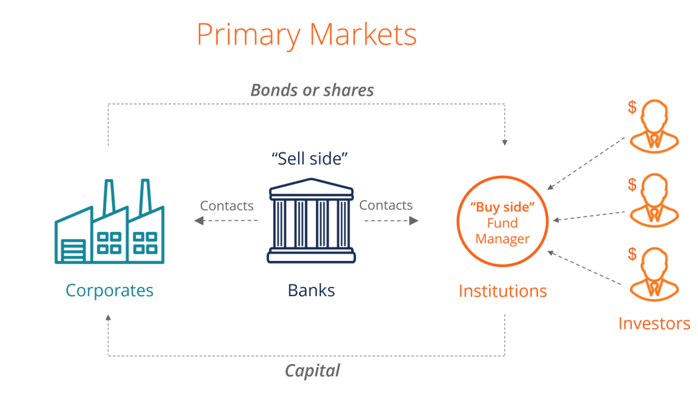
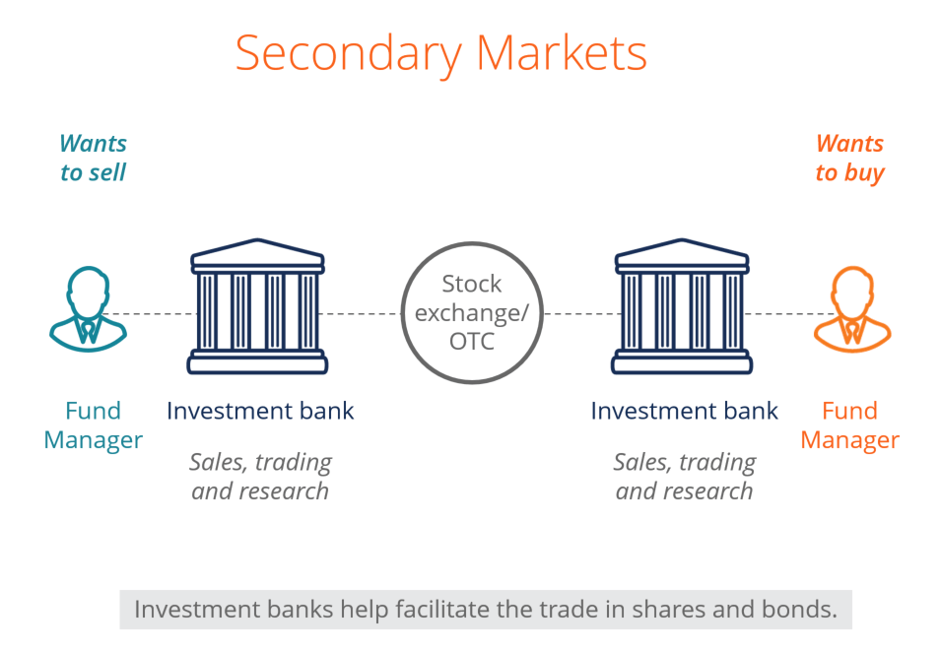
Equity Markets
Primary - The primary market, also called the new issue market, is where issuers raise capital by issuing securities to investors. Fresh securities are issued in this market.
Secondary - The secondary market facilitates trades in already-issued securities, thereby enabling investors to exit from an investment or new investors to buy the already existing securities.
The primary market facilitates creation of financial assets, and the secondary market facilitates their marketability/tradability which makes these two segments of Financial Markets - interdependent and inseparable.
https://corporatefinanceinstitute.com/resources/knowledge/trading-investing/primary-market/

Slide 14

Investing

Slide 15
Investing
Why?
What?
Benjamin Graham in his book “The Intelligent Investor” defines investment activity in the following words: “An investment operation is one which, upon thorough analysis promises safety of principal and an adequate return. Operations not meeting these requirements are speculative.”
How?

Slide 16
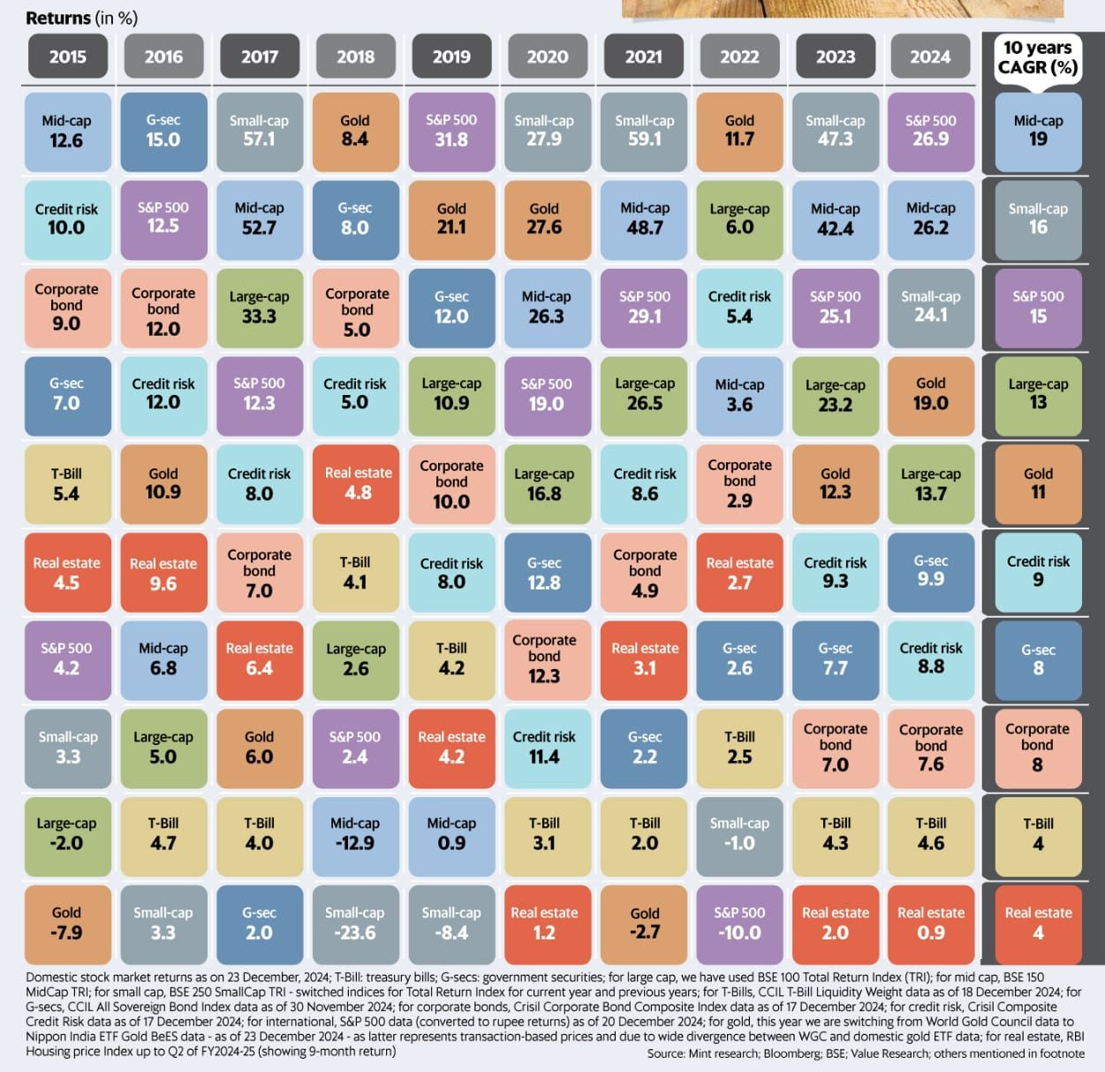
Investment Process
More than a mechanical process
A behavioral process
Asset Allocation
Security Selection

Slide 17
Types of Strategies
Macro
Contrarian
Momentum
Quant

Slide 18

Process
Two Approaches to it
  Top Down :Analysis of the
    Economy
    Industry
    Company
  Bottom Up: Analysis of the
    Company
    Industry
    Economy

Slide 19
Top Down
Country/Economy
Industry
Sub-Industry
Company

Slide 20
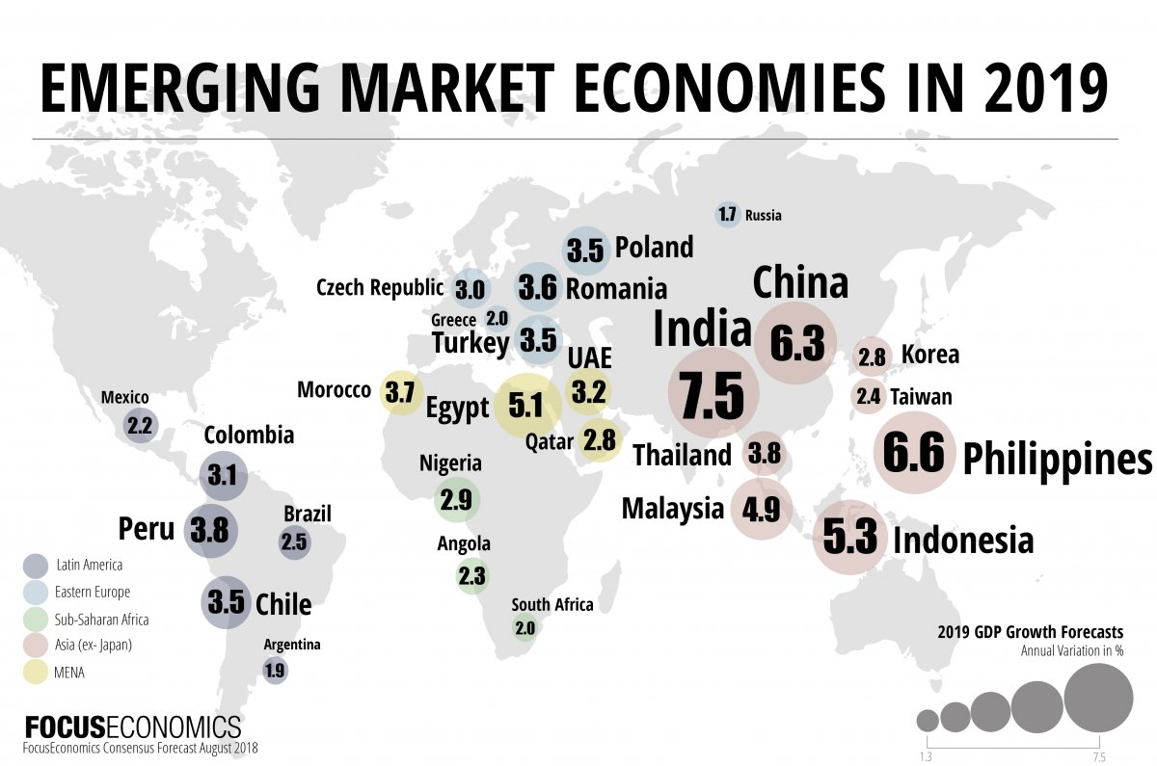

Country/Economy
GDP Growth
Trade Balances
Inflation
Forex Movement
Interest Rates
Policy
Govt Stance
RISK ON / RISK OFF

Slide 21
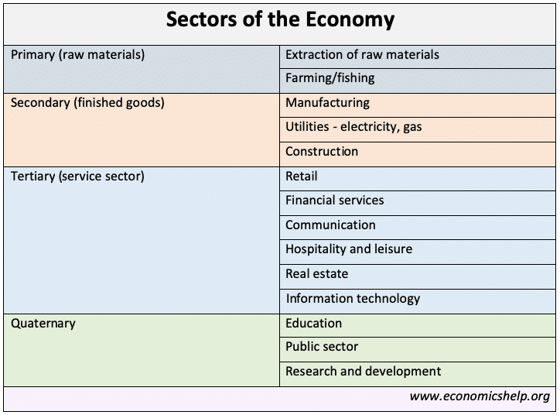
Industry/Sub Industry
ETFs/ Fixed Income Products
Sector Analysis – Healthcare/Banks/ Tech
  Valuation
    Historical
    Any changes from a fundamental viewpoint
https://www1.nseindia.com/products/content/equities/indices/sectoral_indices.htm

Slide 22
Company
About
Business
Margin Profile
Profit and Other ratios
Fundamental Analysis

Slide 23
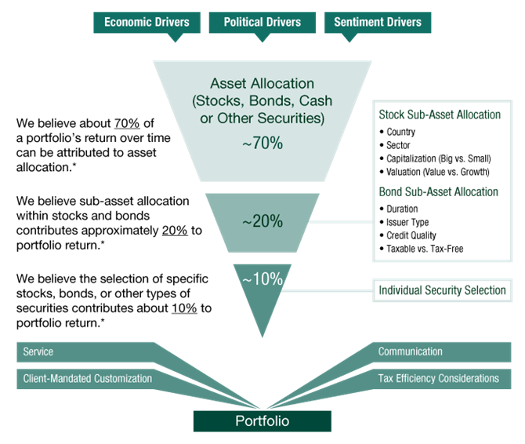
Top Down In action
https://www.fisherinvestments.com/en-us/services/investment-approach/top-down

Slide 24

BottomS UP
Bottom UP
  Analysis of the
  Company – In case you find an undervalued company (or you think is undervalued)
  Industry – Lookout for the Industry and the sector outlook
  Economy – Analyze the country growth and economic prospects before taking a decision
Notes:
Bottom-up is an investment approach that focuses on the fundamentals of the individual company rather than the overall macro environment. Its objective is to pick companies with strong fundamentals that have the ability to perform well regardless of the industry it operates in or the current point in the market cycle. Financial factors that can influence investors’ decisions include a healthy balance sheet, diversified and stable earnings streams, efficient debt and risk management. Operational and strategic factors such as management structure, business model, and competitive products or services are also considered

Slide 25
Individual Company
Try your best to analyse its financials diligently
Try to gauge the management and their viewpoint and endeavours
Get out at the first point you think your narrative has been challenged big time

Slide 26
Value vs Price

Slide 27
Various ways to value a company
Fundamental analysis models a company’s value by assessing its current and future profitability.
- identify mispriced stocks relative to some measure of “true” value derived from financial data.
Various Ways to value:
Dividend Discount Model
Discounted Cash Flow
Comparable - Multiple
  P/B
  P/E
  EV/EBITDA
  P/S
  PEG
SOTP

Slide 28
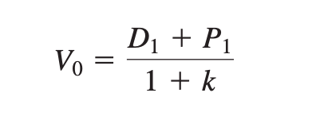
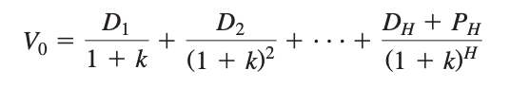
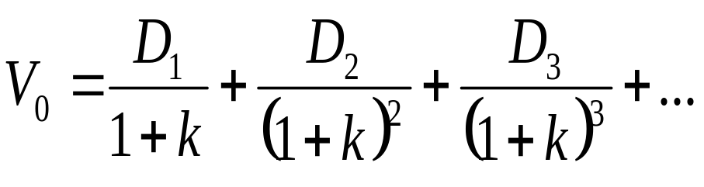
Dividend Discount Model
P₁ = D2 + P2 / (1+k)
V₀ =current value; D_{t}=dividend at time t; k = required rate of return
The DDM says the stock price should equal the present value of all expected future dividends into perpetuity.

Slide 29
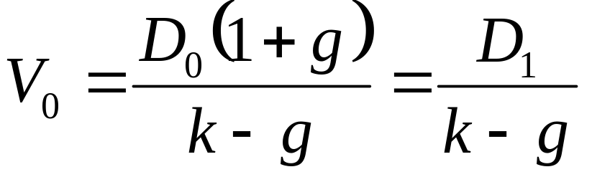
Constant Growth DDM
k= appropriate risk-adjusted interest rate
g= dividend growth rate

Slide 30
Discounted Cash Flow
FCFF (Free Cash flow to Firm)
EBIT* (1-t)
+ Add Back Depreciation
- Subtract all Capital Expenditures that happened during the year
- Subtract (Add) working capital changes (Current Assets – Current Liabilities)
Free cash flow to equity, FCFE, equals:
  FCFF
  Minus after tax interest
  Plus increase in debt

Slide 31
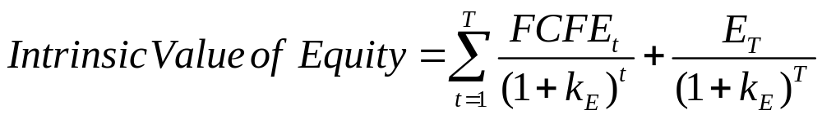
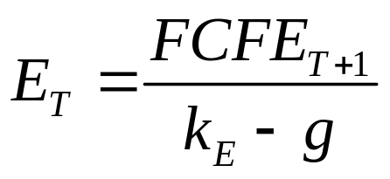
Where:
In practice
  Values from these models may differ
  Analysts are always forced to make simplifying assumptions
Problems with DCF
  Calculations are sensitive to small changes in inputs
  Growth opportunities and growth rates are hard to pin down

Slide 32
ComparableS (Multiples)
  P/B
  P/E
  EV/EBITDA
  P/S
  PEG

Slide 33
Price to BOOK
Price – LTP
Book Value – Net Worth/No. of Shares
LTP / Book Value = Price to Book
Base P/B
TTM P/B
Forward P/B

Slide 34
Price to Earning
Price = LTP
Earnings - EPS (Earning per Share)
LTP/EPS = P/E
Base
TTM
Forward

Slide 35
EV/ EBITDA
EV = Enterprise Value = Mcap + Debt – Cash
EBITDA = Earnings Before Interest Taxes Depreciation and Amortization
EV/EBITDA
Base
TTM
Forward

Slide 36
Price to Sales
Price = LTP
Sales = Revenue (Topline of the company)
Trailing
Base
Forward

Slide 37

PEG

Slide 38
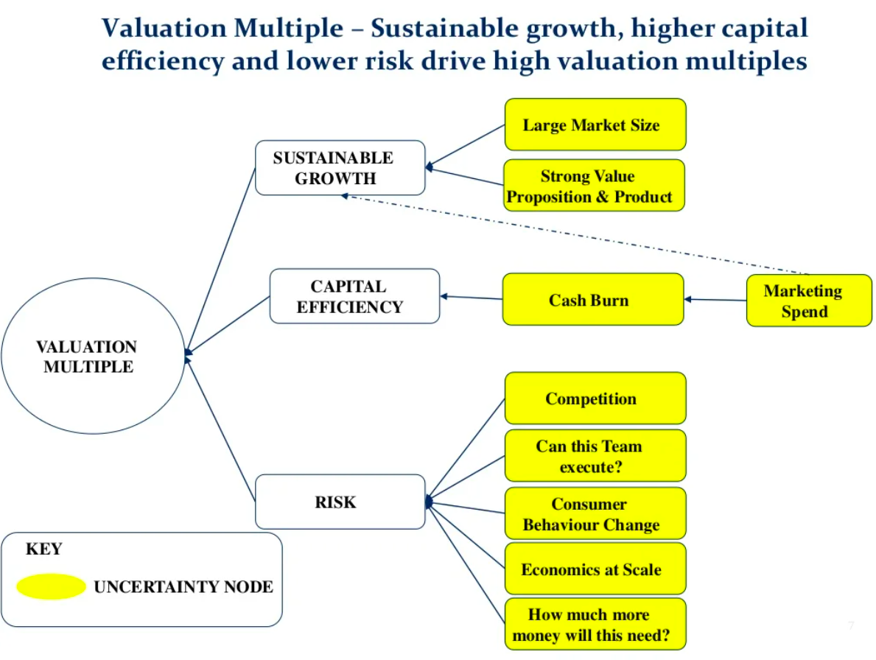
What determines MULTIPLES

Slide 39
Why Multiples EXPAND and Contract
Supply of Money
Immediate Demand and Supply
M&A or Name Lending

