Slide 1
National Income Accounting

Slide 2
Introduction
Why do we study the national income accounts?
    National income accounting provides formal structure for macrotheory models
    Introduces statistics that characterize the economy
Output defined in two ways
    Production side: output = payments to workers (wages), capital (interest and dividends)
    Demand side: output = purchases by different sectors of the economy
Output typically measured as GDP = value of all final goods and services produced within a country over a particular period of time

Slide 3
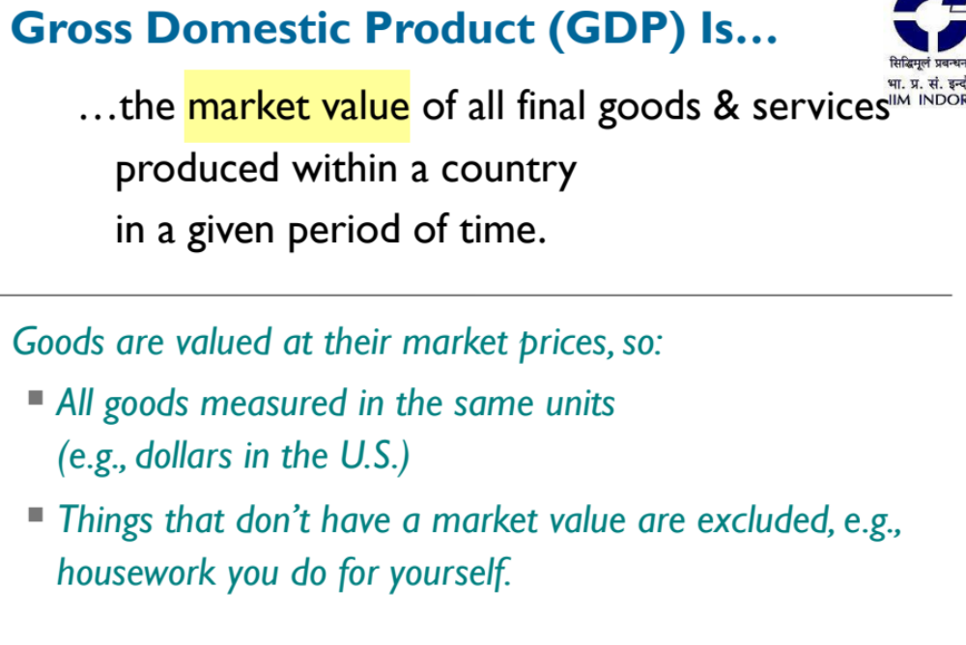

Slide 4
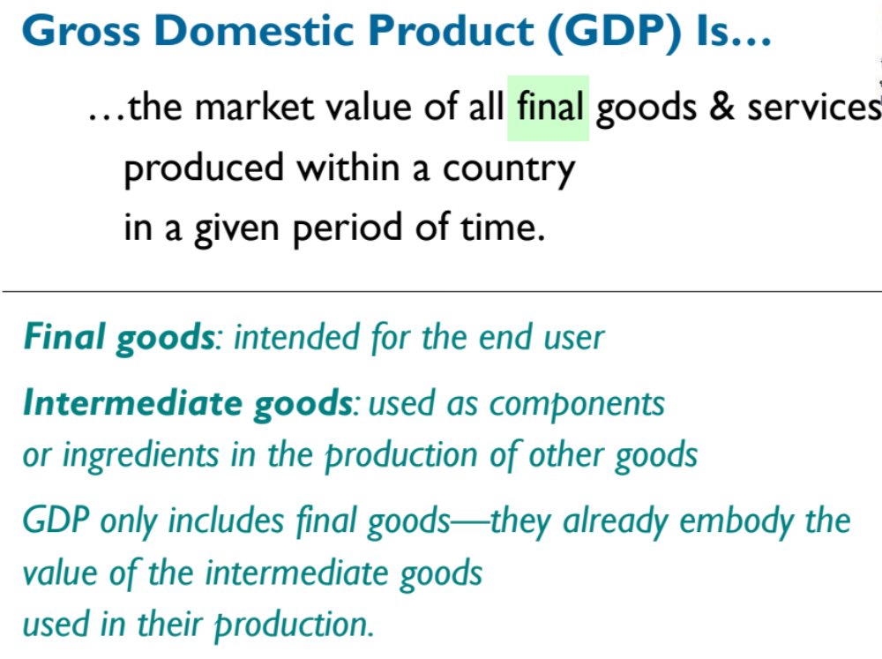

Slide 5
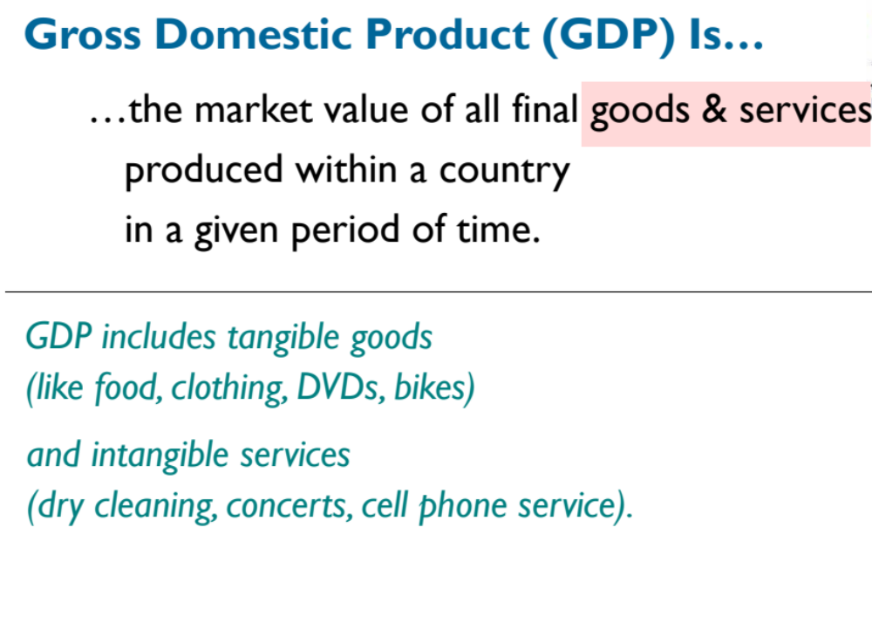

Slide 6

Production Side of the Economy
The production side of the economy transforms inputs (labor, capital) into output (GDP)
  Inputs = factors of production
  Payments to these factors = factor payments
The relationship between inputs and outputs defined by the production function →
where Y = output, N = labor, K = capital
  “Output is a function of labor and capital,” where the functional form can be defined in various ways
  For example: corn = f (land, labor, seed, machines)

Slide 7
The Circular-Flow Diagram
▪A simple depiction of the macroeconomy
▪Preliminaries:
▪Factors of production are inputs like labor, land, capital, and natural resources.
▪Factor payments are payments to the factors of production (e.g., wages, rent).

Slide 8
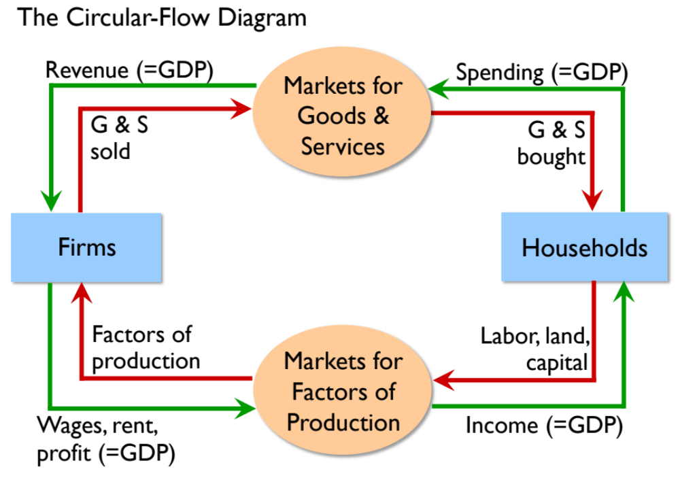

Slide 9

Components of Demand
Total demand for domestic output is made up of four components:
    Consumption spending by households (C)
    Investment spending by firms (I)
    Government spending (G)
    Foreign demand for our net exports (NX)
    The fundamental national income accounting identity is
    (3)

Slide 10
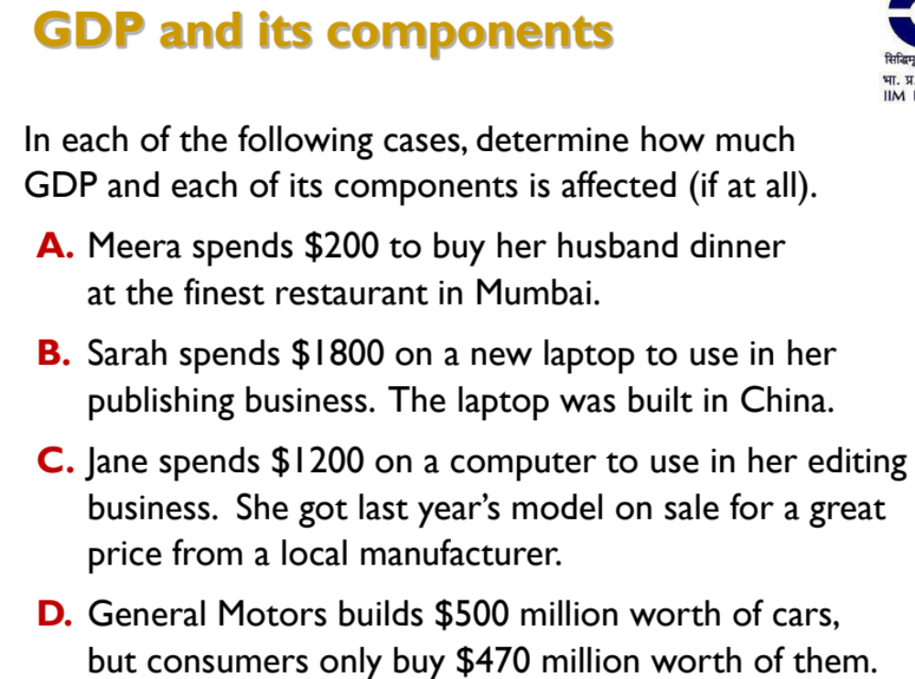

Slide 11
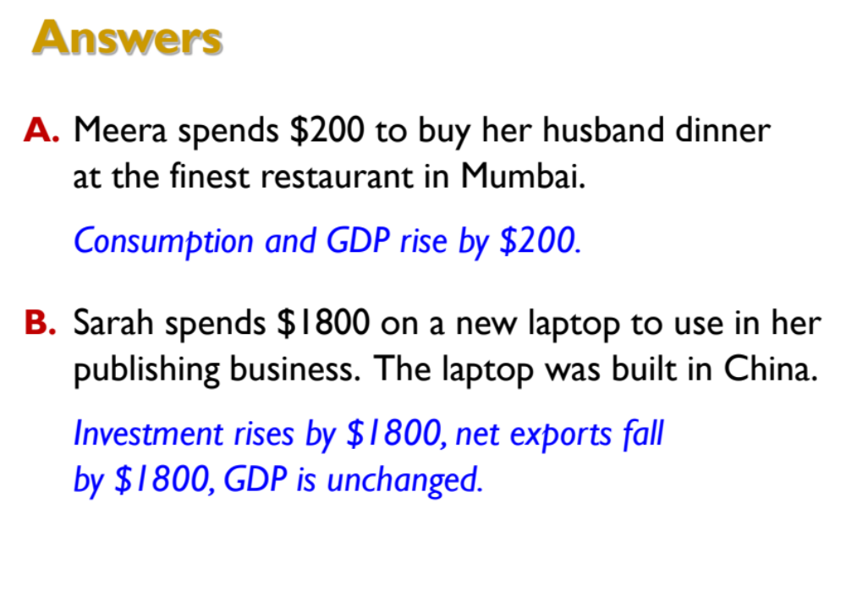

Slide 12
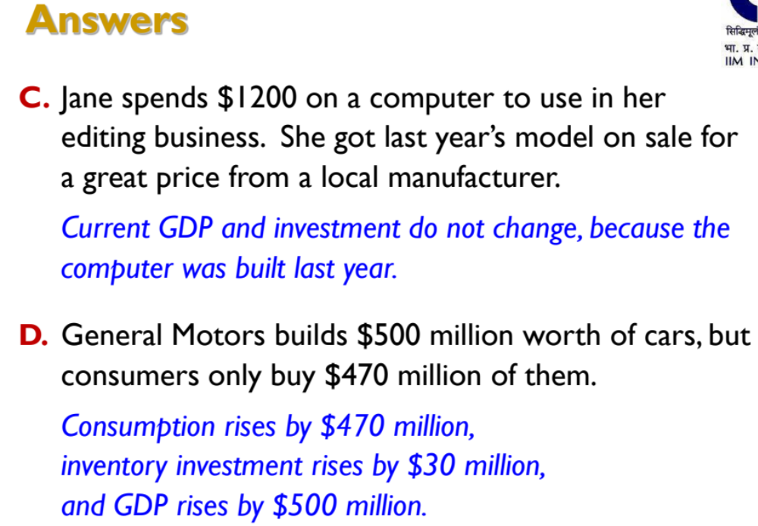

Slide 13
Shanghai: GDP Apostasy
China’s growth story
GDP used as a proxy for success and as a call for future action
  Target to achieve a GDP growth rate of 7.2 percent pr year
  Employment target: Generation of 10 million employment opportunities per year
  Growth targets to provinces
  Provinces/ local government had to finance themselves
  Hukou system: Social security benefits tied to parents’ place of birth

Slide 14
Shanghai: GDP Apostasy
Challenges
Economic
  Ghost cities (loss of million of dollars)
  Seizing of land from poor
  Massive debt: 400 per cent of GDP by 2018
    Concentrated in capital intensive industries
  Underdeveloped financial sector
Environment
  Smog and polluted river
    Use of cheap coal for economic expansion
  Air quality was unsafe
  Only 3% of water supply was safe

Slide 15
Shanghai: GDP Apostasy
Challenges
Social
  Income inequality between urban and rural population – Gini coefficient was 0.474 in 2012
  High migration of labour from rural areas without having access to government benefits
  Increasing informal sector unemployment
  High crime rates

Slide 16
Shanghai: GDP Apostasy
Alternative measures
HDI
  Long and healthy life (life expectancy at birth)
  Being knowledgeable (mean years of schooling for adults and expected years of schooling for children of school entering age)
  Standard of living (GNI per capita)

Slide 17
Shanghai: GDP Apostasy
Alternative measures
Better Life Index
  Housing
  Income
  Jobs
  Community
  Education
  Environment
  Governance
  Health
  Life Satisfaction
  Safety
  Work life balance

Slide 18
Shanghai: GDP Apostasy
Alternative measures
Social Progress Index
  Basic Human needs
  Foundations of Wellbeing
  Opportunity

Slide 19
Shanghai: GDP Apostasy
Alternative measures
Global Competitiveness Index
  Set of institutions, policies and factors that determine the level of productivity of a country
  Basic requirements
  Efficiency enhancers
  Innovation
  Sophistication factors

Slide 20
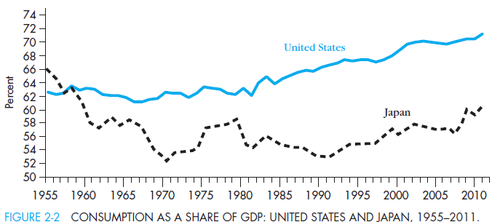
Consumption
Consumption refers to the purchases of goods and services by the household sector
  Includes spending on durable (ex. Cars), non-durable (ex. Food), and services (ex. Medical services)
  Consumption is the primary component of demand
Consumption as a share of GDP varies by country
  Figure 2-2 compares consumption as a share of GDP for the U.S. to Japan

Slide 21
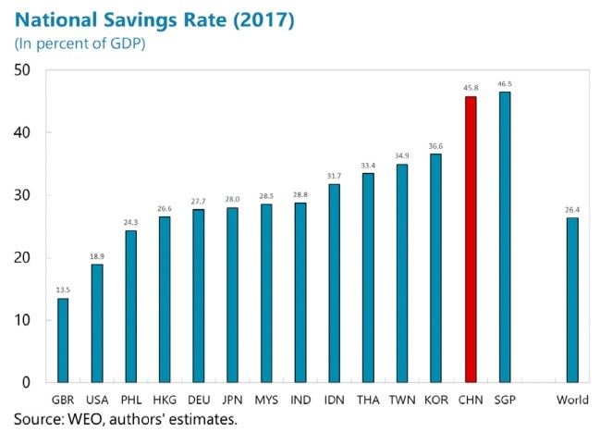

Slide 22
Investment
Investment = additions to the physical stock of capital (i.e. building machinery, construction of factories, additions to firms inventories)
In the national income accounts, investment associated with business sector’s adding to the physical stock of capital, including inventories
  Household’s building up of inventories is considered consumption, although new home constructions considered part of I, not C
Gross investment included in GDP measure, which is net investment plus depreciation

Slide 23
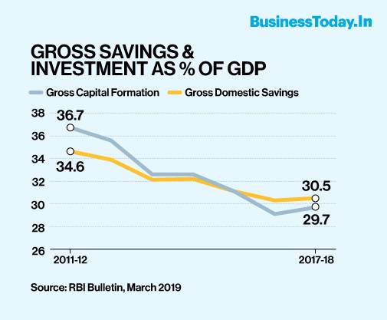
India

Slide 24
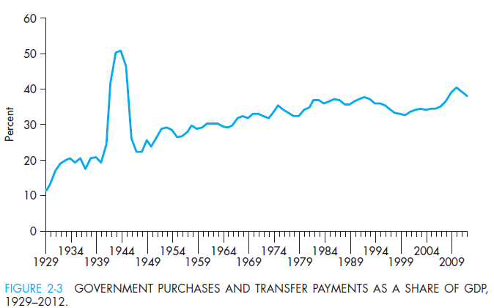
Government
Government purchases of goods and services include national defense expenditures and salaries of government employees
Government also makes transfer payments = payments made to people without their providing a
current service in
exchange
  Ex. Social security, unemployment benefits

Slide 25
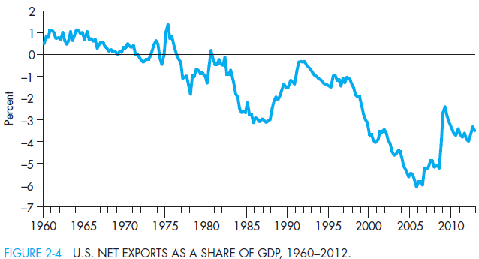
Net Exports
Accounts for domestic purchases of foreign goods (imports) and foreign purchases of domestic goods (exports) → NX = Exports – Imports
  Subtract imports from GDP since accounting for total demand for domestic production
NX can be >, <, or = 0
  U.S. NX has been negative since the 1980’s → trade deficit

Slide 26
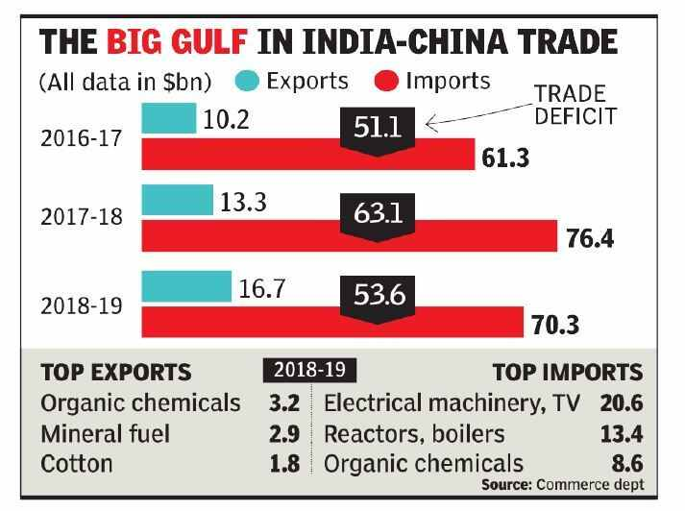

Slide 27
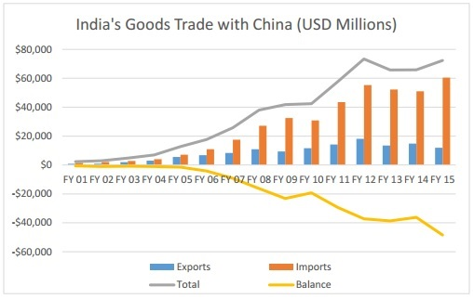

Slide 28
Problems of GDP Measurement
There are three major criticisms of the GDP measure:
    Omits non-market goods and services
      Ex. Work of stay-at-home mothers and fathers not included in GDP
    No accounting for “bads” such as crime and pollution
      Ex. Crime is a detriment to society, but there is no subtraction from GDP to account for it
    No correction for quality improvements
      Ex. Technological improvements are beneficial to the economy, but nothing is added to GDP to account for them
→ Despite these drawbacks, GDP is still considered one of the best economic indicators for estimating growth in an economy

Slide 29
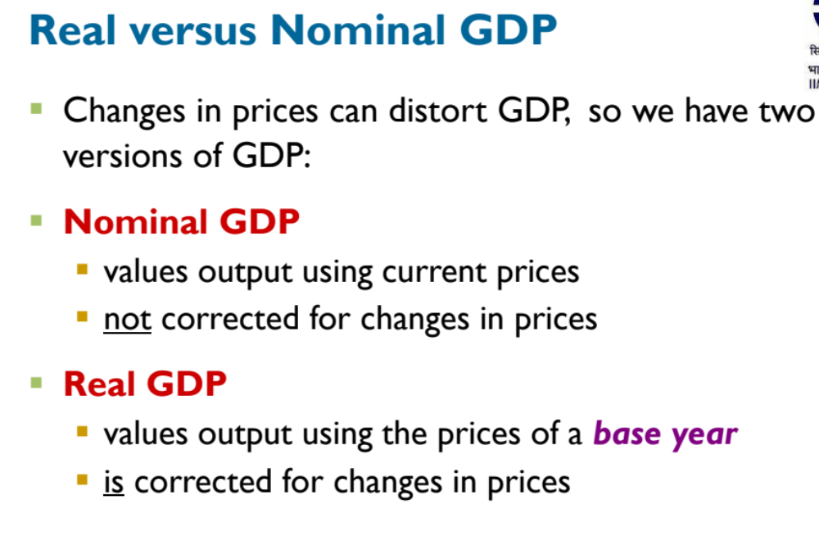

Slide 30
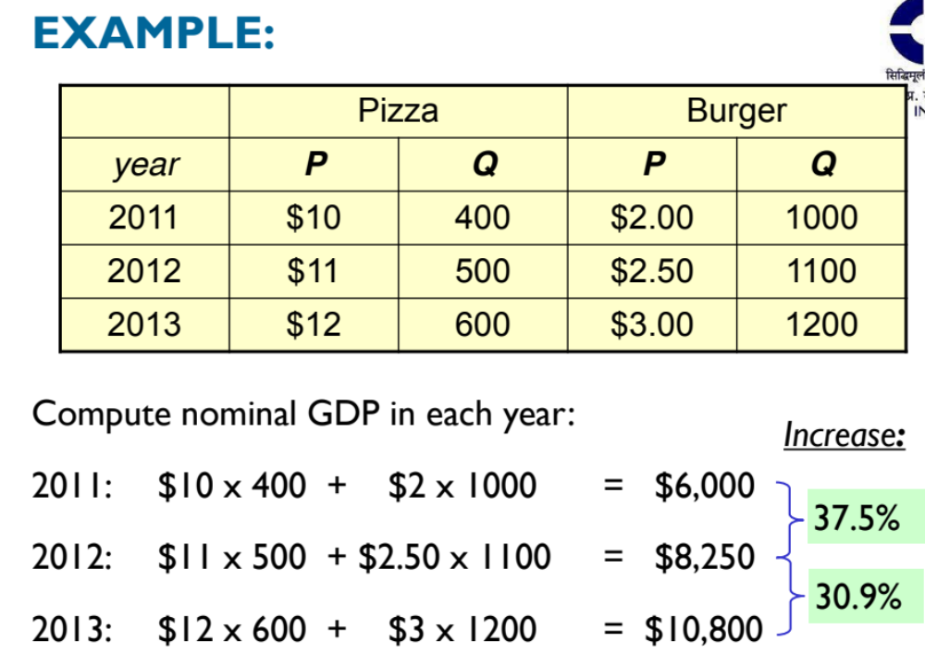
37.5 %
30.9%

Slide 31
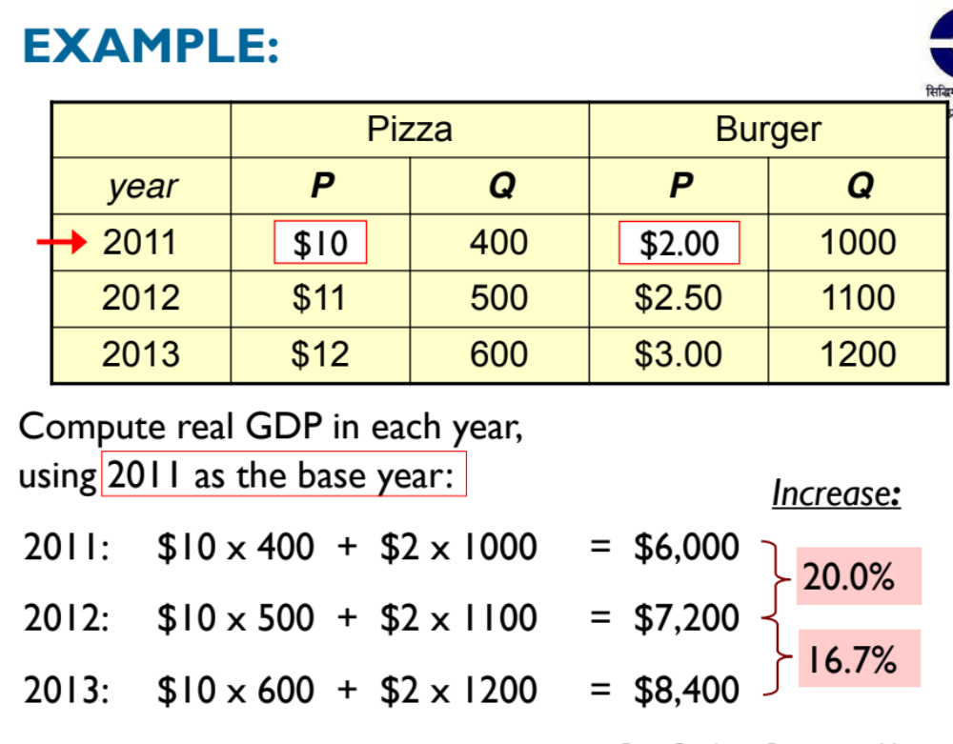

Slide 32
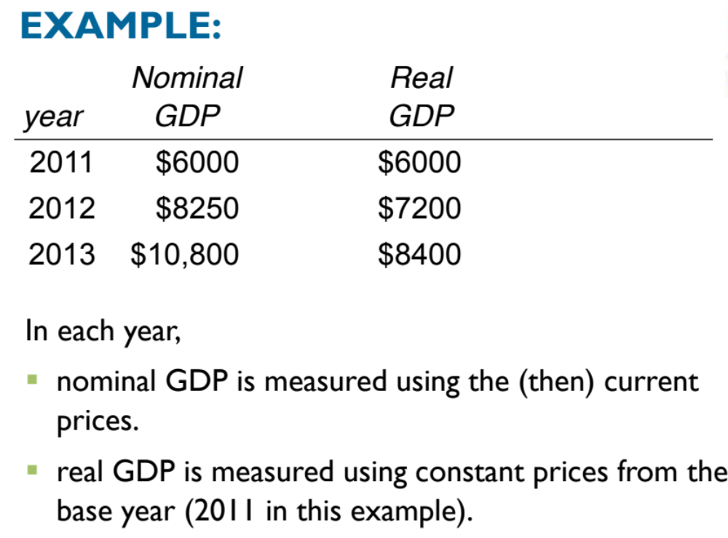

Slide 33
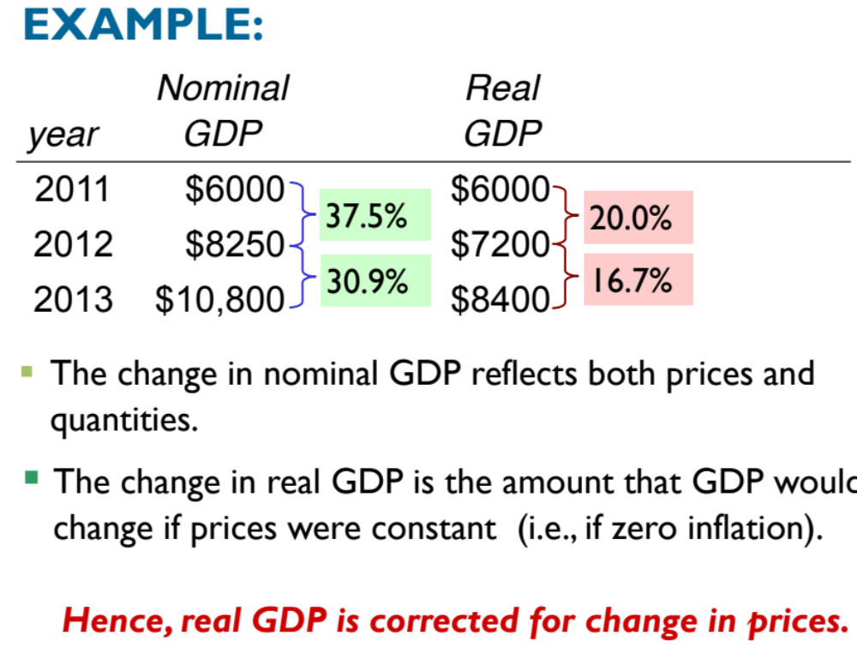

Slide 34
Inflation
Causes of Inflation
  Demand pull
  Cost push
  Inflation expectations
Philips curve and the role of expectations
Gw=-e(u-u*)
  Wages are falling when unemployment rate exceeds the natural rate
  Expectations augmented Philips curve
  I = Iexpected - e(u-u*)

Slide 35
Inflation
Why wages adjust slowly?
  Imperfect information
    With an increase in inflation, the nominal wages of the workers rise which the worker mistake with rise in real wages, hence, willing to work more.
  Coordination problem (price stickiness)
    Firms are not willing to increase the price in response to a policy change in fear of loosing business
    Wages are sticky downwards
  Efficiency wages
    Wages motivate labour

Slide 36
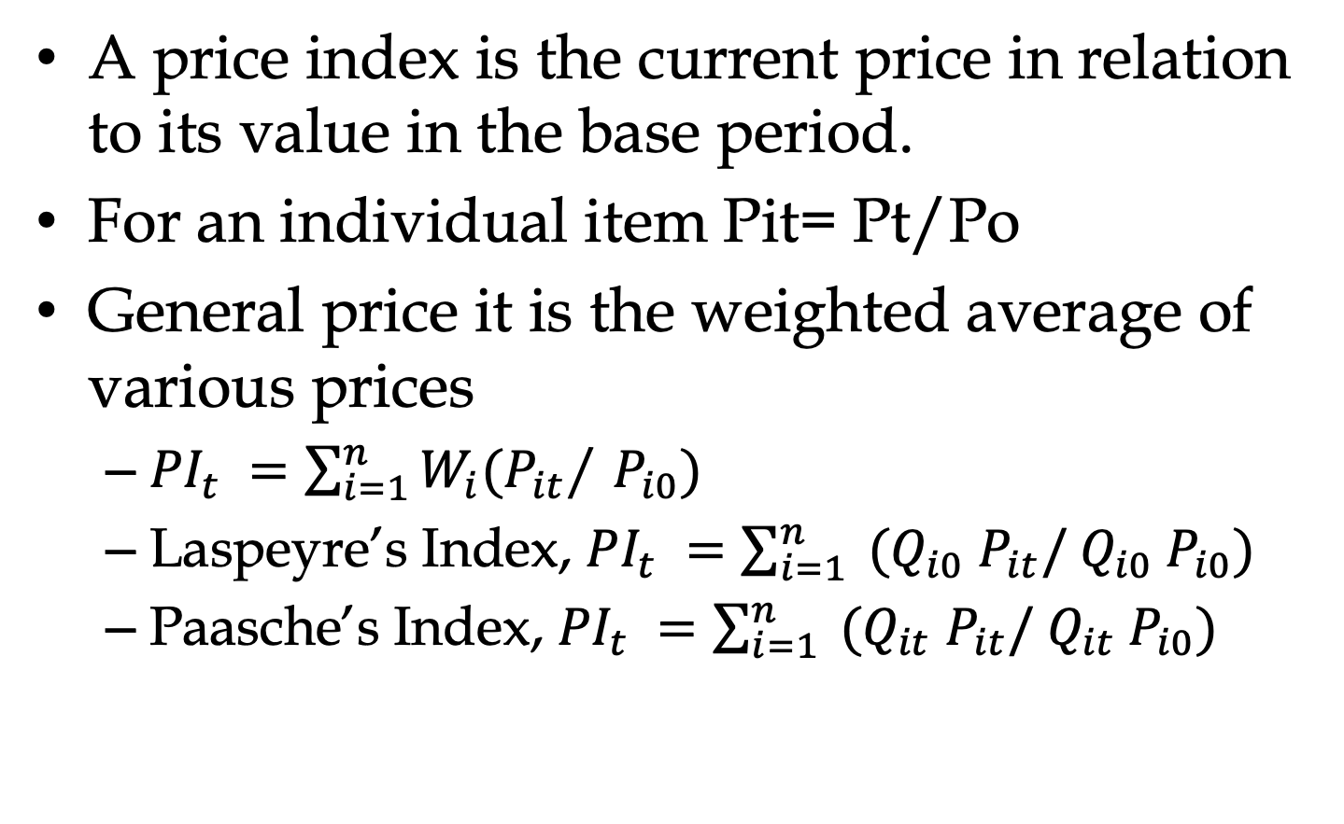
Price Indexes

Slide 37
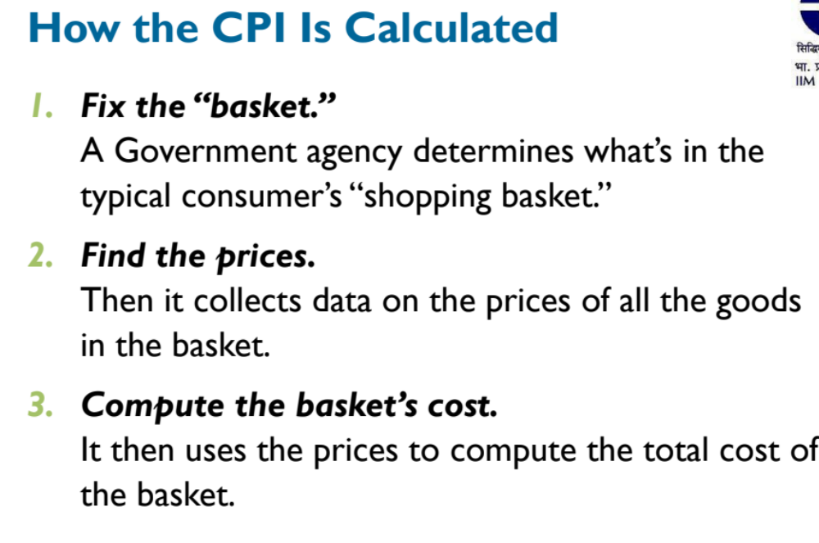

Slide 38
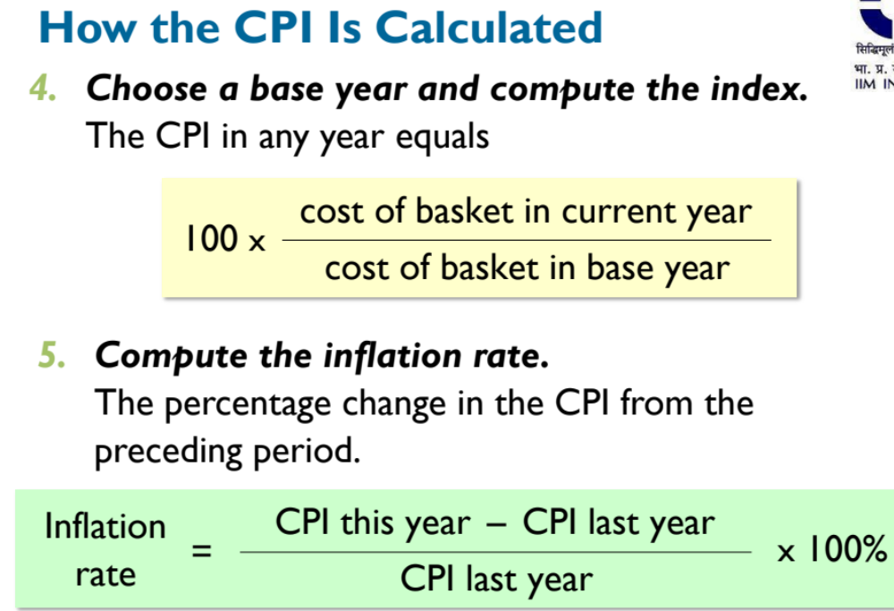

Slide 39
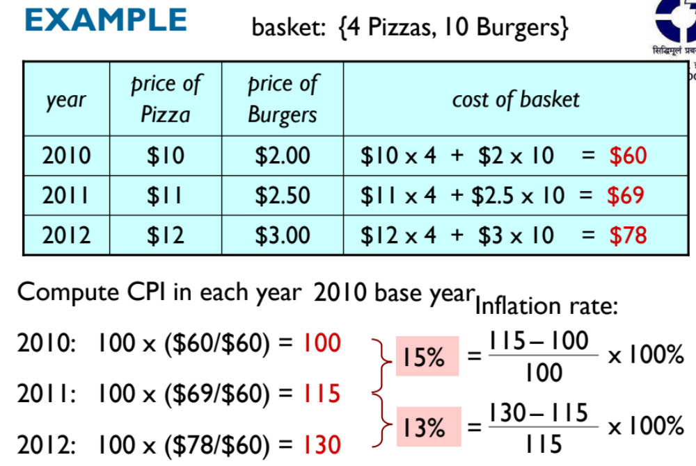

Slide 40
Indexes
 | Rice |  | Shirt |  | House
 | price | quantity | price | quantity | price | quantity
1990 | 10 | 10000 | 120 | 400 | 780 | 50
2020 | 15 | 12000 | 200 | 500 | 1000 | 75
Laspeyre’s price index = (15*10000+200*400+1000*50) / (10*10000+120*400+780*50) = 1.497
Passche’s price index = (15*12000+200*500+1000*75) / (10*12000+200*500+1000*75) = 1.489

Slide 41
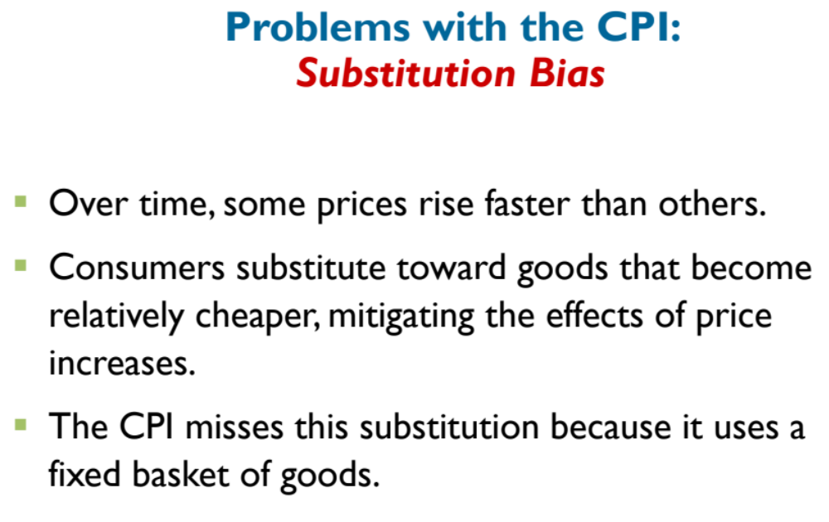

Slide 42
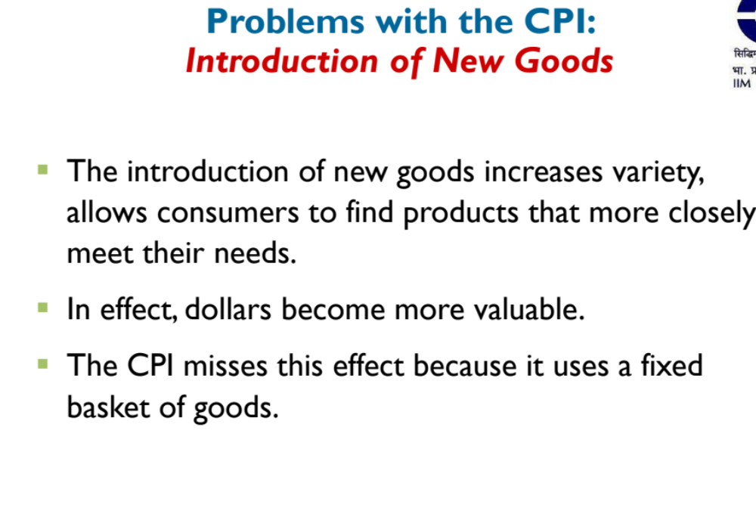

Slide 43
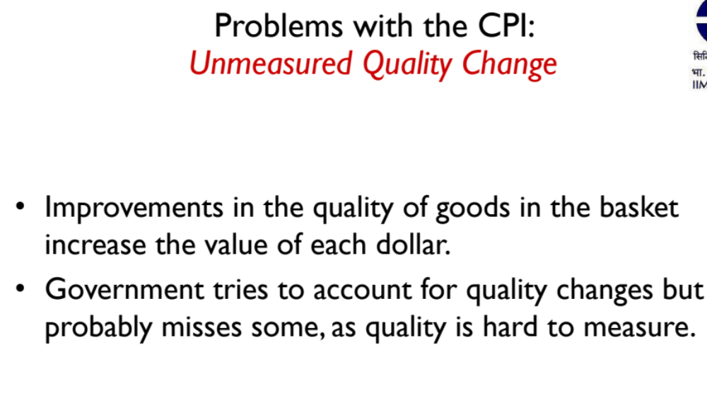

Slide 44
Consumer Price Indices
CPI for Industrial Workers
CPI for urban non-manual employees
CPI for agricultural workers

Slide 45
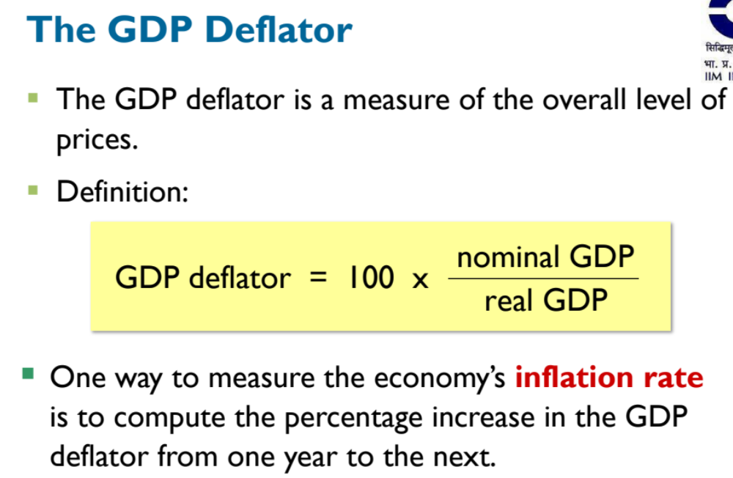

Slide 46
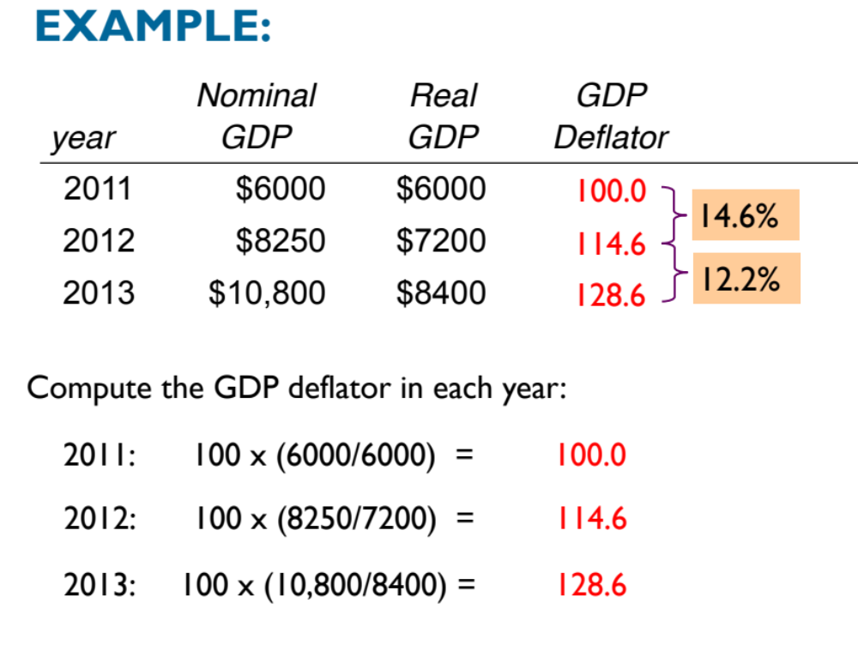

Slide 47
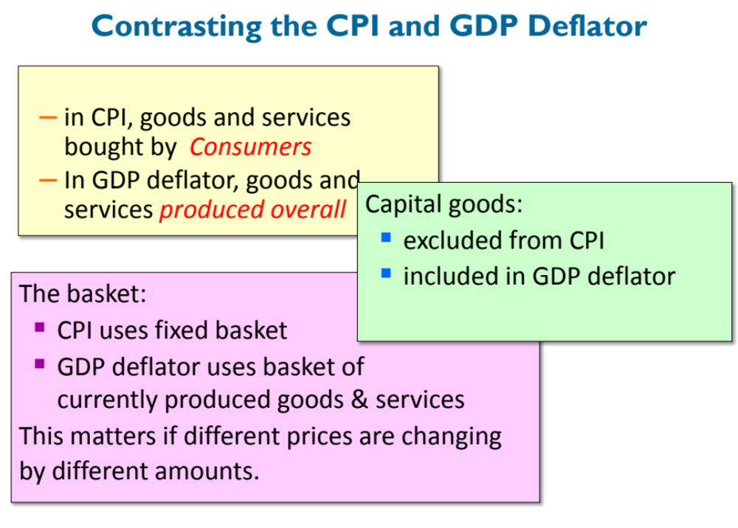

Slide 48
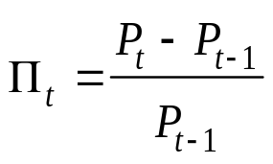
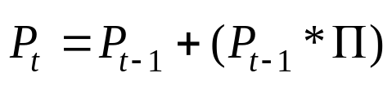
Inflation and Prices
Inflation, Π, is the rate of change of prices:
where P_{t} is today’s price and P_{t-1} is last period’s price
Additionally, , or today’s price equals last year’s price, adjusted for inflation
  If Π > 0, prices are increasing over time → inflation
  If Π < 0, prices are decreasing over time → deflation
How do we measure prices?
  For the macroeconomy, need a measure of overall prices (price index)
  Most common indexes are CPI, PPI, and the GDP deflator

Slide 49
Price Indexes: PPI
PPI measures the cost of buying a fixed basket of goods and services representative of a firm
  Captures the cost of production for a typical firm
  Market basket includes raw materials and semi-finished goods
PPI is constructed from prices at an earlier stage of the distribution process than the CPI
PPI signals changes to come in the CPI and is thus closely watched by policymakers
  → Over long periods of time, the two measures yield similar values and trends for inflation

Slide 50
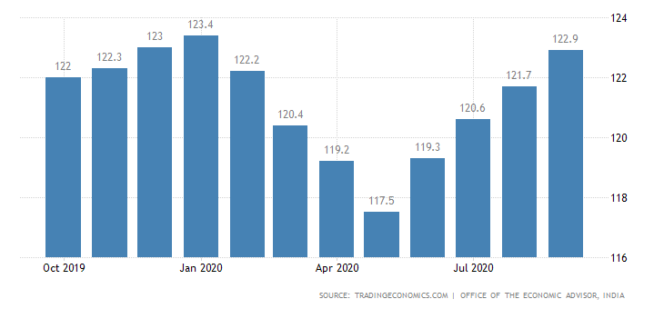
PPI

Slide 51
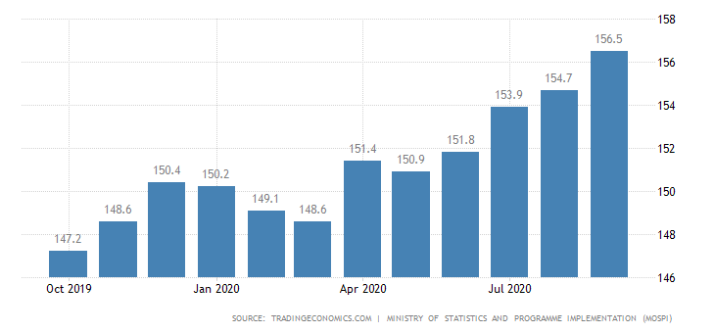
CPI

Slide 52

Interest Rates and Real Interest Rates
Interest rate = rate of payment on a loan or other investment over and above the principle repayment in terms of an annual percentage
  Cost of borrowing money OR benefit of lending money
Nominal interest rate = return on an investment in current dollars
Real interest rate = return on an investment, adjusted for inflation
If R is the nominal rate, and r is the real rate, then we can define the nominal rate as:

Slide 53
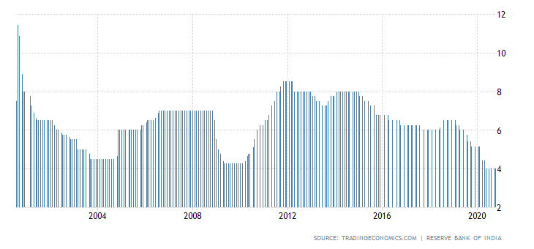
India interest rate

