Slide 1

Essentials of Planning and Managing By Objectives
Dr. Sushil Kumar
Assistant Professor
Entrepreneurship & Strategic Management IIM Visakhapatnam

Slide 2

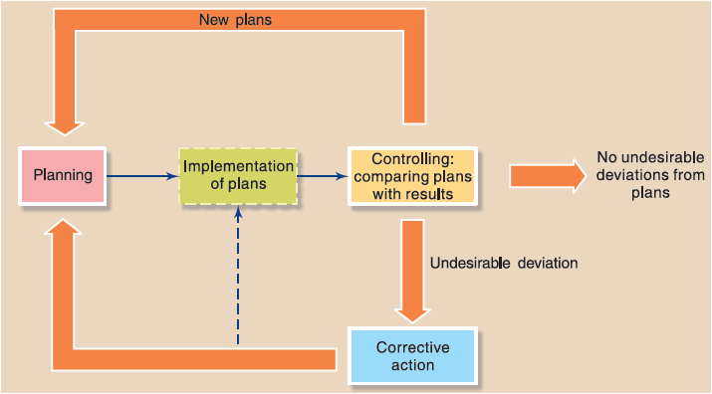
Planning
Planning, Selecting missions and objectives as well as the actions to achieve them, which requires decision making, that is, choosing a course of action from among alternatives.

Slide 3
Types of Plans
Plans can be classified as
Missions or purposes,
Objectives or goals,
Strategies,
Policies,
Procedures,
Rules,
Programs, and
Budgets.

Slide 4
Steps in Planning
Being Aware of Opportunities
Establishing Objectives
Developing Premises
Determining Alternative Courses
Evaluating Alternative Courses
Selecting a Course
Formulating Derivative Plans
Quantifying Plans by Budgeting

Slide 5
Characteristics of Planning
1. Planning is goal-oriented: All plans arise from objectives. Objectives provide the basic guidelines for planning activities. Planning has no meaning unless it contributes in some positive manner to the achievement of predetermined goals.
2. Planning is a primary function: Planning is the foundation of management. It is a parent exercise in management process. It is a preface to business activities.
3. Planning is all-pervasive: Planning is a function of all managers. It is needed and practised at all managerial levels. Planning is inherent in everything a manager does. Managers have to plan before launching a new business.

Slide 6
Characteristics of Planning
4. Planning is a mental exercise: Planning is a mental process involving imagination, foresight and sound judgment. Planning compels managers to abandon guesswork and wishful thinking.
5. Planning is a continuous process: Planning is continuous. It is a never-ending activity. Once plans for a specific period are prepared, they are translated into action.
6. Planning involves choice: Planning essentially involves choice among various alternative courses of action.

Slide 7
Characteristics of Planning
7. Planning is forward looking: Planning means looking ahead and preparing for the future. It means peeping into the future, analysing it and preparing for it.
8. Planning is flexible: Planning is based on a forecast of future events. Since future is uncertain, plans should be reasonably flexible.
9. Planning is an integrated process: Plans are structured in a logical way wherein every lower-level plan serves as a means to accomplish higher level plans. They are highly interdependent and mutually supportive.
10. Planning includes efficiency and effectiveness dimensions: Plans aim at deploying resources economically and efficiently.

Slide 8
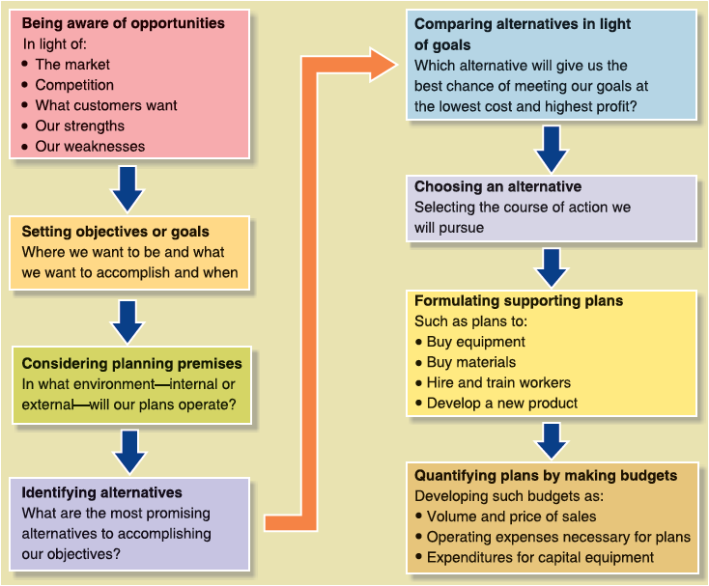
Steps in Planning

Slide 9
Objectives
The Nature of Objectives
Hierarchy of Objectives
Setting Objectives and the Organizational Hierarchy
Multiplicity of Objectives
How to Set Objectives
Quantitative and Qualitative Objectives
Guidelines for Setting Objectives

Slide 10
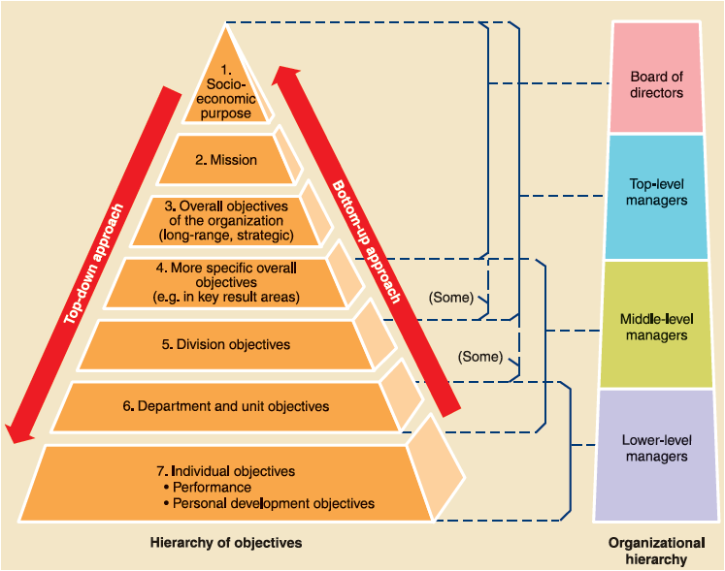
Relationship of objectives and the organizational hierarchy

Slide 11
Evolving Concepts in Management by Objectives
Management by objectives:
a comprehensive managerial system that integrates many key managerial activities in a systematic manner and is consciously directed toward the effective and efficient achievement of organizational and individual objectives.

Slide 12
How to Set Objectives
Nonverifiable Objectives : Examples
  To Make reasonable profit
  To Improve Communication
  To improve productivity of the production department
  To develop better managers
Verifiable Objectives: Examples
To achieve a return on investment of 12 percent at the end of current fiscal year
To increase the production output by 5 percent by December 2024

Slide 13
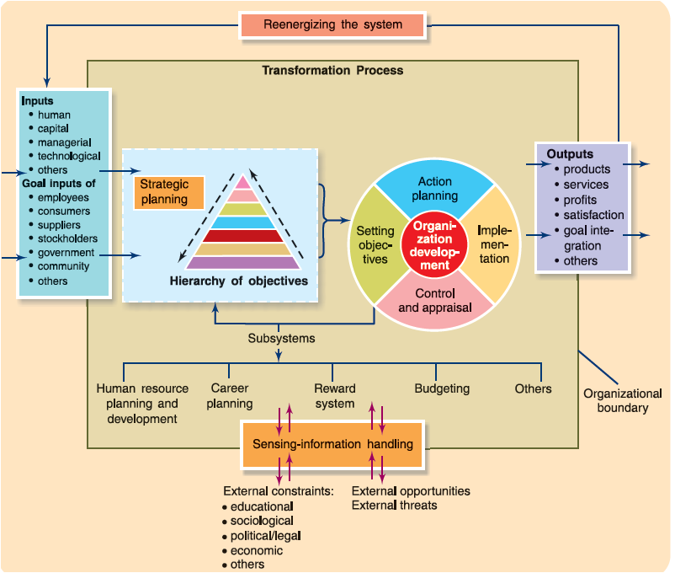
Systems approach to management by objectives

Slide 14
Benefits and Weaknesses of Management by Objectives
  Benefits of Management by Objectives
    Improvement of managing through results-oriented planning
    Clarification of organizational roles and structures as well as delegation of authority according to the results expected from the people occupying the roles
    Encouragement of commitment to personal and organizational goals
    Development of effective controls that measure results and lead to corrective actions
  Failures of Management by Objectives and Some Recommendations

Slide 15
Checklist of Manager Objectives

