Slide 1

Valuation: Principles and Practice

Slide 2
A philosophical basis for Valuation
Many investors believe that the pursuit of 'true value' based upon financial fundamentals is a fruitless one in markets where prices often seem to have little to do with value.
There have always been investors in financial markets who have argued that market prices are determined by the perceptions (and misperceptions) of buyers and sellers, and not by anything as prosaic as cashflows or earnings.
Perceptions matter, but they cannot be all that matter.
Asset prices cannot be justified by merely using the “bigger fool” theory.

Slide 3
Misconceptions about Valuation
Myth 1: A valuation is an objective search for “true” value
Truth 1.1: All valuations are biased. The only questions are how much and in which direction.
Truth 1.2: The direction and magnitude of the bias in your valuation is directly proportional to who pays you and how much you are paid.
Myth 2.: A good valuation provides a precise estimate of value
Truth 2.1: There are no precise valuations
Truth 2.2: The payoff to valuation is greatest when valuation is least precise.
Myth 3: . The more quantitative a model, the better the valuation
Truth 3.1: One’s understanding of a valuation model is inversely proportional to the number of inputs required for the model.
Truth 3.2: Simpler valuation models do much better than complex ones.

Slide 4
Approaches to Valuation
Discounted cashflow valuation: Relates the value of an asset to the present value of expected future cashflows on that asset.
Relative valuation: Estimates the value of an asset by looking at the pricing of 'comparable' assets relative to a common variable like earnings, cashflows, book value or sales.
Contingent claim valuation: Uses option pricing models to measure the value of assets that share option characteristics.

Slide 5
Basis for all valuation approaches
The use of valuation models in investment decisions (i.e., in decisions on which assets are under valued and which are over valued) are based upon
a perception that markets are inefficient and make mistakes in assessing value
an assumption about how and when these inefficiencies will get corrected
In an efficient market, the market price is the best estimate of value. The purpose of any valuation model is then the justification of this value.

Slide 6
Efficient Market Hypothesis (EMH)
Definition 1: A market is said to be efficient with respect to some information set, I_{t}, if it is impossible to make economic profits on the basis of information set I_{t}.
  Economic profits: Profits after adjusting for risk and transaction costs (such as, brokerage fees, investment advisory fees).
      Economic profits = Actual return - Expected return - Transaction costs
      Expected Return: CAPM provides one estimate of expected return. Other estimates: Arbitrage Pricing Theory, Historical Industry Returns.

Slide 7
EMH continued:
Models of Expected Returns
  CAPM: Expected return on stock i = Riskfree rate + (Beta of i with respect to Market)*(Expected return on Market - Riskfree rate)
  APT: Expected return on stock i = Riskfree rate + (Beta of i with respect to Factor 1)*(Expected return on Factor 1 - Riskfree rate) + (Beta of i with respect to Factor 2)*(Expected return on Factor 2 - Riskfree rate) + ...

Slide 8
EMH continued
Models of Expected Returns
  Historical Industry Returns: Expected Return on stock i = Average historical return of other firms in the same industry as company i.

Slide 9
EMH continued:
  Information set:
    Weak form of EMH : Past history of prices of the particular security.
    Semistrong form of EMH: All publicly available information.
    Strong form of EMH: All public and private information.

Slide 10
Efficient Market Hypothesis
Definition 2: If capital markets are efficient then purchase or sale of any security at the prevailing market price is a zero-NPV transaction.
Definition 3 (Technical definition): The capital market is efficient with respect to an information set if and only if revealing that information to all investors would change neither equilibrium prices nor portfolios.

Slide 11

Equity Valuation:
Applications and Processes
Notes:
This chapter provides the introduction to the rest of the text.
We will discuss the terms and framework necessary to understand the more complex subjects that appear later in the book.
The focus in this chapter, and the rest of the text, is on equity valuation. We will discuss the various definitions of value, the valuation process, the application of valuation models, and the roles and responsibilities of analysts.
DISCLAIMER: This presentation is NOT a substitute for the CFA Program curriculum. Candidates should not view this material as reflecting what will be required of them on the CFA exam.

Slide 12
Valuation
Value Estimate
Estimating Variables Related to Future Returns
Examining Values of Comparable Assets
Estimating Proceeds from Immediate Liquidation
Notes:
LOS: Define valuation and intrinsic value and explain sources of perceived mispricing.
Page 2
Valuation is the estimation of an asset’s value using one or more of the three methods shown.
In some cases, all three are used to provide a range of valuations.
These methods are the basis for the rest of the text.

Slide 13
Intrinsic Value
Asset Value Given a
Complete Understanding of an Asset’s Characteristics
“True” or “Real” Value
Not Always Equal
to Market Price
Notes:
LOS: Define valuation and intrinsic value and explain sources of perceived mispricing.
Page 2–4
Intrinsic value is the value of the asset given a (hypothetically) complete understanding of the asset and its investment characteristics (e.g., risk and future cash flows).
The “true” or “real” value of the asset to an individual
Not necessarily the asset’s market price
If the market price > Intrinsic value → Asset is overvalued.
If the market price < Intrinsic value → Asset is undervalued.

Slide 14
Asset Mispricing
Efficient Market Theory:
Intrinsic value = Market price
V_{E} – P = (V – P) + (V_{E} – V)
Market error
Sources of perceived mispricing
Analyst error
Notes:
LOS: Define valuation and intrinsic value, and explain sources of perceived mispricing.
Pages 2–3
The efficient market theory states that information about an asset is reflected in its value so that Market price = Intrinsic value.
Challenges to the efficient market theory:
Grossman–Stiglitz paradox: If assets were always correctly priced, then analysts would not have an incentive to find undervalued stocks.
Trading costs and unclear values: In the case of equity, it is very difficult to determine what the future returns will be. Furthermore, trading costs prevent traders from exploiting divergences from intrinsic value that are less than trading costs.
The formula provides the two sources of perceived mispricing.
V_{E} – P = (V – P) + (V_{E} – V),
where
V_{E} = estimated value
P = market price
V = intrinsic value
The formula says that the difference between valuation estimates and market price is true mispricing, which is the difference between the intrinsic value and the market price less the error in the market’s estimate and the difference between estimated value and the intrinsic value less the error in the analyst’s estimate.
An analyst wants to exploit the first term and minimize the second term. An analyst wants to act on perceived asset mispricing when it arises from the first term, not from the second term.
Furthermore, an analyst must believe not only that the market is wrong but also that it will eventually correct itself within the investment horizon. So to profit, there must be both market mispricing and a catalyst that will eventually cause the market to correct mispricing.
An analyst’s goal is to earn alpha (abnormal return) less a return in excess of what is expected given the amount of risk taken.
Text Integration Note: Alpha and excess returns are discussed in Chapter 2 of the Equity Asset Valuation text.

Slide 15
Going Concern vs. Liquidation Value
Going-concern value: Firm will continue in its business activities
  Firm will continue to sell its goods and services
  Firm will use its assets for value maximization
  Firm will access its optimal sources of financing
Liquidation value: Firm will be dissolved
  Firm assets will be sold separately
Going-concern value > Liquidation value
  Value added from asset synergy
  Value added by managerial skills
Notes:
LOS: Explain the going-concern assumption and contrast a going-concern value to a liquidation-value.
Page 4
The majority of this text focuses on determining the going-concern value of the firm (i.e., its value under the assumption that the firm continues).
Going-concern value is greater than liquidation value for the reasons stated on the slide. Especially when in liquidation, the assets have to be immediately liquidated (e.g., perishable assets). In an orderly liquidation, value would be higher.
The definition of value most relevant to public company valuation is intrinsic value. In most cases, the best estimate of intrinsic value is the going-concern value.
15

Slide 16
Other Definitions of Value
Fair Market Value
Well-informed, willing buyer and seller
Fair Value
Financial reporting
Investment Value
Value to specific buyer
Notes:
LOS: Describe definitions of value and justify which definition of value is most relevant to public company valuation.
Pages 4–5
Although intrinsic value is the relevant value for public equity, different measures of value are needed for other situations.
Fair market value
The price at which an asset would change hands between a willing buyer and willing seller when both are well informed. For example, a private business could be valued in this context. Fair market value is sometimes used to assess taxes.
Fair value
The price used for financial reporting (e.g., when measuring the impairment of an asset).
Investment value
The value to a particular buyer that incorporates the synergies the asset might have for that particular buyer.

Slide 17
Uses of Equity Valuation
Stock Selection
Is the stock under- or overvalued?
Inferring Market Expectations
What does the security price say about expectations?
Evaluating Corporate Events
What is the effect on firm value from a merger?
Fairness Opinions
Is the value paid for the firm fair?
Notes:
LOS: Describe applications of equity valuation.
Pages 5–7
Equity valuation is used for a variety of reasons. We will cover eight potential reasons, with the last four covered on the next slide.
1) Stock selection: The analyst must determine whether a stock is fairly valued relative to its intrinsic value and the value of other securities.
2) Inferring (or extracting) expectations: What does the current price say about the market’s expectations for the stock? What is the market saying about the firm’s fundamentals (the firm’s profitability, financial strength, and risk)?
An analyst will want to examine the market’s expectations for their reasonableness.
Expectations are sometimes used to value a comparable firm.
We will cover examples of expectation extraction in later chapters.
3) Evaluating corporate events: If, for example, a firm merges with another firm, how does this affect firm valuation? Other events that can be analyzed include the following:
Acquisitions: A merger in which one firm is the acquirer.
Divestiture: A firm sells a major component of its business.
Spin-off: A firm separates one of its components and transfers ownership to its shareholders.
Leveraged buyout: A firm is acquired using significant levels of debt (leverage).
4) Rendering fairness opinions: When a firm is sold, a third party may be asked to value the firm to determine whether the value is fair.

Slide 18
Uses of Equity Valuation
Evaluating Business Strategies
What is the effect on firm value of a new strategy?
Communicating with Analysts and Shareholders
How is firm value being affected?
Appraising Private Businesses
What is the value of a private firm?
Compensation
What is the value of equity compensation?
Notes:
LOS: Describe applications of equity valuation.
Pages 5–7
Other uses of equity valuation include the following:
5) Evaluating business strategies and models: To maximize shareholder wealth, companies should examine the effect on firm value of various firm strategies.
6) Communicating with analysts and shareholders: Valuation is important to shareholders and analysts and will be an important part of any communication with them.
7) Appraising private businesses: Determining the value of private businesses is important for tax reasons and transfer of ownership.
An example of the former is when an estate is valued for estate tax purposes.
An example of the latter is when partnership interests are transferred among limited partners.
Private firm valuation is also important when preparing a firm for its initial public offering (IPO) of stock.
8) Share-based payment (compensation): Executives are sometimes paid with equity-type payments (e.g., stock options). Being able to calculate equity value is important in this case.

Slide 19
The Valuation Process
1. Understanding the Business
2. Forecasting Company Performance
3. Selecting the Appropriate Valuation Model
Forecast sales, earnings, dividends, and financial position
Base selection on company characteristics
Industry and competitive analysis
Financial statement analysis
Notes:
LOS: Describe questions that should addressed in conducting an industry and competitive analysis.
Pages 7–8, 17–18
The valuation of equity requires five steps:
Understanding the business provides a basis for forecasting and includes
industry analysis,
an analysis of the firm’s competitive position, and
an analysis of the firm’s financial statements.
2) Forecasting company performance includes
forecasts of sales, earnings, dividends, and future financial position (pro forma analysis) provide the inputs for valuation models;
a top-down or bottom-up approach can be used.
In the top-down approach, the analyst starts with a forecast for the economy and then extrapolates this forecast to an industry forecast and then to a firm forecast.
In the bottom-up approach, the analyst uses firm-level information to forecast firm and industry performance.
3) Selecting the appropriate valuation model is based on firm characteristics and the purpose of the valuation.

Slide 20
The Valuation Process
4. Using Forecasts in a Valuation
Use judgment in valuation application
Valuation opinions
Strategic decisions
Investment recommendations
5. Applying the Valuation Conclusions
Notes:
LOS: Describe questions that should addressed in conducting an industry and competitive analysis.
Pages 7–8
The last two steps in the valuation of equity are the following:
4) Using the forecasts in a valuation
will require judgment in its application.
5) Applying conclusions from the valuation; valuation is used in
making investment recommendations for a particular stock,
providing an opinion regarding whether the price of a transaction is fair, and
providing input into strategic decisions regarding potential investment.

Slide 21
Understanding the Business: Industry Analysis
(Porter’s Competitive Advantage)
Rivalry
New Entrants
Buyer Power
Supplier Power
Substitutes
Notes:
LOS: Describe questions that should addressed in conducting an industry and competitive analysis.
Pages 8–9
To forecast the firm’s financials, an analyst should have an understanding of the industry structure and economic conditions in which the firm operates.
For example, an analyst would want to know that in the airline industry, labor and fuel costs are the two largest components of costs. The analyst could then use forecasts of fuel costs in forecasts of future earnings. The analyst should incorporate sensitivity analysis, in which the sensitivity of earnings to ranges of fuel costs is examined.
One framework for understanding an industry is provided by Michael Porter. In his framework, there are five forces affecting industry profitability:
Intra-industry rivalry: Less rivalry enhances industry profitability.
New entrants: High barriers to entry (e.g., high start-up costs) reduces competition and enhances industry profitability.
Substitutes: When there are fewer substitutes for industry goods and services (or when the costs of switching are high), firms have more pricing power and industry profitability is enhanced.
Supplier power: When there are many suppliers of industry inputs, competition among suppliers increases and industry profitability is enhanced.
Buyer power: When there are many buyers of industry products, buyers have less negotiating power and industry profitability is enhanced.
Analysts should also be aware of other factors for long-term industry profitability, such as demographic trends.

Slide 22
Understanding the Business: Competitive Analysis
Low Cost
Differentiation
Cost Leadership
Cost Focus
Differentiation
Differentiation Focus
Broad
Target
Market
Narrow
Target
Market
Notes:
LOS: Describe questions that should addressed in conducting an industry and competitive analysis
Pages 8–10
In addition to understanding the industry environment, an analyst should also understand the firm’s competitive position within its industry and the firm’s competitive strategy.
Porter states that there are three generic strategies for achieving above-average performance:
Cost leadership: The firm is the lowest-cost producer in the industry and offers comparable products priced at the industry average.
Differentiation: The firm offers unique products or services that command a premium price.
Focus: The firm achieves a competitive advantage within a target segment through either
cost leadership, or
differentiation.

Slide 23
Issues in Financial Statement Analysis
Non-Numeric Analysis
Mature Firms vs. Start-Ups
Sources of Information
Quality of Earnings
Regression toward the Mean
Notes:
LOS: Describe questions that should addressed in conducting an industry and competitive analysis.
Pages 10–17
The valuation of equity also requires an analysis of the firm’s financial statements. Issues that can arise when using financial statements for analysis include the following:
When analyzing a firm’s financial statements, the analyst should also consider non-numeric, conceptual factors. For example, the analyst should consider such intangible assets as licenses.
A firm’s historical statements will change over time, and in general, there is a regression toward the mean. Firms with exceptional performance usually find that other firms will enter the market and compete away their advantage. Firms with weak performance will often be restructured and see their results improve. Many analysts assume that over the long term, firm performance will converge to that of the economy’s mean.
Financial ratio analysis is more useful for mature firms with relatively stable, established performance. For start-ups, nonfinancial measures may be more useful. For example, a biotechnology firm may not have any profits but could be evaluated on the success of its clinical trials.
There are many sources of information available for industry and financial statement analysis, including
firm regulatory filings (e.g., Form 10-K in the United States),
company press releases,
investor relations materials,
company websites, and
third-party sources, such as industry organizations.
A firm’s accounting statements may not be an accurate reflection of its true economic performance. An analyst should scrutinize a firm’s financial statements using quality of earnings analysis. Research has found that a firm’s cash flow is a better predictor of future performance than its reported net income (i.e., cash flow exhibits more persistence). So, the analyst should scrutinize a firm’s earnings carefully. (See the next slide for examples of quality of earnings analysis.)

Slide 24
Quality of Earnings Examples
Example | Potential Interpretation
Firm A recognizes revenue early using bill-and-hold sales | Potentially poor underlying performance, reported income ⇑, and future income ⇓
Firm B capitalizes product development expenses | Potentially poor underlying performance, reported income ⇑, and future income ⇓
Firm C has large amounts of off-balance-sheet financing | Liabilities are understated
Firm D increases its loan-loss reserves | Current income ⇓ so as to inflate future performance
Notes:
LOS: Describe questions that should addressed in conducting an industry and competitive analysis.
Pages 13–17
In each of these examples, the quality of earnings is potentially low. The analyst should adjust the reported earnings and financial information to more accurately reflect the firm’s actual performance.
Firms A and B inflate current income at the expense of lowering future income. Firm D does the opposite in an attempt to show large improvements in the future. In any case, the firm’s financial statements would provide a misleading picture of firm performance.
Firm C has large amounts of off-balance-sheet debt (e.g., leases), which results in an understatement on the financial statements of firm financial leverage and financial risk.

Slide 25
Quality of Earnings Risk Factors
Poor quality of accounting disclosures
Related-party transactions
Frequent management or director turnover
Pressure to make earnings targets
Auditor conflicts of interest or frequent turnover
Incentive compensation tied to stock price
External or internal pressures on profitability
Debt covenant pressures
Previous regulatory/reporting issues
Notes:
LOS: Describe questions that should addressed in conducting an industry and competitive analysis.
Page 17
The following risk factors indicate that the firm may be using deceptive accounting practices to obscure the firm’s actual current or future performance:
Poor quality of accounting disclosures (e.g., lack of discussion of negative factors).
Related-party transactions (e.g., loans to officers).
Frequent management or director turnover.
Pressure to make earnings targets, especially when combined with an aggressive management.
Auditor conflicts of interest or frequent turnover in auditors (e.g., auditor also performs material nonaudit services).
Incentive compensation tied to stock price; although management and director compensation being tied to the stock price is usually desirable, it may also create an incentive for excessive
risk taking.
External or internal pressures on profitability (e.g., industry is declining or firm is losing market share).
Debt covenant pressures (e.g., management may misreport financial figures in order to meet debt covenants, where covenants are the firm’s agreements with debtholders).
Previous regulatory/reporting issues (e.g., a firm that violated securities laws in the past may be inclined to do it again).

Slide 26
Valuation Models
Absolute Valuation Models
Present value models
Relative Valuation Models
Price ratios
Dividend discount models
Free cash flow to equity
Free cash flow to the firm
Residual income
Asset-based models
Price-to-earnings ratio
Price-to-book-value ratio
Price-to-cash-flow ratio
Enterprise value multiples
Notes:
LOS: Contrast absolute and relative valuation models and describe examples of each type of model.
Pages 18–22
Valuing equity is more difficult than valuing bonds. Bonds have indenture agreements—legal binding contracts that specify the future payments. There are no legally required payments with stock, and the discount rate is more difficult to determine.
Absolute valuation models provide an asset’s intrinsic value and compare it with the current market value.
Present value models (discounted cash flow models) are the most important type. The value of an asset is the present value of its future cash flows.
Types of present value models:
Dividend discount: The value of common stock is the present value of future dividends.
Free cash flow to equity: The value of common stock is the present value of all future cash flows available to stockholders after senior claimants (e.g., debtholders) are paid.
Free cash flow to the firm: The value of the firm is the present value of all future cash flows available to the firm.
Residual income: The value of common stock is the present value of future net income in excess of the required return on equity.
Asset-based models: The value of the firm is the market value of its assets. Asset-based valuation is frequently used with natural resource firms for which the price of their commodity assets can be readily determined.
Relative valuation models provide the asset’s value by referencing it to a similar asset. These models are based on the idea that similar assets should sell for similar prices.
Price ratios are the ratio of stock price to a firm fundamental.
Examples:
Price-to-earnings ratio (most common relative value ratio)
Price-to-book-value ratio
Price-to-cash-flow ratio
Enterprise value multiples are the ratio of firm value to an earnings measure.
Example: ratio of enterprise value to EBITDA
Comparing a stock with a group of similar stocks byusing relative value is referred to as the method of comparables.
Relative valuation models are used in pair trading: buying an undervalued stock and shorting a similar overvalued stock.
Text Integration Note: Dividend discount, free cash flow, residual income, and relative valuation models are discussed in greater detail in Chapters 3–6 of the Equity Asset Valuation text.

Slide 27
Choosing a Valuation Model
What are the characteristics of the company?
What is the availability and quality of data?
What is the purpose of the valuation?
Notes:
LOS: Explain broad criteria for choosing an appropriate approach for valuing a given company.
Pages 24–25
What are the characteristics of the company?
For example, a firm with few tangible assets would not be valued using an asset-based approach.
What is the availability and quality of data?
For example, a dividend discount model cannot be applied to a firm that does not pay dividends. Another model, such as a free cash flow model, would have to be applied.
A firm with negative earnings (i.e., losses) cannot be valued by using a relative P/E approach.
What is the purpose of the valuation?
For example, if the investor is going to buy a large stake in a firm and be able to control the firm, a free cash flow to the firm model may be preferred over a dividend discount model because the investor will have control of the firm’s cash flows.
In reality, most analysts use more than one approach to value equity, given the uncertainty in valuing equity.

Slide 28
Other Valuation Model Issues
Sum-of-the-Parts Valuation
Sensitivity Analysis
Situational Adjustments
Notes:
LOS: Describe sum-of-the-parts valuation and conglomerate discounts.
LOS: Explain broad criteria for choosing an appropriate approach for valuing a given company.
Pages 22–28
Sum-of-the-parts valuation (or breakup value or private market value)
In some cases, it may be appropriate to value a firm as the sum of its individual operating segments. This approach is appropriate when
a firm’s operating segments have distinct economic influences and/or
the operating segments have different sets of relevant competitor firms.
An analyst would develop separate valuations using each segment’s earnings and then add them up.
Sometimes a conglomerate discount is applied to firms that have multiple, unrelated segments because conglomerates can be inefficient and poorly managed.
Sensitivity analysis
An analyst will usually want to determine how equity valuation changes given a change in discount rates, in the firm’s competitive environment, or in some other variable. This approach provides a range of valuations that can be used to make the investment decision.
Situational adjustments: Different situations call for different adjustments to the equity valuation.
A control premium is added if the investor will buy enough of the firm to control it.
A marketability discount is applied if the stock is not publicly traded.
An illiquidity discount is applied if the stock is publicly traded but not very liquid.
A blockage factor discount is applied if the investor is going to sell a block of shares that is large relative to the stock’s average trading volume.

Slide 29
Analyst Roles
Sell-Side Analysts
Buy-Side Analysts
Corporate Analysts
Independent Analysts
Notes:
Pages 26–28
Sell-side analysts: An analyst that works at a brokerage firm in which his or her research reports are disseminated to retail and institutional brokerage clients. The research reports provide the analyst’s investment recommendations.
Buy-side analysts: An analyst that works for an investment management firm, a bank trust department, or an institutional investor to provide investment recommendations.
Corporate analysts: An analyst that may help manage a firm’s pension plan or identify and value possible acquisition targets. Analysts at investment banks also assist in acquisitions.
Independent analysts: An analyst that works for independent vendors of information that provide firm valuations or corporate data.
When analysts perform their valuation roles well, they also
help clients make the correct buy and sell decisions,
contribute to the efficiency of capital markets so that asset prices reflect underlying value and capital flows at its highest and best use, and
serve as monitors of management performance.

Slide 30
Analyst Responsibilities:
The Code of Ethics:
Members of …… Institute must … use reasonable care and exercise independent professional judgment when conducting investment analysis, making investment recommendations, taking investment actions, and engaging in other professional activities.
Notes:
Pages 28–32
Analysts should meet standards of competence and standards of conduct.
They should perform due diligence in their valuation analysis.
Analysts who are CFA Institute members have a responsibility to adhere to the CFA Institute Code of Ethics and Standards of Professional Conduct. Exhibit 3 in the text lists eight Standards of Professional Conduct particular to analyst’s research reports.

Slide 31
Research Reports
Effective research reports include the following:
  Timely information
  Clear, incisive language
  Objective and well-researched information
  Clearly distinguished facts and opinions
  Consistent analysis, forecasts, valuation, and recommendations
  Sufficient disclosure of information
  Key risk factors
  Disclosures of conflicts of interest
Notes:
Pages 28 – 32
Analyst research reports provide the analyst’s opinion regarding the security’s intrinsic value. The reader will expect the report to contain persuasive, supporting arguments.
An effective research report
contains timely information regarding the firm’s financial and operating results and the macroeconomic and industry environment.
is written in clear, incisive language.
is objective and well researched, with key assumptions clearly identified. When the report specifies a target price, the report should provide the basis for the intrinsic value, the time it will take the security to reach the target price, and information regarding the certainty of the forecast.
distinguishes clearly between facts and opinions.
contains analysis, forecasts, valuation, and a recommendation that are all internally consistent.
presents sufficient information to allow a reader to critique the valuation.
states the key risk factors involved in an investment in the company.
discloses any potential conflicts of interest faced by the analyst.
The analyst should be sure to distinguish a “good company” from a “good stock.” In other words, a well-run firm is not a good investment if the current stock price is higher than the intrinsic value.

Slide 32
Summary
Valuation
Asset Mispricing
Other Uses of Equity Valuation
Active investors seek to exploit market mispricing
Market expectation extraction, firm strategy and event evaluation, fairness opinions, private firm valuation, shareholder communications, compensation
Intrinsic value: Value given a complete understanding of the asset
Intrinsic value ≠ Market price
Typically assumes the firm is a going concern
Active investors must believe that the market will correct itself within the investment horizon
Notes:
Page 33–34

Slide 33
Summary
Valuation Process
Valuation Models
Absolute models: Present value and asset-based models
Steps: Industry and competitive analysis, forecasting, model selection, valuation, recommendations
Industry analysis: Rivalry, new entrants, substitutes, supplier power, buyer power
Quality of earnings is crucial
Relative valuation models: Price ratios and enterprise value multiples
Model should contain sensitivity analysis and situational adjustments
Notes:
Page 33–34

Slide 34
Summary
Analyst Roles
Analyst Responsibilities
Follow CFA Institute Code of Ethics
Buy-side, sell-side, corporate, and independent analysts
Create research reports that are timely, clear, incisive, objective, and well researched; distinguish between fact and opinion; be consistent and informative; contain risk factors; and disclose conflicts of interest
Follow CFA Institute Standards of Professional Conduct
Notes:
Page 33–34

Slide 35
Return Concepts
Notes:
This chapter discusses the various forms of return encountered in investment management. Among the return types discussed are required returns, which will be used later in the text for equity valuation. The required return is what the investor expects to earn on an investment, given the investment’s risk. To determine the required return, we will use several different models, such as the capital asset pricing model (CAPM).
The topics discussed in this chapter are
an overview of return concepts;
methods of calculating the equity risk premium;
models for determining the required return on equity;
international considerations for the required return on equity;
the weighted average cost of capital for valuing an entire firm; and
which required returns are appropriate for different situations.
DISCLAIMER: This presentation is NOT a substitute for the CFA Program curriculum. Candidates should not view this material as reflecting what will be required of them on the CFA exam.

Slide 36
Why Focus on Return Concepts?
To evaluate expected and past performance
To estimate discount rates for valuation
To understand risk premiums
Notes:
Measuring return is the foundation on which valuation models are built. Returns are the primary metric used to evaluate expected and past performance. And because risk and return go hand in hand, focusing on return concepts allows us to create a framework to understand risk premiums. Ultimately, estimates of expected and required returns are foundational for estimating discount rates in valuation models.

Slide 37
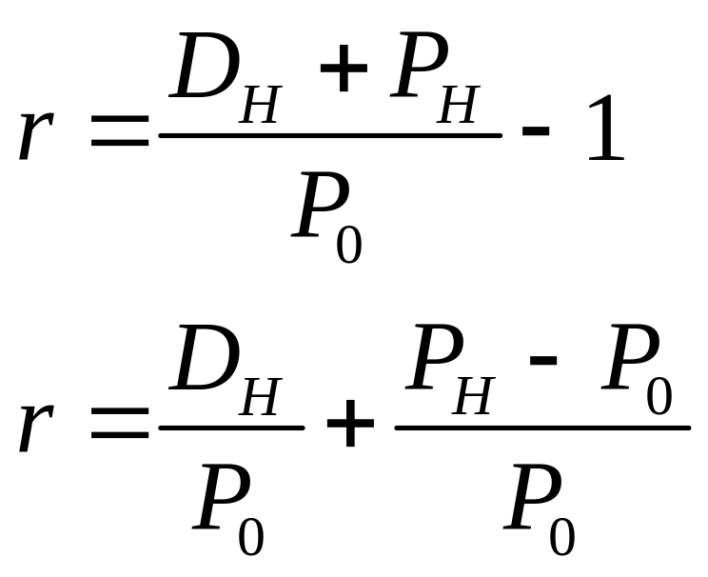
Holding Period Return
Notes:
LOS: Distinguish among realized holding period return, expected holding period return, required return, return from convergence of price to intrinsic value, discount rate, and internal rate of return.
Pages 40–41
The holding period return is the return earned over a specified time period.
The second formula decomposes the first formula.
The 2nd formula says that the holding period return for an equity investment is composed of
the dividend yield (the first term) and
the price appreciation return (the second term),
where D is dividend per share and P is stock price when first bought (t = 0)
and when sold (t = H).
For example, we might say that last year we earned 12% on a stock investment, composed of a 3% dividend yield and 9% price appreciation.
If the holding period return is one that the investor earned in the past, we refer to it as a realized return.
If the holding period return is one that the investor expects to earn in the future, we refer to it as an expected return.

Slide 38
Other Return Concepts
Required Return
Return from Convergence of Price to Intrinsic Value
Internal Rate of Return (IRR)
Discount Rate
Notes:
LOS: Distinguish among realized holding period return, expected holding period return, required return, return from convergence of price to intrinsic value, discount rate, and internal rate of return.
Pages 41–46
The investor’s required return is the minimum return required to make an investment, given the asset’s riskiness. Later in this chapter, we will discuss various methods an investor can use to determine the required return. Although the terms expected return and required return are often used interchangeably, they are distinct.
For example, if the expected return is greater than the required return, the asset is undervalued (the asset is expected to generate a higher return than required). We would also say that the asset has positive expected alpha, where Alpha = Expected return – Required return.
From the issuer’s perspective, the required returns on stock and debt issued are the cost of equity and cost of debt, respectively.
The return from convergence of price to intrinsic value reflects the fact that sometimes an asset is mispriced. If so, an investor may expect that the market price will eventually correct itself and reflect the intrinsic value (i.e., “true” value). If so, the investor will earn this return in addition to the required return given the asset’s risk (the required return is also earned because the intrinsic value will already reflect the asset’s required return).
Note that to earn a return from convergence of price to intrinsic value, the investor must believe that his or her value estimate is better than other investors and that other investors will eventually correct their valuation.
The discount rate is a general term for any rate used to find the present value of future cash flows. It is assumed to reflect compensation for delaying consumption (usually measured by the risk-free rate) plus compensation for the risk of the asset’s cash flow.
The internal rate of return (IRR) is the discount rate that equates the present value of future cash flows with the asset’s current price. Investors will sometimes back out an IRR from an asset’s price and estimated future cash flows to examine the market’s discount rate for the asset.

Slide 39
Equity Risk Premium
Current expected risk-free return
Required return on equity
Equity risk premium
Notes:
LOS: Calculate and interpret an equity risk premium using historical and forward-looking estimation approaches.
Pages 47–51
The required return on equity is the risk-free return plus the equity risk premium. The equity risk premium is the extra return investors expect above the risk-free rate for taking on risk.
The equity risk premium should be based on future expectations because the investor’s return depends on future cash flows. Note, however, that investors commonly use historical data to estimate what the equity risk premium will be going forward.
39

Slide 40
Equity Risk Premium Estimates
Historical Estimates
Forward-Looking Estimates
  Gordon growth model estimates
  Macroeconomic model estimates
  Survey estimates
Notes:
LOS: Calculate and interpret an equity risk premium using historical and forward-looking estimation approaches.
Pages 48–60
Using historical data,
Equity risk premium = Return on a broad-based equity market index – Return on government debt.
Broad-based, market value–weighted indexes are typically used. This approach is a popular method of estimation because by using long time spans of data, the estimates should be objective and unbiased. This method assumes, however, that returns are stationary—that is, the process that generates the returns does not change over time. There are additional issues that should be addressed when using historical estimates (see next slide).
In the slides to follow, we will discuss both historical and forward-looking estimation approaches in more detail. Regarding forward-looking estimates, surveys are usually polls of experts regarding what they think is the proper level of the equity risk premium going forward. Past surveys have reported equity risk premiums in the range of 2% to 3.9%.
40

Slide 41
Issues in Using Historical Equity Risk Premium Estimates
Length of Sample Period
  Balancing long-term and short-term considerations
Geometric vs. Arithmetic Mean
  Geometric mean reflects future value more accurately
Choice of Risk-Free Return
  On-the-run long-term Treasuries
Survivorship Bias
  Using returns from surviving firms artificially inflates estimates of return
Strings of Unusual Events
Notes:
LOS: Calculate and interpret an equity risk premium using historical and forward-looking estimation approaches.
Pages 52–56
Length of Sample Period
Extending the length of the historical data sample increases the precision of the estimate.
But the longer the sample period, the more tenuous the assumption of stationarity, which is especially problematic when the equity risk premium has shifted to some higher or lower value.
Geometric vs. Arithmetic Mean
The geometric mean is the return that equates the future and present values of an investment. The arithmetic mean is just a simple average of past returns.
In practice, the geometric mean will always be lower than the arithmetic mean.
The geometric mean is preferred over the arithmetic mean, in part, because it will most accurately provide the compounded future value of an investment.
Choice of Risk-Free Return
Government debt is typically used because it has near zero default risk.
There are different definitions of the risk-free return; some investors use government bills (maturity of a year or less, typically 30 days), whereas others use government bonds (maturity of more than a year).
There should be consistency between the definition of the risk-free return (used for calculating the required return) and the definition used for estimating the equity risk premium (from historical data).
Another issue is that the duration of the risk-free rate should match the duration of the investment. So, analysts often use bonds because most investments are longer term. However, long-term bonds are subject to interest rate risk.
Analysts often use recently issued (on-the-run) government debt because it is the most liquid and will not have a liquidity risk premium figured into its yield.
Survivorship Bias
This bias occurs when an equity index is constructed that includes only the survivors over a particular period.
See the example in the text on page 55. The Indian Bombay Stock Exchange Sensex 30 Index was first compiled in 1986. However, historical returns from 1979 forward are presented for the index. To determine the historical record from 1979 to 1985, the firms in existence in 1986 were used. These firms were the survivors and were likely the most successful over this period.
Strings of Unusual Events:
If a market has experienced a string of very positive or very negative events, then historical returns may not be as reliable for predicting future events.
For example, many experts believe that equity returns over the past 30 years are high because of favorable events, and they believe that estimates of future equity risk premiums should be adjusted downward.
41

Slide 42
Historical Equity Risk Premium Estimates
Notes:
LOS: Calculate and interpret an equity risk premium using historical and forward-looking estimation approaches.
Pages 48–56
The chart shows the number of markets that have equity risk premiums in the ranges shown on the x-axis.
For example, there is one country with a historical equity risk premium between 1% and 2%: Denmark.
The other countries are
2% to 3%: Austria, Belgium, Ireland, Norway, Spain, Sweden, and Switzerland
3% to 4%: Canada, France, Italy, Netherlands, New Zealand, and the United Kingdom
4% to 5%: Japan and the United States
5% to 6%: Australia, Finland, Germany, and South Africa
The equity risk premiums are estimated by using the geometric mean and government bonds.
The data are from Dimson, Marsh, and Staunton, Credit Suisse Global Investment Returns Sourcebook (2013).
42

Slide 43
Forward-Looking Equity Risk Premium Estimates
Gordon growth model risk premium
Earnings growth rate
Dividend yield
Government bond yield
Notes:
LOS: Calculate and interpret an equity risk premium using historical and forward-looking estimation approaches.
LOS: Estimate the required return on an equity investment using the capital asset pricing model, the Fama–French model, the Pastor–Stambaugh model, macroeconomic multifactor models, and the build-up method (e.g., bond yield plus risk premium).
Pages 57–60
Using the Gordon growth model, the
Equity risk premium = Forecasted dividend yield on an equity index + Forecasted long-term earnings growth rate – Current long-term government bond yield
The first two parts are the components of equity investors’ return, dividends, and capital gain. In this model, the stock price will grow at the same rate as earnings, and thus the earnings growth rate determines the capital gain. The earnings growth rate can be determined by using consensus analyst forecasts.
This model is most appropriate for developed, mature markets because it assumes that earnings and dividends grow at a constant rate. If earnings will not grow at a constant rate (e.g., rapidly growing developing country), then another model would have to be used.
It also assumes that the price-to-earnings ratio (P/E) is constant. If it is not, another model should be used, such as the macroeconomic model (see next slide).
Text Integration Note: The Gordon growth model will be used extensively in Chapter 5 of the Equity Asset Valuation text.
43

Slide 44
Forward-Looking Equity Risk Premium Estimates
Macroeconomic Model Equity Risk Premium (ERP)
where
EINFL = Expected inflation
EGREPS = Expected growth rate in real earnings per share
EGPE = Expected growth in the P/E
EINC = Expected income component
R_{F} = Expected risk-free return
Notes:
LOS: Calculate and interpret an equity risk premium using historical and forward-looking estimation approaches.
LOS: Estimate the required return on an equity investment using the capital asset pricing model, the Fama–French model, the Pastor–Stambaugh model, macroeconomic multifactor models, and the build-up method (e.g., bond yield plus risk premium).
Pages 57–60
Using a macroeconomic model, the
Equity risk premium =
The product of (1 + Expected inflation)(1 + Expected growth rate in real earnings per share)(1 + Expected growth in the P/E) – 1.
This component provides the capital gain portion of return.
The expected income component is then added in. This includes the return from the reinvestment of income.
The expected risk-free return is then subtracted to provide the premium.
The expected inflation can be approximated by comparing the yield of Treasury Inflation-Protected Securities (TIPS) with that of non-inflation-protected securities.
The expected growth in real earnings per share will be approximately equal to the real growth in GDP in the economy.
The GDP may need to be adjusted if earnings growth in the stock index and the larger economy differ.
The real GDP growth should be equal to the sum of the labor supply growth rate and labor productivity growth.
The expected growth in the P/E has a baseline value of zero if markets are efficient.
If the equity market is fairly valued, the P/E is not expected to change.
If the analyst thinks the market is undervalued, the expected change in the P/E is greater than zero.
If the analyst thinks the market is overvalued, the expected change in the P/E is less than zero.
The expected income component is the dividend yield for the equity index, including the return from reinvested income.
This model is said to provide supply-side estimates because it focuses on the variables that fuel GDP.
This model is most reliable when public equities are a large share of the economy, as they are in most developed economies, because it approximates firm earnings growth with GDP growth.
44

Slide 45
Example: Forward-Looking Equity Risk Premium
Yield on treasury bonds | 3.8%
Yield on TIPS | 1.8%
Expected growth in labor productivity | 1.5%
Expected growth in labor supply | 1.0%
Expected growth in the P/E | 0.0%
Expected dividend yield | 2.7%
Return from reinvestment of income | 0.1%
Notes:
LOS: Calculate and interpret an equity risk premium using historical and forward-looking estimation approaches.
LOS: Estimate the required return on an equity investment using the capital asset pricing model, the Fama–French model, the Pastor–Stambaugh model, macroeconomic multifactor models, and the build-up method (e.g., bond yield plus risk premium).
Pages 57–60, Spreadsheet Example
Notice that the P/E is not expected to change. So, the analyst must be assuming that the equity market is currently fairly valued.
We will need to back out the expected inflation, expected growth in real earnings per share, and the expected income component.
See slides to follow for solution.
45

Slide 46
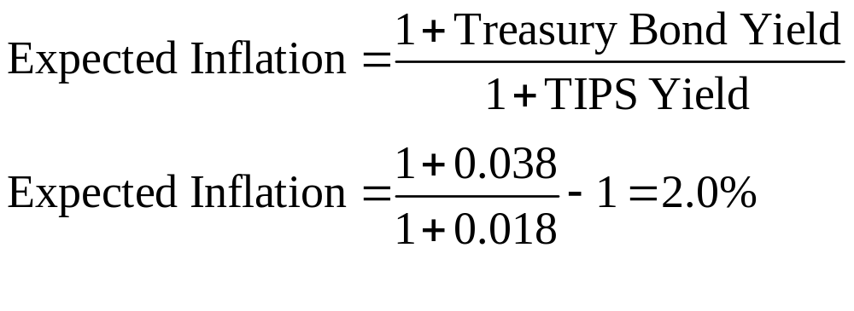
Example: Forward-Looking Equity Risk Premium
Notes:
LOS: Calculate and interpret an equity risk premium using historical and forward-looking estimation approaches.
LOS: Estimate the required return on an equity investment using the capital asset pricing model, the Fama–French model, the Pastor–Stambaugh model, macroeconomic multifactor models, and the build-up method (e.g., bond yield plus risk premium).
Pages 57–60
We first back out the expected inflation (EINFL) from the yield on the Treasury bonds and TIPS.
46

Slide 47
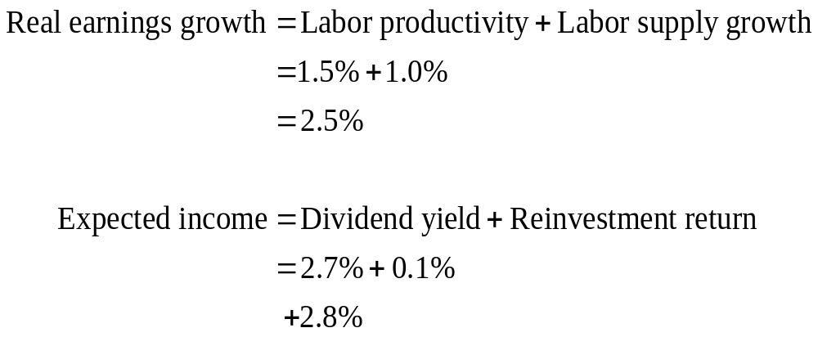
Example: Forward-Looking Equity Risk Premium
Notes:
LOS: Calculate and interpret an equity risk premium using historical and forward-looking estimation approaches.
LOS: Estimate the required return on an equity investment using the capital asset pricing model, the Fama–French model, the Pastor–Stambaugh model, macroeconomic multifactor models, and the build-up method (e.g., bond yield plus risk premium).
Pages 57–60
Next, we calculate the expected growth in real earnings per share (EGREPS), which is the sum of labor productivity growth and the labor supply growth rate: 1.5% + 1.0% = 2.5%.
The expected income component (EINC) is the sum of the dividend yield and the return from the reinvestment of income: 2.7% + 0.1% = 2.8%.
47

Slide 48
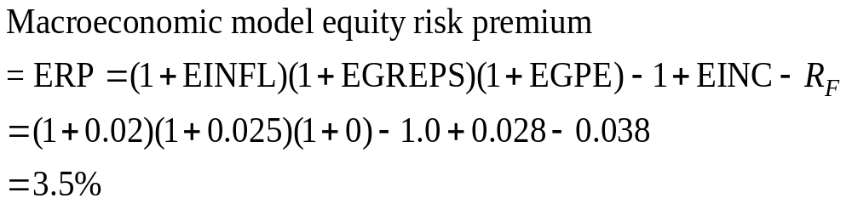
Example: Forward-Looking Equity Risk Premium
Notes:
LOS: Calculate and interpret an equity risk premium using historical and forward-looking estimation approaches.
LOS: Estimate the required return on an equity investment using the capital asset pricing model, the Fama–French model, the Pastor–Stambaugh model, macroeconomic multifactor models, and the build-up method (e.g., bond yield plus risk premium).
Pages 57–60
Equity risk premium
= (1+ Expected inflation)(1+ Expected growth in real earnings per share)(1+ Expected growth in P/E) – 1
+ Expected income component (EINC)
– Expected risk-free return (R_{F}).
Using the macroeconomic model provides a 3.5% equity risk premium.
48

Slide 49
Estimating the Required Return on an Equity Investment
Capital Asset Pricing Model (CAPM)
Macroeconomic models
Build-Up Method
Fama–French model
Pastor–Stambaugh model
Multifactor Models
Statistical models
Notes:
LOS: Estimate the required return on an equity investment using the capital asset pricing model, the Fama–French model, the Pastor–Stambaugh model, macroeconomic multifactor models, and the build-up method (e.g., bond yield plus risk premium).
Pages 60–80
With an understanding of the equity risk premium, we can now examine the required return on equity.
In the slides to follow, we will use the above methods to determine the required return on an equity investment. Multifactor models include the Fama–French model, the Pastor–Stambaugh model, macroeconomic models, and statistical models. To choose between the models, an analyst can examine their explanatory power in a regression.

Slide 50
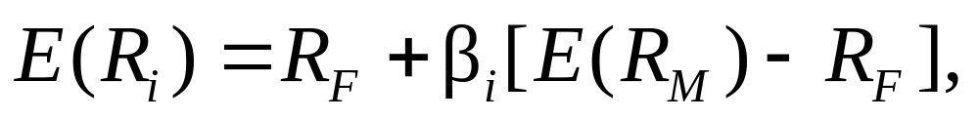
Capital Asset Pricing Model (CAPM)
Where
  E(R_{i}) = Required return on equity for security i
  R_{F} = Current expected risk-free return
  β_{i} = Beta of security i
  E(R_{M}) = Expected return on the market portfolio
  E(R_{M}) – R_{F} = Equity risk premium
Assumptions
  Investors are risk averse
  Investment is based on mean–variance optimization
  Relevant risk is systematic risk
Notes:
LOS: Estimate the required return on an equity investment using the capital asset pricing model, the Fama–French model, the Pastor–Stambaugh model, macroeconomic multifactor models, and the build-up method (e.g., bond yield plus risk premium).
LOS: Explain beta estimation for public companies, thinly traded public companies, and nonpublic companies.
Pages 60–68
The CAPM states that an investor’s required return is equal to the risk-free return plus compensation for systematic risk. The compensation for systematic risk is the stock’s beta times the equity market risk premium, where beta (β) measures systematic risk. Systematic risk measures how the stock covaries with the economy. For example, we would expect a cyclical stock to have a higher beta than a noncyclical stock. (Beta estimation is discussed in greater detail in slides to follow.)
The CAPM assumes that investors are risk averse and that they base investments on the mean and variance of returns. Systematic (not total) risk is the relevant measure of risk.
Most investors use the national equity market index to measure equity market returns and the equity market risk premium. This approach is correct if markets are segmented from one another—that is, the prices of assets are determined by local, not global, factors. But if markets are integrated, then a global equity market index and the international version of the CAPM should be used.
50

Slide 51
Beta Estimation Issues
Choice of Market Index
S&P 500 Index and NYSE Composite are common choices in the United States
Length & Frequency of Data
Five years of monthly data is most common choice
Adjusted Betas
Betas move towards 1.0 over time
Thinly Traded and Private Firms
Adjust comparable betas for leverage
Notes:
LOS: Explain beta estimation for public companies, thinly traded public companies, and nonpublic companies.
Pages 60–68
Beta is usually estimated by using a regression in which the stock’s return is regressed against the return for the market index. A stock with average systematic risk (same as the market) will have a beta of 1.0. There are several issues involved in the estimation of beta.
Choice of the market index: In the United States, the S&P 500 and the NYSE Composite are the most common choices for measuring the return on the market.
Length and frequency of data used for beta estimation: The most common choice is five years of monthly data. However, Bloomberg uses two years of weekly observations, which may be appropriate when beta is changing rapidly in fast-growing markets.
Adjustments to beta: It has been found that, over time, betas move toward 1.0. Therefore, some analysts use an adjustment suggested by Blume, in which the beta used in valuation = 2/3(Estimated beta) + 1/3(1.0).
Determining beta for thinly traded or private firms: For public companies that are thinly traded, infrequent trading can result in calculated betas that are too low. For private firms, beta cannot be readily determined because stock returns are not publicly available. In these cases, the analyst can use the betas for comparable, publicly traded firms and make an adjustment to them.
The adjustment involves reducing the public firm beta for the amount of financial risk (from the use of leverage, or debt) of the public firm. The unleveraged beta is then releveraged by using the financial risk of the private firm.
51

Slide 52
Multifactor Models: Fama–French Model
Required Return on Equity
Value Premium
Size Premium
Market Risk Premium
Risk-Free Return
Notes:
LOS: Estimate the required return on an equity investment using the capital asset pricing model, the Fama–French model, the Pastor–Stambaugh model, macroeconomic multifactor models, and the build-up method (e.g., bond yield plus risk premium).
LOS: Describe strengths and weaknesses of methods used to estimate the required return on an equity investment.
Pages 68–73
The CAPM is a widely used and accepted method of determining the required return on a stock. It best predicts returns when examining a portfolio of stocks, in which the idiosyncratic (firm-specific) risks of individual stocks offset one another so that beta (measuring systematic risk) has the strongest power for predicting returns. The CAPM, however, does not work as well for predicting the return for individual stocks. An analyst should thus examine other methods for determining the required return on stock.
One such tool is multifactor models, in which factors besides the market return are used to model returns. The risk premiums in multifactor models are referred to as factor risk premiums and are analogous to the market risk premium in the CAPM. They are the compensation an investor should receive for exposure to each risk factor. The sensitivity of a stock to each risk factor is referred to as the factor sensitivity or factor beta and is analogous to the beta in the CAPM. The Fama–French model (FFM) is an example of a multifactor model.
The FFM and the CAPM share the risk-free return and the equity market factor. The FFM adds two other factors to determine the required return on a stock. One factor reflects the size of the firm, and the other factor reflects the degree to which the stock is considered a value or growth stock.
(See the next slide for more details.)

Slide 53
Fama–French Model
where
  SMB = The return to small stocks minus the return to large stocks
  β^{size} = The sensitivity of security i to movements in small stocks
  HML = The return to value stocks minus the return to growth stocks
  β^{value} = The sensitivity of security i to movements in value stocks
PASTOR–STAMBAUGH MODEL
where
  LIQ = The return to illiquid stocks minus the return to liquid stocks
  β^{liq} = The sensitivity of security i to movements in illiquid stocks
Notes:
LOS: Estimate the required return on an equity investment using the capital asset pricing model, the Fama–French model, the Pastor–Stambaugh model, macroeconomic multifactor models, and the build-up method (e.g., bond yield plus risk premium).
LOS: Describe strengths and weaknesses of methods used to estimate the required return on an equity investment.
Pages 68–73
The FFM and the CAPM share the risk-free return (R_{F}) and the equity market factor, which is RMRF (the return on the market minus the return on the risk-free rate). The two other factors in the FFM are SMB and HML.
SMB (small minus big) is a size (market-capitalization) factor. It is the return to small stocks minus the return to large stocks. Historical data in developed countries indicate that small stocks have higher returns than large stocks. This risk premium is thought to proxy for the fact that small firms may have competitive disadvantages and decreased capital availability.
HML (high minus low) is a valuation factor, in which share valuation is measured by the book-to-market ratio. This factor is the return to value stocks minus the return to growth stocks. Historical data indicate that value stocks have higher returns than growth stocks. Note that the book-to-market ratio is the firm’s book value of equity divided by the stock price and is the inverse of the price-to-book ratio that is commonly used by analysts. This risk premium’s intent is to proxy for the fact that value (high book-to-market) firms may have greater risk of financial distress. However, some believe that both this premium and the size premium are the result of stock mispricing rather than compensation for risk.
The Pastor–Stambaugh model adds a fourth factor to the FFM, a liquidity risk factor. Less liquid stocks should have higher returns than more liquid stocks because of the increased risk for the stock investor. The liquidity risk premium has been estimated at 4.5% in the United States, with the average stock having zero exposure to this factor.
There are also multifactor macroeconomic models and multifactor statistical models. Multifactor macroeconomic models use variables, such as inflation risk exposure, to determine the required equity return. Multifactor statistical models derive factors that explain stock returns by applying statistical models to historical data.

Slide 54
Example: Fama–French Model
Risk-free rate | 3.0%
Equity risk premium | 5.0%
Beta | 1.20
Size premium | 2.2%
Size beta | 0.12
Value premium | 3.8%
Value beta | 0.34
Notes:
LOS: Estimate the required return on an equity investment using the capital asset pricing model, the Fama–French model, the Pastor–Stambaugh model, macroeconomic multifactor models, and the build-up method (e.g., bond yield plus risk premium).
LOS: Describe strengths and weaknesses of methods used to estimate the required return on an equity investment.
Pages 68–73
Spreadsheet Example
We will use this example and the FFM to estimate the required return on equity.
Note that by examining the sign (positive or negative) of the size and value betas, we can ascertain the stock’s characteristics.
Positive size beta → Small-cap stock because stock has positive exposure to the size premium. A negative beta would indicate a larger than average stock.
Positive value beta → Value stock because stock has positive exposure to the value premium. A negative beta would indicate a growth stock.

Slide 55
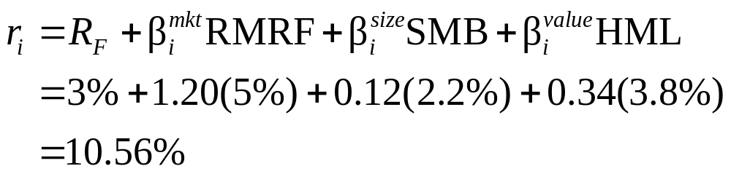
Example: Fama–French Model
Notes:
LOS: Estimate the required return on an equity investment using the capital asset pricing model, the Fama–French model, the Pastor–Stambaugh model, macroeconomic multifactor models, and the build-up method (e.g., bond yield plus risk premium).
LOS: Describe strengths and weaknesses of methods used to estimate the required return on an equity investment.
Pages 68–73
Spreadsheet Example
Using the FFM, the required return on equity is 10.56%.

Slide 56
Build-Up Methods
Required Return on Equity
Risk-Free Rate
Other Risk Premiums
Equity Risk Premium
Other Risk Discounts
For Private Firms
  Typical risk premiums
    size
    firm-specific risk
  Other risk premiums
    marketability
    control
Bond Yield plus Risk Premium Method
  Useful if firm has public debt
  YTM on long-term debt
  + risk premium
Notes:
LOS: Estimate the required return on an equity investment using the capital asset pricing model, the Fama–French model, the Pastor–Stambaugh model, macroeconomic multifactor models, and the build-up method (e.g., bond yield plus risk premium).
LOS: Describe strengths and weaknesses of methods used to estimate the required return on an equity investment.
Pages 75–79
The build-up method is similar to multifactor models because multiple risk premiums are added to the risk-free rate. The build-up method, however, does not use beta adjustments.
Private firms: The build-up method is used to value private firms in present value models (i.e., income models), sometimes for regulatory (e.g., tax assessments) or legal reasons. In addition to market risk, the typical risk premiums are for firm size and idiosyncratic (firm-specific) risk. The latter premium is added in under the assumption that it could be difficult to diversify away firm-specific risk for private firms. The size premium is added in after adjusting for differences in the betas of large and small firms (resulting in a beta-adjusted size premium).
Other adjustments can be made for marketability and control. However, these adjustments are typically made directly in the valuation of the firm not in the discount rate.
Text Integration Note: Recall that in Chapter 1 of the Equity Asset Valuation text, we differentiated liquidity from marketability. A private firm’s stock lacks marketability, which is the ability to immediately sell stock in a public market. However, not all publicly traded stocks are liquid because there may not be many buyers for the stock. Also recall that controlling positions (the investor will buy enough of the firm to control it) are more valuable than noncontrolling positions.
Bond yield plus risk premium method: If a firm has publicly traded debt, a risk premium (typically 3%–4% percent in the United States) can be added to the current yield to maturity (YTM) on long-term debt. The firm’s YTM is useful as a required return because it reflects real interest rates, inflation, and the risk of default. The additional risk premium recognizes that equity has a junior claim on firm assets relative to debt.
The YTM provides a useful check on a calculated equity required return because the YTM should be lower than estimates of the equity return. The bond yield plus risk premium method can be viewed as the build-up method applied to public firms.

Slide 57
International Considerations for Required Returns
Exchange Rates
Emerging Markets
Country spread model
Country risk rating model
Notes:
LOS: Explain international considerations in required return estimation.
Pages 79–80
Among the issues for determining the required return in a global context are exchange rates and issues in emerging markets.
Exchange rates: For an investor, the most important measure of risk and return is that which is in his or her own currency not in the foreign currency. Equity risk premiums measured in the investor’s home currency will differ from those measured in the foreign currency. An analyst will thus want to measure premiums and returns in the home currency using historical data and projections.
Emerging markets: Estimating the required equity return in emerging markets can be challenging. In addition to the traditional models, there are two other methods that can be used for these particular markets.
Country spread model: Emerging equity risk premium = Developed equity risk premium + Country premium
In this model, an analyst starts with the equity risk premium for a developed market. A country premium for the emerging market is then added to that for the developed market. The country premium often used is the sovereign bond yield spread, which is the difference in the government bond yields for the developed and emerging markets, with both yields denominated in the developed market’s currency. For example, if the yield on US Treasury bonds was 3% and the yield in USD on Russian government bonds was 8%, then 5% would be added to the US equity risk premium to determine the Russian equity risk premium.
2) Country risk rating model: In this case, developed equity returns are regressed against the institutional investor’s risk rating. The estimated regression relationship is then applied to an emerging country’s risk rating to determine the emerging country’s required return on equity.

Slide 58
Weighted Average Cost of Capital (WACC)
Weighted Average
Cost of Capital
Debt
Equity
Market Value of Debt
Tax Rate
Cost of Debt
Cost of Equity
Market Value of Equity
Notes:
LOS: Explain and calculate the weighted average cost of capital for a company.
Pages 80–81
A firm’s weighted average cost of capital (WACC) is the weighted average of its sources of funds. Its calculation incorporates debt and equity components.
To calculate the debt component, the tax rate is used because in most jurisdictions, the interest payments on debt are tax deductible, which reduces the effective cost of debt financing (see the following slides for the WACC formula and a numerical example).
Equity, however, is not tax advantaged because the payment of dividends does not reduce a firm’s taxable income.
The firm’s cost of debt is usually calculated as the YTM on the firm’s current debt.
The firm’s cost of equity can be calculated by using the equity required return models previously discussed.
Note that an analyst should use the market (not book) values of debt and equity because market values better reflect current market conditions. Analysts often use the firm’s targeted capital structure instead of the current capital structure if the proportion of debt and equity is expected to change.
The tax rate used should be the marginal tax rate because it is the tax on the next dollar of income.
The WACC is the relevant required return when valuing an entire firm. Once the firm is valued, the equity can also be valued by subtracting the market value of debt.

Slide 59
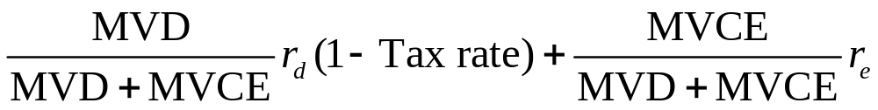
Weighted Average Cost of Capital
Where
  MVD = Current market value of debt
  MVCE = Current market value of common equity
  r_{d} = Before-tax cost of debt (which is transformed into the after-tax cost by multiplying it by 1 – Tax rate)
  r_{e} = Cost of equity
Notes:
LOS: Explain and calculate the weighted average cost of capital for a company.
Pages 80–81
The formula says the WACC is equal to debt and equity component costs.
MVD = Current market value of debt
MVCE = Current market value of common equity
r_{d} = Before-tax cost of debt (which is transformed into the after-tax cost by multiplying it by 1 – Tax rate)
r = Cost of equity
The first term is the debt component, in which the proportion (fraction) of debt in the capital structure is multiplied by the after-tax cost of debt.
The second term is the equity component, in which the proportion (fraction) of equity in the capital structure is multiplied by the cost of equity. Recall from the previous slide that equity is not tax advantaged as debt is.

Slide 60
Example: Weighted Average Cost of Capital
Risk-free rate | 3 | .0%
Equity risk premium | 5 | .0%
Beta | 1 | .20
YTM of long-term bond | 6 | .1%
Long-term debt/Total capital at market value | 40 | %
Tax rate | 30 | %
Notes:
LOS: Explain and calculate the weighted average cost of capital for a company.
Pages 80–81
Spreadsheet Example
In the next slide, we will use the CAPM to determine the required return on equity and then calculate the WACC.

Slide 61
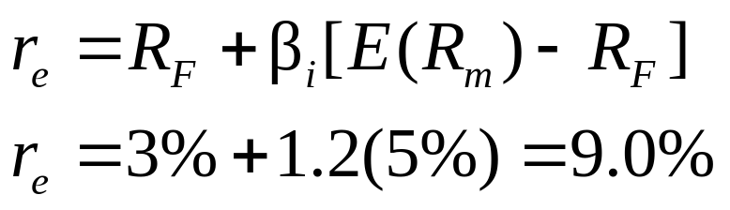
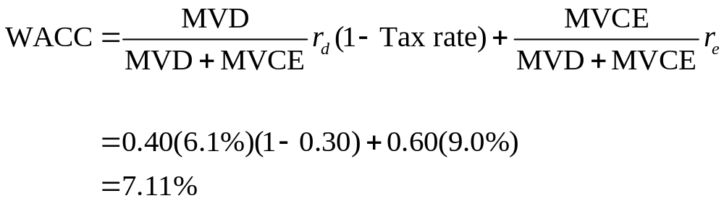
Example: Weighted Average Cost of Capital
Notes:
LOS: Explain and calculate the weighted average cost of capital for a company.
Pages 80–81
Spreadsheet Example
Using the CAPM:
The required return on equity (r) = Risk-free return + β × (Equity risk premium)
= 3% + 1.20(5%) = 9.0%
Notice that the debt cost of 6.1% is reduced by 0.70 (1 – 0.30) to reflect the tax deductibility of debt.
With a ratio of long-term debt to total capital of 0.40, the proportion of equity in the capital structure is the other part (0.60).

Slide 62
Choice of Discount Rate
Cash Flow to the Firm
WACC
Cash Flow to Equity
Required return on equity
Nominal Cash Flows
Nominal discount rates
Real Cash Flows
Real discount rates
Notes:
LOS: Evaluate the appropriateness of using a particular rate of return as a discount rate, given a description of the cash flow to be discounted and other relevant facts.
Page 82
The discount rate should be consistent with the cash flow it is applied to.
When an entire firm and all its cash flows (referred to as the cash flow to the firm) are discounted, the relevant discount rate is the WACC because it reflects all the financing sources.
When just the cash flow to equity is discounted, the relevant discount rate is the required return on equity.
When nominal cash flows (not reduced for inflation) are discounted, nominal discount rates are used, which is the usual case and the method we will use in later chapters. We will use this framework also because taxes are applied to nominal cash flows.
When real cash flows (reduced for inflation) are discounted, real discount rates (reduced by the inflation rate) are used.
Text Integration Note: Free cash flow to the firm and free cash flow to equity are discussed in Chapter 6 of the Equity Asset Valuation text.

Slide 63
Summary
Return Concepts
Equity Risk Premium
= Required return on equity – Risk-free return
Holding period return, realized return, expected return, required return, discount rate, return from convergence of price to intrinsic value, and IRR
Historical estimates
Forward-looking estimates: Gordon growth model estimates, macroeconomic model estimates, survey estimates
Issues in estimation: Sample period length, geometric versus arithmetic mean, risk-free return choice, survivorship bias, strings of unusual events
Notes:
Pages 82–83

Slide 64
Summary
Models for the Required Return on Equity
Beta Estimation Issues
Choice of market index
Capital asset pricing model (CAPM)
Multifactor models
Fama–French model
Pastor–Stambaugh model
Macroeconomic models
Statistical models
Build-up method
Length and frequency of data
Adjusted betas
Thinly traded and private firms
Notes:
Pages 82–83

Slide 65
Summary
Weighted Average Cost of Capital
Choice of Discount Rate
Use WACC for firm cash flows
Use market values, marginal tax rates, current bond YTM, and equity required return
Use equity required return for equity cash flows
Use nominal rates for nominal cash flows
International Considerations for Required Returns
Exchange rates
Emerging markets
Notes:
Pages 82–83

Slide 66
Introduction to
Industry and Company Analysis
Notes:
Questions addressed in this reading:
What are the similarities and differences among industry classification systems?
How does an analyst go about choosing a peer group of companies?
What are the key factors to consider when analyzing an industry?
What advantages are enjoyed by companies in strategically well-positioned industries?
DISCLAIMER: This presentation is NOT a substitute for the CFA Program curriculum. Candidates should not view this material as reflecting what will be required of them on the CFA exam.

Slide 67
Introduction
Company analysis is the analysis of an individual company, and it requires understanding a company’s industry and identifying its peers.
  An industry is a group of companies offering similar products and/or services, whereas a sector is a group of related industries.
  A principal business activity is a source from which a company derives a majority of its revenues and/or earnings.
  A peer group is a group of companies that are engaged in similar business activities, and whose economics and valuation are influence by closely-related factors.
Notes:
Company analysis requires understanding a company’s industry and identifying the company’s peers.
Definitions to help introduce this material:
An industry is a group of companies offering similar products and/or services. (e.g., Pharmaceuticals)
A sector is a group of related industries. (e.g., Health Care)
A principal business activity is a source from which a company derives a majority of its revenues and/or earnings. (e.g., research and development of new drugs)
A peer group is a group of companies that are engaged in similar business activities, and whose economics and valuation are influence by closely related factors. (e.g., Novartis, Pfizer, Roche, Sanofi, Merck & Co.)

Slide 68
Uses of industry analysis
Understanding a company’s business and business environment
Identifying active equity investment opportunities.
Portfolio performance attribution
Stock selection
Credit analysis
Security selection
Industry or sector rotation
Performance attribution
Industry or sector selection
Notes:
LOS: Explain uses of industry analysis and the relation of industry analysis to company analysis.
Page 92
Understanding a company’s business and business environment: Evaluate growth opportunities, competitive dynamics, and credit risk.
Identifying active equity investment opportunities: Identify industry and overweight those for which profit and growth are not fully incorporated in price.
Portfolio performance attribution: Performance attribution focuses on the sources of a portfolio’s returns.

Slide 69
Approaches to identifying similar companies
Products and/or services supplied
Similar products and/or services
Industry and sector classification
A company’s principal business activity
Business-cycle sensitivities
Cyclical companies have profits correlated with the overall economy
Noncyclical companies’ performance is independent of the economy
Statistical similarities
Groups based on correlations of security returns
Based on historical returns, but relationship may not continue in the future
May associate firms based on chance or may exclude important relationships
Notes:
LOS: Compare methods by which companies can be grouped, current industry classification systems, and classify a company, given a description of its activities and the classification system.
Pages 93–95
Goal: Allow comparisons and assessments for competitiveness to allow for estimation of growth, profitability, and valuations.
Example 1: Descriptions related to the cyclical/noncyclical distinction
Noncyclical companies and industries may be divided into defensive (e.g., staple consumer goods) versus growth (i.e., high growth no matter the economy)
Labels, such as “cyclical,” may be confusing because companies may have business lines and industries that are not cyclical. Furthermore, those that are “defensive” may still have other issues (e.g., price wars) that cause them to behave differently from what is expected.

Slide 70
Sectors
Basic Materials and Processing
Consumer Discretionary
Consumer Staples
Energy
Health Care
Financial Services
Industrial/Producer Durables
Technology
Telecommunications
Utilities
Notes:
LOS: Compare methods by which companies can be grouped, current industry classification systems, and classify a company, given a description of its activities and the classification system.
Pages 97–100
Sectors are groups of industries that are related [Note: these are the ten sectors identified in Exhibit 1 in Example 2].
Sectors are part of the framework for understanding forces that affect competitiveness within an industry.
Note: As pointed out in section 4.1, the identification of sectors may differ among analysts or index providers—compare sectors for Global Industry Classification Standard (GICS) versus Russell Global Sectors (RGS) versus Industry Classification Benchmark (ICB).
Example 2: Exercise classifying companies into sectors using a brief description of products or services.

Slide 71
Classification schemes
Commercial industry classification schemes
Produced by private enterprises, such as analysis firms and financial services firms.
Governmental industry classification schemes
Produced by government agencies
Goal: facilitate comparisons over time and across companies
Notes:
LOS: Compare methods by which companies can be grouped, current industry classification systems, and classify a company, given a description of its activities and the classification system.
Pages 97–101
Commercial schemes are discussed in Section 4.1
Governmental schemes are discussed in Section 4.2
Although the purposes are similar, the commercial schemes tend to be updated more frequently than the governmental schemes.

Slide 72
Industry classification schemes
Global Industry Classification Standard (GICS)
Developed by Standard & Poor’s and MSCI
Classifies companies for developing and developed countries
Based on business activity, classifies each company into a sector, industry group, industry, and sub-industry
Russell Global Sectors (RGS)
Classifies companies by products and services
System has sectors, sub-sectors, and industries.
Industry Classification Benchmark (ICB)
Developed by Dow Jones and FTSE
Classifies companies by source of revenues
System has supersectors, sectors, subsectors, and industries
Notes:
LOS: Compare methods by which companies can be grouped, current industry classification systems, and classify a company, given a description of its activities and the classification system.
Pages 97–100
Global Industry Classification Standard (GICS)
As of May 2016, 156 sub-industries, 67 industries, 24 industry groups, and 10 sectors
Adjusted over time to reflect changes in the global equity markets
Russell Global Sectors (RGS)
As of April 2016, 9 sectors
Industry Classification Benchmark (ICB)
As of April 2016, 10 industries, 19 supersectors, 41 sectors, 114 subsectors
Caution: There is different nomenclature among the schemes in terms of what constitutes an “industry” or a “sector”.
Example 3: Multiple choice questions pertaining to industry classification schemes

Slide 73
Governmental Industry Classification Schemes
International Standard Industrial Classification of All Economic Activities (ISIC)
Statistical Classification of Economic Activities in the European Community (NACE)
Australian and New Zealand Standard Industrial Classification (ANZSIC)
North American Industry Classification System (NAICS)
Notes:
LOS: Compare methods by which companies can be grouped, current industry classification systems, and classify a company, given a description of its activities and the classification system.
Pages 100–102
Strengths and weaknesses of current governmental systems
Lack of disclosures regarding specific companies or businesses
Not updated as frequently as commercial systems
Do not distinguish between large and small businesses
Not necessarily adequate for identifying a company’s peer group

Slide 74
Identifying peer groups
Examine classification systems
Review subject company’s annual report
Confirm comparability with potential peers
Review company’s competitors’ annual reports
Notes:
LOS: Explain how a company’s industry classification can be used to identify a potential “peer group” for equity valuation.
Pages 102–106
A peer group is a group of companies engaged in similar business activities.
Process of identifying peer companies:
Review both commercial and governmental classification systems
Review the company’s annual reports for the discussion of its competitive environment.
Review competitors’ annual reports to identify other potential comparable companies.
Confirm comparability by verifying that the potential comparable company has a significant portion of revenues and operating profits from same business activity as subject company.
Example 4: An analyst researches the peer group of Brink’s Home Security
Start with GICS sector
Then GICS industry group
Then GICS industry
Then GICS Sub-industry
Example 5: The semiconductor industry: business cycle sensitivity and peer-group determination
Do the companies have similar business models?
Do the companies have similar customers?
Do the companies depend on the same economic factors that drive demand for their products and services?

Slide 75
Describing and analyzing an industry
Analysts examine statistical relationships between an industry and business and economic variables
Analysts develop forecasts, often developing scenario analyses
Analysts may examine strategic groups, which are companies that share similar business models or specific market segments.
Analysts often classify an industry based on its stage in the industry life cycle.
  The experience curve is a representation of how the direct cost per unit of a good or services produced or delivered declines as a function of cumulative output.
Notes:
LOS: Describe the elements that need to be covered in a thorough industry analysis.
Pages 106–108
Information sources include
economic publications,
business publications,
industry and trade associations, and
company disclosures.
Dimensions: Over time and in comparison with other companies, industries, and the economy
Bottom line: An analyst with superior knowledge about an industry’s characteristics (e.g., competitors, suppliers, customers, trends, and economic influences) will have a competitive edge in evaluating the investment merits of companies in the industry.

Slide 76
Framework for industry analysis
Intensity of competition
Demographic influences
Macro-economic influences
Social influences
Governmental influences
Technological influences
Notes:
LOS: Describe the elements that need to be covered in a thorough industry analysis.
Pages 106–108
A Framework for Industry Analysis
Social influences (e.g., persuasion, conformity, marketing)
Demographic influences (e.g., distribution of consumers by age, gender, socioeconomic status, education)
Macroeconomic influences (e.g., business cycle, trends, spending)
Governmental influences (e.g., regulatory, legal)
Technological influences (e.g., distribution, communication, marketing, speed of change)
The intensity of competition is based on Porter’s Five Forces

Slide 77
Strategic analysis of an industry
Porter’s “Five Forces”
Framework
Rivalry among Existing Competitors
Threat of Entry
Power of Suppliers
Threat of Substitutes
Power of Buyers
Notes:
LOS: Describe the principles of strategic analysis of an industry.
Pages 109–111
Principles of strategic analysis
Focus is on economic fundamentals
Exhibit 3 shows that based on 2006–2008 return on invested capital, some industries earn economic profits (e.g., data networking) and others do not (e.g., air transport)
Economic profits: Returns above the opportunity cost of funds
Porter’s “Five Forces” Framework
Threat of entry: How difficult is it for companies to enter into the industry? Are there barriers to entry?
Power of suppliers: What is the possibility that suppliers can raise prices or restrict supply?
Power of buyers: How much bargaining power can customers exert of the company in terms of pricing?
Threat of substitutes: What is the likelihood that customers will chose a competitor or potential competitor’s products or services?
Rivalry among existing competitors: What is the competitive structure of the industry? Monopolistic competition? Competition? A few large companies dominating the industry?

Slide 78
Factors affecting pricing power and price competition
Barriers to entry are obstacles or hurdles that limit or restrict the entry of new competitors in the market
  These barriers keep or discourage new entrants, hence reducing competition
Industry concentration is the degree to which some companies may dominate the industry in terms of market share.
  Generally, the more concentrated an industry, the less competitive it is
Industry capacity is the maximum amount of a good or service that can be supplied in a given time period
  The more limited the capacity, the greater the companies’ pricing power
Market share stability is the degree to which market shares change over time
  The more stable the market shares, the less competitive the industry
Notes:
LOS: Explain the effects of barriers to entry, industry concentration, industry capacity, and market share stability on pricing power and price competition.
Pages 111–119
Barriers to entry examples:
High start-up costs, such as setting up a production facility (that is, significant economics of scale)
Patents on products
Significant research and development costs
Control of a scarce resource (e.g., mine)
Industry concentration types:
Fragmented industries tend to be more price competitive.
Concentrated industries tend to be less price competitive.
Exhibit 4 shows classifying industries by pricing power (weak versus strong) and concentration (concentrated versus fragmented).
Industry capacity issues
How quickly can the industry adjust so that supply and demand are balanced?
Capacity is limited in the short term but may be adjusted in the long term—the speed of adjustment is industry-specific.
Market share stability
The more that market shares change over time, the lower the barriers to entry, and hence the more competitive the industry.
Lower switching costs for customers can result in greater market share instability (and hence more competition).
Exhibit 5 shows the market share stability in orthopedic devices (2005–2008)

Slide 79
Industry life cycle
Mature
Decline
Growth
Embryonic
Notes:
LOS: Describe industry life-cycle models, classify an industry as to life-cycle stage, and describe limitations of the life-cycle concept in forecasting industry performance.
Pages 119–124
Exhibit 6 shows an industry life-cycle model
Embryonic
Slow growth
High prices
Significant investment
High risk
Growth
Rapidly increasing demand
Improving profitability
Falling prices
Low competition
Shakeout
Slowing growth
Intense competition
Declining profitability
Mature
Little or no growth
Industry consolidations
High barriers to entry
Decline
Negative growth
Excess capacity
High competition

Slide 80
Applying the life-cycle concept
Using the life-cycle model
Newer industries tend to be more competitive than mature industries
Growth companies tend to reinvest in new products and services, and mature companies tend to focus on internal efficiencies
Mature companies are generally more focused on extending successful product lines
Limitations to the life-cycle model
Changes may disrupt the cycle: technological change, regulatory changes, social changes, and demographic shifts.
Not all companies in an industry have the same performance
Notes:
LOS: Describe industry life-cycle models, classify an industry as to life-cycle stage, and describe limitations of the life-cycle concept in forecasting industry performance.
Pages 122–124
There are exceptions to the life cycle:
Some mature companies may seek growth to achieve a larger size, which may not result in better returns to shareholders.
Some mature companies may be able to find growth in new products that enhance returns to shareholders.

Slide 81
Characteristics of industries
Major companies
Level of concentration
Barriers to entry and success
Impact of industry capacity
Industry stability
Life cycle
Price competition
Demographic influences
Government and regulatory influences
Social influences
Technological influences
Growth vs. defensive vs. cyclical
Notes:
LOS: Compare characteristics of representative industries from the various economic sectors.
Pages 106–135
Detailed example in Exhibit 7: Elements of a strategic analysis for three industries (branded pharmaceuticals, oil services, and confections/candy)
Example of comparison: Barriers to entry
Branded pharmaceuticals: Very high because of significant R&D investment, global distribution network, and large-scale manufacturing.
Oil services: Medium because technological expertise required, but high level of innovation permits niche companies to enter industry and compete.
Confections/Candy: Very high because there are low financial and technological hurdles, but new entrants would lack established brands that drive consumer purchase decisions.

Slide 82
External influences on industry growth, profitability, and risk
Macroeconomic influences include the level of production, interest rates, availability of credit, and inflation
Technological influences include new products that change how companies do business
Demographic influences include the distribution of consumers by age and gender
Governmental influences include tax rates and regulations
Social influences include how people work and spend.
Notes:
LOS: Describe macroeconomic, technological, demographic, governmental, and social influences on industry growth, profitability, and risk.
Pages 129–135
Macroeconomic influences
Business cycle sensitivity
Magnitude of economic activity
Interest rates
Availability of credit
Inflation, which affects costs and prices
Technological influences
Moore’s law (originated in 1970): Processing speed will double every two years (i.e., number of transistors that can be affordably placed on an integrated circuit doubles approximately every two years).
Computer hardware industry influenced by the related industries of telecommunications and computer software
Demographic influences
Influences include population distribution by gender, age, and education
Effects include expected workforce availability, demand for age-related services (e.g., nursing homes), and consumer demand.
Example 9 provides an example with the post-WWII baby boom and its effects on the US housing industry
Governmental influences
Regulation (see Example 10 about what happened when the tax advantage of income trusts in Canada was removed)
Laws
Influence on self-regulatory organizations (e.g., stock markets)
Government contracts that may affect specific industries and/or companies (see Example 11 about governmental purchases and the aerospace industry)
Social influences
Trends and movements may affect how individuals work and play
For example, the use of tobacco, which is discouraged by governmental regulation and societal pressures
See Example 12 about women in the workforce and Example 13 about the airline industry

Slide 83
Elements of a Company analysis
Company profile
Relevant industry characteristics
Demand for the company’s products and services
Supply of products and services
Company’s pricing environment
Financial ratio analysis
Notes:
LOS: Describe the elements that should be covered in a thorough company analysis.
Pages 135–139
Company analysis includes the analysis of a company’s
financial position,
products and/or services, and
competitive strategy (i.e., the company’s plan for responding to threats and opportunities).
Exhibit 8 gives a checklist for company analysis
Company profile (overview of the company)
The business: products and services
Investment activities: recent and planned
Research and development
Corporate governance
Insider ownership
Management strengths and weaknesses
Labor relations
Relevant industry characteristics
Stage in the life cycle
Business cycle sensitivity
Typical product life cycles
Barriers to entry or exit
Supplier issues
Opportunities to differentiate products or services
Technology
Government regulation
Labor relations
Demand for the company’s products and services
Sources of demand
Product differentiation
Past record, sensitivities (e.g., to changes in the economic environment)
Supply of products and services, includes analysis of costs
Sources of supply (concentration, competition, substitutes)
Industry capacity: current and future
Cost structure
Import/export considerations
Proprietary products, patents, or trademarks
Company’s pricing environment: degree of price competition
Relationships among demand, supply, and prices
Significance of material and labor costs
Outlook for cost and availability of material and labor.
Financial ratio analysis: over time and compared with competitors
Ratios: activity, liquidity, solvency, profitability
Financial statistics: growth rates per share
Cash flows
Debt maturities
Dividend payout
Off-balance-sheet liabilities and contingent liabilities
Non-arms-length financial dealings
Decomposition of return on equity into profit margin, asset turnover, and financial leverage

Slide 84
Summary
Company analysis and industry analysis are closely interrelated.
Industry analysis is useful for analyzing portfolio opportunities, strategies, and performance.
There are commercial and governmental classification systems, although determining a company’s peers is challenging because of different business activities even within defined industry groups.
The analysis of the competitive environment of an industry includes Porter’s five forces, assessment of barriers to entry, capacity, market share stability, and the industry’s life cycle.
External factors must be considered, including technology, demographics, government, and social factors.
Notes:
Pages 139–142

Slide 85
Summary, continued
A thorough company analysis requires investigating the company’s corporate profile, industry characteristics, demand for its products or services, supply of its products and services, pricing, and financial ratios.
Spreadsheet modeling can assist the analyst in analyzing and forecasting revenues, income, and cash flows, as well as assessing the sensitivity of the analysis to the analyst’s assumptions.
Notes:
Pages 139–142

Slide 86
Industry and Company Analysis
Notes:
DISCLAIMER: This presentation is NOT a substitute for the CFA Program curriculum. Candidates should not view this material as reflecting what will be required of them on the CFA exam.

Slide 87
Approaches to modeling REVENUE
Top-Down Approach
Start with the economy
Look at successively more narrowly defined levels
Bottom-Up Approach
Begin with individual product lines, locations, or business segments
Aggregate projections over products or segments to reach the company level
Hybrid Approach
Aggregate company revenues to reach the industry level
Combine top-down and bottom-up approaches
Notes:
LOS: Compare top-down, bottom-up, and hybrid approaches for developing inputs to equity valuation models.
Pages 148–154
The first step in forecasting revenue is to analyze the components of a company’s revenues
Trends and growth rates
Sources of revenues: product segments and geographic segments
Example 1 is an analysis of revenues of Novo Nordisk
Analysts may use different approaches to forecasting revenues
Top-down approaches
Begin with a forecast of a broad measure (e.g., GDP, market share), and then assess the company’s revenues relative to that broad measure.
“Growth relative to GDP”: Estimate growth related to GDP → forecast GDP → forecast company revenues.
“Market growth and market share”: Estimate market share → forecast market → forecast company revenues.
Bottom-up approaches
Time-series forecasts
Return on capital forecasts
Capacity-based measures (e.g., store sales year-to-year)
Hybrid approaches
Combine the top-down and bottom-up approaches: Can use one approach for individual product lines, and then aggregate for the company as a whole
It may uncover implicit assumptions or errors present in one or both other approaches.
This approach is the most commonly used.
Example 2 is a continuing analysis of Novo Nordisk, with identification and application of the approaches to forecasting.

Slide 88
Top-down Approaches to forecasting revenue
“Growth relative to GDP growth” approach
Forecast the growth rate of nominal gross domestic product (GDP)
Relate the company’s growth rate to the growth of nominal GDP
Forecast real GDP and inflation
Forecast company’s revenues
“Market growth and market share” approach
Forecast growth in a particular market
Evaluate the company’s current and anticipated market share
Apply the expected market share to the forecast
Forecast company’s revenues
Notes:
LOS: Compare “growth relative to GDP growth” and “market growth and market share” approaches to forecasting revenue.
Pages 151–152
“Growth relative to GDP growth”
Requires forecasting the relationship of the company’s growth with that of nominal GDP, as well as forecasting GDP and inflation
Forecast of a company’s growth relative to GDP is often stated in terms of basis point premiums (e.g., 50 bp above GDP)
“Market growth and market share”
Requires forecasting the market’s revenues and the company’s share of that market

Slide 89
Income statement modeling: Operating costs
Analyst can take a top-down, bottom-up, or hybrid approach to analyzing and forecasting costs.
  Consider fixed and variable cost components of operating costs
Economies of scale is present if the average cost per unit falls as revenues increase.
  Indicative of economics of scale: operating margins positively correlated with revenues.
Costs are challenging to estimate based on reported accounts
  For example, companies reserve against losses based on estimates, but the actual losses may differ from the estimates
Notes:
LOS: Evaluate whether economics of scale are present in an industry by analyzing operating margins and sales levels.
Pages 154–167
Approaches are similar to that of forecasting revenues.
Variable costs vary with revenues and can be modeled as a percentage of revenues or in terms of growth of unit sales.
Fixed costs are important to identify, which are related to property, plant, and equipment (PP&E), future PP&E, and capacity growth.
Economies of scale relates to the coverage of fixed costs: the per unit cost decreases with higher levels of output if there is economies of scale.
There are uncertainties with regard to costs, including estimating fixed versus variable costs, estimating costs considering reserves, and estimating costs of future inputs.
Example 3 gives approaches to modeling operating costs in the cases of Walgreens and Rite Aid.
The companies are in the same industry, but have different operating margins.
Some of the difference in margins may be attributable to economies of scale.
There may be qualitative differences (e.g., customer service).
There may be differences in costs, such as in selling, general, and administrative expenses.

Slide 90
Forecasting costs
Cost of goods sold: focus on gross margins
Generally forecasted as a percentage of sales and can be broken down by product line or segment
Consider a company’s hedging activity that may affect costs of raw materials
Compare with competitors’ gross margins.
Selling, general, and administrative (SG&A) expenses: focus on type of expense
Some SG&A expenses vary with cost of goods sold, whereas other SG&A expenses are relatively fixed (e.g., overhead)
Benchmarking against competitors may be useful
Nonoperating costs: depends on the type of cost
Interest income varies with cash and investments, whereas interest expense varies with debt
Taxes are affected by the jurisdiction and the type of business
Notes:
LOS: Forecast the following costs: cost of goods sold, selling general and administrative costs, financing costs, and income taxes.
Pages 154–171
Example 4 is about L’Oréal’s operational cost structure versus competitors.
Segment: Classify product lines into “beauty” and “mass market.”
Margins differ between beauty and mass market, so forecasts depend on which, if any, segment is expanded.
Example 5 offers an analysis of the consumer goods company Unilever.
Segments broken down by geography: (1) Asia, Africa, Central and Eastern Europe;(2) Americas; and (3) Western Europe.
Revenue and profit growth differ among segments.
Profit margins differ among segments.
Forecasts of revenues depend on the growth in each segment and whether margins will change.
Example 6 shows and interest expense calculation for Ahold
$\text{Interest} \text{expense} \text{on} \text{average} \text{gross} \text{debt}\text{ = }\frac{\text{Interest} \text{expense}}{\text{Average} \text{of} \text{beginning} \text{and} \text{ending} \text{gross} \text{debt}} .$
$\text{Interest} \text{rate} \text{on} \text{average} \text{cash} \text{position}\text{ = }\frac{\text{Interest} \text{income}}{\text{Average} \text{of} \text{beginning} \text{and} \text{ending} \text{cash} \text{position}} .$
$\text{Interest} \text{expense} \text{on} \text{average} \text{net} \text{debt}\text{ = }\frac{\text{Interest} \text{expense}}{\text{Average} \text{of} \text{beginning} \text{and} \text{ending} \text{net} \text{debt}}$, where net debt is the difference between gross debt and the cash position.
Example 7 shows tax rate estimates for a hypothetical company.
The effective tax rate is the ratio of taxes to profits before taxes.
Tax deferrals should be considered in estimates.

Slide 91
Balance sheet modeling
Balance sheet modeling is the process of forecasting a company’s balance sheet based on the following:
  Items that flow from the income statement (e.g., retained earnings)
  Items that vary with revenues (e.g., accounts receivable)
  Items that are the result of investment or financing decisions (e.g., gross plant, property, and equipment)
Items affected by the level of revenues can often be forecasted by using historical or projected efficiency (e.g., turnover) ratios.
Forecasts of long-term assets are a function of forecasted capital expenditures and depreciation. Capital expenditures include
  maintenance capital expenditures, needed to sustain the business, and
  growth capital expenditures, needed to expand the business.
Notes:
LOS: Describe approaches to balance sheet modeling.
Pages 172–173
Income statement modeling is the starting point for balance sheet and cash flow statement modeling.
Generally, if an analyst models the income statement and either the balance sheet or cash flow statements, the third statement results directly from the first two statements.
Example 8 offers balance sheet modeling questions that focus on the interrelationships among the statements and the return on invested capital (ROIC).

Slide 92
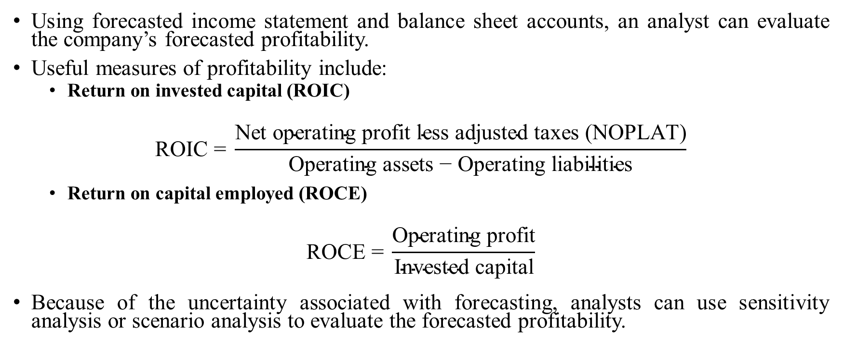
Evaluating Profitability
Using forecasted income statement and balance sheet accounts, an analyst can evaluate the company’s forecasted profitability.
Useful measures of profitability include:
  Return on invested capital (ROIC)
$$\text{ROIC}\text{ = }\frac{\text{Net} \text{operating} \text{profit} \text{less} \text{adjusted} \text{taxes}\text{ (}\text{NOPLAT}\text{)}}{\text{Operating} \text{assets}\text{ − }\text{Operating} \text{liabilities}}$$
  Return on capital employed (ROCE)
$$\text{ROCE}\text{ = }\frac{\text{Operating} \text{profit}}{\text{Invested} \text{capital}}$$
Because of the uncertainty associated with forecasting, analysts can use sensitivity analysis or scenario analysis to evaluate the forecasted profitability.
Notes:
LOS: Describe approaches to balance sheet modeling.
Page 173
Measures used to evaluate forecasted profitability:
ROIC is the ratio of NOPLAT to operating assets minus operating liabilities
Operating assets are receivables, inventories, and prepaid expense plus net fixed assets
Operating liabilities are payables and accrued expenses
ROCE is, essentially, ROIC before taxes.
Invested capital is debt capital plus equity capital
Some use ROIC and ROCE as identical measures
Uncertainty and forecasts
Sensitivity analysis is the evaluation of the effect of changing one assumption (e.g., COGS as a percentage of revenues)
Exhibit 16 shows the distribution of intrinsic value estimates, with the most likely case the center of the distribution
Scenario analysis is the evaluation of the effect of changing many assumptions at the same time and evaluating the resultant possible profitability.

Slide 93
ROIC and Competitive Advantage
Understanding the competitive strength of the industry in which a company operates helps an analyst forecast profitability and, hence, ROIC.
Tools to assess the competitive structure of an industry include Porter’s five forces.
Competitive strength
Threat of substitute products
Intensity of rivalry
Bargaining power of customers
Bargaining power of suppliers
Threat of new entrants
Forecasted
ROIC
Notes:
LOS: Describe the relationship between return on invested capital and competitive advantage.
Pages 173–176
Margins, revenues, capital expenditures, and working capital investment are a result of an assessment of a company’s competitive strength.
The text has an analysis of Anheuser-Busch InBev in Brazil using Porter’s five forces
Threat of substitutes: Medium because there are alternatives, but beer consumers do not shift readily
Rivalry: Low because it is one of the largest produces and has cost advantages because of economies of scale
Bargaining power of suppliers: Low because the inputs are predominantly commodities
Bargaining power of buyers: Low because bars (which account for the majority of buyers) are fragmented, and supermarkets (the other large segment of buyers) are fragmented
Threat of new entrants: Low because barriers to entry are high (i.e., high cost of production plant and distribution system)
Text Integration Note: Porter’s five forces are also discussed in Chapter 3, Section 5.1

Slide 94
Competitive pressures affecting prices and costs
Ability to control costs affects a company’s ROIC
  A company that has weak bargaining power with suppliers has less ability to control costs
Ability to control prices affects a company’s ROIC
  A company that has weak bargaining power with customers is less able to control prices
  If there are lower barriers to entry for an industry, companies in the industry are not be able to control prices
  If there is a strong threat of substitutes, a company has less ability to control prices
  A company in an industry with intense rivalry will not be able to control prices
Notes:
LOS: Explain how competitive factors affect prices and costs.
Pages 176–184
Bargaining power of suppliers: If there are a few large suppliers with little or no ability to substitute inputs for any other suppliers, then suppliers have the ability to raise prices (or reduce quality) and, hence, increase costs to the company.
If labor unions control the price of labor, companies may have little or no control over the price of labor.
The use of just-in-time inventory control shifts bargaining power over inputs from the company to the suppliers.
Bargaining power of customers: If there are a few large customers, then customers may have the ability to refuse price increases.
A plausible threat for businesses that rely on a few large customers is that these customers may be able to produce the product in-house, extending their supply chain to within the firm.
Threat of entrants: If there are few or no barriers to entry, companies have less control over prices because a high ROIC will attract new entrants.
The threat of new entrants is high when there is little capital investment, economies of scale is not an issue, it is easy to set up distribution networks, and the ability of customers to switch to another company’s product is high.
Threat of substitutes: if there are products available that will satisfy the same function or need, there is a high risk of substitutes.
For retailers, customers disposable income is limited, so retailers must compete for the limited disposable income available.
A company’s whose customers can create the product on their own has a high threat of substitution, which will affect the company’s ability raise prices
Intense rivalry: The more intense the competition within the industry, the lower the ROIC.

Slide 95
JUDGING THE Competitive position: EXAMPLES
Industry | Competitive position
Fast food industry Many convenient locations Low start-up costs Alternatives available
Mobile phone industry Capital requirements for manufacturing Patents for hardware and software Innovation-driven market Many substitutes Ties to service providers
?
?
Notes:
LOS: Judge the competitive position of a company based on Porter’s five forces analysis.
Pages 176–184
Two examples (not in the text) to consider for discussion, with room for different interpretations of the industry threats and opportunities.
Fast food industry
Bargaining power of customers: High because there are many alternatives, generally in the same locale.
Bargaining power of suppliers: Low because the industry for raw materials and labor is fragmented.
Threat of new entrants: High because it is easy to establish a restaurant.
Threat of substitutes: High because there are many alternative fast food outlets and many alternatives to fast food (restaurants and cooking at home).
Rivalry within industry: High, with competition on product differentiation and price.
Mobile phone manufacturing industry
Bargaining power of customers: High
Bargaining power of suppliers: Moderate, with suppliers not concentrated for most components.
Threat of new entrants: Low because of high start-up manufacturing costs and R&D.
Threat of substitutes: High, with industry service providers allowing low switching costs.
Rivalry within industry: High
Product differentiation: Relatively low because smart phones must have similar features to compete.
Price sensitivity: High, with customers shopping by both features and price.
Example 9 provides an analysis of the Russian beer market.
Issue: government taxation (excise) in 2010
What is the anticipated change in the margins of Carlsberg (dominant beer producer) from the excise tax increase?
Affect depends on price elasticity of beer in Russia
What is the impact of an increase in the cost of an input (barley)?
Affects margins
What is the anticipated effect of increasing selling expenses to address threats of substitutes and increased rivalry within the industry?
What effect does advertising have on brand loyalty and revenues?

Slide 96
Inflation and deflation
Inflation is the overall increase in the prices of goods and services, and deflation is the overall decrease in the prices of goods and services.
Inflation and deflation affect companies differently and can affect revenues and expenses within a company differently.
Industry structure can affect prices
  In a concentrated market, companies can exert pressure on suppliers against price increases for goods and services because of inflation, whereas companies in a more fragmented market cannot exert such pressure.
  A company’s ability to pass on increased prices to customers depends on the bargaining power of customers and the degree of rivalry among competitors.
  In a highly competitive industry, pricing is influenced by input prices.
Notes:
LOS: Explain how to forecast industry and company sales and costs when they are subject to price inflation or deflation.
Pages 184–192
If there are ready substitutes for a product, such that customers have significant bargaining power, it will be more difficult for companies to pass on price increases to its customers.
For the beer industry, the examples in the text discuss the ability or inability of the industry to exert opposing pressure against price increases from inflation. The beer market is relatively fragmented in the United States and relatively concentrated in Europe.
Exhibit 23 shoes the US general inflation and inflation in beer prices; over time, beer prices and the consumer price index are aligned as brewers pass on price increases to customers.
Exhibit 24 shows Unilever’s overall revenue growth by percentage change in volume and price; as prices of its output were increased, volume decreased. Unilever was unable to pass along cost increases to its customers.
Exhibit 25 shows the UK relationship between food inflation and volume, 1989–2012; there is a negative relationship between the volume of goods sold and food inflation.
Example 10 looks at the question of passing on input cost increases or not, specifically looking at the case of Carrefour.
A case of differing predictions on margins of an increase in the cost of goods sold
Example 11 looks at inflation in input costs at Lindt and Nestlé.
The companies are expected to experience differing sensitivity of the gross profit and operating profit margins to inflation and deflation of costs because of differing costs of goods sold and SG&A expenses as a percentage of revenues.

Slide 97
Technological developments
Technological developments can affect the demand for a product, the quantity of a product, or both.
  Technology can reduce the cost of manufacturing
  Technology can create substitutes
Notes:
LOS: Evaluate the effects of technological developments on demand, selling prices, costs, and margins.
Pages 192–203
Example 12 and Example 13 consider the introduction of the tablet.
The chart in this slide is a representation of the unit sales provided in Example 12, pre- and post-cannibalization.
Tablets have a more dramatic forecasted cannibalization effect for consumer PCs relative to nonconsumer PCs.
The cannibalization affects revenues, margins, and earnings per share (EPS).
The cannibalization issue is important in the case of technological developments because the introduction of technology in product lines brings with it the significant potential to affect the sales of a company’s current product lines.

Slide 98
Forecasting considering technological developments
Begin with base year
Use alternative scenarios to forecast revenues, including possible cannibalization
Analyze the cost structure
(i.e., fixed versus variable)
Project costs and expenses
Forecast net income and earnings per share (EPS) based on forecasts of revenues and expenses
Notes:
LOS: Evaluate the effects of technological developments on demand, selling prices, costs, and margins.
Pages 192–203
The proportion of costs that are fixed are not disclosed in corporate disclosures. A method of estimating the degree to which operating costs are variable, is to use the following formula: $\frac{\text{\%}\text{∆ (}\text{Cost} \text{of} \text{revenue}\text{ + }\text{Operating} \text{expense}\text{)}}{\text{\%}\text{∆ }\text{Revenue}}$
Another method is to estimate the percentage of fixed and variable costs of the various components of operating expenses (e.g., selling, administrative, and operating expenses)
Scenario analysis can be useful in forecasting the effects of technological changes on prices, costs, demand, and supply.

Slide 99
Forecast Horizon
Factors affecting forecast horizon include the following:
  Investment strategy for which the stock is being considered
  Cyclicality of the industry
  Company-specific factors
  Analyst’s employer preferences
Longer-term projections may give a better picture of the normalized earnings of a company.
  Normalized earnings are the expected level of sales mid-cycle, but without unusual or temporary factors.
Notes:
LOS: Explain considerations in the choice of an explicit forecast horizon.
Pages 203–204
The horizon can correspond to the portfolio’s average turnover, and can be stated in the strategy’s investment objectives.
The cyclical nature of an industry is important because the period should be long enough for the company to reach mid-cycle activity.
Company-specific factors include
mergers and acquisitions,
new products/innovations, and
Divestitures.

Slide 100
Projections beyond the short-term horizon
Beyond the short-term horizon, an analyst estimates a terminal value.
Methods of estimating a terminal value include
  multiples (historical or adjusted historical) and
  discounted cash flow (DCF)
Considerations
  When will the future look different than the past—that is, where is the inflection point?
  Economic disruptions
  Regulation
  Technology
  Sustainable long-term growth
Notes:
LOS: Explain an analyst’s choices in developing projections beyond the short-term forecast horizon.
Pages 205–209
Historical multiples can be used, but an analyst may want to consider whether these need to be adjusted for recent and anticipated events (e.g., merger, acquisition, new product)
Example 14 considers historical valuation multiples for a hypothetical company. What adjustments should be made to multiples valuations if
the company is expected to have higher ROIC in the future,
the company’s earnings growth is expected to accelerate in the future,
competition intensity is expected to increase, or
the company makes a major acquisition or divestiture?
DCF models are useful, but an analyst may want to “normalize” the estimates beyond the terminal year so that the forecasts are more representative of the future (e.g., if the terminal year is expected to be a recessionary period, values beyond the terminal year should not simply be extensions of this view, but rather adjusted or normalized.

Slide 101
Constructing the pro forma income statement
Forecast revenues
Forecast cost of goods sold and SG&A expenses
Forecast nonoperating expenses and taxes
Build the
pro forma income statement
Notes:
LOS: Demonstrate the development of a sales-based pro forma company model.
Pages 211–217
Example of building company model is presented in Section 7 using Rémy Cointreau Group.
Exhibit 42 presents a Porter’s five forces analysis for the Cognac industry: It shows a low degree of industry competition.
Company overview: The mix and contributions to revenues and profits are important in making forecasts:
Cognac is 58% of revenues, but 75% of operating profits
Liqueurs and spirits comprise 21% of revenues and operating profits
Partner brands comprise 21% of revenue and less than 2% of operating profits
Exhibit 4 presents an analysis of turnover and operating profit.
Construction of the pro forma income statement:
Exhibit 44 shows the historical and projected information for Rémy Martin (Cognac segment) revenue (actual for 2008–2012 and projected for2013–2015, assuming some decline in the volume growth and mix).
Exhibit 45 shows the consolidated historical and projected income statement for Rémy Cointreau (actual for 2009–2012 and projected for 2013–2015, building in the projections for Rémy Martin).
Exhibit 46 shows the historical and projected operating profit by segment for Rémy Cointreau, coordinating the segment information with the consolidated information.
Exhibit 47 shows the debt position, financial costs, and income for Rémy Cointreau, requiring estimates of debt and cash positions.

Slide 102
Constructing the Pro Forma Cash Flow statement and Balance sheet
Forecast capital investments and depreciation
Forecast working capital accounts
Build the
pro forma cash flow statement
Build the
pro forma balance sheet
Notes:
LOS: Demonstrate the development of a sales-based pro forma company model
Pages 217–223
Continuing example of the Rémy Cointreau
Exhibit 48 shows capex (capital expenditures), depreciation, and amortization breakdown and provides information on anticipated capex and depreciation
Capex are estimated based on a percentage of revenues.
Exhibit 49 shows working capital development for Rémy.
Much of working capital is a percentage of sales.
The growth of revenues will have an effect on inventory investment, which is a negative cash flow.
A complication is that the sale of a product line (champagne) affects the ability to forecast working capital needs.
Exhibit 50 shows projected statement of cash flows for Rémy.
Operating profit from the pro forma income statement (Exhibit 46)
Adjustments from depreciation and other sources (Exhibit 48)
Working capital changes from the pro forma balance sheet and working capital analysis (Exhibit 49)
Other items from pro form income statement (Exhibit 47)
Capex from forecasts (Exhibit 48)
Exhibit 51 shows projected balance sheet for Rémy (abbreviated by major type)
Based on the pro forma income statement (Exhibit 45), pro forma cash flows (Exhibit 50), and historical financial statements

Slide 103
Using the pro forma Financials
Once pro forma income, cash flow, and balance sheet statements are constructed, an analyst can use this information in valuation metrics, such as free cash flow, EPS, EBITDA, or EBIT.
Company-specific information would be required to build a discounted cash flow (DCF) model using these metrics, but these statements and the information used to construct these statements contribute significantly to the basic data needed for a DCF valuation.
Notes:
LOS: Demonstrate the development of a sales-based pro forma company model
Page 223
These estimates are key to using DCF models in valuation (Chapters 5 and 6), multiples valuation (Chapter 7), and residual income valuation (Chapter 8).
Exhibit 52 shows the calculation of free cash flow as a basis for a DCF valuation.
In the exhibit, free cash flow is estimated based on the data used in the pro forma statements.

Slide 104
Summary
Analysts can use a top-down, bottom-up, or a hybrid approach to forecasting income and expenses.
In a “growth relative to GDP” approach, an analyst forecasts the growth rate of nominal GDP as well as industry and company revenue growth relative to GDP growth.
In a “market growth and market share” approach, an analyst forecasts revenue growth of markets and the company’s share in these markets.
Operating margins correlated with sales is evidence of economies of scale.
Some balance sheet items are related to revenues, whereas others flow from the income statement.
Efficiency ratios are commonly used to model working capital accounts.
Notes:
Pages 223–224

Slide 105
Summary
Return on invested capital (ROIC) is an after-tax measure of profitability. A related measure is the return on capital employed (ROCE).
Porter’s five forces can be used to identify competitive factors that may affect the price of goods and services the company needs and the price of goods and services the company provides.
The effect of inflation on pricing depends on the industry’s structure, competitive forces, and the nature of consumer demand.
The possibility of product cannibalization as new products are introduced requires forecasting the effect of such cannibalization.
Forecast horizons are affected by the projected holding period, the investor’s average portfolio turnover, cyclicality of an industry, company specific factors, and employer preferences.
The process of developing pro forma income, cash flow, and balance sheet statements provides an analyst with information that can be used in the valuation of a company.
Notes:
Pages 223–224

Slide 106
Discounted Dividend Valuation
Notes:
Common stock represents an ownership interest in a company and an equity claim on the firm’s future cash flows. The value of common stock is the present value of the future cash flows. This chapter is the first of several to use discounted cash flow (DCF) models for stock valuation.
In this chapter, we assume that the appropriate measure of future equity cash flows is dividends. We will use dividend discount models (DDMs) and the discount rates discussed in Chapter 2 to determine the common stock value.
The topics discussed in this chapter are
an overview of present value models,
the general form of the DDM,
the Gordon growth model,
multistage DDMs, and
the determinants of dividend growth rates.
DISCLAIMER: This presentation is NOT a substitute for the CFA Program curriculum. Candidates should not view this material as reflecting what will be required of them on the CFA exam.

Slide 107
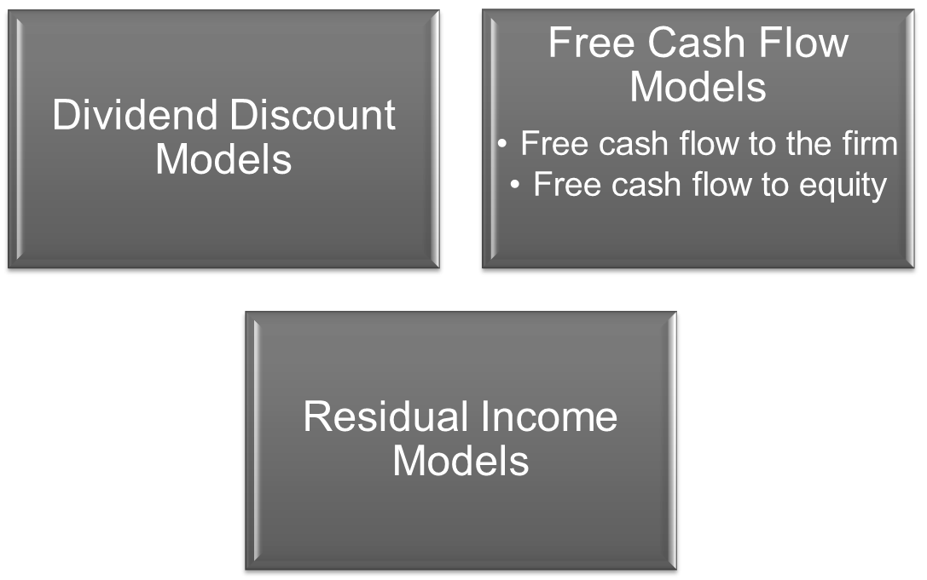
Discounted Cash Flow Models
Notes:
LOS: Compare dividends, free cash flow, and residual income as inputs to discounted cash flow models and identify investment situations for which each measure is suitable.
Pages 232–241
When valuing securities, we must discount the future cash flows to today’s present value. Valuing equity is more difficult than valuing bonds because future equity cash flows are less certain. To value equity, we will use three different definitions of future equity cash flows. The emphasis in this chapter is on dividends. In later chapters, we also examine free cash flows and residual income.
In the dividend discount model (DDM), dividends are the relevant cash flows. The rationale behind the DDM is that the cash flows are the cash flows equity investors will receive in the future. Note, however, that some firms do not pay dividends and other firms reinvest a substantial portion of earnings back in the firm. The argument for using the DDM is that sooner or later, all firms will pay dividends and reinvestment in the firm will increase future dividends.
Free cash flow is the cash flow left over after the firm fulfills certain obligations. When defined as free cash flow to the firm (FCFF), it refers to the cash flow from operations minus that needed to purchase assets needed to sustain the firm’s productive capacity. Using this definition, the value of the firm is the present value of the FCFF minus the market value of the firm’s debt. When free cash flow is defined as free cash flow to equity (FCFE), it is the FCFF minus debt payments. FCFE is the amount of cash flow available for dividends and that which can be paid out without affecting the firm’s productive capacity. Using this definition, the value of the firm is the present value of the FCFE.
Residual income is the income left over after the firm has satisfied its investors’ required return. The investors’ required return is their opportunity cost for allocating capital to the firm. In the residual income model, the value of equity is the book value of common stock plus the present value of future residual income.
Text Integration Note: Free cash flow and residual income models will be used extensively in Chapters 6 and 8 of the Equity Asset Valuation text.

Slide 108
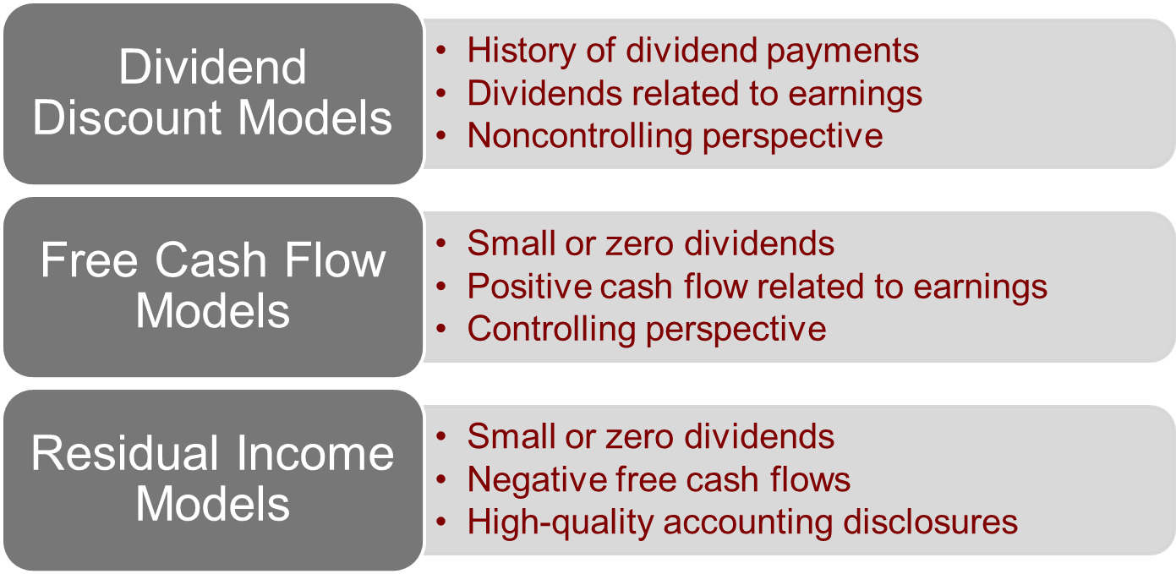
Choice of Discounted Cash Flow Models
Notes:
LOS: Compare dividends, free cash flow, and residual income as inputs to discounted cash flow models and identify investment situations for which each measure is suitable.
Pages 232–241
The choice of the discounted cash flow model for valuation should be based on the subject firm’s characteristics and the valuation perspective.
DDMs are most appropriate when
the firm has a history of dividend payments. This provides an analyst with a history from which to extrapolate future dividends. Otherwise, it is difficult to forecast when a non-dividend-paying firm will start paying dividends and how much they will eventually be.
the firm’s dividends have a consistent relationship with the firm’s earnings. Dividends should be related to firm earnings if they are to be a good indicator of future firm and shareholder wealth.
the valuation perspective is that of a noncontrolling shareholder. If the perspective is that of a controlling shareholder where firm cash flows can be controlled, a free cash flow model would be more appropriate.
DDMs are usually most applicable to mature, profitable firms with a history of stable dividend payments.
Free cash flow models are most appropriate when
the firm does not have a history of dividend payments so DDMs are difficult to use.
the firm does pay dividends, but they are a small part of the firm’s earnings. In this case, free cash flow may be better for valuation.
the firm has positive free cash flow. If a firm has negative cash flows for the foreseeable future because of, for example, large capital expenditures, it can be difficult to forecast when cash flows will become positive.
the firm’s free cash flow has a consistent relationship with the firm’s earnings so that they are a good indicator of future firm and shareholder wealth.
the perspective is that of a controlling shareholder because a controlling shareholder can control all the firm’s cash flows (not just the dividends).
Residual income models are most appropriate when
the firm does not have a history of substantial dividend payments so DDMs are difficult to use.
the firm has negative free cash flow, which makes the application of free cash flow models difficult.
the firm has accounting disclosures of high quality. This allows an analyst to rely on the reported earnings and book value needed to calculate firm value with a residual income model.

Slide 109
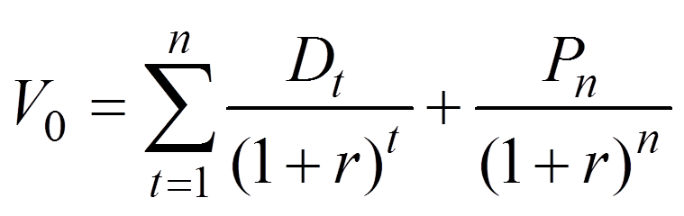
Valuing Common Stock Using a Multiperiod DDM
Notes:
LOS: Calculate and interpret the value of a common stock using the dividend discount model (DDM) for single and multiple holding periods.
Pages 241–244
The DDM is a basic tool in valuing common stock. It is widely used and accepted among practitioners and academics. The DDM is based on the idea that the value of an investment is the present value of future cash flows, where here the future cash flows are the dividends.
The formula says that the value of common stock at time zero (V₀) is equal to the discounted stream of future dividends (D_{t}) plus the expected price (P) of the stock when sold at time period n.
The discount rate is the required return on common equity (r). The formula assumes the stock will be held for n periods.
The example on the next slide illustrates the calculation.

Slide 110
Example: Valuing Common Stock Using a Multiperiod DDM
 | 0 | 1 | 2 | 3
D |  | $1.00 | $1.05 | $1.10
P |  |  |  | $20.00
Notes:
LOS: Calculate and interpret the value of a common stock using the dividend discount model (DDM) for single and multiple holding periods.
Pages 241–244
In this example, we assume that the investor will sell the stock in three years for $20. The dividend stream for the first three years is shown on the slide.
See the next slide for the solution.

Slide 111
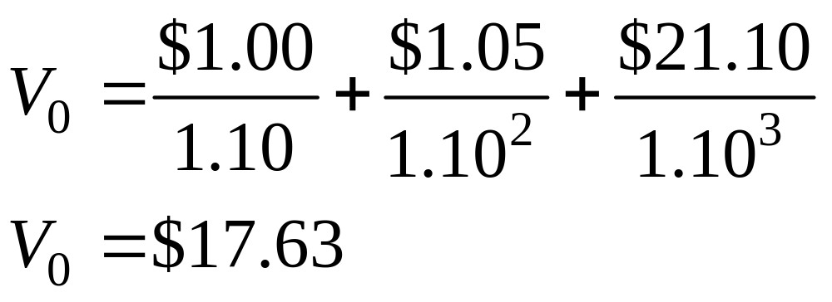
Example: Valuing Common Stock using a Multiperiod DDM
Notes:
LOS: Calculate and interpret the value of a common stock using the dividend discount model (DDM) for single and multiple holding periods.
Pages 241–244
We discount the future cash flows at a required return on equity of 10 (percent).
The total future value in Year 3 is $21.10 (the dividend in Year 3 is $1.10 and the stock price is $20).
In practice, analysts will often forecast dividends for the next 3–10 years. The length of the projected period will often depend on the perceived predictability (referred to as the visibility) of the firm’s earnings.
The stock price in the last year (here the third year) is referred to as the terminal share price.
Note that this terminal share price depends on how much the investor can sell the stock for at that time (i.e., at time three). To determine the price the future buyer will pay at Year 3, we assume the buyer at that time will discount the future stream of dividends from that point in time. Therefore, the value of the stock for the investor at Time 0 depends on all the future dividends, which will be infinite in the case of a corporation (with an unlimited life). So, in the multiperiod DDM formula (two slides previous), if we were to forecast all the future dividends, we would omit the last term, the discounted terminal price, because this term depends on the dividends going forward into eternity.
How can we get an infinite stream of dividends to converge to a finite stock value at Time 0? On the next slide, we examine the Gordon growth model, for which we assume a constant growth rate for the dividends.

Slide 112
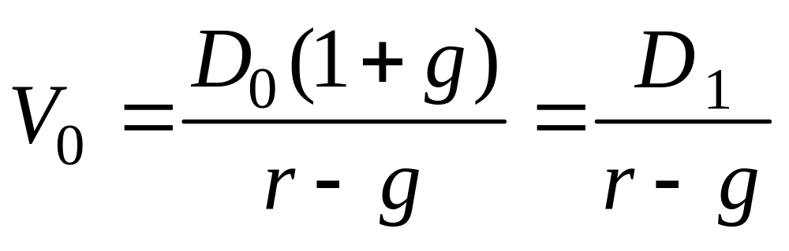
Valuing Common Stock Using the Gordon Growth Model
Notes:
LOS: Calculate the value of a common stock using the Gordon growth model and explain the model’s underlying assumptions.
Pages 244–251
To get an infinite stream of dividends to converge to a finite stock value at Time 0, we must assume that the required return on common equity is greater than the growth rate in dividends. To arrive at a simple stock valuation formula, we must also assume that the growth rate in dividends is constant. The resulting formula is the Gordon growth model.
The Gordon growth model formula says that the value of common stock at Time 0 (V₀) is equal to the dividend next period (D₁) divided by the required return on common equity (r) minus the constant growth rate for dividends (g).
Notice that the dividend next period (D₁) is equal to the current dividend (D₀) times (1 + Constant growth rate in dividends).
The formula assumes the following:
that r > g and
that g is constant.
The example on the next slide illustrates the calculation.

Slide 113
Example: Valuing Common Stock Using the Gordon Growth Model
Risk-free rate | 3 | .0%
Equity risk premium | 6 | .0%
Beta | 1 | .20
Current dividend | $2 | .00
Dividend growth rate | 5 | .0%
Current stock price | $24 | .00
Notes:
LOS: Calculate the value of a common stock using the Gordon growth model and explain the model’s underlying assumptions.
Pages 244–251
The solution is on the next slide.
We will use the CAPM discussed in Chapter 2 of the Equity Asset Valuation text to determine the required return on equity.

Slide 114
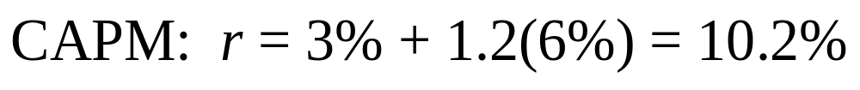
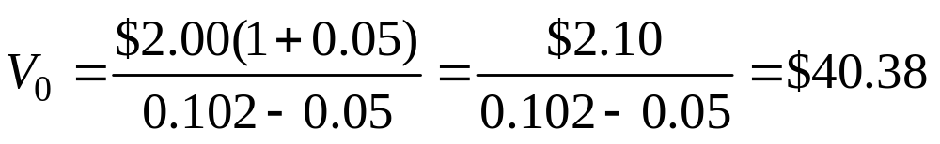
Valuing Common Stock Using the Gordon Growth Model
Notes:
LOS: Calculate the value of a common stock using the Gordon growth model and explain the model’s underlying assumptions.
Pages 244–251
In the CAPM, the required return on equity is the risk-free rate (3%) plus beta (1.20) times the equity risk premium (6%).
The stock valuation starts with the numerator of the $2 current dividend times 1 plus the growth rate. The denominator is the required return minus the growth rate of 5%.
The resulting valuation of $40.38 is greater than the current market stock price of $24, which would indicate that the stock is undervalued in the market.
But before recommending a purchase of the stock, an analyst should perform sensitivity analysis, where the stock is valued under different assumptions for the required return and growth rate. The estimated stock value in the Gordon growth model will be very sensitive to the r – g denominator.

Slide 115
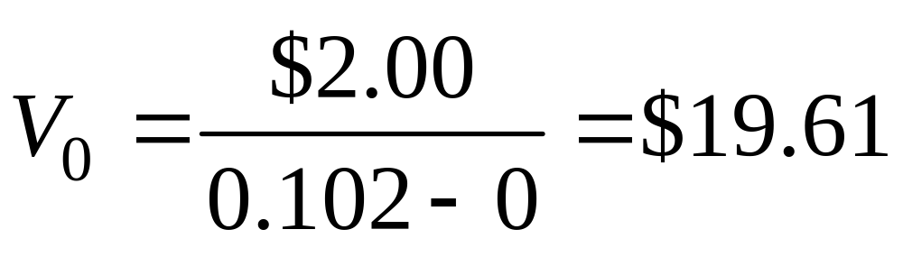
Example: Valuing Preferred Stock
Notes:
LOS: Calculate the value of noncallable fixed-rate perpetual preferred stock.
Pages 250–251
Now let’s use the same model to value preferred stock. Preferred stock is often issued by banks and other financial institutions to raise capital. Preferred stock usually pays a fixed dividend that does not grow. Although preferred stock can be callable (i.e., the issuer can retire the stock early), it sometimes has an infinite maturity (maturity in perpetuity). In this case, we can use the Gordon growth model to value it, but with a growth rate equal to zero.
Because the growth rate is zero (the dividend is constant), we divide by only the required return. For this reason, the required return is often referred to as the capitalization rate (i.e., it capitalizes the dividend).
Preferred stock has a claim on the firm’s assets that is senior to that of common stock, so it is typically considered less risky than common stock and should be valued using a lower required return. With that in mind, let’s use the same numerical example we used for common stock, except that the growth rate is zero. This will help illustrate the effect of the growth rate on stock valuation.
In the case of preferred stock, the value is the $2 dividend divided by the required return of 10.2%. (The zero in the formula represents the zero growth rate.)
The resulting valuation of $19.61 is less than half the $40.38 estimated previously for the common stock. This illustrates that with a growth rate of zero, the security is worth much less than it would be if the growth rate were 5%.

Slide 116
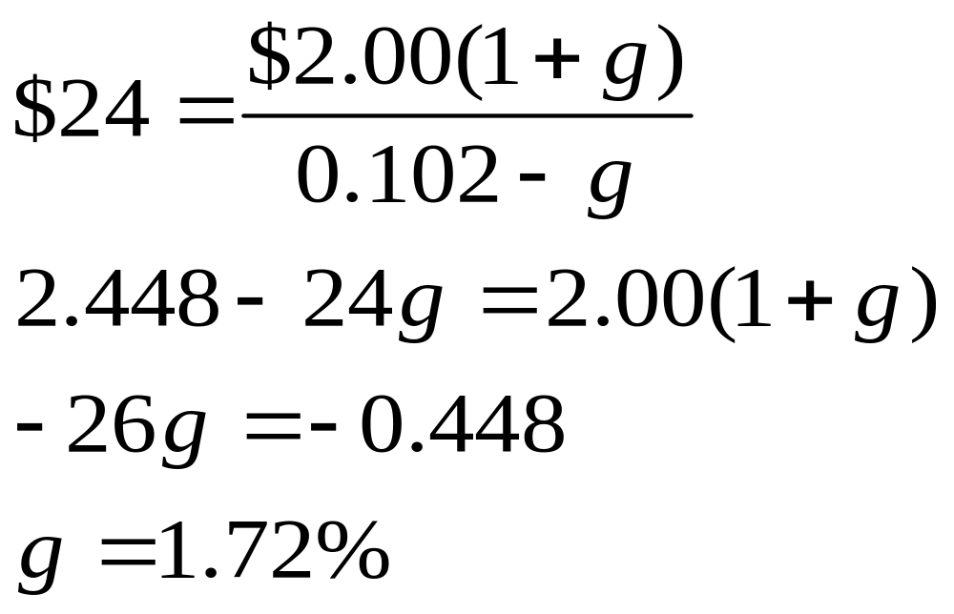
Example: Calculating the Implied Growth Rate Using the Gordon Growth model
Using the previous common stock example and the current stock price of $24, what is the implied growth rate?
Notes:
LOS: Calculate and interpret the implied growth rate of dividends using the Gordon growth model and current stock price.
Pages 253–254
The previous example demonstrated that the growth rate has a large impact on valuation. Another way to evaluate the investment attractiveness of a stock is to back out the growth rate that is implied in the current market price. An analyst would then assess whether this growth rate is reasonable.
Using the previous example in which the market stock price is $24, we can back out the growth rate the market is expecting for the firm’s dividends. We ‘solve’ for g.
The 1.72% implied growth rate is quite modest. If an analyst thinks the firm can increase dividend growth beyond 1.72%, he or she would be favorably inclined towards the stock as an investment.
Notice that the implied growth rate of 1.72% is lower than the previous given growth rate of 5% because the market stock price of $24 is less than the previous valuation of $40.38.

Slide 117
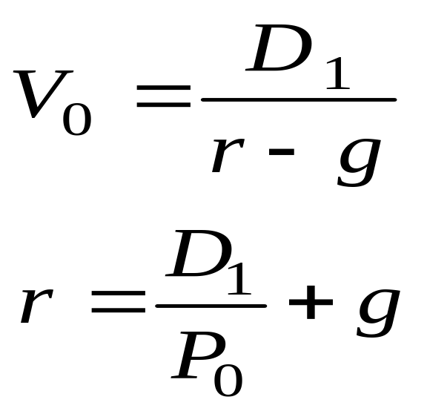
Calculating the Implied Required Return Using the Gordon Growth Model
Notes:
LOS: Estimate a required return based on any DDM, including the Gordon growth model and the H-model.
Pages 259, 274–275
Using the firm’s current stock price, we can also use the Gordon growth model to calculate the implied required return. We rearrange the Gordon growth model to calculate the required return implied by the current stock market price.
Assuming that Price (P) = Value (V), we arrive at the second formula. The first part of the formula (D/P) is the dividend yield, and the second part (g) is the capital gain (i.e., appreciation yield).
The growth rate proxies for capital appreciation because, assuming that Price = Value (markets are efficient), the stock price will grow as fast as the earnings growth rate. Furthermore, assuming a constant dividend payout ratio, the earnings growth rate and the dividend growth rate will be equal. This also results in future dividend yield (forward dividend yield) and capital appreciation components remaining constant through time.
Note, however, that if price is not equal to value, then the stock price can grow at a different rate than g. In this case, the future path of the stock price can be independent of g (e.g., the mispricing corrects itself).
The next slide uses the previous example to calculate the implied required return.

Slide 118
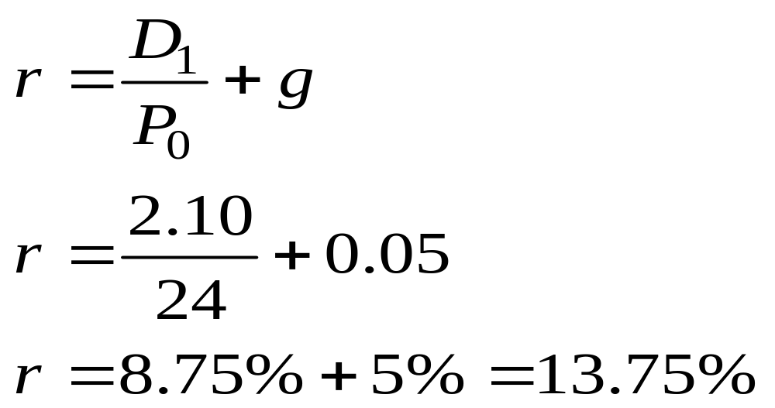
Example: Calculating the Implied Required Return Using the Gordon Growth Model
Using the previous common stock example and the current stock price of $24, what is the implied required return?
Notes:
LOS: Estimate a required return based on any DDM, including the Gordon growth model and the H-model.
Pages 259, 274–275
Using the previous example with the given stock price of $24 and given the growth rate of 5%, the implied required return of 13.75% consists of an 8.75% dividend yield and a 5% capital appreciation (from the growth rate).
Note that this is higher than the 10.2% required return we calculated using the CAPM. One interpretation is that the market is placing too high of a required return on the stock relative to the CAPM required return, which is why the stock is currently undervalued in the market.

Slide 119
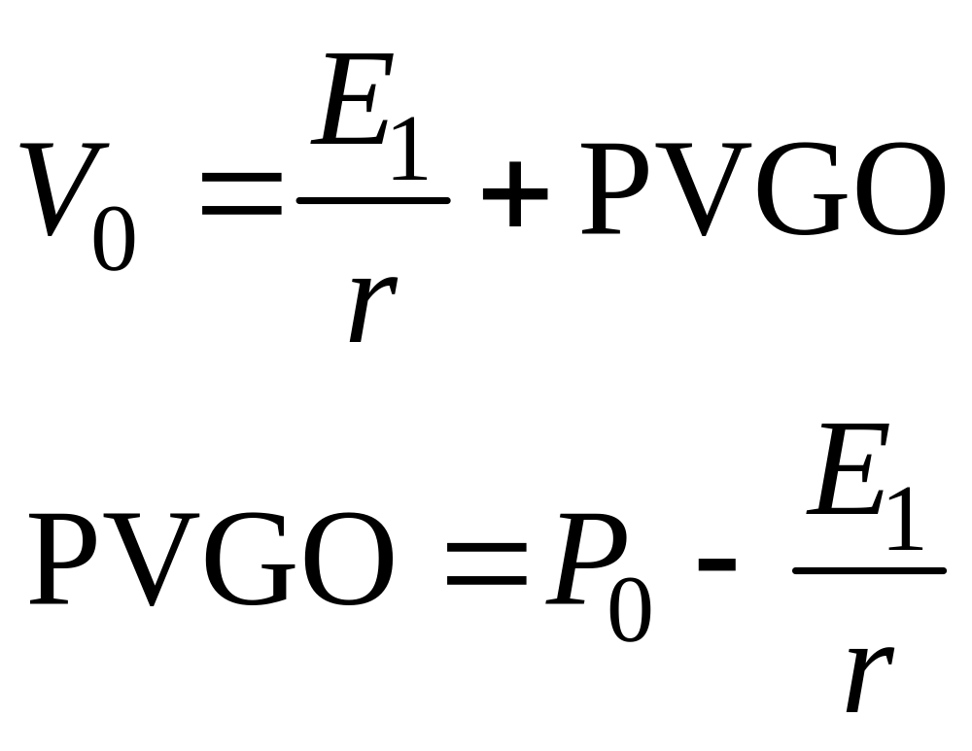
Present Value of Growth Opportunities
Notes:
LOS: Calculate and interpret the present value of growth opportunities (PVGO) and the component of the leading price-to-earnings ratio (P/E) related to PVGO.
Pages 254–256
The value of a firm can be thought of as the value of the firm without earnings reinvestment plus the firm’s present value of growth opportunities (PVGO), also known as the value of growth.
Consider a firm with a 10% required return on equity. If the firm has new projects available with returns greater than 10%, the firm should invest in them because they will generate positive net present values (NPVs). If, on the other hand, a project’s return is less than 10%, the firm should pay all earnings out as dividends. In the latter case, the firm should pay out all earnings as dividends and earnings will be constant in perpetuity (because the firm does not reinvest in its operations). Firms in this position are referred to as no-growth companies. The no-growth value per share is valued as the perpetuity of E/r (the first term in the formula above using expected next period earnings, E₁).
If, however, the firm does have positive NPV projects and we were to discount those future cash flows, we would arrive at the PVGO. In the formula shown, if we assume that Price (P) = Value (V), then we arrive at a calculation for the PVGO. Essentially, we assume that the market stock price reflects a no-growth value for a firm plus the PVGO. We obtain the market’s estimate of the PVGO using the formula shown.
Firms with greater opportunities and those that have greater flexibility to modify projects through time (referred to as real options) will have higher PVGO. The latter value arises because real options allow firms to respond to changes in the marketplace.

Slide 120
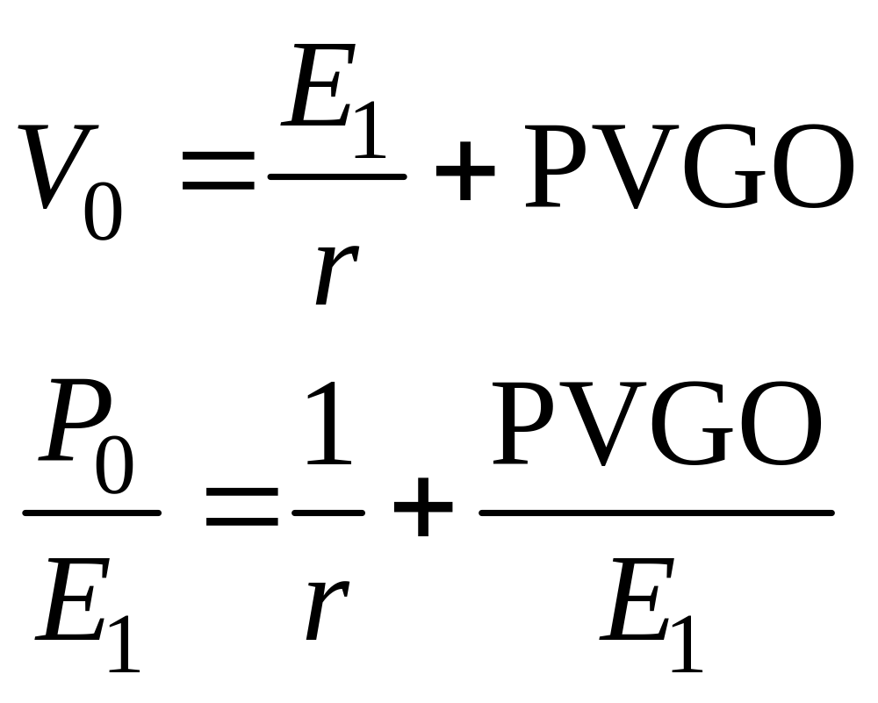
Present Value of Growth Opportunities
Notes:
LOS: Calculate and interpret the present value of growth opportunities (PVGO) and the component of the leading price-to-earnings ratio (P/E) related to PVGO.
Pages 254–256
The formula can also be rearranged to solve for the percent of the P/E related to the PVGO. In the formula, we divide both sides by expected earnings (E₁) and assume that Price (P) = Value (V).
The first term in the bottom formula represents the P/E for a no-growth company. The second term is the part of the P/E value related to growth opportunities.
The example on the next slide illustrates the calculation of these concepts.

Slide 121
Example: Present Value of Growth Opportunities
Stock price | $80 | .00
Expected earnings | $5 | .00
Required return on stock | 10 | %
Notes:
LOS: Calculate and interpret the present value of growth opportunities (PVGO) and the component of the leading price-to-earnings ratio (P/E) related to PVGO.
Pages 254–256

Slide 122
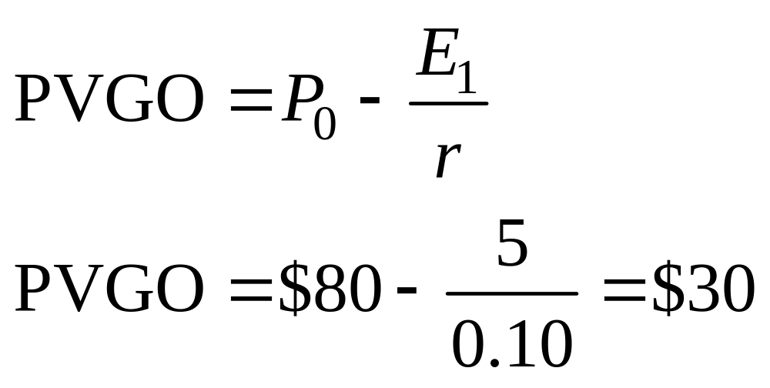
Example: Present Value of Growth Opportunities
Notes:
LOS: Calculate and interpret the present value of growth opportunities (PVGO) and the component of the leading price-to-earnings ratio (P/E) related to PVGO.
Pages 254–256
$50 (i.e., $5/0.10) of the firm’s value is attributable to the no-growth value per share. The rest of the firm’s value, $30, is attributable to PVGO.
As a percent, 30/80 or 37.5% of firm value is explained by the PVGO.

Slide 123
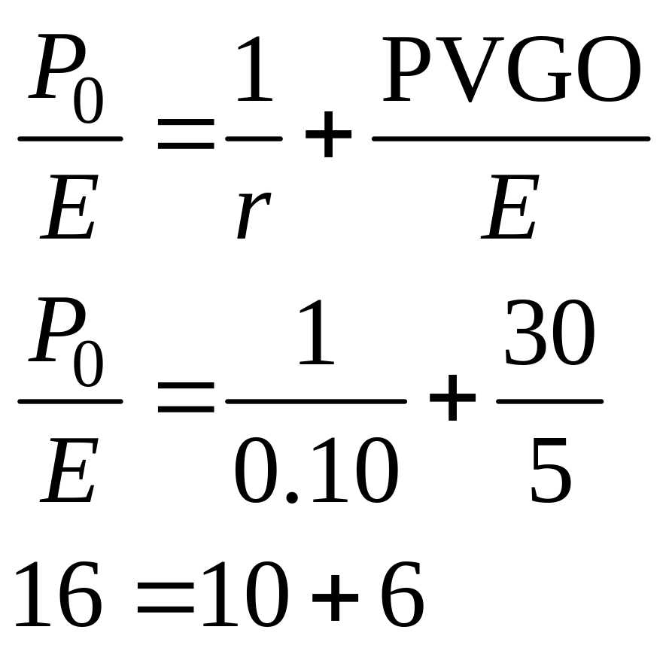
Example: Present Value of Growth Opportunities
Notes:
LOS: Calculate and interpret the present value of growth opportunities (PVGO) and the component of the leading price-to-earnings ratio (P/E) related to PVGO.
Pages 254–256
Of the firm’s P/E of 16, 10 is attributable to the no-growth value. The remaining 6 is attributable to PVGO.

Slide 124
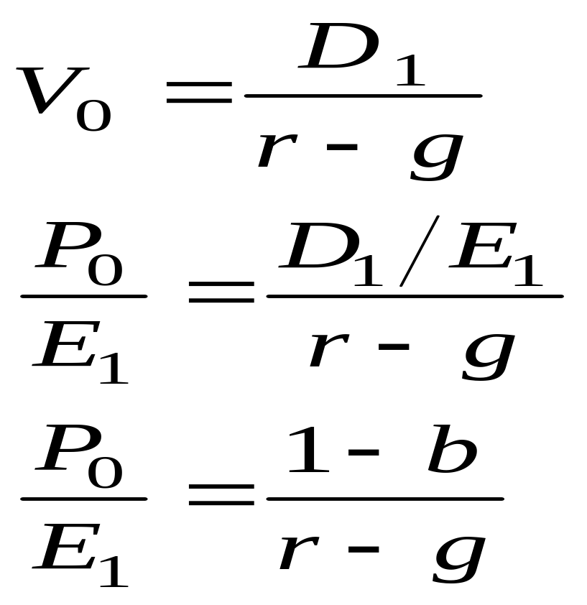
Using the Gordon Growth Model to Derive a Justified Leading P/E
Notes:
LOS: Calculate and interpret the justified leading and trailing P/Es using the Gordon growth model.
Pages 256–258
We can also use the Gordon growth model to derive a justified P/E. The justified P/E can be used to determine what the P/E should be, given the firm’s characteristics. This P/E is referred to as the fundamental P/E, and its use may be more helpful than using only the Gordon growth model because the P/E is so widely used. Using the current market stock price, a justified P/E can also be used to back out the market’s implied growth rate for the firm. This market-implied growth rate can then be examined for its reasonableness.
To determine the justified leading P/E, we take the Gordon growth model and divide both sides by the earnings next year (E₁), which results in the second formula shown. We’ll define b as the retention ratio, which is that portion of earnings that is reinvested in the firm. Recognizing that 1 – b is the dividend payout ratio (D/E), we have the third formula.
Note that, as in earlier derivations using the Gordon growth model, we assume that Price (P) = Value (V).
On the next slide, we derive a trailing P/E based on fundamentals using the Gordon growth model.

Slide 125
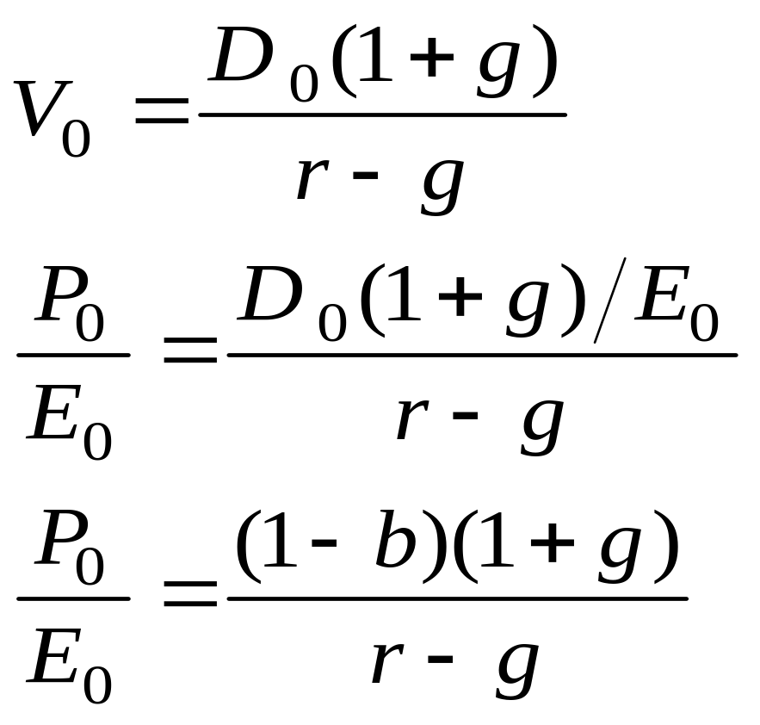
Using the Gordon Growth Model to Derive a Justified Trailing P/E
Notes:
LOS: Calculate and interpret the justified leading and trailing P/Es using the Gordon growth model.
Pages 256–258
To derive a trailing P/E based on fundamentals using the Gordon growth model, we will use current dividends (D₀) and current earnings (E₀). Assuming that Price (P) = Value (V), we then divide both sides by E₀. Once again recognizing that 1 – b is the dividend payout ratio (D/E), we have the third formula.
The example on the next slide illustrates the calculation.

Slide 126
Example: Using the Gordon Growth Model to Derive a Justified P/E
Stock price | $50 | .00
Trailing earnings per share | $4 | .00
Current dividends per share | $1 | .60
Dividend growth rate | 5 | .0%
Required return on stock | 9 | .0%
Notes:
LOS: Calculate and interpret the justified leading and trailing P/Es using the Gordon growth model.
Pages 256–258

Slide 127
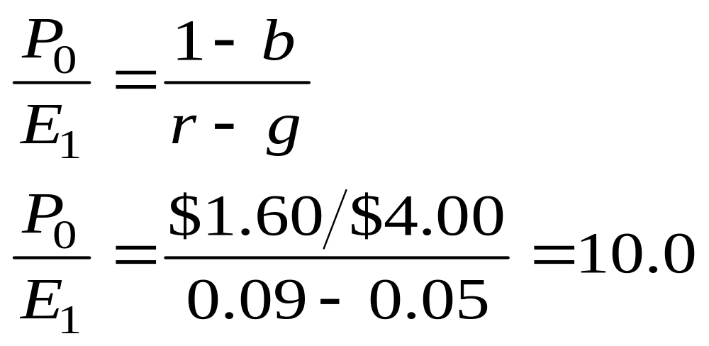
Example: Using the Gordon Growth Model to Derive a Justified Leading P/E
Notes:
LOS: Calculate and interpret the justified leading and trailing P/Es using the Gordon growth model.
Pages 256–258
To determine the justified leading P/E, we divide the dividend payout ratio by r – g. Note that 1 – b (b = Retention ratio) is the dividend payout ratio, which is just $1.60/$4.00.
The resulting P/E is 10.0.
On the next slide, we calculate the trailing P/E.
Note to instructor: The derivation we did on slide 19 for the justified leading P/E uses D₁/E₁ in the numerator. We use D₀/E₀ here (as does the text), assuming that the dividend payout ratio stays constant from time period 0 to 1.

Slide 128
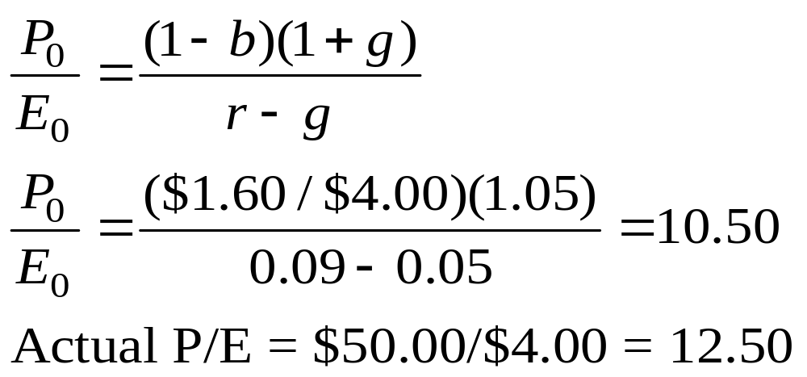
Example: Using the Gordon Growth Model to Derive a Justified Trailing P/E
Notes:
LOS: Calculate and interpret the justified leading and trailing P/Es using the Gordon growth model.
Pages 256–258
To determine the justified trailing P/E, we multiply the dividend payout ratio by 1 + g and then divide by r – g, which results in 10.50.
To obtain the actual trailing P/E, divide the actual stock price of $50 by the trailing earnings of $4 to obtain 12.50.
Because the market is valuing the firm’s earnings more than that justified by the firm’s fundamentals, the stock is overvalued.

Slide 129
Issues Using the Gordon Growth Model
Strengths
Simple and applicable to stable, mature firms
Limitations
Not applicable to non-dividend-paying firms
g must be constant
Can be applied to firms that repurchase stock
g can be estimated using macro data
Can be applied to entire markets
Stock value is very sensitive to r – g
Most firms have nonconstant growth in dividends
Notes:
LOS: Describe strengths and limitations of the Gordon growth model and justify its selection to value a company’s common shares.
Pages 244–254, 256–260
The strengths of the Gordon growth model are the following:
It is simple to understand and applicable to stable, mature firms that have constant growth in dividends.
It can be used to value an entire stock market using the data for the entire stock market.
g, the growth rate in dividends, can be estimated using g = nominal GDP (gross domestic product) growth, which is the sum of real GDP growth and long-term inflation. Note that estimated long-term dividend growth rates should not be much higher than the GDP growth rate because a firm’s growth cannot greatly exceed the economy’s over the long term.
The Gordon growth model can be applied to firms that both pay dividends and repurchase stock if an analyst forecasts per share dividends that reflect the number of shares that will be repurchased over time. Note, however, that firms do not commit to repurchase policies the way they do dividend policies; forecasting repurchases is thus difficult.
The limitations of the Gordon growth model are the following:
The model cannot be reliably applied to firms without a dividend history because forecasting future dividends becomes more difficult. Dividends should also have a consistent relationship with the firm’s earnings.
The model assumes that the dividend growth rate is constant, so it cannot be applied to firms with several different future growth rates in dividends. Recall also that the model assumes that the required return on equity (r) is greater than the dividend growth rate.
The estimated stock value is very sensitive to the r – g denominator. If the denominator changes by just 1%, for example, estimated valuations will change by a large monetary value. For this reason, an analyst should perform sensitivity analysis, where the stock is valued under different required returns and growth rates.
Many, perhaps most, firms have nonconstant growth in future dividends, so the Gordon growth model cannot be directly applied. For these firms, we will need to use multistage models, which are discussed in the slides to follow.
129

Slide 130
Choice of Discounted Cash Flow Models
Growth
Transition
Earnings growth slows
Maturity
ROE = r
Capital reinvestment slows
FCFE and dividends increasing
Earnings and dividends growth matures
Gordon growth model useful
Small or no dividends
Heavy reinvestment
Rapidly increasing earnings
Notes:
LOS: Explain the growth phase, transitional phase, and maturity phase of a business.
Pages 260–261
Most firms have nonconstant growth in future earnings and dividends, so we will need to use multistage models for these firms. For many firms, practitioners assume that growth has three stages, which are characterized as follows.
Growth phase
Markets and earnings are rapidly increasing.
Firm has high profit margins.
Heavy reinvestment, which often results in a negative free cash flow to equity (FCFE).
Little or no dividends paid because reinvestment offers high returns.
Growth eventually slows as competitors enter the marketplace.
Transition phase
Earnings are still increasing but at a slower rate as competition increases.
Earnings growth is above average but is declining toward the growth rate for the overall economy.
Capital reinvestment slows, resulting in positive free cash flow and increasing dividend payout ratios.
Mature phase
Return on reinvestment in firm (ROE) equals required returns.
Earnings, dividend payout ratios, and return on equity stabilize to long-term rates.
Earnings and dividends grow at the mature growth rate.
Firm can be valued during this phase using the Gordon growth model.
Firms often try to extend the growth phase using changes in strategy or business mix. Technology may also change the duration of the growth phase. Nevertheless, the three stages are a useful approximation for many firms’ phases. They form the rationale for the multistage models we look at next.

Slide 131
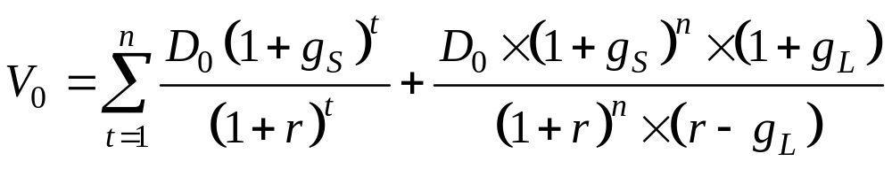
General Two-Stage Dividend discount model (DDM)
Notes:
LOS: Explain the assumptions and justify the selection of the two-stage DDM, the H-model, the three-stage DDM, or spreadsheet modeling to value a company’s common shares.
LOS: Calculate and interpret the value of common shares using the two-stage DDM, the H-model, and the three-stage DDM.
Pages 261–267
There are two forms of the two-stage DDM. We’ll look at the first version here, referred to as the general two-stage DDM. In this model, the first stage of rapid growth abruptly transitions to a second stage of constant growth.
A firm that is expected to have a high rate of growth until patents expire, for example, should be modeled by this two-stage model, with one rate of growth before the patent expires and another rate thereafter. The general two-stage DDM is appropriate when the firm has a temporary advantage in the market, such as first-mover advantage. The model assumes that earnings eventually decline to a long-term rate equal to that of the economy.
The formula says that the value of common stock at Time 0 (V₀) is equal to two terms:
the discounted stream of dividends during the high-growth phase, which grows at g_{S} (the short-term growth rate); and
the present value of the dividend stream growing in perpetuity at g_{L} (the long-term growth rate).
The example on the next slide illustrates the calculation.

Slide 132
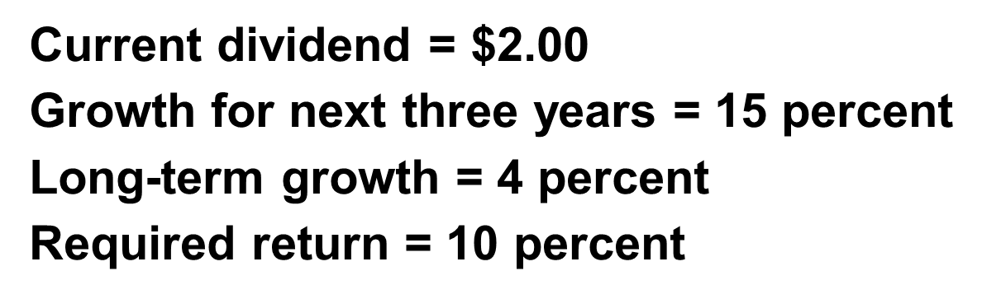
Example: General Two-Stage DDM
Notes:
LOS: Explain the assumptions and justify the selection of the two-stage DDM, the H-model, the three-stage DDM, or spreadsheet modeling to value a company’s common shares.
LOS: Calculate and interpret the value of common shares using the two-stage DDM, the H-model, and the three-stage DDM.
Pages 261–267
See the next slide for the solution.

Slide 133
Example: General Two-Stage DDM
Step 1: Calculate the first three dividends:
  D1 = $2.00 x (1.15) = $2.30
  D2 = $2.30 x (1.15) = $2.6450
  D3 = $2.6450 x (1.15) = $3.0418
Step 2: Calculate the Year 4 dividend:
  D4 = $3.0418 x (1.04) = $3.1634
Step 3: Calculate the value of the constant growth dividends:
  V3 = $3.1634 / (0.10 – 0.04) = $52.7237
Notes:
LOS: Explain the assumptions and justify the selection of the two-stage DDM, the H-model, the three-stage DDM, or spreadsheet modeling to value a company’s common shares.
LOS: Calculate and interpret the value of common shares using the two-stage DDM, the H-model, and the three-stage DDM.
Pages 261–267
Notice that we use the Gordon growth model to determine the value of the perpetual stream of dividends that starts in Year 4. This value, V₃, is referred to as the terminal value and is also known as the continuing value.
See the next slide for the discounting of the future cash flows.

Slide 134
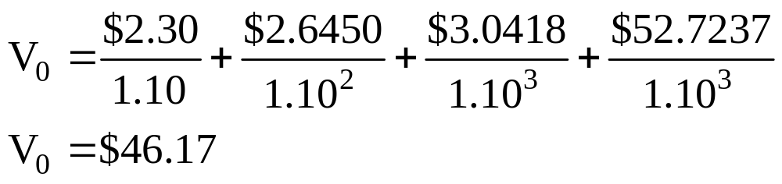
Example: General Two-Stage DDM
Notes:
LOS: Explain the assumptions and justify the selection of the two-stage DDM, the H-model, the three-stage DDM, or spreadsheet modeling to value a company’s common shares.
LOS: Calculate and interpret the value of common shares using the two-stage DDM, the H-model, and the three-stage DDM.
Pages 261–267

Slide 135
Example: General Two-Stage DDM
Using the previous example, now we’ll use the trailing P/E to determine the terminal value
D4 is $3.1634
Assume also that the projected P/E is 13.0 in Year 4 and that the firm will pay out 60% of earnings as dividends
Year 4 earnings are then $3.1634/0.60 = $5.2724
The stock price in Year 4 is then $5.2724 × 13 = $68.54
Notes:
LOS: Explain the assumptions and justify the selection of the two-stage DDM, the H-model, the three-stage DDM, or spreadsheet modeling to value a company’s common shares.
LOS: Calculate and interpret the value of common shares using the two-stage DDM, the H-model, and the three-stage DDM.
Pages 261–267
Now we will use the P/E in Year 4 instead of the Gordon growth model to determine the terminal value.
See the next slide for the resulting stock value.

Slide 136
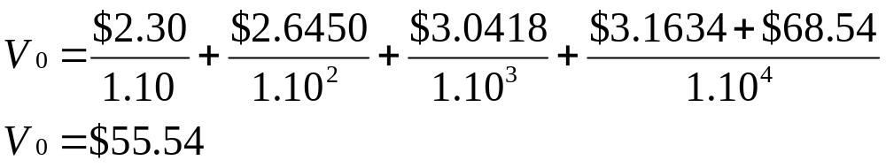
Example: General Two-Stage DDM
Notes:
LOS: Explain the assumptions and justify the selection of the two-stage DDM, the H-model, the three-stage DDM, or spreadsheet modeling to value a company’s common shares.
LOS: Calculate and interpret the value of common shares using the two-stage DDM, the H-model, and the three-stage DDM.
Pages 261–276
Notice that in this calculation, we assume the investor receives the Year 4 dividend of $3.1634 and then sells the stock at $68.54.
The resulting stock value of $55.54 is higher than what we previously calculated because the estimated Year 4 terminal value is higher.

Slide 137
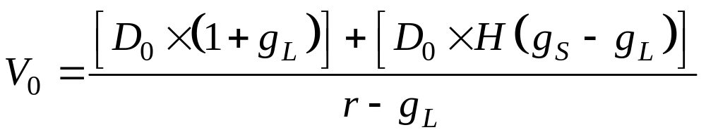
Two-Stage H-Model
Notes:
LOS: Explain the assumptions and justify the selection of the two-stage DDM, the H-model, the three-stage DDM, or spreadsheet modeling to value a company’s common shares.
LOS: Calculate and interpret the value of common shares using the two-stage DDM, the H-model, and the three-stage DDM.
Pages 265–267
We now examine the second form of a two-stage DDM, the H-model. The H-model assumes an initially high rate of growth that declines linearly over a specified period until it reaches a normal rate that exists in perpetuity. An example would be a firm facing competition that is expected to increase. Growth declines as competitors enter the market and then stabilizes as the industry matures.
In the formula shown:
H = half-life (in years) of high-growth period
g_{S} = short-term growth rate
g_{L} = long-term growth rate
r = required equity return
The formula assumes that the high-growth period lasts 2 x H years. Stocks with longer high-growth periods and greater high-growth rates will have higher values. Note that the H-model provides the approximate stock value. It is less accurate when there are very long growth periods (high H) and large differences between g_{S} and g_{L}. In this case, a spreadsheet can be helpful for valuing the stock.
The example on the next slide illustrates the calculation.

Slide 138
Example: Two-Stage H-Model
Current dividend | $3 | .00
g_{s} | 20 | %
g_{L} | 6 | %
H | 5
Required return on stock | 10 | %
Current stock price | $120
Notes:
LOS: Explain the assumptions and justify the selection of the two-stage DDM, the H-model, the three-stage DDM, or spreadsheet modeling to value a company’s common shares.
LOS: Calculate and interpret the value of common shares using the two-stage DDM, the H-model, and the three-stage DDM.
Pages 265–267
See the next slide for the solution.

Slide 139
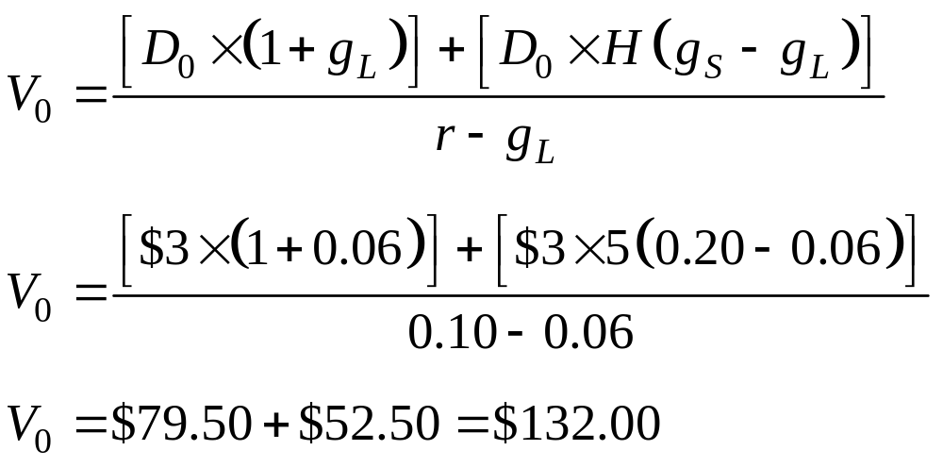
Example: Two-Stage H-Model
Notes:
LOS: Explain the assumptions and justify the selection of the two-stage DDM, the H-model, the three-stage DDM, or spreadsheet modeling to value a company’s common shares.
LOS: Calculate and interpret the value of common shares using the two-stage DDM, the H-model, and the three-stage DDM.
Pages 265–267
With an H of 5, the high-growth period lasts 10 years.
The value of the normal growth is $79.50 or 60.2% (79.50/132) of total stock value.
The value of the high growth is $52.50 or 39.8% (52.50/132) of total stock value.
The total value of $132 is greater than the current price of $120, which indicates that the stock is undervalued.
On the next slide, we will use the H-model to determine the required return implied by the current market stock price.

Slide 140
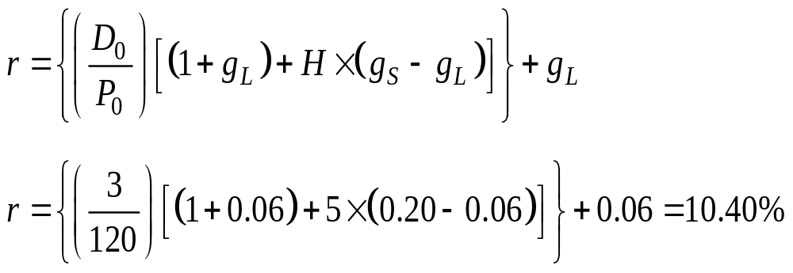
Solving for the Required Return Using the Two-Stage H-Model
Notes:
LOS: Estimate a required return based on any DDM, including the Gordon growth model and the H-model.
Page 274–275
The H-model can be rearranged to solve for the required return (r) using the current market stock price. This is essentially an internal rate of return (IRR) and the return that investors should expect assuming that the market is efficient (i.e., the stock is correctly valued). If the stock is not correctly valued, this expected return would have to be adjusted for eventual correction of mispricing in the market.
We apply this formula using the previous example in which the stock price was $120. Solving for the required return implied by the current stock price, we calculate 10.40%, which is consistent with our previous conclusion that the stock is undervalued. Previously, we used a required return of 10%. Because we believe the stock is not as risky as the market expects, we are willing to pay more than the market price.
This example is stylized in that it conforms to the H-model. Other examples that we have covered were also stylized in that the cash flows were assumed to follow a standardized pattern that fits a model. If the dividend pattern is more complex and does not follow a standardized pattern, we could use a spreadsheet program to value the stock or find the implied required return. For example, if growth was 20% for two years, then 15% for three years, then 10% for another three years before declining to 5% for eternity, a spreadsheet program would be quite useful. This is particularly true when the IRR cannot be calculated directly from a formula and must be determined using an iterative process. Spreadsheets can also be used to develop complex models of the firm’s operating and financial environment. These can then be used to develop pro forma balance sheet and income statements, which are useful for forecasting dividends and valuation.

Slide 141
Example: Three-Stage Model
Firm pays a current dividend of $1.00
Growth rate is 20% for next two years
Growth then declines over six years to a stable rate of 5%
Required return is 10%
Current stock price is $50
Notes:
LOS: Explain the assumptions and justify the selection of the two-stage DDM, the H-model, the three-stage DDM, or spreadsheet modeling to value a company’s common shares.
LOS: Calculate and interpret the value of common shares using the two-stage DDM, the H-model, and the three-stage DDM.
Pages 267–272
We will use the H-model for the last two stages, where the H = 3, g_{S} = 20%, and g_{L} = 5%.
The solution is on the next slide.

Slide 142
Three-Stage Model
Assumes three distinct growth stages:
  First stage of growth
  Second stage of growth
  Stable phase of growth
H-model can be used for last two stages if growth declines linearly
Notes:
LOS: Explain the assumptions and justify the selection of the two-stage DDM, the H-model, the three-stage DDM, or spreadsheet modeling to value a company’s common shares.
LOS: Calculate and interpret the value of common shares using the two-stage DDM, the H-model, and the three-stage DDM.
Pages 267–272
We can also specify a three-stage DDM. The three-stage DDM can be specified assuming
constant growth in the second stage or
growth during the second stage that declines linearly to the mature growth rate.
Under the second assumption, the second and third stages of dividend growth can be valued using the H-model. The example on the next slide illustrates this case.

Slide 143
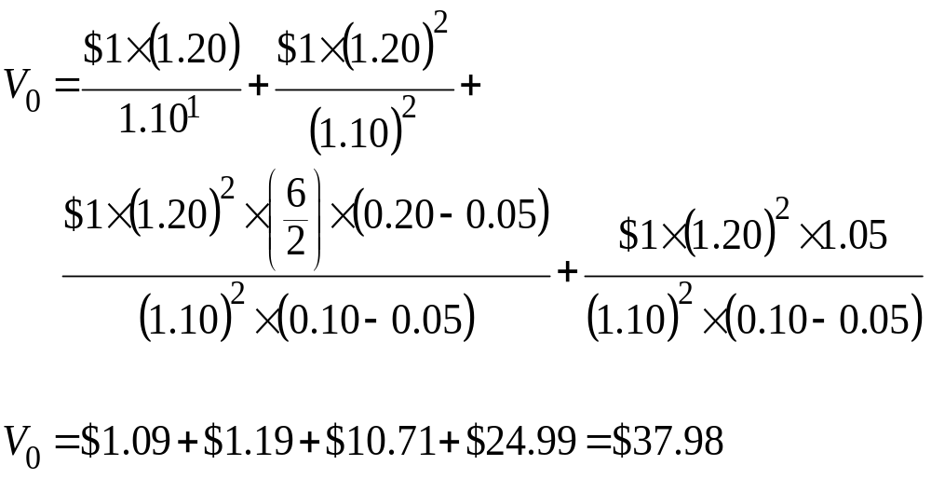
THREE-STAGE MODEL EXAMPLE
Notes:
LOS: Explain the assumptions and justify the selection of the two-stage DDM, the H-model, the three-stage DDM, or spreadsheet modeling to value a company’s common shares.
LOS: Calculate and interpret the value of common shares using the two-stage DDM, the H-model, and the three-stage DDM.
Pages 267–272
The first two terms are the present values of the first two dividends.
Note that the third and fourth terms are from the H-model.
We discount those terms by 10% to bring the Year 2 present value back to Year 0.
The total value of $37.98 is less than the current price of $50, which indicates that the stock is overvalued.
The value of the first two dividends is $1.09 + $1.19 = $2.28 or 6% (2.28/37.98) of total stock value. The other 94% of value comes from the second and third stages of growth. Because such a large part of value comes from the final two stages, an analyst should examine the model valuations under various assumptions. Furthermore, an analyst should keep in mind that the arrival of new technologies could dramatically change the parameters of his or her model.
On the next slide, we will discuss methods used to determine the growth rate, g.

Slide 144
Estimating the Growth Rate
Industry or Macroeconomic Average
g = b × ROE
DuPont formula
ROE = r
ROE = industry ROE
Notes:
LOS: Calculate and interpret the sustainable growth rate of a company and demonstrate the use of the DuPont analysis to estimate a company’s sustainable growth rate.
Page 276–281
The mature growth rate in dividends (g) will have a large impact on valuation when used in the Gordon growth model or when used in multistage models to determine the terminal value. To determine the mature growth rate, an analyst can take several approaches.
Estimate g using industry and macroeconomic growth rate projections, assuming the firm’s g is related to that of the industry and economy.
Use g = b (retention ratio in the mature phase) × ROE (return on equity in the mature phase). To determine ROE, analysts can use
The DuPont formula, where ROE is decomposed into net profit margin, total asset turnover, and the equity multiplier (see the slides to follow).
ROE = r, which assumes that a mature firm can do no more than to earn the required return on equity.
ROE = median industry ROE.

Slide 145
The Sustainable Growth Rate
g
b
ROE
Notes:
LOS: Calculate and interpret the sustainable growth rate of a company and demonstrate the use of the DuPont analysis to estimate a company’s sustainable growth rate.
Page 276–281
The sustainable growth rate (g) in dividends and earnings is that which a firm can maintain through time without changing its capital structure and without issuing new external equity.
The formula implies that the lower (higher) the ROE, the lower (higher) the dividend growth rate, g. It also implies that the lower (higher) the retention ratio (b), the lower (higher) the dividend growth rate. This relationship has been called the “dividend displacement of earnings” (paying more dividends reduces future earnings growth).
It is useful to define g in terms of that sustainable from internal equity (internally generated funds) because external equity (new issuances of stock) is more costly, as a result of, in part, the associated investment banking fees. A firm will keep its capital structure constant under these assumptions because the firm will issue new debt as internal equity grows.
In reality, retention ratios and growth rates will have year-to-year volatility. The above relationship is useful, however, for projecting a growth rate over a long horizon.

Slide 146
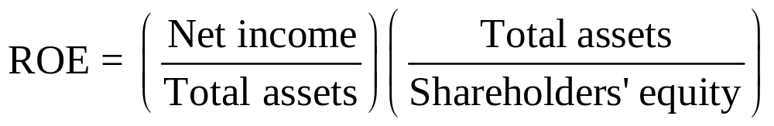
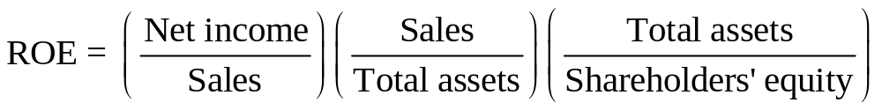
The DuPont Model
Notes:
LOS: Calculate and interpret the sustainable growth rate of a company and demonstrate the use of the DuPont analysis to estimate a company’s sustainable growth rate.
Page 276–281
We can use the DuPont equation to estimate the ROE using the components of the ROE.
The first equation states that the ROE is equal to the return on assets (Net income/Total assets) times the equity multiplier (Total assets/Shareholders’ equity). The greater the firm’s use of debt (financial leverage), the higher the equity multiplier.
We decompose ROE further in the second equation. It states that the ROE is equal to the net profit margin (Net income/Sales) times the total asset turnover (Sales/Total assets) times the equity multiplier (Total assets/Shareholders’ equity). The first two ratios measure the firm’s operating efficiency. The total asset turnover tells us how much sales the firm generates given a level of asset investment.
In the third equation, we use the retention ratio (the first term) and the DuPont decomposition of the ROE to calculate the growth rate. Two of the factors for the growth rate are primarily functions of the firm’s financing decisions (earnings retention and leverage), and two are functions of operating performance (net profit margin and asset turnover). The formula tells us that the higher a firm’s retention of earnings, profit margin, asset use efficiency, and financial leverage, the higher the sustainable growth rate.
The example on the next slide illustrates the calculation.

Slide 147
Example: DuPont Model
Net profit margin | 5 | .00%
Total asset turnover | 1 | .5
Equity multiplier | 2 | .0
Retention ratio | 60 | %
Notes:
LOS: Calculate and interpret the sustainable growth rate of a company and demonstrate the use of the DuPont analysis to estimate a company’s sustainable growth rate.
Page 276–281

Slide 148
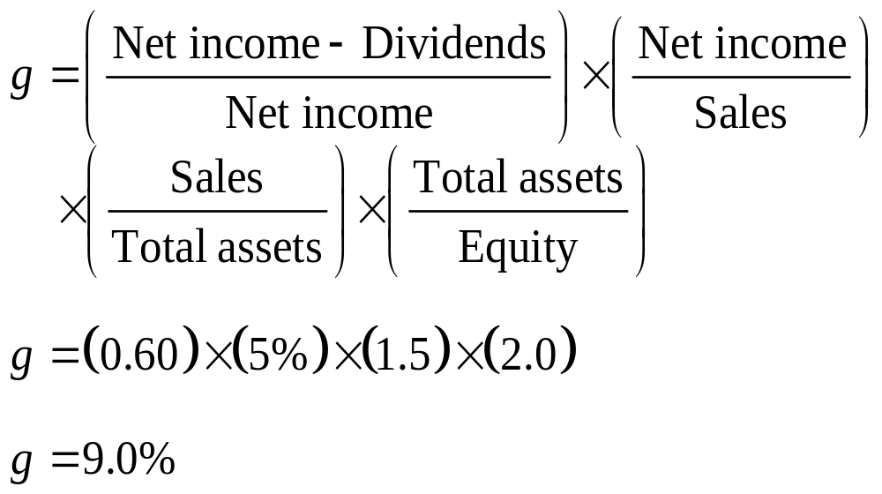
Example: DuPont Model
Notes:
LOS: Calculate and interpret the sustainable growth rate of a company and demonstrate the use of the DuPont analysis to estimate a company’s sustainable growth rate.
Page 276–281
The calculations provide a sustainable growth rate (SGR) of 9.0%. If the firm increases dividends at a rate faster than 9%, the growth is not sustainable using internally generated funds.
This decomposition has also been referred to as the PRAT model, in which the SGR is a function of the profit margin (P), the retention rate (R), the asset turnover (A), and the degree of financial leverage (T).
In this example, the ROE is 15% (5% × 1.5 × 2). An analyst should consider whether high ROEs are sustainable perpetually, given competitive product markets and technological changes.

Slide 149
Summary
Choice of Discounted Cash Flow Models
Gordon Growth Model
Assumes constant g and r > g
Dividend discount models, free cash flow models, residual income models
Dividend models most appropriate for
Mature, profitable, dividend-paying firms
Noncontrolling shareholder perspective
Applicable to mature, stable firms
Estimated value very sensitive to r – g denominator
Notes:
Pages 283–285

Slide 150
Summary
Uses of Gordon Growth Model
Phases of Growth
Growth
Preferred stock valuation where g = 0
PVGO – Value from future growth
Justified leading and trailing P/Es
Implied r and g
Transition
Maturity
Notes:
Pages 283–285

Slide 151
Summary
Multistage Models
Sustainable Growth Rate
g = Retention ratio × ROE
General two-stage model: growth abruptly declines
H-model: growth gradually declines
Three-stage model: can use general or H-model
DuPont analysis:
ROE = Profit margin × Asset turnover × Equity multiplier
Notes:
Pages 283–285

Slide 152
Free Cash Flow
Valuation
Notes:
In Chapter 5, we used dividends as the measure of shareholder cash flow in stock valuation. In Chapter 6, we will use the concept of free cash flow. Whereas dividends are the cash flow actually paid to shareholders, free cash flow (FCF) is the cash flow available to shareholders.
Unlike dividends, data on free cash flows are not readily available. Stock analysts must interpret financial statements to determine free cash flows. Although free cash flow analysis can prove quite challenging, many analysts consider free cash flow models more relevant than dividend discount models.
In this chapter, we begin by examining two definitions of free cash flow. We then discuss the determination of free cash flows so that they can be used in valuation models. We will use models similar to dividend discount models (DDMs), such as the stable-growth model, two-stage model, and three-stage model.
DISCLAIMER: This presentation is NOT a substitute for the CFA Program curriculum. Candidates should not view this material as reflecting what will be required of them on the CFA exam.

Slide 153
Free Cash Flow
Free Cash Flow to the Firm
Free Cash Flow to Equity
= Cash flow available to
Common stockholders
= Cash flow available to
Debtholders
Preferred stockholders
Common stockholders
Notes:
LOS: Compare the free cash flow to the firm (FCFF) and free cash flow to equity (FCFE) approaches to valuation.
Pages 296–298
Free cash flow to the firm (FCFF) is the cash flow available to all the firm’s suppliers of capital once the firm pays all operating expenses (including taxes) and expenditures needed to sustain the firm’s productive capacity. The expenditures include what is needed to purchase fixed assets and working capital, such as inventory. The firm’s suppliers of capital include common stockholders, bondholders, and preferred stockholders (if the firm has preferred stock outstanding).
Free cash flow to equity (FCFE) is the cash flow available to the firm’s common stockholders once operating expenses (including taxes), expenditures needed to sustain the firm’s productive capacity, and payments to (and receipts from) debtholders are accounted for.
Note that the cash flow from operations as reported in the firm’s financial statements is not the same as free cash flow. Later, however, we will adjust the firm’s financial statement figures to derive free cash flow. Unadjusted financial income measures—such as earnings before interest, taxes, depreciation, and amortization (EBITDA)—do not provide an accurate description of the free cash flow available to the firm’s capital providers. For example, EBITDA and net income do not account for the investment in assets needed to sustain the firm’s productive capacity.

Slide 154
FCFF vs. FCFE Approaches to Equity Valuation
FCFF Discounted at WACC – Debt Value
FCFE Discounted at Required Equity Return
Equity Value
Notes:
LOS: Compare the free cash flow to the firm (FCFF) and free cash flow to equity (FCFE) approaches to valuation.
LOS: Explain the ownership perspective implicit in the FCFE approach.
Page 296–298
There are two ways to estimate the equity value using free cash flows.
An entire firm and all its cash flows (FCFF) are discounted, with the relevant discount rate being the weighted average cost of capital (WACC) because it reflects all the firm’s sources of capital. The value of the firm’s debt is then subtracted to calculate the equity value.
Only the FCFE are discounted, with the relevant discount rate being the required return on equity. This provides a more direct way of estimating equity value.
In theory, both approaches should yield the same equity value if the inputs are consistent. However, the FCFF approach would be favored in two cases :
The firm’s FCFE is negative.
The firm’s capital structure (mix of debt and equity financing) is unstable. The FCFF approach is favored here because (1) the required return on equity used in the FCFE approach will be more volatile when the firm’s financial leverage (use of debt) is unstable and (2) when using historical data to estimate free cash flow growth, FCFF growth might reflect the firm’s fundamentals better than FCFE growth, which would fluctuate as debt fluctuates.
Text Integration Note: The estimation of the WACC (weighted average cost of capital) was covered in Chapter 2 of the Equity Asset Valuation text.

Slide 155
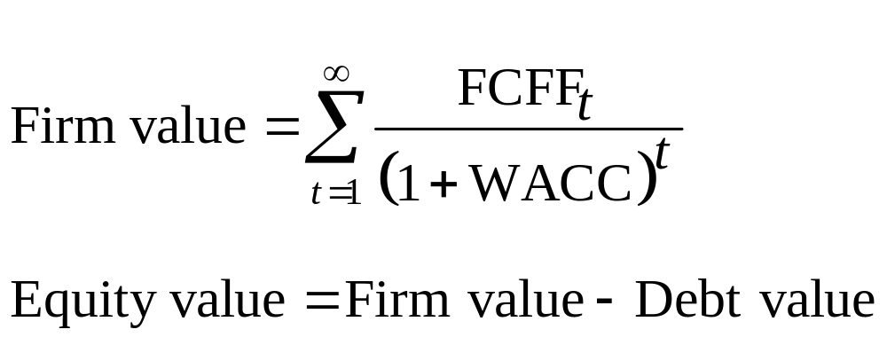
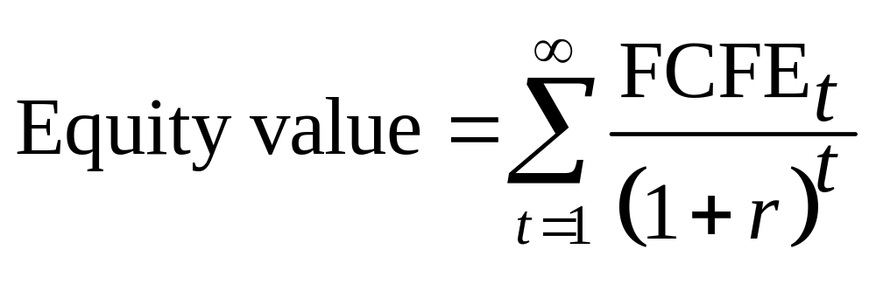
FCFF vs. FCFE Approaches to Equity Valuation
Notes:
LOS: Compare the free cash flow to the firm (FCFF) and free cash flow to equity (FCFE) approaches to valuation.
LOS: Estimate a company’s value using the appropriate free cash flow model(s).
Pages 296–299
Another way of differentiating the FCFF and FCFE approaches to valuation is to examine the respective valuation formulas.
This slide shows the valuation formulas using the FCFF approach on the top two lines and the FCFE approach on the third line.
The FCFF approach says that the value of the firm is equal to the infinite stream of FCFF discounted by the WACC. The market value of debt is then subtracted to arrive at the equity value.
The FCFE approach says that the value of equity is equal to the infinite stream of FCFE discounted by the required return on equity (r).

Slide 156
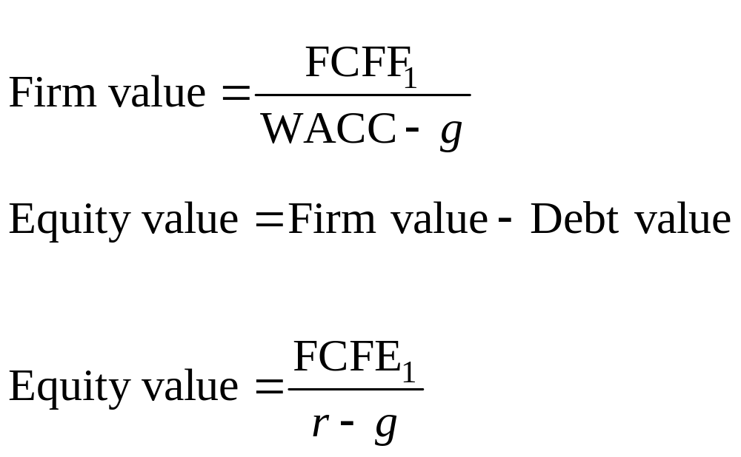
Single-Stage Free Cash Flow Models
Notes:
LOS: Explain the single-stage (stable-growth), two-stage, and three-stage FCFF and FCFE models and select and justify the appropriate model given a company’s characteristics.
LOS: Estimate a company’s value using the appropriate free cash flow model(s).
Pages 299–301
If we assume that free cash flows grow at a constant rate forever, the FCFF and FCFE valuation models can be rewritten in a form that is very similar to the Gordon growth model in Chapter 5.
This slide shows the single-stage (stable-growth) valuation formulas using the FCFF approach on the top two lines and the FCFE approach on the third line.
The FCFF approach says that the value of the firm is equal to next period’s FCFF divided by the WACC minus the growth in FCFF (g). The market value of debt is then subtracted to arrive at the equity value.
The FCFE approach says that the value of equity is equal to next period’s FCFE divided by the required return on equity (r) minus the growth in FCFE (g).
Note that the growth rate for FCFF and FCFE need not be and frequently are not the same.
On the next slide, we’ll do an example using the FCFF approach.

Slide 157
Example: Single-Stage FCFF Model
Current FCFF | $6,000,000
Target debt to capital | 0.25
Market value to debt | $30,000,000
Shares outstanding | 2,900,000
Required return on equity | 12%
Cost of debt | 7%
Long-term growth in FCFF | 5%
Tax rate | 30%
Notes:
LOS: Explain the single-stage (stable-growth), two-stage, and three-stage FCFF and FCFE models and select and justify the appropriate model given a company’s characteristics.
LOS: Estimate a company’s value using the appropriate free cash flow model(s).
Pages 299–301, Spreadsheet Example
The solution is on the slides to follow.

Slide 158
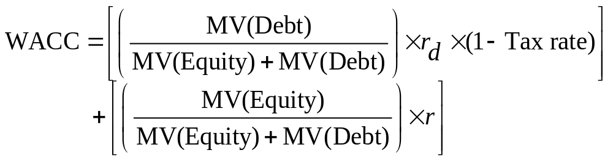
Example: Single-Stage FCFF Model
Notes:
LOS: Explain the single-stage (stable-growth), two-stage, and three-stage FCFF and FCFE models and select and justify the appropriate model given a company’s characteristics.
LOS: Estimate a company’s value using the appropriate free cash flow model(s).
Pages 299–301
We first must calculate the WACC for the firm.
The formula says the WACC is determined by debt and equity component costs.
MV(Debt) = current market value of debt
MV(Equity) = current market value of common equity
r_{d} = before-tax cost of debt (which is transformed into the after-tax cost by multiplying by 1 – Tax Rate)
r = cost of equity
To calculate the debt component, the tax rate is used because in most jurisdictions, the interest payments on debt are tax deductible, which reduces the effective cost of debt financing. Equity financing, however, is not subject to such favorable tax treatment because the payment of dividends does not reduce the firm’s taxable income.
Plugging in the numbers from our example, we arrive at a WACC = 10.23%.
Note that the debt-to-capital ratio of 0.25 means that 25% of firm assets are financed with debt and the other 75% are financed with equity. In some cases (as in this example), analysts use the ratio of target debt to capital instead of using current market value weights because they frequently assume that the targeted debt ratio is that which the firm will use over the long term.

Slide 159

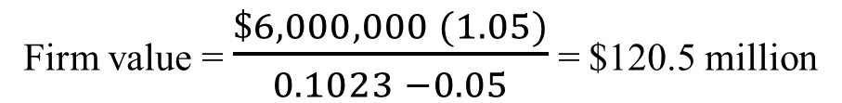
Example: Single-Stage FCFF Model
Firm value = $\frac{FCFF1}{WACC −g}$
Firm value = $\frac{\$6,000,000 (1.05)}{0.1023 −0.05}$ = $120.5 million
Equity value = $120.5 million – $30 million = $90.5 million
Equity value per share = $90.5 million/2.9 million = $31.21
Notes:
LOS: Explain the single-stage (stable-growth), two-stage, and three-stage FCFF and FCFE models and select and justify the appropriate model given a company’s characteristics.
LOS: Estimate a company’s value using the appropriate free cash flow model(s).
Pages 299–301
Next, we use our estimate of the WACC and plug it into the stable-growth FCFF models.
We grow the current $6 million in FCFF out one period at 5% to arrive at next period’s FCFF.
The debt value of $30 million is subtracted from the firm value to arrive at an equity value of $90.5 million.
On a per share basis, the equity value is $31.21. Note that your final answer may differ by a few cents from the above because of rounding.
Note also that here the FCFF is discounted by the firm’s WACC. If the FCFE were provided, it would be discounted by the shareholder’s required return to obtain the equity value.
On the next slide, we will look at how FCFF would be calculated using the firm’s financial statements.

Slide 160
Using Net Income to Determine FCFF
Notes:
LOS: Explain the appropriate adjustments to net income, earnings before interest and taxes (EBIT), earnings before interest, taxes, depreciation, and amortization (EBITDA), and cash flow from operations (CFO) to calculate FCFF and FCFE.
LOS: Calculate FCFF and FCFE.
Pages 301–312
In the formula:
NI = net income
NCC = net noncash charges
Int = interest expense
FCInv = investment in fixed capital (commonly known as capital expenditures)
WCInv = investment in working capital
The basic approach is to adjust financial statement flows so that they better reflect the cash flow available to all investors in the firm. Net income is the bottom line on the income statement and is the income after all charges except for common dividends. We will adjust net income to arrive at FCFF, which is the cash flow available to all the firm’s capital providers.
Depreciation expense is typically the largest NCC and is added back to net income. Depreciation expense is a method of recognizing the cost of a piece of equipment over its life. In the year depreciation expense is reported, it is not actually incurred, so it is added back to obtain FCFF.
Interest expense is subtracted out to obtain net income and is available to one of the firm’s capital providers (the debtholders), so it is added back. We use after-tax interest expense because the WACC used to discount FCFF is after tax.
Investment in fixed capital is a cash outflow used to support the firm’s current and future operations and is subtracted out. Any cash the firm receives from selling assets would be netted from capital expenditures.
Lastly, we subtract out investments in working capital, for which working capital is Current assets/Current liabilities, excluding cash and notes payable and current portion of long-term debt. We exclude cash because it is the amount we are trying to explain. We exclude notes payable and the current portion of long-term debt because they are financing amounts, not operating amounts (i.e., they were not used to calculate net income, so we do not have to use them to adjust net income to FCFF).
In the formula, we assumed the firm did not have preferred shareholders. If it did, we would add preferred dividends to obtain the FCFF because net income is net of preferred dividends.

Slide 161
Other Noncash Adjustments
Amortization
Restructuring Income
Restructuring Expense
Capital Gains
Subtracted out
Added back
Added back
Subtracted out
Deferred Taxes
Added back?
Tax Asset
Subtracted out?
Capital Losses
Added back
Employee Option Exercise
Added back
Notes:
LOS: Explain the appropriate adjustments to net income, earnings before interest and taxes (EBIT), earnings before interest, taxes, depreciation, and amortization (EBITDA), and cash flow from operations (CFO) to calculate FCFF and FCFE.
LOS: Calculate FCFF and FCFE.
Pages 301–312
As mentioned previously, depreciation expense is typically the largest noncash adjustment and is added back to net income to determine FCFF. The working capital accounts as recorded in the WCInv are also adjusted for noncash events. Other adjustments for noncash events to net income are as follows:
If the firm amortizes intangibles, that expense should be added back to net income to determine FCFF. When the firm amortizes a bond discount, that would also be added back. Note, however, that the amortization of a bond premium would be subtracted out.
If the firm records a restructuring expense that is a noncash event, then that amount should be added to net income to determine FCFF. However, if the restructuring expense is meant to cover future firm expenses, then forecasts of future FCFF should be reduced by those amounts.
If the firm records restructuring income that is a noncash event (e.g., the firm reverses an earlier accrual), then that amount should be subtracted from net income to determine FCFF.
If the firm sells an asset that has a book value of $60,000 for $100,000, $40,000 will be recorded as a capital gain in the net income. This $40,000 amount is noncash and should be subtracted out. Note, however, that the $100,000 is classified under FCInv and is thus a cash inflow.
A capital loss would be added back, with the cash sale proceeds as an inflow to FCInv.
The exercise of employee stock options results in cash for the firm. However, an analyst should forecast FCFF per share on a basis that reflects the additional shares that will result from option exercise.
Changes in deferred tax liabilities would be added back to net income if the firm will be able to consistently defer taxes in the future. If, however, the deferred tax charge will reverse in the future, then this amount would not be added back.
Likewise, sometimes a firm has tax assets as a result of the firm recording charges that are not deductible for tax purposes. In this case, taxes on the financial statement are lower than taxes actually paid and the firm records a tax asset. If the firm expects this situation to be persistent, then future net income should be adjusted downward. If it is expected to reverse, however, no adjustment needs to be made.

Slide 162
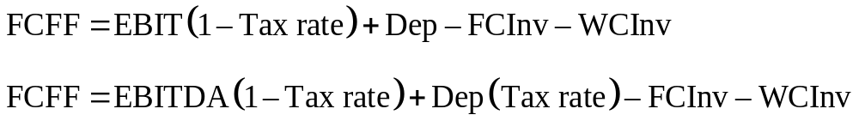
Using EBIT and EBITDA to Determine FCFF
Notes:
LOS: Explain the appropriate adjustments to net income, earnings before interest and taxes (EBIT), earnings before interest, taxes, depreciation, and amortization (EBITDA), and cash flow from operations (CFO) to calculate FCFF and FCFE.
LOS: Calculate FCFF and FCFE.
Pages 318–320
In the formulas:
EBIT = earnings before interest and taxes
Dep = depreciation
EBITDA = earnings before interest, taxes, depreciation, and amortization
FCInv = investment in fixed capital (commonly known as capital expenditures)
WCInv = investment in working capital
Now we work with a number higher on the income statement than net income to calculate FCFF. On the previous slide, we added back interest expense because interest is subtracted out to arrive at net income. Because EBIT and EBITDA are calculated before interest expense is subtracted out, we do not need to add it back here.
In the formulas on this slide, we assume that the only net noncash charge is depreciation, so NCC = Dep. If starting with EBIT, we need to add back depreciation because it was subtracted to obtain EBIT. If starting with EBITDA, we add back only the depreciation tax shield (Dep × Tax Rate = Amount the firm saves on taxes by being able to claim the noncash depreciation expense). We add it back because although EBITDA is before depreciation, the depreciation tax shield saves the firm on taxes and adds to its cash flows.
As on the previous slide, we subtract out investments in fixed assets (FCInv) and working capital (WCInv) to obtain FCFF.

Slide 163

Using Cash Flow from Operations to Determine FCFF
Notes:
LOS: Explain the appropriate adjustments to net income, earnings before interest and taxes (EBIT), earnings before interest, taxes, depreciation, and amortization (EBITDA), and cash flow from operations (CFO) to calculate FCFF and FCFE.
LOS: Calculate FCFF and FCFE.
Pages 312–318
In the formula:
CFO = cash flow from operations
Int = interest expense
FCInv = investment in fixed capital (commonly known as capital expenditures)
Analysts often start with CFO to calculate FCFF because CFO already reflects depreciation expense, other noncash charges, and investments in working capital.
We need to add back interest because it was subtracted out to obtain CFO and it is available to one of the firm’s capital providers (the debtholders).
As on the previous slides, investment in fixed capital is a cash outflow used to support the firm’s current and future operations and is subtracted out. Any cash the firm receives from selling assets would be netted from capital expenditures.

Slide 164
Calculating FCFE from FCFF, Net Income, and CFO
FCFE from net income (NI) and FCFF:
FCFF = NI + NCC + Int(1-Tax rate) – FCInv – WCInv
FCFE = NI = NCC – FCInv – WCInv + Net borrowing
FCFE from CFO and FCFF:
FCFF = CFO + Int(1-Tax rate)- FCInv
FCFE = CFO – FCInv + Net borrowing
Notes:
LOS: Explain the appropriate adjustments to net income, earnings before interest and taxes (EBIT), earnings before interest, taxes, depreciation, and amortization (EBITDA), and cash flow from operations (CFO) to calculate FCFF and FCFE.
LOS: Calculate FCFF and FCFE.
Pages 312–318
Once we obtain the FCFF, we can easily calculate the FCFE. Recall that the FCFF is the cash flow available to all firm capital providers, whereas the FCFE is the cash flow available to only the common equity holders. Therefore, in the first formula, we subtract interest payments from FCFF because they are not available to common equity holders. We add net borrowing to FCFF because it is the cash flow available to common equity holders. (If the firm has preferred shareholders, then preferred issuance amounts would also be added to get FCFE)
Recognizing the relationship between FCFF and FCFE in the top formula, we can then calculate FCFE by using the formulas that calculated FCFF from net income and CFO. Substitution into the FCFF formulas results in formulas for the FCFE. We could also do this for the formulas for EBIT and EBITDA.
Note that the FCFE will be different in magnitude from dividends because the FCFE is the amount available to be paid to common equity holders, whereas dividends are the amount actually paid out. Dividends are at the discretion of the board of directors, and firms prefer to gradually increase the dividend amount. So, they will not usually pay out all their earnings because they do not want to have to cut the dividend later.

Slide 165
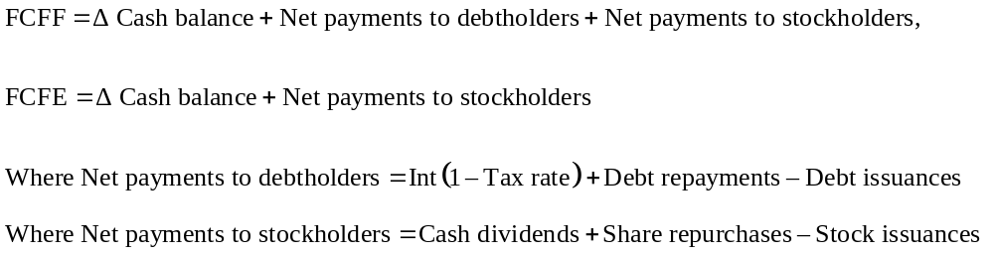
FCFE and FCFF on a Uses-of-FCF-Basis
Notes:
LOS: Explain the appropriate adjustments to net income, earnings before interest and taxes (EBIT), earnings before interest, taxes, depreciation, and amortization (EBITDA), and cash flow from operations (CFO) to calculate FCFF and FCFE.
LOS: Calculate FCFF and FCFE.
Pages 320–322
Previously, we calculated FCFF and FCFE by examining the sources of FCF (e.g., we adjusted net income, which was a source of FCF). We could also calculate FCFE and FCFE by examining the uses of FCF.
Under this approach, we would start with the change in the firm’s cash balance and then adjust that for the use of cash flow. In general, a firm has three alternative uses of FCF: (1) retain the cash; (2) pay it to debtholders; or (3) pay it to stockholders. The advantage of the uses approach is that we can examine how the firm’s capital structure changes. If the firm uses FCF from the issuance of equity to pay down debt, then the firm has decreased its leverage. If the firm uses FCF from the issuance of debt to pay dividends or repurchase stock, then the firm has increased its leverage.
In the formulas, we start with change in cash balance and then add net payments to debtholders and stockholders to obtain FCFF. For FCFE, we follow the same process but just add net payments to stockholders. The values we obtain should be the same as the values when we calculate FCFF and FCFE using the sources of FCF.
In the slides to follow, we will practice calculating FCFF and FCFE using the formulas we have covered. You will see that regardless of the formula used, we end up with the same numbers for FCFF and FCFE.

Slide 166
Example: Calculating FCFF
EBITDA | $1,000
Depreciation expense | $400
Interest expense | $150
Tax rate | 30 | %
Purchases of fixed assets | $500
Change in working capital | $50
Net borrowing | $80
Common dividends | $200
Notes:
LOS: Explain the appropriate adjustments to net income, earnings before interest and taxes (EBIT), earnings before interest, taxes, depreciation, and amortization (EBITDA), and cash flow from operations (CFO) to calculate FCFF and FCFE.
LOS: Calculate FCFF and FCFE.
Pages 318–322
The solution is on the next slide.

Slide 167
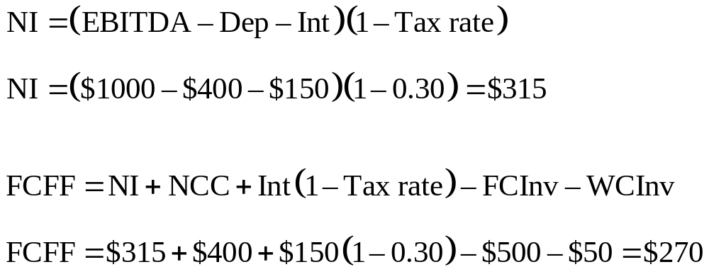
Example: Calculating FCFF from Net Income
Notes:
LOS: Explain the appropriate adjustments to net income, earnings before interest and taxes (EBIT), earnings before interest, taxes, depreciation, and amortization (EBITDA), and cash flow from operations (CFO) to calculate FCFF and FCFE.
LOS: Calculate FCFF and FCFE.
Pages 318–322
We start our examples of calculating FCFF and FCFE by using the formula for FCFF and net income. We first must obtain net income from the example provided, which is the EBITDA after depreciation, interest, and taxes: ($1000 – $400 – $150)(1 – 0.30) = $315.
Assuming that depreciation expense (of $400) is the only NCC, the resulting value for FCFF is $270.
Notice that to get net income, we subtracted depreciation and interest from EBITDA. To get FCFF, we added them back. This suggests that we could have calculated FCFF more easily by working higher on the income statement at EBITDA. This is what we do on the next slide.

Slide 168
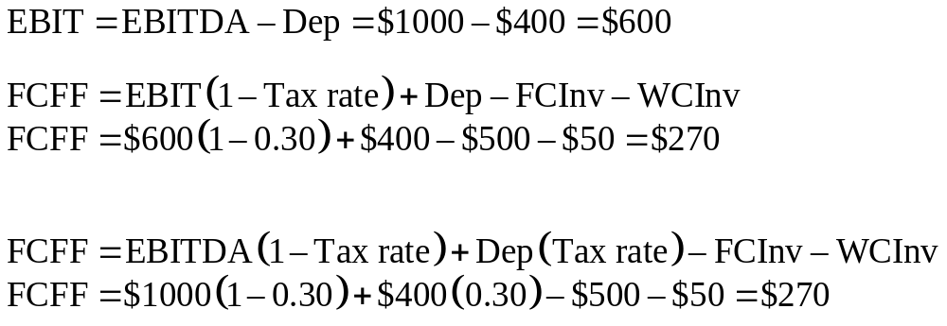
Example: Calculating FCFF from EBIT and EBITDA
Notes:
LOS: Explain the appropriate adjustments to net income, earnings before interest and taxes (EBIT), earnings before interest, taxes, depreciation, and amortization (EBITDA), and cash flow from operations (CFO) to calculate FCFF and FCFE.
LOS: Calculate FCFF and FCFE.
Pages 318–322
We first must obtain EBIT from the example provided, which is the EBITDA after depreciation: $1000 – $400 = $600.
Calculating FCFF using EBIT, we again arrive at $270.
Starting higher on the income statement at EBITDA, we again calculate $270.
Recall our discussion from the previous slide where we first examined the EBIT and EBITDA formulas:
If starting with EBIT, we add back depreciation because it was subtracted to obtain EBIT. If starting with EBITDA, we add back only the depreciation tax shield (Dep × Tax Rate = Amount the firm saves on taxes by being able to claim the noncash depreciation expense). We add it back because although EBITDA is before depreciation, the depreciation tax shield saves the firm on taxes and adds to its cash flows.

Slide 169
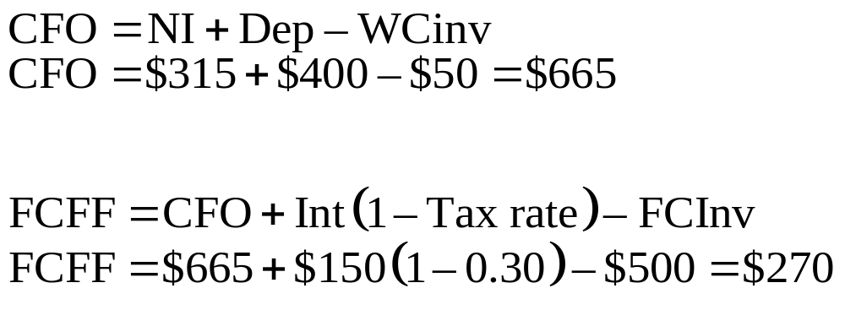
Example: Calculating FCFF from CFO
Notes:
LOS: Explain the appropriate adjustments to net income, earnings before interest and taxes (EBIT), earnings before interest, taxes, depreciation, and amortization (EBITDA), and cash flow from operations (CFO) to calculate FCFF and FCFE.
LOS: Calculate FCFF and FCFE.
Pages 318–322
Next we calculate FCFF from cash flow from operations. We first must obtain CFO from the example provided, which is the net income plus depreciation minus the change in working capital: $315 + $400 – $50 = $665.
Using the formula for FCFF, we again obtain $270.
We add back interest because it was subtracted out to obtain CFO and it is available to one of the firm’s capital providers (the debtholders). The investment in fixed capital is a cash outflow that was not included in the calculation of CFO, so it is subtracted out.

Slide 170


Example: Calculating FCFE from
FCFF, Net Income, and CFO
Notes:
LOS: Explain the appropriate adjustments to net income, earnings before interest and taxes (EBIT), earnings before interest, taxes, depreciation, and amortization (EBITDA), and cash flow from operations (CFO) to calculate FCFF and FCFE
LOS: Calculate FCFF and FCFE
Pages 318–322
Turning our attention to FCFE, we see that it can be easily calculated from FCFF. We subtract interest payments from FCFF because they are not available to common equity holders. We add net borrowing to FCFF because these are cash flows available to common equity holders, which results in a FCFE of $270 – $150(0.70) + $80 = $245.
We can also calculate the same FCFE amount using the formulas that start from net income and CFO. This again results in $245 in both cases.

Slide 171

Example: Calculating FCFE and FCFF on a Uses Basis
Notes:
LOS: Explain the appropriate adjustments to net income, earnings before interest and taxes (EBIT), earnings before interest, taxes, depreciation, and amortization (EBITDA), and cash flow from operations (CFO) to calculate FCFF and FCFE
LOS: Calculate FCFF and FCFE
Pages 320–322
Lastly, we calculate FCFF and FCFE from a uses basis. We start by calculating net payments to debtholders and stockholders. For the net payments to debtholders, the firm has no debt repayments, so the net payments to debtholders equals after-tax interest net of debt issuances: $150(0.70) – $80 = $25. For the net payments to stockholders, the firm has no stock repurchases or issuances, so the net payments to stockholders equals the dividends of $200.
In this example, the change in cash balance is calculated from the statement of cash flows as the CFO minus investing activities (FCInv) minus financing activities (net borrowing minus the common dividends): $665 – $500 + $80 – $200 = $45.
The FCFF is then calculated as the change in cash plus any cash flows to/from the firm’s capital providers: $45 + $25 + $200 = $270.
The FCFE is calculated as the change in cash plus any cash flows to/from the firm’s stockholders: $45 + $200 = $245.
Using the formulas for our example, we have seen that regardless of the formula used, we end up with $270 for FCFF and $245 for FCFE.

Slide 172

Forecasting FCFF and FCFE
Notes:
LOS: Describe approaches for forecasting FCFF and FCFE.
Pages 322–327
Two approaches are commonly used to forecast FCFF and FCFE:
Use historical free cash flow and apply a growth rate under the assumptions that growth will be constant and firm fundamentals are unchanged.
Forecast the underlying components of free cash flow. This relates sales growth to future capital expenditures, depreciation expenses, and changes in working capital.
Capital expenditures are assumed to have two components: outlays needed to maintain existing capacity (fixed capital replacement) and outflows needed to support growth. The first outlay is related to the current level of sales and the second depends on the predicted sales growth. We estimate incremental capital expenditures as FCInv – Depreciation (i.e., that in excess of depreciation).
When forecasting FCFE, we assume that a firm maintains a constant target debt financing ratio (DR) for net new investment in fixed capital and working capital. This assumption allows forecasts of FCFE without having to specifically forecast debt issuance or repayment.
In the formulas shown:
EBIT = earnings before interest and taxes
FCInv = investment in fixed capital
WCInv = investment in working capital
DR = target debt ratio
NI = net income
Dep = depreciation
We forecast FCFF as the after-tax EBIT minus the change in capital expenditures and WCInv that occurs with sales growth. This method will yield the same result as previous equations if depreciation is the only noncash expense.
The formula for FCFE says that FCFE is equal to net income minus the incremental capital expenditures and WCInv financed by equity (1 – DR).
The example on the next slide illustrates the calculations.

Slide 173
Example: Forecasting FCFF and FCFE
Sales | $4,000
Sales growth | $200
EBIT | $600
Tax rate | 30 | %
Purchases of fixed assets | $800
Depreciation expense | $700
Change in working capital | $50
Net income margin | 10 | %
Debt ratio | 40 | %
Notes:
LOS: Describe approaches for forecasting FCFF and FCFE.
Pages 322–327
In this example, we assume that
sales growth continues at the same rate;
the relationship between sales and EBIT margin, FCInv, and WCInv is constant; and
figures are from last year’s financial statements.
The solution is on the next slide.

Slide 174

Example: Forecasting FCFF and FCFE
Notes:
LOS: Describe approaches for forecasting FCFF and FCFE.
Pages 322–327
We first calculate sales growth, EBIT margin, the relationship between incremental FCInv and WCInv, and sales growth.

Slide 175

Example: Forecasting FCFF
Notes:
LOS: Describe approaches for forecasting FCFF and FCFE.
Pages 322–327
Next year’s sales are the previous year’s sales: $4000, plus the growth of $200 = $4200.
EBIT is 15% of next year’s sales, which is $630. After-tax EBIT is $441.
With sales growth of $200, incremental FC and WC is $100 and $50, respectively.
Using these inputs, we arrive at FCFF = $291.

Slide 176

Example: Forecasting FCFE
Notes:
LOS: Describe approaches for forecasting FCFF and FCFE.
Pages 322–327
Now we forecast FCFE.
Using the given net income margin of 10%, we calculate next year’s net income at $420.
The incremental FC and WC calculated on the previous slide are repeated here to refresh your memory.
Using the given debt ratio (DR) of 40%, we calculate a FCFE of $330. A FCFE of $330 is equal to net income of $420 minus the incremental FCInv and WCInv financed by the 60% equity (1 – 0.40).

Slide 177
Issues in FCF Analysis
Dividends vs. FCFE
Effect of Shareholder Cash Flows and Leverage
FCFF and FCFE vs. EBITDA and Net Income
Financial Statement Discrepancies
Country Adjustments
Sensitivity Analysis
Nonoperating Assets
Notes:
LOS: Compare the FCFF and model and dividend discount models.
LOS: Evaluate the use of net income and EBITDA as proxies for cash flow in valuation.
LOS: Explain the use of sensitivity analysis in FCFF and FCFE valuations.
LOS: Explain how dividends, share repurchases, share issues, and changes in leverage may affect future FCFF and FCFE.
Pages 327–333, 345–346
When determining FCFF and FCFE, analysts should be aware of the following issues:
Discrepancies between balance sheet items and cash flow statement items: The reasons for these discrepancies are firm acquisitions/divestitures and the presence of foreign subsidiaries. An analyst should adjust cash flow projections for these contaminants.
Dividends versus FCFE: Firms with low dividends (e.g., a young start-up) usually also have low FCFE because they have large capital expenditures or are facing difficulties. However, many analysts consider FCFE more relevant than dividend discount models because (1) for firms that pay no or small dividends, future dividends are difficult to forecast; (2) for firms being valued for acquisition, the acquirer can in the future control all the firm’s cash flows (not just the dividends); and (3) FCFE is often a better indicator of future shareholder wealth because it reflects all the cash flows available to the firm, not just those paid out.
Effect of dividends, repurchases, share issuances, and leverage on FCFE and FCFF: Dividends, share repurchases, share issues do not change the FCFE and FCFF because these measure the firm’s available cash flow. In other words, a stock repurchase program affects the distribution of available cash flows but not their availability. Increases in leverage (debt) do increase FCFE by the debt issue in the year issued. Future FCFE increases by the tax savings from the interest tax shield but is decreased by future interest payments to debtholders. FCFF only changes by the tax savings from the interest tax shield.
FCFF and FCFE vs. EBITDA and net income: Although commonly used in valuation, EBITDA is a poor substitute for FCFF and FCFE because it does not account for depreciation, FCInv, and WCInv. Likewise, net income is a poor substitute for FCFE because it does not account for depreciation, FCInv, WCInv, and net borrowings.
Country adjustments in international valuations: An analyst should adjust for differing interest rates, inflation, growth, and accounting practices. A build-up approach can be used to determine the appropriate required rate of return in a country (as discussed in Chapter 2). Real cash flows and real discount rates are frequently used instead of nominal values when inflation is high and volatile.
Sensitivity analysis: Such inputs as future growth rates and the initial FCFF and FCFE can have large affects on the calculated valuations. Therefore, an analyst should examine how valuations change with changes in each of a model’s inputs. Some variables will have a greater impact on the valuation than others.
Nonoperating assets: Analysts often exclude the value of nonoperating assets, such as investments in cash and marketable securities, when discounting future FCFF and FCFE. In this case, the value of cash and marketable securities should be added to the value of a firm after the present value (PV) of FCF is calculated.
Value of firm = Value of nonoperating assets + Value of operating assets.

Slide 178


Simple Two-Stage FCF Models
Notes:
LOS: Explain the single-stage (stable-growth), two-stage, and three-stage FCFF and FCFE models and select and justify the appropriate model given a company’s characteristics.
LOS: Describe approaches for calculating the terminal value in a multistage valuation model.
Pages 336–343
As when we discounted dividends, there are two forms of FCF two-stage models. We will look at the first version here, referred to as the simple two-stage model. In this model, the first stage of rapid growth for n years abruptly transitions to a second stage of constant growth that exists in perpetuity. This FCF model is similar to the general two-stage dividend discount model (DDM) discussed in Chapter 3 of the text. However, the forecasts of FCF will be more complicated than forecasts of dividends because we will also need to project FCInv, WCInv, and other variables (as in the example to follow).
A firm that is expected to have a high rate of growth until , for example, patents expires, sould be modeled by this two-stage model, with one rate of growth before the patent expires and another rate thereafter.
Recall that when we are discounting FCFF, the relevant discount rate reflects all the firm’s capital, which is the WACC. When we are discounting FCFE, the relevant discount rate is the required return on equity (r).
The formulas say that firm or equity value at time zero is equal to two terms:
the discounted stream of FCF during the initial growth phase and
the present value of the dividend stream growing in perpetuity at g (the long-term growth rate).
The growth rates can be determined using FCF growth or the growth in sales or net income. If an analyst is using the latter two growth rates, they must be adjusted for changes in profit margins, operating assets, and/or financing (see the example on the slides to follow).
The example on the following slides illustrate the calculation.

Slide 179
Example: Simple Two-Stage FCFE Model
Current sales per share | $10
Sales growth for first three years | 20 | %
Sales growth for year 4 and thereafter | 5 | %
Net income margin | 10 | %
FCInv/Sales growth | 40 | %
WCInv/Sales growth | 25 | %
Debt financing of FCInv and WCInv growth | 30 | %
Required return on equity | 12 | %
Notes:
LOS: Explain the single-stage (stable-growth), two-stage, and three-stage FCFF and FCFE models and select and justify the appropriate model given a company’s characteristics.
LOS: Describe approaches for calculating the terminal value in a multistage valuation model.
LOS: Calculate FCFF and FCFE.
Pages 336–343
In this example, we are given the sales growth, and from that we must derive the FCFE. As an example, we’ll calculate the FCFE in Year 1 on the next slide.
The solution is on the next slide.

Slide 180

Example: Simple Two-Stage FCFE Model
Notes:
LOS: Explain the single-stage (stable-growth), two-stage, and three-stage FCFF and FCFE models and select and justify the appropriate model given a company’s characteristics.
LOS: Describe approaches for calculating the terminal value in a multistage valuation model.
LOS: Calculate FCFF and FCFE.
LOS: Describe approaches for forecasting FCFF and FCFE.
Pages 336–343
For the Year 1 FCFE, the FCFE is equal to the net income minus incremental FCInv and WCInv plus new debt financing.
Sales in Year 1 is Current sales x (1 + Sales growth rate) = $10(1.2) = $12.
The change is sales is then $2. Net income is 10% of sales or $1.20.
FCInv will increase by the sales growth times the incremental FCInv growth: $2 x 40% = $0.80.
WCInv will increase by the sales growth times the incremental WCInv growth: $2 x 25% = $0.50.
Of the increase in FCInv and WCInv (total 65% of sales growth), 30% will be financed by debt: $2 x 65% x 30% = $0.39.
FCFE is then $1.20 – $0.80 – $0.50 + $0.39 = $0.29.
The FCFE in the other years is presented on the next slide.

Slide 181
Example: Simple Two-Stage FCFE Model
 | Year
 | 1 | 2 | 3 | 4 | 5
Percentage sales growth | 20% | 20% | 20% | 5% | 5%
Sales per share | $12.000 | $14.400 | $17.280 | $18.144 | $19.051
EPS | $1.200 | $1.440 | $1.728 | $1.814 | $1.905
FCInv per share | $0.800 | $0.960 | $1.152 | $0.346 | $0.363
WCInv per share | $0.500 | $0.600 | $0.720 | $0.216 | $0.227
Debt financing per share | $0.390 | $0.468 | $0.562 | $0.168 | $0.177
FCFE per share | $0.290 | $0.348 | $0.418 | $1.421 | $1.492
Growth in FCFE |  | 20.0% | 20.0% | 240.3% | 5.0%
Notes:
LOS: Explain the single-stage (stable-growth), two-stage, and three-stage FCFF and FCFE models and select and justify the appropriate model given a company’s characteristics.
LOS: Describe approaches for calculating the terminal value in a multistage valuation model.
LOS: Calculate FCFF and FCFE.
LOS: Describe approaches for forecasting FCFF and FCFE.
Pages 336–343
Notice that the FCFE grows at the same rate as the sales except in Year 4, when it grows at 240%. This is because in that year, sales increase at 5% but incremental FCInv and WCInv decrease sharply. The reason is because incremental FCInv and WCInv are calculated relative to the dollar growth in sales, which decreases in that year (even though absolute dollar sales increases).
On the next slide, we’ll discount the FCFE to obtain a stock value.

Slide 182

Example: Simple Two-Stage FCFE Model
Notes:
LOS: Explain the single-stage (stable-growth), two-stage, and three-stage FCFF and FCFE models and select and justify the appropriate model given a company’s characteristics.
LOS: Describe approaches for calculating the terminal value in a multistage valuation model.
LOS: Calculate FCFF and FCFE.
LOS: Describe approaches for forecasting FCFF and FCFE.
Pages 336–343
Notice that to get the present value (PV) of the infinite stream of FCFE, we can start at the Year 4 FCFE when, thereafter, FCFE starts to grow at the constant 5% rate (even though on the previous slide we forecasted FCFE out to Year 5).
The terminal value of $14.4491 is a large part of stock value, 94.5% to be exact ($14.4491/$15.28). For this reason, an analyst may want to evaluate the terminal value using sensitivity analysis. This terminal value can also be calculated using the projected earnings and P/E ratio (as we did in Chapter 3).

Slide 183
Declining Growth Two-Stage FCFE Model
Initially
High earnings growth
Large capital expenditures
Competition Later Increases
Capital expenditures decline
FCFE increases
Low or negative FCFE
Earnings growth slows
Notes:
LOS: Explain the single-stage (stable-growth), two-stage, and three-stage FCFF and FCFE models and select and justify the appropriate model given a company’s characteristics.
LOS: Describe approaches for calculating the terminal value in a multistage valuation model.
LOS: Calculate FCFF and FCFE.
LOS: Describe approaches for forecasting FCFF and FCFE.
Pages 339–343
Instead of assuming that growth drops sharply from the first to second stage, we could also assume that growth gradually declines. This is the second form of the two-stage FCF model we examine.
It is sometimes the case that a small firm has rapidly increasing earnings but low or negative FCFE because of high capital expenditures. Eventually competition slows the firm’s earnings grow, but FCFE increases because the firm can reduce capital spending as it matures. Equity valuation is then largely dependent on these later FCFs. That is the assumption in the example to follow.
In the real world, analysts may want to evaluate the FCFs of firm subsidiaries and then aggregate the FCFs to arrive at total firm or equity value.

Slide 184
Example: Declining Growth Two-Stage FCFE Model
Current EPS | $1 | .00
WCInv/FCInv | 40 | %
Debt financing of FCInv and WCInv growth | 30 | %
Required return on equity | 12 | %
EPS and FCInv growth for Year 5 and thereafter | 5 | %
Notes:
LOS: Explain the single-stage (stable-growth), two-stage, and three-stage FCFF and FCFE models and select and justify the appropriate model given a company’s characteristics.
LOS: Describe approaches for calculating the terminal value in a multistage valuation model.
LOS: Calculate FCFF and FCFE.
LOS: Describe approaches for forecasting FCFF and FCFE.
Pages 339–343
In this example, we are given the EPS, and from that we must derive the FCFE. Additional assumptions are provided on the next slide.

Slide 185
Example: Declining Growth Two-Stage FCFE Model
 | Year
 | 1 | 2 | 3 | 4 | 5
EPS growth | 30% | 21% | 13% | 8% | 5%
FCInv per share | $1.50 | $1.25 | $1.00 | $0.75 | $0.50
Notes:
LOS: Explain the single-stage (stable-growth), two-stage, and three-stage FCFF and FCFE models and select and justify the appropriate model given a company’s characteristics.
LOS: Describe approaches for calculating the terminal value in a multistage valuation model.
LOS: Calculate FCFF and FCFE.
LOS: Describe approaches for forecasting FCFF and FCFE.
Pages 339–343
Notice that EPS and FCInv are gradually slowing. We will calculate the FCFE in Year 1 on the next slide.

Slide 186

Example: Declining Growth Two-Stage FCFE Model
Notes:
LOS: Explain the single-stage (stable-growth), two-stage, and three-stage FCFF and FCFE models and select and justify the appropriate model given a company’s characteristics.
LOS: Describe approaches for calculating the terminal value in a multistage valuation model.
LOS: Calculate FCFF and FCFE.
LOS: Describe approaches for forecasting FCFF and FCFE.
Pages 339–343
For the Year 1 FCFE, the FCFE is equal to the EPS minus incremental FCInv and WCInv plus new debt financing.
EPS in Year 1: Current EPS x (1 + Sales growth rate) = $1.00(1.3) = $1.30.
The FCInv is given at $1.50.
WCInv will increase by 40% times the incremental FCInv growth: $1.50 x 40% = $0.60.
Of the increase in FCInv and WCInv, 30% will be financed by debt: ($1.50 + $0.60) x 30%.
FCFE is then $1.30 – $1.50 – $0.60 + ($1.50 + $0.60) x 30% = –$0.17.
The FCFE in the other years is presented on the next slide.

Slide 187
Example: Declining Growth Two-Stage FCFE Model
 | Year
 | 1 | 2 | 3 | 4 | 5
EPS | $1.300 | $1.573 | $1.777 | $1.920 | $2.016
FCInv per share | $1.500 | $1.250 | $1.000 | $0.750 | $0.500
WCInv per share | $0.600 | $0.500 | $0.400 | $0.300 | $0.200
Debt financing per share | $0.630 | $0.525 | $0.420 | $0.315 | $0.210
FCFE per share | –$0.170 | $0.348 | $0.797 | $1.185 | $1.526
Notes:
LOS: Explain the single-stage (stable-growth), two-stage, and three-stage FCFF and FCFE models and select and justify the appropriate model given a company’s characteristics.
LOS: Describe approaches for calculating the terminal value in a multistage valuation model.
LOS: Calculate FCFF and FCFE.
LOS: Describe approaches for forecasting FCFF and FCFE.
Pages 339–343
Notice that the FCFE starts out negative but then gradually increases because FCInv and WCInv are slowing and EPS is still growing (albeit at a slower rate).
On the next slide, we’ll discount the FCFE to obtain a stock value.

Slide 188

Example: Declining Growth Two-Stage FCFE Model
Notes:
LOS: Explain the single-stage (stable-growth), two-stage, and three-stage FCFF and FCFE models and select and justify the appropriate model given a company’s characteristics.
LOS: Describe approaches for calculating the terminal value in a multistage valuation model.
LOS: Calculate FCFF and FCFE.
LOS: Describe approaches for forecasting FCFF and FCFE.
Pages 339–343
Notice that the terminal value is estimated at $21.80, which is the PV at Year 4 of the FCFE that grows at a constant 5% rate forever. When we discount this back to Year 0, we obtain a $13.8543 PV for the perpetual stream.
We determine the total value of the stock to be $15.30. On the next slide, we’ll calculate a P/E for Years 0 and 4, assuming that the present value we calculated will equal the stock price.

Slide 189

Example: Declining Growth Two-Stage FCFE Model
Notes:
LOS: Explain the single-stage (stable-growth), two-stage, and three-stage FCFF and FCFE models and select and justify the appropriate model given a company’s characteristics.
LOS: Describe approaches for calculating the terminal value in a multistage valuation model.
LOS: Calculate FCFF and FCFE.
LOS: Describe approaches for forecasting FCFF and FCFE.
Pages 339–343
Note that the P/E is greater at Year 0 than at Year 4 because the EPS growth rate has gradually declined through time.

Slide 190
Example: Three-Stage FCF Models
Current FCFF in millions | $100 | .00
Shares outstanding in millions | 300 | .00
Long-term debt value in millions | $400 | .00
FCFF growth for Years 1 to 3 | 30 | %
FCFF growth for Year 4 | 24 | %
FCFF growth for Year 5 | 12 | %
FCFF growth for Year 6 and thereafter | 5 | %
WACC | 10 | %
Notes:
LOS: Explain the single-stage (stable-growth), two-stage, and three-stage FCFF and FCFE models and select and justify the appropriate model given a company’s characteristics.
LOS: Describe approaches for calculating the terminal value in a multistage valuation model.
LOS: Calculate FCFF and FCFE.
LOS: Describe approaches for forecasting FCFF and FCFE.
Pages 343–345
There are two approaches we could use when working with the three stages of FCF growth. One approach is to assume that growth is constant in each of the three stages. Another approach would be to assume that growth is constant in Stages 1 and 3 but gradually declines in Stage 2.
We make the latter assumption in this example in which we discount FCFF using the WACC. We will work with a direct forecast of FCFF, instead of forecasting it from inputs of income, capital expenditures, and debt financing (as we did for the two-stage model examples).
The solution is on the next slide.

Slide 191
Example: Three-Stage FCF Models
 | Year
 | 1 | 2 | 3 | 4 | 5 | 6
FCFF growth rate | 30% | 30% | 30% | 24% | 12% | 5%
FCFF | $130.0 | $169.0 | $219.7 | $272.4 | $305.1 | $320.4
PV of FCFF | $118.2 | $139.7 | $165.1 | $186.1 | $189.5
Notes:
LOS: Explain the single-stage (stable-growth), two-stage, and three-stage FCFF and FCFE models and select and justify the appropriate model given a company’s characteristics.
LOS: Describe approaches for calculating the terminal value in a multistage valuation model.
LOS: Calculate FCFF and FCFE.
LOS: Describe approaches for forecasting FCFF and FCFE.
Pages 343–345
The FCFF are projected here by growing FCFF at the respective growth rates. They are then discounted at the WACC of 10% to determine their PV. The terminal value calculation is on the next slide.

Slide 192

Example: Three-Stage FCF Models
Note : The above formula shows the present value of perpetual stream at t = 0
Notes:
LOS: Explain the single-stage (stable-growth), two-stage, and three-stage FCFF and FCFE models and select and justify the appropriate model given a company’s characteristics.
LOS: Describe approaches for calculating the terminal value in a multistage valuation model.
LOS: Calculate FCFF and FCFE.
LOS: Describe approaches for forecasting FCFF and FCFE.
Pages 343–345
To calculate the PV of the terminal value at Time 0, we discount the Year 6 FCFF of $320.4 using the constant-growth formula. We then discount this amount back five periods using the WACC of 10% to obtain $3979.

Slide 193

Example: Three-Stage FCF Models
Notes:
LOS: Explain the single-stage (stable-growth), two-stage, and three-stage FCFF and FCFE models and select and justify the appropriate model given a company’s characteristics.
LOS: Describe approaches for calculating the terminal value in a multistage valuation model.
LOS: Calculate FCFF and FCFE.
LOS: Describe approaches for forecasting FCFF and FCFE.
Pages 343–345
The total firm value is the PV of future FCFF discounted at the WACC. Using the inputs from the previous slides, we have $4,777.
To obtain the equity value of $4,377, we subtract the market value of debt from the firm value.
Dividing by the number of shares (300), we obtain a per share value of $14.59.

Slide 194
Summary
FCFF vs. FCFE
Equity Valuation with FCFF and FCFE
Discount FCFF with WACC
FCFF = Cash flow available to all firm capital providers
FCFE = Cash flow available to common
equity holders
FCFF is preferred when FCFE is negative or when capital structure is unstable
Equity value = PV(FCFF) – Debt value or PV(FCFE)
Discount FCFE with required return on equity
Notes:
Pages 346–348

Slide 195
Summary
Adjustments for Calculating Free Cash Flows
Approaches for Calculating FCFF and FCFE
Depreciation, amortization, restructuring charges, capital gains/losses, employee stock options, deferred taxes/tax assets
EBIT
EBITDA
CFO
Uses
Sources: Adjust for noncash events and work from
Change in cash balances and net payments to debtholders and stockholders
Net income
Notes:
Pages 346–348

Slide 196
Summary
Issues in FCF Analysis
Dividends versus free cash flows
Financial statement discrepancies
Shareholder cash flows and leverage
FCFF and FCFE versus EBITDA and net income
Country adjustments
Sensitivity analysis
Nonoperating assets
Notes:
Pages 346–348

Slide 197
Summary
Forecasting FCFF and FCFE
FCF Valuation Models
Assume EBIT margin, FCInv, and WCInv are proportional to sales
Forecast sales growth
For FCFE, assume debt ratio is constant
Two-stage with distinct growth in each stage
Two-stage with declining growth from Stage 1 to Stage 2
Three-stage model
Notes:
Pages 346–348

Slide 198
Market-Based
Valuation:
Price and Enterprise
Value Multiples
Notes:
In Chapter 5, we used the Gordon growth model to derive a justified price-to-earnings ratio (P/E) for a stock, given its fundamentals. In this chapter, we will examine the P/E and other ratios that scale a firm’s market valuation to a measure of firm value. These ratios will be used to determine the relative valuation of a common share. They are widely used in practice because in a single number, they provide the firm’s market valuation relative to some firm fundamental.
In this chapter, we also examine
the issues that affect the evaluation of valuation ratios,
how the ratios relate to firm fundamentals,
the rationales and drawbacks to the various ratios,
the challenges of using valuation ratios internationally, and
the use of momentum indicators.
DISCLAIMER: This presentation is NOT a substitute for the CFA Program curriculum. Candidates should not view this material as reflecting what will be required of them on the CFA exam.

Slide 199
Valuation Indicators
Price Multiples
Enterprise Value Multiples
Momentum Indicators
Notes:
LOS: Distinguish between the method of comparables and the method based on forecasted fundamentals as approaches to using price multiples in valuation, and explain economic rationales for each approach.
Pages 362–363
Price multiples are ratios of the stock price to some measure of fundamental value. The intuition behind price multiples is that they tell the investor what one share buys, whether that is earnings, cash flow, net assets, or some other measure of value.
Enterprise value multiples are ratios of total firm value divided by a measure of fundamental value, such as earnings before interest and taxes (EBIT), sales, or operating cash flow.
Momentum indicators can also be used in valuation, in which the stock price or some firm fundamental (e.g., earnings) is related to the time series of its own past values. The logic behind their use is that they may forecast future returns.

Slide 200
Methods for Price and Enterprise Value Multiples
1. Method of Comparables
2. Method Based on Forecasted Fundamentals
Justified Price Multiples
Economic rationale is the law of one price
Reflects firm fundamentals and future cash flows
Can be determined using either method
Notes:
LOS: Distinguish between the method of comparables and the method based on forecasted fundamentals as approaches to using price multiples in valuation, and explain economic rationales for each approach.
Pages 363–366
The method of comparables compares the price and enterprise value multiples of the subject firm with those of similar assets.
The similar assets are referred to as the comparables, comps, guideline assets, or guideline companies.
For example, we could compare the P/E multiple of a subject firm with that of firms that are comparable in terms of risk, profitability, and growth. The comparables could be a similar firm or a group of firms in the same industry.
If a firm had a higher P/E than the comparables, it would be deemed overvalued. Note that this assumes that the comps themselves are correctly valued.
The economic rationale for the method of comparables is the law of one price (i.e., identical assets should sell for the same price).
The method based on forecasted fundamentals compares the firm’s actual valuation with one determined by using the firm’s fundamentals.
This is the method we used in Chapter 3, when the Gordon growth model was used to derive a justified P/E of a stock, given its fundamentals.
The firm’s actual price multiple is compared with that derived from its fundamentals, which reflect the firm’s future cash flows.
If, for example, the actual price multiple is more than that justified by the firm’s fundamentals, the stock is deemed overvalued.
Note that a justified price multiple can also be derived using the method of comparables—that is, the justified price multiple is determined by examining the price multiples for a similar set of companies.

Slide 201
Price-to-Earnings Multiple Rationales and Drawbacks
Rationales
Drawbacks
EPS is driver of value
Zero, negative, or very small earnings
Widely used
Related to stock returns
Permanent versus transitory earnings
Management discretion for earnings
Notes:
LOS: Describe rationales for and possible drawbacks to using alternative price multiples and dividend yield in valuation.
Pages 366–367
We begin our discussion of various valuation multiples by examining the P/E multiple, which is the most widely used multiple in valuation. We will examine this multiple in detail: Its variations, the issues in calculating earnings, and how it is used in practice.
We first discuss the rationales for its use:
Earnings power, as measured by the denominator earnings per share (EPS), is the primary driver of investment value.
The P/E is widely recognized and used by investors.
P/E differences are significantly related to long-run average stock returns according to empirical research.
Potential drawbacks to its use derive from the use of earnings and include the following:
Earnings can be very small, zero, or negative relative to price, any of which produces a P/E without economic meaning.
The transitory portion of earnings can be difficult to distinguish from the permanent component that is most important for valuation.
Managers have discretion in determining reported earnings, which lessens the comparability of P/Es across firms.

Slide 202
Price-to-Earnings Multiple Definitions
Trailing P/E
Uses last year’s earnings
Forward P/E
Preferred when forecasted earnings are not available
Uses next year’s earnings
Preferred when trailing earnings are not reflective of future
Notes:
LOS: Calculate and interpret alternative price multiples and dividend yield.
Pages 368–369
When calculating the P/E multiple, the stock price numerator is unambiguous for publicly traded companies. The earnings denominator, however, can generally be characterized in two different ways: the time horizon over which it was measured and the adjustments to accounting earnings (required so that P/Es are comparable across firms).
The time horizon for earnings results in two broad definitions of the P/E:
The trailing P/E (also referred to as the current P/E), which uses the past four quarters of earnings, referred to as the trailing 12-month (TTM) EPS.
The forward P/E (also referred to as the leading or prospective P/E), which uses next year’s expected earnings (based on analyst or database estimates).
The forward P/E is preferred over the trailing P/E when trailing earnings are not representative of the firm’s future. The trailing P/E is preferred when forecasted earnings are not available, which is often the case for small firms that are not widely followed.
If earnings are zero or negative, an analyst may use a longer-term or future (positive) earnings figure. Regardless, an analyst should use the same definition of earnings when making comparisons across firms.

Slide 203
Example: Forward P/E
Stock price* | $20 | .00
2016:Q1 EPS | $0 | .18
2016:Q2 EPS | $0 | .25
2016:Q3 EPS | $0 | .32
2016:Q4 EPS | $0 | .35
2016 Fiscal year forecast | $1 | .10
2017:Q1 EPS | $0 | .43
2017:Q2 EPS | $0 | .48
2017:Q3 EPS | $0 | .50
2017:Q4 EPS | $0 | .59
2017 Fiscal year forecast | $2 | .00
* Assume we are at the beginning of December 2016.
Notes:
LOS: Calculate and interpret alternative price multiples and dividend yield.
Pages 376–379
Forward P/Es are often favored over trailing P/Es because they are forward looking. There are many different interpretations, however, of the forward earnings figure. Forward earnings could be
EPS for the next four quarters;
EPS for the next 12 months (NTM); or
EPS for the future fiscal year. The future fiscal year itself may be defined in different ways:
If the time of prediction is between fiscal year-ends, the fiscal year used can be the current one, for which some time has already elapsed.
The fiscal year used can be the next fiscal year.
The example here illustrates the various calculations of the forward P/E. We will assume that the P/E is calculated and the stock price is recorded in November 2011. We also assume that the fiscal year-end is the calendar year-end (December).

Slide 204

Example: Forward P/E
Notes:
LOS: Calculate and interpret alternative price multiples and dividend yield.
Pages 376–379
We will first calculate the forward EPS and P/E using the EPS for the next four quarters. The next four quarters are defined here as the current quarter (Q4 2011) plus the first three quarters in 2012. The resulting forward EPS is $1.76, and the P/E is 11.4
Under the second method, the EPS for the next 12 months (NTM) is the weighted average of the current year and next year’s forecasts. There is just one month left in 2011, so we weight the 2011 fiscal year figure by 1/12 and the 2012 fiscal year figure by 11/12 to arrive at $1.925. The resulting forward P/E is 10.4.
We’ll look at the other two methods on the next slide.

Slide 205

Example: Forward P/E
Notes:
LOS: Calculate and interpret alternative price multiples and dividend yield.
Pages 376–379
When using the current fiscal year as the future fiscal year, we would use the 2011 EPS of $1.10. The resulting forward P/E is 18.2.
When using the next fiscal year as the future fiscal year, we would use the 2012 EPS of $2.00. The resulting forward P/E is 10.0.
Notice that the P/Es from the two methods on this slide are quite different. If a firm’s earnings are volatile, an analyst may want to use a normalized earnings figure, described on the slides to follow.

Slide 206
Issues in Calculating EPS
EPS Dilution
Underlying Earnings
Normalized Earnings
Differences in Accounting Methods
Notes:
LOS: Calculate and interpret underlying earnings, explain methods of normalizing earnings per share (EPS), and calculate normalized EPS.
Pages 369–375
Having examined the earnings denominator over the time horizon over which it was measured, we now examine the adjustments to accounting earnings that financial analysts will make for comparisons across firms.
When using trailing P/Es, an analyst should adjust the EPS for the following:
Potential dilution of EPS;
Transitory, nonrecurring earnings components that are firm specific;
Transitory earnings components that are attributable to business or industry cycles; and
Differences in accounting methods (when comparing P/Es of various firms).
Potential dilution of EPS: An analyst’s job is made easier here because firms are required to report basic EPS and diluted EPS. Basic EPS uses the actual number of shares outstanding during the period. Diluted EPS uses the number of shares that would be outstanding and the accompanying earnings if all executive stock options, equity warrants, and convertible bonds were exercised. The P/E from diluted EPS is typically higher than that from basic EPS. Analysts generally prefer diluted EPS P/Es because they make comparisons across firms more relevant.
When calculating a P/E, an analyst should focus on the earnings that are expected to continue into the future. These earnings are referred to as the underlying earnings (also referred to as the persistent earnings, continuing earnings, or core earnings). See the next slide for an example of their calculation.
Because of earnings volatility from business or industry cycles, the most recent four quarters of earnings for a firm may not reflect the long-term earning potential of a firm. This is particularly true for cyclical firms, such as auto and steel companies. In this case, the P/E may be inflated based on deflated earnings at the bottom of the business cycle and deflated based on inflated earnings at the top of the business cycle. This effect is known as the Molodovsky effect and is corrected by calculating an EPS under midcycle conditions, known as the normalized or normal EPS. On the slides to follow, we will examine two different methods for calculating a normalized EPS.
When comparing firms, an analyst should adjust for differences in EPS calculation so that the P/Es are comparable. For example, an analyst may be comparing one company using LIFO (last in, first out) inventory accounting (permitted by US GAAP but not the IFRS) with another using FIFO (first in, first out) accounting.

Slide 207
Example: Underlying Earnings
Reported EPS from previous four quarters | $4 | .00
Restructuring charges | $0 | .10
Amortization of intangibles | $0 | .15
Impairment charge | $0 | .20
Stock price | $50 | .00
Notes:
LOS: Calculate and interpret alternative price multiples and dividend yield.
LOS: Calculate and interpret underlying earnings, explain methods of normalizing earnings per share (EPS), and calculate normalized EPS.
Pages 369–375
As stated on the previous slide, an analyst should focus on the earnings that are expected to persist into the future, which are referred to as underlying earnings. Some firms will report adjusted earnings, pro forma earnings, or core earnings. These reported figures, however, are not always equal to the underlying earnings desired for P/E calculation. In these cases, an analyst will need to adjust the firm’s figures.
We will first calculate the core earnings that a firm may report on the next slide.

Slide 208

Example: Underlying Earnings
Notes:
LOS: Calculate and interpret alternative price multiples and dividend yield.
LOS: Calculate and interpret underlying earnings, explain methods of normalizing earnings per share (EPS), and calculate normalized EPS.
Pages 369–375
The P/E based on reported earnings is 12.5.
We then calculate the core earnings that a firm may report. Core earnings are a non-IFRS and non-GAAP concept, so there are no prescribed rules for their calculation. In this example, the firm adds the restructuring charge ($0.10), the amortization of intangibles ($0.15), and the impairment charge ($0.20) to the reported EPS to obtain core earnings of $4.45. The resulting P/E is 11.2.
An analyst then scrutinizes the firm’s accounting statements and determines that the firm has consistently reported charges from restructuring and amortization. If, in the example, we consider the only nonrecurring charge to be the impairment charge, then only it is added to the EPS to arrive at underlying earnings of $4.20. The resulting P/E is 11.9. Note that this P/E is more likely to indicate that the stock is overvalued, relative to the P/E calculated from the firm’s reported core earnings.
This example illustrates that an analyst will need to adjust firm figures to arrive at underlying earnings, which may require an examination of the footnotes and management discussion sections in the accounting statements. Earnings can also be decomposed into accrual and cash flow components, giving greater weight to the cash flow component because it may be more persistent. Regardless, an analyst should use a consistent adjustment process so that P/Es are comparable across firms.

Slide 209
Example: Normalized Earnings
Year | EPS | BVPS | ROE
2015 | $0.66 | $4.11 | 16.1%
2014 | $0.55 | $3.67 | 15.0%
2013 | $0.81 | $2.98 | 27.2%
2012 | $0.73 | $2.12 | 34.4%
2011 | $0.34 | $1.61 | 21.1%
2016 stock price |  | $24.00
Notes:
LOS: Calculate and interpret alternative price multiples and dividend yield.
LOS: Calculate and interpret underlying earnings, explain methods of normalizing earnings per share (EPS), and calculate normalized EPS.
Pages 368–375
Now we adjust for earnings volatility from business or industry cycles by calculating a normalized EPS.
We will examine two different methods for calculating a normalized EPS.
Method of historical average EPS:
Normalized EPS = Average EPS over the most recent full cycle.
Method of average return on equity (ROE):
Normalized EPS = Average ROE over the most recent full cycle × Current equity book value per share.
The first method does not account for changes in a business’s size, whereas the second method does. For this reason, the second method is often preferred.
Using the second method, an analyst may want to adjust the current book value per share if the current value is distorted because of write-downs. Normalized earnings can also be estimated by using a long-run ROE if a more recent ROE is negative.
We will use the example shown to illustrate our two primary methods for calculating a normalized EPS.

Slide 210

Example: Normalized Earnings
Notes:
LOS: Calculate and interpret alternative price multiples and dividend yield.
LOS: Calculate and interpret underlying earnings, explain methods of normalizing earnings per share (EPS), and calculate normalized EPS.
Pages 368–375
Under the first method of historical average EPS, the normalized EPS is calculated by determining the average EPS over five years, which is $0.618. The resulting P/E is 38.8.

Slide 211

Example: Normalized Earnings
Notes:
LOS: Calculate and interpret alternative price multiples and dividend yield.
LOS: Calculate and interpret underlying earnings, explain methods of normalizing earnings per share (EPS), and calculate normalized EPS.
Pages 368–375
Under the second method of average ROE, the average ROE over five years is first determined, which is 22.8%. The average ROE is then multiplied by the current equity book value per share, which results in a normalized EPS of $0.937. The resulting P/E is 25.6.
Note that the EPS under this method is larger than under the first method because this method reflects the larger current scale of the firm. Note that the book value from 2006 to 2010 grew by 155% ($4.11/$1.61 – 1). The EPS under this method better reflects the current size of the firm.
The corresponding P/E under this method reflects a lower market valuation (lower P/E) for the firm (a 25.6 P/E under this method versus a 38.8 P/E under the first method).

Slide 212

Justified Forward P/E from Fundamentals
Notes:
LOS: Calculate and interpret the justified price-to-earnings ratio (P/E), price-to-book ratio (P/B), and price-to-sales (P/S) for a stock, based on forecasted fundamentals.
LOS: Describe fundamental factors that influence alternative price multiples and dividend yield.
Pages 379–381
In the formula:
P₀ = current share price
V₀ = current value per share
D₁ = expected dividend per share in one year
E₁ = expected earnings per share in one year
r = shareholders’ required rate of return
g = constant growth rate in dividends
In Chapter 3 of the Equity Asset Valuation text, we used the Gordon (constant) growth model to derive a justified P/E. The justified P/E can be used to determine what the P/E should be, given the firm’s characteristics. This P/E is also referred to as the fundamental P/E. Both forward (leading) and trailing P/Es can be determined.
To determine the justified forward P/E, we take the Gordon growth model and divide both sides by the earnings next year (E₁). We assume that Price (P) = Value (V). That results in the second formula shown, in which the P/E is equal to the dividend payout ratio (D/E) divided by the required return minus the growth rate.
We will define b as the retention ratio, which is that portion of earnings reinvested in the firm. Recognizing that 1 – b is the dividend payout ratio, we have the third formula.
On the next slide, we derive a trailing P/E based on fundamentals using the Gordon growth model.

Slide 213

Justified Trailing P/E from Fundamentals
Notes:
LOS: Calculate and interpret the justified price-to-earnings ratio (P/E), price-to-book ratio (P/B), and price-to-sales (P/S) for a stock, based on forecasted fundamentals.
LOS: Describe fundamental factors that influence alternative price multiples and dividend yield.
Pages 379–381
To derive a trailing P/E based on fundamentals using the Gordon growth model, we will use current dividends (D₀) and current earnings (E₀). Assuming that Price (P) = Value (V), we then divide both sides by E₀. Once again recognizing that 1 – b is the dividend payout ratio (D/E), we have the third formula.
From this slide and the previous slide, we see that the justified P/E based on fundamentals will be higher when
the dividend growth rate is higher and
the required return is lower.
The example on the next slide illustrates the calculation of a justified forward P/E.

Slide 214
Example: Justified Forward P/E from Fundamentals
Retention ratio | 0 | .36
Dividend growth rate | 4 | .0%
Required return on stock | 10 | .0%
Notes:
LOS: Calculate and interpret the justified price-to-earnings ratio (P/E), price-to-book ratio (P/B), and price-to-sales (P/S) for a stock, based on forecasted fundamentals.
LOS: Describe fundamental factors that influence alternative price multiples and dividend yield.
Pages 379–381
The solution is on the next slide.

Slide 215

Example: Justified Forward P/E from Fundamentals
Notes:
LOS: Calculate and interpret the justified price-to-earnings ratio (P/E), price-to-book ratio (P/B), and price-to-sales (P/S) for a stock, based on forecasted fundamentals.
LOS: Describe fundamental factors that influence alternative price multiples and dividend yield.
Pages 379–381
To determine the justified forward P/E, we divide one minus the retention ratio (1 – 0.36) by r – g: that is, (1 – 0.36)/(0.10 – 0.04).
The resulting P/E is 10.7.
If the firm’s actual forward P/E as priced in the market is higher than 10.7, it would indicate that the stock is overvalued.

Slide 216

Example: Justified P/E from
Regression on Fundamentals
Values for Subject Firm
Dividend payout ratio | 0 | .40
Beta | 1 | .20
Earnings growth rate | 6 | .00%
Actual P/E | 15 | .0
Notes:
LOS: Calculate and interpret the justified price-to-earnings ratio (P/E), price-to-book ratio (P/B), and price-to-sales (P/S) for a stock, based on forecasted fundamentals.
LOS: Describe fundamental factors that influence alternative price multiples and dividend yield.
LOS: Calculate and interpret a predicted P/E, given a cross-sectional regression on fundamentals, and explain limitations to the cross-sectional regression methodology.
Pages 381–383
Another method of determining the justified P/E is to use a cross-sectional regression in which the P/E is related to fundamentals, such as the earnings growth rate, the payout ratio, and a risk measure (such as beta or the standard deviation of earnings changes).
However, this method is not frequently used for three reasons:
The regression will capture the relationship for a specific stock over a specific time period but not necessarily for other time periods and stocks.
The explanatory power of the regression will decline over time as the relationships change and as the distribution of multiples change.
Interpreting coefficients is difficult if there is multicollinearity between the independent variables.
In the example shown, we use regression analysis and find that the P/E multiple is a function of the dividend payout ratio, beta, and the earnings growth rate. The intercept in the regression is 11.5. The slope coefficients are 2.2, –0.03, and 16.2 on the dividend payout ratio, beta, and the earnings growth rate, respectively.
The values for the subject firm are given below the regression equation.
On the next slide, we will use this example to predict the P/E.

Slide 217

Example: Justified P/E from Regression on Fundamentals
Notes:
LOS: Calculate and interpret the justified price-to-earnings ratio (P/E), price-to-book ratio (P/B), and price-to-sales (P/S) for a stock, based on forecasted fundamentals.
LOS: Describe fundamental factors that influence alternative price multiples and dividend yield.
LOS: Calculate and interpret a predicted P/E, given a cross-sectional regression on fundamentals, and explain limitations to the cross-sectional regression methodology.
Pages 381–383
Using the values for the subject firm in our regression equation, we obtain a justified P/E of 13.3. Because the actual P/E based on the market stock price is 15, we would conclude that the stock is overvalued.

Slide 218
Method of Comparables
Benchmark Value of the
Multiple Choices
Industry peers
Industry or sector index
Broad market index
Firm’s historical values
Notes:
LOS: Evaluate a stock using the method of comparables and explain the importance of fundamentals in using the method of comparables.
Pages 383–385
When using the method of comparables, an analyst will compare the price multiple for the subject stock with the mean or median price multiple of similar stocks. The price multiple of the comparison is referred to as the benchmark value of the multiple.
An analyst’s choices for the comparison stocks and the benchmark value of the multiple include the following:
the company’s peers within its industry,
the company’s industry or sector,
a representative broad market equity index, and
the average historical price multiple for the subject firm.
In the first three cases, the P/E for the firm can be compared historically on a relative basis. For example, if the firm’s P/E is currently 15 and the comparable is 10, the 1.5 (15/10) ratio can be compared with what it has been historically.
There are many different industry classification systems, such as those provided by Standard and Poor’s/MSCI Barra, Dow Jones/FTSE, and others. An analyst should be aware that the different classification systems can group firms differently.
When making conclusions based on the benchmark value of the multiple, an analyst should adjust for differences in the fundamentals of the subject stock and the comparison group. Financial ratios can highlight differences in liquidity, asset use efficiency, financial leverage, interest expense coverage, and profitability.
We will examine the four choices for the comparables on the slides to follow.

Slide 219
Method of Comparable Using Peer Company Multiples
Law of one price
Risk and earnings growth adjustments
PEG limitations:
  Assumes linear relationship
  Does not account for risk
  Does not account for growth duration
Notes:
LOS: Evaluate a stock using the method of comparables and explain the importance of fundamentals in using the method of comparables.
LOS: Calculate and interpret the P/E-to-growth ratio (PEG) and explain its use in relative valuation.
Pages 385–389
The advantage of using the company’s peers within its industry in the method of comparables is that the firms are typically quite similar to the subject firm. This is consistent with the idea underlying the method of comparables: the law of one price (i.e., identical assets should sell for the same price). Instead of comparing P/Es, an analyst can equivalently multiply the subject firm’s EPS by the benchmark P/E to derive an estimated stock value that can be compared with the firm’s actual stock price (see the example on the slides to follow).
An analyst should examine whether differences in P/Es can be explained by differences in fundamentals, including risk and expected earnings growth. Firms with expected earnings growth higher than the benchmark should sell for higher price multiples. Firms with higher risk than the benchmark should sell for lower price multiples.
One method of adjusting for differences in expected earnings growth between the firm and the benchmark is to calculate the P/E-to-growth ratio (PEG), in which the firm’s P/E is divided by the expected earnings growth in percent. All else being equal, firms with lower PEGs are more attractive than firms with higher PEGs. Firms with PEGs less than 1 are often considered especially attractive.
But PEGs must be interpreted with care for the following reasons:
The PEG assumes a linear relationship between P/E and growth, but using the dividend discount model (DDM) to derive a justified P/E demonstrates that the relationship is not linear.
The PEG does not account for differences in risk.
The PEG does not account for the earnings growth duration. For example, if the denominator is the five-year growth rate, it would not capture differences in longer-term growth prospects.
The example on the next slide illustrates the calculation of PEG.

Slide 220
Example: Method of Comparable Using P/E and PEG
Values for subject firm
Five-year EPS growth rate | 8 | .0%
Consensus EPS forecast | $4 | .50
Current stock price | $28 | .00
Values for peer group
Median P/E | 9 | .00
Median PEG | 1 | .60
Notes:
LOS: Evaluate a stock using the method of comparables and explain the importance of fundamentals in using the method of comparables.
LOS: Calculate and interpret the P/E-to-growth ratio (PEG) and explain its use in relative valuation.
Pages 385–389
In this example, we will calculate the P/E, PEG, and intrinsic value for the stock. We will then judge whether the stock is overvalued or undervalued.
See the next slide for the solution.

Slide 221

Example: Method of Comparable Using P/E and PEG
Notes:
LOS: Evaluate a stock using the method of comparables and explain the importance of fundamentals in using the method of comparables.
LOS: Calculate and interpret the P/E-to-growth ratio (PEG) and explain its use in relative valuation.
Pages 385–389
We first calculate the P/E, which is the stock price divided by the EPS forecast: $28/$4.50 = 6.2. Notice that this is a forward P/E because we are using an earnings forecast. It is also lower than the peer group P/E of 9, indicating that the subject firm is undervalued.
The PEG is then the P/E divided by the forecasted EPS growth rate: 6.2/8.0 = 0.78.
Because the subject firm’s PEG is lower than its peers of 1.6, it would indicate undervaluation. Furthermore, many analysts consider a PEG under 1.0 to indicate undervaluation. However, an analyst should compare the fundamentals of the subject stock and peers to make sure they are truly comparable. For example, it could be that the subject stock has a lower PEG because it has greater risk than the comps.
To determine the intrinsic value for the stock, we apply the peer group P/E against the firm’s forecasted EPS to obtain 9.0 × $4.50 = $40.50. Because the firm’s stock is actually selling for $28, we would conclude on the basis of this calculation that the stock is undervalued.
On the next slide, we’ll examine the use of industry and market multiples for valuation.

Slide 222
Method of Comparable Using Industry and Market Multiples
Industry or Sector Index
  Mean vs. median
  Check industry valuation against market
Broad Market Index
  Adjust for differences in fundamentals
  and size
  Use relative values on a historical basis
Notes:
LOS: Distinguish between the method of comparables and the method based on forecasted fundamentals as approaches to using price multiples in valuation, and explain economic rationales for each approach.
LOS: Evaluate a stock using the method of comparables and explain the importance of fundamentals in using the method of comparables.
Pages 363–364
The company’s industry or sector is frequently used as the benchmark value of the multiple. Although many databases use the mean industry or sector values, the median multiple will be less susceptible to outliers than the mean.
As a check on industry valuations, an analyst can compare the firm’s multiple with that of the broad market. This comparison can provide information as to whether the industry itself is mispriced. For example, in the late 1990s, a tech stock would likely have appeared overvalued relative to the broad market, even though it may have appeared fairly valued within the tech industry.
Using a broad equity market index for the benchmark value is a potential approach, but again, an analyst should adjust for differences in size and fundamentals between the subject firm and the index. Many equity index P/Es are calculated by weighting individual firm P/Es by firm market capitalization. Larger firms will thus receive greater weight in the index than smaller firms.
A time series of broad market multiples can be used to examine valuation on a relative basis between an individual firm and the broad market. For example, if a firm has traditionally sold at a discount to the broad market but is now selling at a premium, then the stock might be overvalued. Note, though, that the use of historical figures assumes that underlying economic relationships are stable through time.

Slide 223
Method of Comparables
Valuing the Market
Fed Model: Earnings Yield vs. T-Bond Yield
  Does not account for inflation correctly
  Relationship between earnings yield and interest rates is nonlinear
  Small rate changes → large changes in P/E
Yardeni Model
Notes:
LOS: Distinguish between the method of comparables and the method based on forecasted fundamentals as approaches to using price multiples in valuation, and explain economic rationales for each approach.
LOS: Evaluate a stock using the method of comparables and explain the importance of fundamentals in using the method of comparables.
Pages 363–364
An analyst may also be interested in whether the market itself is fairly valued. The current market price multiple could be compared with historical multiples, but again, this comparison assumes that past relationships are relevant in the current period.
The Fed Model can also be used to evaluate broad market valuation. The Fed Model compares the equity market earnings yield with the 10-year Treasury bond yield. The rationale is that the earnings yield should be higher than the yield on a credit-risk-free investment. If the earnings yield is less than the T-bond yield, the equity market would be deemed overvalued. Using the Fed Model, the justified P/E is the inverse of the T-bond yield.
Criticisms of the Fed Model include the following:
It does not correctly account for inflation.
The relationship between earnings yield and interest rates is nonlinear.
Small changes in interest rates can have a dramatic impact on the justified P/E multiple.
Another criticism of the Fed Model is that it does not account for the growth in earnings. The Yardeni Model incorporates both the bond yield and the growth rate. The model’s results are that higher growth rates should result in higher justified price multiples and higher bond yields should result in lower multiples.

Slide 224
Method of Comparable Using Own Historical Multiples
Rationale: Regression to the Mean
Approaches:
  Average of four middle values over past 10 years
  Five-year average trailing P/E
Potential Problems from Changes in
  firm business
  firm financial leverage
  interest rate environment
  economic fundamentals
  inflationary environment
Notes:
LOS: Distinguish between the method of comparables and the method based on forecasted fundamentals as approaches to using price multiples in valuation, and explain economic rationales for each approach.
LOS: Evaluate a stock using the method of comparables and explain the importance of fundamentals in using the method of comparables.
Pages 392–395
Our final method of comparables is to compare the firm’s current price multiple with its historical values. The rationale is that a stock’s P/E will regress to historical average levels. The historical average can be defined as the rounded average of the four middle values for the annual P/Es over the past 10 years. This is the approach Value Line uses. The five-year average trailing P/E is another approach to calculating the historical value.
An analyst should, however, be aware of the changes over time in
the firm’s business,
the firm’s financial leverage,
the interest rate environment,
economic fundamentals, and
inflation (firms may have difficulty passing inflation through to consumers in different inflationary environments).
See the cross-country comparisons on later slides for further discussion of inflation.

Slide 225
Using P/Es for Terminal Value
Justified P/E
P/E =
(D/E)/(r – g)
P/E Based on Comparables
Grounded in market data
Sensitive to required inputs
If comp is mispriced, terminal value will be mispriced
Notes:
LOS: Calculate and explain the use of price multiples in determining terminal value in a multistage discounted cash flow (DCF) model.
Pages 397–398
We can also use price multiples to estimate the terminal value for a stock, which should reflect the earnings growth the firm can sustain over the long run. Analysts frequently use the P/E and price-to-book ratio to estimate terminal value; such multiples are referred to as terminal price multiples. There are two methods that can be used.
Terminal price multiple based on fundamentals: In this method, an analyst would use the Gordon growth model to derive the justified P/E multiple (as in Chapter 3). This method requires specific estimates of the model inputs and is very sensitive to changes in the inputs. Note that a more direct estimate would be to use the Gordon growth model to calculate the estimated terminal stock value (which is what we do in the example on the next slide).
Terminal price multiple based on comparables: In this method, the median industry P/E, mean industry P/E, or the firm’s past P/E are typically used as the terminal P/E. The advantage of this approach is that it is grounded in market data. A disadvantage is that if the benchmark value is mispriced, the terminal value will be mispriced.
The example on the next slide illustrates the calculation of both methods.

Slide 226
Example: Using P/Es for Terminal Value
Values for subject firm
Required rate of return | 11 | .0%
EPS forecast for Year 3 | $2 | .50
Values for peer group
Mean dividend payout ratio | 0 | .40
Mean ROE | 8 | .0%
Median P/E | 9 | .00
Notes:
LOS: Calculate and explain the use of price multiples in determining terminal value in a multistage discounted cash flow (DCF) model.
Pages 397-398
We will use this example to calculate the terminal value using (1) fundamentals and (2) the terminal price multiple based on comparables. We will calculate the terminal value in three years.
The next slide provides the solution.

Slide 227

Example: Using P/Es for Terminal Value
Using Gordon Growth Model
Notes:
LOS: Calculate and explain the use of price multiples in determining terminal value in a multistage discounted cash flow (DCF) model.
Pages 397–398
Using fundamentals, we must first calculate the dividend in three years using the EPS at that time and the comparable dividend payout ratio: $2.50 × 0.40 = $1.00.
We then calculate the retention ratio, which is just one minus the dividend payout ratio: 1 – 0.40 = 0.60. The growth rate is the retention ratio times the peer group return on equity (ROE): 0.60 × 8% = 4.8%.
The Gordon growth model provides a valuation of $16.90.
On the next slide, we calculate the terminal value in year 3 using the price multiple based on comparables.

Slide 228

Example: Using P/Es for Terminal Value
Using Comparables
Notes:
LOS: Calculate and explain the use of price multiples in determining terminal value in a multistage discounted cash flow (DCF) model.
Pages 397–398
Using the terminal price multiple based on comparables, we apply the comparable median P/E to the terminal EPS arrive at a value of 9 × $2.50 = $22.50.
Notice that the terminal price multiple based on comparables provides a higher value than the Gordon growth model. An analyst would want to use his or her judgment to determine how to incorporate these values into his or her analysis.

Slide 229
Price-to-Book Value Multiple
Rationales
Book Value Is Usually Positive
More Stable than EPS
Appropriate for Financial Firms
Appropriate for Firms that Will Terminate
Can Explain Stock Returns
Notes:
LOS: Calculate and interpret alternative price multiples and dividend yield.
LOS: Describe fundamental factors that influence alternative price multiples and dividend yield.
Pages 399–401
Our second price multiple is the price-to-book ratio (P/B), which is the market price of the stock divided by the book value of equity on a per share basis. The P/E is based on the EPS from the income statement, whereas the P/B uses the book value of equity from the balance sheet. The book value of equity is stated on a per share basis and is the asset value minus total liabilities and preferred stock (if issued by the firm).
The P/B was recently found to be as popular a valuation tool as P/E among analysts. The following are rationales for its use:
Book value is a cumulative amount that is generally positive, even when EPS is negative or zero. Thus, the P/B can usually be used when EPS is negative or zero.
Book value is more stable than EPS, so it may be more meaningful than P/E when EPS is particularly high, low, or variable.
Book value is a particularly appropriate measure of net asset value for firms composed of chiefly liquid assets (such as finance, investment, insurance, and banking firms) because book values can be adjusted to market values (when the two differ and when market values are available) as opposed to being recorded at historical cost.
Book value is appropriate for firms that are not expected to continue as a going concern.
Research shows that the P/B can explain long-run average stock returns.

Slide 230
Price-to-Book Value Multiple Drawbacks
Does Not Recognize Nonphysical Assets
Misleading when Asset Levels Vary
Can Be Misleading Because of Accounting Practices
Less Useful when Asset Age Differs
Can Be Distorted Historically by Repurchases
Notes:
LOS: Calculate and interpret alternative price multiples and dividend yield.
LOS: Describe fundamental factors that influence alternative price multiples and dividend yield.
Pages 399–401
The following are drawbacks of using the P/B:
Book value does not recognize the value of nonphysical assets, such as business reputation and employee skills and knowledge (human capital).
P/Bs can be misleading when firms have significant differences in the utilization level of assets. For example, some firms will have relatively small asset levels, such as those that use just-in-time inventory practices and merely assemble their products (as opposed to manufacturing them).
Accounting standards may compromise the usefulness of book value. For example, intangible assets that are generated internally are not recognized on the balance sheet, whereas those that are acquired often are.
Book value reflects the historical cost of an asset, net of depreciation. Inflation and technological change can make it difficult to compare firms with different ages of assets.
Stock repurchases or issuances can distort historical comparisons. Over time, repurchases generally reduce the book value per share because stock, which reflects the cost of the repurchased shares, will grow. This will inflate the P/B over time.

Slide 231
Adjustments to Book Value
Intangible Assets
Inventory Accounting
Off-Balance- Sheet Items
Fair Value
Notes:
LOS: Calculate and interpret alternative price multiples and dividend yield.
Pages 401–407
An analyst should consider adjusting book value to make the P/B more accurate and comparable across firms. The following are some of the common adjustments.
Some analysts use tangible book value, which is the book value of equity less intangible assets, such as goodwill from acquisitions and patents. Although excluding intangibles may not be theoretically warranted, many analysts exclude goodwill from book value because it reflects a premium paid in an acquisition and possible overpayment.
Firms using first in, first out (FIFO) accounting cannot be accurately compared with those using last in, first out (LIFO) accounting because the latter’s book value will be understated in inflationary environments. This firm’s book value should be restated using FIFO accounting to make the P/Bs comparable.
Book values should be adjusted for significant off-balance-sheet assets and liabilities, such as the guarantee to pay another firm’s debt.
Book values may need to be adjusted for the fair value of assets and liabilities. Although many financial assets are recorded at fair value, physical assets are typically recorded at historical cost. In the case of IFRS, asset values may be written down or up to market value, whereas US GAAP allows assets to only be written down to market value via an impairment charge.

Slide 232


Justified P/B
Notes:
LOS : Calculate and interpret the justified price-to-earnings ratio (P/E), price-to-book ratio (P/B), and price-to-sales ratio (P/S) for a stock, based on forecast fundamentals.
Pages 407–408
In the first formula, the justified P/B is derived from the Gordon growth model. From the formula, we can see the following, all else being equal:
P/B increases as the return on equity (ROE) increases.
Because both the numerator and denominator are differences from g, the larger the spread between ROE and r, the higher the P/B. In other words, the higher the return the firm earns relative to the required return on equity (r), the greater the firm’s valuation.
In the second formula, the justified P/B is derived from the residual income model we discussed in Chapter 5 of the Equity Asset Valuation text. The formula implies that
if the firm’s residual income is zero (the firm just earns its required return on equity), then the justified P/B is 1.0.
if the firm’s residual income is greater than (less than) zero, then the justified P/B is greater than (less than) 1.0.
The method of comparables for P/B is similar to that for P/E, except that forecasted book values are usually not available, so analysts usually use a trailing P/B. The use of relative P/B should consider differences in ROE, risk, and expected earnings growth among firms.

Slide 233
Price-to-Sales Multiple Rationales
Sales Are Always Positive
P/S More Stable Than P/E
Can Explain Stock Returns
Sales Less Easily Manipulated
P/S Appropriate For Mature, Cyclical, and Distressed Firms
Notes:
LOS: Calculate and interpret alternative price multiples and dividend yield.
LOS: Describe fundamental factors that influence alternative price multiples and dividend yield.
Pages 410–411
Our third price multiple is the price-to-sales ratio (P/S), which is the market price of the stock divided by the sales, on a per share basis. According to a survey, about 20% of analysts use this ratio in valuation.
The rationales for using the P/S include
Compared with EPS and book value, sales are less subject to manipulation or distortion. For example, by choosing different expensing conventions, managers can affect the level of EPS. Sales, however, are before all expenses.
Sales are always positive, so the P/S can be used even if EPS is negative (i.e., when the P/E is not meaningful).
Research has found that the P/S may be particularly appropriate for valuing the stocks of mature, cyclical, and zero-income companies.
The P/S is not as volatile as the P/E because EPS reflects operating and financial leverage. The P/S may be more meaningful than the P/E when EPS is abnormally high or low.
Empirical research finds that differences in the P/S are significantly related to differences in long-term stock returns.

Slide 234
Price-to-Sales Multiple Drawbacks
Sales ≠ Earnings and Cash Flow
Numerator and Denominator Not Consistent
P/S Can Be Misleading Because of Accounting Practices
P/S Does Not Reflect Cost Differences
Notes:
LOS: Calculate and interpret alternative price multiples and dividend yield.
LOS: Describe fundamental factors that influence alternative price multiples and dividend yield.
Pages 410–411
The following are drawbacks to using the P/S:
High growth in sales does not necessarily indicate positive EPS and cash flow. To have value, a firm must ultimately generate earnings and cash flow.
Stock prices are net the cost of debt (interest expense). However, sales is a pre-debt (pre-interest expense) figure, so the P/S numerator and denominator are not consistent. For this reason, some analysts prefer the enterprise-value-to-sales ratio because enterprise value incorporates debt value.
The P/S does not capture differences in cost structures among companies.
Although the P/S is less subject to distortion, revenue recognition practices can still distort the P/S. For example, analysts should look for company practices that tend to speed up revenue recognition.
An example of the last bullet point are sales on a bill-and-hold basis, which entails selling products and delivering them at a later date. This practice accelerates sales into earlier reporting periods and distorts the P/S. Another example is the use of bartering during the internet bubble. Firms would advertise on each other’s website, and each would record a sales amount from the transaction.

Slide 235


Justified P/S
Notes:
LOS: Calculate and interpret the justified price-to-earnings ratio (P/E), price-to-book ratio (P/B), and price-to-sales (P/S) for a stock, based on forecasted fundamentals.
LOS: Describe fundamental factors that influence alternative price multiples and dividend yield.
Pages 414–416
In the first formula, the justified P/S is derived from the Gordon growth model. The E₀/S₀ is the firm’s profit margin and is stated in trailing terms. But an analyst may also forecast a future profit margin for use in the formula.
From the formula, we can see that, all else being equal, a higher profit margin (PM) results in a greater justified P/S. The PM also influences the P/S through the decomposition of the growth rate, g.
In the second formula, the growth rate is decomposed into the retention rate (b) and the ROE. The ROE is further decomposed using the DuPont framework, in which the ROE is equal to the product of the profit margin, asset turnover (Sales/Assets), and equity multiplier (Assets/Equity).
In summary, the P/S will increase, all else being equal, if
the profit margin increases and
the earnings growth rate increases.
The method of comparables for the P/S is similar to that for the other ratios. An analyst may want to forecast P/S and consider differences in profit margins, risk, and expected earnings growth among firms.

Slide 236
Example: Calculating the Actual and Justified
P/E, P/B, and P/S
Stock price | $50 | .00
EPS | $2 | .00
Dividends per share | $1 | .20
Book value of equity per share | $6 | .25
Sales per share | $15 | .00
ROE | 22 | .5%
Required return on stock | 12 | .0%
Notes:
LOS: Calculate and interpret the justified price-to-earnings ratio (P/E), price-to-book ratio (P/B), and price-to-sales (P/S) for a stock, based on forecasted fundamentals.
LOS: Describe fundamental factors that influence alternative price multiples and dividend yield.
Pages 366–416
We will use this example to illustrate the calculation of actual and justified P/E, P/B, and P/S for a stock.

Slide 237

Example: Calculating the Actual P/E, P/B, and P/S
Notes:
LOS: Calculate and interpret the justified price-to-earnings ratio (P/E), price-to-book ratio (P/B), and price-to-sales (P/S) for a stock, based on forecasted fundamentals.
LOS: Describe fundamental factors that influence alternative price multiples and dividend yield.
Pages 366–416
We first calculate the actual (based on the market stock price) price multiples. Notice that we are using the most recent, actual (not expected) fundamental values, so we are calculating trailing ratios.
On the next slide, we will calculate inputs for the justified ratios.

Slide 238

Example: Calculating the Inputs for the Justified
P/E, P/B, and P/S
Notes:
LOS: Calculate and interpret the justified price-to-earnings ratio (P/E), price-to-book ratio (P/B), and price-to-sales (P/S) for a stock, based on forecasted fundamentals.
LOS: Describe fundamental factors that influence alternative price multiples and dividend yield.
Pages 366–416
On the next slide, we calculate the justified ratios using the inputs above.

Slide 239


Example: Calculating the Justified
P/E, P/B, and P/S
Notes:
LOS: Calculate and interpret the justified price-to-earnings ratio (P/E), price-to-book ratio (P/B), and price-to-sales (P/S) for a stock, based on forecasted fundamentals.
LOS: Describe fundamental factors that influence alternative price multiples and dividend yield.
Pages 366–416
Comparing the actual and justified ratios, we have the following comparisons:
P/E: Actual 25.0 > Justified 21.8
P/B: Actual 8.0 > Justified 4.5
P/S: Actual 3.3 > Justified 2.9
All three comparisons would lead us to believe that the stock is overvalued. But we would want to evaluate other multiples (as described on the slides to follow) and qualitative information before we draw conclusions.

Slide 240
Price-to–Cash Flow Multiple Rationales
Ratio More Stable Than P/E
Ratio Addresses Quality of Earnings Issue with P/E
Ratio Can Explain Stock Returns
Cash Flow Less Easily Manipulated
Notes:
LOS: Describe rationales for and possible drawbacks to using alternative price multiples and dividend yield in valuation.
LOS: Describe fundamental factors that influence alternative price multiples and dividend yield.
Pages 417–418
Our fourth price multiple is the price-to–cash flow ratio (P/CF), which is the market price of the stock divided by cash flow.
The following are rationales for using P/CF:
Cash flow is less subject to manipulation by management than earnings.
P/CF is more stable than P/E because cash flow is more stable than earnings.
Reliance on cash flow rather than earnings addresses the issue of differences in the quality of reported earnings.
Empirical research finds that differences in P/CF are significantly related to differences in long-term stock returns.

Slide 241
Price-to–Cash Flow Multiple Drawbacks
Cash Flow Can Be Distorted
Cash Flow Increasingly Managed by Firms
FCFE More Volatile and More Frequently Negative
Notes:
LOS: Describe rationales for and possible drawbacks to using alternative price multiples and dividend yield in valuation.
LOS: Describe fundamental factors that influence alternative price multiples and dividend yield.
Pages 417–418
The following are drawbacks to using P/CFs:
When cash flow from operations is defined as EPS plus noncash charges, then such items as noncash revenue and net changes in working capital are ignored. If the firm uses aggressive revenue practices (e.g., front-end loading sales), the cash flow measure will also be distorted.
Theoretically, free cash flow to equity (FCFE) is preferable to cash flow for use in the price multiple. But FCFE is more volatile and more frequently negative than cash flow.
As cash flow has become more popular among analysts, firms have found new ways to enhance it. For example, a firm can sell off its accounts receivable to speed up the recognition of cash flow.

Slide 242
Definitions of Cash Flow
CF
CFO
FCFE
EBITDA
Earnings + Depreciation + Amortization + Depletion
From statement of cash flows
Most valid but volatile
Best used with enterprise value
Notes:
LOS: Explain alternative definitions of cash flow used in price and enterprise value (EV) multiples and describe limitations of each definition.
Pages 419–421
Analysts often use a simple approximation for cash flow, referred to as the earnings-plus-noncash-charges method, in which depreciation, amortization, and depletion charges are added to earnings. We abbreviate this measure as CF. Other, more technically accurate measures of cash flow are to follow. A trailing figure is usually calculated for CF using the last four quarters of CF per share.
Another measure of CF is cash flow from operations (CFO) from the statement of cash flows. This measure may require adjustments for items not expected to persist in the future and for different accounting standards. For example, under GAAP, interest expense is classified under operating cash flows but under IFRS, it can be classified under either operating or financing cash flows.
FCFE, discussed in Chapter 4 of the Equity Asset Valuation text, can also be used. It has the strongest support from valuation theory but can differ substantially among firms because it is net of capital expenditures, which can differ sharply over time. For example, if one firm purchases a large amount of assets at the beginning of Year 1 and another firm does the same at the beginning of Year 2, their P/FCFE ratios will differ sharply from one year to the next. A trailing P/FCFE is thus not necessarily more informative than other measures when it is highly volatile. An analyst, however, could calculate an expected P/FCFE or average P/FCFE over several years.
EBITDA (earnings before interest, taxes, depreciation, and amortization) is also used as a measure of cash flow. Because EBITDA is a pretax, pre-interest measure that represents a flow to both equity and debt, it is more appropriate to use it in a ratio with total firm value (e.g., enterprise value/EBITDA) rather than just the stock price (P/EBITDA). We will discuss enterprise value multiples in greater detail later.

Slide 243

Justified P/CF
Notes:
LOS: Describe fundamental factors that influence alternative price multiples and dividend yield.
Page 421
The formula provides the value of equity using discounted FCFE. Once the value is calculated, it would be divided by the FCFE to obtain a justified P/FCFE. This same process could be used with any of the multiples we discussed earlier.
The method of comparables using relative P/CFs is similar to that for the other ratios. A relatively low P/CF multiple would suggest that the firm is undervalued. However, we would want to examine the growth and risk of the subject firm and comparables to see if there are significant differences.

Slide 244
Dividend Yield Rationales and Drawbacks
Rationales
Drawbacks
Component of return
It is only one component of return
Dividends may displace future earnings
Dividends less risky than future capital gains
Market may not favor dividends
Notes:
LOS: Describe fundamental factors that influence alternative price multiples and dividend yield.
LOS: Discuss rationales for and possible drawbacks using alternative price multiples and dividend yield in valuation.
Pages 422–423
This chapter has focused on multiples in which the price is in the numerator. Many firms, however, do not pay dividends, and putting dividends in the denominator for these firms would result in a meaningless ratio. Therefore, the dividend yield (D/P) is the preferred way to examine the dividend multiple.
A trailing dividend yield is usually calculated by dividing the dividend rate by the current stock price. The dividend rate is the annualized amount of the most recent dividend. If the dividend is paid quarterly, the most recent dividend would be multiplied by four. Note, though, that some databases use the last year of dividends as the dividend rate.
The leading dividend yield uses forecasted next year dividends in the numerator.
The following are rationales for using the dividend yield:
D/P is a component of total return.
Dividends are less risky than the capital appreciation component of total return.
The following are drawbacks of using the dividend yield:
Dividend yield is only one component of total return, and focusing only on it ignores the capital appreciation.
Dividends paid now displace future earnings because the firm has less cash flow to reinvest. This concept is known as the dividend displacement of earnings.
The argument that dividends are less risky than the capital appreciation component of total return assumes that the market is biased in its assessment of the relative risk of the return components.

Slide 245

Justified Dividend Yield
Notes:
LOS: Describe fundamental factors that influence alternative price multiples and dividend yield.
Pages 423–424
We once again relate our valuation multiple to fundamentals using a formula derived from the Gordon growth model.
The formula for the justified dividend yield shows that the dividend yield is
negatively related to the expected growth in dividends and
positively related to the required return.
The former relationship implies that choosing stocks with a high dividend yield is a value (rather than a growth) investment strategy.
The method of comparables for the dividend yield is similar to that for the other multiples. In addition to evaluating the firm and comparables on dividend yield, risk, and dividend growth, an analyst should also examine the security of the dividend. Firms with high dividend payout ratios, relative to their industry, may have a difficult time sustaining the dividend. Other measures of dividend sustainability include the interest coverage ratio and the net-debt-to-EBITDA ratio.

Slide 246
Inverse Price Ratios
Price Ratio | Inverse Price Ratio
Price-to-earnings (P/E) | Earnings yield (E/P)
Price-to-book (P/B) | Book-to-market (B/P)
Price-to-sales (P/S) | Sales-to-price (S/P)
Price-to-cash-flow (P/CF) | Cash flow yield (C/P)
Price-to-dividends (P/D) | Dividend yield (D/P)
Notes:
LOS: Explain and justify the use of earnings yield (E/P).
Pages 375–376
When calculating price multiples, the presence of zero or negative denominators poses particular problems. For example, the P/E cannot be used when earnings are zero because dividing by zero results in an undefined value. When ranking firms by P/E, high P/E firms are usually thought to be highly valued and low P/E firms are thought to be potentially undervalued. A negative P/E, then, would rank below a low P/E firm, but a firm with negative earnings is actually a costly stock.
One solution would be to use the inverse of the price multiple. In the case of the P/E, this would be the earnings yield, E/P. Ranking firms by E/P results in the correct valuation rankings because zero and negative earnings firms will be ranked as highly valued—more highly valued than low E/P (high P/E) firms. Another advantage of using the earnings yield is that, when forming portfolios, it mitigates the effect of outlier P/Es. For firms with very low earnings, the P/E can be extremely high. For example, if earnings are $0.01 and the stock price is $10, the P/E is 1,000. The mean P/E for the portfolio would be skewed by this outlier. Although the use of a median P/E would mitigate the influence of this outlier, the earnings yield would also do so.
The inverse of other price multiples can also be useful.
The inverse of the P/B is the B/P, referred to as the book-to-market ratio. It is favored among academics in research, but among practitioners it is not used as much, probably because the book value of equity is less commonly negative than EPS.
The inverse of the P/S, the S/P, is not used much because sales is usually positive for going concerns. It could be favored when stocks are being ranked by other inverse ratios.
Both the P/CF and CF/P are commonly used.
The P/D is not used as frequently as its inverse, the dividend yield. This is because many firms pay no dividends, which would result in an undefined P/D.

Slide 247
Enterprise Value/EBITDA Multiple Rationales and Drawbacks
Rationales
Drawbacks
Useful for comparing firms of different leverage
Exaggerates cash flow
Useful for comparing firms of different capital utilization
Usually positive
FCFF more strongly grounded
Notes:
LOS: Explain alternative definitions of cash flow used in price and enterprise value (EV) multiples and describe limitations of each definition.
Pages 426–432
We now move on from price multiples and discuss enterprise value (EV) multiples, where the total company value (market value of debt, common, and preferred stock) is in the numerator. EBITDA is the usual denominator. Enterprise value multiples take a control perspective because they utilize total firm value in the numerator. The denominator also takes a total firm approach in that EBITDA is a flow available to both debt and equity investors. Using EV multiples, an analyst can derive the total firm value and then derive the equity value from the total firm value.
The following are rationales for using enterprise value multiples:
EV/EBITDA can be more useful than P/E in reflecting total firm value when comparing firms with different degrees of financial leverage because EBITDA is pre-interest whereas EPS is post-interest.
EBITDA is before depreciation and amortization, whereas EPS is after depreciation and amortization. This makes EV/EBITDA particularly useful for comparing capital-intensive companies (e.g., cable and steel firms).
EBITDA is frequently positive even when EPS is negative.
The following are drawbacks of using EV/EBITDA:
EBITDA will exaggerate cash flow from operations if working capital is growing. It also ignores the revenue recognition policies that affect cash flow.
Free cash flow to the firm (FCFF) is more strongly linked with valuation theory than EBITDA because FCFF reflects required capital expenditures. EBITDA will reflect differences in firm capital expenditures only if capital expenses equal depreciation expenses.

Slide 248
Issues in Using Enterprise Value Multiples
Justified EV/EBITDA
EV = Market value of stock + Debt – Cash – Investments
Positively related to FCFF growth
Positively related to ROIC
Negatively related to WACC
Comparables May Use Total Invested Capital
Other EV Multiples
EV/EBITA
EV/EBIT
EV/S
EV/FCFF
Notes:
LOS: Explain alternative definitions of cash flow used in price and enterprise value (EV) multiples and describe limitations of each definition.
Pages 426–432
When we calculate enterprise value, we subtract out cash and short-term investments (referred to as nonearning assets) because an acquirer’s net price paid for a firm would be lowered by the amount of the target’s liquid assets—for example, they could be used to pay off some of the debt used to finance the acquisition. Analysts will want to use market values of debt and stock, not the book values, because the market values best reflect the cost of buying the firm.
The justified EV/EBITDA is:
Positively related to the growth rate in FCFF,
Positively related to the expected profitability as measured by the return on invested capital (ROIC), and
Negatively related to the firm’s weighted average cost of capital (WACC).
ROIC is calculated as the after-tax operating profit divided by the total invested capital. ROIC is the appropriate measure because we examine total firm value when using the EV.
The method of comparables for EV/EBITDA is similar to that for price multiples. A relatively low EV/EBITDA multiple would suggest that the firm is undervalued. As before, however, we would want to examine the growth and risk of the subject firm and comparables to see if there are significant differences. When using comparables, analysts sometimes use total invested capital (TIC), which is similar to EV except that TIC does not subtract out cash and marketable securities. TIC is also referred to as the market value of invested capital.
Other EV multiples use different income measures, including FCFF, EBITA, and EBIT. EBITA is used when amortization (but not depreciation) is a major expense for firms under comparison. EBIT may be chosen when neither is a major expense. Notice that EBITDA, EBITA, and EBIT all reflect flows available to both debt and equity providers (they are all before interest and before dividends). Industry specific multiples can also be used—e.g., EV/Subscribers may be useful in the cable television industry.
EV/Sales can be more useful than the P/S because the P reflects the common stock price whereas the S reflects funds available to both debt and equity. Using the P/S, comparing a firm with little leverage with one with high leverage would not be valid because the former firm would have more funds flowing to equity, all else being equal. Using EV/S would provide a more valid comparison.

Slide 249
Cross-Country Comparisons
US GAAP vs. IFRS
Net income higher under IFRS
Shareholder's equity lower under IFRS
Valuation Multiples
P/CFO and P/FCFE most comparable
P/B, P/E, and EBITDA multiples least comparable
Inflation
Higher inflation → Lower justified price multiples
Higher pass-through rates → Higher justified price multiples
ROE higher under IFRS
Notes:
LOS: Explain the sources of differences in cross-border valuation comparisons.
Pages 395–397, 435–437
Valuation multiples for firms in the same industry but different countries has been shown to vary widely. When comparing price multiples of companies in different countries, the comparison will be influenced by differences in culture, macroeconomic environment, risk, growth, and accounting standards.
With regard to accounting standards, we have seen that, even within the same country, there will be differences in practices for different companies (e.g., LIFO versus FIFO accounting). Comparing firms in different countries creates additional challenges. Even though there has been a movement toward global accounting harmonization, research has found that net income as reported under IFRS is higher than that reported under US GAAP. Shareholder’s equity under IFRS is lower, with the result that ROE is higher under IFRS than US GAAP.
Comparing the multiples, P/CFO and P/FCFE will be the least affected by accounting differences and most comparable across countries. P/B, P/E, and EBITDA multiples will be the most affected.
With regard to macroeconomic environments, the level of inflation can differ from one country to the next. The ability of firms to pass inflation through to consumers will influence price multiples.
If firms cannot pass inflation through to consumers to its full extent, the following relationships hold:
Higher inflation rates result in lower justified price multiples.
Higher pass-through rates (i.e., greater ability to pass cost increases onto consumers) result in higher justified price multiples.

Slide 250


Momentum Indicators: Earnings Surprises
Notes:
LOS: Describe momentum indicators and their use in valuation.
Pages 437–442
The valuation indicators known as momentum indicators relate price or a fundamental, such as earnings, to its own past values or expected values. We examine three momentum indicators.
The unexpected earnings (UE, also known as earnings surprise) is the difference between reported earnings, EPS, and expected earnings, E(EPS_{t}).
The unexpected earnings is typically scaled by a measure that expresses the variability of analysts’ EPS forecasts. The principle is that the less disagreement there is among analysts, the more meaningful the EPS forecast error of a given size.
If we scale by the standard deviation of analysts’ earnings forecasts, the measure is referred to as the scaled earnings surprise. The rationale for examining earnings surprises is that positive surprises may be associated with persistent positive abnormal returns.
A similar measure is the standardized unexpected earnings (SUE) measure, which scales the unexpected earnings by the standard deviation of unexpected earnings over a previous historical time period.
The principle behind SUE is that the smaller the historical forecast error’s size is, the more meaningful a given size of EPS forecast error.

Slide 251
Momentum Indicators: Relative Strength
Past Performance
Relative to an Index
Inherently Self-Destructing
Notes:
LOS: Describe momentum indicators and their use in valuation.
Pages 437–442
The third type of momentum indicators we examine is based on past prices and is referred to as a technical indicator. The technical indicators we will discuss are known as relative strength indicators. Relative strength indicators compare a stock’s performance during a given time period with its own historical performance or that of a group of stocks. The rationale is that patterns of stock returns may exist that are related to the length of the time horizon over which they are measured.
When using the past performance of the stock, the indicator is referred to as a price momentum indicator. One form determines buy and sell signals by examining the short-term moving average for a stock versus that of a longer time period.
A second form scales a stock’s performance by the performance of an equity index. If the ratio is increasing, the stock displays positive relative strength.
An analyst should be aware that the use of technical indicators is inherently self-destructing: Once a rule is discovered, it is invalidated when masses of traders exploit it. Some analysts view momentum indicators as providing evidence as to whether a stock is moving closer to or further away from fundamental value.

Slide 252
Valuation Indicators in Practice: Averaging Multiples
Arithmetic Mean and Weighted Mean
Overestimate of index P/E
Harmonic Mean
Closer to index P/E but is influenced by small outliers
Weighted Harmonic Mean
Equal to index P/E
Notes:
LOS: Explain the use of the arithmetic mean, the harmonic mean, the weighted harmonic mean, and the median to describe the central tendency of a group of multiples.
Pages 442–444
To derive the P/E for an index, we would aggregate over all the stocks in an index—that is, divide the sum of all of the firms’ stock market capitalizations by the sum of all the firms’ earnings.
But the question is, how can individual stock P/Es be averaged to produce this aggregate value?
One method is to calculate the arithmetic mean of the individual P/Es or to calculate a weighted mean of individual P/Es in which the weights are the relative market capitalizations. However, both these measures will overestimate the aggregate index value.
The harmonic mean is closer to the aggregate index P/E value. In this calculation, the individual P/Es are inverted, equally weighted, summed, and then inverted again. However, the harmonic mean can be influenced by small outliers.
The weighted harmonic mean precisely corresponds to the aggregate index P/E value. It is similar to the harmonic mean except that the inverted P/Es are not equally weighted but instead weighted by their market capitalization.

Slide 253
Valuation Indicators in Practice: Stock Screens
Database Limitations
Variables are predetermined
Does not contain qualitative data
Look-Ahead Bias
Assumes investor has info not yet available
Sector Rotation
Notes:
Pages 447–449
Most investors use more than one valuation metric to select stocks. A survey found that investors use an average of 8.5 factors to select stocks. The application of a set of criteria to narrow the suitable subset of stocks is referred to as screening. Investors will use the measures discussed in this chapter as well as other fundamental criteria to screen for stocks. There are many databases available that can be used to implement screens. However, their limitations can include the following:
The user usually has no control over how such key variables as EPS are calculated.
The databases typically do not contain qualitative data.
When backtesting an investment strategy to screen for stocks, an analyst must be careful not to engage in look-ahead bias. For example, an analyst may want to see if the P/E predicts future stock returns. Using historical data, an analyst might measure the P/E using the 2 January stock price of previous years and 31 December fiscal year-end EPS. However, for most firms, year-end earnings would not have been available to investors on 2 January.
In this example, the test implicitly assumes that investors have more information available to them than they do—that is, there is look-ahead bias in the test. The correct methodology would be to measure the P/E when the EPS is actually available to investors (e.g., 31 March of each previous year).
The metrics that we have discussed can also be applied to industries and sectors. An analyst may want to use them in a sector rotation strategy, where undervalued sectors are bought and overvalued sectors are sold over time.

Slide 254
Summary
Price and Enterprise Value Multiples
Price-to-Earnings Rationales and Drawbacks
Method of comparables
Rationales: EPS → Driver of value, widely used, and related to stock returns
Method based on forecasted fundamentals
Drawbacks: Zero, negative, or very small earnings; transitory components; management discretion for earnings
Trailing and forward P/Es
Notes:
Pages 449–452

Slide 255
Summary
Issues in Calculating EPS
Method of Comparables
EPS dilution
Underlying earnings
Normalized earnings
Differences in accounting methods
Industry peers
Industry or sector index
Own historical values
Broad market index
Notes:
Pages 449–452

Slide 256
Summary
Issues in Calculating Book Value
Intangible assets
Price-to-Book Rationales and Drawbacks
Rationales: Book value usually > zero, more stable than EPS, appropriate for financial firms and firms that will terminate, and explains stock returns
Drawbacks: Doesn’t recognize nonphysical assets, misleading if asset levels vary or differ from accounting practices, less useful when asset age differs, and can be distorted by repurchases
Inventory accounting
Off-balance-sheet items
Fair value
Notes:
Pages 449–452

Slide 257
Summary
Price-to-Sales Rationales and Drawbacks
Rationales: Sales less easily distorted, sales always positive, P/S more stable than P/E, appropriate for many firms, and explains stock returns
Drawbacks: Sales ≠ Earnings and Cash flow, numerator and denominator not consistent, does not reflect cost differences, and can be distorted
Price-to-Cash-Flow Rationales and Drawbacks
Rationales: CF less easily manipulated, more stable than P/E, addresses quality of earnings issue, and explains stock returns
Drawbacks: can be distorted, FCFE more volatile and more frequently negative, and increasingly managed by firms
Notes:
Pages 449–452

Slide 258
Summary
Measures of Cash Flow
CF: Earnings + Depreciation + Amortization + Depletion
CFO: From statement of cash flows
FCFE: Most valid but volatile
EBITDA: Best used with enterprise value
Dividend Yield Rationales and Drawbacks
Rationales: A component of return, dividends less risky than future capital gains
Drawbacks: Only one component of return, dividends may displace future earnings, and market may not favor dividends
Notes:
Pages 449–452

Slide 259
Summary
Enterprise Value Multiples
Rationales: Useful for comparing firms of different leverage and capital utilization, usually positive
Drawbacks: Exaggerates cash flow, FCFF more strongly grounded
EV = Market value of stock + Debt – Cash – Investments
Inverse Price Ratios
Useful when denominators are small, low, or negative (e.g., earnings)
Earnings yield, book-to-market, sales-to-price, cash flow yield, and dividend yield
Notes:
Pages 449–452

Slide 260
Summary
Justified Multiples
P/E: + related to g, – related to r
P/B: + related to ROE, – related to r
P/S: + related to g and PM, – related to r
P/CF: + related to g, – related to r
D/P: – related to g, + related to r
EV/EBITDA: + related to g and PM,
– related to WACC
Notes:
Pages 449–452
In the above:
+ refers to positively related
– refers to negatively related
g is the growth rate
r is the required return
ROE is the return on equity
PM is the profit margin

Slide 261
Summary
Cross-Country Comparisons
IFRS ROE higher than GAAP ROE
P/CFO and P/FCFE most comparable
P/B, P/E, and EBITDA multiples least comparable
Higher inflation → Lower justified price multiples
Higher pass-through rates → Higher justified price multiples
Notes:
Pages 449–452

Slide 262
Summary
Stock Screens
Database limitations
Potential look-ahead bias
Used in sector rotation
Momentum Indicators
Unexpected earnings (UE)
Standardized unexpected earnings (SUE)
Relative strength
Notes:
Pages 449–452

Slide 264
Residual Income Valuation:
Valuing Common Equity
Notes:
This chapter builds on the previous chapter by providing the analyst another tool with which to value firm equity.
The tool used here is residual income valuation.
As with the free cash flow valuation covered in Chapter 6, residual income valuation is useful when the firm does not pay dividends.
We will discuss
How residual income is measured.
How it is used in valuation.
How it looks in real-world examples.
How it compares with other valuation techniques.
When it is most appropriate.
How it depends on accounting data.
DISCLAIMER: This presentation is NOT a substitute for the CFA Program curriculum. Candidates should not view this material as reflecting what will be required of them on the CFA exam.

Slide 265
Residual Income
Economic Profit
Residual Income
Abnormal Earnings
Economic Value Added
Notes:
LOS: Calculate and interpret residual income, economic value added, and market value added.
Pages 464–467
As an economic concept, residual income has a long history, dating back to Alfred Marshall in the late 1800s. More recently, residual income has received renewed attention, sometimes under the names
economic profit,
abnormal earnings, or
economic value added (EVA).
The appeal of residual income models stemmed from a shortcoming of traditional accounting models which ignore a charge for the cost of equity capital.
Text Integration Note: Residual income was introduced in Chapter 5 of the Equity Asset Valuation text.

Slide 266
Residual Income
Net Income
Equity Charge
Residual Income
NOPAT
Capital Charge
Residual Income
Notes:
LOS: Calculate and interpret residual income, economic value added, and market value added.
Pages 464–467
In the traditional income statement, net income accounts for the cost of debt capital (in the interest expense) but does not account for the cost of equity capital. Residual income accounts for the cost of both debt and equity capital.
The equity charge is also known as
the cost of equity capital, and
the required return on equity.
Note that a firm could have positive net income but negative residual income (see the example on the next slide).
Net Operating Profit after Tax (NOPAT)
The first expression focuses on cash flows and capital charges associated with equity. The second expression works with cash flows and capital charges related to the whole firm.
Text Integration Note: Residual income was introduced in Chapter 3 of the Equity Asset Valuation text.

Slide 267
Example: Residual Income
Total assets | $5,000,000 | .00
Debt-to-total capital ratio | 0 | .60
Cost of debt (before tax) | 8 | %
Cost of equity | 12 | %
Tax rate | 40 | %
Notes:
LOS: Calculate and interpret residual income, economic value added, and market value added.
Pages 464–467
Notice that the amount of debt financing is 0.60 × $5,000,000 = $3,000,000.
The rest of the solution is on the next two slides.
267

Slide 268
Example: Residual Income
EBIT | $400,000
Less interest Expense | $240,000
Pretax income | $160,000
Less income tax expense | $64,000
Net income | $96,000
Notes:
LOS: Calculate and interpret residual income, economic value added, and market value added.
Pages 464–467
Interest expense = $3,000,000 × 8% = $240,000.
Pretax income = $400,000 – $240,000 = $160,000.
Income tax expense = $160,000 × 40% = $64,000.
Net income = $160,000 – $64,000 = $96,000.
We calculate the equity charge on the next slide.
268

Slide 269
Example: Residual Income
Equity capital | $2,000,000
Equity charge | $240,000
Net income | $96,000
Less equity charge | $240,000
Residual income | -–$144,000
Notes:
LOS: Calculate and interpret residual income, economic value added, and market value added.
Pages 464–467
The amount of equity financing is (1 – 0.60) × $5,000,000 = $2,000,000.
Equity charge = $2,000,000 × 12% = $240,000.
Residual income is what is leftover after the equity charge is subtracted from net income.
Residual income = $96,000 – $240,000 = –$144,000.
Notice that although the firm had positive net income, the residual income is negative, which means the following:
The firm is covering the debt charge but not the total capital charge (from both debt and equity).
The firm has accounting profit but not economic profit.
The firm is not creating value; it is destroying value (the firm’s use of the assets is not justified by the return generated).
269

Slide 270
Related Measures
Economic Value Added (EVA)
NOPAT
C% × TC
  NOPAT = Net operating profit after taxes
  C% = Cost of capital
  TC = Total capital
Market Value Added (MVA)
Market Value of the Firm
Book Value of Total Capital
Notes:
LOS: Calculate and interpret residual income, economic value added, and market value added.
Pages 464–467
Concepts related to residual income:
EVA
EVA is trademarked by Stern Stewart & Co.
NOPAT and TC are adjusted for a number of items. For example, R&D expenses are capitalized and then amortized instead of being expensed. The adjustments made are usually different from those used by analysts to calculate residual income.
MVA
Market value > Book value if economic profit is positive.

Slide 271
Uses of Residual Income
Valuation
Measuring Goodwill Impairment
Measuring Internal Corporate Performance
Determining Executive Compensation
Notes:
LOS: Describe the uses of residual income models.
Pages 467 & 468
Using residual income for valuation is the main focus of this chapter and is illustrated on the slides to follow.
Residual income has also been used to measure goodwill impairment, which is the reduction in an intangible asset that may appear on the balance sheet from the purchase of another firm.
Higher levels of residual income indicate better firm performance and potentially greater compensation for management.

Slide 272

Forecasting Residual Income
Residual income per share
Earnings per share (EPS)
Beginning book value per share (BVPS)
Required return on equity (Re)
Notes:
LOS: Calculate and interpret residual income, economic value added, and market value added.
Pages 469–471
B_{t–1} is the end of period book value per share from the previous period (i.e., the beginning of the current period book value per share is B₀).
The formula says
If the firm’s earnings exceed the equityholder’s required return on his or her investment, then residual income will be positive.
If the firm’s earnings are less than the equityholder’s required return on his or her investment, then residual income will be negative.
The example on the next slide illustrates the calculation.

Slide 273
Example: Forecasting Residual Income
 | 0 | 1 | 2
Earnings |  | $2.50 | $3.00
Dividends |  | $1.00 | $1.10
Book value | $20.00
Required equity return | 10%
Notes:
LOS: Calculate and interpret residual income, economic value added, and market value added.
Pages 469–471

Slide 274
Example: Forecasting Residual Income in One Year
Charge for Equity Capital =
  Required return on equity × Beginning book value per share
  10% × $20.00 = $2.00
Residual Income in Year 1 =
  EPS – Charge for equity capital
  $2.50 – $2.00 = $0.50
Notes:
LOS: Calculate and interpret residual income, economic value added, and market value added.
Pages 469–471
The residual income in Year 1 is the earnings of $2.50 minus the equity charge of $2.00.

Slide 275
Example: Forecasting Residual Income in Two Years
End-of-Year Book Value for Year 1 =
  Beginning-of-year book value + Earnings – Dividends
  $20.00 + $2.50 – $1.00 = $21.50
  Beginning book value for Year 2
Charge for Equity Capital in Year 2 =
  Required return on equity × Beginning book value per share
  10% × $21.50 = $2.15
Residual Income in Year 2 =
  $3.00 – $2.15 = $0.85
Notes:
LOS: Calculate and interpret residual income, economic value added, and market value added.
Pages 469–471
To forecast the residual income out two years, we must first calculate the book value per share at the beginning of the Year 2.
Beginning book value in Year 2 = Ending book value in Year 1.
End-of-year book value per share in Year 1 = Book value per share at Time 0 ($20.00) + Earnings per share in Year 1 ($2.50) – Dividend per share in Year 1 ($1.00).
We then use Year 2 EPS ($3.00) to get the Year 2 residual income per share of $0.85.

Slide 276

Valuing Common Stock Using Residual Income
Notes:
LOS: Calculate and interpret the intrinsic value of a common stock using single-stage (constant-growth) and multistage residual income models.
Pages 469–476
The formula says the value of common stock is equal to the book value of equity plus the discounted stream of future residual income, where the discount rate is the required return on common equity. Notice that the formula starts with the book value as the base value for the common stock. If the firm earns any extra (residual) income, this increases firm valuation beyond the book value.
The example on the next slide illustrates the calculation.

Slide 277
Example: Valuation Using Residual Income
From the Previous Example:
  Beginning book value at time 0 = $20.00
  Residual income in Year 1 = $0.50
  Residual income in Year 2 = $0.85
  Required return on equity = 10%
Additionally, Assume:
  Residual income in Year 3 = $1.00
  The firm ceases operations in three years
Notes:
LOS: Calculate the intrinsic value of a share of common stock using the residual income model.
Pages 469–476

Slide 278

Example: Valuation Using Residual Income
Notes:
LOS: Calculate the intrinsic value of a share of common stock using the residual income model.
Pages 469–476
Notice that the beginning book value of equity contributes a large portion of share value (i.e., $20 of the $21.91).
The stream of the discounted stream of residual income contributes a relatively small amount ($1.91).
Because the firm has earnings in excess of the capital charge (positive residual income), the stock value is greater than the book value of equity ($20).

Slide 279

Determinants of Residual Income
ROE > r
RI > 0
V > B
ROE < r
RI < 0
V < B
Notes:
LOS: Explain fundamental determinants of residual income.
Page 477–478
Recall the previous formula:
Residual income (RI) = E – rB.
Recognize that E = ROE × B, where ROE = Return on equity.
So:
RI = (ROE × B) – (r × B).
RI = (ROE – r) B.
The figures tell us that
If the firm’s ROE > Required return on equity → Residual income is positive → Stock value > Book value of equity.
If the firm’s ROE < Required return on equity → Residual income is negative → Stock value < Book value of equity.
So, ROEs that are higher than equity required returns → Higher stock values.
We’ll use this decomposed residual income in the stock valuation example to follow.

Slide 280


Residual Income Valuation and the P/B
Notes:
LOS: Explain the relation between residual income valuation and the justified price-to-book ratio based on forecasted fundamentals.
Page 477–478
The first formula is just an single-stage (constant-growth) version of the valuation formula we used in the previous example.
The numerator in the second term is the residual income, where the RI = (ROE – r) B_{0.}
The stock value is the book value plus the infinite stream of residual income divided by r – g.
Now we divide both sides by B_{0.}
In the second formula, if Price = Value, then we will have a formula for the P/B.
So as before, ROEs that are higher than equity required returns → Higher stock values AND higher P/Bs.
Note also that
If the firm’s ROE > Required return on equity → Justified P/B > 1.0.
If the firm’s ROE < Required return on equity → Justified P/B < 1.0.
Text Integration Note: The justified P/B was discussed in greater detail in Chapter 7 of the Equity Asset Valuation text. We could decompose the second formula on this slide to get P/B = (ROE – g)/(r – g). For those interested, to obtain P/B = (ROE – g)/(r – g), you would do the following: Substitute (r – g)/(r – g) for 1 in the second formula on the slide and then cancel out the r’s.

Slide 281
Example: Using a Single-Stage Residual Income Model
Book value of equity per share | $30 | .00
Return on equity | 18 | %
Required return on equity | 12 | %
Residual income growth rate | 8 | %
Notes:
LOS: Calculate and interpret the intrinsic value of a common stock using a single-stage (constant-growth) and multistage residual income model.
Pages 478–479
Solution is on the next slide.

Slide 282


Example: Using a Single-Stage Residual Income Model
Notes:
LOS: Calculate and interpret the intrinsic value of a common stock using a single-stage (constant-growth) and multistage residual income model.
Pages 478–479
The stock value is the book value ($30) plus the infinite stream of residual income ($1.80) divided by r – g.
Notice that the firm is valued at $75, which is more than twice the book value, because the ROE of 18% was greater than the equity required return of 12%.
If the ROE was less than the equity required return, the firm would be valued at less than book value.
Note also that the formula assumes the ROE – r differential and earnings growth are constant.
More likely, high ROEs will attract competition and the firm’s ROE will decline over time.
Likewise, when an industry is dominated by low ROE firms, some firms will exit the industry and industry ROEs will rise over time.
In subsequent slides, we will discuss a multistage model that can accommodate such scenarios.

Slide 283

Example: Using a Single-Stage Residual Income Model
Suppose that the current stock price is $80 in the previous example. What is the implied growth rate?
Notes:
LOS: Calculate an implied growth rate in residual income, given the market price-to-book ratio and an estimate of the required rate of return on equity.
Page 478–479
Notice that the implied growth rate in residual income of 8.4% is higher than the previous given growth rate of 8% because the market stock price of $80 is greater than the previous valuation of $75.

Slide 284
Continuing Residual Income
= Long-Term Residual Income
Potential Scenarios:
RI is constant forever
RI is zero at the terminal period
RI gradually declines to zero, where ROE = r
RI gradually declines to a constant level, where ROE > r
Notes:
LOS: Explain continuing residual income and justify an estimate of continuing residual income at the forecast horizon, given company and industry prospects
Pages 480–484
In a multistage valuation model, residual income will grow at a short-term rate that is different from the longer-term, perpetual rate.
This long-term residual income is referred to as the continuing residual income.
The different scenarios provide some common assumptions for the level of continuing residual income.
The examples on the slides to follow illustrate some of these scenarios.
Text Integration Note: In Chapter 5 of the Equity Asset Valuation text, we used the H-model in a multistage dividend discount model. Recall that the H-model assumes that the dividend growth rate declines linearly to a stable, long-term rate. This is similar to the latter assumptions above.

Slide 285
Continuing Residual Income and Persistence Factors
High Persistence
Low dividend payout
Historically high industry ROEs
Low Persistence
Extreme ROE
Extreme levels of special items
Extreme accounting accruals
Notes:
LOS: Explain continuing residual income and justify an estimate of continuing residual income at the forecast horizon, given company and industry prospects
Pages 480–484
Persistence factors can be specified for continuing residual income. The maximum persistence factor is 1.0, which means that residual income does not decline and will continue indefinitely. The minimum persistence factor is 0, which means that residual income stops after the initial stage. Firms with stronger market positions will have higher persistence factors.
Higher persistence factors → Higher valuations.
High persistence factors are more likely when
the firm has a low dividend payout (i.e., has been reinvesting more in its business).
the industry has been able to maintain ROEs above equity required returns historically.
Low persistence factors are more likely when
ROE is extremely high and likely to revert downward.
high levels of special items, such as nonrecurring items that will weigh down future ROE exist.
high levels of accruals will weigh down future ROE.
Examples using the persistence factor are on the following slides.
Text Integration Note: In the H-model, high Hs indicate that it takes longer for high growth in dividends to decline to a constant level. Firms with high Hs likely have higher persistence in continuing residual income.

Slide 286

Valuing Continuing Residual Income
Persistence Factor (ω)
  0 ≤ ω ≤ 1
  ω = 1 → Residual income will not fade
  ω = 0 → Residual income will not persist after the initial forecast to rise
  ω = 0.62 → It has been observed, on average, empirically
Notes:
LOS: Calculate and interpret the intrinsic value of a common stock using single-stage (constant-growth) and multistage residual income models.
Pages 480–484
While initially imposing, the formula is similar to those used before. In the two latter parts of the formula, the numerator is simply the residual income.
The formula says, the Value of equity = Book value + PV of residual income during the initial stage + PV of the continuing residual income after the initial stage.
The period (capital) T is the period in which continuing residual income starts (i.e., Period T – 1 is the last period of the initial stage).
The last part of the formula uses the persistence factor omega ω, where 0 ≤ ω ≤ 1.

Slide 287
Example: Multistage Residual Income Model
From the First Valuation Example:
  Beginning book value at Time 0 = $20.00
  Residual income in Year 1 = $0.50
  Residual income in Year 2 = $0.85
  Residual income in Year 3 = $1.00
  Required return on equity = 10%
  Value was $21.91
Now Assume:
  The firm continues operations after three years
Notes:
LOS: Calculate and interpret the intrinsic value of a common stock using single-stage (constant-growth) and multistage residual income models.
Pages 480–484
Now we expand the example on Slides 13–14. Because the firm will continue operations after three years, we need to value any continuing residual income after Year 3.

Slide 288

Example: Multistage Model Case 1: ω = 0
Notes:
LOS: Calculate and interpret the intrinsic value of a common stock using single-stage (constant-growth) and multistage residual income models.
Pages 480–484
In Case 1, the persistence factor omega ω = 0—that is, continuing residual income drops to zero immediately in Year 4 and thereafter.
Notice that the value of the stock is the same as what we had calculated before, $21.91. This is because the denominator in the last term is effectively the same as before, (1+ r)^3 and because the $1.00 of residual income in Year 3 is the last residual income.

Slide 289

Example: Multistage Model Case 2: ω = 1.0
Notes:
LOS: Calculate and interpret the intrinsic value of a common stock using single-stage (constant-growth) and multistage residual income models.
Pages 480–484
In Case 2, the persistence factor omega ω = 1—that is, continuing residual income is constant from Year 3 to eternity.
Notice that the stream of residual income from Year 3 to eternity is a perpetuity. The denominator in the last term is effectively r times (1+ r)^2, where r is the discount factor for a perpetuity and (1+ r)^2 discounts the PV of the perpetuity back to Time 0.
Notice also that the value of the stock has changed from $21.91 to $29.42. The valuation is higher because continuing residual income does not drop to zero here (as when omega ω = 0).

Slide 290

Example: Multistage Model Case 3: ω = 0.60
Notes:
LOS: Calculate and interpret the intrinsic value of a common stock using single-stage (constant-growth) and multistage residual income models.
Pages 480–484
In Case 3, the persistence factor omega ω = 0.60. Now continuing residual income gradually declines to zero as the firm’s ROE gradually decreases to the required return on equity.
The choice of 0.60 is based on empirical evidence because previous research found a persistence factor of about 0.60 for real-world firms.
With an omega ω = 0.60, which is between 0 and 1, notice that the valuation brackets the previous valuations of $21.91 and $29.42.

Slide 291
Example: Multistage Model Using the P/B
Calculate the PV of continuing residual income using P/B
  Use this to determine terminal value
Assume for the previous example
  Book value in Year 3 = $25.00
  P/B is projected in Year 3 as 1.10
The projected stock price in Year 3:
  $25 × 1.10 = $27.50
Notes:
LOS: Calculate and interpret the intrinsic value of a common stock using single-stage (constant-growth) and multistage residual income models.
Pages 480–484
As another method of valuing continuing residual income, we now use the concept introduced at the beginning of our discussion:
Stock price = Book value + PV of residual income.
The difference between the stock price and the book value is the PV of residual income.
P – B = PV of residual income
We will need two additional inputs: the book value in Year 3 and the ratio of stock price to book value in Year 3.
We then calculate a projected Year 3 stock price of $27.50, which we use on the next slide.

Slide 292

Example: Multistage Model Using the P/B
Notes:
LOS: Calculate and interpret the intrinsic value of a common stock using single-stage (constant-growth) and multistage residual income models.
Pages 480–484
The $2.50 difference between the stock price ($27.50) and the book value ($25) is the PV at Year 3 of the continuing residual income after Year 3. We discount this difference and the initial residual income to time 0 to arrive at a value of $23.79.
Notice that this stock value of $23.79 is higher than $21.91, which was the value when we assumed that the continuing residual income drops to zero (omega ω = 0).

Slide 293
Residual Income and Dividend and FCFE Model Valuations
Residual Income Model Valuation
Required return on equity
Book value + PV (residual income)
Dividend and FCFE Model Valuations
PV (equity cash flows)
Required return on equity
Notes:
LOS: Compare residual income models to dividend discount and free cash flow models.
Pages 484–486
Residual income, dividend discount, and free cash flow to equity models all use the required return on equity to value common stock.
The residual income model starts with book value and then discounts the income leftover (residual) for the equityholders.
The dividend discount and free cash flow to equity models discount cash flows.
In theory, the three approaches should result in the same valuation (see next slide for example).
Text Integration Note: Dividend discount and free cash flow models were discussed in Chapters 5 and 6 of the Equity Asset Valuation text.

Slide 294
Example: Residual Income and Dividend Models
Example Assumptions
All earnings are paid out as dividends, so book value is constant
Earnings and dividends are constant forever
Earnings per share | $1 | .00
Book value of equity | $7 | .00
Required return on equity | 10 | %
Notes:
LOS: Compare residual income models to dividend discount and free cash flow models.
Pages 484–486

Slide 295


Example: Residual Income and Dividend Models
Valuation Using a Constant Dividend Model
  Assume a 100% dividend payout ratio
Valuation Using a Residual Income Model
Notes:
LOS: Compare residual income models to dividend discount and free cash flow models.
Pages 484–486
In the dividend discount model, we value the constant dividend as a perpetuity to arrive at a $10 stock value.
In the residual income model:
The capital charge is $0.70 ($7 × 10%).
The remaining 30 cents is the residual income.
Discounting the 30 cents by 10% results in a PV of residual income of $3.00.
Add the $3 and $7 together to get $10, the same valuation as with the dividend model.
In both models, $1 of perpetual dividends is valued.
In the residual income model, $7 of the PV of the dividend stream is allocated to book value.
The remaining $3 represents the PV of the residual income stream.
So, both methods provide consistent stock valuations.

Slide 296
Residual Income vs. Dividend and FCFE Models
Residual Income Model Valuation
Value =
Book value + PV (residual income)
Large weight on current book value
Dividend and FCFE Model Valuations
Value =
PV (Early cash flows + Terminal value)
Large weight on later cash flows
Notes:
LOS: Calculate the intrinsic value of a common stock using the residual income model and compare value recognition in residual income and other present value models.
Pages 484–486
Although the example on the previous slide demonstrated that model valuations should be the same in theory, in application they are rarely the same.
The reason is that the residual income model places more weight on the current book value and less on later flows.
In contrast, the dividend and free cash flow models typically discount the first few flows and then assume a large later terminal value. These models place more weight on later flows.
In real-world applications, it is difficult to estimate later flows, and thus model valuations will diverge.
The residual income model is less sensitive to terminal value estimates. Thus, the residual income model is useful when terminal values are highly uncertain.

Slide 297
Residual Income Model Strengths and Weaknesses
Strengths
Puts less weight on the terminal value
Weaknesses
Relies on accounting data
Uses available accounting data
Is useful for non-dividend-paying firms
Is useful when cash flows are unpredictable
Is based on economic value
Is useful for firms without free cash flows
May require adjustments to accounting data
Relies on clean surplus relation
Assumes that Cost of debt = Interest expense
Notes:
LOS: Explain strengths and weaknesses of residual income models and justify the selection of a residual income model to value a company’s common stock.
Pages 487–488
Advantages
Puts terminal value as a relatively smaller portion of present value compared with other valuation models.
Uses readily available accounting data.
Can be applied to non-dividend-paying companies and firms without free cash flows in the near term.
Can be used when cash flows are difficult to forecast.
Is based on sound concept of economic value.
Disadvantages
Uses accounting data that may have been manipulated or distorted.
May require adjustment of accounting data to account for distortions. (See slides to follow for more detailed discussion.)
Requires that the clean surplus relation holds (i.e., changes in book value equals net income less dividends; that is, all changes to book value other than ownership transactions flow through earnings). (See slides to follow for more detailed discussion.)
Assumes that the cost of debt is accurately reflected by the interest expense recorded on the income statement.

Slide 298
Residual Income Model Appropriateness
Most Appropriate
At non-dividend-paying firms
Least Appropriate
When the clean surplus relationship does not hold
When terminal values are highly uncertain
At firms without free cash flows
When the determinants of residual income are not predictable
Notes:
LOS: Explain strengths and weaknesses of residual income models and justify the selection of a residual income model to value a company’s common stock.
Pages 487–488
The residual income model is most useful and appropriate when
a company does not pay dividends or dividends are not predictable.
free cash flow is negative over a comfortable forecast horizon.
there is great uncertainty in estimating terminal values.
The residual income model is least useful and appropriate when
there are significant departures from clean surplus accounting (i.e., changes in book value = Net income – Dividends). (See slides to follow for more detailed discussion.)
determinants of residual income (e.g., book value and ROE) are not predictable.

Slide 299
Clean Surplus Accounting
Beginning book value of equity
Net income
Ending book value of equity
Dividends
Notes:
LOS: Describe accounting issues in applying residual income models.
Pages 488–497
The primary financial statement determinants of residual income are net income and book value. The residual income valuation model assumes that clean surplus accounting holds.
However, in some case, changes are made to the stockholder’s equity on the balance sheet that do not originate from the middle circles above (i.e., Net income – Dividends). Note that violations of clean surplus accounting are more prevalent in some countries than others.
For example, available-for-sale assets are recorded on the balance sheet at market value. A change in their value is reflected as a change in stockholder’s equity under “comprehensive income” and not as income on the income statement. (See next slide for example.)

Slide 300
Accounting Adjustments for the Residual Income Model
Example | Adjustment to Financial Statement
Over several years, Firm A has consistently recorded losses in its available-for-sale securities | Adjust net income downward
Firm B consistently capitalizes expenditures that should have been expensed | Adjust net income and book value downward
Firm C has recorded foreign currency translation losses on its balance sheet over several years; the losses are expected to continue | Adjust net income downward
Firm D accelerates revenues to the current period and defers expenses to later periods | Adjust net income and book value downward
Notes:
LOS: Describe accounting issues in applying residual income models.
Pages 488–502
In these examples, we assume an analyst is using historical financial statement information to project the inputs for the residual income model. The first and third examples violate clean surplus accounting, whereas the second and fourth do not.
Firm A: Losses from available-for-sale assets will be recorded as changes in stockholder’s equity and not recorded on the income statement. In many cases, analysts assume that losses and gains to available-for-sale assets will, over the long-term, average to zero and they may not make an adjustment. This, however, does not appear to be the case here. So, the analyst should adjust historical net income downward. Note that historical stockholder’s equity does not need to be adjusted because it already reflects the losses.
Firm B: A firm that consistently capitalizes expenditures that should have been expensed will report inflated net income. The book value of equity will also be inflated. The analyst should, therefore, adjust earnings and book value downward.
Firm C: An analyst should adjust net income downward. Historical stockholder’s equity does not need to be adjusted because it already reflects the losses.
Firm D: Net income and the book value of equity will be inflated. The analyst should, therefore, adjust earnings and book value downward.

Slide 301
Summary
Residual Income = Income Leftover after All Capital Charges
Equity Value = Book Value + PV (Residual Income)
Can be used with single-stage and multistage models
Firms with stronger market positions will have greater persistence factors
= Net income – (Equity required return × Book value)
Related to EVA and MVA
= (ROE – Equity required return) × Book value
Can be specified with a persistence factor
Notes:
Pages 503–504

Slide 302
Summary
Relative to Other Valuation Models
Use of Accounting Data
Assumes clean surplus relation holds
Useful when a firm does not have dividends or free cash flow
Puts less emphasis on later cash flows
May require adjustments to accounting data
Notes:
Pages 503–504

Slide 304
Private Company Valuation
Notes:
Private company valuations are used to
value the divisions of public companies;
evaluate the price paid for acquired companies; and
test for the impairment of goodwill and the development of fair value estimates.
DISCLAIMER: This presentation is NOT a substitute for the CFA Program curriculum. Candidates should not view this material as reflecting what will be required of them on the CFA exam.

Slide 305
Public vs. Private Valuation: Company-Specific Differences
Private Firms | Public Firms
Less mature | Later in life cycle
Smaller size → ↑ risk → ↑ risk premiums | Larger and have access to public financing
Managers often have substantial ownership position | Greater external shareholder ownership
Potentially ↓ quality and depth of management | Greater quality and depth of management
Notes:
LOS: Compare public and private company valuation.
Pages 514–516
Stage of Development
Private: Includes those in the earliest stages of development.
Public: Typically further advanced in their life cycle and have more capital, assets, and employees.
Size
Private: Are generally smaller in size and therefore riskier. Lack of access to public equity financing may limit firm growth. Public equity financing, however, also entails regulatory burden.
Public: Tend to be larger based on income, assets, cash flows, or other measures. As a result, they are less risky. Larger size and lower risk may increase growth prospects by increasing access to public capital to fund the growth of operations and operating activities.
Managerial Ownership
Private: Have management that has a controlling interest, which may reduce agency costs. May be able to take a longer-term view.
Public: Have greater pressure from external shareholders.
Managerial Quality & Depth
Private: Have lower quality/depth of management. This may reduce growth and increase risk.
Public: Have greater quality/depth of management.

Slide 306
Public vs. Private Valuation: Company-Specific Differences
Private Firms | Public Firms
Lower quality of information disclosure → ↑ risk and ↓ valuations | ↑ pressure to make timely, detailed disclosures
Shareholders have a longer-term perspective | More emphasis on short-term performance
Greater emphasis on tax management | Less emphasis on tax management
Notes:
LOS: Compare public and private company valuation.
Pages 514–516
Quality of Information
Private: Are not required to provide as much financial and other information. May require more investor due diligence.
Public: Are required to make detailed and timely disclosures of financial and other information. Investors/analysts may also demand that management provide higher quality information.
Focus of Investors
Private: Have less pressure from short-term investors, so can take more of a long-term investment focus.
Public: Management may be more motivated to take actions or make decisions to try to support the share price in the short term since earnings consistency and growth rates are often perceived to be critical to the stock performance of public companies. In turn, management’s continued employment, as well as its incentive compensation is also linked to stock performance.
Taxes
Private: May be motivated to reduce taxable income and corporate taxes due to advantages for private owners.
Public: Tax management less important.
Controlling ownership interest has positive valuation implications (controlling ownership interest) for private companies. However, the other differences (life cycle, smaller size, lower management depth/quality, lack of available information, and taxes) have negative valuation implications.

Slide 307
Public vs. Private Valuation: Stock-Specific Differences
Private Firms | Public Firms
Shares are less liquid → liquidity discount | Greater number of shareholders
Concentration of control | Share ownership and control are more diffuse
Potential restrictions on sale of shares | Public market for shares
Notes:
LOS: Compare public and private company valuation.
Page 516
Stock-specific differences have a negative impact on private company valuations.
Liquidity: The limited number of existing shareholders and potential buyers reduces the value of the shares.
Concentration of control: Can lead to transactions that transfer value away from noncontrolling shareholders to controlling shareholders (i.e., above average compensation to a controlling shareholder).
Agreements may restrict the ability of private shareholders to sell shares.
These stock-specific differences usually have a negative influence on private share valuation.
The greater heterogeneity in private firms leads to greater heterogeneity in risk and discount rates.
This also results in a greater range of valuation assumptions and methods applied to private companies.

Slide 308
Reasons for Private Equity Valuations
Transaction Related
Private financing
IPOs
Acquisitions
Bankruptcy
Compensation
Compliance Related
Financial reporting
Tax reporting
Litigation Related
Damages
Lost profits
Shareholder disputes
Notes:
LOS: Describe uses of private business valuation and explain applications of greatest concern to financial analysts.
Pages 516–518
Transaction related: Transactions encompass events affecting the ownership or financing of a business and are a primary reason for private valuations.
Private financing/venture capitalists: Capital for development stage based on the achievement of key milestones. Because expected future cash flows of the company are uncertain, valuations are often informal or negotiated between the company and investors.
IPOs: Liquidity option. Investment bankers prepare valuations as part of the IPO process. Key element: identifying public companies that are similar to the one going public.
Acquisitions: Liquidity option for development stage for mature companies. Acquisition-related valuations are performed by management of the target and/or the acquirer.
Bankruptcy: Valuations of the business and its underlying assets may help assess whether the company is more valuable dead (liquidated) or alive (as a going concern).
Compensation: Share-based payments, such as stock options and stock ownership plans.
2. Compliance related: Actions required by law or regulation.
Financial reporting: IFRS and US GAAP require annual impairment testing of goodwill. These tests entail comparing the estimated fair value of a reporting (cash-generating) unit with its carrying value. They entail using private valuation techniques for components of a public company.
Tax reporting: Tax-related reasons for valuations include corporate and individual tax reporting.
3. Litigation related
Legal proceedings including those related to damages, lost profits, shareholder disputes, and executive divorces.
Each of these areas requires specialized knowledge and skills, which has led many valuation professionals to focus their efforts in one of these areas—that is, transaction related (investment bankers), compliance related (accountants), litigation related (lawyers).

Slide 309
Definitions of Value
Fair Market Value
Tax reporting
Market Value
Real estate and tangible asset appraisal
Fair Value
Financial reporting and litigation
Investment Value
Private company sale
Intrinsic Value
Investment analysis
Notes:
LOS: Explain various definitions of value and demonstrate how different definitions can lead to different estimates of value.
Pages 518–520
Different Definitions of Value can lead to different value estimates.
Key elements in determining the definition of value to apply include the following:
The status of the company (i.e., whether it is a going concern)
The reason for the valuation.
Fair Market Value: Price (cash) at which an asset would change hands between a hypothetical willing and able buyer and a willing and able seller in an arm’s length transaction.
Market Value: The International Valuation Standards Committee defines market value as “the estimated amount for which a property should exchange on the date of valuation between a willing buyer and a willing seller in an arm’s length transaction after proper marketing wherein the parties had each acted knowledgeably, prudently, and without compulsion.” This definition is often used in real estate and other tangible asset appraisals when money is borrowed against the value of such assets.
Fair Value: Used in financial reporting and litigation. Under IFRS, fair value is “the price that would be received for an asset or paid to transfer a liability in a current transaction between marketplace participants in the reference market for asset or liability.” Under US GAAP, fair value is defined as “the price that would be received for an asset or paid to transfer a liability in an orderly transaction between market participants at the measurement date.” The definition of fair value in a litigation context is similar to the above definitions.
Investment Value: The value to a particular investor based on the investor’s investment requirements and expectations. It differs from the other definitions because it focuses on a specific buyer rather than the value in a “market” context.
Intrinsic Value: The value that an investor considers, on the basis of an evaluation or available facts, to be the “true” or “real” value that will become the market value when other investors reach the same conclusion. This definition attempts to capture the value of an asset absent any short-term pricing aberrations perceived as resulting in an asset value that is over- or understated.

Slide 310
Private Valuation Approaches
Income Approach
Based on the present value of expected future cash flows or income
Market Approach
Based on pricing multiples from sales of similar companies
Asset-Based Approach
Based on the value of the company’s net assets (assets minus liabilities)
Notes:
LOS: Explain the income, market, and asset-based approaches to private company valuation and factors relevant to the selection of each approach.
Pages 520–546
Valuation Approach:
Depends on the
nature of operations and
life cycle stage.
In addition, the approach may change over time as the company moves through different stages of its life cycle.
Valuation Approach and Life Cycle Stage:
Earliest stage: Asset-based approach because the going-concern premise of value and/or the expected future cash flows may be uncertain or difficult to predict.
Development stage: Income/free cash flow method if the company is growing rapidly.
Mature stage: Market approach.
Income and Asset-Based Approaches: Absolute valuation models
Market Approach: Relative valuation model

Slide 311
Earnings Normalization
Reported earnings
Adjustments (for nonrecurring, noneconomic, unusual items)
Normalized earnings
(earnings capacity of the business if it is run efficiently)
Notes:
LOS: Explain cash flow estimation issues related to private companies and adjustments required to estimate normalized earnings.
Pages 521–524
Disadvantages of Using Reported Earnings:
They may reflect inefficiencies or redundancies that may detract from their relevance as a baseline for forecasting future earnings.
Earnings may be managed to minimize taxes resulting in reported earnings not reflecting “normal earnings.”
Concentration of Ownership and Control:
It is a key difference between private and public companies and may result in reported earning that
reflects discretionary expenses or transactions that are not at arm’s length.
may be affected by transactions between the company and its owners that work in the company or may be affected by transactions with entities controlled by controlling shareholders.
Transactions that Reduce Taxable Income:
Above market compensation, personal and entertainment expenses, personal use assets, life insurance, and loans to shareholders. (See next slide for examples.)
Text Integration Note: In Chapter 6 of the Equity Asset Valuation text, we calculated a normalized earnings that was the average earnings over the business cycle. In this chapter, the calculated normalized earnings adjusts for more firm-specific characteristics.

Slide 312
Example: Earnings Normalization
Example | Adjustment to Income Statement
Private firm CEO is paid $1,200,000. Analyst estimates market rate for CEO is $800,000. | Reduce SG&A expenses by $400,000.
Firm leases a warehouse for $200,000/year from a family member. Analyst estimates market rate is $300,000. | Increase SG&A expenses by $100,000.
Firm owns a vacant building that has reported expenses of $90,000 and depreciation expenses of $15,000. The building is noncore. | Reduce SG&A expenses by $90,000. Reduce depreciation expenses by $15,000.
Firm may be acquired by a strategic Buyer A that expects synergies with cost savings of $230,000. Buyer B is a financial buyer. | Reduce SG&A expenses by $230,000 when calculating normalized earnings for Buyer A, but not for Buyer B.
Notes:
LOS: Explain cash flow estimation issues related to private companies and adjustments required to estimate normalized earnings.
Pages 521–524
SG&A = Selling, general, and administrative
A transaction may be either strategic or financial.
Strategic Transaction: Firm is bought partly based on synergies with the acquirer.
Financial (Nonstrategic) Transaction: There are no synergies. An example of a financial transaction is buying a firm in a dissimilar industry.

Slide 313
Cash Flow Estimation
Free Cash Flow to the Firm (FCFF)
Start with normalized earnings
Remove interest expense
Include an estimate of income taxes on operating income
Add back depreciation
Subtract a provision for capital expenditures and working capital
Free Cash Flow to Equity (FCFE)
Start with FCFF
Subtract after tax interest expense
Add net new borrowing
Notes:
313
LOS: Explain cash flow estimation issues related to private companies and adjustments required to estimate normalized earnings.
Pages 525–527
Cash Flow Estimation Issues:
The nature of the equity interest being appraised (i.e., majority versus minority versus total interest) and the intended use of the valuation are key determinants of the appropriate definition of value to use.
Uncertainty regarding future class flows may result in a wide range of potential future cash flow possibilities.
FCFF vs. FCFE
FCFF is more practical when substantial capital changes are expected because weighted average cost of capital (WACC) is less sensitive to the cost of equity.
FCFE is often used by appraisers at small firms.
Text Integration Note: The estimation of FCFF is also covered in Chapter 6 of the Equity Asset Valuation text. Noncash charges in Chapter 6 are referred to as depreciation and amortization in the current chapter.

Slide 314
Income Approach: Three Methods
Free Cash Flow
  Based on the present value of future estimated cash flows and terminal value using a risk-adjusted discount rate
  PV of expected future cash flows + PV of terminal value
Capitalized Cash Flow
  Based on a single estimate of economic benefits divided by an appropriate capitalization rate
Residual Income (Excess earnings)
  Based on an estimate of the value of intangible assets, working capital, and fixed assets
Notes:
LOS: Explain the income, market, and asset-based approaches to private company valuation and factors relevant to the selection of each approach.
Page 527–536
Free Cash Flow Method:
The free cash flow method is similar to the method used for public companies.
The free cash flow method used here is a two-stage model.
The terminal value estimate captures the value of the business at the end of the initial projection period.
Capitalized Cash Flow Method:
The capitalized cash flow method is a single-stage model.
The capitalized cash flow method assumes stable growth (i.e., should not be used when earnings growth is non-constant).
Text Integration Note: Single-stage and two-stage models are discussed in Chapters 5 and 6 of the Equity Asset Valuation text.
Excess Earnings Method:
The excess earnings method is useful for small firms and when there are intangible assets to value.

Slide 315
Capitalized Cash Flow Method
V_{f} = FCFF₁/(WACC – g_{f})
V_{f} = Value of the firm
FCFF₁ = Free cash flow for next 12 months
WACC = Weighted average cost of capital
g_{f} = Sustainable growth rate of FCFF
V_{e} = FCFE₁/(r – g_{f})
r = Required return on equity
g = Sustainable growth rate of FCFE
Notes:
LOS: Explain the income, market, and asset-based approaches to private company valuation and factors relevant to the selection of each approach.
Pages 533–535
Uses for the Capitalized Cash Flow Method:
To value small private companies in which no multi-period projections are available and that have expectations of stable future operations.
To value a private company in which market pricing evidence from public companies or transactions is limited (so market approach could not be used).
To value companies that are not expected to grow at a constant rate because the free cash flow method uses a series of discrete cash flow projections.
Capitalization Rate = Denominator [i.e., (WACC – g) or (r – g)]

Slide 316

Excess Earnings Method
Residual income (RI) =
  Normalized earnings – Return on working capital – Return on fixed assets
Value of intangible assets =
Value of the firm =
  Working capital + Fixed assets + Intangible assets
Notes:
LOS: Explain the income, market, and asset-based approaches to private company valuation and factors relevant to the selection of each approach.
Pages 535–536
Excess Earnings Method:
Entails estimating the earnings remaining after deducting amounts that reflect the required returns on working capital and fixed assets (tangible assets).
Used to value intangible assets and very small companies (where market approach could not be used) and to value portions of public companies.
Steps:
Calculate residual income.
Calculate the value of intangible assets: The residual amount of earnings (excess earnings) is capitalized using the “cap rate” to estimate the value of intangible assets.
Calculate the value of the firm: The value of the firm is the sum of working capital, fixed assets, and intangible assets.
See next few slides for an example.

Slide 317
Example: Excess Earnings Method
Working capital | $400,000
Fixed assets | $1,600,000
Normalized earnings | $225,000
Required return for working capital | 5 | %
Required return for fixed assets | 12 | %
Growth rate of residual income | 3 | %
Discount rate for intangible assets | 18 | %
Notes:
LOS: Explain the income, market, and asset-based approaches to private company valuation and factors relevant to the selection of each approach.
Pages 535–536
Solution on next two slides and accompanying spreadsheet.
317

Slide 318
Example: Excess Earnings Method
Return on working capital = 5% x $400,000 = $20,000
Return on fixed assets = 12% x $1,600,000 = $192,000
Residual income = $225,000 – $20,000 – $192,000 = $13,000
Value of intangible assets = ($13,000 x 1.03) / (0.18 – 0.03) = $89,267
Value of firm = $400,000 + $1,600,000 + $89,267 = $2,089,267
Notes:
LOS: Explain the income, market, and asset-based approaches to private company valuation and factors relevant to the selection of each approach.
Pages 535–536
Step 1) Calculate the required return on working capital.
Step 2) Calculate the required return on fixed assets.
Step 3) The residual income is just that, what is leftover from normalized earnings after the returns on working capital and fixed assets are subtracted.
Step 4) To get the value of the intangible assets, discount the residual income using a one-stage model and its discount and growth rates.
Step 5) Value of the firm = Value of the working capital + Value of fixed assets + Value of intangible assets.
318

Slide 319
Discount Rate Estimation Issues
Size Premiums
  Size effect can increase discount rate
Cost Debt
  Relative availability may be limited → increased cost of debt
  Higher operating risk → increased cost of debt
Discount Rates in an Acquisition Context
  Should be consistent with cash flows, not buyer’s cost of capital
Projection Risk
  Uncertainty associated with future cash flows
Life Cycle stage
  Classification, early stage difficulties, company-specific risk
Notes:
LOS: Explain factors that require adjustment when estimating the discount rate for private companies.
Pages 528–532
Size Premiums: Private companies tend to be smaller than their public counterparts. Smaller size typically increases risk levels. Therefore, risk premiums for small size are often applied in estimating required rates of return.
WACC: Generally higher for private companies than for public companies because of
lack of availability of debt: Private companies have less access to debt financing than public companies. As a result, private firms may have to rely more on equity financing, which tends to increase their WACC.
cost of debt: The smaller size of private companies can lead to higher operating risk and, therefore, a higher cost of debt.
Acquisition: When a private company is being acquired,
the cost of capital that should be used for valuation should be the one that is consistent with the riskiness of its cash flows and not the buyer’s cost of capital.
the WACC should also be consistent with the capital structure of the combined (target) firm.
Projection risk: Because there is generally less information available about a private vs. a public company, there is greater uncertainty about cash flow and other projections. In addition, management may have less experience forecasting future financial performance. As a result, a higher required rate of return may be appropriate to account for projected risk.
Life Cycle Stage:
It may be difficult to classify a company into a specific life cycle stage.
It may be difficult to estimate a discount rate for an early stage development firm.
High levels of company-specific risk may make using the CAPM problematic.

Slide 320
Required Rate of Return Models
The CAPM
R_{f}
Β_{i}(equity risk premium)
Expanded CAPM
R_{f}
Β_{i}(equity risk premium)
Small stock premium
Company-specific risk
Build-Up Approach
R_{f}
Equity risk premium
Small stock premium
Company-specific risk
Industry risk premium
Notes:
LOS: Compare models used to estimate the required rate of return to private company equity (for example, the CAPM, the expanded CAPM, and the build-up approach).
Pages 528–532
The CAPM
Disadvantage: Beta estimate may be inappropriate if the private company has no intention of going public or being acquired.
Expanded CAPM
Premium added to take into consideration a premium for small size and company-specific risk.
Build-Up Approach
No beta is used because it is assumed to be equal to one.
Instead, risk premiums are added to the risk-free rate.
There are challenges to estimating an industry risk premium.
This approach is used when guideline public companies are not available or of questionable comparability (i.e., you can’t easily estimate beta).

Slide 321
Example: Required Return Models
Risk-free rate | 1.00 | %
Equity risk premium | 6.00 | %
Beta | 1.50
Small stock premium | 4.00 | %
Company-specific risk premium | 1.50 | %
Industry risk premium | 1.20 | %
Notes:
LOS: Compare models used to estimate the required rate of return to private company equity (for example, the CAPM, the expanded CAPM, and the build-up approach).
Pages 528–532
Solution is on next slide.
321

Slide 322
Example: Required Return Models
The CAPM
1.00%
1.50 (6%)
Expanded CAPM
1.00%
1.50 (6%)
1.50%
Build-Up Approach
6.00%
4.00%
1.50%
1.20%
= 10.00%
= 15.50%
1.00%
=13.70%
4.00%
Notes:
LOS: Compare models used to estimate the required rate of return to private company equity (for example, the CAPM, the expanded CAPM, and the build-up approach).
Pages 528–532
The CAPM:
Risk-free rate + Beta (equity risk premium)
Expanded CAPM
Same as the CAPM buts adds premiums for small size and company-specific risk.
Build-Up Approach
Note that beta is assumed to be equal to one and equity risk premium is just added in.
Small company, company-specific risk, and industry risk premiums are added to the risk-free rate.

Slide 323
Market Approach: Three Methods
Guideline Public Company
Based on the observed multiples of comparable companies
Guideline Transactions
Based on pricing multiples from the sale of entire companies
Prior Transaction Method
Based on actual transactions in the stock of the private company
Notes:
LOS: Calculate the value of a private company based on market approach methods and describe advantages and disadvantages of each method.
Pages 537–544
Market approach
Advantage: It relies on data generated from actual market transactions.
Key assumption: Transactions providing pricing evidence are reasonably comparable to the subject company.
Biggest challenge: Finding comparable companies and accurately assessing their pricing.
Multiples reflect expected growth and risk. Therefore, public company multiples must be adjusted for company-specific and stock-specific factors that distinguish private companies.
Key factors for selecting guideline companies: Desire the same industry membership, operations, size, and life cycle.

Slide 324
Guideline Public Company Method
Identify group of comparable public companies
Derive pricing multiples for the guideline companies
Adjust pricing multiples for relative risk and growth prospects
Notes:
LOS: Calculate the value of a private company based on market approach methods and describe advantages and disadvantages of each method.
Pages 539–542
Guideline Public Company
Primary advantage: Large number of guideline companies and the significant availability of descriptive, financial, and trading information about them.
Disadvantage: Issues regarding comparability and subjectivity in the risk and growth adjustments to the pricing multiple.

Slide 325
Guideline Transactions Method
Most relevant for valuing the controlling interest in a private company
Transaction data based on public filings by parties to the transaction or from certain transaction databases
Factors to consider in assessing pricing multiples:
Synergies
Contingent consideration
Noncash consideration
Availability of transactions
Changes between transaction and valuation dates
Notes:
LOS: Calculate the value of a private company based on market approach methods and describe advantages and disadvantages of each method.
Pages 542–544
Guideline Transaction Method
Advantage:
Unlike the guideline public company method, this method uses pricing multiples from acquisitions of entire public or private companies. The GPCM uses data for partial ownership.
Transaction multiples are the most relevant event for the valuation of a controlling interest in a private company.
Disadvantage: Data may be unreliable because transaction data are not always disclosed or confirmed.
Factors to Consider
Synergies: Pricing of strategic acquisitions may include payment for anticipated synergies.
Contingent consideration represents potential future payments to the seller that are contingent on the achievement of certain agreed upon events.
Noncash consideration, such as stock, included in the consideration.
Availability of transactions: Meaningful transactions for a specific private company may be limited, i.e., transaction could have occurred a significant period prior to the valuation date.
Changes between transaction and valuation dates: Pricing evidence could be from acquisition of control of firms at different points in the past. As a result, changes in the marketplace could result in differing risk and growth expectations, requiring an adjustment to the pricing multiple.

Slide 326
Prior Transaction Method
Underlying Principle
Based on actual transactions in the stock of the subject company
Based on either the actual price paid or the multiples implied from the transaction
Most relevant when valuing the minority equity interest of a company
Advantages
Provides the most meaningful evidence of value since it based on actual transactions in the company’s stock
Disadvantages
It can be a less reliable method if transactions are infrequent
Notes:
LOS: Calculate the value of a private company based on market approach methods and describe advantages and disadvantages of each method.
Page 544

Slide 327
Example: Guideline Public Company Method
Market value of debt | $6,800,000
Normalized EBITDA | $28,000,000
Average MVIC/EBITDA multiple | 9
Control premium from past transactions | 20 | %
Discount for increased risk | 18 | %
Notes:
LOS: Discuss and illustrate market approaches to private company valuation, including the guideline public company method, the guideline transactions method, and the prior transaction method, and the advantages and disadvantages of each.
Pages 539–542
Although public firms are often valued on the basis of price-to-earnings ratios, private firm valuation is often based on EBIT or EBITDA multiples.
The numerator here will be the market value of invested capital (MVIC).

Slide 328
Example: Guideline Public Company Method
Public price multiple will be deflated by 18%
  Because of increased risk of private firm
If buyer is strategic
  A control premium of 20% from previous transactions is applied
If buyer is nonstrategic
  No control premium is applied
Notes:
LOS: Discuss and illustrate market approaches to private company valuation, including the guideline public company method, the guideline transactions method, and the prior transaction method, and the advantages and disadvantages of each.
Pages 539–542

Slide 329
Example: Guideline Public Company Method
Strategic Buyer
Risk adjustment: 9.0 × (1 – 0.18) = 7.4
Control premium of 20% applied: 7.4 × (1 + 0.20) = 8.9
Value of firm: 8.9 × $28,000,000 = $249,200,000
Value of equity: $249,200,000 – $6,800,000 = $242,400,000
Notes:
LOS: Discuss and illustrate market approaches to private company valuation, including the guideline public company method, the guideline transactions method, and the prior transaction method, and the advantages and disadvantages of each.
Pages 539–542
The price multiples are rounded to one decimal place before valuations are calculated.
The control premium is used because the buyer is strategic and synergies are available from control.
The adjusted price multiple is applied against the normalized EBITDA to obtain firm value.
Debt is then subtracted to obtain equity value.

Slide 330
Example: Guideline Public Company Method
Financial Buyer
Risk adjustment: 9.0 × (1 – 0.18) = 7.4
The control premium is not applied
Value of firm: 7.4 × $28,000,000 = $207,200,000
Value of equity: $207,200,000 – $6,800,000 = $200,400,000
Notes:
LOS: Discuss and illustrate market approaches to private company valuation, including the guideline public company method, the guideline transactions method, and the prior transaction method, and the advantages and disadvantages of each.
Pages 539–542
The price multiples are rounded to one decimal place before valuations are calculated.
The control premium is NOT used because the buyer is financial (nonstrategic).
The adjusted price multiple is applied against the normalized EBITDA to obtain firm value.
Debt is then subtracted to obtain equity value.

Slide 331
Asset-Based Approach
Underlying Principle
The value of ownership is equivalent to the fair value of its assets less the fair value of its liabilities
Rarely Used for Going Concerns
Difficulty in valuing
intangible assets
special purpose tangible assets
individual assets
Most Appropriate for
Resource firms
Financial services firms
Investment companies (real estate investment trusts, closed-end investment companies)
Small businesses with limited intangible assets or early stage companies
Notes:
LOS: Describe the asset-based approach to private company valuation.
Pages 545–546
Underlying principle: The value of ownership is equivalent to the fair value of its assets less the fair value of its liabilities.
Of the income, market, and asset-based approaches, the asset-based approach usually results in the lowest valuation because the use of a firm’s assets in combination typically results in greater value creation than each of its parts individually.
The asset-based approach is most appropriate for
resource firms: Their assets can be valued using comparables sales.
financial services: Their loan and security values can be determined by examining market prices and factors.
investment companies: For example, real estate investment trusts (REITs), where the underlying assets are determined using the market or income approaches.
small companies or early stage companies with few intangible assets.

Slide 332
Valuation Discounts/Premiums
Discounts
Amount or percentage deduction from the value of an equity interest
Lack of Control Discount (DLOC)
Reflects the absence of some or all control
DLOC = 1 – [1/(1 + Control premium)]
Reflects the absence of marketability
Applied when valuing a noncontrolling interest
Lack of Marketability Discount (DLOM)
Notes:
LOS: Explain and evaluate the effects on private company valuations of discounts and premiums based on control and marketability.
Pages 546–553
Key difference between valuing public versus private companies:
Incorporating control and marketability adjustments in valuing the interests in private companies
Applying control premiums and lack of control/marketability discounts: Fact specific and done on a case-by-case basis
Lack of Control Discount: May be necessary if the value of total equity was developed on a controlling interest basis. The discount is attributable to the fact that the investor may be unable to select officers, directors, and management that control the entity.
Without control, the investor cannot affect the value of the investment and payout policies.
Lack of Marketability: A potential opportunity cost attributable to an inability to redeploy investment funds.
The following variables affect marketability:
Prospects for liquidity
Contractual arrangements affecting marketability
Restrictions on transferability
Pool of potential buyers
Concentration of ownership
Data from restricted stock transactions, stocks sales prior to an IPO, and IPOs are often used to quantify lack of marketability discounts.

Slide 333

DLOC Example
Given a control premium of 19%
Notes:
LOS: Explain and evaluate the effects on private company valuations of discounts and premiums based on control and marketability.
Pages 548–549
333

Slide 334
Valuation Discounts
Estimated Value of Equity Interest
Pro rata value of equity interest
Lack of control discount
Lack of marketability discount
Estimated Value of Equity Interest
Pro rata value of equity interest
x (1 – Control discount)
x (1 – Marketability discount)
Notes:
LOS: Explain and evaluate the effects on private company valuations of discounts and premiums based on control and marketability.
Pages 546–553
The DLOC and the DLOM are applied multiplicatively. See next slide for example.

Slide 335
Valuation Discounts
Given a DLOC of 20% & DLOM of 16%
Notes:
LOS: Explain and evaluate the effects on private company valuations of discounts and premiums based on control and marketability.
Pages 548–553
The DLOC and the DLOM are applied multiplicatively and are NOT additive.
So, the total discount is 32.8%, NOT 36%.

Slide 336
Valuation Standards
Objective
To protect third-party users by promoting and maintaining a high level of trust in the appraisal and valuation practice
Function
To provide generally accepted and recognized standards for appraisals and valuations
To establish requirements for impartiality, independence, objectivity, and competent performance
International Valuation Standards (IVS)
Focus on business valuation, real estate, and tangible assets
Adopted by 53 countries
Notes:
LOS: Describe the role of valuation standards in valuing private companies.
Pages 553–554
Goal of Valuation Standards: To protect users of valuations and the public.

Slide 337
Summary
Differences between Private and Public Companies
Reasons for Private Company Valuations
Definitions of Value
Company specific
Stock specific
Transactions
Compliance (financial or tax reporting)
Litigation
Fair market value
Market value
Fair value for financial reporting or in a litigation context
Investment value
Intrinsic value
Notes:
Pages 555–556

Slide 338
Summary
Valuation Method
Discounts
Valuation Standards
Income approach: Free cash flow, capitalized cash flow, and residual income methods
Asset-based approach
Market approach: Guideline public company, guideline transactions, and prior transaction methods
Lack of control
Lack of marketability
Cover the development and reporting of valuations
Protect users and the public
Notes:
Pages 555–556

Slide 339


