Slide 1
Employee Value Proposition

Slide 2
Employer Value Proposition (EVP)
Your company's core benefits that make up your wider employer Brand.
It as a promise between an employer and a potential applicant.
What can your company and culture offer them, in exchange for their talent, skills, and experience.

Slide 3
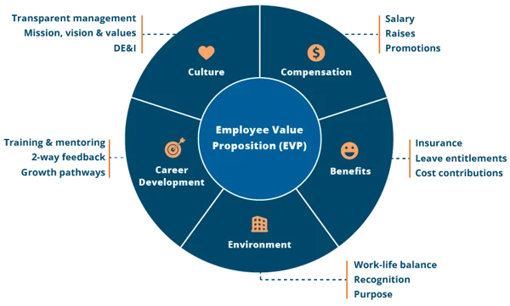
EVP

Slide 4
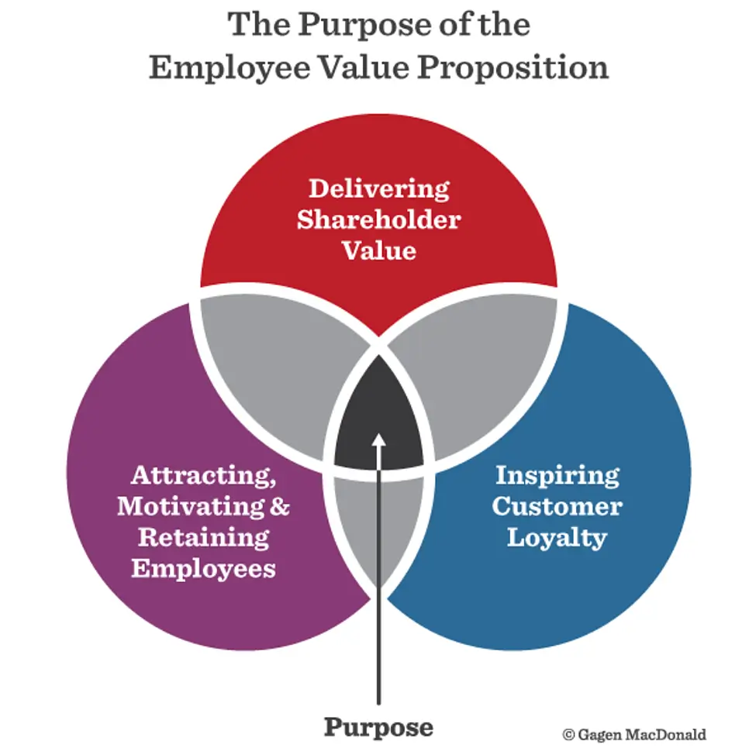

Slide 5
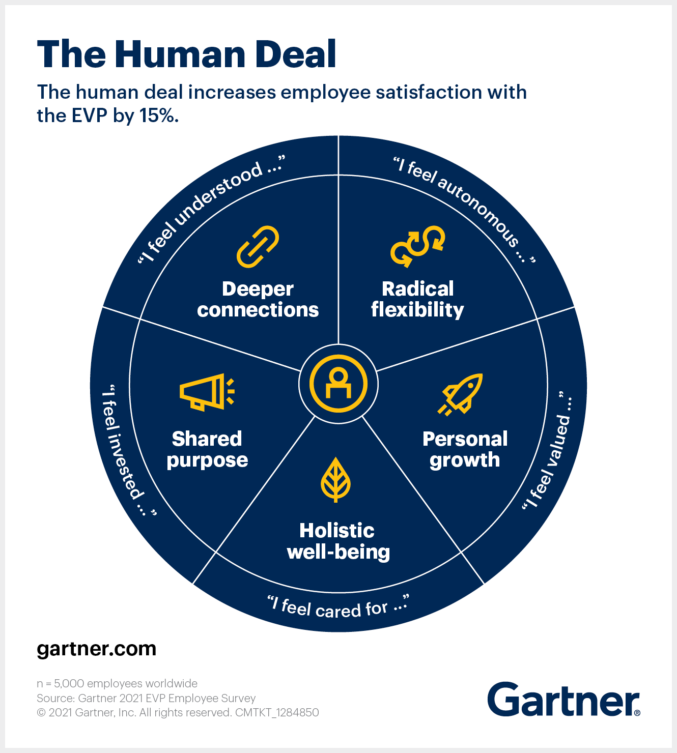
Consequences of EVP

Slide 6

Consequences of EVP

Slide 7
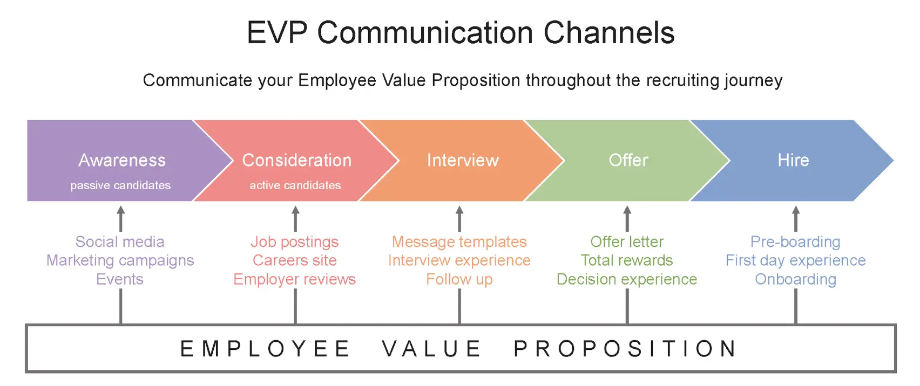
So WHAT ??

Slide 8
EVP
How employers attract graduate recruits??

Slide 9
Training and Development

Slide 10


Slide 11

Evaluation

Slide 12
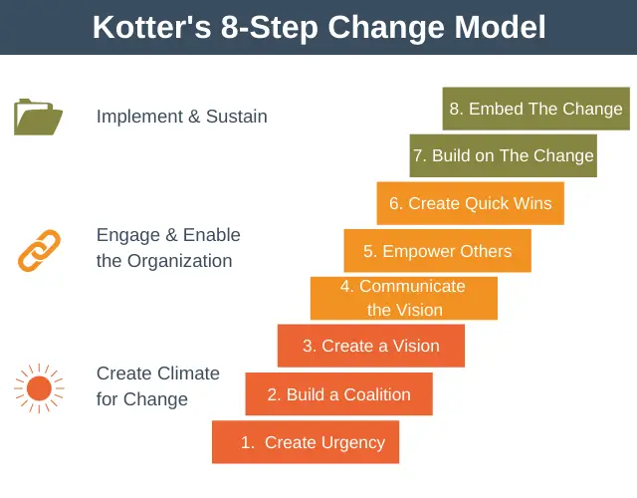
How to lead change

Slide 13


Slide 14
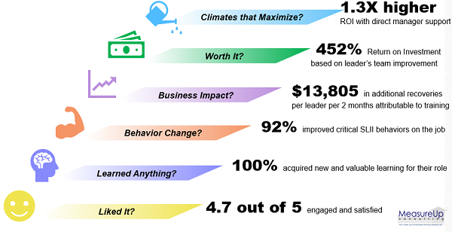
Some Training and Development Metrics

