Slide 1
Elasticity

Slide 2
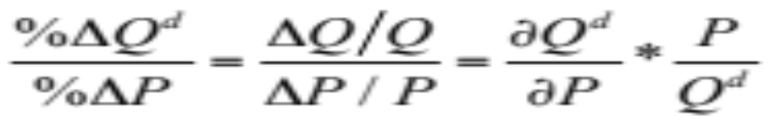
Takeaway 1: Elasticity of Demand
Tells us how demand for a good changes when determinants of demand change.
The percentage change in quantity demanded resulting from a 1 percent change in another variable.
Own price elasticity of demand: how demand for a good changes when the price (P) of that good changes

Slide 3
Takeaway 1: Elasticity of Demand
Price Elasticity of Demand is very useful.
Suppose own a car business total revenue is: price * quantity= P.Q
You can increase the price (P), but if you do that demand (Q) for your good will drop
The price elasticity of demand tell you how much the quantity will drop.
If the demand is elastic (the quantity demanded is relatively sensitive to price), the quantity reduction will outweigh the benefit of the higher price, and total revenue will fall.
If the demand is inelastic (the quantity demanded is relatively insensitive to price), the quantity reduction will not be too severe, and total revenue will go up.

Slide 4
Takeaway 2: Types of Elasticity
When a one percent change in price leads to a greater than one-percent change in quantity demanded, the demand curve is elastic.
When a one-percent change in price leads to a less than one-percent change in quantity demanded, the demand curve is inelastic.
When a one-percent change in price leads to an exactly one-percent change in quantity demanded, the demand curve is unit elastic.

Slide 5
Takeaway 2: Types of Elasticity
D₂
Perfectly Inelastic
P
P₁
D₁
Perfectly Elastic
Q₂
Q

Slide 6
Takeaway 2: Types of Elasticity
P
ε_{Q,P} = -∞
a/b
Elastic region
•
ε_{Q,P} = -1
a/2b
Inelastic region
ε_{Q,P} = 0
a
Q
0
a/2

Slide 7
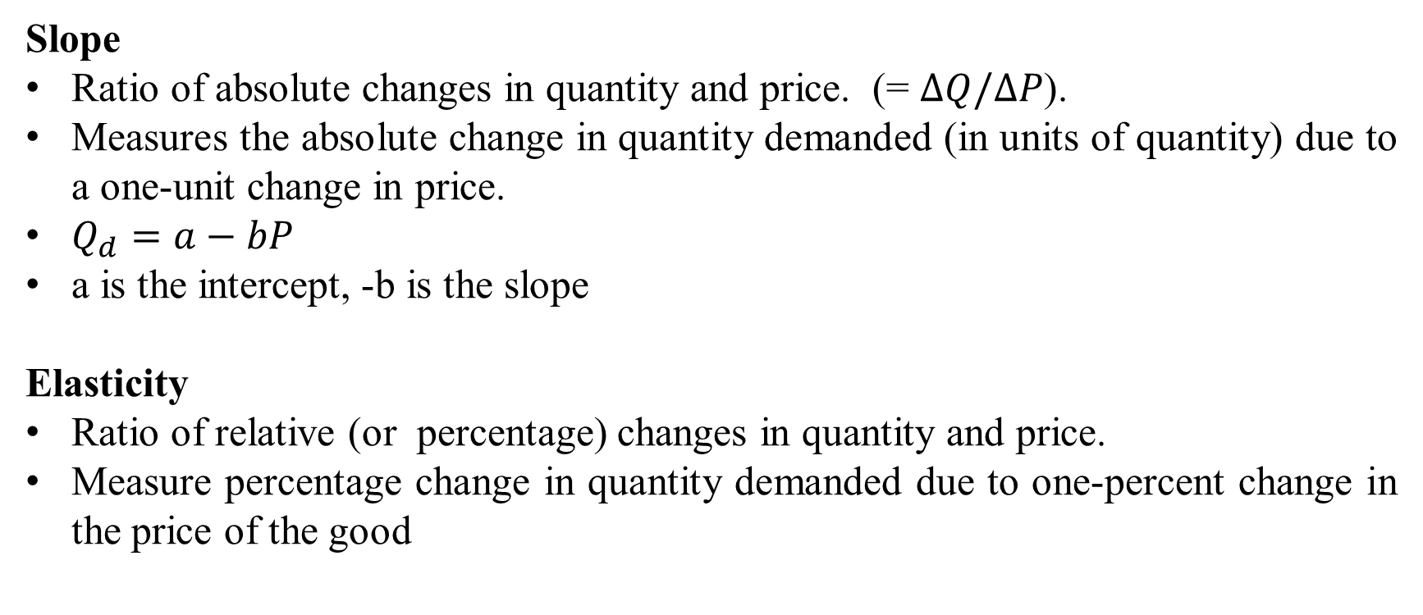
Takeaway 3: Elasticity versus Slope
Slope
Ratio of absolute changes in quantity and price. (= $∆Q/∆P$).
Measures the absolute change in quantity demanded (in units of quantity) due to a one-unit change in price.
$Q_{d}=a−bP$
a is the intercept, -b is the slope
Elasticity
Ratio of relative (or percentage) changes in quantity and price.
Measure percentage change in quantity demanded due to one-percent change in the price of the good

Slide 8
Takeaway 4: Use of Elasticity
It is unitless so allows us to easily compare across countries and goods
Units of quantities will be different for different goods. How to compare snow boards to oranges.

Slide 9
Takeaway 5: Factors Affecting Elasticity
Availability of substitutes
Percentage of income spending on product
Necessity products
Time period

Slide 10
Takeaway 6: Other Types of Elasticity
Income elasticity of demand
Cross price elasticity of demand
Price elasticity of supply
Other elasticities

Slide 11
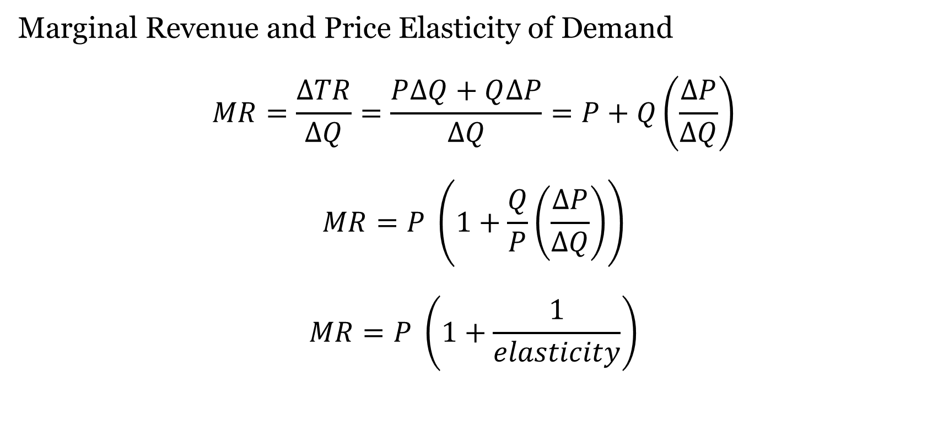
Takeaway 7: Other Issues
Marginal Revenue and Price Elasticity of Demand
$$MR=\frac{∆TR}{∆Q}=\frac{P∆Q+Q∆P}{∆Q}=P+Q\left(\frac{∆P}{∆Q}\right)$$
$$MR=P \left(1+\frac{Q}{P}\left(\frac{∆P}{∆Q}\right)\right)$$
$$MR=P \left(1+\frac{1}{elasticity}\right)$$

Slide 12
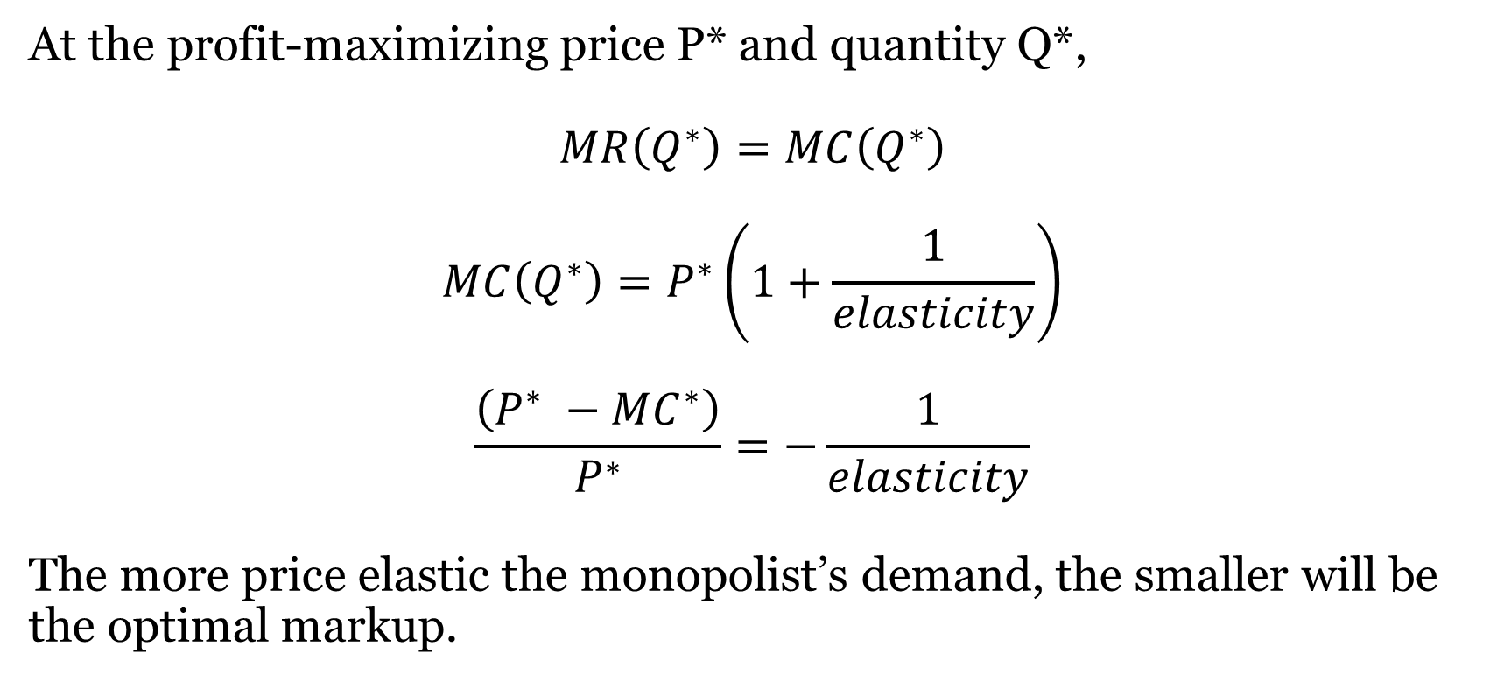
Takeaway 7: Other Issues
At the profit-maximizing price P* and quantity Q*,
$$MR\left(Q^{∗}\right)=MC\left(Q^{∗}\right)$$
$$MC\left(Q^{∗}\right)=P^{∗}\left(1+\frac{1}{elasticity}\right)$$
$$\frac{\left(P^{∗} −MC^{∗}\right)}{P^{∗}}=−\frac{1}{elasticity}$$
The more price elastic the monopolist’s demand, the smaller will be the optimal markup.

Slide 13
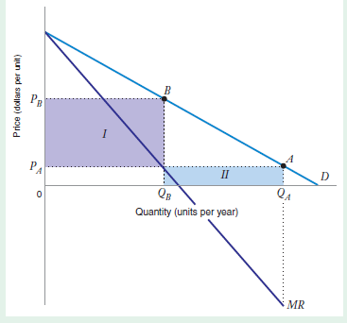
Takeaway 7: Other Issues
The monopolist always produces on the elastic region of the market demand curve.

