Slide 1
Economics: Session 1

Slide 2
Takeaway 1: Economics and its Central Questions
Economics deals with the allocation of limited resources to satisfy unlimited human wants.
Resources are said to be scarce because their supply is limited.
  We are constrained in the choices we can make about the goods and services we produce and/or consume.
That is why economics is often described as the science of constrained choice.

Slide 3
Takeaway 1: Economics and its Central Questions
Regardless of its market system, every society must answer these questions:
  What goods and services will be produced, and in what quantities?
  Who will produce the goods and services, and how?
  Who will receive the goods and services?

Slide 4
Takeaway 2: Consumer Preferences
Consumer Preferences
How the consumer would rank any two combinations of goods
Assuming these were available to the consumer at no cost
These allotments of goods are referred to as baskets or bundles.

Slide 5
Takeaway 2: Consumer Preferences
Units of
Clothes
•
A ≡ (1,5 )
•
C ≡ (4,5 )
•
B ≡ (8,1 )
Units of Food

Slide 6
Takeaway 2: Consumer Preferences
Properties of Consumer Preferences
Completeness- a>b, b>a, indifferent between a and b.
Transitivity- a>b, b>c so a>c.
More is better- More of goods (nonsatiation).

Slide 7
Takeaway 2: Consumer Preferences
Utility Function
Assigns a number to each basket so that more preferred baskets get a higher number than less preferred baskets.
Utility- Name economists give to the benefits consumers obtain from the goods and services they consume
U=f(X,Y)
U=f(20,30)> U=f(15,32)

Slide 8
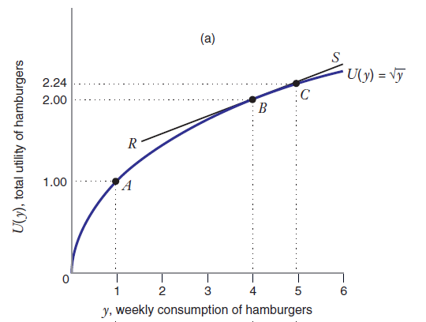
Takeaway 2: Consumer Preferences

Slide 9
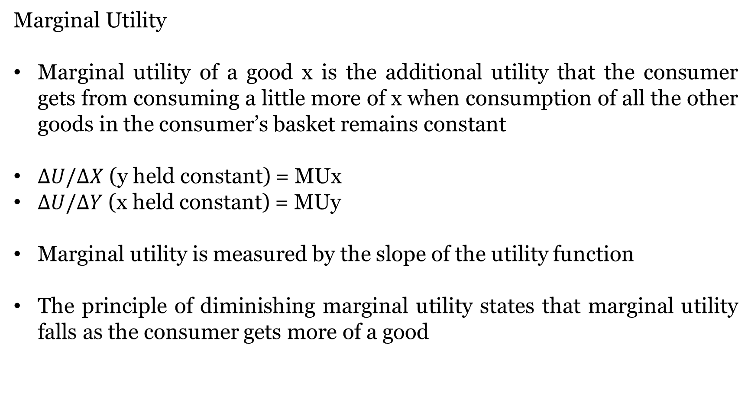
Takeaway 2: Consumer Preferences
Marginal Utility
Marginal utility of a good x is the additional utility that the consumer gets from consuming a little more of x when consumption of all the other goods in the consumer’s basket remains constant
$∆U/∆X$ (y held constant) = MUx
$∆U/∆Y$ (x held constant) = MUy
Marginal utility is measured by the slope of the utility function
The principle of diminishing marginal utility states that marginal utility falls as the consumer gets more of a good

Slide 10
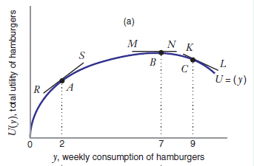
Takeaway 2: Consumer Preferences

Slide 11
Takeaway 2: Consumer Preferences
Indifference Curves
An Indifference Curve is the set of all baskets for which the consumer is indifferent
An Indifference Map illustrates a set of indifference curves for a given consumer

Slide 12
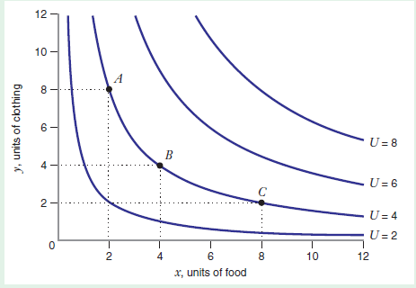
Takeaway 2: Consumer Preferences

Slide 13
Takeaway 2: Consumer Preferences
Properties of Indifference Curves
Each basket lies on one indifference curve
Indifference curves do not cross
Downward Sloping
Convex to the Origin
Cannot be thick

Slide 14
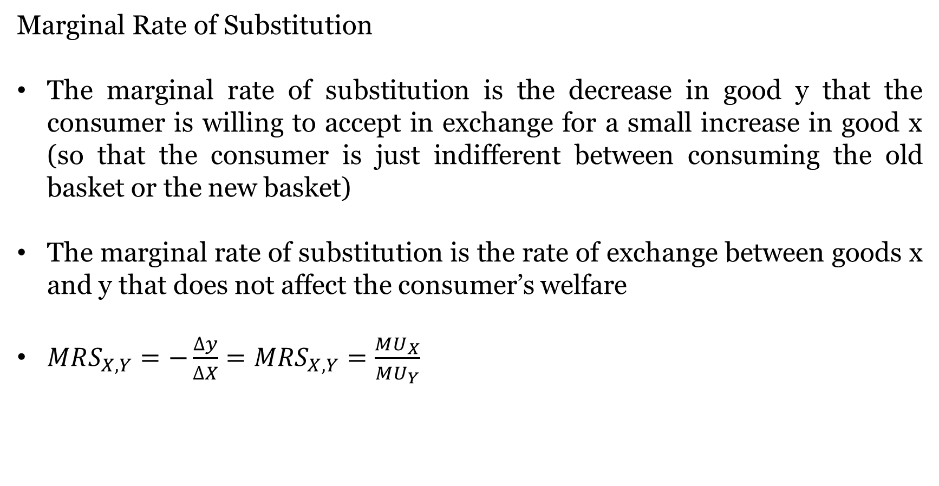
Takeaway 2: Consumer Preferences
Marginal Rate of Substitution
The marginal rate of substitution is the decrease in good y that the consumer is willing to accept in exchange for a small increase in good x (so that the consumer is just indifferent between consuming the old basket or the new basket)
The marginal rate of substitution is the rate of exchange between goods x and y that does not affect the consumer’s welfare
$MRS_{X,Y}=−\frac{∆y}{∆X}=MRS_{X,Y}=\frac{MU_{X}}{MU_{Y}}$

Slide 15
Takeaway 2: Consumer Preferences
Special Preferences
Perfect Substitutes
Perfect Complements

Slide 16
Takeaway 3: Consumer Choice
Assume only two goods available (x and y)
Px Price of x
Py Price of y
I Income
Total expenditure on basket (X,Y): PxX + PyY
The basket is affordable if total expenditure does not exceed total income: PxX + PyY ≤ I

Slide 17
Takeaway 3: Consumer Choice
Budget Constraint
Y, Clothes
Two goods available: X and Y
    I = $10, P_{x} = $1,P_{y} = $2
    1X+2Y=10 Or Y=5-1/2X
•
A
I/P_{Y}= 5
D
•
Slope -P_{X}/P_{Y} = -1/2
•
C
B
•
X, Food
I/P_{X} = 10

Slide 18
Takeaway 3: Consumer Choice
The set of baskets that are affordable is the consumer’s budget set:
PxX + PyY = I
The budget constraint defines the set of baskets that the consumer may purchase given the income available:
PxX + PyY ≤ I
The budget line is the set of baskets that are just affordable:
Y = I/Py – (Px/Py)X

Slide 19
Takeaway 3: Consumer Choice
Change in Income
Y
I₁ = $10, I₂ = $12
P_{X} = $1
P_{Y} = $2
Y = 5 - X/2 BL1
Y = 6 - X/2 BL2
6
5
BL₂
BL₁
10
12
X

Slide 20
Takeaway 3: Consumer Choice
Change in Price
Y
If the price of Y rises, the budget line gets flatter and the vertical intercept shifts down
If the price of Y falls, the budget line gets steeper and the vertical intercept shifts up
5
BL₁
I = $10
P_{X} = $1
P_{Y1} = $2 , P_{Y2} = $3
Y = 5-X/2…BL₁
Y = 3.33 - X/3 …. BL₂
3.33
BL₂
10
X

Slide 21
Takeaway 3: Consumer Choice
Interior Consumer Optimum
Y
Preference direction
B
•
At the optimal point
MRSxy=Px/Py
Slope of indifference curve is equal to the slope of the budget line
•
D
•
F
U=30
U=10
U=5
BL
0
X

Slide 22
Takeaway 3: Consumer Choice
Corner Solution
A corner solution takes place when the consumer consumes only one good. Optimal bundle contains none of one of the goods.
The tangency condition may not hold at a corner solution
How do you know whether the optimal bundle is having interior optimum or corner solution?
  Graph the indifference curves
  Check to see whether tangency condition ever holds at positive quantities of X and Y

Slide 23
Takeaway 3: Consumer Choice
Corner Solution
Y
X + 2Y = 10
0
X

Slide 24
Takeaway 4: Demand
Quantity demanded
  The amount of a good or service consumers are willing and able to purchase during a given period.
Three types of demand relations:
  General demand functions which show how quantity demanded is related to product price and five other factors that affect demand.
Example- Income, Price of related goods etc.
  Direct demand functions which show the relation between quantity demanded and the price of the product. Other factors are held constant.
  Inverse demand functions which show maximum prices buyers are willing to pay to obtain various amounts of product.

Slide 25
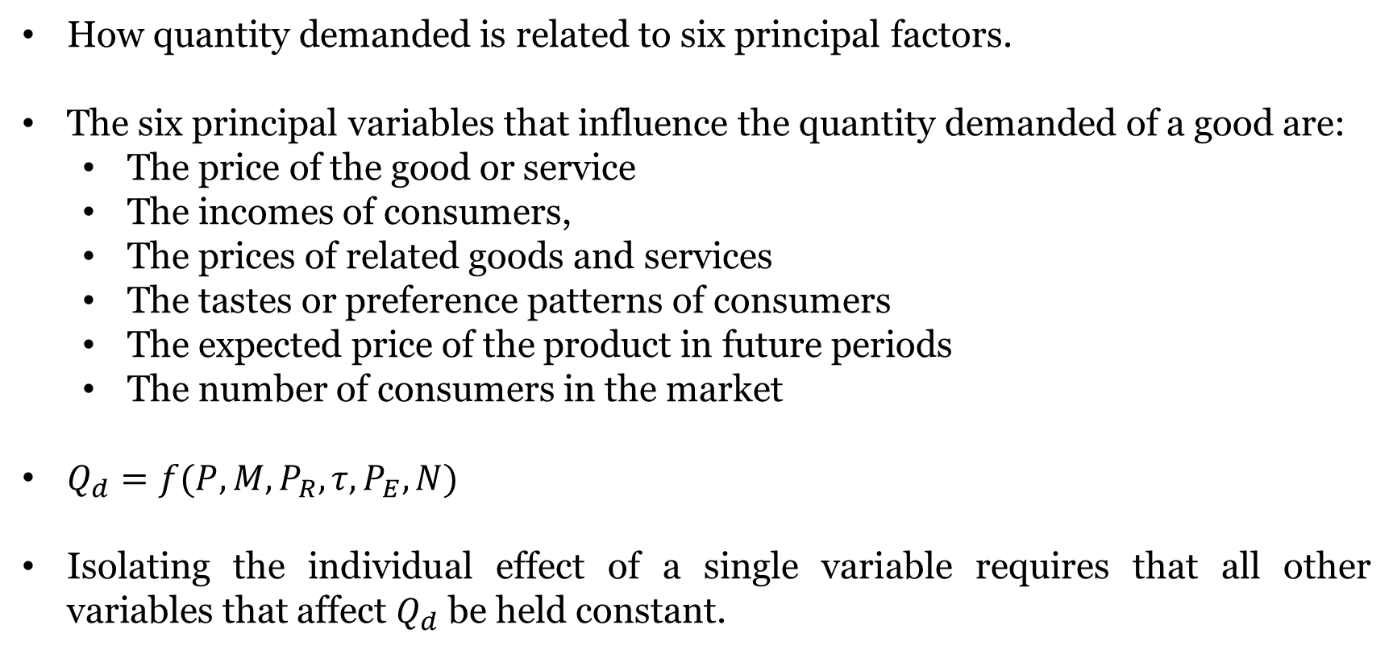
Takeaway 4: Demand
How quantity demanded is related to six principal factors.
The six principal variables that influence the quantity demanded of a good are:
  The price of the good or service
  The incomes of consumers,
  The prices of related goods and services
  The tastes or preference patterns of consumers
  The expected price of the product in future periods
  The number of consumers in the market
$Q_{d}=f(P, M, P_{R}, τ, P_{E}, N)$
Isolating the individual effect of a single variable requires that all other variables that affect $Q_{d}$ be held constant.

Slide 26
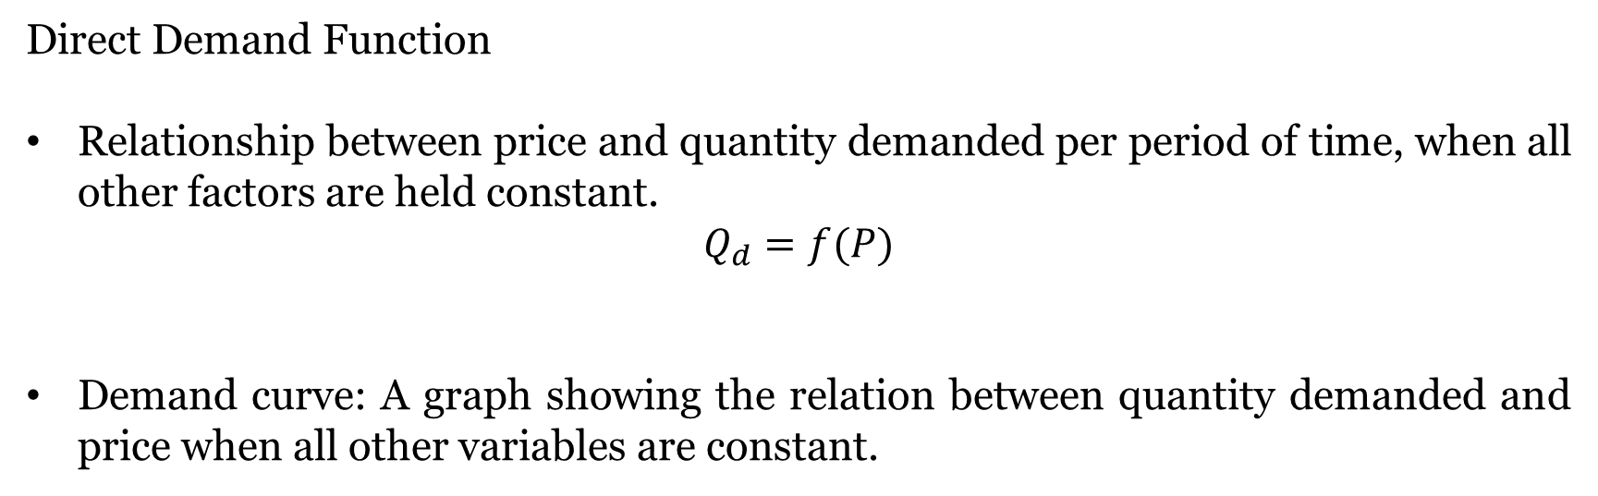
Takeaway 4: Demand
Direct Demand Function
Relationship between price and quantity demanded per period of time, when all other factors are held constant.
$$Q_{d}=f(P)$$
Demand curve: A graph showing the relation between quantity demanded and price when all other variables are constant.

Slide 27
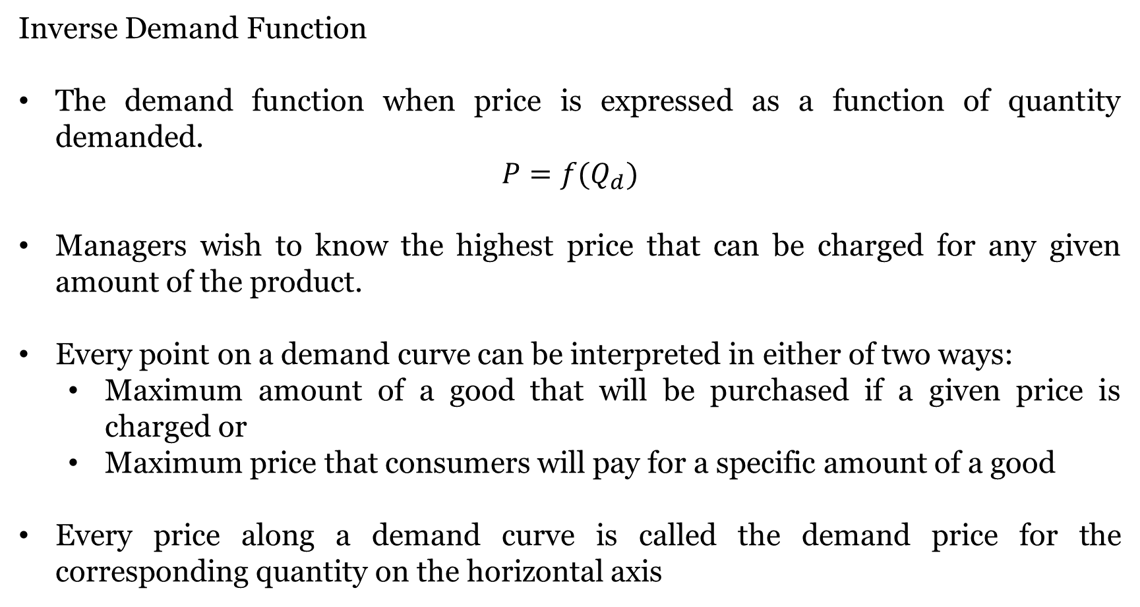
Takeaway 4: Demand
Inverse Demand Function
The demand function when price is expressed as a function of quantity demanded.
$$P=f(Q_{d})$$
Managers wish to know the highest price that can be charged for any given amount of the product.
Every point on a demand curve can be interpreted in either of two ways:
  Maximum amount of a good that will be purchased if a given price is charged or
  Maximum price that consumers will pay for a specific amount of a good
Every price along a demand curve is called the demand price for the corresponding quantity on the horizontal axis

Slide 28
Takeaway 4: Demand
A movement along the demand curve for a good can only be triggered by a change in the price of that good.
  Law of Demand - Other things remaining constant there is inverse relationship between price and quantity demanded.
Any change in another factor that affects the consumers willingness to pay for the good results in a shift in the demand curve for the good.
  Increase in demand- Rightward shift in the demand curve
  Decrease in demand-Leftward shift in the demand curve

Slide 29
Takeaway 5: Supply
The amount of a good or service offered for sale during a given period of time.
Economists assume that the quantity of a good offered for sale depends on six major variables:
  The price of the good itself.
  The prices of the inputs used to produce the good.
  The prices of goods related in production.
  The level of available technology.
  The expectations of the producers concerning the future price of the good.
  The number of firms or the amount of productive capacity in the industry

Slide 30
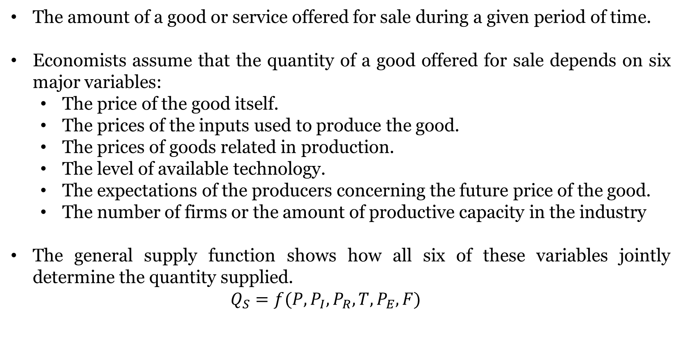
Takeaway 5: Supply
The amount of a good or service offered for sale during a given period of time.
Economists assume that the quantity of a good offered for sale depends on six major variables:
  The price of the good itself.
  The prices of the inputs used to produce the good.
  The prices of goods related in production.
  The level of available technology.
  The expectations of the producers concerning the future price of the good.
  The number of firms or the amount of productive capacity in the industry
The general supply function shows how all six of these variables jointly determine the quantity supplied.
  $$Q_{S}=f(P,P_{I}, P_{R}, T, P_{E}, F)$$

Slide 31
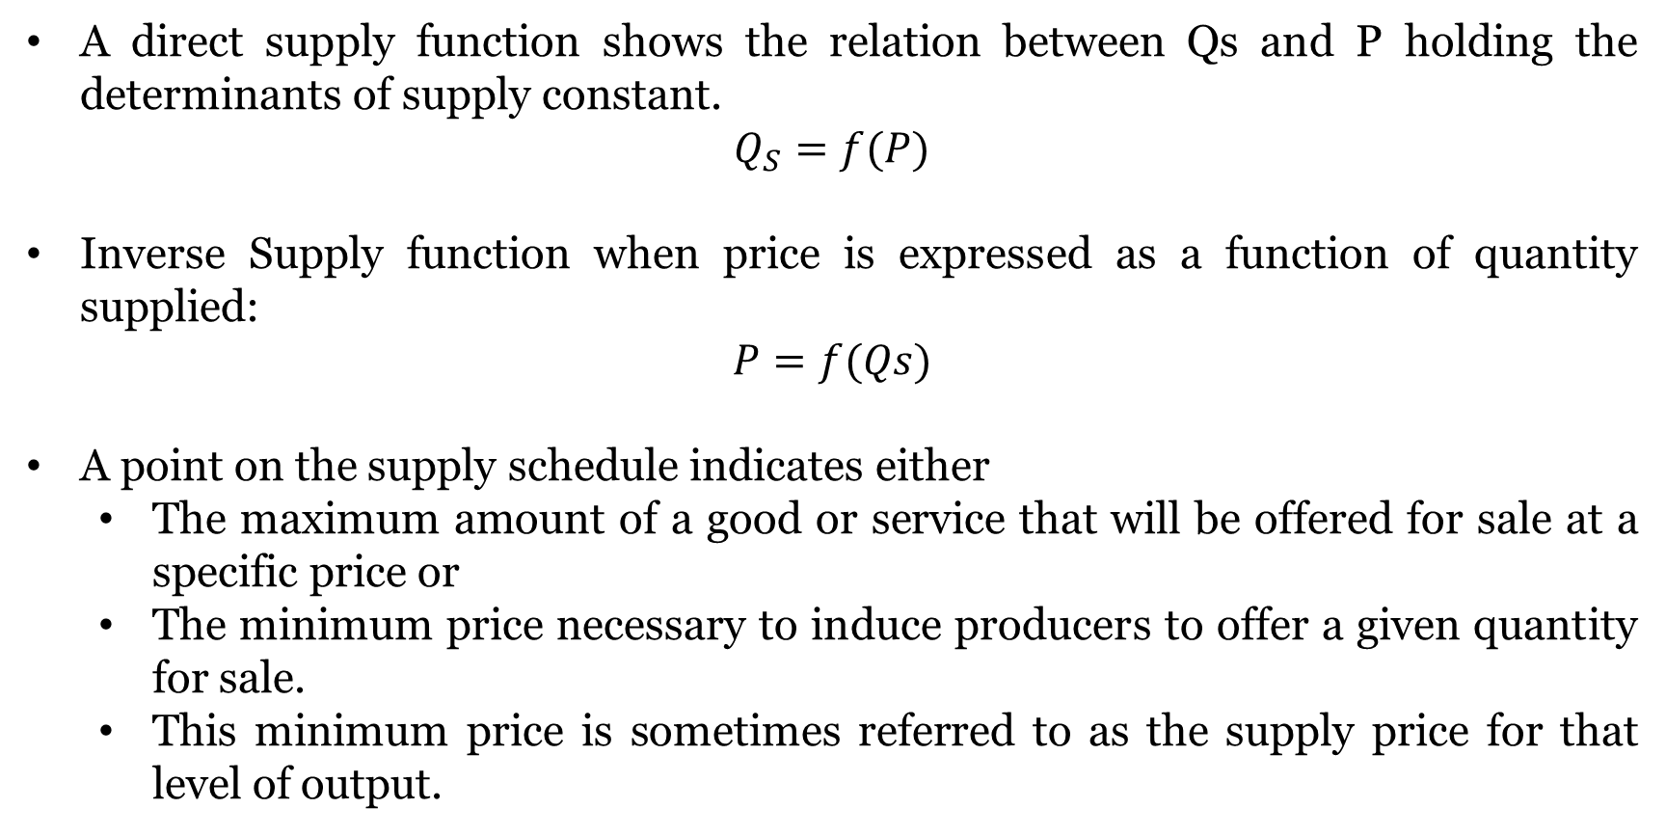
Takeaway 5: Supply
A direct supply function shows the relation between Qs and P holding the determinants of supply constant.
$$Q_{S}=f(P)$$
Inverse Supply function when price is expressed as a function of quantity supplied:
$$P=f(Qs)$$
A point on the supply schedule indicates either
  The maximum amount of a good or service that will be offered for sale at a specific price or
  The minimum price necessary to induce producers to offer a given quantity for sale.
  This minimum price is sometimes referred to as the supply price for that level of output.

Slide 32
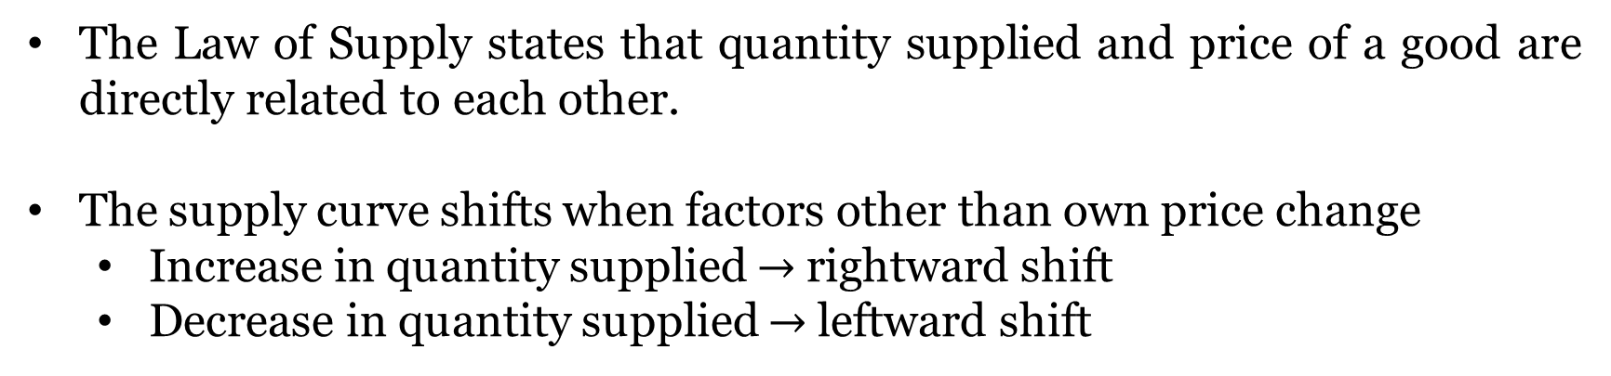
Takeaway 5: Supply
The Law of Supply states that quantity supplied and price of a good are directly related to each other.
The supply curve shifts when factors other than own price change
  Increase in quantity supplied $→$rightward shift
  Decrease in quantity supplied $→$leftward shift

Slide 33
Takeaway 5: Supply
A market equilibrium is a price such that, at this price, the quantities demanded and supplied are the same. (Demand and supply curves intersect at equilibrium)
Excess supply or a surplus exists when the quantity supplied exceeds the quantity demanded
When quantity demanded exceeds quantity supplied it is called excess demand or a shortage.

Slide 34
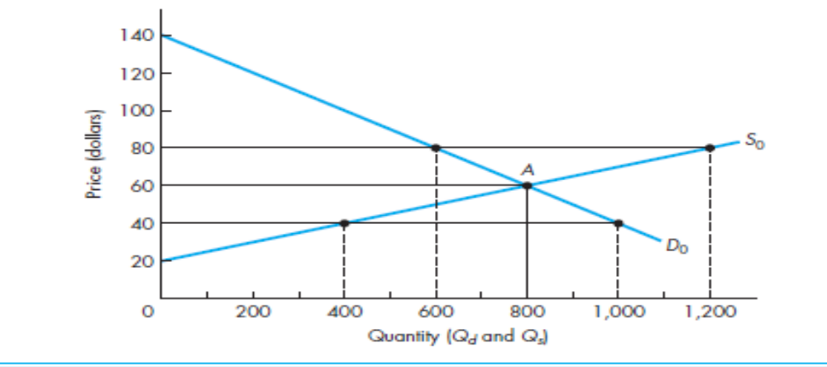
Takeaway 6: Market Equilibrium

Slide 35
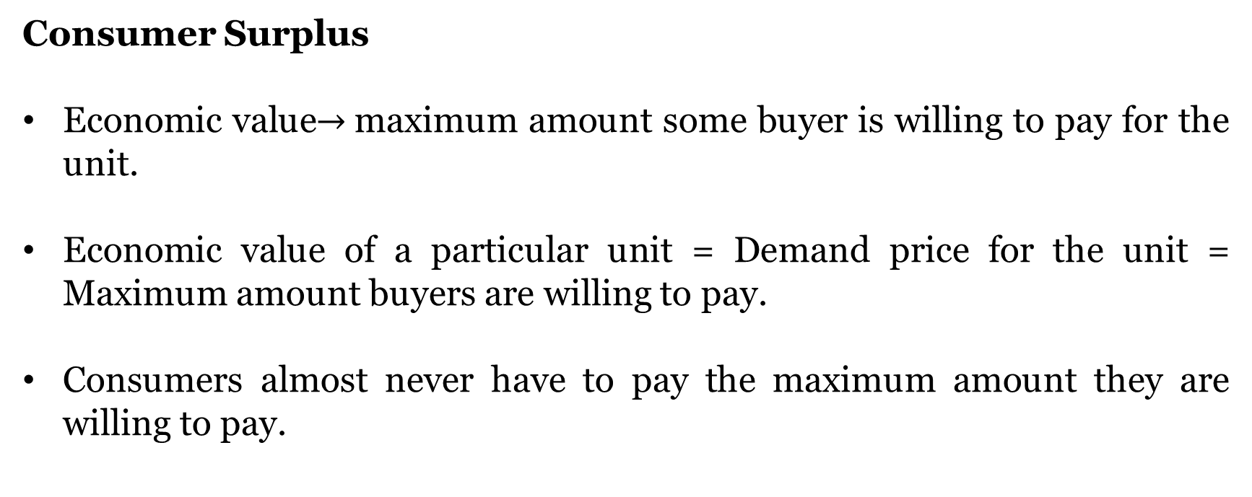
Takeaway 7: Value of Market Exchange
Consumer Surplus
Economic value$→$maximum amount some buyer is willing to pay for the unit.
Economic value of a particular unit = Demand price for the unit = Maximum amount buyers are willing to pay.
Consumers almost never have to pay the maximum amount they are willing to pay.

Slide 36
Takeaway 7: Value of Market Exchange
Consumer Surplus
They instead must pay the market price, which is lower than the maximum amount consumers are willing to pay.
The difference between the economic value of a good and the price of the good is the net gain to the consumer, and is called consumer surplus.
Area below the demand curve above the market price over the required output range.

Slide 37
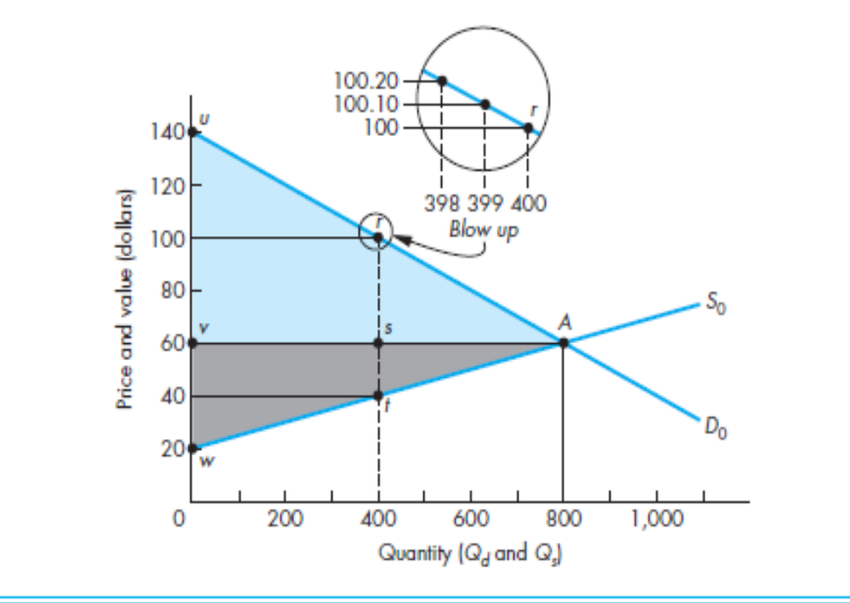
Takeaway 7: Value of Market Exchange
Consumer Surplus

Slide 38
Takeaway 7: Value of Market Exchange
Producer Surplus
Producers typically receive more than the minimum payment necessary to induce them to supply their product.
The difference between the market price received and the minimum price producers would accept to supply is called producer surplus.
PS-area below market price and above supply curve.

Slide 39
Takeaway 7: Value of Market Exchange
Producer Surplus

Slide 40
Takeaway 7: Value of Market Exchange
Social Surplus
Social Surplus is consumer surplus plus producer surplus.

Slide 41
Case: Fee Regulation in Private Schooling: The case of Gujarat

Slide 42
Questions
Q1. What are supply and demand in terms of educational services?

Slide 43
Questions
Q2. What is the problem statement?

Slide 44
Questions
Q3. Why there is a need for government intervention?

Slide 45
Questions
Q4. What would be the long-term impact of FRA on the education sector in Gujarat?

Slide 46
Questions
Q5. Which stakeholders would be impacted the most?

Slide 47
Questions
Q6. Instead of fee cap, what would happen if the government reduced the barriers to entry for private schools?

Slide 48
Questions
Q7. What should the private schools and government do to maximize social welfare?

Slide 49
Questions
Q8. What are the consequences of free market vis-à-vis regulated market?

Slide 50
Takeaway 8: Changes in Market Equilibrium
Changes in demand-supply constant.
Changes in supply-demand constant.
Simultaneous shifts in demand and supply.
  DD increases SS increases- Price may rise or fall, quantity rises.
  DD increases SS decreases-Price rises, quantity may rise or fall.

Slide 51
Takeaway 9: Ceiling and Floor Prices
Ceiling price
  The maximum price the government permits sellers to charge for a good.
  When this price is below equilibrium, a shortage occurs.
Floor price
  The minimum price the government permits sellers to charge for a good.
  When this price is above equilibrium, a surplus occurs.

