Slide 1
Recognizing Opportunities and Generating Ideas

Slide 2
What is An Opportunity?
1 of 2
An opportunity is a favorable
set of circumstances that
creates a need for a new
product, service or business.
Opportunity Defined

Slide 3
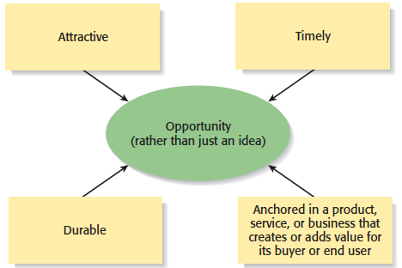
What is an Opportunity?
2 of 2
An opportunity has four essential qualities

Slide 4

Three Ways to Identify an Opportunity

Slide 5
Business Ideas
The following are examples of possible sources of business ideas:
Based on work experience.
Based on hobby and interest.
Based on chance encounters or observations while travelling.
Based on family business.
Based on suggestion from spouse, siblings and friends.
Based on business networks.
Based on local needs, wants, problem or finding gaps in the market place.
Based on market trend or market growth potential.
Based on copying successful business model.

Slide 6
Business Ideas (cont.)
Based on franchise business.
Based on searching and seeking of good opportunities in the environment.
Based on experimentation, trial and error methods and better product development.
Based on building internal strengths such as skills, capability, experiences, resources and networks so that you become the best and most suitable person to capture the opportunity. These additional strengths that you build may make opportunities seek you or single you out from your competitors.
Based on readings from magazines, books and internet.
Looking for good existing business for sale.

Slide 7
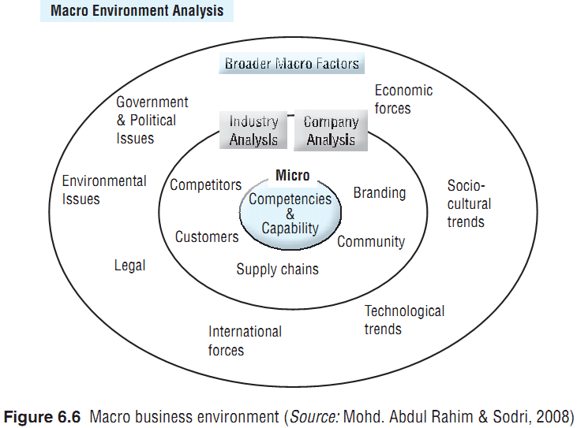
Macroenvironment Analysis

Slide 8
First Approach: Observing Trends
1 of 2
Observing Trends
  Trends create opportunities for entrepreneurs to pursue.
  The most important trends are:
    Economic forces.
    Social forces.
    Technological advances.
    Political action and regulatory change.
  It’s important to be aware of changes in these areas.

Slide 9
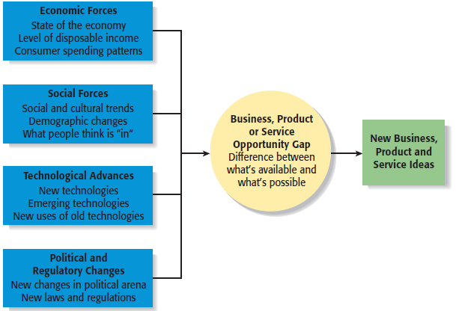
First Approach: Observing Trends
2 of 2
Environmental Trends Suggesting Business or Product Opportunity Gaps

Slide 10
Trend 1: Economic Forces
Example of Economic Trend Creating a Favorable Opportunity
Economic trends help determine areas that are ripe for new startups and areas that startups should avoid.
Economic trends favor
startups that help consumers
save money.
An example is GasBuddy.com,
a company started to help
consumers save money on gas.

Slide 11
Trend 2: Social Forces
Examples of Social Trends
Social trends alter how people and businesses behave and set their priorities. These trends provide opportunities for new businesses to accommodate the changes.
Retirement of baby boomers.
The increasing diversity of
the workplace.
Increasing interest in health,
fitness, and wellness.
Emphasis on alternative forms
of energy.
New forms of music and other
types of entertainment.

Slide 12
Trend 3: Technological Advances
1 of 2
Examples of Entire Industries that Have Been Created as the Results of Technological Advances
Advances in technology frequently create business opportunities.
Computer industry
Internet
Biotechnology
Digital photography
Digital technology
IoT / AI / ML

Slide 13
Trend 3: Technological Advances
2 of 2
Example: H20Audio
Once a technology is created, products often emerge to advance it.
An example is H20Audio, a company started by four former San Diego State University students, that makes waterproof headphones and accessories for the Apple iPod.

Slide 14
Trend 4: Political Action and Regulatory Changes
1 of 2
General Example
Political action and regulatory changes also provide the basis for opportunities.
Laws to protect the environment have created opportunities for entrepreneurs to start firms that help other firms comply with environmental laws and regulations.

Slide 15
Trend 4: Political Action and Regulatory Changes
2 of 2
Specific Example
Company created to help other companies comply with a specific law.
The No Child Left Behind Act of 2002 requires states to develop criterion-based assessments in basic skills to be periodically given to students in certain grades. Kim and Jay Kleeman, two high school teachers, started Shakespeare Squared, a content development company that helps high schools comply with the act.

Slide 16
Second Approach: Solving a Problem
1 of 2
Solving a Problem
  Sometimes identifying opportunities simply involves noticing a problem and finding a way to solve it.
  These problems can be pinpointed through observing trends and through more simple means, such as intuition, serendipity, or change.

Slide 17

Second Approach: Solving a Problem
2 of 2
A problem facing the U.S. and
other countries is finding
alternatives to fossil fuels.
A large number of
entrepreneurial firms, like
this wind farm, are being
launched to solve this problem.

Slide 18
Third Approach: Finding Gaps in the Marketplace
1 of 2
Gaps in the Marketplace
  A third approach to identifying opportunities is to find a gap in the marketplace
  A gap in the marketplace is often created when a product or service is needed by a specific group of people but doesn’t represent a large enough market to be of interest to mainstream retailers or manufacturers.

Slide 19
Third Approach: Finding Gaps in the Marketplace
2 of 2
Specific Example
Product gaps in the marketplace represent potentially viable business opportunities.
In 2000 Tish Cirovolv realized there were no guitars on the market made specifically for women. To fill this gap, she started Daisy Rock Guitars, a company that makes guitars just for women.

Slide 20
Personal Characteristics of the Entrepreneur
Characteristics that tend to make some people better at recognizing opportunities than others
Prior Experience
Cognitive Factors
Social Networks
Creativity

Slide 21
Prior Experience
Prior Industry Experience
  Several studies have shown that prior experience in an industry helps an entrepreneur recognize business opportunities.
    By working in an industry, an individual may spot a market niche that is underserved.
    It is also possible that by working in an industry, an individual builds a network of social contacts who provide insights that lead to recognizing new opportunities.

Slide 22
Cognitive Factors
Cognitive Factors
  Studies have shown that opportunity recognition may be an innate skill or cognitive process.
  Some people believe that entrepreneurs have a “sixth sense” that allows them to see opportunities that others miss.
  This “sixth sense” is called entrepreneurial alertness, which is formally defined as the ability to notice things without engaging in deliberate search.

Slide 23
Social Networks
1 of 3
Social Networks
  The extent and depth of an individual’s social network affects opportunity recognition.
  People who build a substantial network of social and professional contacts will be exposed to more opportunities and ideas than people with sparse networks.
  In one survey of 65 start-ups, half the founders reported that they got their business idea through social contacts.
Strong Tie Vs. Weak Tie Relationships
  All of us have relationships with other people that are called “ties.” (See next slide.)

Slide 24
Social Networks
2 of 3
Nature of Strong-Tie Vs. Weak Tie Relationships
  Strong-tie relationship are characterized by frequent interaction and form between coworkers, friends, and spouses.
  Weak-tie relationships are characterized by infrequent interaction and form between casual acquaintances.
Result
  It is more likely that an entrepreneur will get new business ideas through weak-tie rather than strong-tie relationships. (See next slide.)

Slide 25
Social Networks
3 of 3
Why weak-tie relationships lead to more new business ideas than strong-tie relationships
Strong-Tie Relationships
Weak-Tie Relationships
These relationships, which typically form between like minded individuals, tend to reinforce insights and ideas that people already have.
These relationships, which form between casual acquaintances, are not as apt to be between like-minded individuals, so one person may say something to another that sparks a completely new idea.

Slide 26
Creativity
1 of 2
Creativity
  Creativity is the process of generating a novel or useful idea.
  Opportunity recognition may be, at least in part, a creative process.
  For an individual, the creative process can be broken down into five stages, as shown on the next slide.

Slide 27
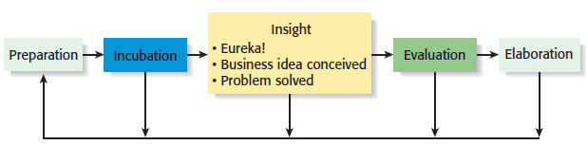
Creativity
2 of 2
Five-Steps to Generating Creative Ideas

Slide 28
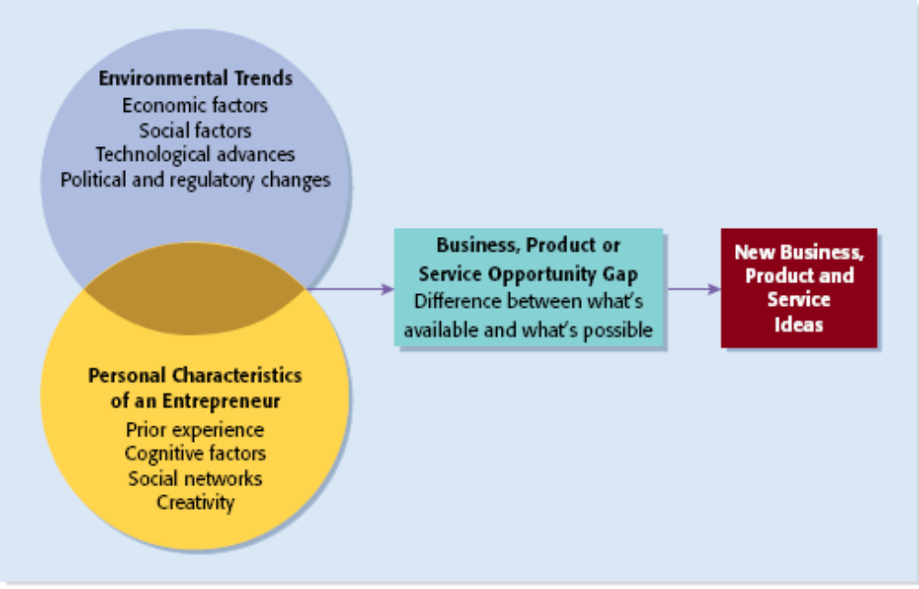
Full View of the Opportunity Recognition Process
Depicts the connection between an awareness of emerging trends and the personal characteristics of the entrepreneur

Slide 29
Techniques For Generating Ideas
Brainstorming
Focus Groups
Library and
Internet Research

Slide 30
Brainstorming
Brainstorming
  Is a technique used to generate a large number of ideas and solutions to problems quickly.
  A brainstorming “session” typically involves a group of people, and should be targeted to a specific topic.
  Rules for a brainstorming session:
    No criticism.
    Freewhelling is encouraged.
    The session should move quickly.
    Leap-frogging is encouraged.

Slide 31
Focus Groups
Focus Group
  A focus group is a gathering of five to ten people, who have been selected based on their common characteristics relative to the issues being discussed.
  These groups are led by a trained moderator, who uses the internal dynamics of the group environment to gain insight into why people feel they way they do about a particular issue.
  Although focus groups are used for a variety of purposes, they can be used to help generate new business ideas.

Slide 32
Library and Internet Research
1 of 3
Library Research
  Libraries are an often underutilized source of information for generating new business ideas.
  The best approach is to talk to a reference librarian, who can point out useful resources, such as industry-specific magazines, trade journals, and industry reports.
  Simply browsing through several issues of a trade journal or an industry report on a topic can spark new ideas.

Slide 33
Libraries and Internet Research
2 of 3
Examples of Useful Search Engines and Industry Reports
Large public and university libraries typically have access to search engines and industry reports that would cost thousands of dollars to access on your own.
Lexis-Nexis Academic
ProQuest
IBISWorld
Mintel
Standard & Poor’s Net
Advantage

Slide 34
Library and Internet Research
3 of 3
Internet Research
  If you are starting from scratch, simply typing “new business ideas” into a search engine will produce links to newspapers and magazine articles about the “hottest” new business ideas.
  If you have a specific topic in mind, setting up Google or Yahoo! e-mail alerts will provide you to links to a constant stream of newspaper articles, blog posts, and news releases about the topic.
  Targeted searches are also useful.

Slide 35
Other Techniques
Customer Advisory Boards
  Some companies set up customer advisory boards that meet regularly to discuss needs, wants, and problems that may lead to new ideas.
Day-In-The-Life Research
  A type of anthropological research, where the employees of a company spend a day with a customer.

Slide 36
Encouraging New Ideas
Establishing a Focal Point for Ideas
  Some firms meet the challenge of encouraging, collecting, and evaluating ideas by designating a specific person to screen and track them—for if its everybody’s job, it may be no one’s responsibility.
  Another approach is to establish an idea bank (or vault), which is a physical or digital repository for storing ideas.
Encouraging Creativity at the Firm Level
  Creativity is the raw material that goes into innovation and should be encouraged at the organizational and individual supervisory level.

Slide 37
Protecting Ideas From Being Lost or Stolen
Step 1
  The idea should be put in a tangible form such as entered into a physical idea logbook or saved on a computer disk, and the date the idea was first thought of should be entered.
Step 2
  The idea should be secured. This may seem like an obvious step, but is often overlooked.
Step 3
  Avoid making an inadvertent or voluntary disclosure of an idea, in a manner that forfeits the right to claim exclusive rights to it.

Slide 38

Sources of Information
trade
magazines
specialty
magazines
government
agencies
Sources
of
Information
trade shows
the Internet
exhibitions
newspapers
38

Slide 39

Where to Find a Business
newspapers
business
publications
Finding
Business
Opportunities
business
brokers
networking
39

Slide 40
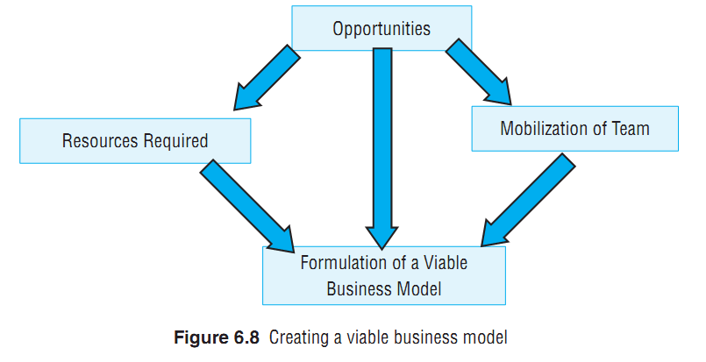
Business Model

