Slide 1
Supply chain Management
Supply chain drivers and metrics

Slide 2



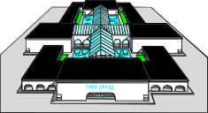
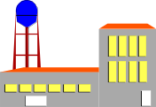



Customers,
demand
centers
sinks
Field
Warehouses:
stocking
points
Sources:
plants
vendors
ports
Regional
Warehouses:
stocking
points
Supply
Inventory &
warehousing
costs
Production/
purchase
costs
Transportation
costs
Transportation
costs
Inventory &
warehousing
costs

Slide 3
Objective of Supply Chain Management?
Supply chain management is concerned with the efficient integration of suppliers, factories, warehouses and stores so that merchandise is produced and distributed:
  In the right quantities
  To the right locations
  At the right time
In order to
  Minimize total system cost
  Satisfy customer service requirements

Slide 4
The Objective of a Supply Chain
Maximize overall value generated
Supply Chain Surplus
= Customer Value – Supply Chain Cost
To get the cash as soon s possible

Slide 5
The Objective of a Supply Chain
Example: a customer purchases a wireless router from Best Buy for $60 (revenue)
Supply chain incurs costs (information, storage, transportation, produce components, assembly, etc.)
Difference between $60 and the sum of all of these costs is the supply chain profit
Supply chain profitability is total profit to be shared across all stages of the supply chain
Success should be measured by total supply chain profitability, not profits at an individual stage

Slide 6
1. Strategies for SCM
All of the advanced strategies, techniques, and approaches for Supply Chain
Management focus on:
  Global Optimization
  Managing Uncertainty

Slide 7

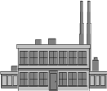

Sequential Optimization vs. Global Optimization
Sequential Optimization
Procurement
Planning
Manufacturing
Planning
Distribution
Planning
Demand
Planning
Global Optimization
Supply Contracts/Collaboration/Information Systems and DSS
Procurement
Planning
Manufacturing
Planning
Distribution
Planning
Demand
Planning
Source: Duncan McFarlane

Slide 8
Tools and Strategies for Optimization
Decision Support Systems
Inventory Control
Network Design
Design for Logistics
Cross Docking
Notes:
DSS support human decisions
Why is inventory control difficult in supply chains?
What is a network?
What impact does design have?

Slide 10
Conflicting Objectives in the Supply Chain
1. Purchasing
• Stable volume requirements
• Flexible delivery time
• Little variation in mix
• Large quantities
2. Manufacturing
• Long run production
• High quality
• High productivity
• Low production cost

Slide 11
Conflicting Objectives in the Supply Chain
3. Warehousing
• Low inventory
• Reduced transportation costs
• Quick replenishment capability
4. Customers
• Short order lead time
• High in stock
• Enormous variety of products
• Low prices

Slide 12
Supply chain Uncertainty
What is variation?
What tools and approaches help us to deal with these issues?
Notes:
Contrast variation between time periods with random differences between time periods.
Suggestions for tools and approaches in three slides.
What about forecasting?

Slide 13
Why Is Uncertainty Hard to Deal With?
Matching supply and demand is difficult.
Forecasting doesn’t solve the problem.
Inventory and back-order levels typically fluctuate widely across the supply chain.
Demand is not the only source of uncertainty:
  Lead times
  Yields
  Transportation times
  Natural Disasters
  Component Availability
Notes:
Examples of Sept. 11, Taiwan earthquake

Slide 14
Supply Chain Variability
Manufacturer Forecast
of Sales
Volumes
Actual
Consumer
Demand
Retailer Warehouse
to Shop
Retailer Orders
Production Plan
Time
Source: Tom Mc Guffry, Electronic Commerce and Value Chain Management, 1998
Notes:
What is shown here is how divergent these various forecasts are in relation to real demand.
Why?? Because they are developed independently from each other and are dated, and unconnected to each other and the daily fluctuations in the market

Slide 15
What Management Gets...
Volumes
Consumer
Demand
Production Plan
Time
Source: Tom Mc Guffry, Electronic Commerce and Value Chain Management, 1998
Notes:
What is shown here is how divergent these various forecasting are in relation to real demand.
Why?? Because they are developed independently from each other and are dated, and unconnected to each other and the daily fluctuations in the market

Slide 16
What Management Wants…
Production Plan
Volumes
Consumer
Demand
Time
Source: Tom Mc Guffry, Electronic Commerce and Value Chain Management, 1998
Notes:
What is shown here is how divergent these various forecasting are in relation to real demand.
Why?? Because they are developed independently from each other and are dated, and unconnected to each other and the daily fluctuations in the market
Why do we care?

Slide 17
Dealing with Uncertainty
Pull Systems
Risk Pooling
Centralization
Postponement
Collaborative Forecasting

Slide 18
2. Process Views of a Supply Chain
Cycle View: The processes in a supply chain are divided into a series of cycles, each performed at the interface between two successive stages of the supply chain.
Push/Pull View: The processes in a supply chain are divided into two categories, depending on whether they are executed in response to a customer order or in anticipation of customer orders. Pull processes are initiated by a customer order, whereas push processes are initiated and performed in anticipation of customer orders.

Slide 19
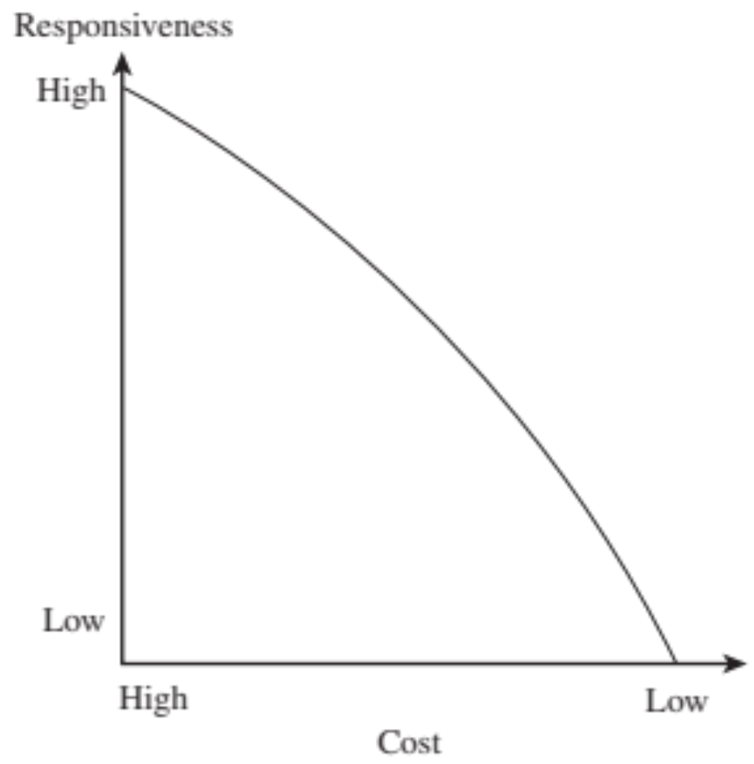
Cost-Responsiveness Efficient Frontier

Slide 20
Efficient and Responsive Supply Chains
 | Efficient Supply Chains | Responsive Supply Chains
Primary goal | Supply demand at the lowest cost | Respond quickly to demand
Product design strategy | Maximize performance at a minimum product cost | Create modularity to allow postponement of product differentiation
Pricing strategy | Lower margins because price is a prime customer driver | Higher margins because price is not a prime customer driver
Manufacturing strategy | Lower costs through high utilization | Maintain capacity flexibility to buffer against demand/supply uncertainty
Inventory strategy | Minimize inventory to lower cost | Maintain buffer inventory to deal with demand/supply uncertainty
Lead-time strategy | Reduce, but not at the expense of costs | Reduce aggressively, even if the costs are significant
Supplier strategy | Select based on cost and quality | Select based on speed, flexibility, reliability, and quality

Slide 21
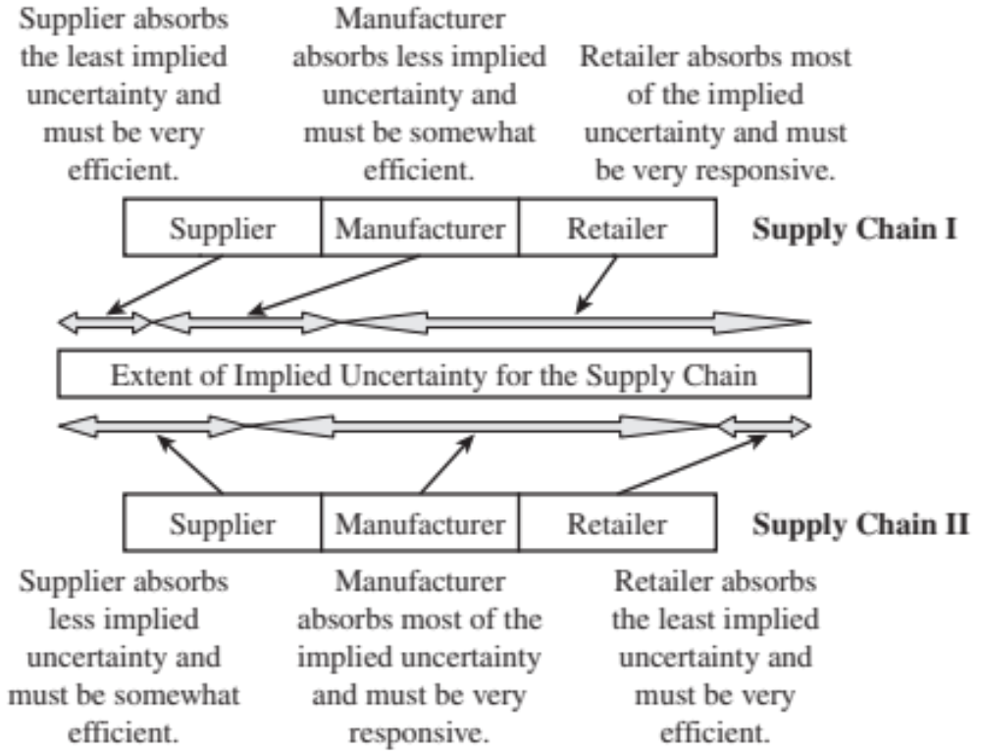
Roles and Allocations
FIGURE 2-6

Slide 22
Supply chain Drivers

Slide 23
Supply chain drivers
Describe key financial measures of firm performance.
Identify the major drivers of supply chain performance.
The role of each driver in creating strategic fit between the supply chain strategy and the competitive strategy.
Key metrics that track the performance of the supply chain in terms of each driver.

Slide 24
Drivers of Supply Chain Performance
Facilities
  The physical locations in the supply chain network where product is stored, assembled, or fabricated
Inventory
  All raw materials, work in process, and finished goods within a supply chain
Transportation
  Moving inventory from point to point in the supply chain

Slide 30
Drivers of Supply Chain Performance
Information
  Data and analysis concerning facilities, inventory, transportation, costs, prices, and customers throughout the supply chain
Sourcing
  Who will perform a particular supply chain activity
Pricing
  How much a firm will charge for the goods and services that it makes available in the supply chain

Slide 31
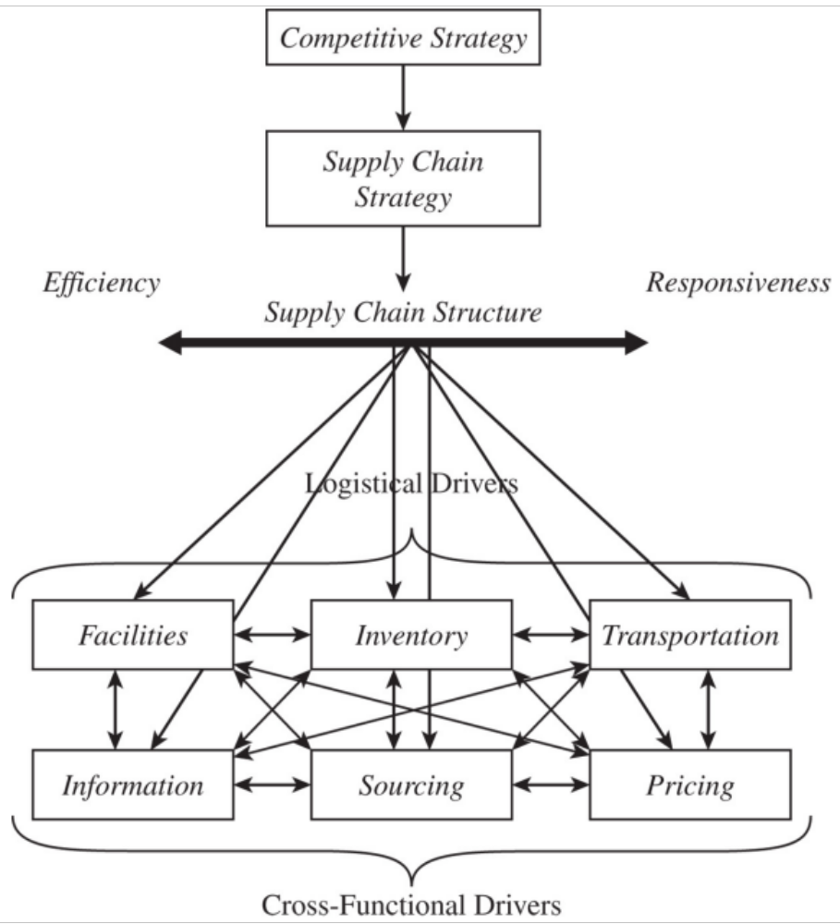
Framework for
Structuring Drivers

