Slide 1

Product Architecture
Instructor:
Dr. Sushil Kumar
Assistant Professor
Entrepreneurship , IIM Visakhapatnam

Slide 2
WHAT IS PRODUCT ARCHITECTURE?
Product architecture is the assignment of the functional elements of a product to the physical building blocks of the product.
The functional elements of a product are the individual operations and transformations that contribute to the overall performance of the product.

Slide 3
Cont…
The physical elements of a product are the parts, components, and subassemblies that ultimately implement the product’s functions.
The most important characteristic of a product’s architecture is its modularity.

Slide 4
A Modular Architecture
Chunks implement one or a few functional elements in their entirety.
The interactions between chunks are well defined and are generally fundamental to the primary functions of the product.

Slide 5
An Integrated Architecture
Functional elements of the product are implemented using more than one chunk.
A single chunk implements many functional elements.
The interactions between chunks are ill defined and may be incidental to the primary functions of the products.

Slide 6
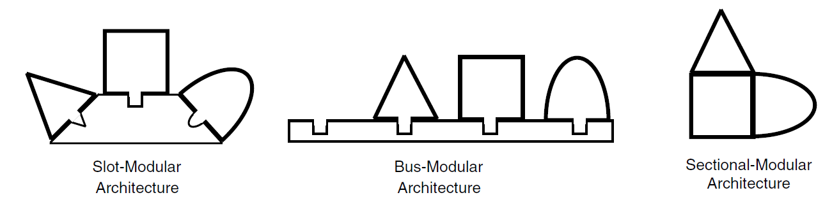
Types of modularity

Slide 7
IMPLICATIONS OF THE ARCHITECTURE
Product Change
Product Variety
Component Standardization
Product Performance
Manufacturability
Product Development Management

Slide 8
ESTABLISHING THE ARCHITECTURE
Create a schematic of the product.
Cluster the elements of the schematic.
Create a rough geometric layout.
Identify the fundamental and incidental interactions.

Slide 9
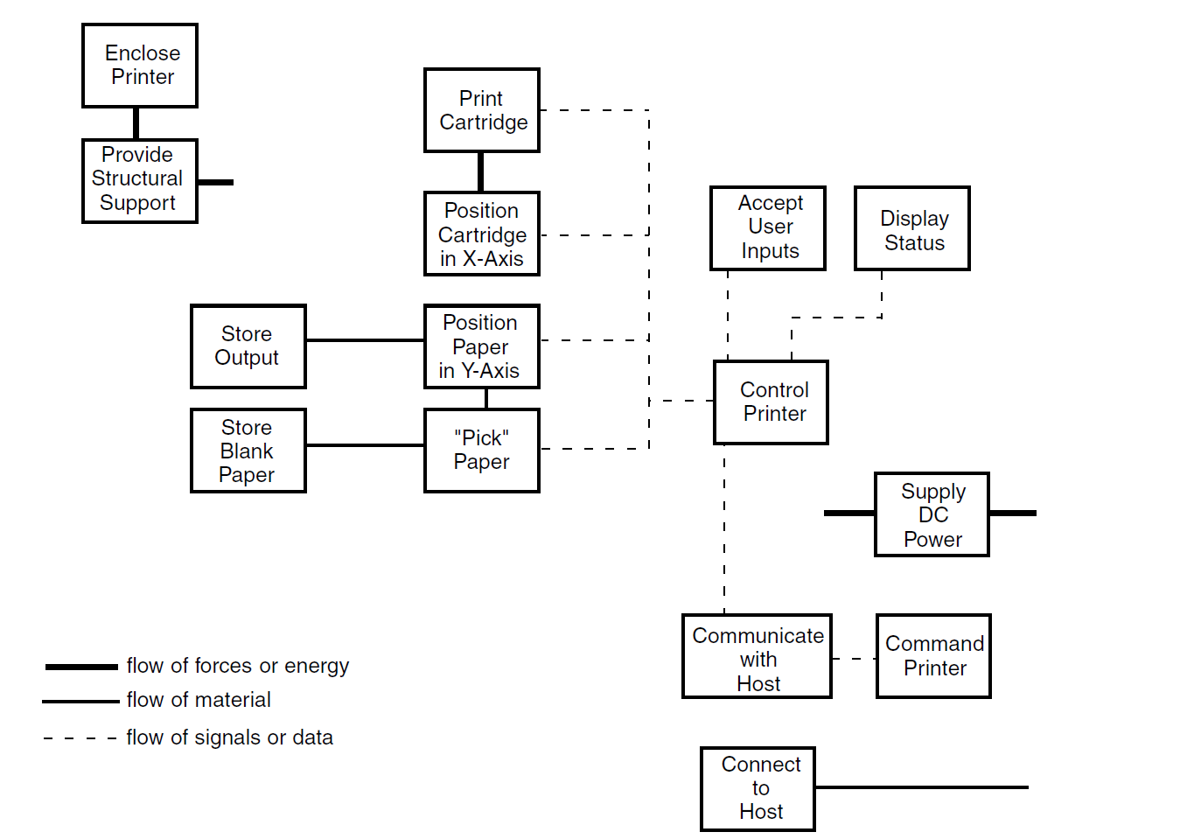
Step 1: Create a Schematic of the Product
The schematic should reflect the team’s best understanding of the state of the product, but it does not have to contain every imaginable detail.
Schematic of the DeskJet printer

Slide 10
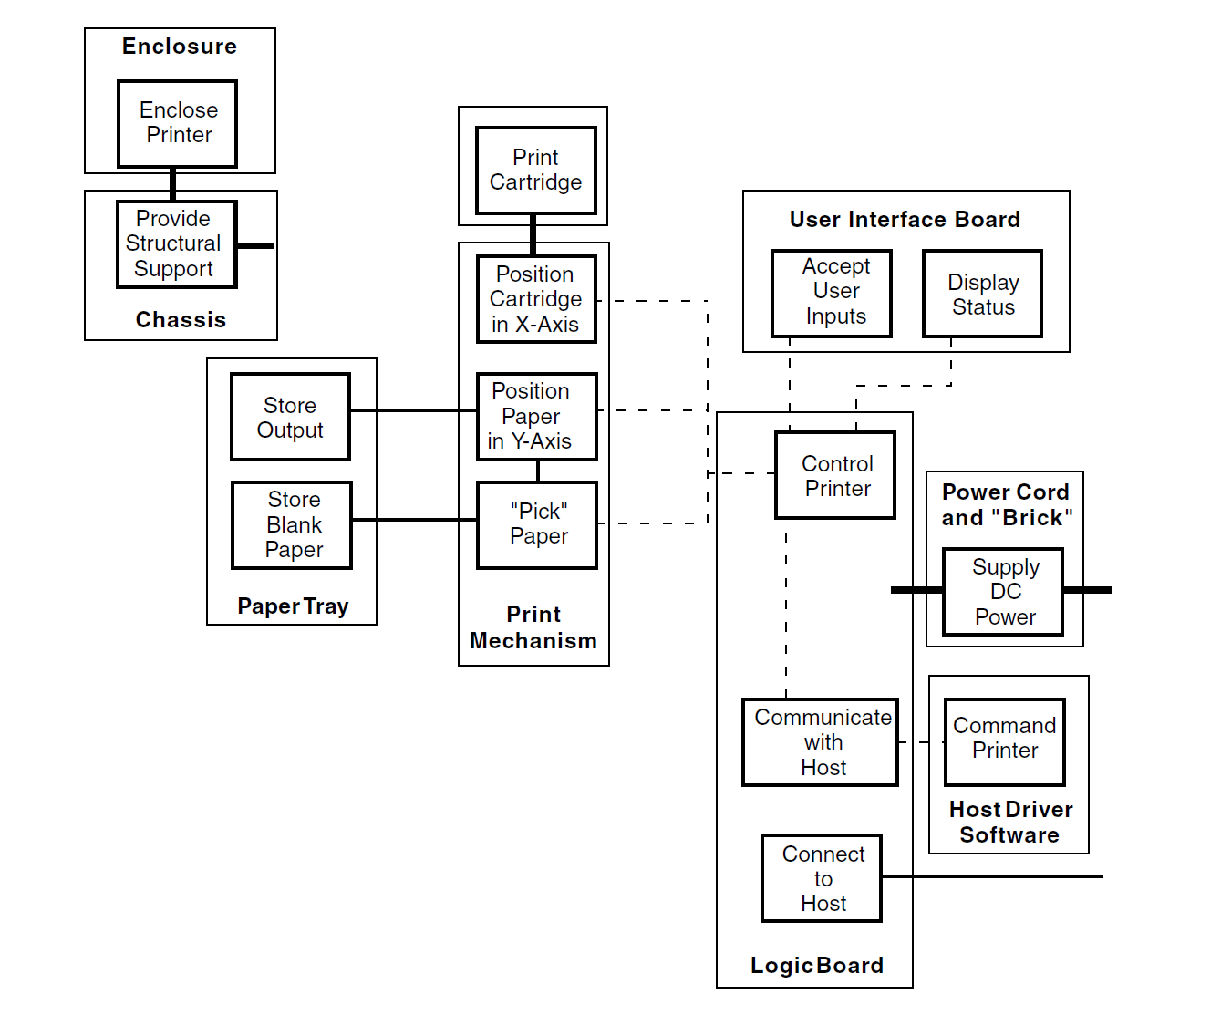
Step 2: Cluster the Elements of the Schematic
Clustering the elements into chunks. Nine chunks make up this proposed architecture for the DeskJet printer.

Slide 11
Situations Under Which Clustering Is Advantageous
Geometric integration and precision
Function sharing
Capabilities of vendors
Similarity of design or production technology
Localization of change
Accommodating variety
Enabling standardization
Portability of the interfaces

Slide 12
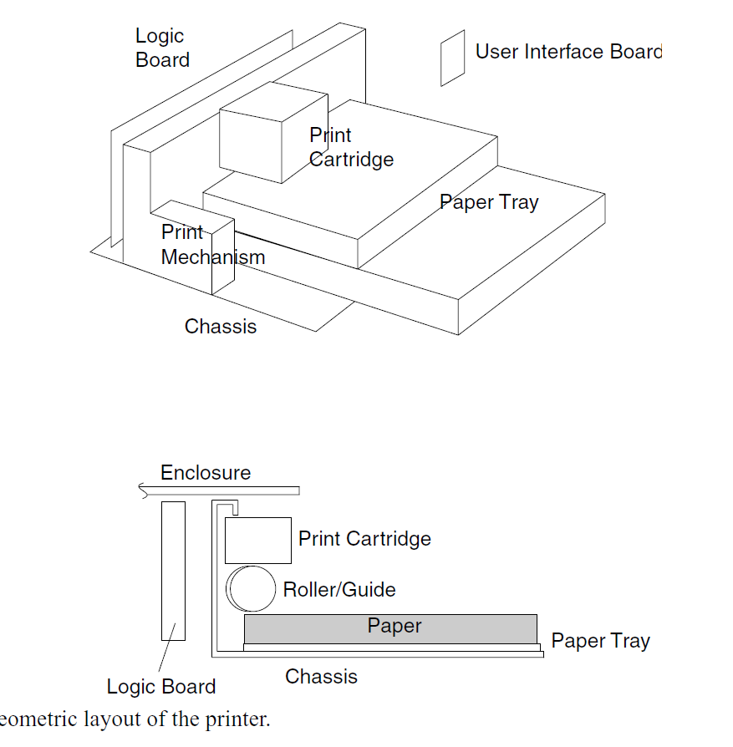
Step 3: Create a Rough Geometric Layout
Geometric Layout of the printer

Slide 13
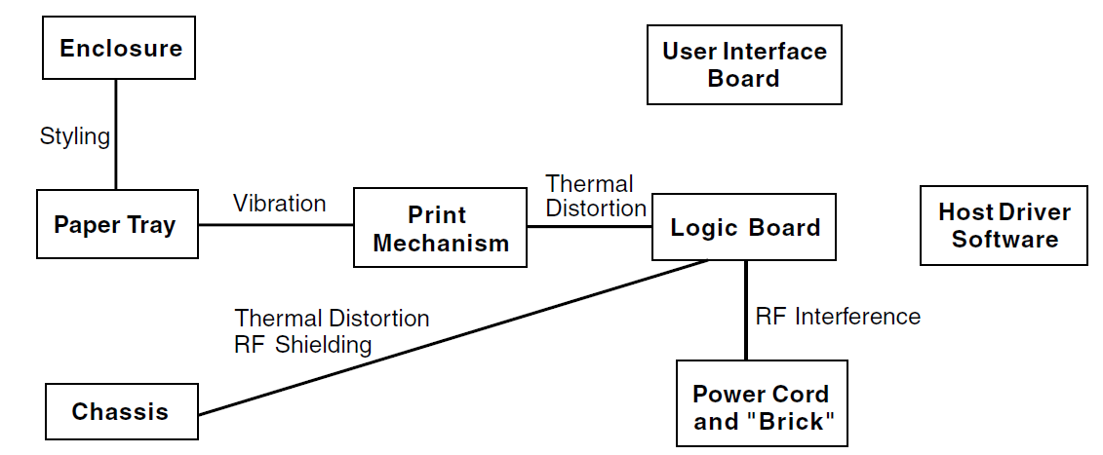
Step 4: Identify the Fundamental and Incidental Interactions
Incidental interaction graph

Slide 14
DELAYED DIFFERENTIATION
Two design principles are necessary conditions for postponement:
  The differentiating elements of the product must be concentrated in one or a few chunks.
  The product and production process must be designed so that the differentiating chunk(s) can be added to the product near the end of the supply chain.

Slide 15
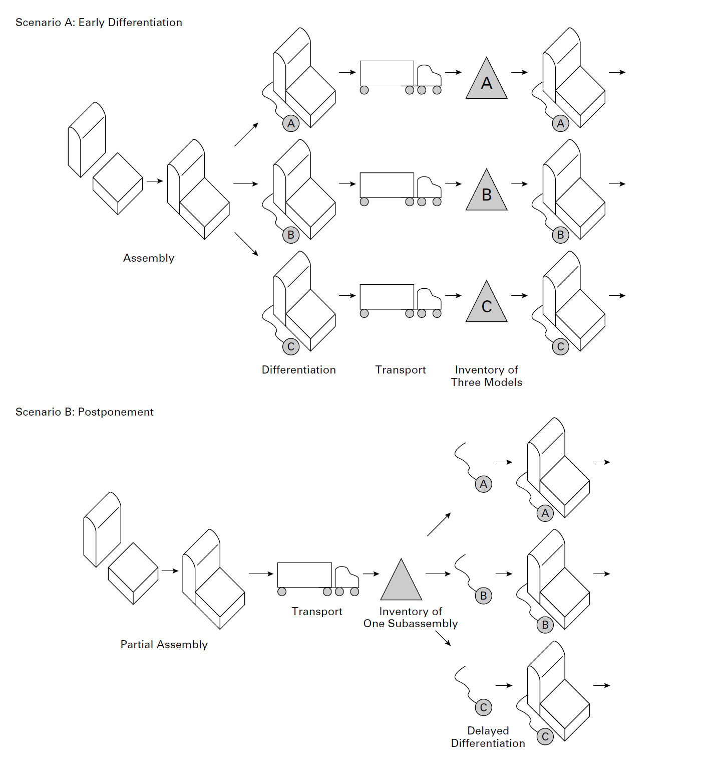
Postponement involves delaying differentiation of the product until late in the supply chain. In
Scenario A, three versions of the product are created during assembly and before transportation. In Scenario B, the three versions of the product are not created until after transportation.

Slide 16
PLATFORM PLANNING
Planning the product platform involves managing a basic trade-off between distinctiveness and commonality.
Two simple information systems allow the team to manage this trade-off: the differentiation plan and the commonality plan.

Slide 17
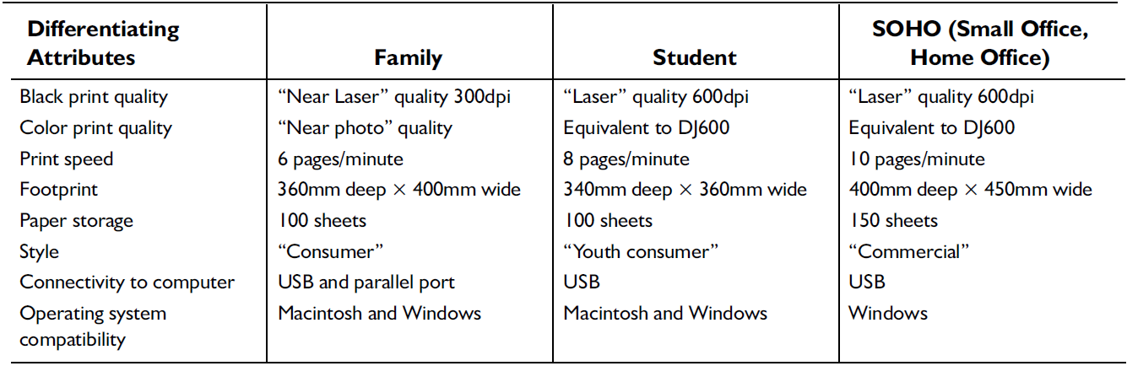
Differentiation Plan
The differentiation plan explicitly represents the ways in which multiple versions of a product will be different from the perspective of the customer and the market.
An example differentiation plan for a family of three printers

Slide 18
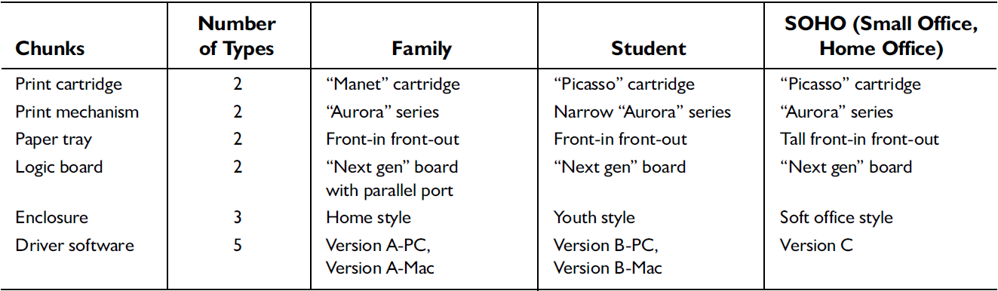
Commonality Plan
The commonality plan explicitly represents the ways in which the different versions of the product are the same physically.
An example commonality plan for a family of three printers

Slide 19
Managing the Trade-Off between Differentiation and Commonality
Platform planning decisions should be informed by quantitative estimates of cost and revenue implications.
Iteration is beneficial.
The product architecture dictates the nature of the trade-off between differentiation and commonality.

Slide 20
RELATED SYSTEM-LEVEL DESIGN ISSUES
Defining Secondary Systems
Establishing the Architecture of the Chunks
Creating Detailed Interface Specifications

