Slide 1
PBM- 2Jan
Session 3

Slide 2
Everyone considers them a marketing expert
Family
Friends Strangers

Slide 3
Marketing helps…
Attract new customers
Retain customers

Slide 4
Value proposition
A value proposition is a thirty-second “elevator speech” stating the specific benefits offerings(product or service) provide a buyer.
The following is an example of a value proposition developed by a sales consulting firm: “Our clients grow their business, large or small, typically by a minimum of 30–50% over the previous year. They accomplish this without working 80 hour weeks and sacrificing their personal lives.”
Value proposition focuses on the target market

Slide 5
Why Value proposition is essential
It helps define strategy for the company.
For example: if a company’s value proposition states that the firm is the largest retailer in the region with the most stores and best product selection, opening stores or increasing the firm’s inventory might be a key part of the company’s strategy

Slide 6
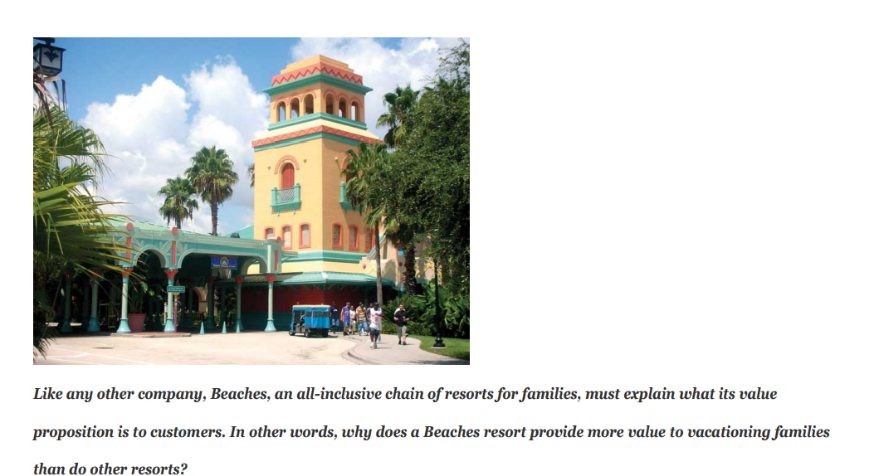
Class Exercise-1

Slide 7
Class exercise-2
You are interviewing for an internship. Create a value proposition for yourself that you may use as your thirty-second “elevator speech” to get the company interested in hiring you or talking to you more.

Slide 8
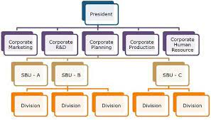
Strategic Planning
Strategic planning is a process that helps an organization allocate its resources to capitalize on opportunities in the marketplace.
In large organizations, strategic planning is likely to occur at a number of different levels. For example, top executives will develop strategic plans for the corporation as a whole. These are corporate level plans.
A strategic business unit (SBU) is a business or product line within an organization that has its own competitors, customers, and profit center for accounting purposes. A firm’s SBUs may also have their own mission statement (purpose) and will generally develop strategic plans for themselves. These are called business level plans.
The different departments, or functions (accounting, finance, marketing, and so forth) within a company or SBU, might also develop strategic plans. For example, a company may develop a marketing plan or a financial plan, which are functional level plans.

Slide 9
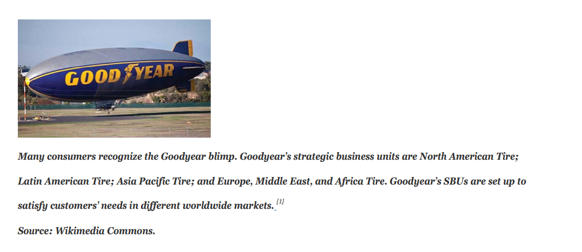

Slide 10
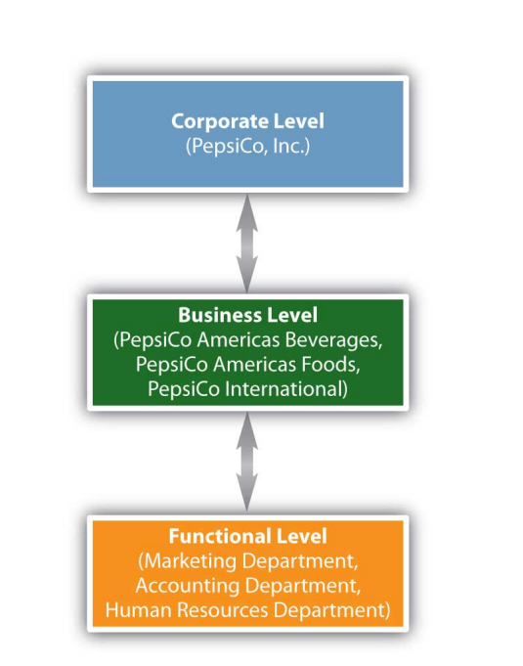
For example, take PepsiCo, which has committed itself to achieving business and financial success while leaving a positive imprint on society.
PepsiCo identifies its three divisions (business units) as
(1) PepsiCo Americas Beverages, which is responsible for products such as Pepsi soft drinks, Aquafina waters, Tropicana juices, and Gatorade products.
(2) PepsiCo Americas Foods, which is responsible for Frito-Lay and Quaker Oats products; and
(3) PepsiCo International, which consists of PepsiCo’s businesses in Asia, Africa, Europe, and Australia.

Slide 11
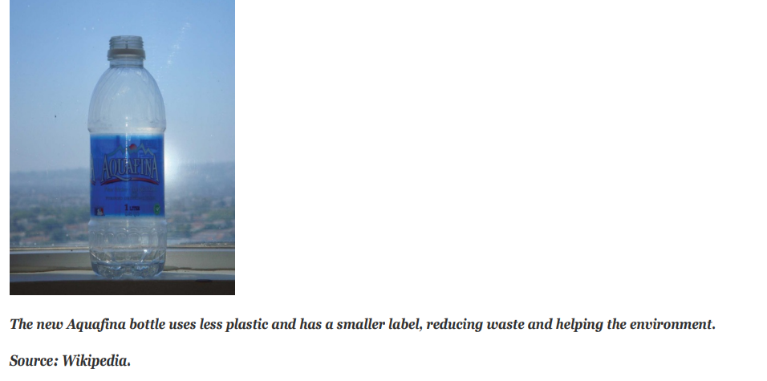
At the functional (marketing) level, to increase PepsiCo’s profits, employees responsible for different products or product categories such as beverages or foods might focus on developing healthier products and making their packaging more environmentally friendly so the company captures more market share.
For example, the new Aquafina bottle uses less plastic and has a smaller label, which helps the environment by reducing the amount of waste.

Slide 12
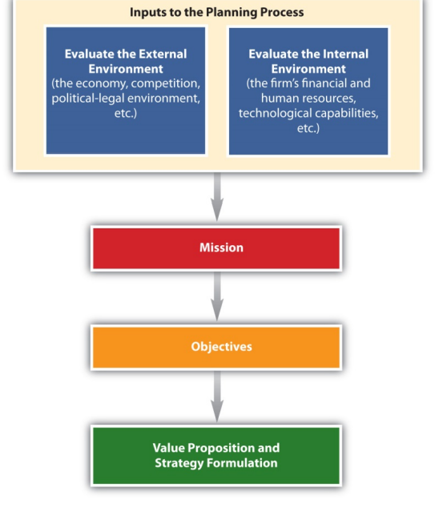
Strategic Planning Process
The strategic planning process includes conducting a situation analysis and developing the organization’s mission statement, objectives, value proposition, and strategies.

Slide 13
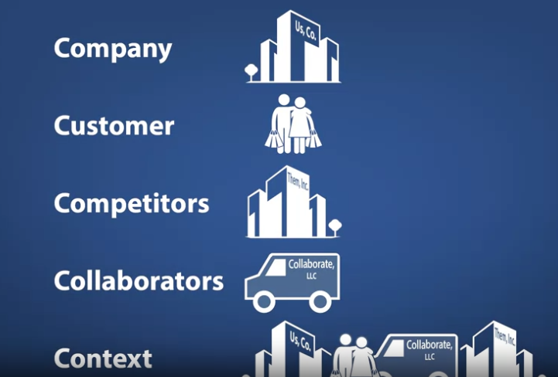
Scanning the environment- 5 C Framework

Slide 14
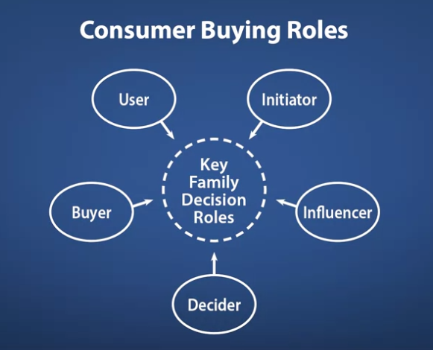


Slide 15
Initiator: the person who first suggests the idea of buying a particular product or service.
Influencer: is a person whose views or advice carry some weight in making the final buying decision.
Decider: the person who ultimately makes the buying decision
Buyer: the person who makes the actual purchase.
User: the person who consumes the product/service

Slide 16
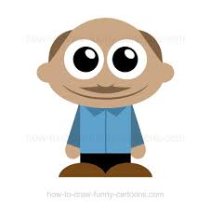



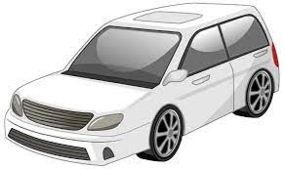
No One knows how to drive except me
Ok Car A looks good, I also heard praises about it. I will send Ramesh with the cheque to get it
Well, I saw this new car A which is really cool and within budget
FATHER
MOTHER
Dad Mr. Sharmas’ got a car
SON
DAUGHTER

Slide 17
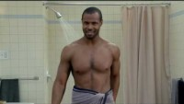
https://youtu.be/owGykVbfgUE

Slide 18
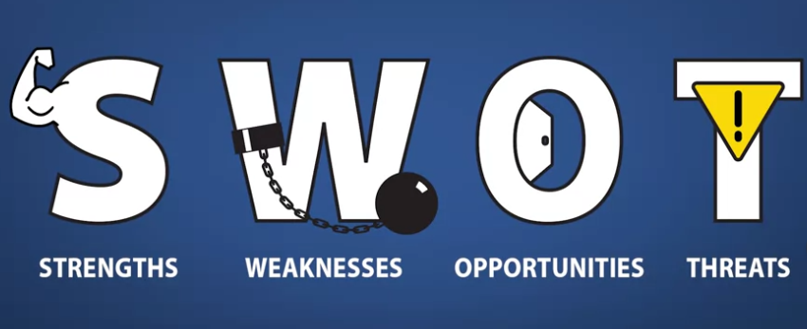
Company

Slide 19
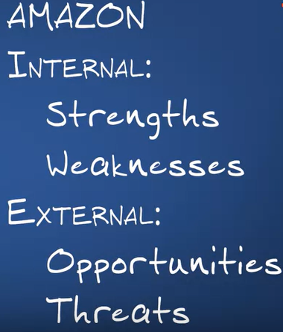

Slide 20

? ?

Slide 21
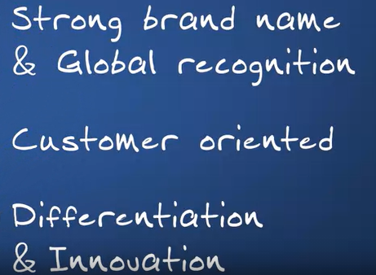
Strengths

Slide 22

Example-Innovativeness
https://www.youtube.com/watch?v=NrmMk1Myrxc

Slide 23
Weaknesses?

Slide 24
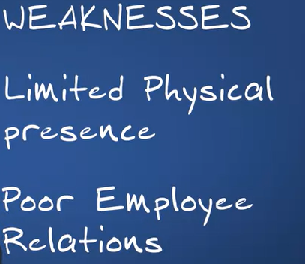

Slide 25

Poor work relations- https://youtu.be/tvdyxXhVNRE

Slide 26
Opportunities
Podcasting
Covid crisis- At home delivery
Morgan Stanley- Delivery alone for Amazon will take away $100 bn revenue from other delivery players

Slide 27
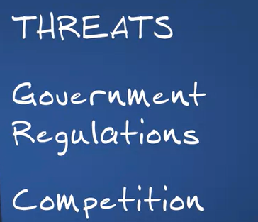
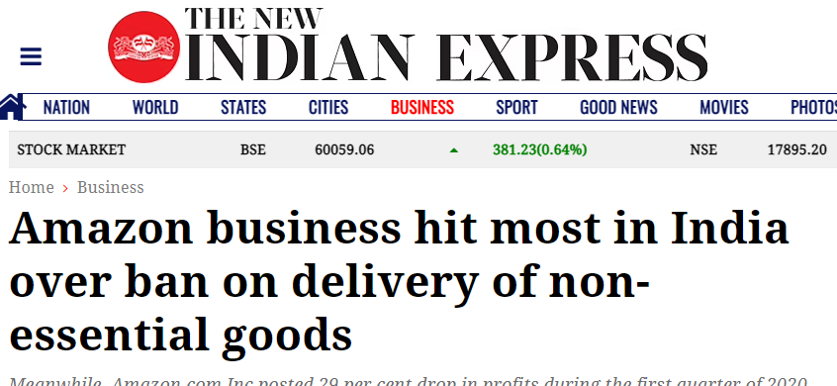
Threats

Slide 28
Some key takeaways- SWOT
Strengths may act as tools for the organization to utilize the opportunity and gain competitive advantage
Example: the loyalty of a firm’s employees can be a major strength, which can provide it with a competitive advantage. Loyal and knowledgeable employees are easier to train and tend to develop better relationships with customers. This helps organizations pursue more opportunities.
Strength and weakness are controllable while opportunities and threats are not.

Slide 29
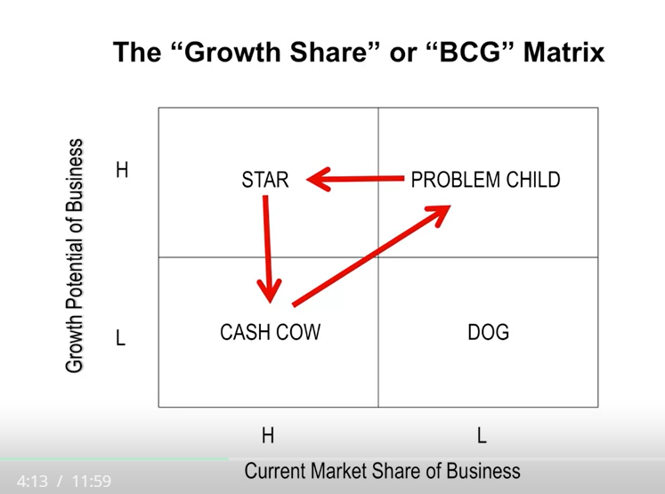

Slide 30
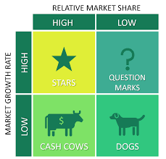
BCG MATRIX

Slide 31
Market Growth vs Market Share
How much is the industry growing?
The portion of a market controlled by a particular company or product.

Slide 32
APPLE
Mobile/Iphone
Laptop/MacBook
Tablet/Ipad
Music Player/IPod

Slide 33
Smartphone/Iphone
The Global Smartphone Market is expected to grow from USD 179,972.89 Million in 2018 to USD 290,098.28 Million by the end of 2025 at a Compound Annual Growth Rate (CAGR) of 7.05%

Slide 34
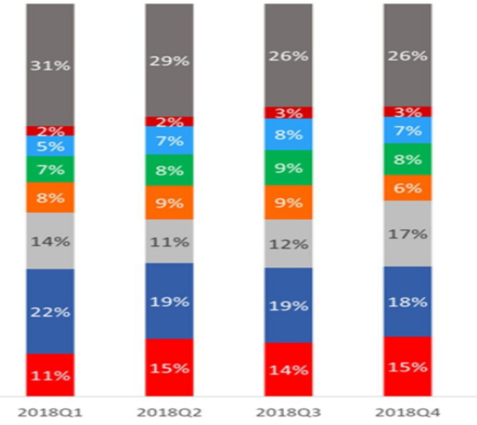

Slide 35
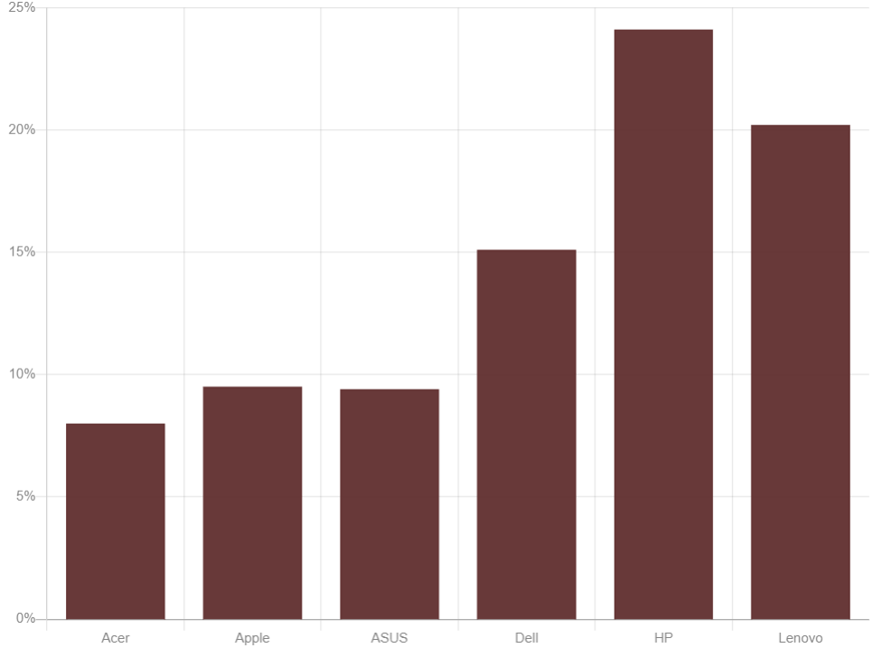
Laptop/Macbook
Revenue in the Laptops segment is projected to reach US$4,693.70m in 2020. Revenue is expected to show an annual growth rate (CAGR 2020-2025) of 4.0%

Slide 36
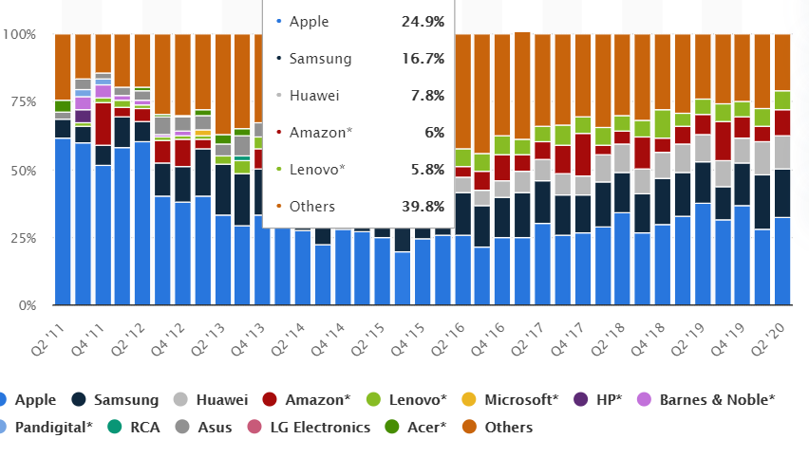
Tablet/ IPAD
The market is expected to grow annually by 2.6% (CAGR 2020-2025).

Slide 37
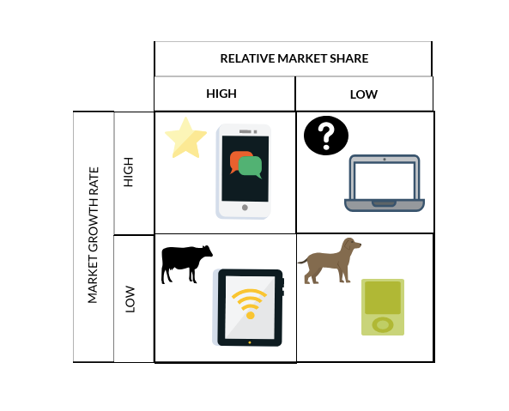
HOLD
BUILD
DIVEST
HARVEST

Slide 38
Strategies to adopt
1. Build strategy
Create a new brand and a new target audience by means of a Question Mark.
2. Hold strategy
Maintain this success and benefit from market growth by means of a Star.
3. Harvest strategy
Make as much money as possible with the product by means of the Cash Cow. This can be achieved by improving or renewing the product or by manufacturing by-products.
4. Divest strategy
Abandon the investment in the product by means of a Dog; the market is saturated or there is no or little interest in the product.

Slide 39
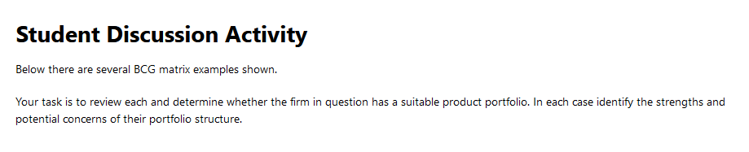
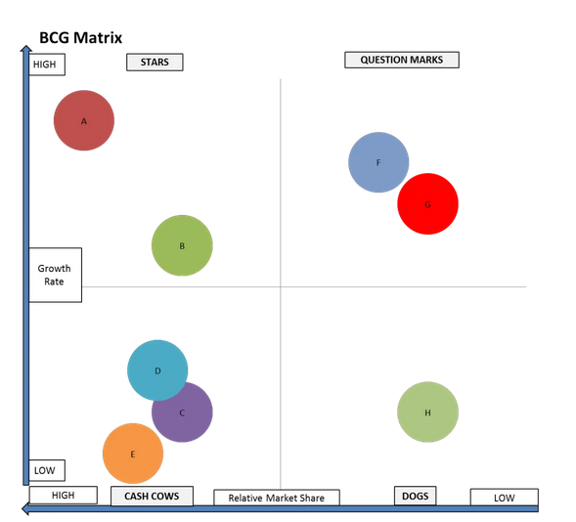
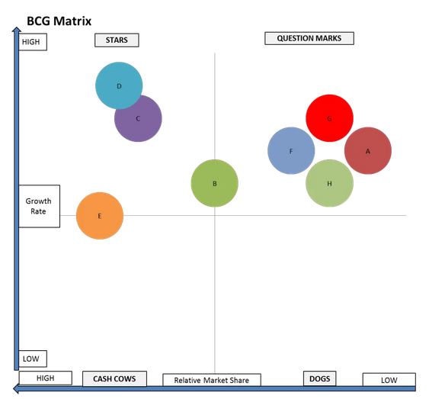
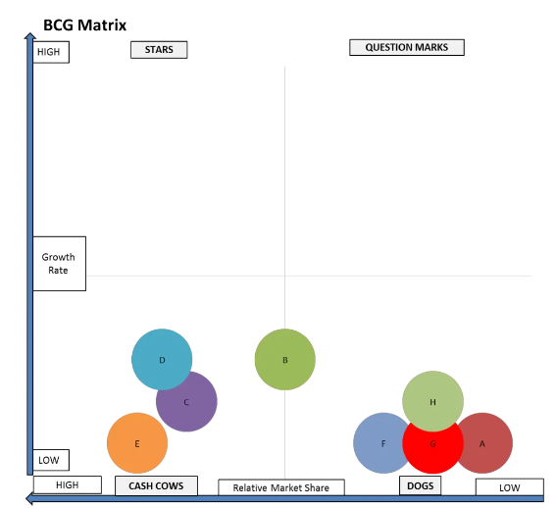

Slide 40
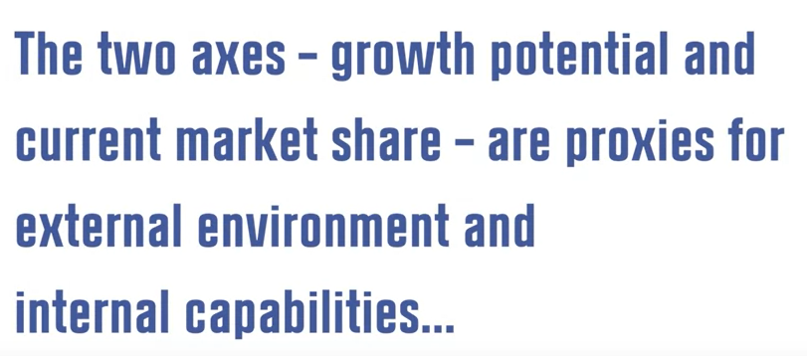
Criticism- BCG Matrix
Overly Simple

Slide 41
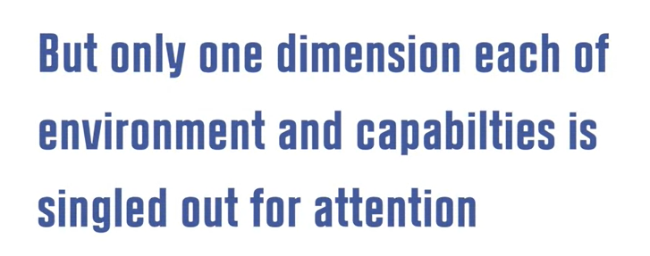

Slide 42
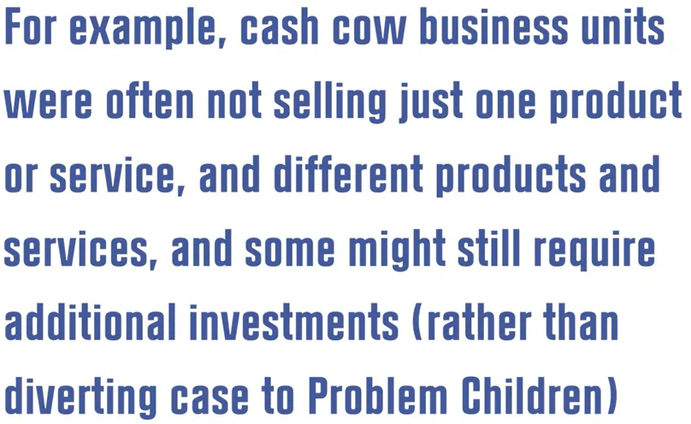
Looking into limited dimensions

Slide 43
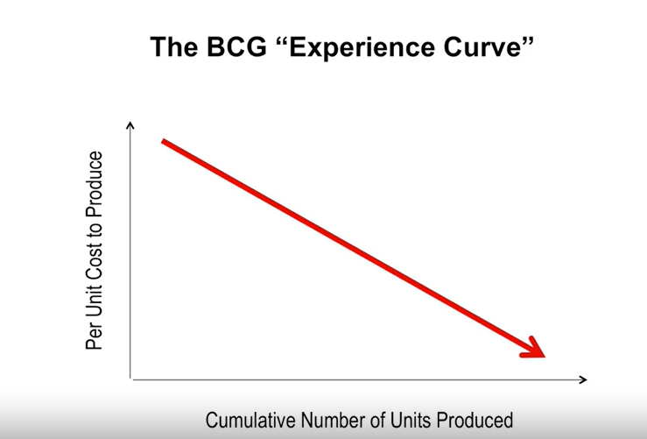

Slide 44
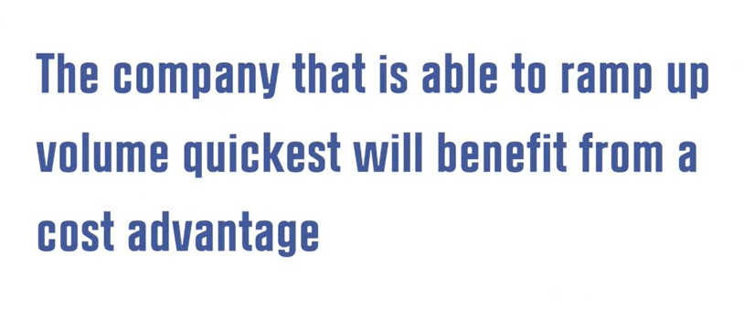

Slide 45
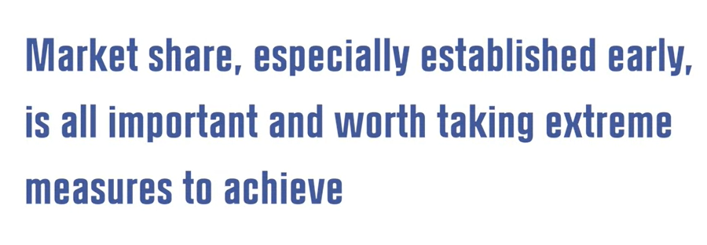

Slide 46
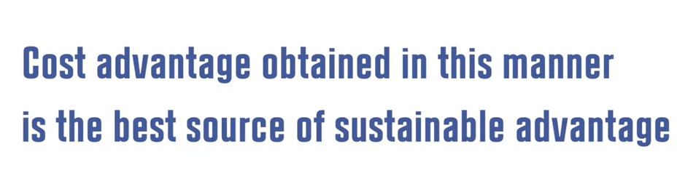

Slide 47
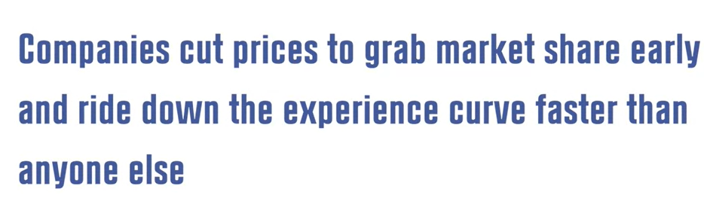

Slide 48
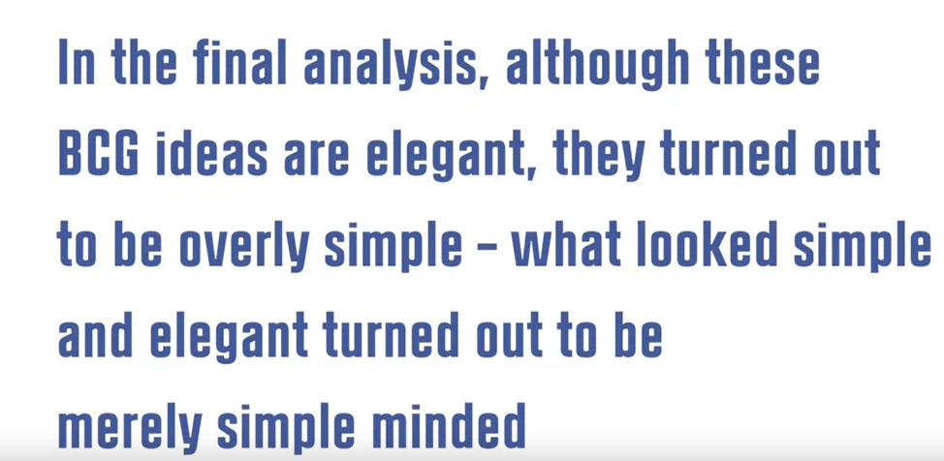

Slide 49
Competition
What is the competitive landscape like?
Who are your competitors?
Who can compete against you in the future?

Slide 50
What could be the ways to know what your competitors are doing?

Slide 51
Mystery Shopping-Direct Competition
Mystery shoppers, or people who act like customers, might visit competitors to learn about their customer service and their products.
Imagine going to a competitor’s restaurant and studying the menu and the prices and watching customers to see what items are popular and then changing your menu to better compete.

Slide 52
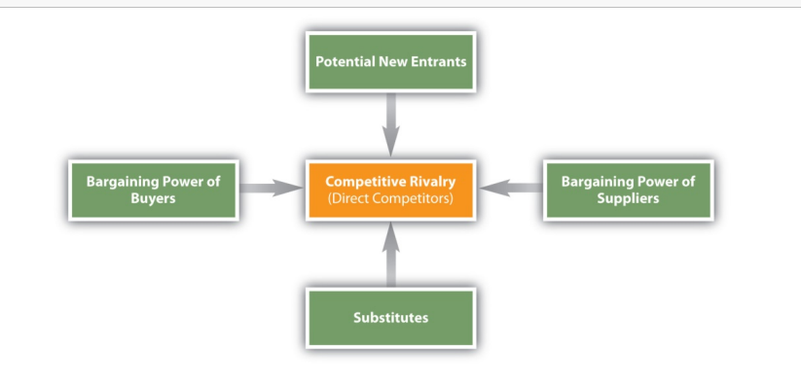
Porter five forces

Slide 53
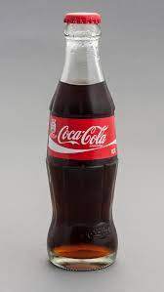
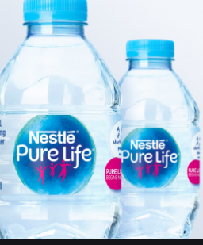
Few examples- Buyer and New competition
Buyers buying few soft drinks
For example, because buyers are consuming fewer soft drinks these days, companies such as Coke and Pepsi have had to develop new, substitute offerings such as vitamin water and sports drinks

Slide 54
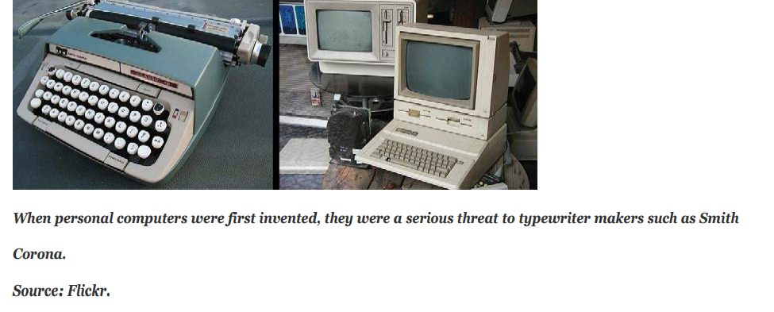
Subsitutes

Slide 55
Threat of Suppliers
Suppliers, the companies that supply ingredients as well as packaging materials to other companies, must also be considered.
If a company cannot get the supplies it needs, it’s in trouble. Also, sometimes suppliers see how lucrative their customers’ markets are and decide to enter them.

Slide 56
Threat of Buyers
Buyers, who are the focus of marketing and strategic plans, must also be considered because they have bargaining power and must be satisfied. If a buyer is large enough, and doesn’t purchase a product or service, it can affect a selling company’s performance.
Walmart, for instance, is a buyer with a great deal of bargaining power. Firms that do business with Walmart must be prepared to make concessions to them if they want their products on the company’s store shelves

Slide 57
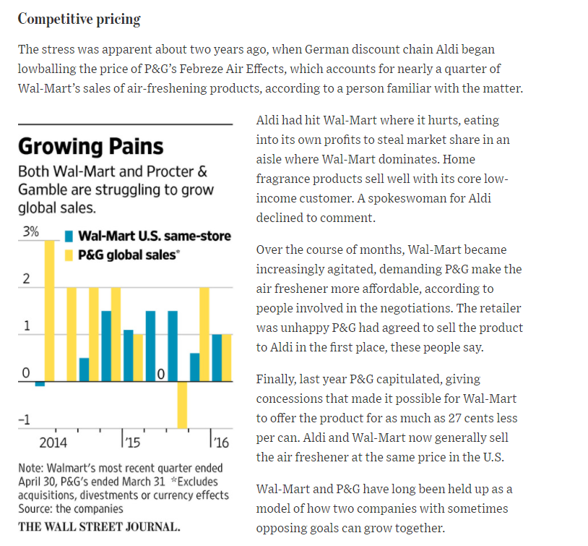

Slide 58
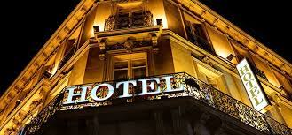

Slide 59
Threat to Substitutes

Slide 60
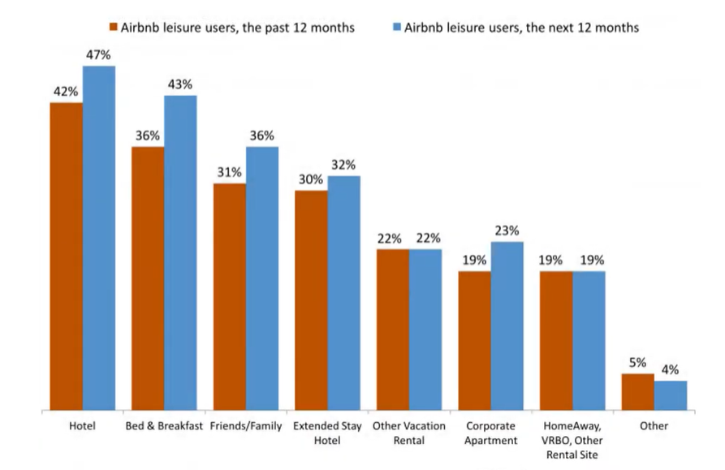
Substitute

Slide 61
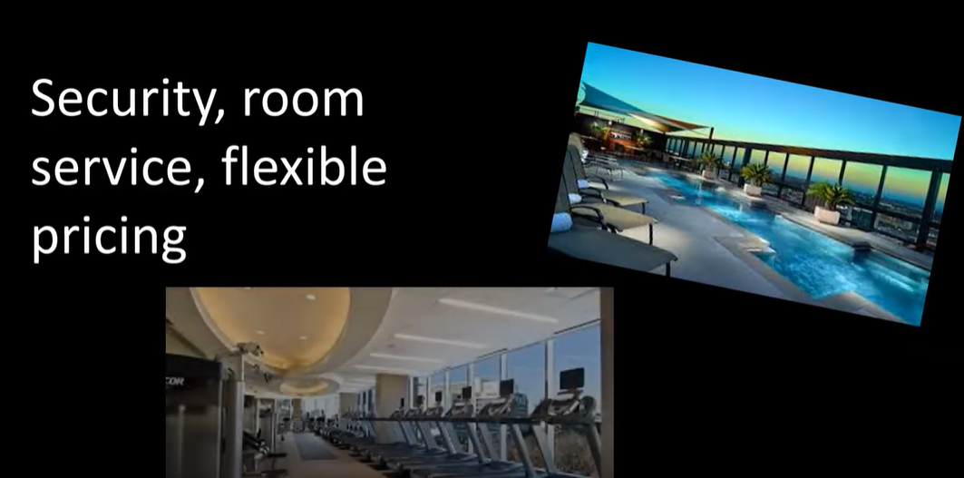

Slide 62


Slide 63
Threat to New Entrants

Slide 64
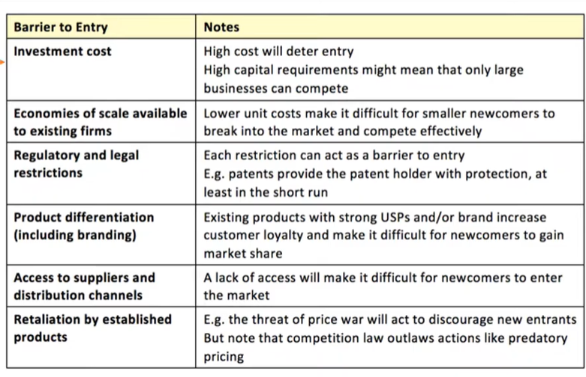
Threats to new Entrants

Slide 65
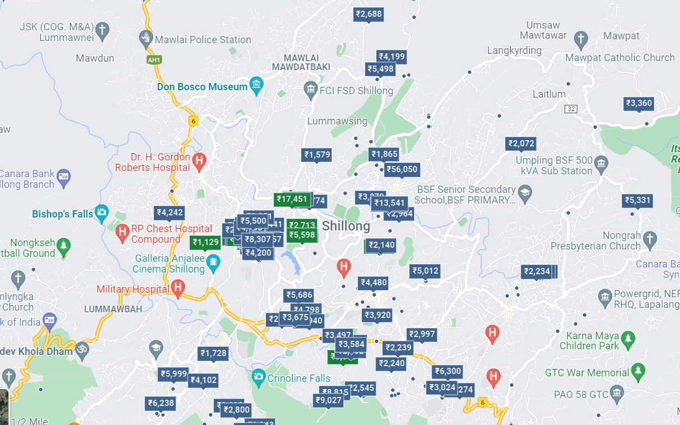

Slide 66
Competition-Rivalry
Competitive Pricing
Intense Competition

Slide 67
Bargaining Power of Buyers

Slide 68
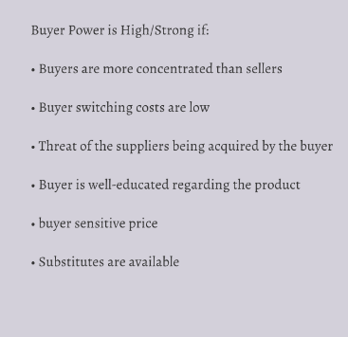

Slide 69
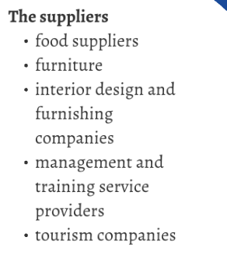
Bargaining Power of Suppliers

Slide 70
Problem with 5 forces

Slide 71
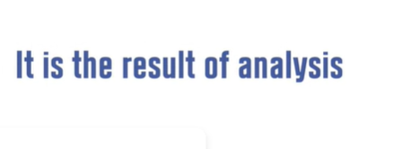
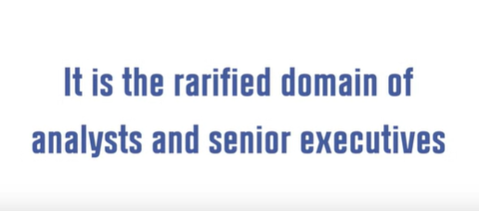


Slide 72


Slide 73


Slide 74



Slide 75



Slide 76


Slide 77



Slide 78



Slide 79


Slide 80
Collaborators
With which companies you can partner?
Who will be the suppliers (Upstream)?
Who will be the retailers (Downstream)?

Slide 81
Context
What is the environment in which the company is operating?
Will be the factors work for or against the company for delivering the value that you promise the consumer?
PESTEL Framework

Slide 82

Used to access the macro environment

Slide 83


The Political and Legal Environment
All organizations must comply with government regulations and understand the political and legal environments in which they do business.

Slide 84
Political and legal environment becomes more important when operating abroad
If you are considering opening the factory in France (perhaps because the demand in Europe for your product is strong), you need to know that it is illegal for employees in that country to work more than thirty-five hours per week.

Slide 85
The Economic Environment
Economic factors include variables such as inflation, unemployment, interest rates, and whether the economy is in a growth period or a recession.
The economic downturn that began in 2008 affected consumers and businesses at all levels worldwide.
Consumers reduced their spending, holiday sales dropped, financial institutions went bankrupt, the mortgage industry collapsed, and the “Big Three” U.S. auto manufacturers (Ford, Chrysler, and General Motors) asked for emergency loans

Slide 86

The Social and Cultural Environment
The social and cultural environment—including social trends, such as people’s attitudes toward fitness and nutrition; demographic characteristics, such as people’s age, income, marital status, education, and occupation; and culture, which relates to people’s beliefs and values—is changing in the global marketplace.

Slide 87


Slide 88

Fulla Doll

Slide 89

https://www.youtube.com/watch?v=jnfxtq7DWwg

Slide 90
Technology
Many consumers get information, read the news, use text messaging, and shop online.
As a result, marketers have begun allocating more of their promotion budgets to online ads and mobile marketing and not just to traditional print media such as newspapers and magazines.

Slide 91


Slide 92
Environmental- Natural Resources
Natural resources are scarce commodities, and consumers are becoming increasingly aware of this fact. Today, many firms are doing more to engage in “sustainable” practices that help protect the environment and conserve natural resources.
Green marketing involves marketing environmentally safe products and services in a way that is good for the environment.

Slide 93

Example- Patagonia
https://www.youtube.com/watch?v=UAZ8Ts9CC6I

Slide 94
HW- 5 C Analysis for Reinventing Adobe
Each group should send to CR before the next class

