Slide 1
Valuation of stock

Slide 2
Pricing a stock
How is a stock priced?
  Let $P_{0 }$be today stock price
  Let $P_{1 }$be the expected stock price next year
  Assume the expected dividend at the end of the year ${Div}_{t }$
  Since a very long-lived assets, let us go one period at a time…
  $P_{0}$=$\frac{{DIV}_{1}+P_{1}}{(1+r)}$
  What is expected $P_{1}$?

Slide 3
Pricing a stock
  What is expected $P_{1}$?
  $P_{1}$=$\frac{{DIV}_{2}+P_{2}}{(1+r)}$
  So what is $P_{0}?$
  $P_{0}$= $\frac{{DIV}_{1}}{(1+r)}$+ $\frac{\frac{{DIV}_{2}+P_{2}}{(1+r)}}{{\left(1+r\right)}^{}}$
  $P_{0}$= $\frac{{DIV}_{1}}{(1+r)}$+$\frac{{DIV}_{2}}{{\left(1+r\right)}^{2}}+\frac{P_{2}}{{\left(1+r\right)}^{2}}$

Slide 4
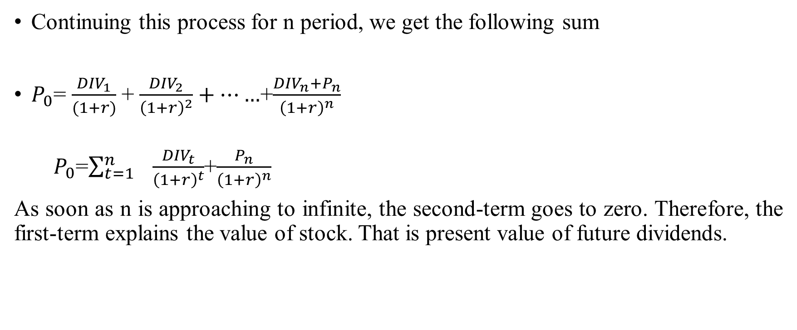
The stock price (Formula…)
Continuing this process for n period, we get the following sum
$P_{0}$= $\frac{{DIV}_{1}}{(1+r)}$+ $\frac{{DIV}_{2}}{{\left(1+r\right)}^{2}}+……$+$\frac{{DIV}_{n}+P_{n}}{{\left(1+r\right)}^{n}}$
  $P_{0}$=$\sum_{t=1}^{n}{ \frac{{DIV}_{t}}{{\left(1+r\right)}^{t}}}$+$\frac{P_{n}}{{\left(1+r\right)}^{n}}$
As soon as n is approaching to infinite, the second-term goes to zero. Therefore, the first-term explains the value of stock. That is present value of future dividends.

Slide 5
Special case I: Dividend stock
Suppose dividends expected to remain approximately constant till perpetuity (going-concern), what is the price?
$P_{0}$= $\frac{{DIV}_{}}{(1+r)}$+ $\frac{{DIV}_{}}{{\left(1+r\right)}^{2}}+……$+$\frac{{DIV}_{}}{{\left(1+r\right)}^{\text{∞}}}$
$P_{0}$= $\frac{{DIV}_{}}{r}$

Slide 6
Special case I: Dividend stock (Income stock)
Suppose ABC firm, utility firm, is expected to be dividend of Rs 10 per share for the foreseeable future and cost of equity is 10%. What should be the value of the stock be ?
$P_{0}$= $\frac{10}{0.10}=Rs 100$

Slide 7
Is forever really forever?
What if the firm paid the dividends for the next 30 years? What would the price be?
Value of stock=$10∗\frac{{\left(1+10\%\right)}^{30}−1}{{\left(1+10\%\right)}^{30}∗10\%}$=Rs 94.27

Slide 8
Special Case II: Growth stock
Suppose dividends are expected to grow at a rate of g per year, what is the value of the stock?
$P_{0}$= $\frac{{DIV}_{}}{r−g}$

Slide 9
Special Case II: Growth stock
Suppose ABC firm is expected to pay dividend of Rs 10 per share and dividends are expected to grow by 5% per year. The cost of equity is 10%. What should be the price of the stock be ?
$P_{0}$= $\frac{10}{10\%−5\%}=Rs 200$

Slide 10
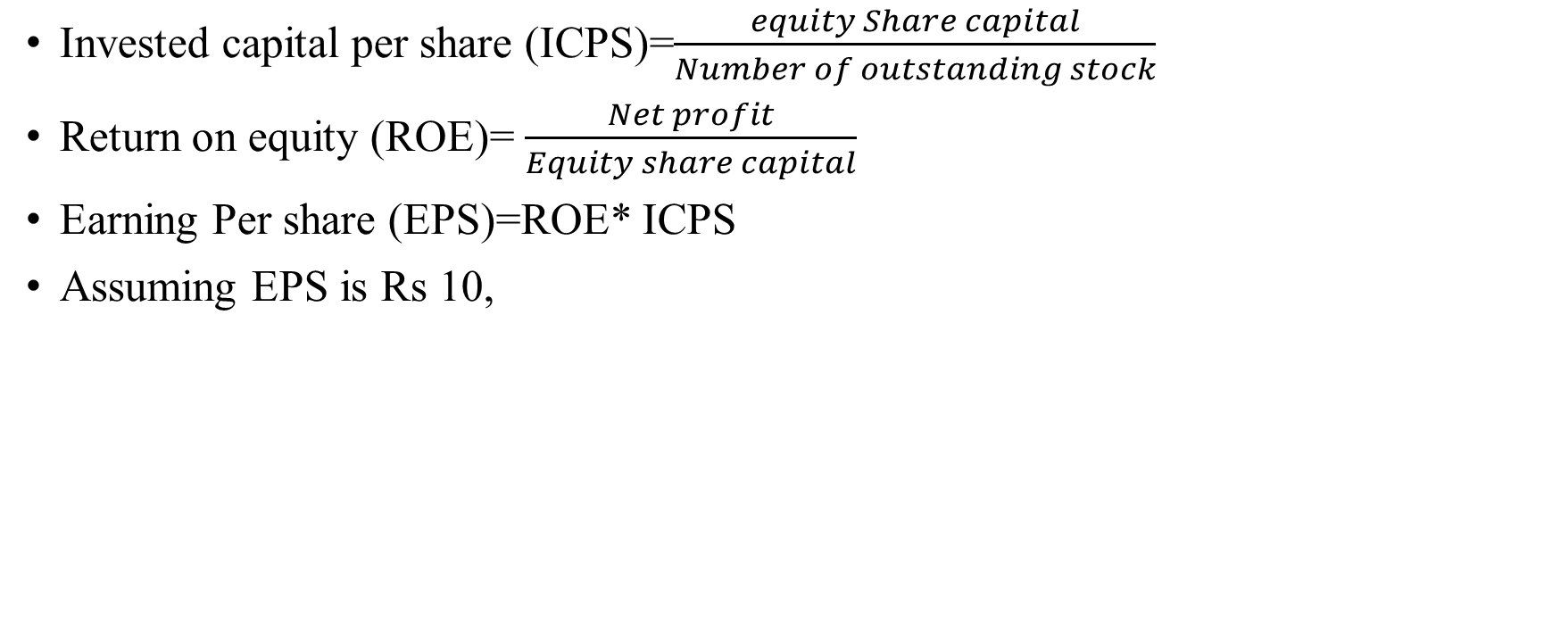
Engine of growth
Invested capital per share (ICPS)=$\frac{equity Share capital}{Number of outstanding stock}$
Return on equity (ROE)= $\frac{Net profit}{Equity share capital}$
Earning Per share (EPS)=ROE* ICPS
Assuming EPS is Rs 10,
EPS
Retained earnings per share
Dividend per share

Slide 11
Engine of growth (assume perpetuities)
A firm reports after-tax operating income Rs 75 million on invested capital of Rs 1 billion. It does not plan to reinvest in new asset but will maintain existing assets and its current return on capital. What should be the growth rate?
If this firm thinks that it can invest 50 million without improving return on capital what growth rate will you see in operating income next year?
If this firm thinks that it can improve its return on capital on existing assets from 7.5% to 10% next year by making them more efficient, what growth rate will you see in operating income next year?

Slide 12
Engine of growth
Current investment
Rs 1000
Current ROE
7.5%
Current earnings
Rs 75
X
=
Current investment
Rs 1000
X
Current ROE
7.5%
New investment
Rs 50
Current ROE 7.5%
Next period earnings
Rs 78.75
+
X
=
Current investment
Rs 1000
Change in Current ROE
0
New investment
Rs 50
Current ROE
7.5%
Change in next period earnings
Rs 3.75
X
+
X
=
$$\frac{reinvestment amount}{Current earning}X ROE=\frac{Change in current in earnings}{Previous earnings}$$
$\frac{50}{75} X 7.5\%=\frac{3.75}{75}$=5%

Slide 13
Expected long-term growth in EPS
We use the following inputs
  Reinvestment rate (retention ratio)=retained earnings/current earnings
  Return on equity=net income/book value of equity
Growth rate=Retention ratio*ROE
The above equation suggests the growth rate cannot be more than ROE. Therefore, we can take total new equity investment, in place of retention ratio.

Slide 14
Estimating expected growth in EPS: Sun Pharma
Book value of equity (2019)=Rs. 27855.39
Net income= Rs. 9995.92
Return on equity= 9995.92/27855.39=35.885%
Retained amount=Rs. 1,239.73
Retention ratio= 1,239.73/ 9995.92=12.4%
Implied growth rate=12.4%*35.885%=4.45%

Slide 15
Good or Bad Growth
Suppose you know this about Microsoft, Inc.
  It is expected to earn 10% on its existing assets
  Has $60 of capital per share
  Expected return on stock (the cost of equity) is 12%
  The firm is not planning to grow, what would the value of the stock
  Return on per stock=10% * $60=$6
  Value of stock=$\frac{Dividend }{K_{e}−g}=\frac{6}{0.12}=\$50 per share$

Slide 16
Good or Bad Growth
  Assume, growth rate is 5%
  How much should be reinvesting to grow 5%
  Growth=retained earnings rate * ROE
  5%=Retained earnings * 10%
  Retained earnings rate=$\frac{5\%}{10\%}=50\%$
  Dividend per share=$6*50%=$3
  Value of stock=$\frac{Dividend per share∗}{K_{e}−g}=\frac{3}{0.12−0.05}=\$42.85 per share$

Slide 17
Case 1: Good growth-: ROE> Cost of equity
Expected EPS | DPR | Retention ratio | Ke | ROE | Growth rate | Dividend Amount | Equity Value
100 | 10% | 90% | 10% | 11% | 9.90% | 10 | 10000.00
100 | 20% | 80% | 10% | 11% | 8.80% | 20 | 1666.67
100 | 30% | 70% | 10% | 11% | 7.70% | 30 | 1304.35
100 | 40% | 60% | 10% | 11% | 6.60% | 40 | 1176.47
100 | 50% | 50% | 10% | 11% | 5.50% | 50 | 1111.11
100 | 60% | 40% | 10% | 11% | 4.40% | 60 | 1071.43
100 | 70% | 30% | 10% | 11% | 3.30% | 70 | 1044.78
100 | 80% | 20% | 10% | 11% | 2.20% | 80 | 1025.64
100 | 90% | 10% | 10% | 11% | 1.10% | 90 | 1011.24
100 | 100% | 0% | 10% | 11% | 0.00% | 100 | 1000.00

Slide 18
Case 2: Bad growth :- Cost of equity>ROE
Expected EPS | DPR | Retention ratio | Ke | ROE | Growth rate | Dividend Amount | Equity Value
100 | 10% | 90% | 10% | 9% | 8.10% | 10 | 526.32
100 | 20% | 80% | 10% | 9% | 7.20% | 20 | 714.29
100 | 30% | 70% | 10% | 9% | 6.30% | 30 | 810.81
100 | 40% | 60% | 10% | 9% | 5.40% | 40 | 869.57
100 | 50% | 50% | 10% | 9% | 4.50% | 50 | 909.09
100 | 60% | 40% | 10% | 9% | 3.60% | 60 | 937.50
100 | 70% | 30% | 10% | 9% | 2.70% | 70 | 958.90
100 | 80% | 20% | 10% | 9% | 1.80% | 80 | 975.61
100 | 90% | 10% | 10% | 9% | 0.90% | 90 | 989.01
100 | 100% | 0% | 10% | 9% | 0.00% | 100 | 1000.00

Slide 19
Case 3: Who cares:- Cost of equity= ROE
Expected EPS | DPR | Retention ratio | Ke | ROE | Growth rate | Dividend Amount | Equity Value
100 | 10% | 90% | 10% | 10% | 9.00% | 10 | 1000.00
100 | 20% | 80% | 10% | 10% | 8.00% | 20 | 1000.00
100 | 30% | 70% | 10% | 10% | 7.00% | 30 | 1000.00
100 | 40% | 60% | 10% | 10% | 6.00% | 40 | 1000.00
100 | 50% | 50% | 10% | 10% | 5.00% | 50 | 1000.00
100 | 60% | 40% | 10% | 10% | 4.00% | 60 | 1000.00
100 | 70% | 30% | 10% | 10% | 3.00% | 70 | 1000.00
100 | 80% | 20% | 10% | 10% | 2.00% | 80 | 1000.00
100 | 90% | 10% | 10% | 10% | 1.00% | 90 | 1000.00
100 | 100% | 0% | 10% | 10% | 0.00% | 100 | 1000.00

Slide 20
Value of high growth stocks
CheckMate forecasts that its dividend will grow at 20% per year for the next four years before settling down at a constant 8% forever. Dividend (current year,2019) = Rs 12; Expected rate of return (cost of equity) = 15%. What is the value of the stock now?
Value of stock=$\frac{14.40}{(1+15\%)}+\frac{17.28}{{(1+15\%)}^{2}}+\frac{20.74}{{(1+15\%)}^{3}}+\frac{24.88}{{(1+15\%)}^{4}}+$ $\frac{26.87}{{(1+15\%)}^{4}∗(15\%−8\%)}=$ $276.42
 | 0 | 1 | 2 | 3 | 4
Dividend amount | 12.00 | 14.40 | 17.28 | 20.74 | 24.88

