Slide 1


Slide 2
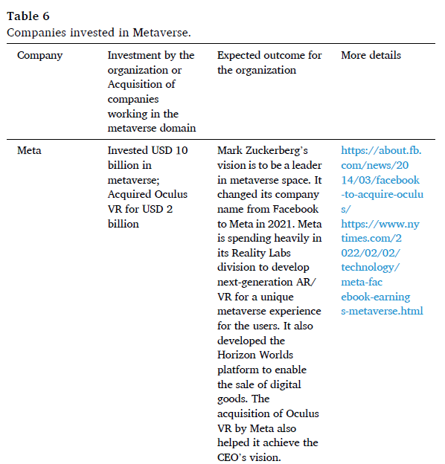

Slide 3
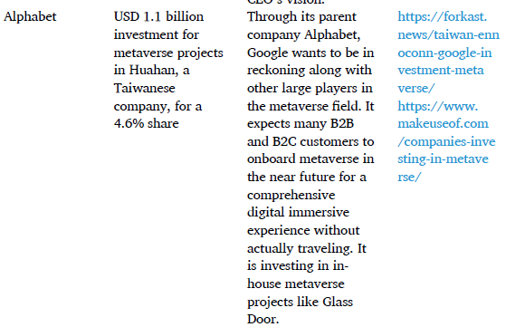

Slide 4
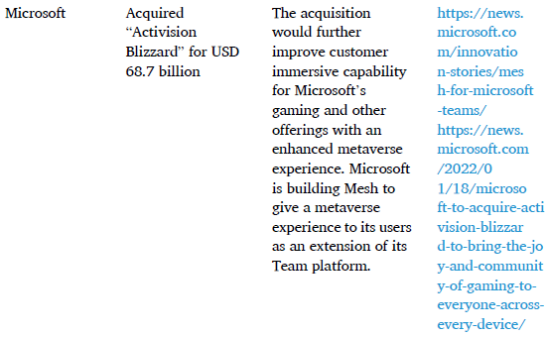

Slide 5
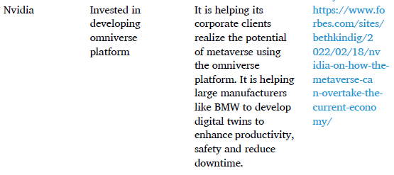

Slide 6
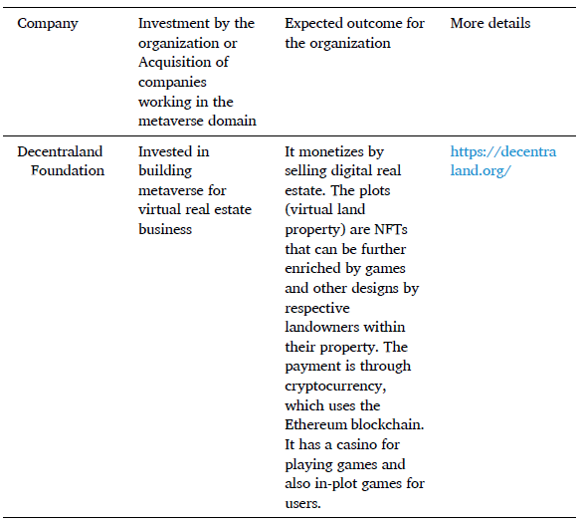

Slide 7
Metaverse with the environment, interface, interaction, security and privacy

Slide 8
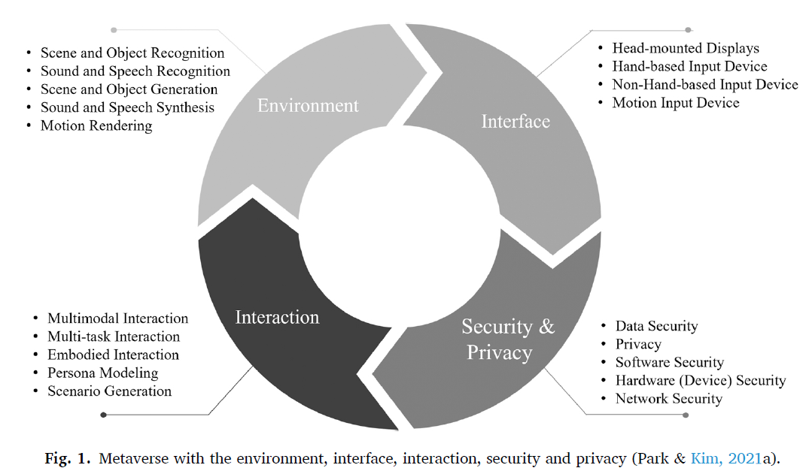

Slide 9
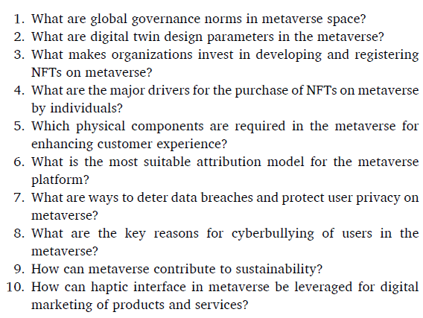

Slide 10
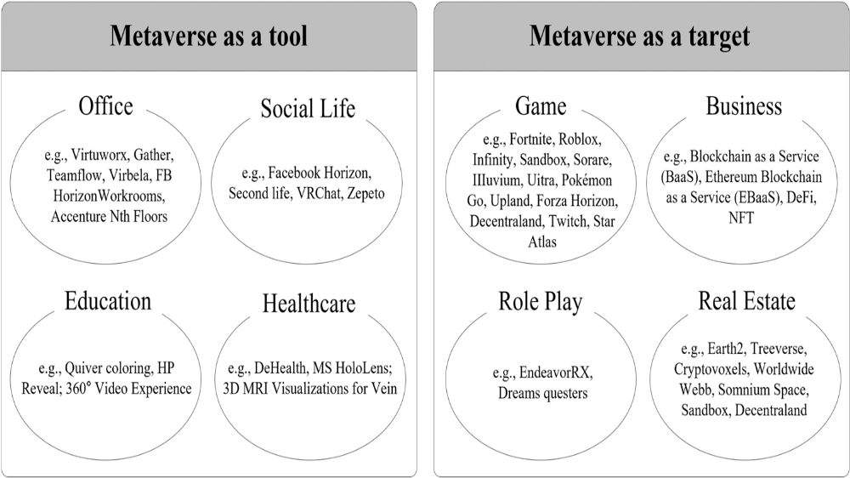

Slide 11
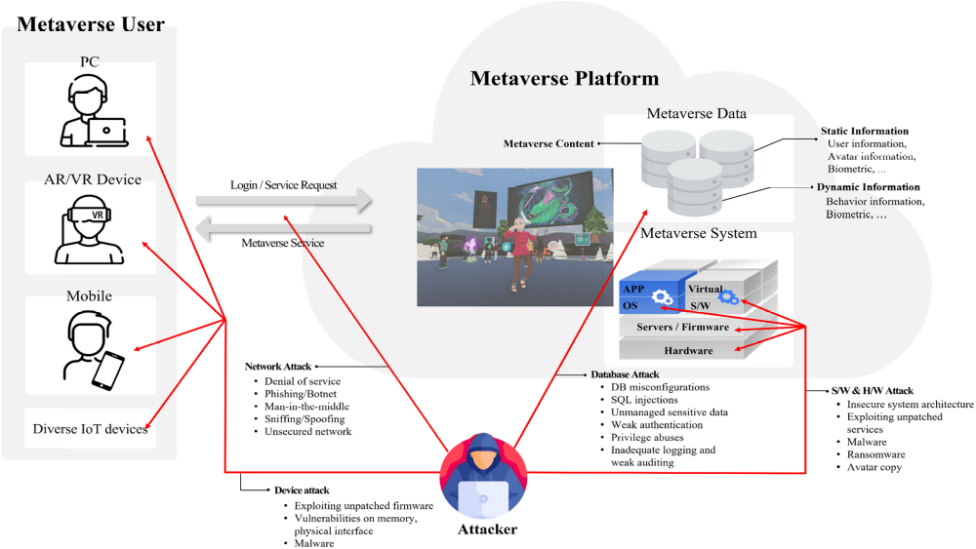

Slide 12
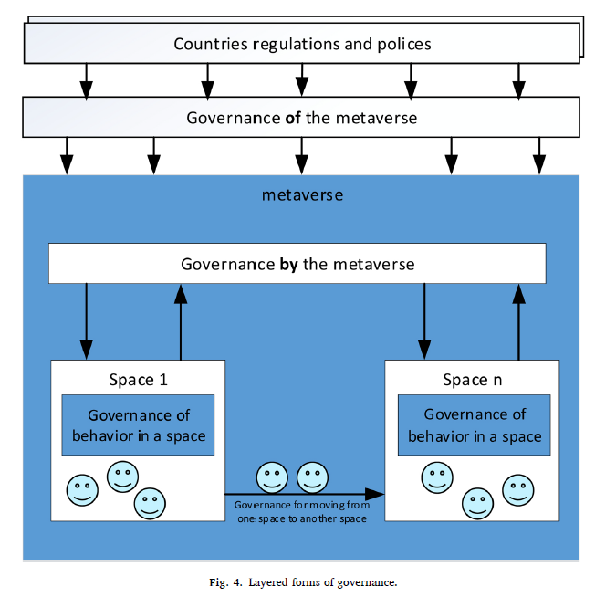

Slide 13
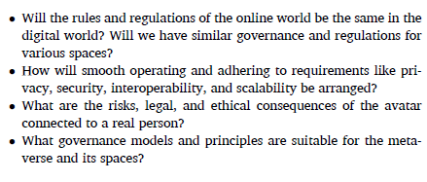


Slide 14
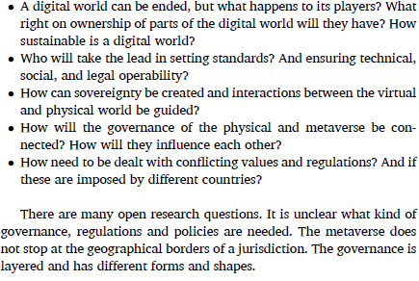

Slide 15
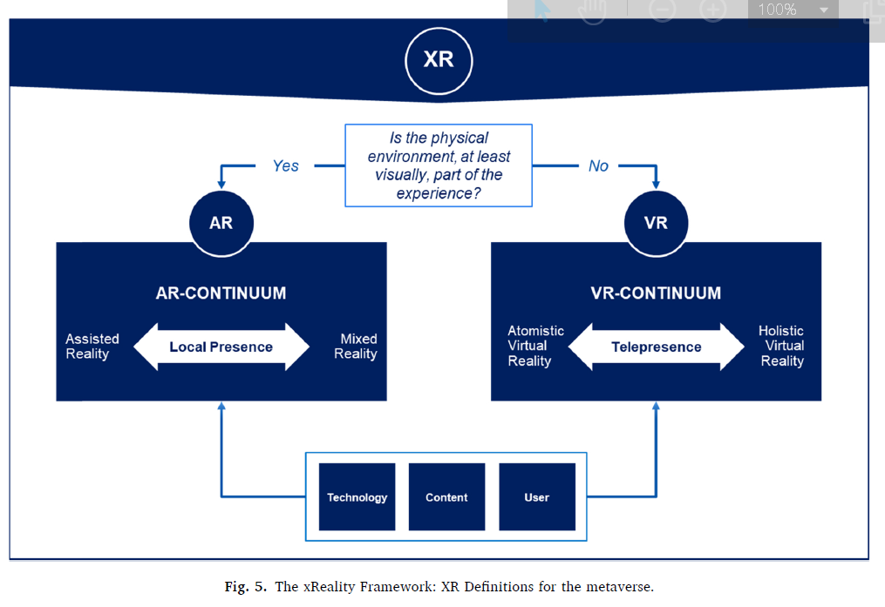

Slide 16
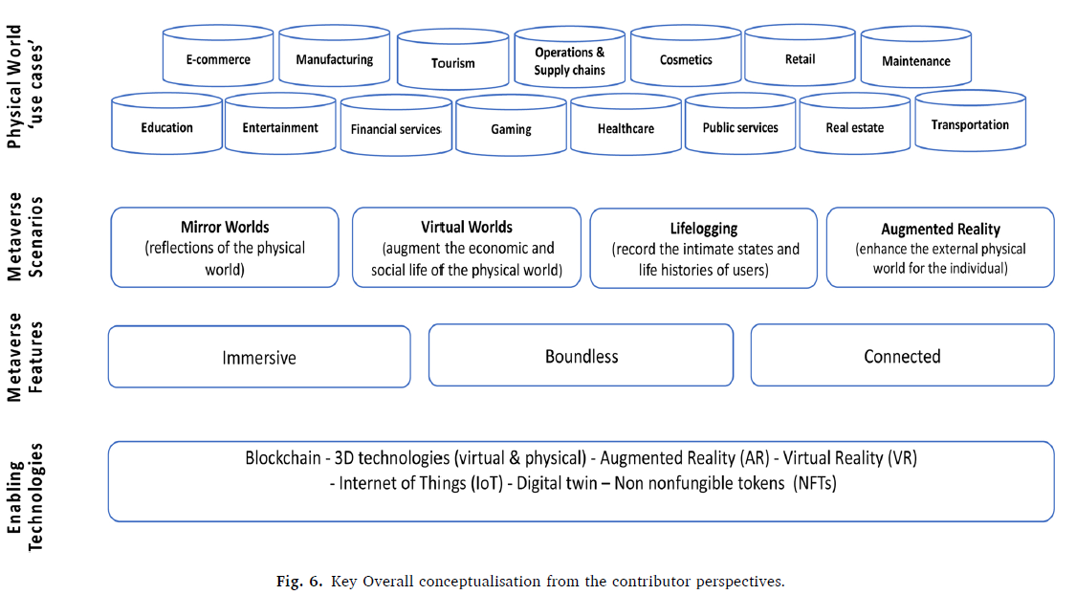

Slide 17
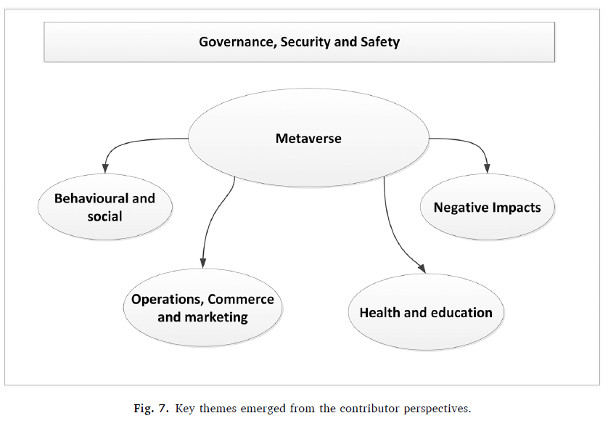

Slide 18
Metaverse and Marketing Opportunities
Virtual Items
Content Creation / User Generated Contents
Entertainment Based Items e.g. OTT, Songs, Games
Experience Products
Sensory Products

Slide 19
Metaverse and Segmentation
Active Users
Buyers
Connectors

