Slide 1


Slide 2
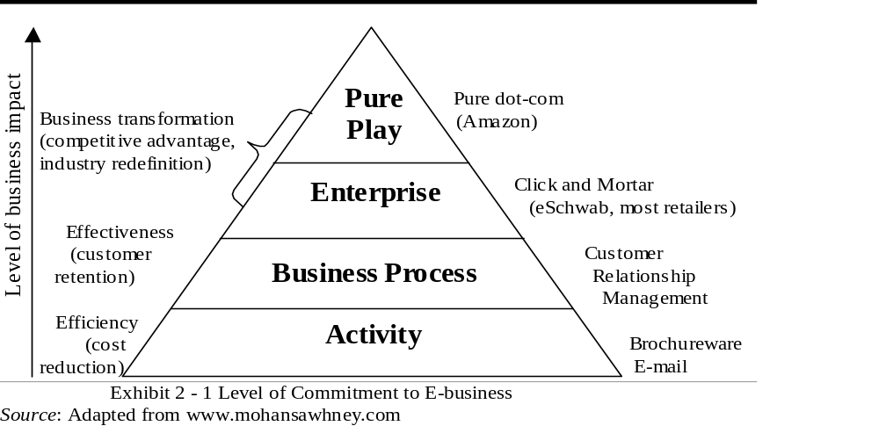

Slide 3
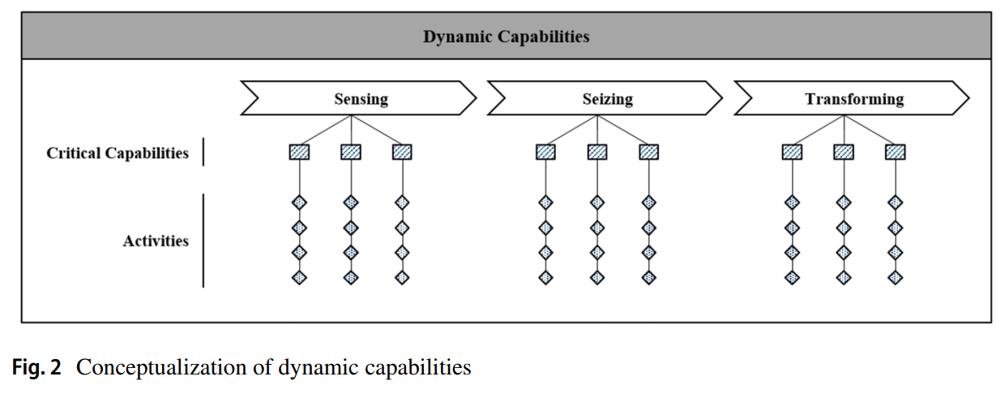

Slide 5
Context of Business Model Change Required
Adept
Renew
Acquire
Built

Slide 6


Slide 7
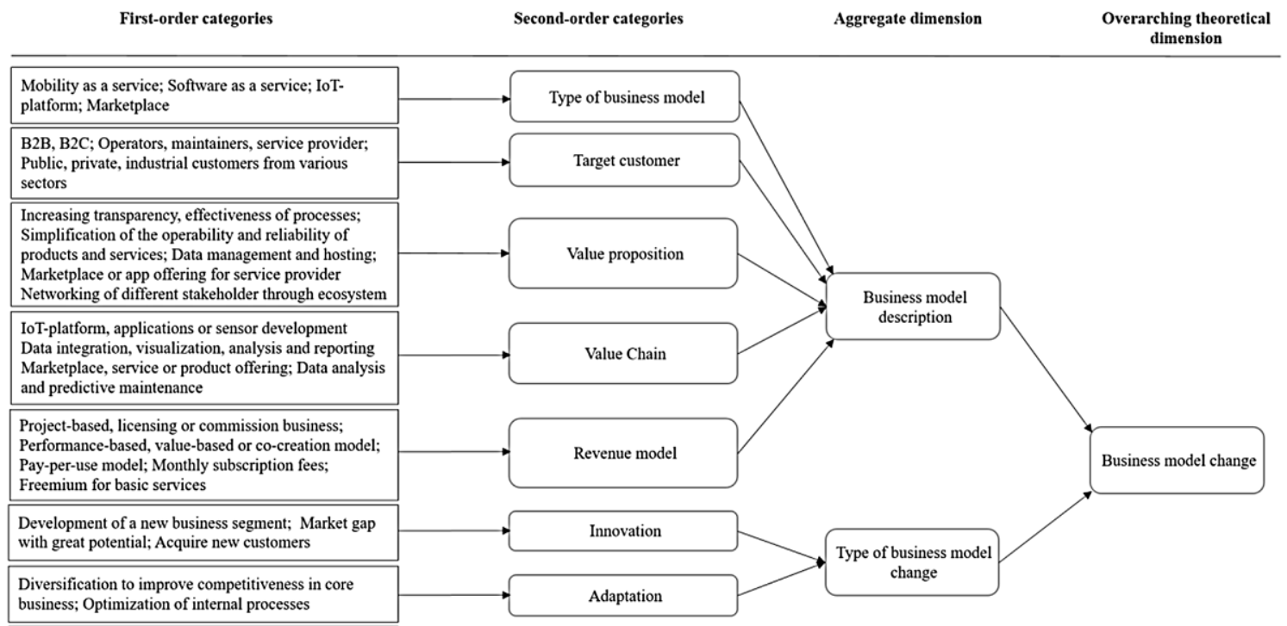

Slide 8
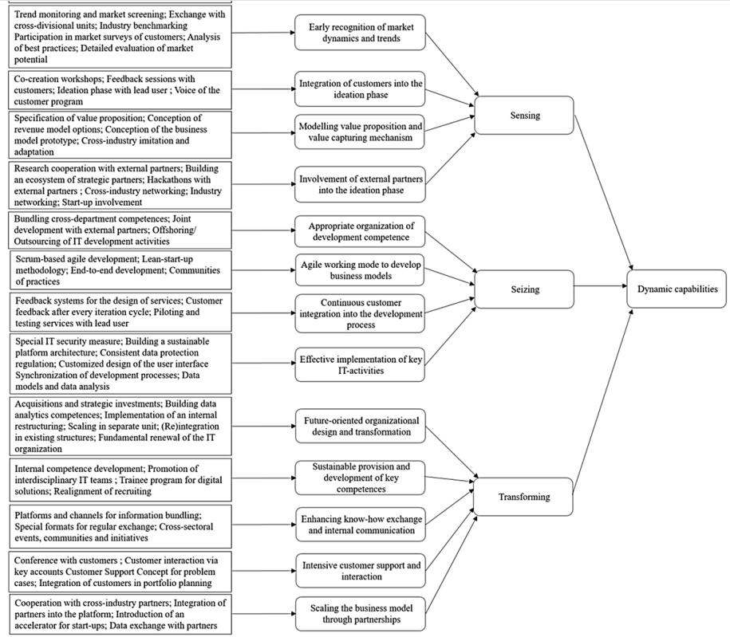

Slide 9
