Slide 1
Design the perfect financing instrument

Slide 2
A Rationale for Debt/Equity Securities
Value of Levered Firm = Value of Unlevered Firm + PV of Tax Benefits - PV of Expected Bankruptcy Costs.
Since bankruptcy costs are largely a result of the fact that the firm must make fixed payments even in periods when earnings are poor
Assume that borrowing money on a security where interest payments are not fixed but vary as earnings vary. This reduces the expected bankruptcy cost and increases both the optimal debt ratio for a firm and the total firm value at that leverage.

Slide 3
Design the perfect financing instrument
The objective in designing debt is to make the cash flows on debt match up as closely as possible with the cash flows that the firm makes on its assets. The intuition is very much like asset- liability matching of banks.
  A bank that chose to borrow entirely in US dollars and lend in Indian rupee would have a significant currency mismatch.
  A bank could have significant long-term assets (such as housing loans) funded by short-term liabilities, such as time deposits. If short-term interest rates rise, the short-term liabilities re-price at maturity, while the yield on the longer-term, fixed-rate assets remains unchanged. Income from the longer-term assets remains unchanged, while the cost of the newly re-priced liabilities funding these assets increases. This is sometimes called a maturity mismatch.
  A bank might borrow money by issuing floating interest rate bonds, but lends money with fixed-rate. It is called interest rate mismatch.

Slide 4
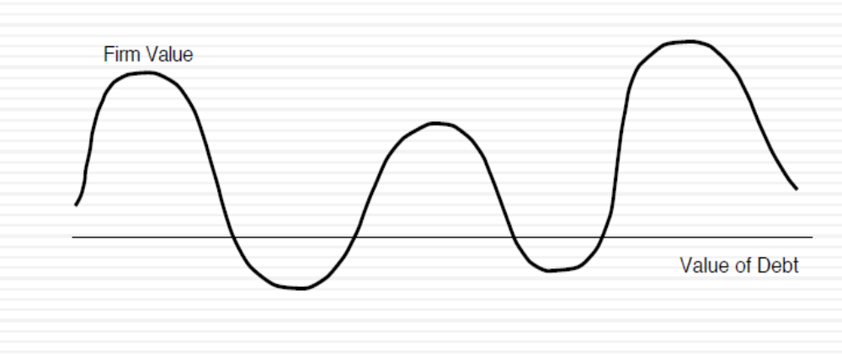
Firm with mismatched debt
Value of equity=value of firm - value of debt
Bankruptcy risk

Slide 5
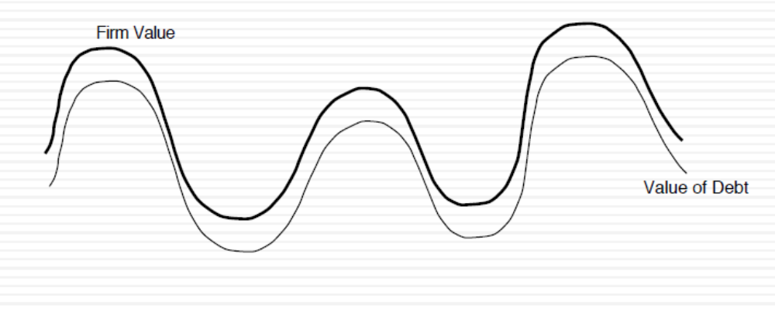
Firm with matched Debt
By having such debt, the firm can have higher leverage, but lower bankruptcy risk

Slide 6
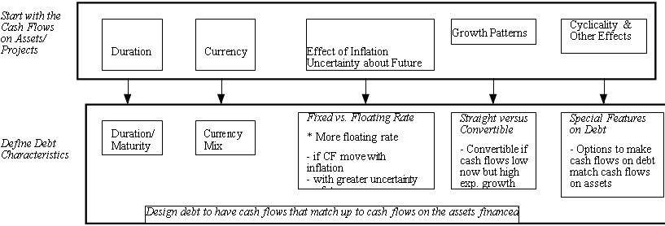
Design the perfect financing instrument
The perfect financing instrument will
  Have all of the tax advantages of debt
  While preserving the flexibility offered by equity

Slide 7
Intuitive Approach - Reliance Industries Limited
Business | Project cashflow characteristic | Type of financing
Energy, petrochemicals, and natural resources | Projects are likely to be Very long-term Currency will be a function of the region, where resources are sold. Affected by success of exploration | Debt should be Long-term Mix of currencies, based on resources sale If possible, tied to the success of exploration.
Textiles, and retail | The projects are likely to Be short-term Have cash outflows primarily in rupee (because Textiles and retail originate from India) | Debt should be 1. Short-term 2. Indian currency debt
Telecommunications | Projects are likely to Be short- to medium-term, with high growth potential and significant risk Cashflows are likely to be in Indian rupee. | Debt should be short-term-medium term , convertible Indian rupee debt.

Slide 8
Application Test: Choosing your Financing Type
Based upon the business that your firm is in, and the typical investments that it makes, what kind of financing would you expect your firm to use in terms of
  Duration (long term or short term)
  Currency
  Fixed or Floating rate
  Straight or Convertible

Slide 9
Large project specific financing
With project specific financing, you match the financing choices to the project being funded. The benefit is that the debt is truly customized to the project.
Project specific financing makes the most sense when you have a few large, independent projects to be financed. It becomes both impractical and costly when firms have portfolios of projects with interdependent cashflows.
For project specific financing, we estimate the duration of project’s cashflows.
  The duration of a financial asset that consists of fixed cash flows, for example a bond, is the weighted average of the times until those fixed cash flows are received.

Slide 10
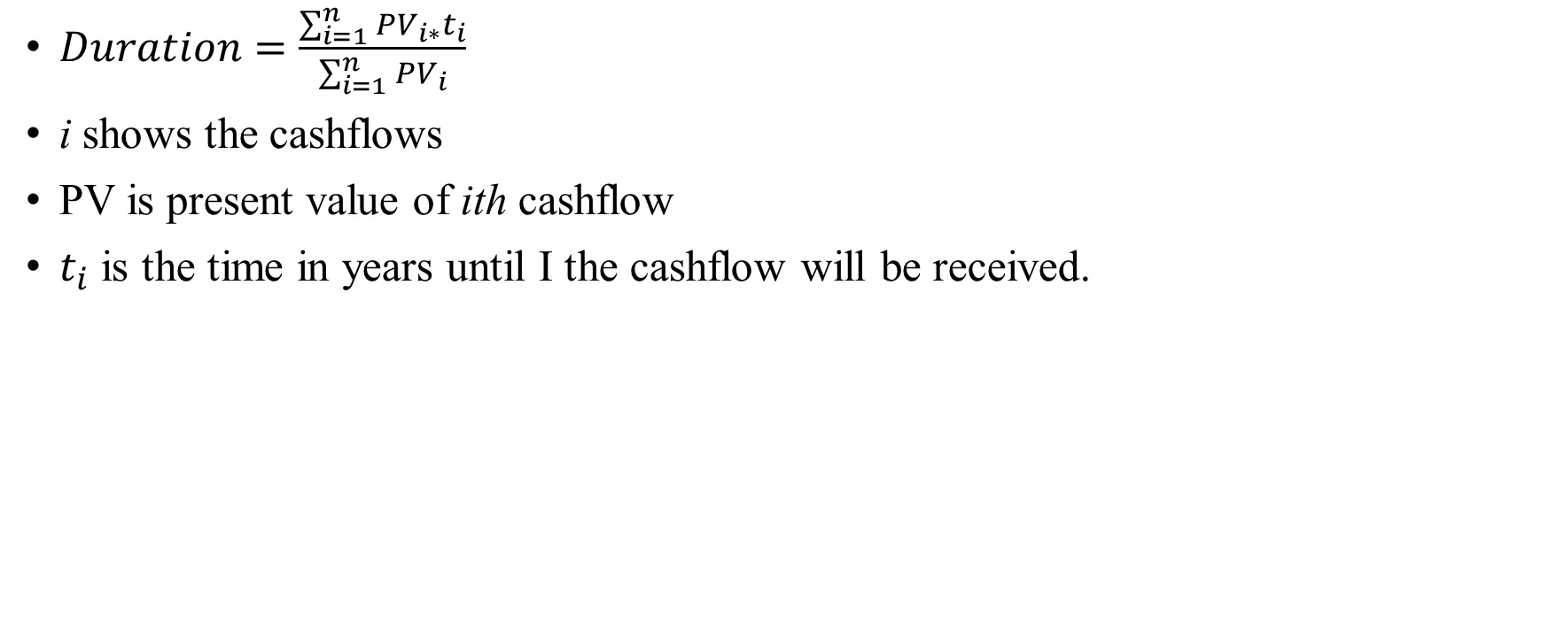
Duration Formula
$Duration=\frac{\sum_{i=1}^{n}{{PV}_{i∗}t_{i}}}{\sum_{i=1}^{n}{{PV}_{i}}}$
i shows the cashflows
PV is present value of ith cashflow
$t_{i}$ is the time in years until I the cashflow will be received.

Slide 11
Duration of project cashflows
Year | Annual Cashflows
0 | -2000
1 | -1000
2 | -859
3 | -267
4 | 340
5 | 466
6 | 516
7 | 555
8 | 615
9 | 681
10 | 715
Cost of capital is 8.46%
Terminal value=11275

Slide 12
Project duration
Year | Annual Cashflows | Terminal value | PV | PV*t
0 | -2000 |  | -2000 | 0
1 | -1000 |  | -922 | -922
2 | -859 |  | -730 | -1460
3 | -267 |  | -209 | -628
4 | 340 |  | 246 | 983
5 | 466 |  | 310 | 1552
6 | 516 |  | 317 | 1902
7 | 555 |  | 314 | 2200
8 | 615 |  | 321 | 2569
9 | 681 |  | 328 | 2951
10 | 715 | 11275 | 5323 | 53226
 | PV of cashflows |  | 3298 | 62373
 | Duration of the project |  | 18.91

Slide 13
The perfect debt…
The perfect debt for this project would have a duration of roughly 19 years and be in an Indian rupee , since it has most of revenue from US dollar.
If possible, you should tie the interest payments of debt to the outcome of projects.
However, project-specific financing makes sense when project should be independent from other firm’s projects. For instance, GMR raised USD 350 million via bonds for Delhi airport expansion by 10 years bond in 2019.

