Slide 1
The Option Contract
A call option gives its holder the right to buy an asset:
  At the exercise or strike price
  On or before the expiration date
Exercise the option to buy the underlying asset if market value > strike price
A put option gives its holder the right to sell an asset:
  At the exercise or strike price
  On or before the expiration date
Exercise the option to sell the underlying asset if market value < strike price

Slide 2
The Option Contract
The call option buyer has the right to buy the underlying asset but not the obligation
The call option seller (also called the option writer) has the obligation to deliver the asset if the buyer chooses to buy i.e., exercise his option.
The put option buyer has the right to sell the underlying asset but not the obligation
The put option seller writer has the obligation to take delivery of the asset if the buyer chooses to exercise his option.
For this one-sided privilege, the option buyer must pay a premium to the option writer up-front.
The premium is non-refundable whether or not the option buyer exercises the option.

Slide 3
The Option Contract
The purchase price of the option is called the premium.
Sellers (writers) of options receive premium income.
If holder exercises the option, the option writer must make (call) or take (put) delivery of the underlying asset.

Slide 4
Example
Call Options contract on TATAMOTORS with an exercise price of Rs 800 scheduled to expire on January 30, 2025.
Premium = Rs 7.00
What happens when the terminal stock price is Rs 810?
What happens when the terminal stock price is Rs 790?

Slide 5
Market and Exercise Price Relationships
In the Money - exercise of the option produces a positive cash flow
Call: exercise price < asset price
Put: exercise price > asset price
Out of the Money - exercise of the option would not be profitable
Call: asset price < exercise price
Put: asset price > exercise price
At the Money - exercise price and asset price are equal

Slide 6
American vs. European Options
American - the option can be exercised at any time before expiration or maturity
European - the option can only be exercised on the expiration or maturity date
https://www.nseindia.com/live_market/dynaContent/live_watch/derivative_stock_watch.htm

Slide 7
Payoffs and Profits at Expiration - Calls
Notation
Stock Price = S_{T} Exercise Price = X
Payoff to Call Holder
(S_{T} - X) if S_{T} >X
0 if S_{T} < X
Profit to Call Holder
Payoff - Premium

Slide 8
Payoffs and Profits at Expiration - Calls
Payoff to Call Writer
- (S_{T} - X) if S_{T} >X
0 if S_{T} < X
Profit to Call Writer
Payoff + Premium

Slide 9
Payoffs and Profits at Expiration - Puts
Payoffs to Put Holder
0 if S_{T} > X
(X - S_{T}) if S_{T} < X
Profit to Put Holder
Payoff - Premium

Slide 10
Payoffs and Profits at Expiration – Puts
Payoffs to Put Writer
0 if S_{T} > X
-(X - S_{T}) if S_{T} < X
Profits to Put Writer
Payoff + Premium

Slide 11
Option versus Stock Investments
Could a call option strategy be preferable to a direct stock purchase?
Suppose you think a stock, currently selling for $100, will appreciate.
A 6-month call with an exercise price of $100 costs $10 (contract size is 100 shares).
You have $10,000 to invest.
Strategy A: Invest entirely in stock. Buy 100 shares, each selling for $100.
Strategy B: Invest entirely in at-the-money call options. Buy 1,000 calls, each selling for $10. (This would require 10 contracts, each for 100 shares.)
Strategy C: Purchase 100 call options for $1,000. Invest your remaining $9,000 in 6-month T-bills, to earn 3% interest. The bills will be worth $9,270 at expiration.

Slide 12
Option versus Stock Investments
Investment Strategy Investment
Equity only Buy stock @ 100 100 shares $10,000
Options only Buy calls @ 10 1000 options $10,000
Leveraged Buy calls @ 10 100 options $1,000
equity Buy T-bills @ 3% $9,000
Yield

Slide 13
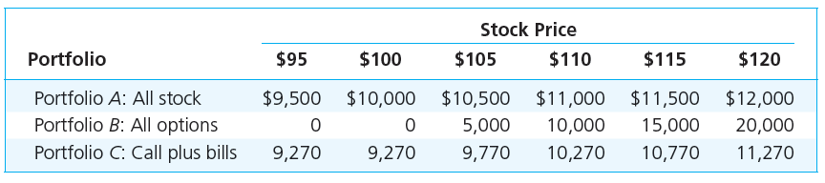
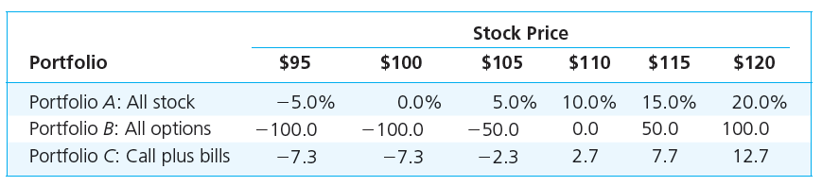
Strategy Payoffs

Slide 14
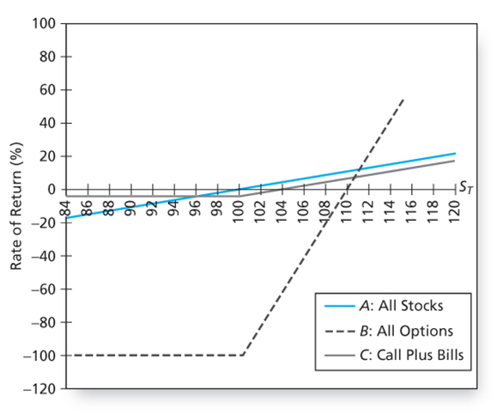
Rate of Return

Slide 15
Strategy Conclusions
The all-option portfolio, B, responds more than proportionately to changes in stock value; it is levered.
Portfolio C, T-bills plus calls, shows the insurance value of options.
  C ‘s T-bill position cannot be worth less than $9270.
  Some return potential is sacrificed to limit downside risk.

Slide 16
Option Strategies
Protective Put
Covered Call
Straddle
Spreads
Collar

Slide 17
Put-Call Parity
Buy a call option
Buy Treasury bills with face value equal to the exercise price of the call option, and with maturity date equal to the expiration date of the option.
For each option that you hold with exercise price X, you would purchase a risk-free zero-coupon bond with face value X.
 | S_{T}<= X | S_{T} >X
Value of call option | 0 | S_{T} - X
Value of zero-coupon bond | X | X
Total | X | S_{T}

Slide 18
Put-Call Parity
Protective Put : Invest in stock and purchase a put option on the stock
 | S_{T}<= X | S_{T} >X
Stock | S_{T} | S_{T}
Put | X - S_{T} | 0
Total | X | S_{T}

Slide 19
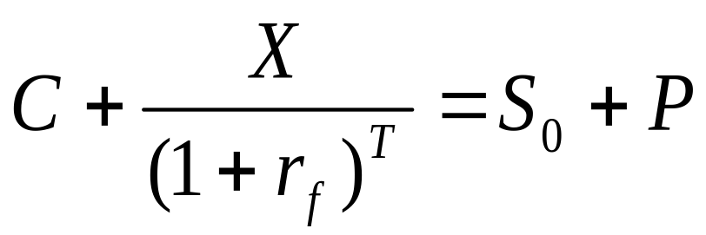
Put-Call Parity
The call-plus-bond portfolio (on left) must cost the same as the stock-plus-put portfolio (on right):

Slide 20

Put Call Parity - Disequilibrium Example
Stock Price = 110 Call Price = 17
Put Price = 5 Risk Free = 5%
Maturity = 1 yr X = 105
117 > 115
acquire the low-cost alternative and sell the high-cost alternative

Slide 21
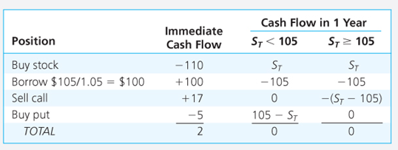
Arbitrage Strategy

Slide 22
Option Values
Intrinsic value - profit that could be made if the option was immediately exercised
  Call: stock price - exercise price
  Put: exercise price - stock price
Time value - the difference between the option price and the intrinsic value, given immediate expiration

Slide 23
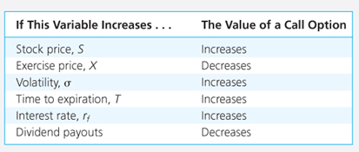
Determinants of Call Option Values

Slide 24
Binomial Option Pricing
Replicating Portfolio
Hedge Ratio

Slide 25
Black-Scholes Option Valuation
C_{o} = S_{o}N(d₁) - Xe^{-rT}N(d₂)
d₁ = [ln(S_{o}/X) + (r + σ²/2)T] / (σ T^{1/2})
d₂ = d₁ - (σ T^{1/2})
C_{o} = Current call option value ; S_{o} = Current stock price
N(d) = probability that a random draw from a normal distribution will be less than d
X = Exercise price; e = 2.71828, the base of the natural log
r = Risk-free interest rate (annualized, continuously compounded with the same maturity as the option)
T = time to maturity of the option in years
ln = Natural log function; σ = Standard deviation of the stock

