Slide 1
Deep Learning

Slide 2
Machine Learning Basics
Machine Learning Basics
Artificial Intelligence is a scientific field concerned with the development of algorithms that allow computers to learn without being explicitly programmed
Machine Learning is a branch of Artificial Intelligence, which focuses on methods that learn from data and make predictions on unseen data
Data
Machine Learning algorithm
Training
Prediction
Data
Learned model
Prediction

Slide 3
Machine Learning Types
Machine Learning Basics
Supervised: learning with labeled data
  Example: email classification, image classification
  Example: regression for predicting real-valued outputs
Unsupervised: discover patterns in unlabeled data
  Example: cluster similar data points
Reinforcement learning: learn to act based on feedback/reward
  Example: learn to play Go

Slide 4
Supervised Learning
Machine Learning Basics
Supervised learning categories and techniques
  Numerical classifier functions
    Linear classifier, perceptron, logistic regression, support vector machines (SVM), neural networks
  Parametric (probabilistic) functions
    Naïve Bayes, Gaussian discriminant analysis (GDA), hidden Markov models (HMM), probabilistic graphical models
  Non-parametric (instance-based) functions
    k-nearest neighbors, kernel regression, kernel density estimation, local regression
  Symbolic functions
    Decision trees, classification and regression trees (CART)
  Aggregation (ensemble) learning
    Bagging, boosting (Adaboost), random forest

Slide 5
Unsupervised Learning
Machine Learning Basics
Unsupervised learning categories and techniques
  Clustering
    k-means clustering
    Mean-shift clustering
    Spectral clustering
  Density estimation
    Gaussian mixture model (GMM)
    Graphical models
  Dimensionality reduction
    Principal component analysis (PCA)
    Factor analysis

Slide 6
Nearest Neighbor Classifier
Machine Learning Basics
Nearest Neighbor – for each test data point, assign the class label of the nearest training data point
  Adopt a distance function to find the nearest neighbor
    Calculate the distance to each data point in the training set, and assign the class of the nearest data point (minimum distance)
  It does not require learning a set of weights
Test example
Training examples from class 2
Training examples from class 1

Slide 7
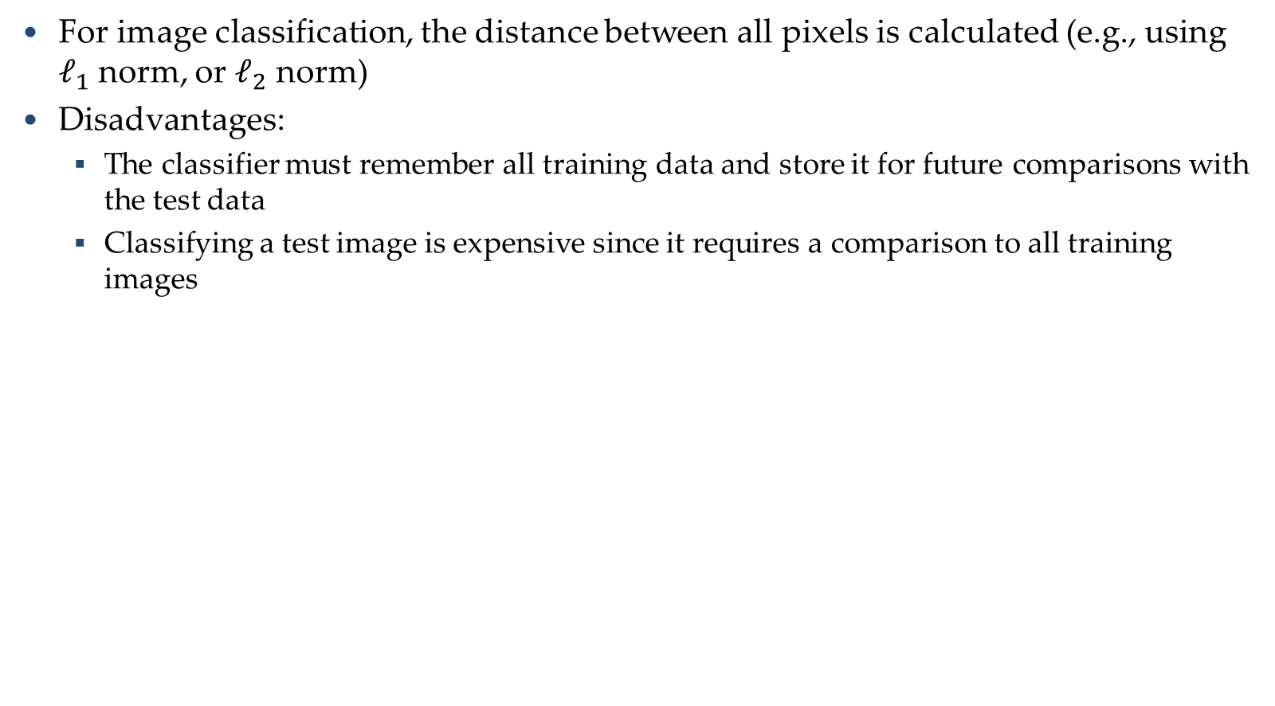
Nearest Neighbor Classifier
Machine Learning Basics
For image classification, the distance between all pixels is calculated (e.g., using $ℓ_{1}$ norm, or $ℓ_{2}$ norm)
Disadvantages:
  The classifier must remember all training data and store it for future comparisons with the test data
  Classifying a test image is expensive since it requires a comparison to all training images

Slide 8
k-Nearest Neighbors Classifier
Machine Learning Basics
k-Nearest Neighbors approach considers multiple neighboring data points to classify a test data point
  E.g., 3-nearest neighbors
    The test example in the figure is the + mark
    The class of the test example is obtained by voting (based on the distance to the 3 closest points)
x2
x
x
x
o
x
x
x
x
+
o
x
o
o
x
o
+
o
o
o
o
x1

Slide 9
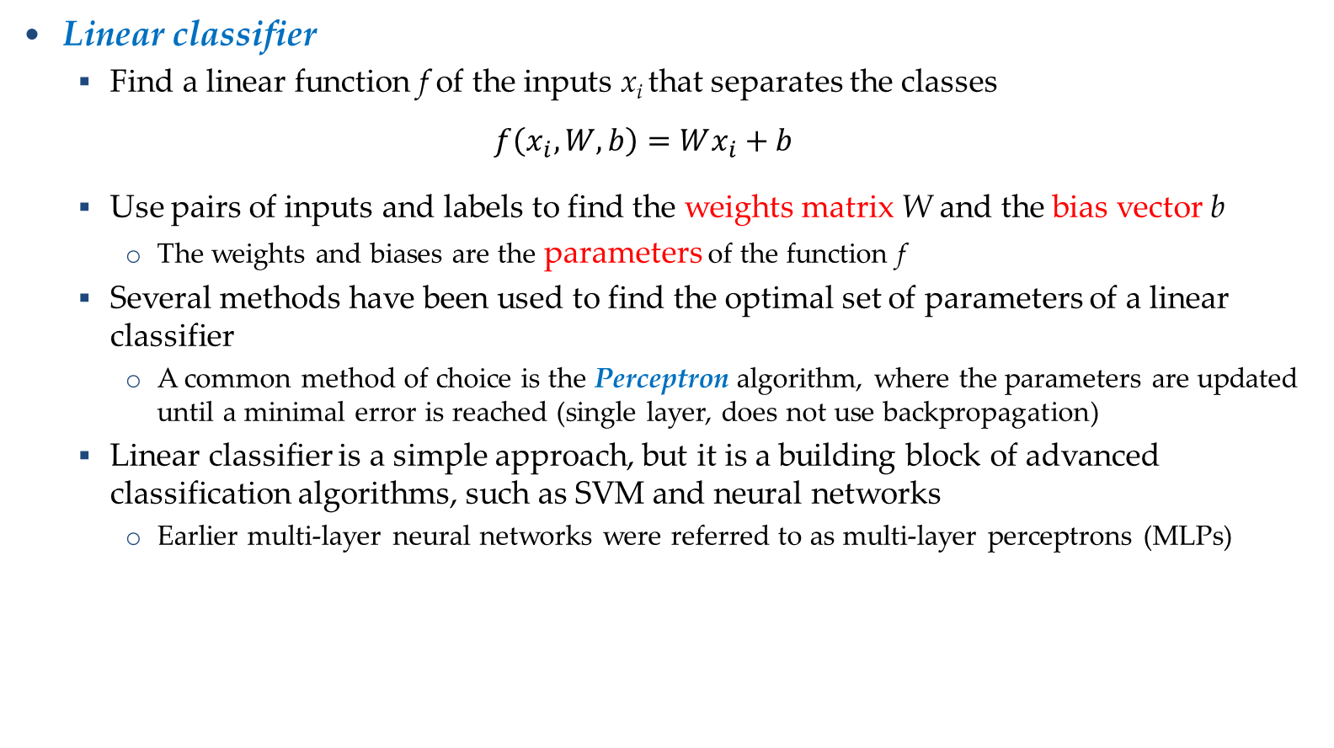
Linear Classifier
Machine Learning Basics
Linear classifier
  Find a linear function f of the inputs x_{i} that separates the classes
  $$f\left(x_{i},W,b\right)=Wx_{i}+b$$
  Use pairs of inputs and labels to find the weights matrix W and the bias vector b
    The weights and biases are the parameters of the function f
  Several methods have been used to find the optimal set of parameters of a linear classifier
    A common method of choice is the Perceptron algorithm, where the parameters are updated until a minimal error is reached (single layer, does not use backpropagation)
  Linear classifier is a simple approach, but it is a building block of advanced classification algorithms, such as SVM and neural networks
    Earlier multi-layer neural networks were referred to as multi-layer perceptrons (MLPs)

Slide 10
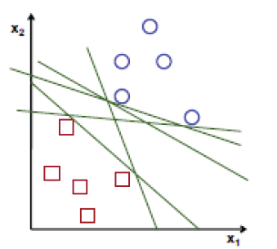
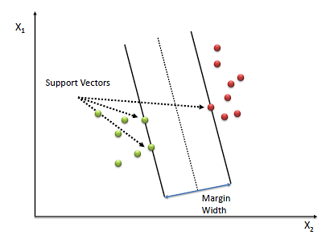
Support Vector Machines
Machine Learning Basics
Support vector machines (SVM)
  How to find the best decision boundary?
    All lines in the figure correctly separate the 2 classes
    The line that is farthest from all training examples will have better generalization capabilities
  SVM solves an optimization problem:
    First, identify a decision boundary that correctly classifies the examples
    Next, increase the geometric margin between the boundary and all examples
  The data points that define the maximum margin width are called support vectors
  Find W and b by solving:

Slide 11
Linear vs Non-linear Techniques
Linear vs Non-linear Techniques
Linear classification techniques
  Linear classifier
  Perceptron
  Logistic regression
  Linear SVM
  Naïve Bayes
Non-linear classification techniques
  k-nearest neighbors
  Non-linear SVM
  Neural networks
  Decision trees
  Random forest

Slide 12
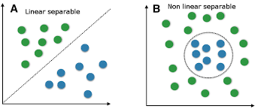


Linear vs Non-linear Techniques
Linear vs Non-linear Techniques
For some tasks, input data can be linearly separable, and linear classifiers can be suitably applied
For other tasks, linear classifiers may have difficulties to produce adequate decision boundaries

Slide 13
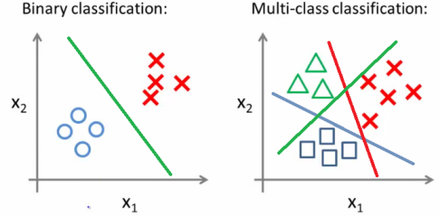
Binary vs Multi-class Classification
Binary vs Multi-class Classification
A classification problem with only 2 classes is referred to as binary classification
  The output labels are 0 or 1
  E.g., benign or malignant tumor, spam or no-spam email
A problem with 3 or more classes is referred to as multi-class classification

Slide 14
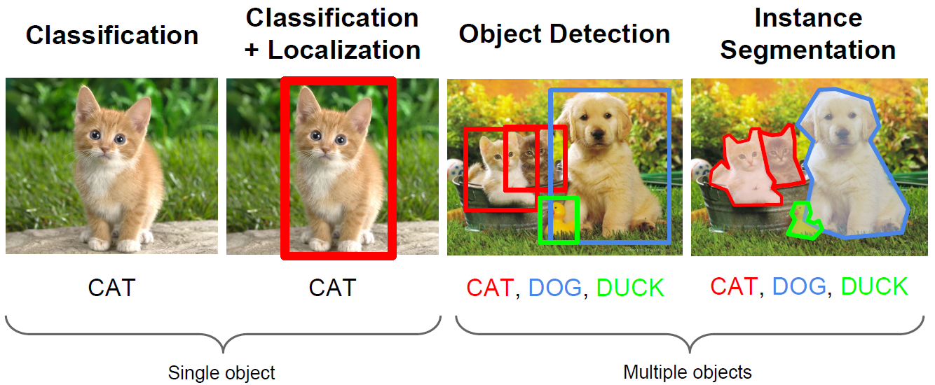
Computer Vision Tasks
Machine Learning Basics
Computer vision has been the primary area of interest for ML
The tasks include: classification, localization, object detection, instance segmentation

Slide 15
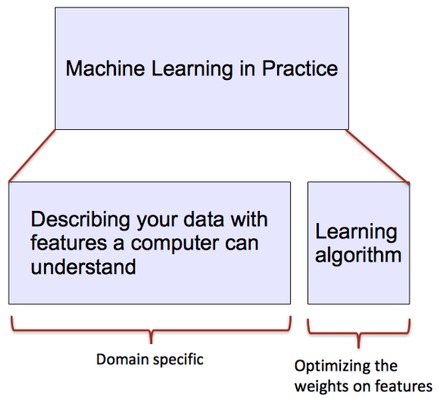
ML vs. Deep Learning
Introduction to Deep Learning
Conventional machine learning methods rely on human-designed feature representations
  ML becomes just optimizing weights to best make a final prediction

Slide 16
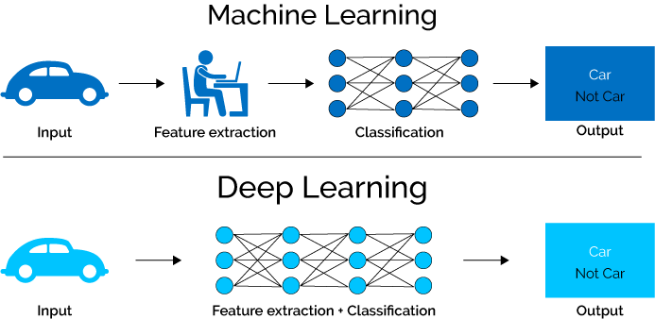
ML vs. Deep Learning
Introduction to Deep Learning
Deep learning (DL) is a machine learning subfield that uses multiple layers for learning data representations
  DL is exceptionally effective at learning patterns

Slide 17
Why is DL Useful?
Introduction to Deep Learning
DL provides a flexible, learnable framework for representing visual, text, linguistic information
  Can learn in supervised and unsupervised manner
DL represents an effective end-to-end learning system
Requires large amounts of training data
Since about 2010, DL has outperformed other ML techniques
  First in vision and speech, then NLP, and other applications

Slide 18
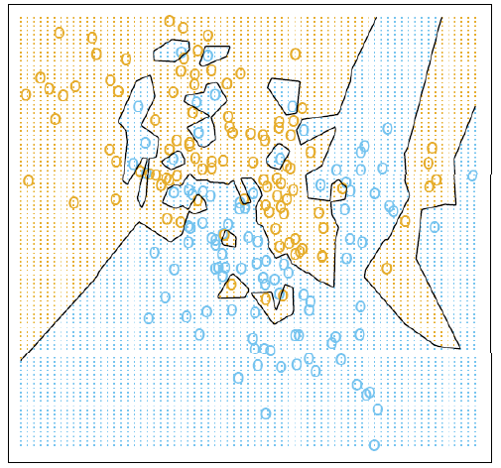
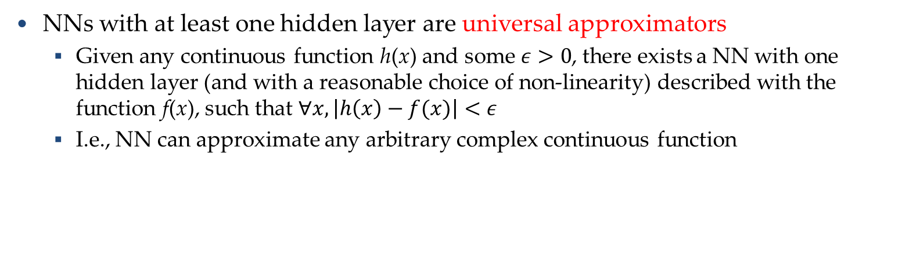
Representational Power
Introduction to Deep Learning
NNs with at least one hidden layer are universal approximators
  Given any continuous function h(x) and some $ε>0$, there exists a NN with one hidden layer (and with a reasonable choice of non-linearity) described with the function f(x), such that $∀x, \left|h\left(x\right)−f(x)\right|<ε$
  I.e., NN can approximate any arbitrary complex continuous function
NNs use nonlinear mapping of the inputs x to the outputs f(x) to compute complex decision boundaries
But then, why use deeper NNs?
  The fact that deep NNs work better is an empirical observation
  Mathematically, deep NNs have the same representational power as a one-layer NN

Slide 19

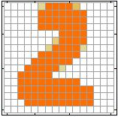

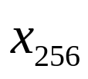
Introduction to Neural Networks
Introduction to Neural Networks
Handwritten digit recognition (MNIST dataset)
  The intensity of each pixel is considered an input element
  Output is the class of the digit
Input
Output
y₁
is 1
0.1
y₂
is 2
0.7
The image is “2”
……
……
……
y₁₀
0.2
is 0
16 x 16 = 256
Ink → 1
No ink → 0
Each dimension represents the confidence of a digit

Slide 20


Introduction to Neural Networks
Introduction to Neural Networks
Handwritten digit recognition
y₁
Machine
y₂
“2”
……
……
$$f:R^{256}→R^{10}$$
y₁₀
The function $f$ is represented by a neural network

Slide 21
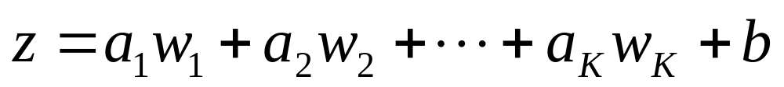
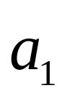
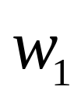
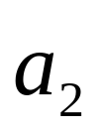
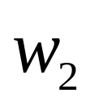

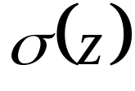



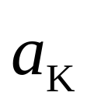


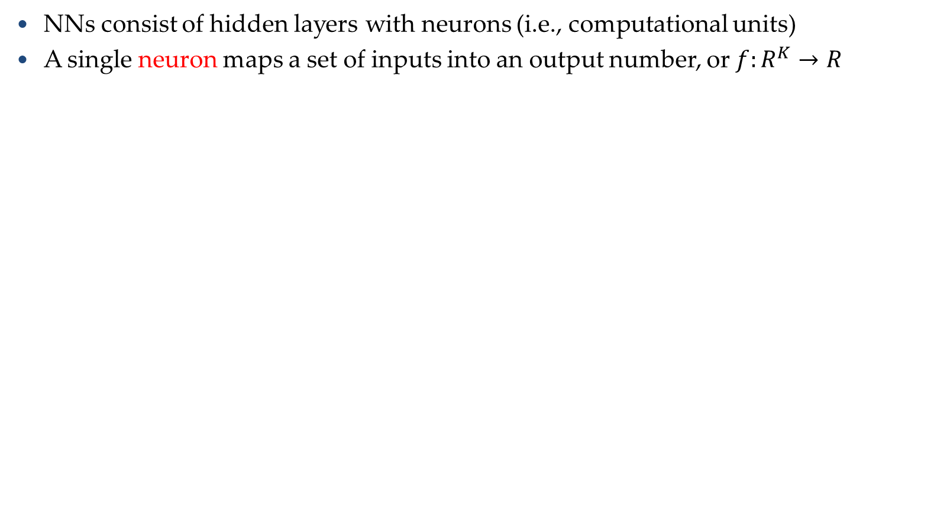
Elements of Neural Networks
Introduction to Neural Networks
NNs consist of hidden layers with neurons (i.e., computational units)
A single neuron maps a set of inputs into an output number, or $f:R^{K}→R$
$$a=σ\left(z\right)$$
…
…
output
Activation function
weights
input
bias

Slide 22
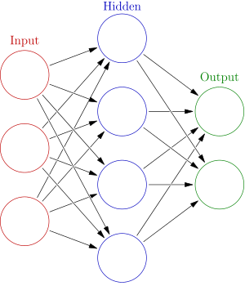




Elements of Neural Networks
Introduction to Neural Networks
A NN with one hidden layer and one output layer
Weights
Biases
$$hidden layer h=σ(W_{1}x+b_{1})$$
$$output layer y=σ(W_{2}h+b_{2})$$
Activation functions
4 + 2 = 6 neurons (not counting inputs)
[3 × 4] + [4 × 2] = 20 weights
4 + 2 = 6 biases
26 learnable parameters
$$y$$
$$x$$
$$h$$

Slide 23

Elements of Neural Networks
Introduction to Neural Networks
Deep NNs have many hidden layers
  Fully-connected (dense) layers (a.k.a. Multi-Layer Perceptron or MLP)
  Each neuron is connected to all neurons in the succeeding layer
Input
Layer 1
Layer 2
Layer L
Output
……
y₁
……
y₂
……
……
……
……
……
……
y_{M}
Input Layer
Output Layer
Hidden Layers

Slide 24
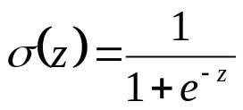

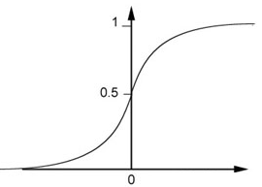



Elements of Neural Networks
Introduction to Neural Networks
A simple network, toy example
$$\left(1∙1\right)+\left(−1\right)∙\left(−2\right)+1=4$$
0.98
Sigmoid Function
1
4
1
-2
1
-1
-2
0.12
-1
1
0
1 $∙ \left(−1\right)+\left(−1\right)∙1+0=$-2

Slide 25

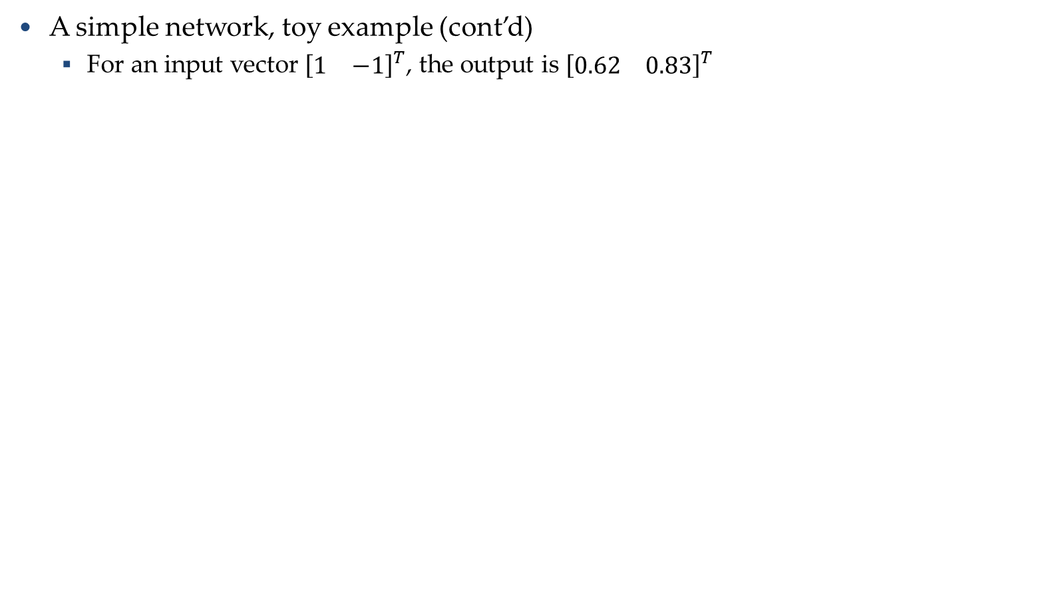
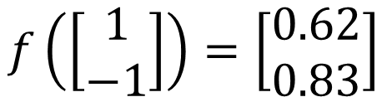
Elements of Neural Networks
Introduction to Neural Networks
A simple network, toy example (cont’d)
  For an input vector ${[\begin{matrix}1 & −1\end{matrix}]}^{T}$, the output is ${[\begin{matrix}0.62 & 0.83\end{matrix}]}^{T}$
1
4
0.98
2
0.86
3
0.62
1
-2
-1
-1
1
0
-2
-1
-2
0.12
-2
0.11
-1
0.83
-1
1
-1
4
0
0
2
$$f\left(\left[\begin{matrix}1 \\ −1\end{matrix}\right]\right)=\left[\begin{matrix}0.62 \\ 0.83\end{matrix}\right]$$
$$f:R^{2}→R^{2}$$

Slide 26

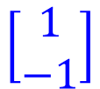
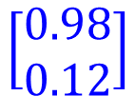


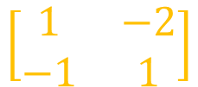
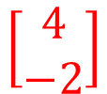
Matrix Operation
Introduction to Neural Networks
Matrix operations are helpful when working with multidimensional inputs and outputs
1
4
0.98
1
W
x
b
a
+
-2
$σ\left( \right) =$
1
-1
-2
0.12
$$\left[\begin{matrix}1 & −2 \\ −1 & 1\end{matrix}\right]$$
$$\left[\begin{matrix}1 \\ −1\end{matrix}\right]$$
$$\left[\begin{matrix}1 \\ 0\end{matrix}\right]$$
$$=$$
$$\left[\begin{matrix}0.98 \\ 0.12\end{matrix}\right]$$
$$σ\left( \right)$$
$$+$$
-1
1
0
$$\left[\begin{matrix}4 \\ −2\end{matrix}\right]$$

Slide 27
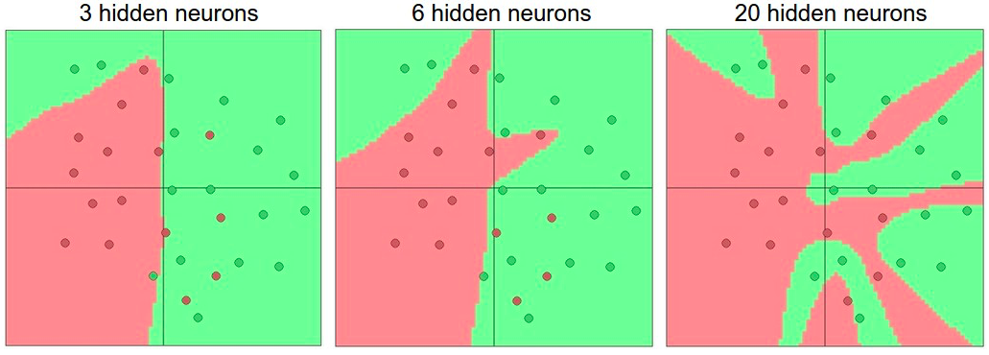
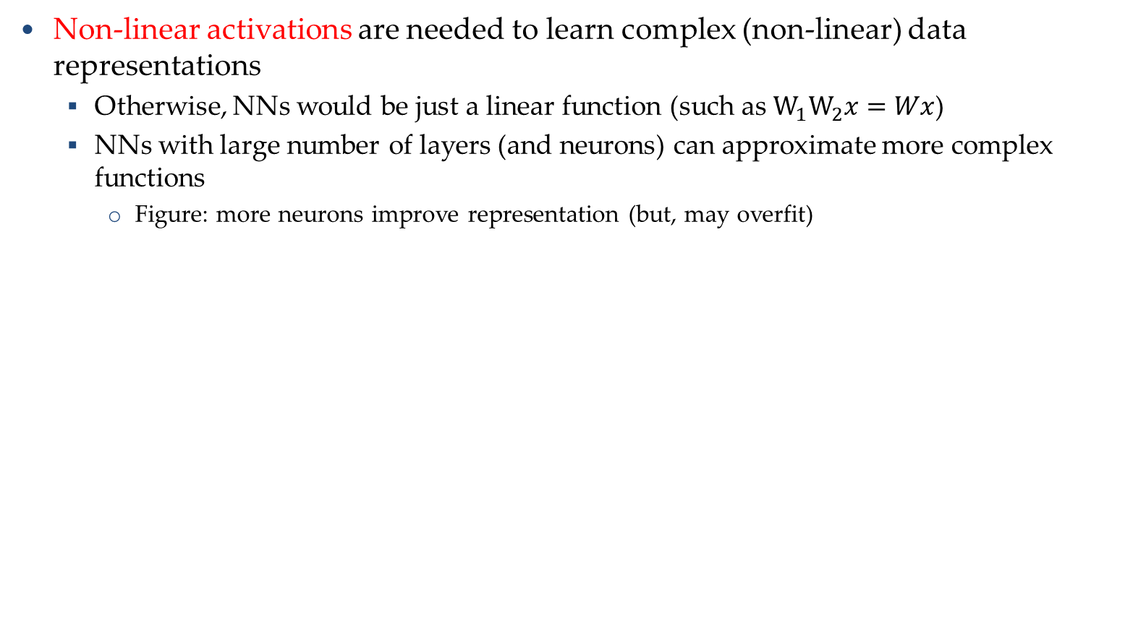
Activation Functions
Introduction to Neural Networks
Non-linear activations are needed to learn complex (non-linear) data representations
  Otherwise, NNs would be just a linear function (such as $W_{1}W_{2}x=Wx$)
  NNs with large number of layers (and neurons) can approximate more complex functions
    Figure: more neurons improve representation (but, may overfit)

Slide 28
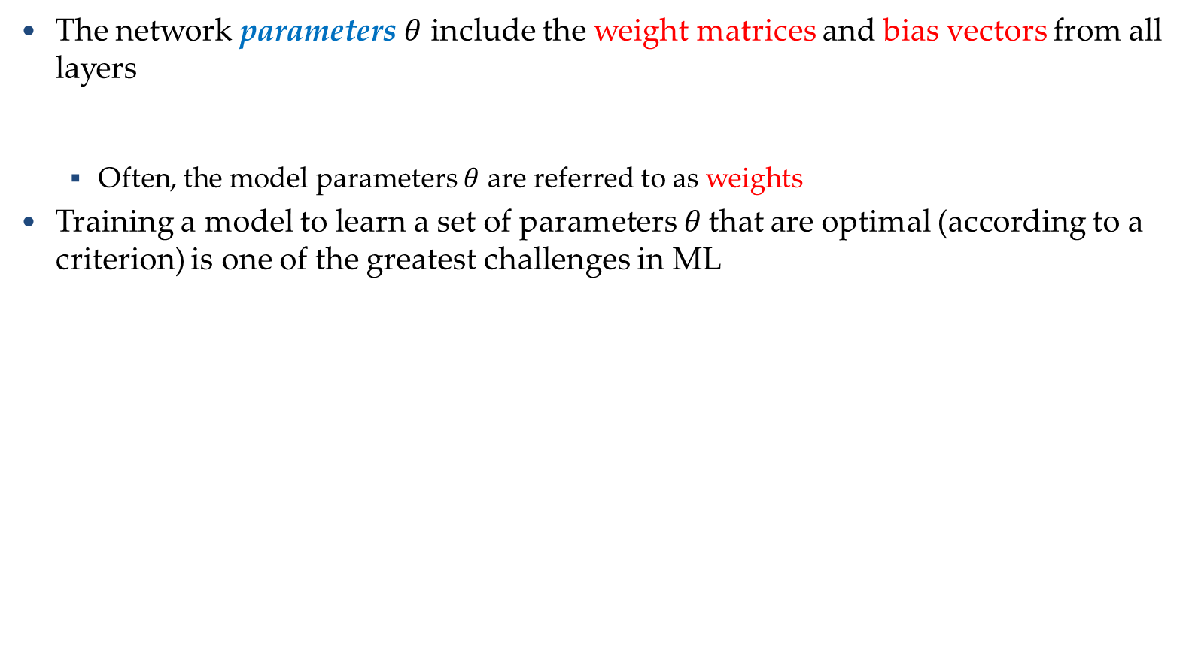
Training NNs
Training Neural Networks
The network parameters $θ$ include the weight matrices and bias vectors from all layers
  Often, the model parameters $θ$ are referred to as weights
Training a model to learn a set of parameters$θ$ that are optimal (according to a criterion) is one of the greatest challenges in ML
$$θ=\left\{W^{1},b^{1},W^{2},b^{2},⋯W^{L},b^{L}\right\}$$
……
y₁
is 1
0.1
……
y₂
0.7
is 2
Softmax
……
……
……
……
y₁₀
is 0
0.2
16 x 16 = 256

Slide 29
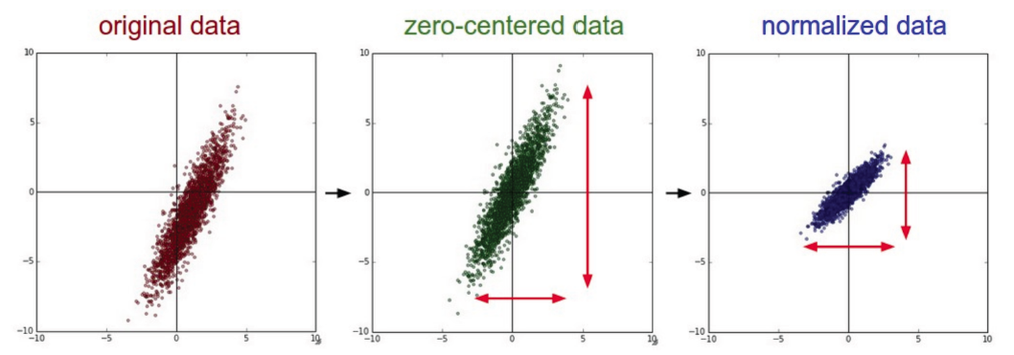
Training NNs
Training Neural Networks
Data preprocessing - helps convergence during training
  Mean subtraction, to obtain zero-centered data
    Subtract the mean for each individual data dimension (feature)
  Normalization
    Divide each feature by its standard deviation
      To obtain standard deviation of 1 for each data dimension (feature)
    Or, scale the data within the range [0,1] or [-1, 1]
      E.g., image pixel intensities are divided by 255 to be scaled in the [0,1] range

Slide 30




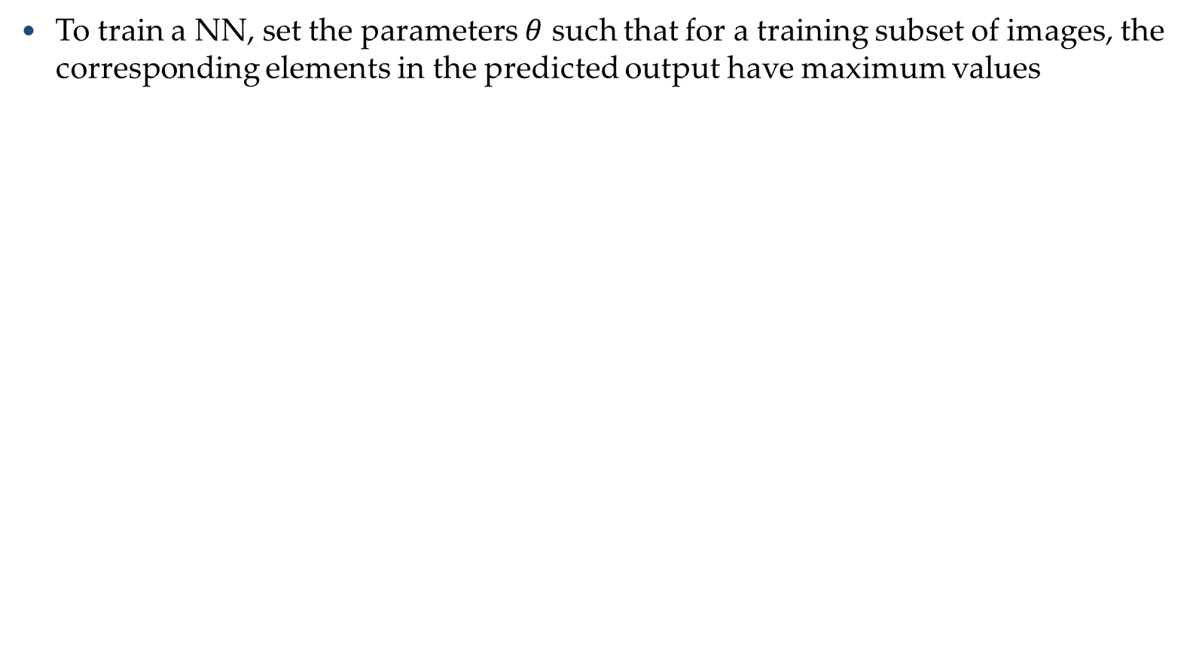
Training NNs
Training Neural Networks
To train a NN, set the parameters $θ$ such that for a training subset of images, the corresponding elements in the predicted output have maximum values
Input:
y₁ has the maximum value
Input:
y₂ has the maximum value
.
.
.
Input:
y₉ has the maximum value
Input:
y₁₀ has the maximum value

Slide 31

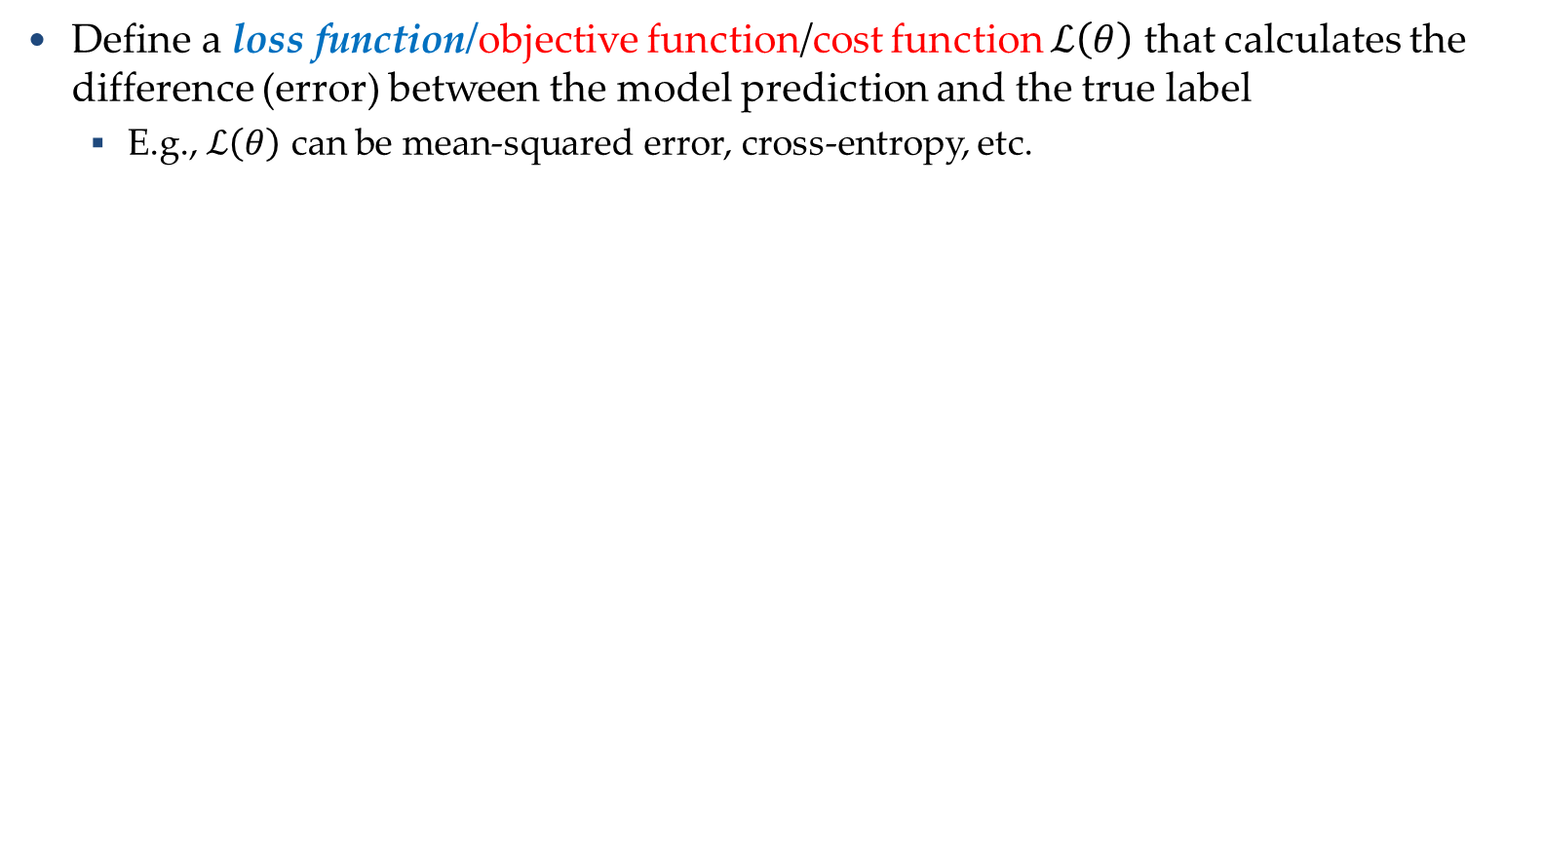

Training NNs
Training Neural Networks
Define a loss function/objective function/cost function $ℒ\left(θ\right)$ that calculates the difference (error) between the model prediction and the true label
  E.g., $ℒ\left(θ\right)$ can be mean-squared error, cross-entropy, etc.
……
y₁
1
0.2
……
y₂
0
0.3
……
……
……
Cost
……
……
……
……
y₁₀
$$ℒ(θ)$$
0
0.5
True label “1”
Notes:
Loss function line

Slide 32






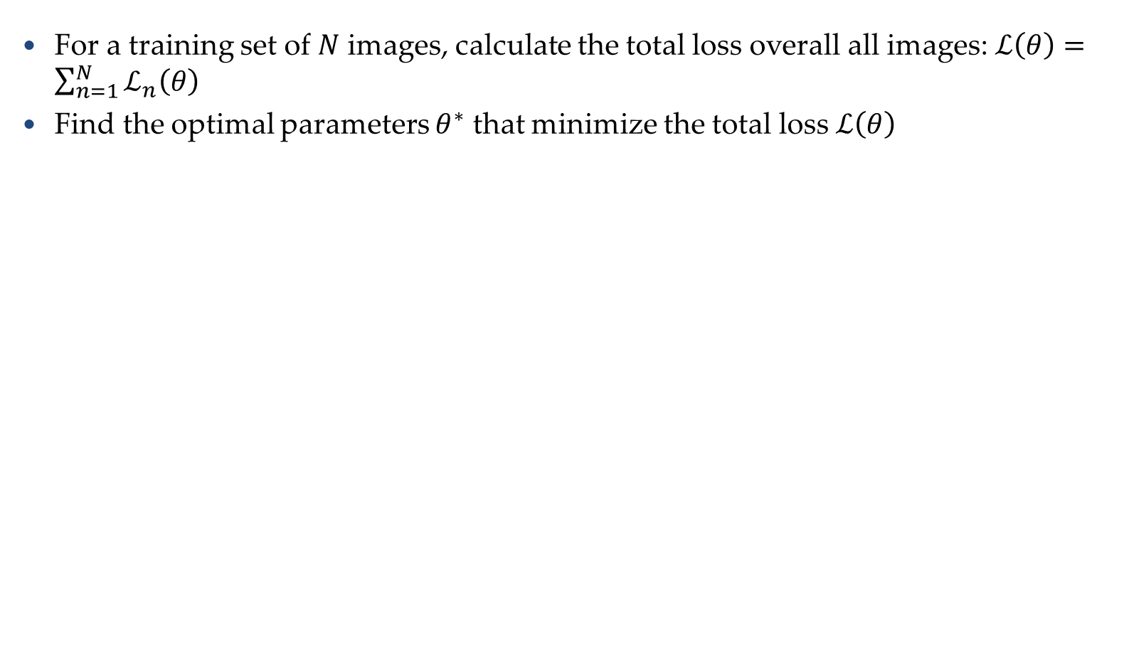




Training NNs
Training Neural Networks
For a training set of $N$ images, calculate the total loss overall all images: $ℒ\left(θ\right)=\sum_{n=1}^{N}{ℒ_{n}\left(θ\right)}$
Find the optimal parameters $θ^{∗}$ that minimize the total loss $ℒ\left(θ\right)$
$$ℒ_{1}\left(θ\right)$$
x¹
NN
y¹
$${\hat{y}}^{1}$$
NN
$$ℒ_{2}\left(θ\right)$$
x²
$${\hat{y}}^{2}$$
y²
NN
$$ℒ_{3}\left(θ\right)$$
x³
$${\hat{y}}^{3}$$
y³
……
……
……
……
NN
$$ℒ_{n}\left(θ\right)$$
x^{N}
$${\hat{y}}^{N}$$
y^{N}

Slide 33
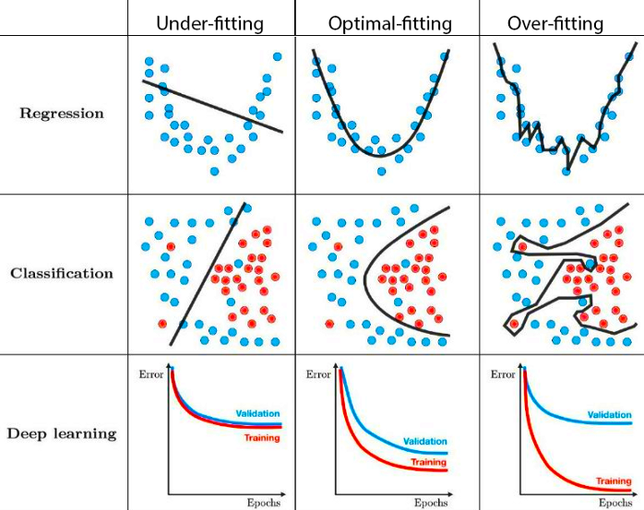
Generalization
Generalization
Underfitting
  The model is too “simple” to represent all the relevant class characteristics
  E.g., model with too few parameters
  Produces high error on the training set and high error on the validation set
Overfitting
  The model is too “complex” and fits irrelevant characteristics (noise) in the data
  E.g., model with too many parameters
  Produces low error on the training error and high error on the validation set

Slide 34
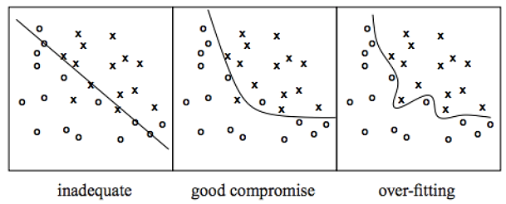
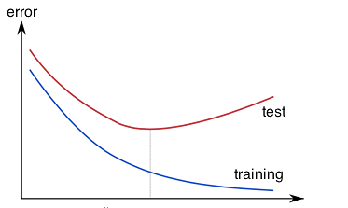
Overfitting
Generalization
Overfitting – a model with high capacity fits the noise in the data instead of the underlying relationship
The model may fit the training data very well, but fails to generalize to new examples (test or validation data)

Slide 35
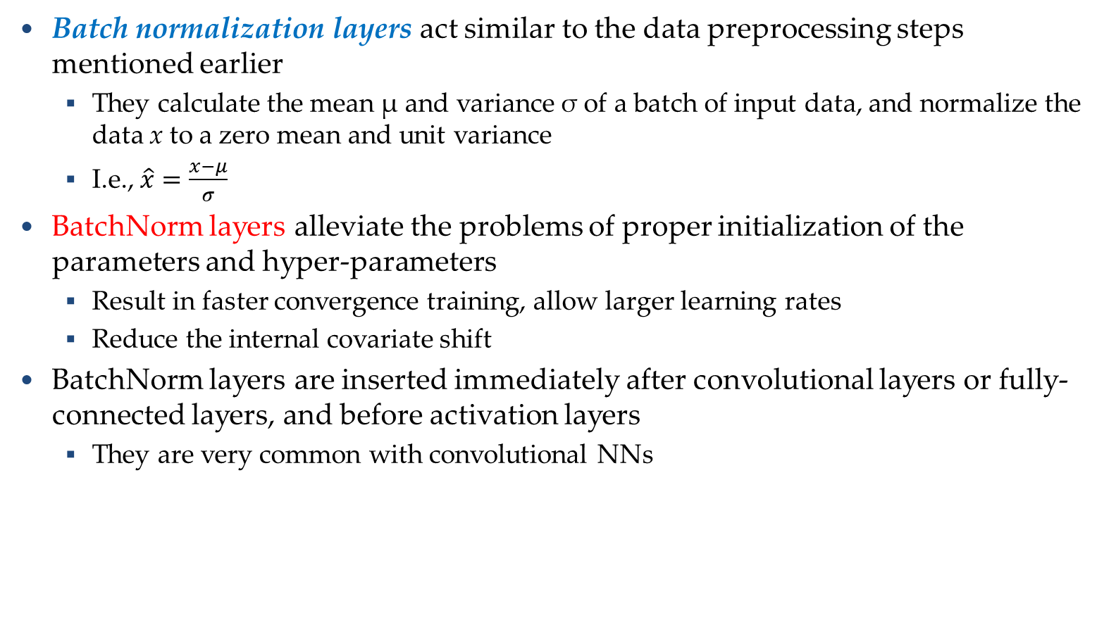
Batch Normalization
Regularization
Batch normalization layers act similar to the data preprocessing steps mentioned earlier
  They calculate the mean μ and variance σ of a batch of input data, and normalize the data x to a zero mean and unit variance
  I.e., $\hat{x}=\frac{x−μ}{σ}$
BatchNorm layers alleviate the problems of proper initialization of the parameters and hyper-parameters
  Result in faster convergence training, allow larger learning rates
  Reduce the internal covariate shift
BatchNorm layers are inserted immediately after convolutional layers or fully-connected layers, and before activation layers
  They are very common with convolutional NNs

Slide 36
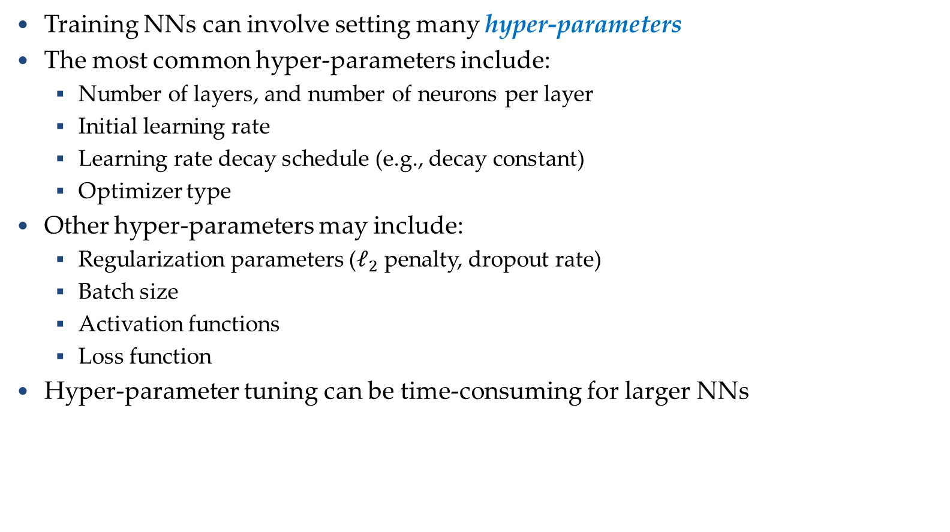
Hyper-parameter Tuning
Hyper-parameter Tuning
Training NNs can involve setting many hyper-parameters
The most common hyper-parameters include:
  Number of layers, and number of neurons per layer
  Initial learning rate
  Learning rate decay schedule (e.g., decay constant)
  Optimizer type
Other hyper-parameters may include:
  Regularization parameters ($ℓ_{2}$ penalty, dropout rate)
  Batch size
  Activation functions
  Loss function
Hyper-parameter tuning can be time-consuming for larger NNs

Slide 37
k-Fold Cross-Validation
k-Fold Cross-Validation
Using k-fold cross-validation for hyper-parameter tuning is common when the size of the training data is small
  It also leads to a better and less noisy estimate of the model performance by averaging the results across several folds
E.g., 5-fold cross-validation
  Split the train data into 5 equal folds
  First use folds 2-5 for training and fold 1 for validation
  Repeat by using fold 2 for validation, then fold 3, fold 4, and fold 5
  Average the results over the 5 runs (for reporting purposes)
  Once the best hyper-parameters are determined, evaluate the model on the test data

Slide 38
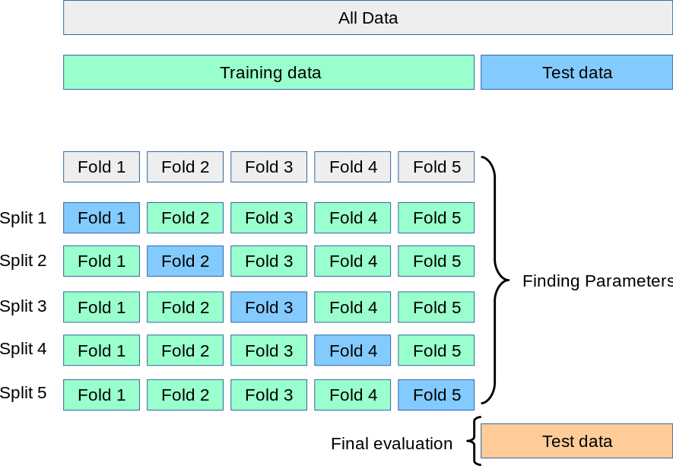
k-Fold Cross-Validation
k-Fold Cross-Validation
Illustration of a 5-fold cross-validation

Slide 39
Ensemble Learning
Ensemble Learning
Ensemble learning is training multiple classifiers separately and combining their predictions
  Ensemble learning often outperforms individual classifiers
  Better results obtained with higher model variety in the ensemble
  Bagging (bootstrap aggregating)
    Randomly draw subsets from the training set (i.e., bootstrap samples)
    Train separate classifiers on each subset of the training set
    Perform classification based on the average vote of all classifiers
  Boosting
    Train a classifier, and apply weights on the training set (apply higher weights on misclassified examples, focus on “hard examples”)
    Train new classifier, reweight training set according to prediction error
    Repeat
    Perform classification based on weighted vote of the classifiers

Slide 40
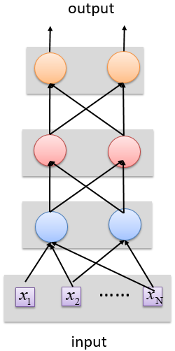

Deep vs Shallow Networks
Deep vs Shallow Networks
Deeper networks perform better than shallow networks
  But only up to some limit: after a certain number of layers, the performance of deeper networks plateaus
output
Shallow NN
Deep
NN
……
……
input

Slide 41
Neural Networks
Convolutional neural networks (CNNs) were primarily designed for image data
Recurrent NNs are used for modeling sequential data and data with varying length of inputs and outputs
  Videos, text, speech, DNA sequences, human skeletal data
Long Short-Term Memory (LSTM) networks are a variant of RNNs
LSTM mitigates the vanishing/exploding gradient problem
  Solution: a Memory Cell, updated at each step in the sequence

