Slide 1

Decision Making
Dr. Sushil Kumar
Assistant Professor
Entrepreneurship & Strategic Management IIM Visakhapatnam

Slide 2

Learning Objectives
LO 1 Analyze decision making as a rational process
LO 2 Develop alternative courses of action with consideration of the limiting factor
LO 3 Evaluate alternatives and select a course of action from among them
LO 4 Differentiate between programmed and non-programmed decisions
LO 5 Understand the differences between decisions made under conditions of certainty, uncertainty, and risk
LO 6 Recognize the importance of creativity and innovation in managing

Slide 3
Decision making
Decision making is defined as the selection of a course of action from among alternatives; it is at the core of planning.

Slide 4
The Importance and Limitations of Rational Decision Making
Rationality in Decision Making
Limited, or “Bounded,” Rationality

Slide 5
Development of Alternatives and the
Limiting Factor
Principle of the limiting factor
  By recognizing and overcoming factors that stand critically in the way of a goal, the best alternative course of action can be selected.

Slide 6
Heuristics in Decision Making
Sometimes when there seem to be too many alternatives to choose from, managers rely on their own decision rules.
These decision rules are called heuristics, and they allow complex judgments to be made more simply.

Slide 7
Evaluation of Alternatives
Quantitative and Qualitative Factors
Quantitative factors are factors that can be measured in numerical terms.
Qualitative, or intangible, factors are factors that are difficult to measure numerically.
Marginal Analysis
Marginal analysis is comparing the additional revenue and the additional cost arising from increasing output.
Cost-Effectiveness Analysis
Cost-effectiveness analysis seeks the best ratio of benefit and cost.

Slide 8
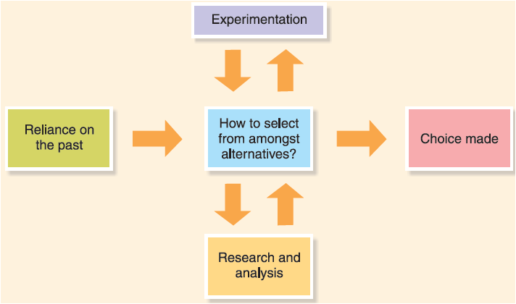
Selecting an Alternative: Three Approaches
Experience
Experimentation
Research and Analysis
Bases for selecting from among alternative courses of action

Slide 9
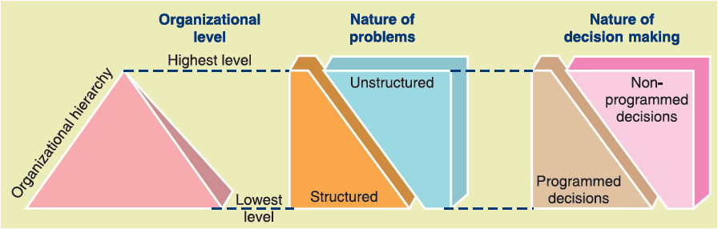
Programmed and Non-programmed Decisions
Programmed decisions are used for structured or routine work.
Non-programmed decisions are used for unstructured, novel, and ill-defined situations of a nonrecurring nature.

Slide 10

Decision Making under Certainty, Uncertainty, and Risk
Virtually all decisions are made in an environment of at least some uncertainty. However, the degree will vary from relative certainty to great uncertainty

Slide 11
Creativity and Innovation
Creativity is the ability to develop new ideas that are relevant to the issue.
Innovation is the use or commercialization of creative ideas or inventions

Slide 12
The Creative Process
Four phases of the creative process: Unconscious scanning, intuition, insight, and logical formulation or verification.
Brainstorming
Limitations of Traditional Group Discussion
The Creative Manager
Invention and Innovation

